Slide 1
Cultural Humility
Definition and Evolution…

Slide 2
Please complete the pre-test questions
Notes:
[NOTE TO FACILITATOR: if you choose not to have participants complete the knowledge assessment questions, delete this slide.]

Slide 3
Discussion points from last module
In what languages do you most frequently need education materials?

Slide 4
Objectives
By the end of the program participants will:
Define cultural humility and understand its evolution in the physical healthcare field.
Notes:
(Note: Read the material from the slide) Ask by a show of hands, how many of you have heard of or read something about cultural humility? (If hands are raised, ask people to please share their knowledge and perspectives as we go through the training.) (If no hands are raised, say that you hope they will find this to be a valuable and interesting topic.)

Slide 5
What is Cultural Humility?
Notes:
Facilitator: ask the audience if anyone has heard this term before, if so, how would they define it? Spend just a little bit of time letting people bring up their opinions.

Slide 6
Cultural Humility History
Cultural humility is a term developed in the 1990’s by Melanie Tervalon, M.D., M.P.H. and Jann Murray-Garcia, M.D., M.P.H.¹
Cultural humility was developed in response to increasing diversity in the United States and the belief that “sociocultural mismatches” between patient and provider compromise care.¹
Traditional cultural competence programs used a finite learning model with a defined endpoint.¹
Notes:
The focus of today and the next five discussions will be on cultural humility and its relevance to healthcare settings. Cultural humility has been around as a concept since the 1990’s when it was developed by two doctors Melanie Tervalon and Jann Murray-Garcia¹. Cultural humility was developed in response to increasing diversity in the United States and the belief that what Dr. Tervalon and Dr. Murray-Garcia called “sociocultural mismatches” compromised care¹. Cultural humility also was also discussed as an alternative to traditional cultural competence programs that had a finite learning model¹. This means that these programs had a defined endpoint where someone had “finished” or “passed” the training¹.

Slide 7
Health Disparities
In 2003, The Institute of Medicine documented lower quality care for racial and ethnic minorities. The report defined other segments of the population receiving disparate care^{2,3}, including:
African Americans
Appalachian poor
Asian Americans
Elders
Immigrants and refugees
Individuals with disabilities
Latinos/ Hispanics
Members of the LGBTQIA community
Native Americans
People who are overweight
Prisoners
Some religious minorities
Women^{2,3}
Notes:
Why is it important that we talk about cultural humility? One reason is health disparities. In 2003, the Institute of Medicine wrote a report titled, Unequal Treatment
Confronting Racial and Ethnic Disparities in Health Care. This report showed a large amount of evidence that racial and ethnic minorities receive lower quality healthcare^{2,3}. The report also showed that a number of other segments of our society receive different care, including women, seniors, individuals with disabilities, members of the LGBTQIA community and the others you see listed here^{2,3}. It is important to note that the reasons for these disparities in care are complex and involve many individuals and institutions at several levels^{2,3}. In the set of modules on cultural humility, we will primarily be discussing what can be done at the individual, clinical level. However, the intention is not to say that other institutional and community factors do not contribute to these disparities.

Slide 8
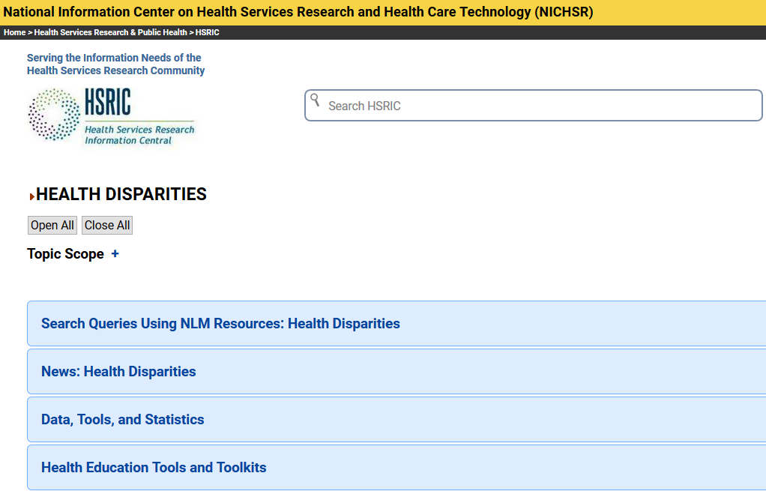
Health Services Research Information Central (HSRIC)
Notes:
We’re not going to spend a lot more time talking about health disparities in these modules, but there is a lot more information out there documenting the existence of disparities and research around how to address them. The National Library of Medicine portal, Health Services Research Information Central (HSRIC) is a great place to look for more information about this topic. You’ll find information here on health disparities from research to toolkits to news. I’ll send you an e-mail following this session with the link to this HSRIC page [Note to Facilitator: only say this if you plan to send e-mail follow up #1]

Slide 9
Unconscious Bias
Research strongly suggests that unconscious, or implicit, biases are one of the reasons that disparities in health care persist.⁴
It is reasonable to assume that all of us have some type unconscious bias²
It is more likely that unconscious bias will come into play when someone is stressed, tired or multi tasking.^{2,4}
Notes:
One of the reasons for the persistence of health disparities is unconscious bias⁴. This can also be called implicit bias, meaning that we are not aware of it and act automatically in line with our bias⁴. Explicit biases can be more consciously controlled⁴, where implicit biases include stereotypes or negative evaluations toward a social group⁴. Examples of implicit bias include associating black men with athleticism or women with lack of mathematical ability⁴. It is reasonable to assume that all of us have some type unconscious bias². In fact, sometimes training of healthcare professionals emphasizes things like population level risk factors, which could lead to thinking about a group of patients similarly⁵. Implicit bias is also more likely to come into play when someone is feeling stressed, tired, or is multi-taking^{2,4}.

Slide 10
Counteracting Unconscious Bias
“Counteracting unconscious bias requires awareness, introspection, authenticity, humility, compassion, communication, and a willingness to act.”²
Notes:
What can we do to counteract unconscious bias? You can see a quote here from an article published in the Journal for Racial and Ethnic Health Disparities titled, Some Advice for Physicians and Other Clinicians Treating Minorities, Women and Other Patients at Risk of Receiving Health Care Disparities. The authors state that “counteracting unconscious bias requires awareness, introspection, authenticity, humility, compassion, communication, and a willingness to act”². You can see that humility is one focus of counteracting unconscious bias…

Slide 11
Cultural Humility Defined
A process that requires humility…
“…as individuals continually engage in self-reflection and self-critique as lifelong learners and reflective practitioners.”¹
“…in how physicians bring into check the power imbalances that exist in the dynamics of physician-patient communication by using patient-focused interviewing and care.”¹
“…to develop and maintain mutually respectful and dynamic partnerships with communities...”¹
Notes:
Which brings us to the concept of cultural humility. You can see three quotes here from the original article defining cultural humility by Tervalon and Murray-Garcia where they explain that cultural humility is a process that requires humility in actions such as engaging in self-reflection and self-critique, take action around power imbalances in physician-patient communication and develop respectful partnerships with communities¹.

Slide 12
Cultural Humility & Health Literacy
Cultural humility and health literacy are closely linked⁶
Healthy People 2020 puts these topics under the umbrella of improving health communication to reduce health disparities⁶
Instead, these could be discussed as “best strategies to improve communication to reduce health disparities”⁶
Notes:
We just finished talking about health literacy [NOTE TO FACILITATOR: If you are completing these sections in an order other than suggested in the facilitation guide, you may need to adjust this note] and while this is a different set of modules, there is a close link between cultural humility and health literacy⁶. Both cultural misunderstanding and health literacy have an impact on healthcare an can be addressed through improved communication⁶. Healthy People 2020, the nation’s set of ten year health goals, puts cultural communication and health literacy under the umbrella of improving health communication to address health care quality and healthy equity⁶. Instead of considering these to be different topic areas, some have suggested that we actually discuss them to be “best strategies to improve communication to reduce health disparities”^{6.} In fact, many of the other topics in Clinical Conversations such as Social Determinants of Health, Motivational Interviewing, Shared Decision Making, fall under this definition as well. [NOTE TO FACILITATOR: Adjust this note of not planning to teach these topics following this training].

Slide 13
Take home message
Consider:
What are ways you have seen implicit bias affect health care?
Developed resources reported in this presentation are supported by the National Library of Medicine (NLM), National Institutes of Health (NIH) under cooperative agreement number UG4LM012342 with the University of Pittsburgh, Health Sciences Library System. The content is solely the responsibility of the authors and does not necessarily represent the official views of the National Institutes of Health.
Notes:
(Note: read the Take home message from the slide) Then say, please think about these two questions. This is where we are going to start at our next session. Please be prepared to share why you agree or disagree with the questions.

Slide 14
References
Tervalon, M., Murray-Garcia, J. (1998). Cultural Humility Versus Cultural Competence: A Critical Distinction in Defining Physician Training Outcomes in Multicultural Education. Journal of Health Care for the Poor and Underserved, 9(2), 117-125.
White, A. & Stubblefield-Tave, B. (2017). Some Advice for Physicians and Other Clinicians Treating Minorities, Women, and other Patients at Risk of Receiving Health Care Disparities. Journal of Racial and Ethnic Health Disparities, 4, 472-479.
Smedley, B., Stith, A., Nelson, A. (Eds.) (2003). Unequal Treatment: confronting racial and ethnic disparities in health care. Washington DC: National Academies Press.
Byrne, A. & Tanesini, A. (2015). Instilling New Habits: Addressing Implicit Bias in Healthcare Professionals. Advances in Health Sciences Education, 20, 1255-1262.
Chapman, E., Kaatz, A., Carnes, M. (2013). Physicians and Implicit Bias: How Doctors May Unwittingly Perpetuate Health Care Disparities. Journal of General Internal Medicine, 28(11), 1504-1510.
Lie, D., Carter-Pokras, O., Braun, B., Coleman, C. (2012). What do Health Literacy and Cultural Competence Have in Common? Calling for a Collaborative Pedagogy. Journal of Health Communication, 12(3), 13-22.

