Slide 1
Empowering Teens Through Media and Health Literacy: The Role of Health Sciences Librarians
March 26, 2025
Jill R. Kavanaugh, MLIS, AHIP
Division of Adolescent and Young Adult Medicine Boston Children’s Hospital
Strategic Training Initiative for the Prevention of Eating Disorders Harvard TH Chan School of Public Health

Slide 2
Disclosure and content notice
Funding Disclosure: The project, “Building Adolescent Skills in Health Literacy and Public Health Advocacy,” has been funded in whole with federal funds from the National Library of Medicine, National Institutes of Health, under Cooperative Agreement UG4LM012347 with the University of Massachusetts, Worcester.
Content Notice: This presentation includes references to eating disorders, which may be sensitive or triggering for some attendees. Please feel free to take a break or log out if needed.

Slide 3
A librarian’s role in health literacy

Slide 4
Learning objectives
Identify key media and health literacy challenges affecting adolescents and young adults, particularly in the context of misinformation on social media and its impact on health behaviors.
01
Evaluate evidence-based strategies for integrating media and health literacy education into library programs, including multimodal learning approaches, media deconstruction techniques, and hands-on content creation.
02
Develop actionable plans to incorporate media and health literacy resources within health sciences and public health libraries, supporting NNLM Region 4 communities in promoting critical evaluation of health information.
03

Slide 5
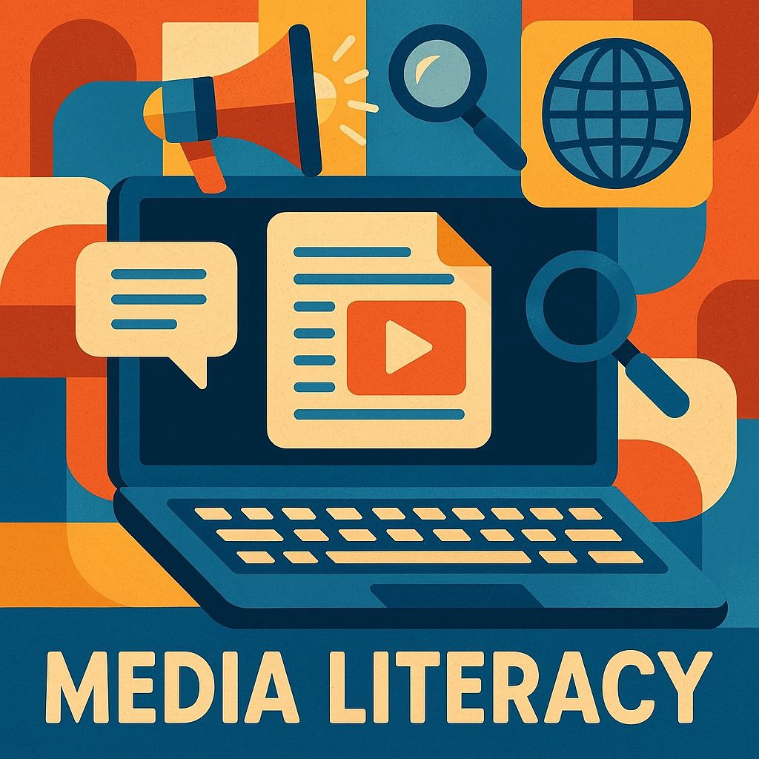
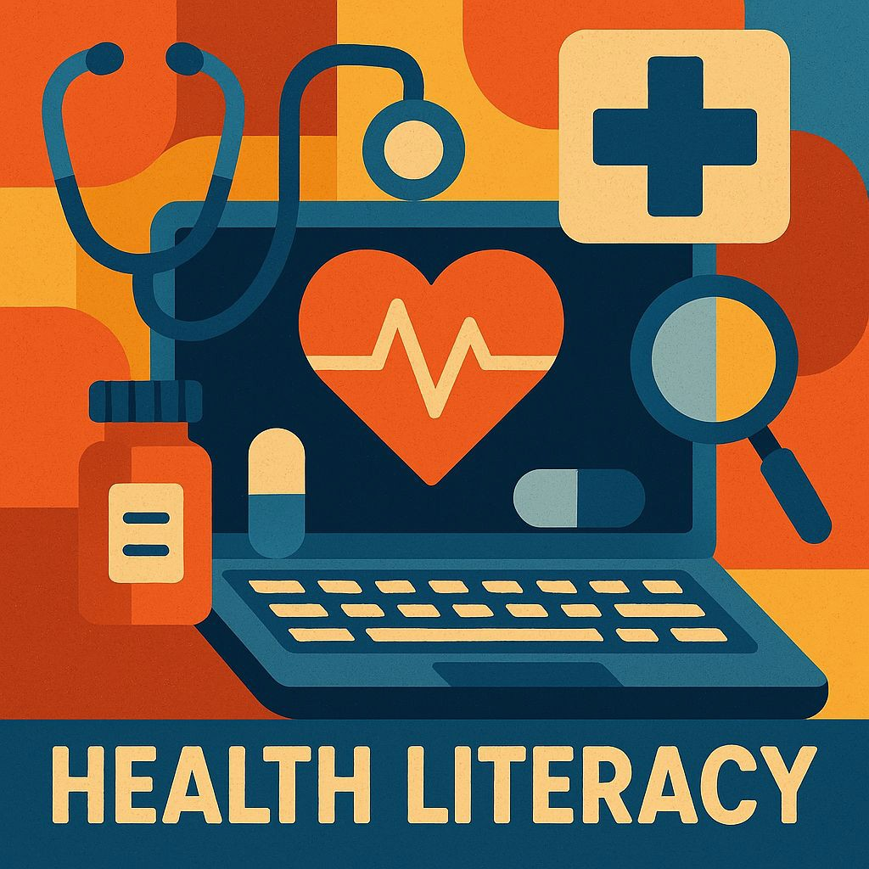
Why media and health literacy matter
Skills to critically analyze and create media.
Ability to access and use health information effectively.
Librarians create safe spaces to guide teens through misinformation and support informed decisions.

Slide 6
The spread of health misinformation on social media
Health misinformation is rampant on social media.
Algorithm-driven feeds amplify sensationalized and extreme content.
Adolescents often struggle to identify misinformation.
Misinformation (and disinformation) can be nuanced and subtle.

Slide 7
Misinformation in weight-loss and muscle-building supplement marketing
Common misleading claims:
Promises like “Lose weight fast—no diet or exercise” or “Doctor-approved” without credible evidence
Influencer ads that appear genuine, but are sponsored
Marketed as “all-natural” and safe—but lack FDA regulation
What’s missing:
Reliable scientiﬁc evidence
Adequate safety oversight
Clear disclosure of ﬁnancial incentives

Slide 8
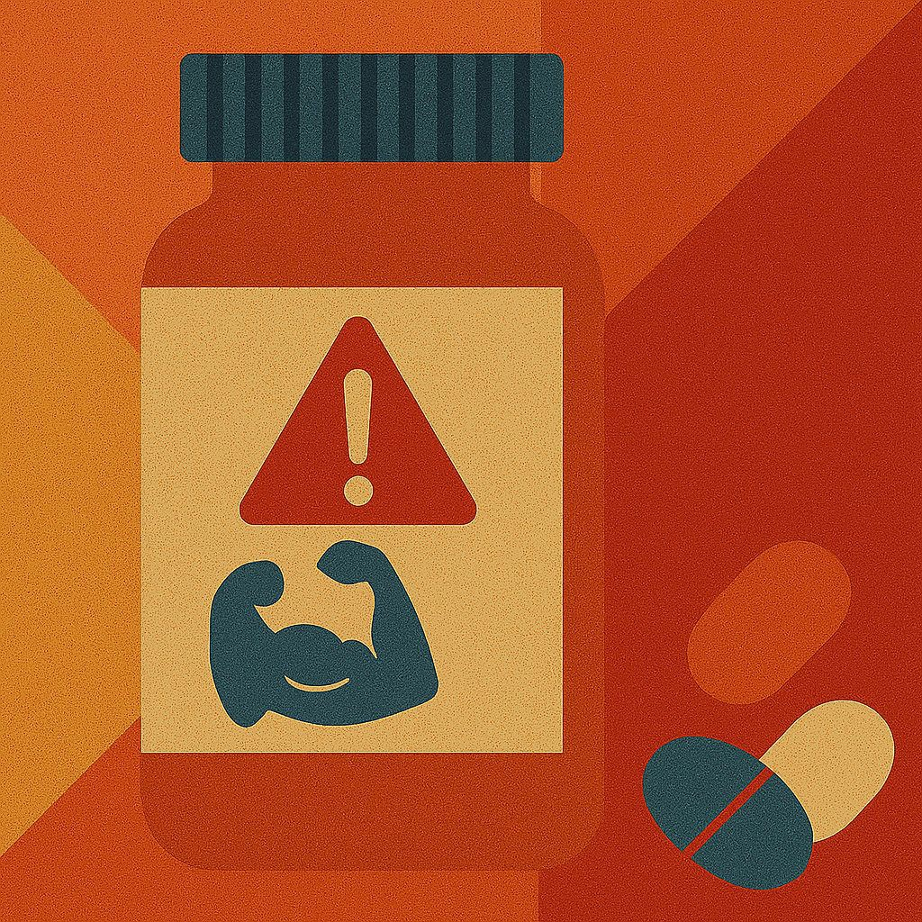
Health risks of weight-loss and muscle-building supplements
May contain hidden or toxic ingredients
Linked to heart problems, liver damage—even death
Strongly associated with disordered eating behaviors
Girls using diet pills are 4–6× more likely to develop an eating disorder
Boys influenced by ﬁtness culture may turn to anabolic steroids

Slide 9
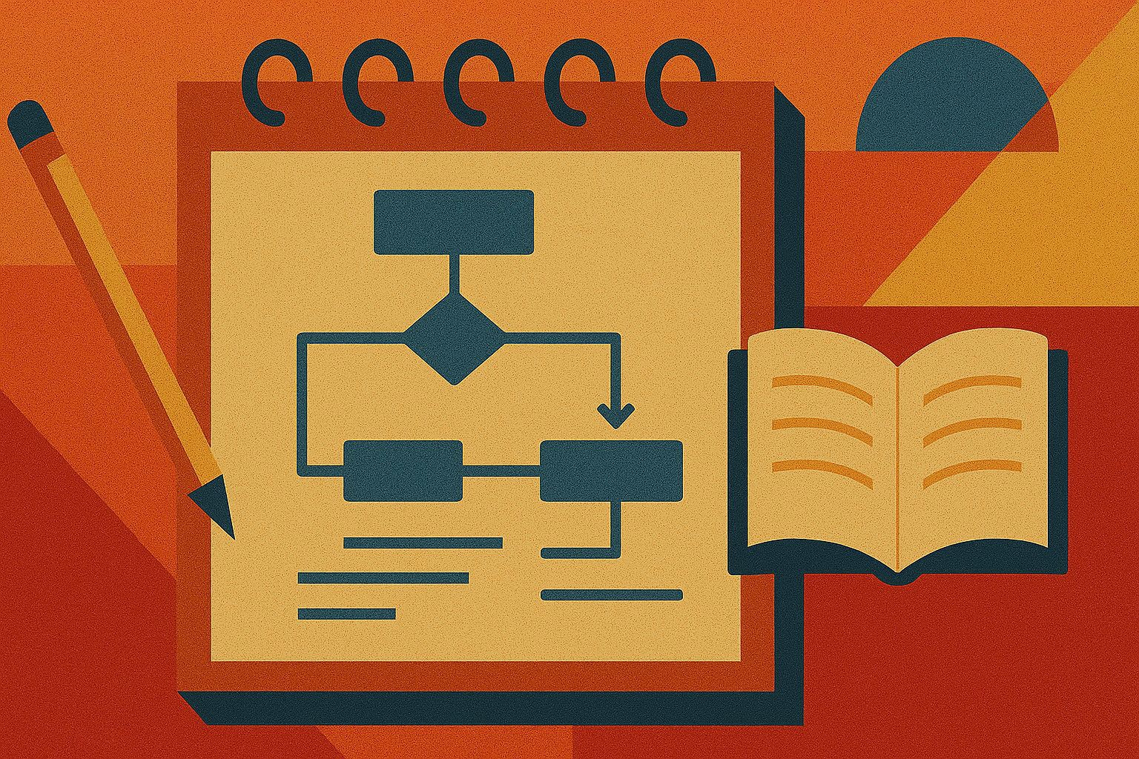
From problem to action: Why we developed the course
Teens need skills to navigate health misinformation.
Librarians and educators are trusted guides.
We created a media & health literacy course focused on supplement misinformation.

Slide 10
Course planning and development
Why: Teens needed tools; educators needed structured support
What: Grant-funded media & health literacy course on supplement misinformation
Who: Collaboration with STRIPED experts in eating disorder prevention
How: Real-world examples, media literacy strategies, public health research
Guiding Principles: Evidence-based, interactive, youth-centered

Slide 11
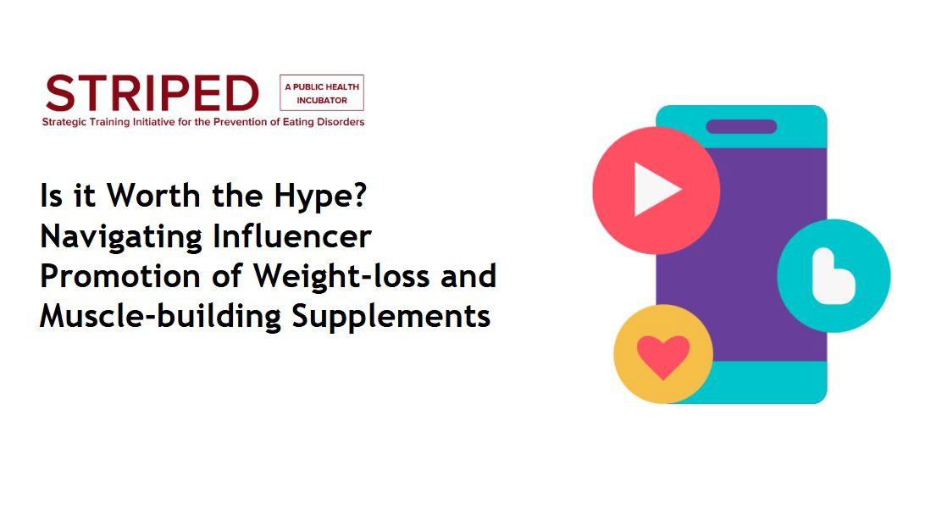
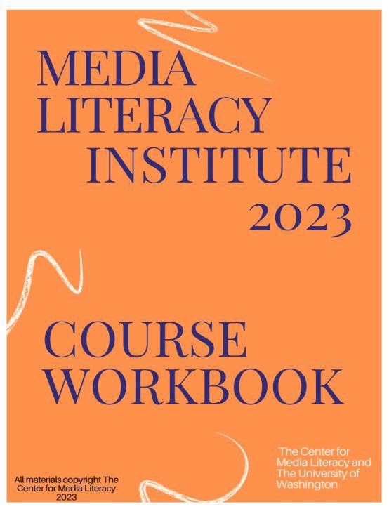
The course

Slide 12
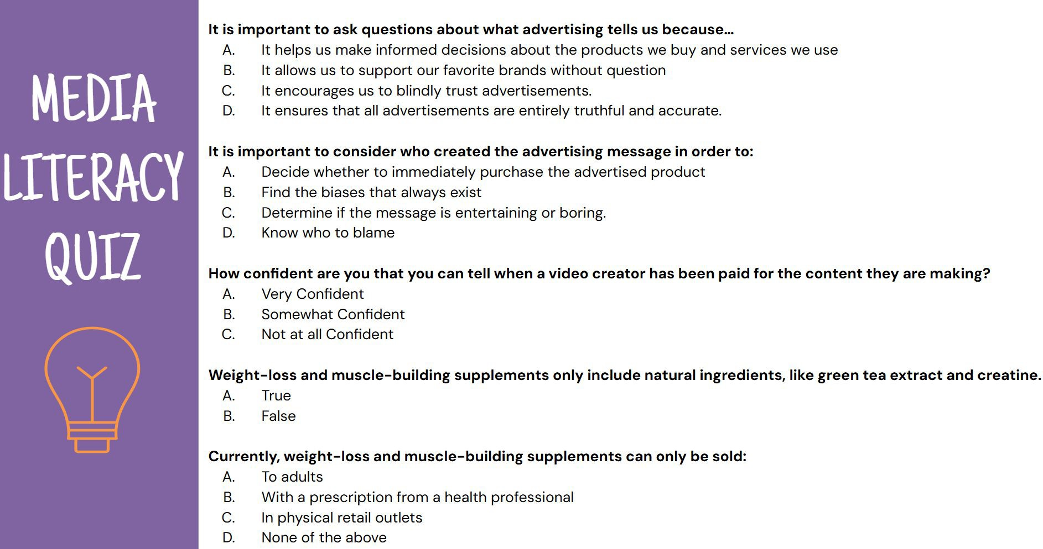
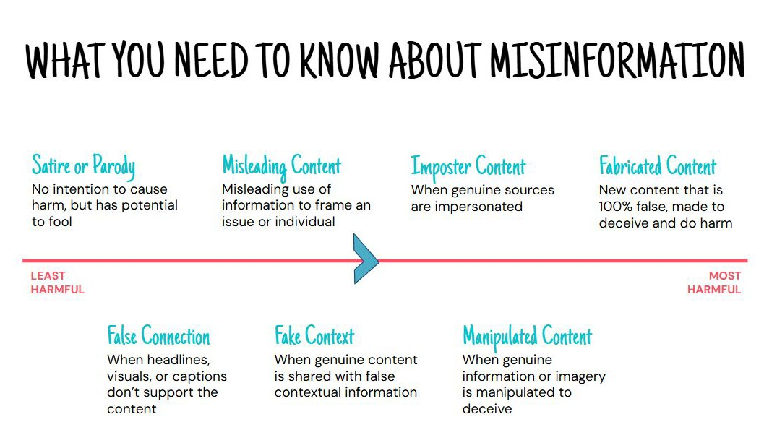
Engaging teens: Course components librarians can use
Pre-Quiz
Deconstruction Full Group Activity
Lecture
Construction Small Group Activity

Slide 13
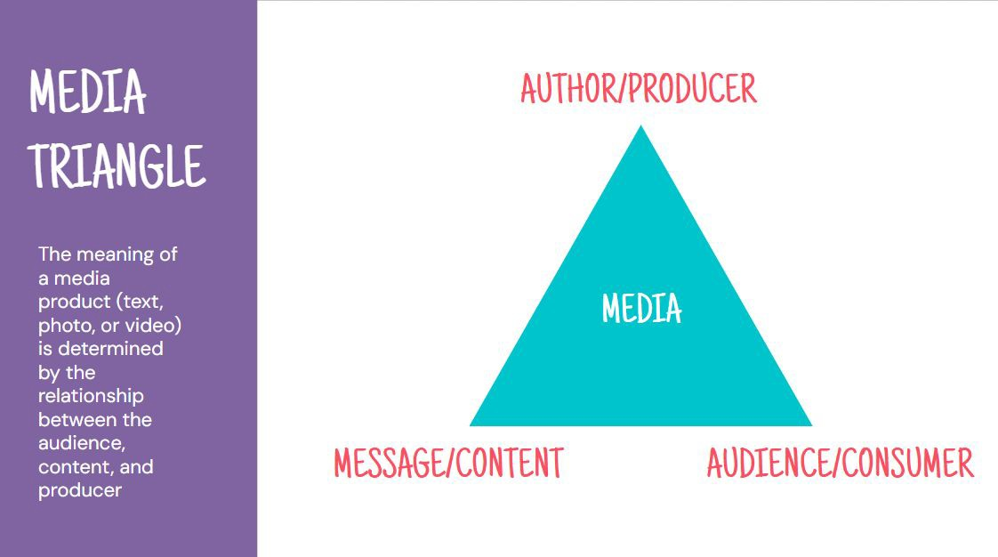
Evidence-based strategies librarians can use
Strategy 1: Use core media literacy tools
Media Triangle
Key concepts: content, technique, purpose
Strategy 2: Incorporate multimodal learning
Social media videos, quizzes, peer discussion
Strategy 3: Explore train-the-trainer models
Flexible scheduling & support tools required

Slide 14
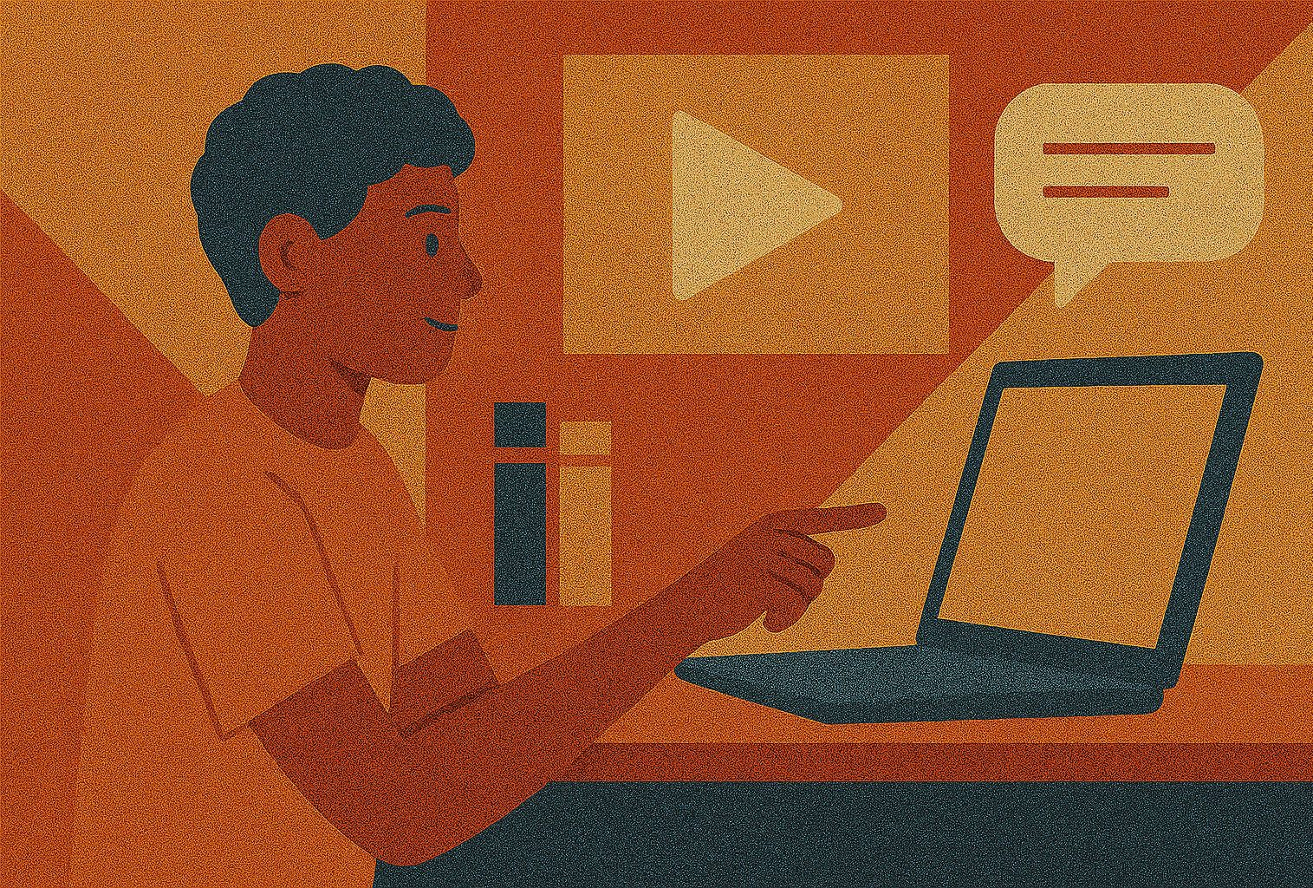
The role of libraries & key takeaways
Teens face a flood of health misinformation—especially on social media
Media and health literacy are teachable, life-long skills
Librarians are trusted guides who can empower youth with these skills
Our course offers adaptable strategies: media deconstruction, multimodal learning, and
real-world examples
Libraries—public and academic—can lead this work with support from partners like NNLM
With the right tools, libraries can play a powerful role in protecting youth health
Thank you!
jill.kavanaugh@childrens.harvard.edu

