Slide 1
Gender Non-Conforming & Non-Binary
Learn and improve care for all…

Slide 2
Discussion points from last module
The transgender community is as diverse as every other community- how have you seen this demonstrated among your patients?

Slide 3
Objectives
By the end of the program, participants will:
Understand what it means to be gender non-conforming and/or non-binary
Recall various identities associated with gender non-conforming and non-binary communities

Slide 4
What do you think?
Which definition below belongs to gender non-conforming and which belongs to non-binary? And why?
A broad term referring to people who do not behave in a way that conforms to the traditional expectations of their gender, or whose gender expression does not fit neatly into a category¹
An adjective describing a person who does not identify exclusively as a man or a woman; may identify as being both a man and a woman, somewhere in between, or as falling complete outside these categories¹
Notes:
[NOTE to FACILITATOR: ask the audience to guess] Which definition below belongs to gender non-conforming and which belongs to non-binary? And why?
A broad term referring to people who do not behave in a way that conforms to the traditional expectations of their gender, or whose gender expression does not fit neatly into a category¹
An adjective describing a person who does not identify exclusively as a man or a woman; may identify as being both a man and a woman, somewhere in between, or as falling complete outside these categories¹
The answer? Gender non-conforming is A, non-binary is B

Slide 5
Non-binary Identities
Genderqueer
Gender Fluid
Non-binary
Gender Expansive
Gender Creative
Demigender
Bigender
Androgyne
Agender
Two-spirit
Notes:
Genderqueer
Gender Fluid
Non-binary
Gender Expansive
Gender Creative
Demigender
Bigender
Androgyne
Agender
Two-spirit
This is just a sample of some of the non-binary identities that exist. It is not a comprehensive list. It is not important that you know or memorize all these terms, just that you are aware that there are many ways to identify and there are more than just two genders.

Slide 6
What Does it Mean?
Gender non-conforming and non-binary people:
Generally do not conform to traditional gender roles
May or may not appear binary, that is they may or may not appear male or female
May identify as masculine or feminine or both or neither or something else entirely
Can be assigned any sex at birth
Have any sexual orientation
Notes:
So, what does being non-binary mean? Gender non-conforming and non-binary people:
Generally do not conform to traditional gender roles
May or may not appear binary, that is they may or may not appear male or female. Some people who identify as non-binary may appear to be cisgender or appear to be a feminine woman, for example, when they do not identify that way. Conversely, some non-binary people may look very androgynous and it could be difficult to tell their sex based on appearance.
May identify as masculine or feminine or both or neither or something else entirely
Can be assigned any sex at birth. Non-binary people could be assigned male or female or something else at birth. Non-binary people come in all sexes.
Have any sexual orientation. People who are non-binary can identify as gay, straight, lesbian, bisexual, pansexual, asexual, etc.

Slide 7
Transgender is an Umbrella
Transgender
Binary
Trans man
Trans woman
Non-Binary
Bigender
Agender
Genderqueer
Gender Fluid
Non-binary
More!
Notes:
Some people may ask if being non-binary is the same as being transgender. No, not necessarily. All non-binary people fit under the transgender umbrella but not all trans people identify as non-binary. Transgender is the umbrella term for which non-binary and gender non-conforming people fit. Trans men and trans women who identify as men and women fall under a binary identity but because they are trans, they are under the transgender umbrella. Non-binary people also fall under the transgender umbrella.

Slide 8
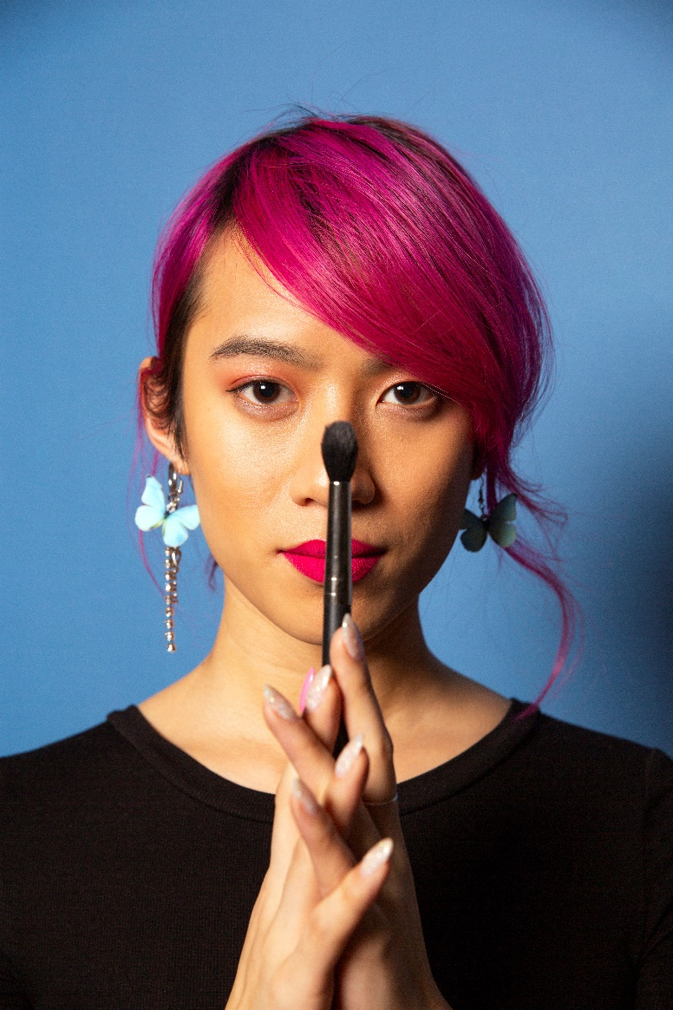
Non-binary in Relation to Trans
Some people who are non-binary may medically transition; not all non-binary people will.
Some people who are transgender may identify as non-binary; many trans people do not.
Notes:
Some people who are non-binary may medically transition; not all non-binary people will. Some people who are transgender may identify as non-binary; many trans people do not. Many trans people identify within the binary, meaning they identify as male or female, not as gender non-conforming or non-binary.

Slide 9
Gender is a Universe
Notes:
Gender is complex. Instead of viewing gender as a spectrum with masculine on one side and feminine on the other, this is another way of viewing gender. We are all part of the universe and we all make up separate individual stars. In 2016 at a the National Sexual Assault Conference, an individual named Liat Wexler from the Center for Community Solutions discussed this “three dimensional” concept, explaining that some of the continuums that describe gender don’t fit for everyone⁴. They explained that instead of thinking where a person fits on a straight line, that the identities of man, woman, agender, bigender, genderqueer and beyond are a galaxy with every individual in that galaxy their own star⁴.

Slide 10
Pronouns
Fig 1. Trans Student Educational Resources (2019). Infographics. Retrieved from: URL to Source
Notes:
Pronouns matter. Here you can see different pronouns that someone may prefer. If you don’t know how someone would like to be addressed, it’s okay to ask them what pronouns they use. Always state your own pronouns before asking someone else’s theirs.

Slide 11
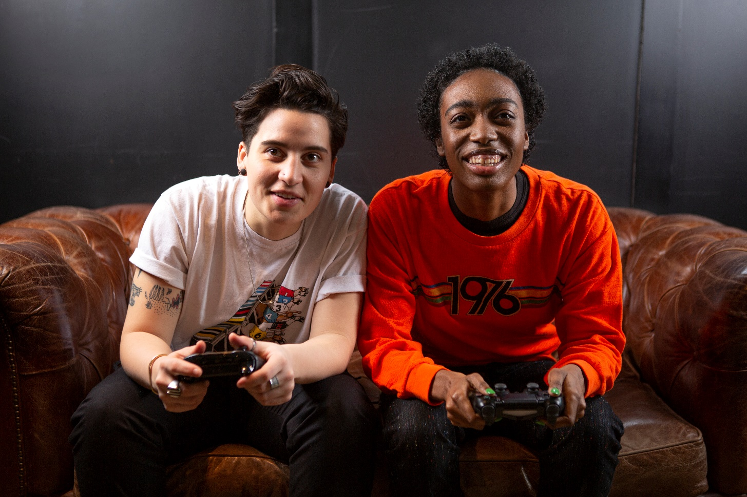
The Future is Non-binary.
Notes:
This statement is included at the end because some think that we're moving away from a binary gender society. This doesn't mean that people who identify as men and women will disappear, but rather that we are making way for more non-binary identities. More states may begin to allow gender-neutral X on driver's licenses instead of just M or F, more gender-neutral and all-gender restrooms, more co-ed sports teams, and generally less division between the sexes. Not only are we redefining what it means to be male and female, but we're redefining what it means to be human.

Slide 12
Take home message
Consider:
How can we be more inclusive of people who are non-binary and/or gender non-conforming?
Remember:
Not all people who are transgender are non-binary but all non-binary people are transgender
Developed resources reported in this presentation are supported by the National Library of Medicine (NLM), National Institutes of Health (NIH) under cooperative agreement number UG4LM012342 with the University of Pittsburgh, Health Sciences Library System. The content is solely the responsibility of the authors and does not necessarily represent the official views of the National Institutes of Health.

Slide 13
References
Human Rights Campaign. “LGBTQ Definition for Adults: Welcoming Schools.” Human Rights Campaign, URL to Source
Brawbaw, Kasandra. “Allosexual, Demisexual, Bicurious - & Other Sexualities You Need to Know.” Refinery 29, 18 June 2019, URL to Source
Brown, Eliza and Paula England. “Sexual orientation versus Behavior – Different for Men and Women?” Contexts.org, 29 February 2016, URL to Source
California Coalition Against Sexual Assault (2017, June 28). Applying the Universe Model of Gender in Prevention [video file]. Retrieved from: URL to Source
Trans Student Educational Resources (2019). Infographics. Retrieved from: URL to Source

