Slide 1
How successful was my inquiry?
Assess

Slide 2
Objectives
By the end of the program, participants will:
Assess the success of the entire research process from formation of the question through the search, appraisal of the information, and implementation; identify areas of potential improvement.

Slide 3
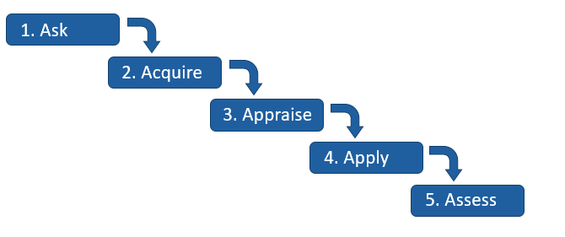
The EBP Process
Notes:
This is going to be predominantly a discussion-based module! We’re going to go through each of the steps of the EBP process or cycle, and brainstorm ways we could evaluate if that step was successful for a particular situation. We’ll think about how we can measure success and how we can identify areas of improvement.

Slide 4
Ask
Notes:
What are some ways in which you could evaluate if your research question was successful?
Example: Did my query yield sufficient relevant results when searching in a database?

Slide 5
Acquire
Notes:
Now let’s think about how we could evaluate the ‘acquire’ step.
For example, did you look in an appropriate database for the information you needed?

Slide 6
Appraise
Notes:
To evaluate the appraise step, think about whether you appropriately narrowed down your results and evaluated them for relevance and quality. What are some specific aspects you might want to consider here?

Slide 7
Apply
Notes:
Finally, let’s think of some ways you could evaluate how you implemented (or did not implement) the information you found.

Slide 8
Take home message
Remember:
EBP is a 5-step process that incorporates the best available clinical evidence, your own expertise, and patient preferences
Research databases like PubMed are a great place to look for high-quality evidence
Self-evaluation of the way you searched for and implemented evidence is essential to future improvement
Developed resources reported in this presentation are supported by the National Library of Medicine (NLM), National Institutes of Health (NIH) under cooperative agreement number UG4LM012342 with the University of Pittsburgh, Health Sciences Library System. The content is solely the responsibility of the authors and does not necessarily represent the official views of the National Institutes of Health.
Notes:
[NOTE TO FACILITATOR: If you want to complete group discussion immediately following this module content, change the title of this slide to ‘Group Discussion’ and delete the slide with corresponding questions in the next module. If you would like to have discussion take place using your internal LMS system, you can include instructions here for how participants can participate. Then, adjust the slide with the corresponding questions in the next module as needed.]

