Slide 1
Team Science and Diversity

Slide 2
Disclosures
No relevant disclosures.

Slide 3
Objectives
Describe literature supporting the value of workforce diversity.
Discuss the current state of Black, Indigenous, and People of Color (BIPOC) and women conducting clinical research.
Outline and provide an example of team science as a method of to promote a diverse and equitable clinical research workforce.

Slide 4
What Can You Do to Foster Diversity and Inclusion?

Slide 5
The preeminence of ethnic diversity in scientific collaboration
Analyzed > 9 million papers and 6 million scientists
Assessed the relationship between research impact and 5 classes of diversity:
Ethnicity
Gender
Discipline
Affiliation Academic Age
Notes:
Ethnic diversity → impact gain of 10.6% for papers and 47.7% for scientists

Slide 6
Papers with 4 or 5 authors of multiple ethnicities have, on average, 1-2
more citations than those written by authors of all of the same ethnicity. This effect represents a 5-10% difference in the mean number of citations for a given publication.

Slide 7
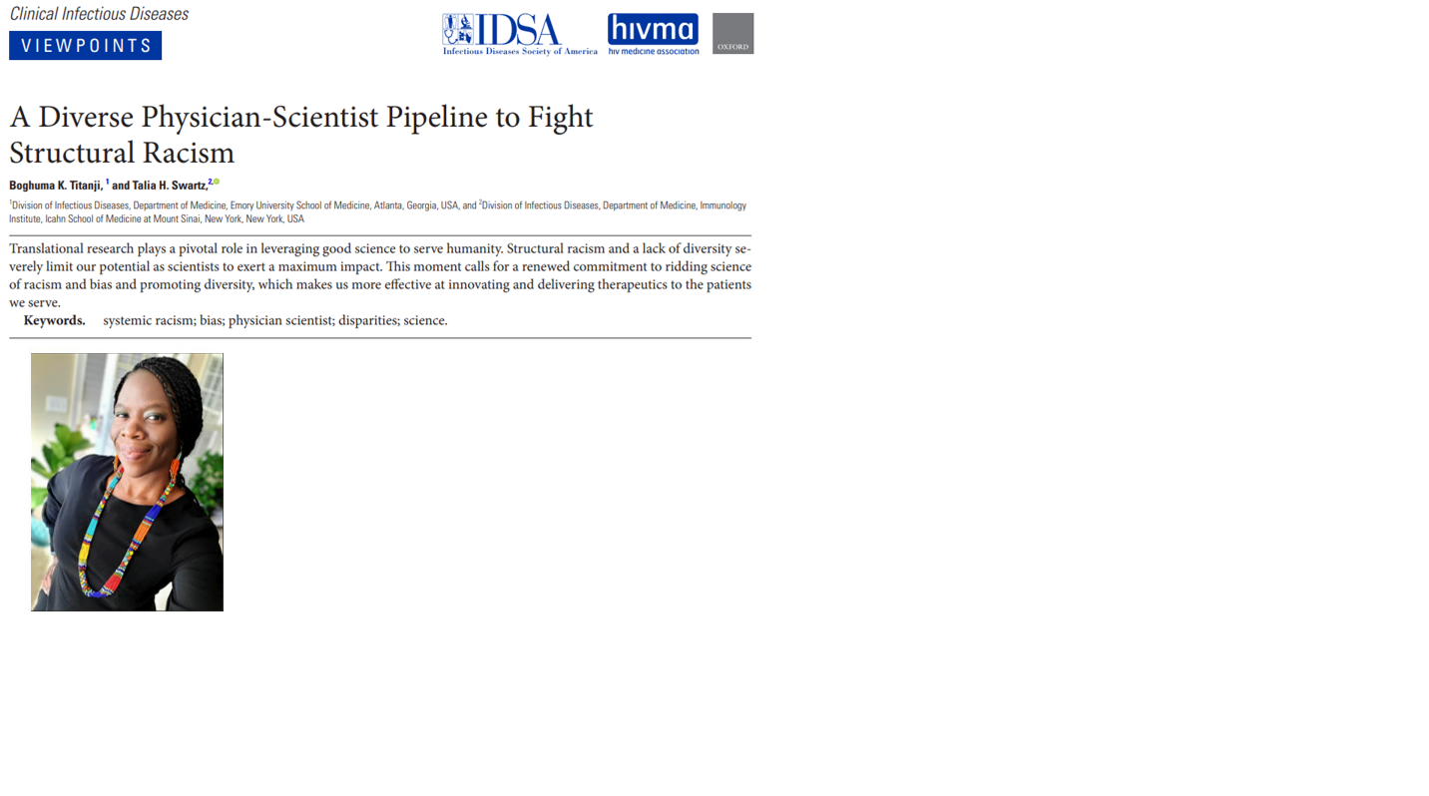
A Diverse Physician-Scientist Pipeline to Fight Structural Racism

Slide 8
Gender-Heterogeneous Working Groups Produce Higher Quality Science

Slide 9
Where are the women? Gender inequalities in COVID-19 research and authorship

Slide 10
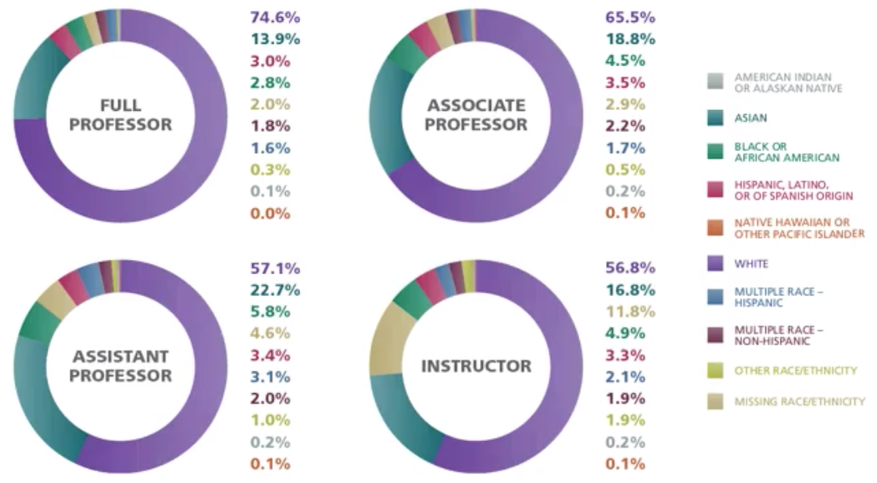
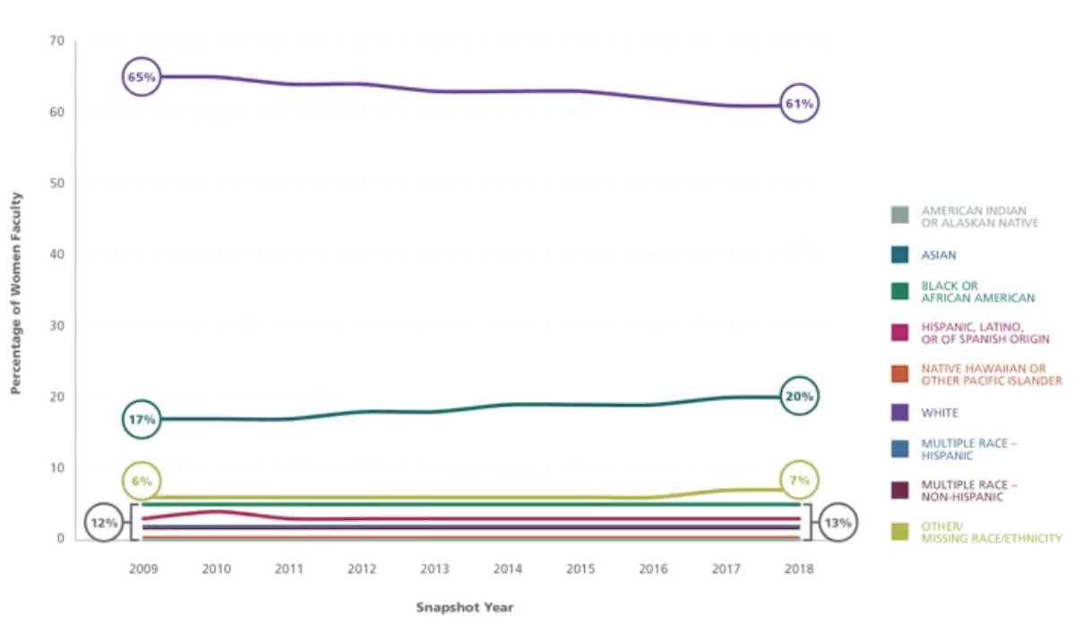
Full-Time Women Faculty by Rank and Race/Ethnicity, 2018

Slide 11
Invasive Nontypeable Haemophilus influenzae infection among adults with HIV in Metropolitan Atlanta, Georgia, 2008 - 2018

Slide 12
Hospitalists as Integral Stakeholders in Antimicrobial Stewardship

Slide 13
Allergy Clin Immunol Pract2020

Slide 14
The impact of an electronic medical record nudge on reducing testing for hospital-onset Clostridioides difficile infection

Slide 15
Catheter-Associated Urinary Tract Infections in Adults: Diagnosis, Treatment, and Prevention

Slide 16
Disorders

Slide 17
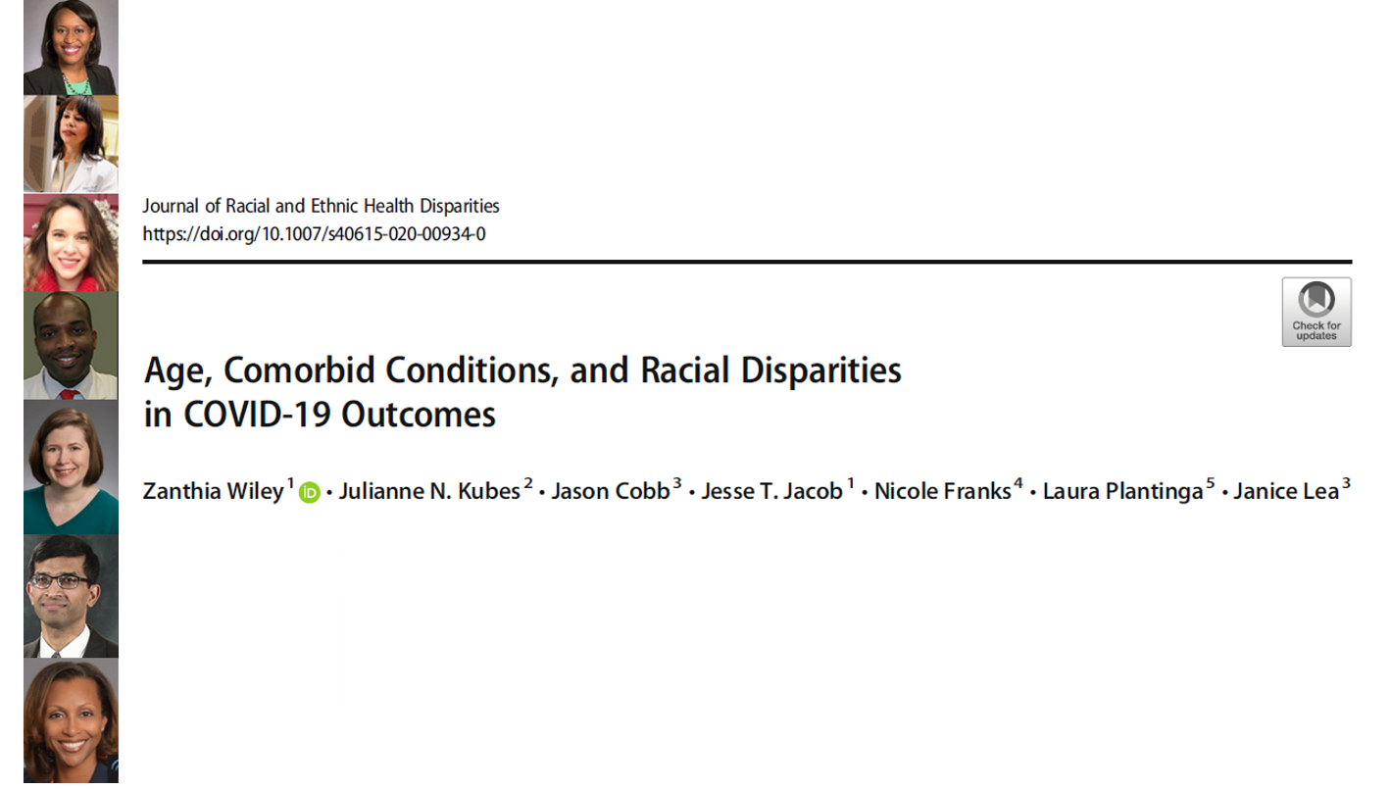
Age, Comorbid Conditions, and Racial Disparities in COVID-19 Outcomes

Slide 18
Social isolation at the time of social distancing

Slide 19
Racial and Ethnic Differences and Clinical Outcomes of COVID-19 Patients Presenting to the Emergency Department

Slide 20
Black and Hispanic Americans turn to doctors who look like them for reassurance on vaccinations

Slide 21
COVID-19 Disparities: Emory University Hospital Midtown

Slide 22
COVID-19 Characteristics of Readmissions and Outcomes and Social Determinants of Health Study (CROSS) at Eight Atlanta Hospitals
Intramural Grant – Emory Woodruff Health Sciences Center COVID-19 Center for Urgent Research Engagement (CURE) Reward ($200,000).
Notes:
$200,000

Slide 23
CROSS Team
8 hospitals - Emory Healthcare, Grady, Atlanta VAMC
3 health systems – Emory Healthcare, Kaiser, Morehouse
Infectious Diseases, Emergency Medicine, Hospital Medicine, Family Medicine, General Internal Medicine, Chief Quality Officer, Chief Information Officer
Notes:
March 1-August 14

Slide 24
Demographic Characteristics of CROSS Team Members

Slide 25
Team Member Roles

Slide 26
Intended Allocation of Time
Intended Allocation of Time

Slide 27
CROSS: How is it going?

Slide 28
Success

Slide 29
Southeast Regional Clinical and Translational Conference

Slide 30
Health Equity Day

Slide 31
Recap Health Equity Day
Poster Presentations
1. How limited access to water triggered life threatening illness and death
Pangulur P, Xu JW, Kebbel KBS, Johnson D, Kobaidze K
2. COVID in Spanish for the Latinx community
Pinzon I, Angular Alvarado M, Alfonso S, Del Rio C, Patino A, Rebolledo P, Cantos Lucio V
3. Expanding the Pipeline of URiM Investigators: The Work of the DOM Research Affinity Group
Alvarez JA, Blanding JO, Han J, Henry T, Bussey-Jones J, Mitchell N, Morris A
4. Increasing the Ranks of Black, Indigenous, People of Color and Women in Research
Franks N, Hanna J, Kobaidze K, Wiley Z and the CROSS Collaborative
5. What about race and ethnicity in antimicrobial stewardship?
Fortin-Leung K, Wiley Z
6. Beyond Collection of Demographic Data: Stratification of Outcomes as a First Step to Address Health Disparities in a Health System
Franks N, Kubes J, Overton E, Truss L, Shu J, Shabbir H
Racial and Ethnic Differences and Clinical Outcomes of COVID-19 Patients Presenting to the Emergency Department
Smothers L, Ross-Driscoll K, Wang Z, Mehta AK, Patzer RE, Wiley Z
A Mixed-methods Approach to Understanding the Perspectives, Experiences and Attitudes of Cognitive Behavioral Therapy for African Americans with Type-2 Diabetes
Subramanya V, Cornely R, Owen A, Pasquel FJ, McGee R.E., Kulshreshtha A
COVID-19 Characteristics of Readmissions and Outcomes and Social Determinants of Health Study (CROSS)
at Eight Atlanta Hospitals
Wiley Z, Lanka V, Surapaneni P, Elutilo-Ayoola T, Byrd R, Li D, Kubes JN, Kulshreshtha A, Kandiah S, Kobaidze K, The CROSS Collaborative, Franks N
~ 40% of our CROSS team submitted posters

Slide 32
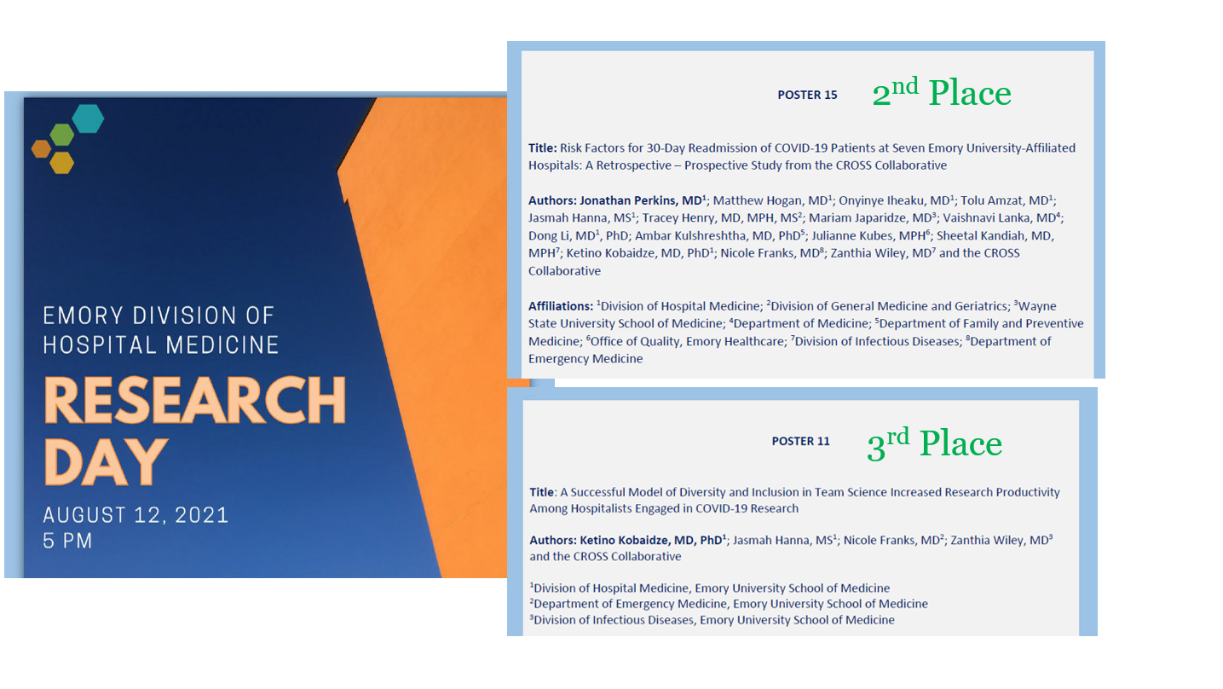
Research Day

Slide 33
2021 Research Day Awards

Slide 34
CROSS Manuscripts

Slide 35
Clinical characteristics and social determinants of health associated with 30-day hospital readmissions of paitents with COVID-19
Notes:
Academy Health Annual Research Meeting; members have given > 75 lectures/webinars/NYT stories, Grand Rounds on COVID-19 in minority communities)

Slide 36
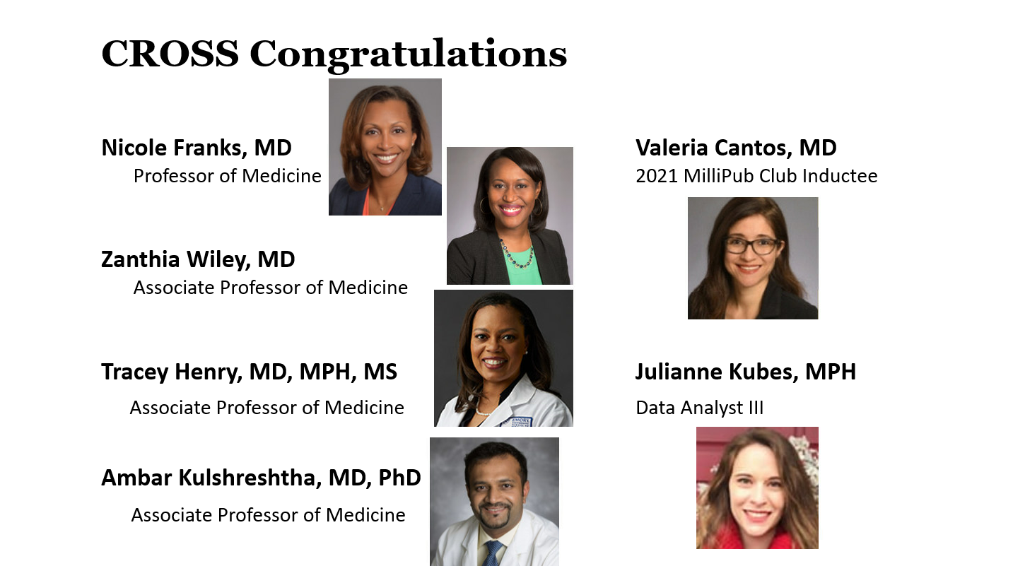
CROSS Congratulations

Slide 37
COVID-19 Collaborative Community Outreach and Health Disparities Research Group

Slide 38
CROSS work

Slide 39
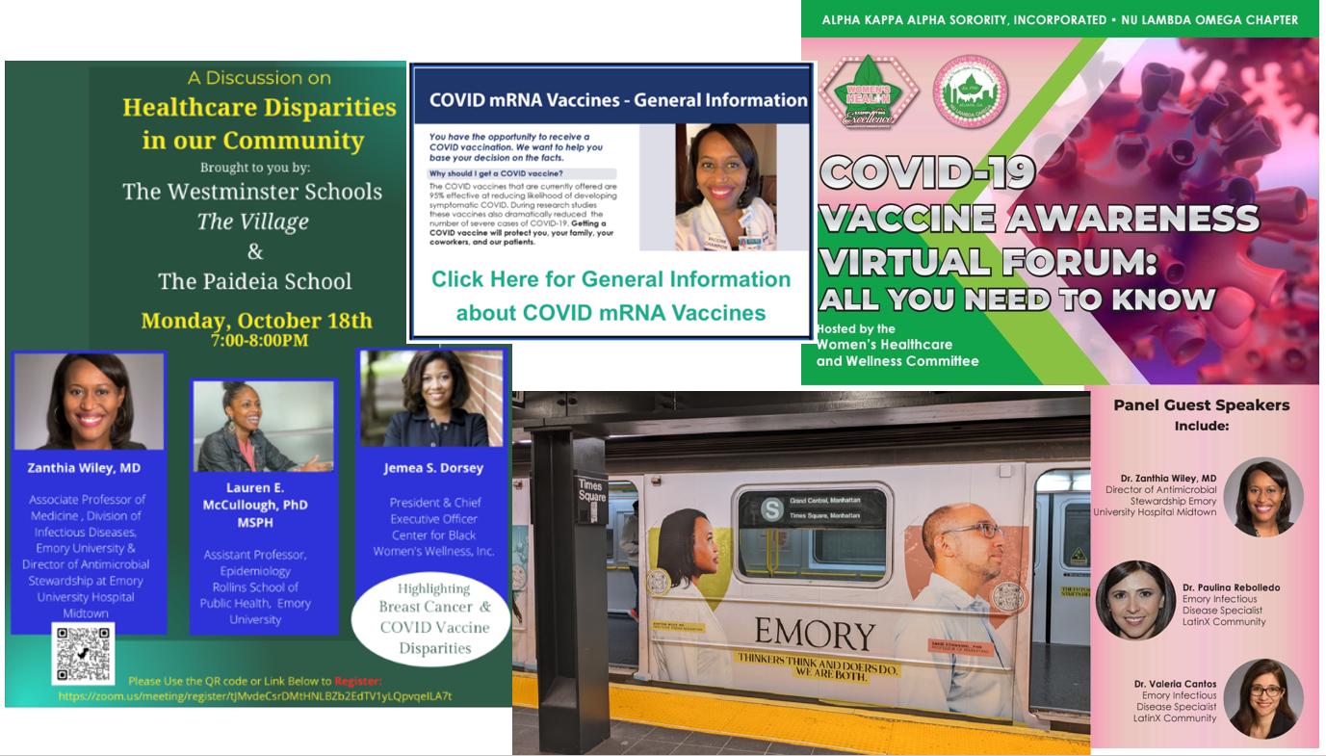
CROSS work continued

Slide 40
Letter to the Editor

Slide 41
The Science and Value of Diversity

Slide 42
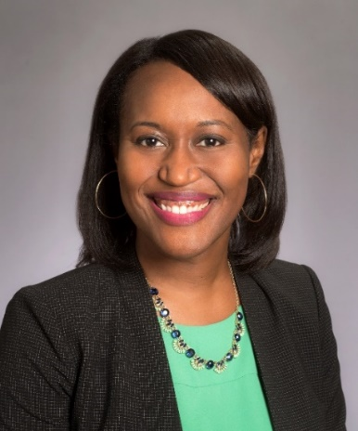
Thank You
Zanthia Wiley, MD
Associate Professor of Medicine
Di Division of Infectious Diseases
zwiley@emory.edu
Notes:
March 1-August 14

