Slide 1
MedlinePlus
Help your patients find trusted health information

Slide 2
Discussion points from last module
Do you notice any health literacy red flags when working with patients?
Notes:
FACILITATOR NOTE: You can ask a few audience members to share - encourage them to describe a real life situation to the rest of the group and see if others have had similar experiences. If time permits, you can ask if anyone has ideas for a solution.
[NOTE TO FACILITATOR: If you are completing these modules in an order other than suggested in the facilitation guide, you may need to adjust these discussion points.]

Slide 3
Objectives
By the end of the program, participants will:
Discuss the use of MedlinePlus for patient education
Demonstrate basic MedlinePlus navigation

Slide 4
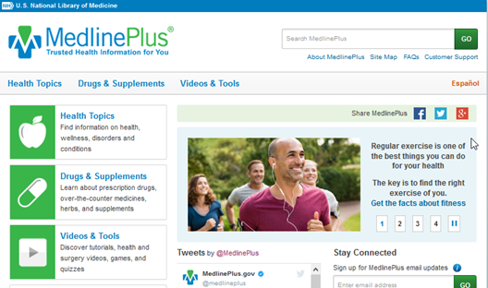
MedlinePlus
NLM main portal for consumer health information
Information on over 1,000 health topics, including:
Medications and supplements
Lab tests
Health conditions
Wellness
Demographic groups
Available in English and Spanish
Notes:
MedlinePlus is a resource from the National Library of Medicine. It is their main consumer health portal and the information that you or your patients find here will only be from trusted sources. It’s common for members of the general public to search for health information online, but it can be hard for them to know how reputable some sources are. In the previous modules, we talked about one feature of health literacy being the ability for someone to find, evaluate and understand health information. MedlinePlus is one way they can do this. MedlinePlus only links to reliable, trusted sources of health information, so it takes away the guesswork for consumers. MedlinePlus has information on over 1,000 health topics, including medications, lab tests, and health concerns of different demographic groups. The entire site is also available in both English and Spanish.
[NOTE TO FACILITATOR: If you are completing these modules in an order other than suggested in the facilitation guide, you may need to adjust these discussion points.]

Slide 5
Why MedlinePlus?
72% of internet users looked for health information online in 2012¹
The information obtained may increase feelings of self-efficacy and empowerment²
There is variation in the accuracy of online health information, and therefore a need for e-health literacy¹
Those with higher e-health literacy get more positive outcomes from searching for health information online²
Do you come across patients who have been visiting Dr. Google?
You’re not alone.
Notes:
Why are reliable and accessible patient education resources important? Well, 72% of internet users in 2012 reported that they use the internet to look for health information¹. And there are some positives to doing this - being educated in this way can make someone feel more empowered and increase their self-efficacy². However, there is a wide variety of information out there and with that comes a wide variation in accuracy of the materials that people are coming across online¹. And with this comes a need for e-health literacy, which is someone’s ability to select trustworthy resources when they are searching online¹. With some people having limited understanding of information resources or ability to navigate what they find online, it is especially important that our patients know where they can go for reliable information. Literature highlights that those with higher e-health literacy are more likely to get the positive benefits of looking for health information².
FACILITATOR NOTE: If your hospital uses specified databases for patient education, MedlinePlus can be taught and discussed as a tool that patients can use if they search for information at home. Many subscription databases are only available for a provider to print information. However, MedlinePlus is freely available to anyone, even to patients at home.

Slide 6
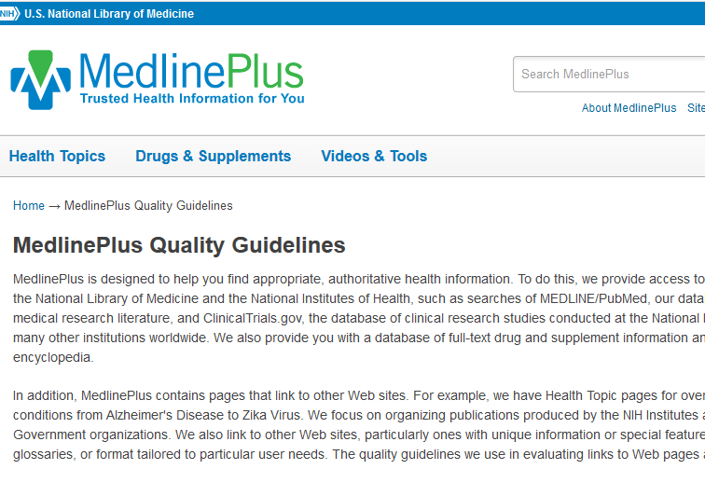
MedlinePlus Quality Guidelines
Accurate, science-based information
Information appropriate for MedlinePlus audience & easy to use
List of links are reviewed
Preference given to pages free from advertising
Availability and maintenance of webpage
Notes:
The National Library of Medicine is not creating all the informational tools that you will find in MedlinePlus but simply making sure that the ones you find in a search are trustworthy. How does MedlinePlus decide what resources to include? They have a set of quality guidelines. Some of these guidelines include that the source provides accurate, science-based information that is easy to use. They also ensure that any links on the page are reviewed. There is preference given to resources that do not have advertising (if there is advertising, is shouldn’t suggest a commercial influence on health content, and the difference between content and advertising should be clear). The availability and maintenance of the page are taken into consideration - there shouldn’t be a login required to get the information and the date of update, and the entity responsible for the content should be stated. If you’re interested in more detailed information about the quality guidelines, you can find a link on the bottom of the MedlinePlus homepage.

Slide 7
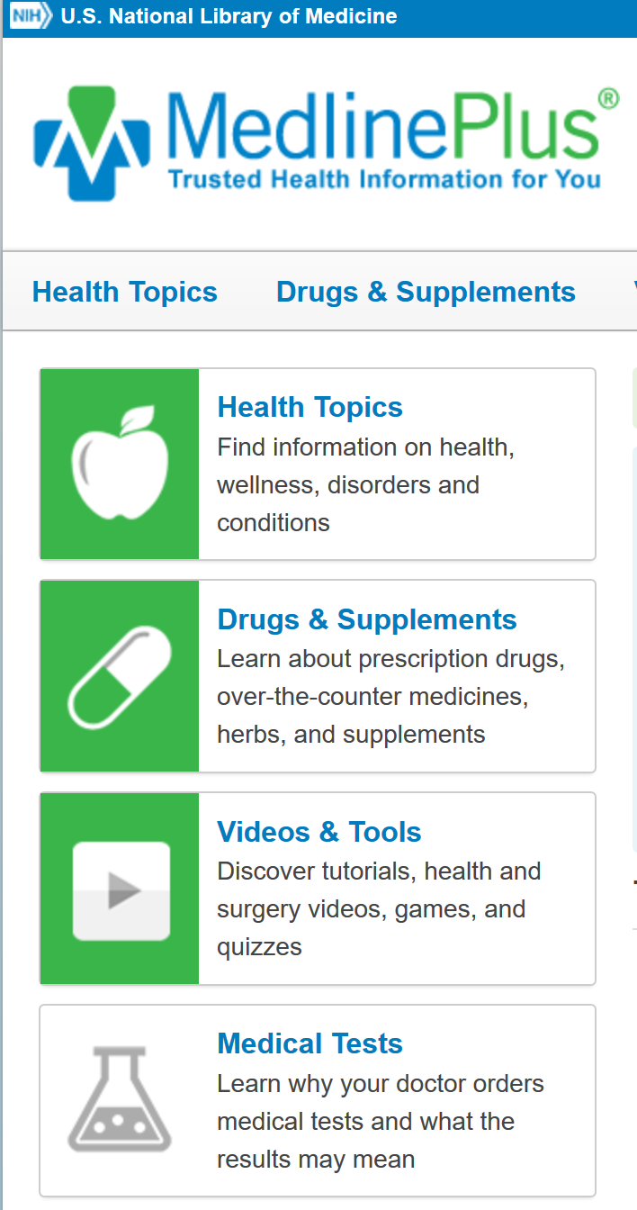
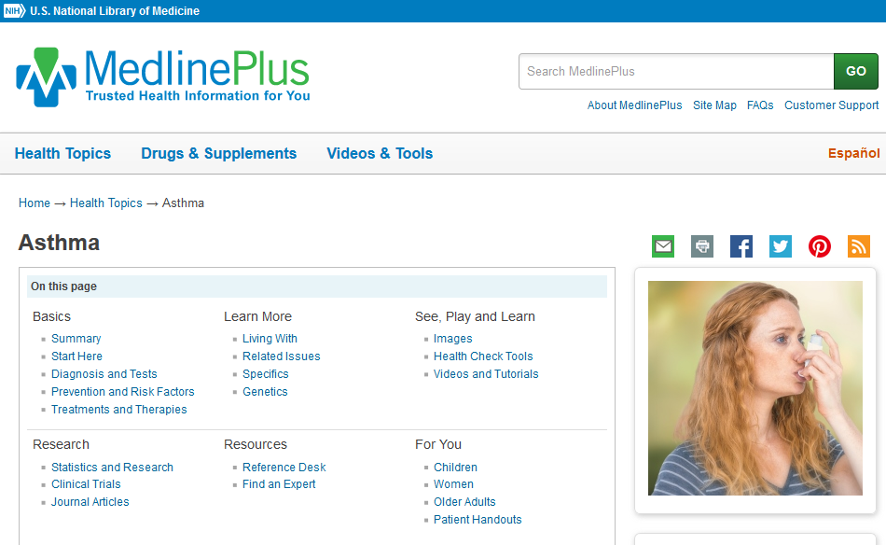
MedlinePlus navigation
Notes:
We’ll touch on some basic ways to navigate the site, which is likely to feel intuitive to all of you but may not be for patients. One section that is good to know about is health topics. This will take the user to a list of all the categories of information available on MedlinePlus - or something that MedlinePlus calls topic pages. Topic pages will take the user to a list of reliable resources on their topic of interest that is easy to navigate. You can see the topic page for asthma here.

Slide 8
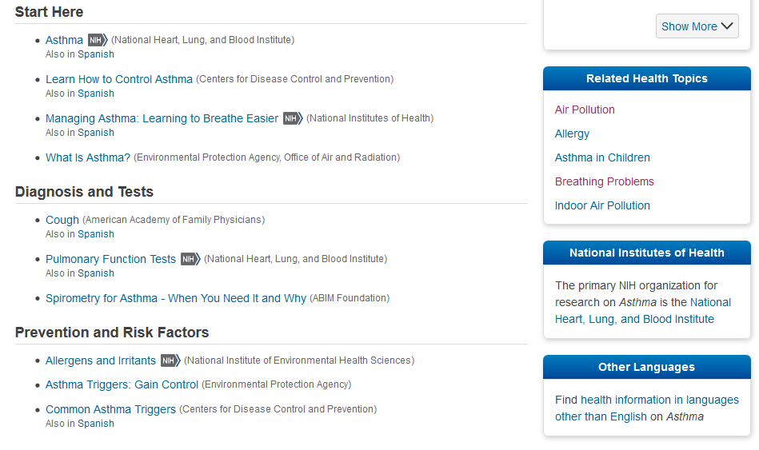
MedlinePlus navigation 2
Notes:
As someone scrolls down on this asthma topic page, they can find information about the disease itself along with information about diagnosis, prevention, risk factors and so on. There is a source listed after each linked document. While MedlinePlus is a portal from the National Library of Medicine, NLM does not create the resources that are linked here, they are simply directing the user to trusted resources from places such as the American Academy of Family Physicians or the National Institute of Environmental Health Sciences. What you won’t find linked here are ads, blog posts, and anecdotal stories that your patient could come across using a standard search engine.

Slide 9
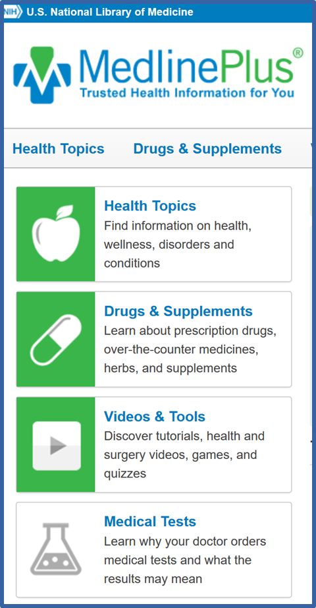
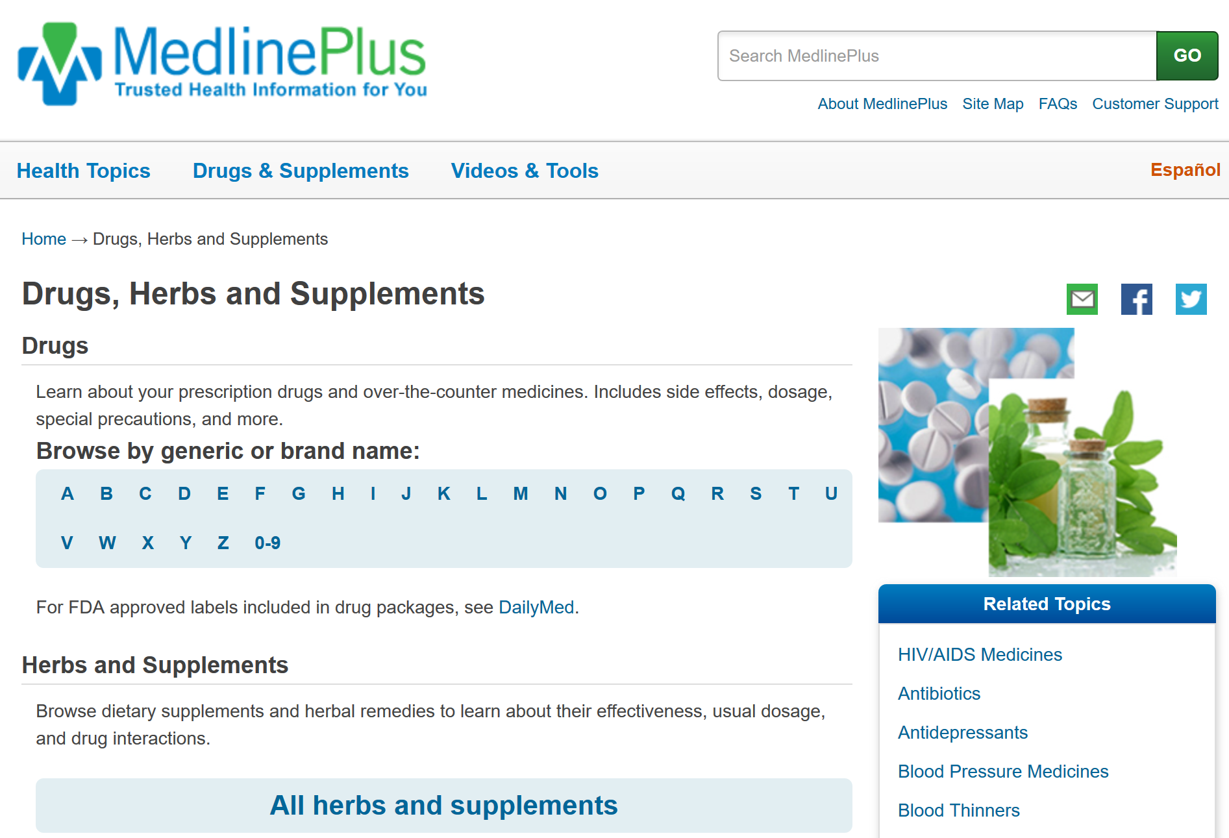
MedlinePlus Navigation 3
Notes:
From the homepage, your patient can also find easy to understand resources about drugs and supplements. These are arranged alphabetically.

Slide 10
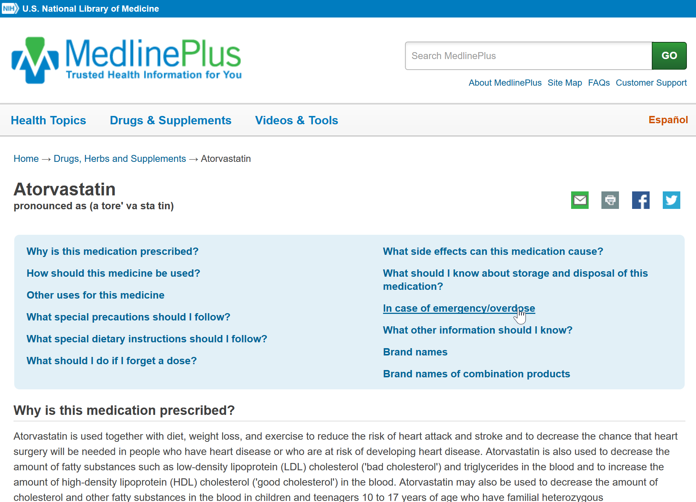
MedlinePlus navigation 4
Notes:
For example, here is a page about Atorvastatin. It is showing someone things like why the medication was prescribed, side effects and other important information. The supplement section will show similar information about commonly used supplements like bee pollen, St. John’s Wort or Echinacea. I always found these helpful when working with patients because they show what research has actually shown us about these supplements or what we still do not know about them.

Slide 11
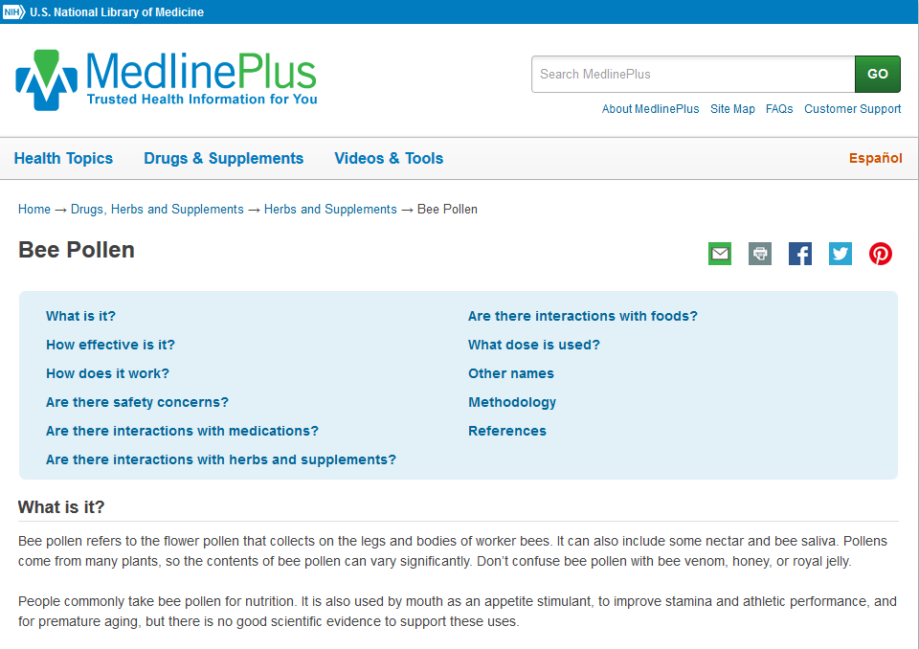
MedlinePlus navigation 5
Notes:
There is similar information available about over the counter drugs and supplements. The information will cover things like the effectiveness and safety of supplements that patients may hear about from friends or the media. While the best bet for them to learn if something is safe for them is to contact their healthcare provider, MedlinePlus will at least provide the true evidence and facts as opposed to ads promoting a product that can be found searching elsewhere.

Slide 12
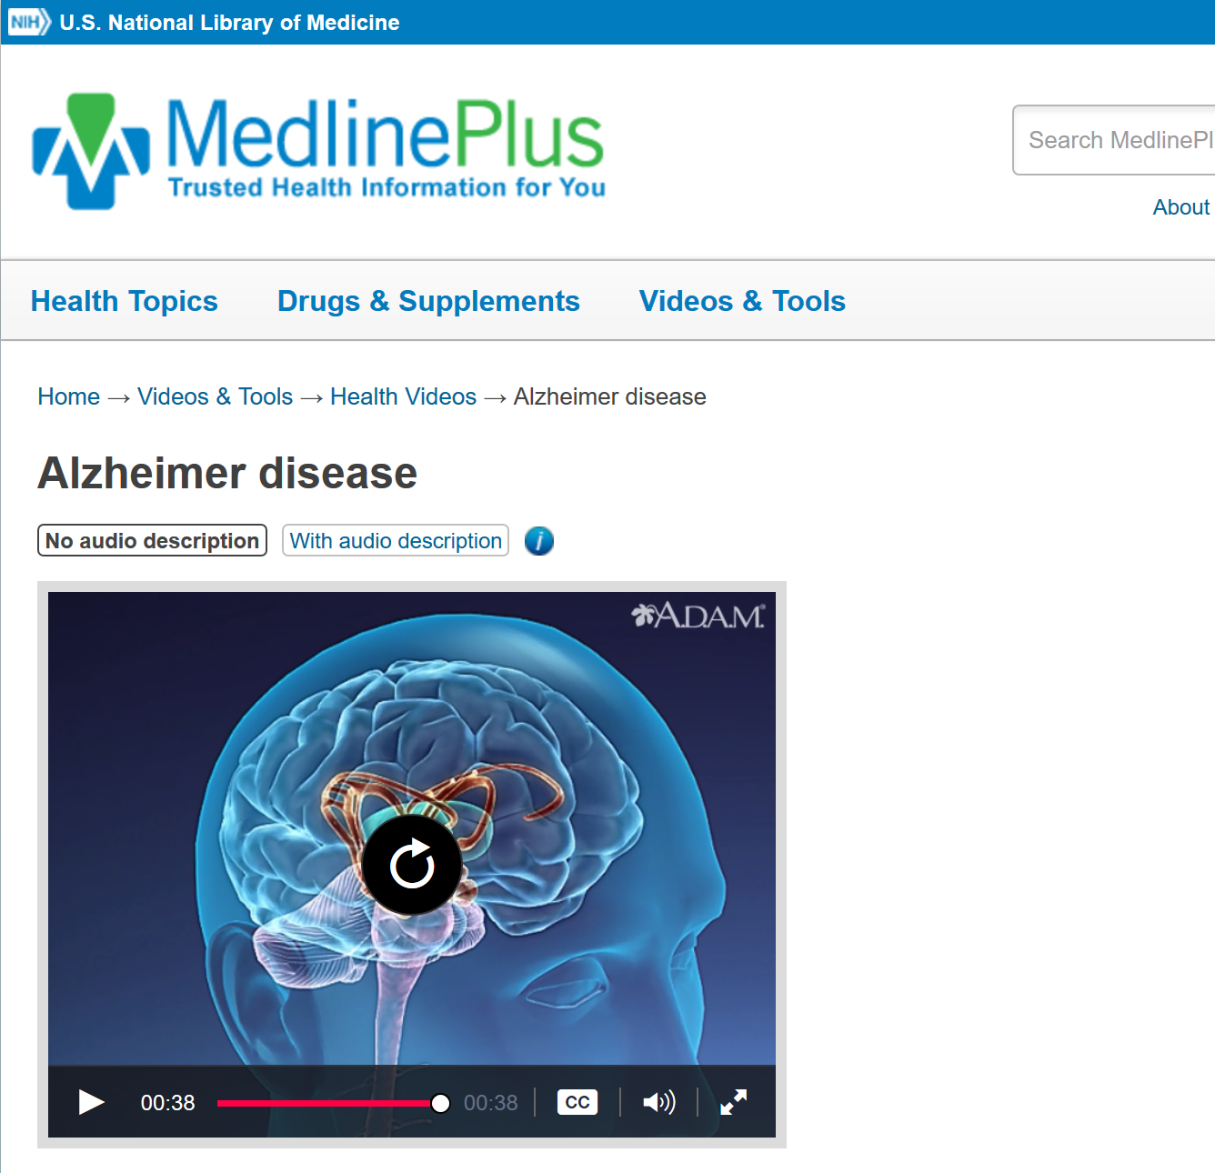
MedlinePlus navigation 6
Notes:
MedlinePlus will also link to brief videos about health conditions like this one you see here about Alzheimer disease. These can be great learning opportunities for patients who have lower health literacy and learn visually.

Slide 13
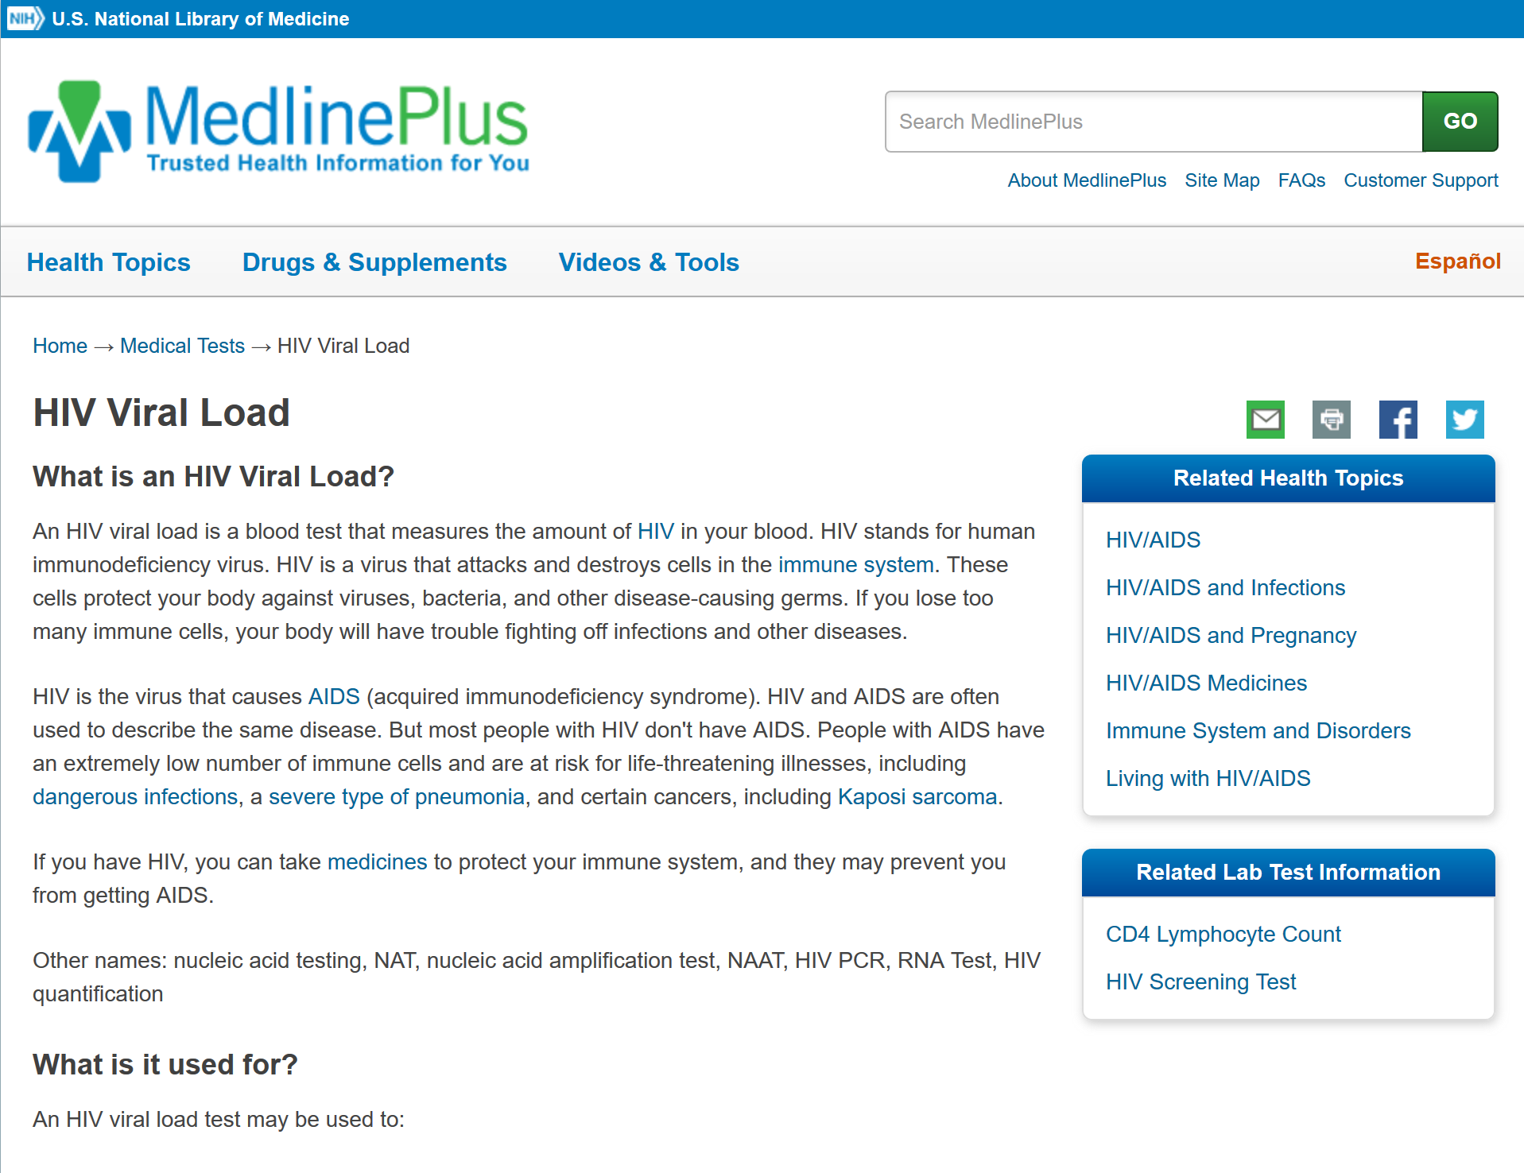
MedlinePlus navigation 7
Notes:
Patients can also locate information about a variety of lab tests to learn more about why they were ordered and what they can expect during the test. This information will include information about blood rests such as HIV viral load seen here…

Slide 14
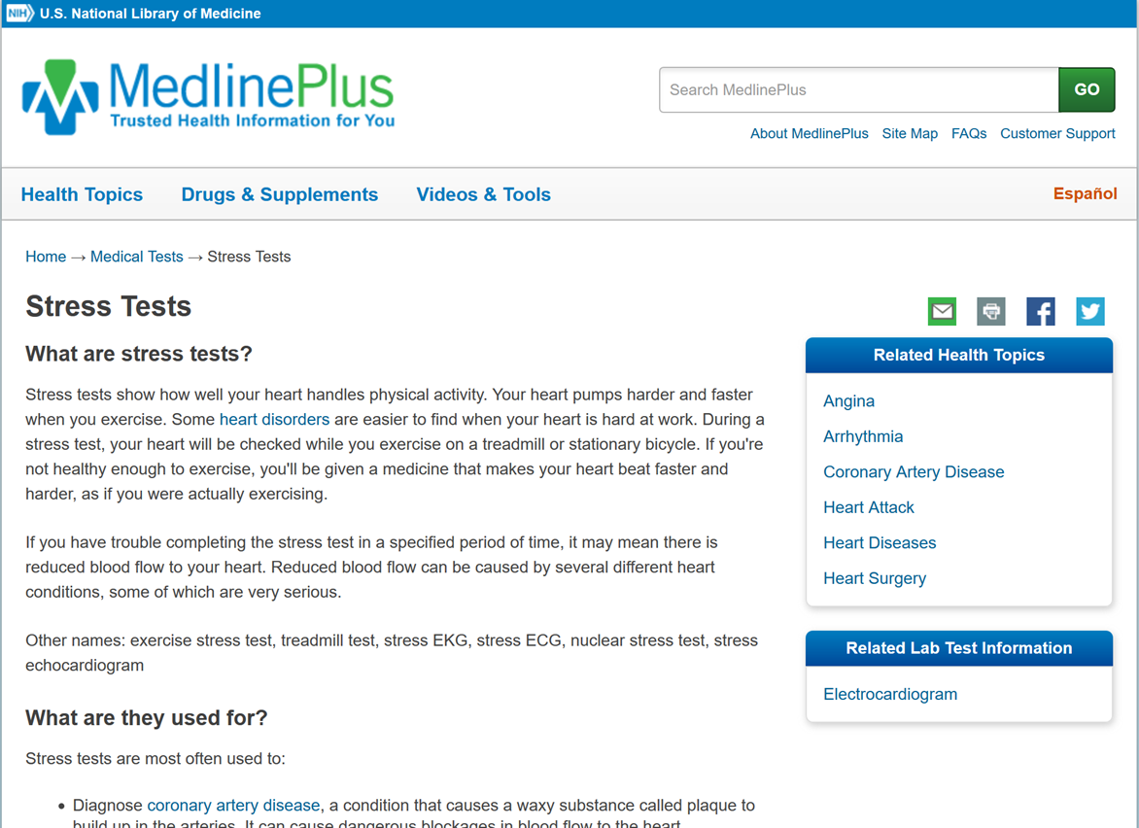
MedlinePlus navigation 8
Notes:
Or other tests, like a stress test.

Slide 15
MedlinePlus Topic Pages
Opioid Abuse and Addiction
Heart Diseases
Depression
Health Insurance
Diabetes
Oral Health
Alcohol
Caregivers
Parenting
Bereavement
Homeless Health Concerns
Domestic Violence
Teen Health
Seniors’ Health
Notes:
We could spend all day talking about information available here, but given our timeframe, I want to highlight the variety of information available. It isn’t just lab tests and diagnoses, but information for different age groups and wellness related topics.

Slide 16
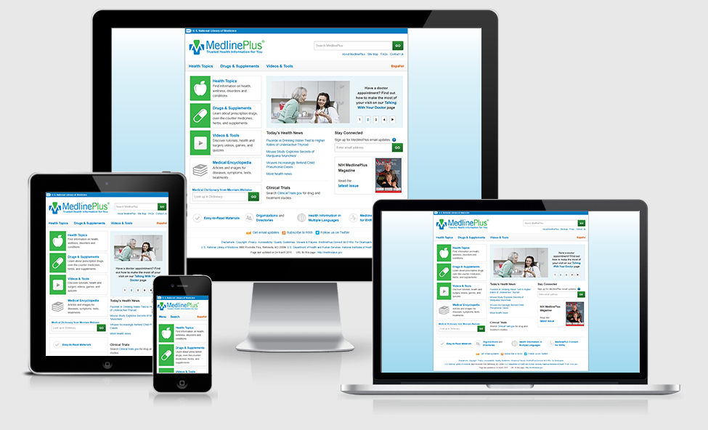
MedlinePlus- Available on any device
Notes:
Many people use phones or tablets now to search for health information, so MedlinePlus is a mobile friendly website. It can be used on a desktop, tablet or phone.

Slide 17
Take home message
Consider:
In addition to appropriate health information, what can you do to improve communication with patients?
Practice:
How can you recommend patients use MedlinePlus when looking for health information at home?
Developed resources reported in this presentation are supported by the National Library of Medicine (NLM), National Institutes of Health (NIH) under cooperative agreement number UG4LM012342 with the University of Pittsburgh, Health Sciences Library System. The content is solely the responsibility of the authors and does not necessarily represent the official views of the National Institutes of Health.
Notes:
[NOTE TO FACILITATOR: If you want to complete group discussion immediately following this module content, change the title of this slide to ‘Group Discussion’ and delete the slide with corresponding questions in the next module. If you would like to have discussion take place using your internal LMS system, you can include instructions here for how participants can participate. Then, adjust the slide with the corresponding questions in the next module as needed.]

Slide 18
References
LaValley, Kiviniemi & Gage-Bouchard (2016). Where People Look for Online Health Information. Health Information & Libraries Journal, 34, 146-155.
Sbaffi & Rowley (2017). Trust and Credibility in Web-Based Health Information: A Review and Agenda for Future Research. Journal of Medical Internet Research, 19(6), e218.

