Slide 1
Health Statistics on the Web
Network of the National Library of Medicine
February 15,
2024
Notes:
Thank you for that introduction Donald. And thank you for coming to Health Statistics on the Web.

Slide 2
NNLM
Notes:
In case you are not familiar with the NNLM, I’d like to share a few words about who we are!

Slide 3
Hierarchy of NIH, NLM, and NNLM
National Institutes of Health
Nation’s leading research agency
NIH
NNLM
ROC
NLM
National Library of Medicine
World’s largest biomedical library
Network of the
National Library of Medicine
Outreach program of the NLM
Regions, Offices, and Centers
7 regional medical libraries
3 national offices
4 national centers
NNLM Homepage
NNLM.gov
Notes:
You may be familiar with these acronyms but unsure of how they relate to one another.
NLM - the National Library of Medicine - is one of the 27 institutes and offices of the National Institutes of Health. It is the world’s largest biomedical library and produces online resources like PubMed and MedlinePlus.
NNLM - the Network of the National Library of Medicine - is an outreach program of the NLM, working to ensure health professionals and the public have equal access to health information.
The NNLM is made up 7 regional medical libraries, 3 national offices, and 4 national centers, all providing training, funding, and engagement opportunities to over 9,000 NNLM member organizations.
If you’d like to connect with your regional medical library, or learn how your institution can become a Network member, you can find your region and check out our website at NNLM.gov.

Slide 4
Objectives
Recognize
Recognize the differences between data, data sets, and statistics.
Understand
Understand a four-step process used to locate relevant health statistics for a particular circumstance or issue.
Identify
Identify online resources that provide health statistics at the national, state, and local level.
Notes:
We have three objectives for our class today. They are to:
Recognize the differences between data, data sets, and statistics,
Understand a 4-step process used to locate relevant health statistics for a particular circumstance or issue,
And identify online resources that provide health statistics at the national, state, and local level.
We will not be doing any math or talking about how to calculate statistics today. Instead, we’ll be focused on how to locate and select health statistics that are available online through free, high-quality resources.

Slide 5
Class Materials
PowerPoint slides Online table Guided handout
Notes:
There are a few class materials to share with you. If you weren’t able to download these prior to class, Donald will send these out after the class.
We have:
the presentation slides for your future reference
an online table to use to find health statistics by topic within the resources we’ll be covering today - https://www.nnlm.gov/node/10694
and a guided handout for you to use during this class. It has a few questions on it to test your knowledge during class and space for you to make your own notes. It lists several resources we will be covering today as well as a couple we will not, but that are available. There is also an in-class exercise around the 4-step process for finding health statistics, but we will not be covering that today in order to fit everything in 1 hour.

Slide 6
Agenda
Statistics overview
Steps to finding health statistics
Live demonstration of key resources
Wrap up
Notes:
Our agenda for the next 45ish minutes begins with a very brief overview of data, statistics, and their uses.
We’ll talk about the steps to finding relevant health statistics. And we’ll spend the majority of our time after that exploring key resources for health statistics through live demonstrations.
You can choose to either just watch the demos, or you can follow along on your device.
We will pause for questions throughout and after the demos, we’ll wrap things up by addressing any remaining questions.
With that, I am going to turn off my camera and move into our class content.

Slide 7
Data vs. Statistics
Data
Raw numbers
Data set
Major unit of data storage and retrieval
Statistics
Data analyzed and summarized
Counts of individual events or services
Collected at local, state, national, etc. levels
May or may not represent entire population
Most data on websites are compiled statistics
Presented as percentage, graph, table, map, etc.
Data collected & organized according to criteria
Notes:
A good way to start talking about data and statistics is to define what they are, and what they are not.
Data are the raw numbers or individual counts of something that have not been processed, cleaned, or organized in any way.
A data set is a collection of data maintained in an organized form according to particular criteria.
And statistics are data that has been analyzed or summarized in a way that makes it actionable, helping us to answer questions like, “how much” or “how many.”
Much of the health information that we see reported is in the statistic form. It can be presented in a variety of ways, such as a %, graph, table, figure, or a map.

Slide 8
Key Features of Health Statistics
A numerical summary of data computed on samples
Characterize the health of a population and the influences that affect health
Parameters are values that describes a characteristic of a population
Often collected and analyzed over a specific period
Collected to meet needs of the collector
Notes:
One definition of statistics is, “a numerical summary of measures computed on samples.”
Health statistics are a numerical summary of data that characterize the health of a population and the influences that affect health.
A population could be an entire country or a neighborhood – it could be all adults in New England or all Asian American children in California. Because you can almost never measure an entire population, we take representative samples and analyze them.
The samples are often collected over a specified period and are large enough to conduct adequate analysis. This then enables us to estimate various parameters.
Parameters are values that describe a characteristic of a population, such as birth rate, disease prevalence, or education level.
While there are many important uses of health statistics – which we’ll touch on in the next slide – it’s important to remember that statistics are collected to meet the needs of the collector.
This means that they can be influenced by the collector’s perspective or bias, which could in turn affect what data is gathered to begin with or what outcomes are reported.
So always look for notes that describe the reasons for, and methods of, data collection, and be sure to review them carefully.
It’s also good to remember that information on a topic may be collected in different ways in different surveys, and that estimates of the same statistic might vary between those surveys. For example, there are multiple surveys that measure cigarette use, and while each provides statistics on the same topic – cigarette use - the estimates of use can differ between them because they may use different methodologies, sampling frames, questionnaires, and definitions.

Slide 9
Uses of Health Statistics
Provide information about the health of a population and what influences it
Monitor health status and risk factors
Guide research, policy, and program development
Evaluate research, policy and program effectiveness
Notes:
Health statistics can be used in many different ways. They can provide information about the health of a population and what influences it. While statistics are population based, they can also help an individual understand where they fit within the larger context of their community, and identify the health disparities that exist between different community subgroups.
Statistics can be used to track and monitor trends in health status and health care delivery.
They can also be used to guide research, policy, and program development by helping us identify needs, shape how resources are allocated, and evaluate effectiveness and impact.

Slide 10
Steps to Finding Health Statistics
Formulate the question
Choose the best resource
Evaluate the results
Repeat as necessary
Notes:
Let’s talk broadly now on how to go about finding health statistics using a 4-step process.
The 1st step is to formulate a question. You may want to consider the age range, geography, and timeframe that you need the statistic for. Some examples of your question might be:
“What % of adults aged 21 and over reported having coronary heart disease in Kentucky in 2019?”
OR
“How has the rural-urban distribution of the geriatric patient population in the United States changed over the last decade?”
The 2nd step is to choose the best resource to answer your question by thinking about who might collect the data to produce or publish the statistic you’re interested in. You can consider federal agencies and state and local organizations, or institutions tied to the subject of your search. That online table in your class materials can help with this step.
After you’ve decided which resource to use, the 3rd step is to perform your search and evaluate what you’ve found to determine if it is appropriate and sufficient to answer your question. This is where you’ll carefully review the notes describing the methods used for data collection and statistical analysis.
The 4th step is to repeat as needed, either for additional information or for a different question.
I will pause here briefly to see if we have any questions before we dive into specific resources for finding statistics.

Slide 11
Class Exercise Part I:
What question or topic will you search today?
Take two minutes to formulate a question for a health statistic you are interested in finding today. You may want to include age, range, geography, and/or time frame in your question.
Example questions:
What percentage of adults aged 21 and over reported having coronary heart disease in Kentucky in 2019?
How has the rural-urban distribution of the geriatric patient population in the United States changed over the last decade?
Notes:
All right, time to break out your Guided Handout, if you haven’t already.
We are going to take 2 minutes to work on Part 1 of our class exercise. Using step 1 of our 4-step process, formulate a question for a health statistic you are interested in finding today, and write it down on your handout.
Depending on the statistic you are trying to find, you may want to include an age range, geography, and/or timeframe in your question.
Those example questions I shared with you a moment ago are on the slide for you to reference - they are also on your handout.
Let’s take two minutes to do this.
Okay, that’s two minutes. How did you do? Does anyone have any questions about the 1st step of the process?

Slide 12
Statistics Portals
Notes:
We’re going to start looking at those key resources for health statistics now.
Again, you can choose to either just watch the demos, or you can follow along on your own device.
As we explore these resources, feel free to make notes on your handout about which ones might help you answer the statistical question you’ve formulated.
We’ll begin with 2 statistics portals. Our 1st portal is the National Center for Health Statistics, or NCHS.

Slide 13
National Center for Health Statistics (NCHS)
Principal health statistics agency for the U.S.
Part of Centers for Disease Control & Prevention (CDC) since 1987
Compiles statistics from numerous data sources
Provides information to guide decisions on policies, the health care system, and health disparities
Adheres to quality guidelines to maximize the integrity of the information provided to the public
NCHS Homepage
cdc.gov/nchs
Notes:
NCHS is the nation’s principal health statistics agency, and it’s been part of the Centers for Disease Control and Prevention since 1987.
Its mission is to provide statistics and data to guide public policies and actions to improve the health of Americans.
Because they are a federal agency, NCHS is required to adhere to quality guidelines to ensure the integrity of the information they provide to the public. These include:
using the best available science and statistical methods,
being transparent about the data and methods they use,
and ensuring information is presented in a way that’s comprehensive, informative, and understandable.
For those of you who would like to follow along, you’ll find the URL for the NCHS website at the bottom right corner of the slide, and I’m going to share my screen now with the website loaded up on it.
(Open homepage) https://www.cdc.gov/nchs/index.htm
You could simply start looking for a particular statistic by typing some keywords into the search box in the upper right-hand corner,
but since I’m going to highlight some different features of this resource, we’ll pull up statistics as we navigate around the site.
The area at the top of the homepage is dedicated to highlighting new reports, data files, and resources that are available, so these will change out over time.
Scrolling down, you’ll find several tabs running horizontally across the screen, such Programs, Data and Tools, Publications – that allow you to quickly navigate to different types of content,
Further down below that , there’s a “What’s New” section, and
To the right is the always interesting Stat of the Day, [Read stat of the day]
and below the Stat of the Day are links to content grouped for different users, the General Public, Researchers, even Students and Librarians
NCHS conducts a number of different surveys to acquire data. If you go back to the list of tabs we just passed , under Data Collection Systems are prominent surveys
You will see them cited as the data source in many of the other resources we look at today, so it’s good to get familiar with them. They are grouped into 4 categories – Population Survey, Vital Records, Provider Surveys and Historical Surveys. We are going to start by looking at Population Surveys.
Click on Population Surveys.
On this page see the title of each survey,
the data source and methods used,
and a list of selected data items, which gives an idea of the type of information we’d find in the survey.
I’m going to click on the National Health Interview Survey, which is one of the ways the NCHS monitors health trends in the country.
This survey collects information on the sociodemographic characteristics of respondents, which include things like:
age, race, sex, education, employment, family size, and geographic region of residence.
On the right side of the screen, click on Interactive Data Query System to start exploring.
We are going to look at information about adults, so scroll down to find Interactive Summary Heath Statistics for Adults and click on it.
This shows the % of adult respondents who had ever been told by a doctor or other health professional that they had angina.
With the gray bar on the lefthand side, we can select different topics, including Mental Health topics. We can look at Trends over time or narrow the data to a Single year.
Using the Group by: pull-down menu, we can explore and access sociodemographic characteristics:
I’m going to click on Sexual orientation to view the available statistics separated by that characteristic.
The National Health Interview Survey began collecting sexual orientation information with the 2013 survey.
This is an area that has historically been limited, but both public health and clinical data collection is progressing.
Currently, this survey includes questions about sexual orientation but not gender identity. Under notes, you can find the codebook and more about how this survey question was asked.
I’m going to going back to our list of characteristics now and scroll down to Family income – here income is presented as it relates to the Federal Poverty Level (FPL).
The generated tables and graphs can be downloaded by clicking on the Download icon by the graph title. Download plot.
You can also explore the Interactive Summary Health Statistics by Race and Hispanic or Asian Origin Subgroups, where you can further break down these statistics for specific and detailed self-identified, racial groups.
(homepage)
Now I’m going to click return to the homepage, and look at another Data Collection Systems – Vital Records. [don’t click on it]
Here you’ll find the National Vital Statistics System [don’t click on it], which provides access to official birth, death, marriage, and divorce statistics,,
and the National Death Index [don’t click on it], which researchers can use to find out who in their datasets has died.
And Vital Statistics Rapid Release [click on it] which provides access to extremely timely information.
It uses provisional data to estimate important statistics for public health surveillance much faster than would be possible using final annual data.
This enables us to recognize and track developing health threats, like we did when COVID-19 became a pandemic, and the goal is for this to be a nearly real-time public health surveillance tool.
On the left under Surveillance Activities –is the Provisional Drug Overdose Death Counts – This information is being closely monitored as these deaths have been rising in recent years.
Click on Provisional Monthly National and State-Level Drug Overdose Death Counts
Then Scrolling down, we are able to see dynamic visualizations of the data:
You can view the death trends over time nationally,
And you view a map of the percent change in deaths in a 12-month period.
You can hover over individual states to see percent change. Orange states are increasing. Blue states are decreasing.
To the right of the map is the percent change nationally – which is 2.8%
Underneath the map are the Technical Notes which provide details on the data and how these statistics were compiled.
Scrolling back to the top of the page. I’ll click on Vital Statistics Rapid Release then Reports. This section is based on the current flow of vital statistics data on surveillance issues. You can see recent reports. These reports can be helpful if you are having difficulties understanding and interpreting the vital statistics data.
They provide detailed methodological information, in-depth analyses, and a Discussion section for the topic.
I’ll go back to the NCHS (homepage).
NCHS disseminates the information they create through a variety of reports and publications. One more that I’d like to show you are their excellent Data Briefs, which you’ll find under the PUBLICATIONS tab.
These are short reports sharing statistics from their various data collection systems.
You can search these by the by year – going back to 2007, by survey used, and by keyword.
I’ll search for “nutrition” as an example. Then select Children Living in Households That Experienced Food Insecurity: United States, 2019-2020
Important statistics can be found in the Key Findings section.
This brief highlights the age, race, disability and socioeconomic status, and the rural-urban differences in the percentage of children living in food insecure households. [Scroll back up]
All of the Data Briefs include a PDF version for printing, and many also include visual abstracts.
These can be engaging ways to share the key statistical information in presentations or on social media.
Then back to the- homepage.
Though we’re focusing on statistics rather than data in this class, I’ll quickly point out publicly available datasets.
You’ll find links to their available data and information on how to download and use it under Data and Tools – Data Access.
Also here, under Data Visualizations on the far right, is Stats of the States.
You can click on specific states and see statistics on key health indicators, as well as birth and death information.
You can click on any of the hyperlinks which brings up a national map visualizing how your state fits in overall. Let’s say you want to look at Teen Birth Rate. Now you can compare the states.
Light color states – darker color states.
We’re looking at 2021 data – we take a look at 2005 to see how rates have changed.
[Close tab - homepage]
There’s much more information on this site, and I encourage you to spend some time exploring it after this class.
Before leaving, I do want to mention the option to receive email updates. [Scroll to bottom right corner box]
There’s an extensive list of topics you can choose to subscribe to, so you can be alerted whenever new information is available in areas of interest to you.

Slide 14
MedlinePlus
National Library of Medicine’s consumer health portal
Information on diseases and conditions, wellness issues, drugs and supplements, and medical tests
Sourced from over 500 vetted organizations
Health Topic pages can be used to quickly access statistics on a particular topic
MedlinePlus Homepage
medlineplus.gov
Notes:
MedlinePlus is the National Library of Medicine’s consumer health portal, which links to information on diseases and conditions, wellness issues, drugs and supplements, and medical tests from over 500 vetted organizations.
You can also use the Health Topic pages on MedlinePlus to quickly access statistics on a particular topic.
Here is the homepage.
Click on Health Topics.
You can find a topic either through the alphabetical listing, or by looking under one of these categories.
I’m interested in Breast Cancer. I can click the B; or I’ll click on Cancers, which takes us to a list of all the cancer-related topic pages that are available. I’m going to scroll down and choose Breast Cancer.
These top boxes serve as a table of contents for the page. Here, under Research, is a link for Statistics and Research.
There are several different statistics resources linked here. You’ll see the name of the organization providing the information in parentheses – Breast Cancer Statistics from the CDC.
Clicking the link for Cancer Stat Facts from the National Cancer Institute takes you away from MedlinePlus and on to the National Cancer Institute’s page, where you can start right in on looking for statistics on a particular topic.
Survival Statistics – scroll down to Additional Information – More about Survival Statistics
So, just as when you might use MedlinePlus as a starting point when you’re unfamiliar with a particular disease or condition, it can also be a great starting point when you’re not sure who might produce statistics on a particular topic.

Slide 15
Question Check 1
Questions?
Notes:
Alright, I am going to pause again to see if there are any questions on the 4 local resources we covered.

Slide 16
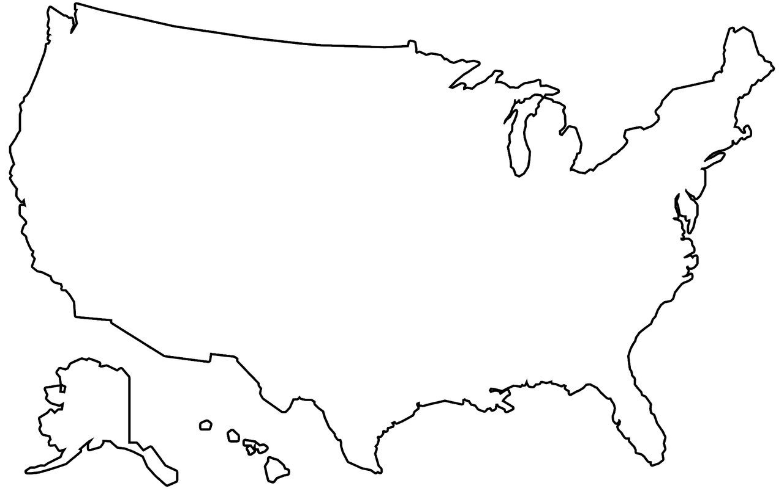
National Statistics
Notes:
We’re going to move away from the portals now to focus on 2 resources where you can find national statistics.
Both of these also happen to provide statistics at the state level, allowing you to directly compare national and state information.

Slide 17
Behavioral Risk Factor Surveillance System (BRFSS)
Sponsored by the CDC and other federal agencies
World’s largest continuously conducted health survey
Health risk behaviors
Chronic conditions
Use of preventive services
Collects self-reported data from all 50 states, Washington D.C., and U.S. territories
BRFSS Homepage
cdc.gov/brfss
Notes:
The Behavioral Risk Factor Surveillance System, or BURFISS, is sponsored by the CDC and other federal agencies. First conducted in 1984, it is now the world’s largest continuously conducted survey system.
BURFISS collects data from adults 18 years and older about health risk behaviors, chronic diseases and conditions, and use of preventive health services,
and then uses the data they obtain to plan health promotion activities.
Though sponsored at the national level, the surveys are conducted at the state level, with all 50 states, the District of Columbia, and the US territories overseeing thousands of interviews every year.
If you’re of a certain age, you might recall the data used to be collected just through landline phone surveys, but as technology and culture has changed, they now utilize cell phone, mail, and internet surveys.

Slide 18
State Health Facts
Produced by the Kaiser Family Foundation
Provides data at the national and state level
Over 800 health indicators including:
Demographics and economy
Women’s health
Minority health
Health insurance
State Health Facts Page
kff.org/statedata
Notes:
Okay, let’s move on to our 2nd national resource - State Health Facts.
This is produced by the Kaiser Family Foundation, a non-profit organization focused on health policy research, polling, and news in the United States.
The organization refers to themselves as KFF, which is what you’ll see on the website when we open it up in a minute.
You’ll find statistics on more than 800 health indicators, including those related to coverage and insurance, providers and care, as well as issues of current concern like COVID-19 and mental health.
The data come from a variety of sources, including KFF reports, public websites, government surveys, and private organizations.

Slide 19
Question Check 2
Questions?
Notes:
Okay, time for a Question check!
What questions do you have on the 2 portals or 2 national resources we’ve covered so far?

Slide 20
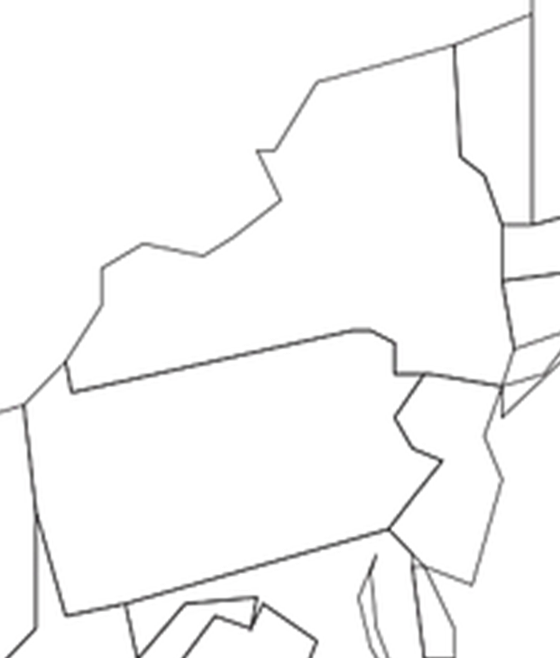
Local Statistics
Notes:
We’re moving on to finding local statistics, such as those at a zip code or county level.
We have 4 to look at, and the 1st one will have a familiar name - the US Census Bureau.

Slide 21
U.S. Census Bureau
Federal government’s largest statistical agency
Provides facts and figures about America’s people, places, and economy
Levels include state, county, city, town, zip code, census tract, congressional district, tribal areas
Other surveys available include:
American Community Survey
Current Population Survey
Survey of Income and Program Participation
Census Homepage
data.census.gov
Notes:
The Census Bureau is a federal agency and is part of the U.S. Dept of Commerce. It serves as the nation’s leading provider of data about US residents.
The Census is conducted every 10 years with a focus on population count. On the website, you’ll find data and statistics about the US population and economy,
and information on geographies at various levels, including state, county, city, town, zip code, census tract, congressional districts, and tribal areas.
Census Bureau data covers topics like populations and people, employment, income, housing, government, and education. With regards to health, you can find statistics pertaining to disability and fertility, health insurance, and the business of health care.
The data on this site currently goes back to 2000 and pulls from several other surveys in addition to the Census, like the American Community Survey, which is conducted annually and has a bigger focus on community needs.

Slide 22
County Health Rankings & Roadmaps
Collaboration between Robert Wood Johnson Foundation and University of Wisconsin Population Health Institute
Ranks counties on key health factors and health outcomes
Statistics at the county level on factors such as:
Quality of life
Health behavior
Social and economic factors
Physical environment
CHRR homepage
countyhealthrankings.org
Notes:
The 2nd local resource that we are going to look at is County Health Rankings and Roadmaps.
This is a collaboration between the Robert Wood Johnson Foundation and the University of Wisconsin Population Health Institute.
They pull data from several sources including BURFSS, and then analyze and summarize it, to produce their annual rankings, which provide a snapshot of a community’s health.
We’ll be focusing on the statistical information that’s available here, but I want to mention that an equal focus of this resource is not only to help people identify the top health concerns in a population, but to enable people to act on what they learn - they offer evidence-based strategies to take action to address these concern, grow community power, and improve health equity.

Slide 23
City Health Dashboard
Created by the Department of Population Health and the School of Public Service at NYU in partnership with the National Resource Network
Over 40 measures of health for over 900 U.S. cities
Data at the city, zip code, and census tract levels
Measures align with County Health Rankings & Roadmaps
Dashboard Homepage
cityhealthdashboard.com
Notes:
All right, moving on to our 3rd local resource now, we have City Health Dashboard
This resource is from the Dept of Population Health and the School of Public Service at NYU, in partnership with the National Resource Network. It focuses on health in US cities, which is important as more than 80% of the US population lives in urban areas.
The Dashboard began gathering data for the 500 largest cities in the United States in 2018, but in 2020, they expanded to include small and midsize cities with populations over 50k, so it currently provides data for over 900 cities.
The 43 indicators they measure align with those used in Co Health Rankings & Roadmaps, and are focused on health, the factors that shape health, and the drivers of health equity. And, like Co Health Rankings & Roadmaps, this is a resource to support and drive positive change towards health and equity for communities. Some of the indicators can be narrowed down to the zip code or census tract level while others are just available at the city level.
And in January, they launched a new sister website – the Congressional District Health Dashboard – which provides health and equity data for all 435 congressional districts to support state and national policymaking.

Slide 24
Rural Health Information Hub (RHIhub)
Funded by the Federal Office of Rural Health Policy
National clearinghouse on rural health issues
Statistics for metro and non-metro counties on:
Demographics
Health disparities
Social determinants
Access to services
RHIhub Homepage
ruralhealthinfo.org
Notes:
So, what if you’d like information on a place that is not one of the 906 largest cities?
In this instance, our 4th local resource, Rural Health Information Hub, might be helpful.
RHIhub is funded by the Federal Office of Rural Health Policy and operated by the Center for Rural Health at the University of North Dakota School of Medicine and Health Sciences.
It serves as a national clearinghouse on rural health issues. There is an incredible amount of information on this site related to rural healthcare delivery and population health including in depth topical and state guides, interactive maps, county-level data, case studies, toolkits, and opportunities for funding and collaboration.

Slide 25
National Neighborhood Data Archive
Cognability – how your neighborhood supports cognitive health through places to be physically active, socially engaged, and keep your mind active
NaNDA Data Repository – open data for research questions that address “place”
Social Determinants of Health
Crime rates
Police districts
Polluting sites
Public transit
NaNDA Health Bytes Recording (scroll to bottom)
Notes:
So, what if you’d like information on a place that is not one of the 906 largest cities?
In this instance, our 4th local resource, Rural Health Information Hub, might be helpful.
RHIhub is funded by the Federal Office of Rural Health Policy and operated by the Center for Rural Health at the University of North Dakota School of Medicine and Health Sciences.
It serves as a national clearinghouse on rural health issues. There is an incredible amount of information on this site related to rural healthcare delivery and population health including in depth topical and state guides, interactive maps, county-level data, case studies, toolkits, and opportunities for funding and collaboration.

Slide 26
Question Check 3
Questions?
Notes:
Alright, I am going to pause again to see if there are any questions on the 4 local resources we covered.
Lastly, before we leave this section, I just want to mention that health departments can also be a great source for local statistics.
And don’t forget your organization’s electronic health record – you can pull statistics from your data warehouse.

Slide 27
Class Exercise Part II
Take five minutes and use the question you formulated in Part 1 to explore steps 2 through 4 of the 4-step process for locating health statistics.
Perform a search for your question and take some notes on what you find.
Step 2. Choose the best resource
Step 3. Evaluate what you’ve found
Step 4. Repeat as needed
Notes:
Let’s return to the question you formulated on your guided handout and do part II of our exercise.
This involves working through steps 2 through 4 of our 4-step process for locating health statistics.
Those steps are up on the slide – and they are also on your handout.
We’ll take 5 minutes to perform Step 2, which is to choose the best resource to answer your question by thinking about who might collect the data to produce or publish the statistic you’re interested in,
Step 3, which is to search and evaluate what you find to see if it’s appropriate and sufficient to answer your question,
And Step 4, which is to repeat as needed to find an answer to your question.

Slide 28
Final Questions and Evaluation
Christine Nieman Hislop, MSLIS | Data Education Librarian
NNLM Region 1 | cnieman@hshsl.umaryland.edu
Katie Pierce Farrier, MIS | Data Science Strategist |
NNLM Region 3 | katie.pierce-farrier@unthsc.edu
More trainings available at NNLM.gov/training
Funded by the National Library of Medicine.
NLM and NNLM are service marks of the US Department of Health and Human Services. Updated February 2024.
Notes:
We’ve reached the end of our class content!
Does anyone have any final questions before we wrap up our session?
If you have any questions in the future, please feel free to reach out to us.
Thank you for attending the session today!

