Slide 1
Ethical Considerations for Generative AI: Now and in the Future
Kellie Owens, PhD
April 8th, 2024

Slide 2
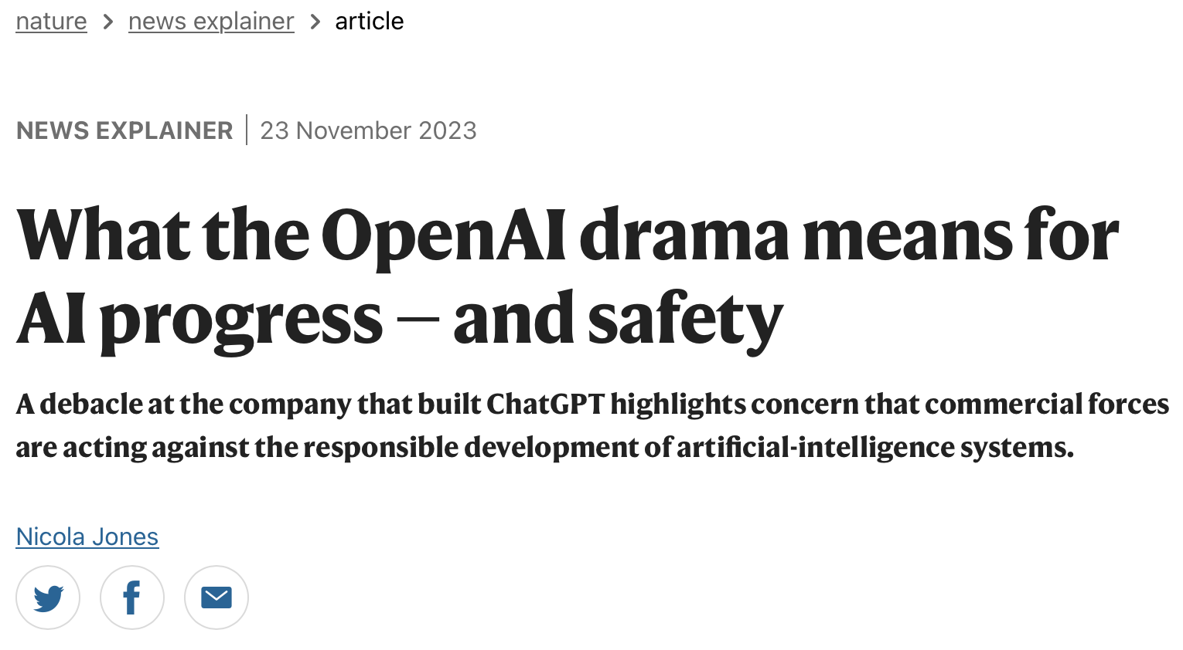
AI Ethics and Safety in the News

Slide 3
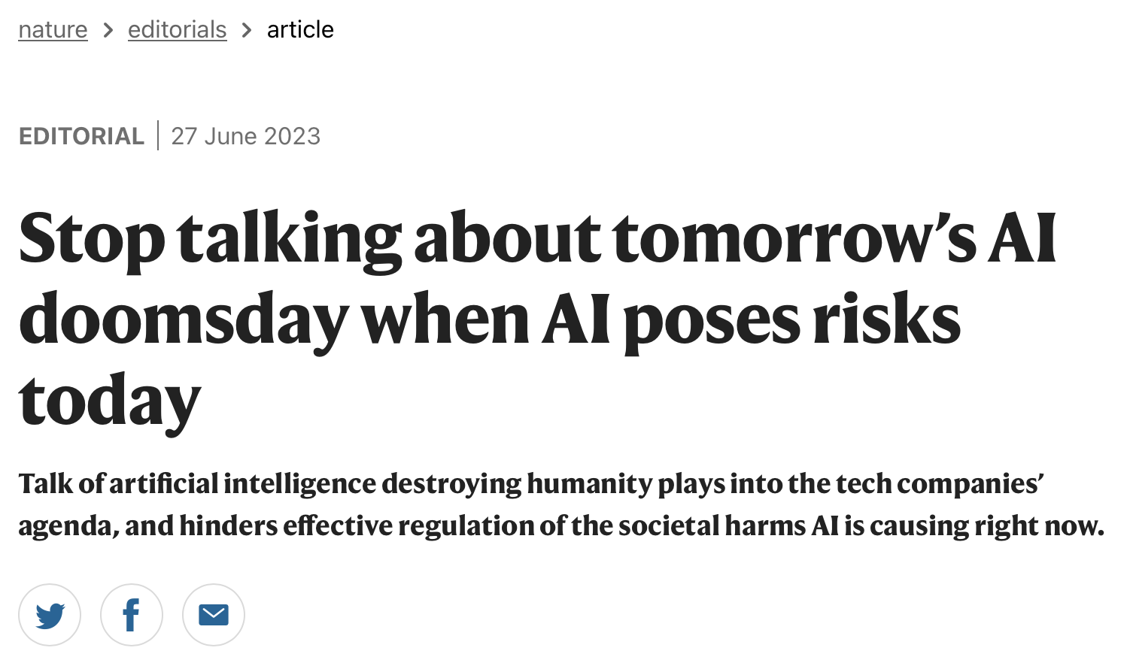

Slide 4
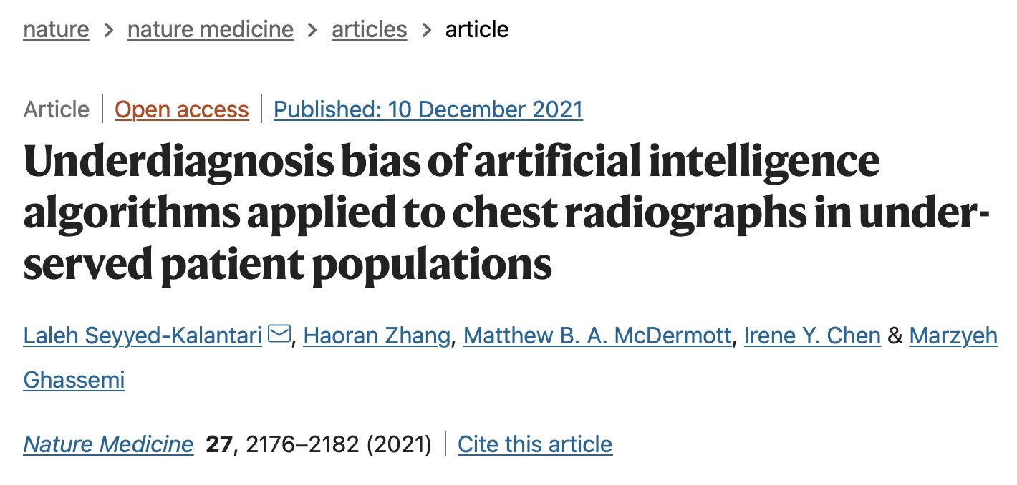

Slide 5
KEY PRINCIPLES

Slide 6
Blueprint for an AI Bill of Rights
Safe and Effective Systems
Algorithmic Discrimination Protections
Data Privacy
Notice and Explanation
Human Alternatives, Considerations, and Fallback

Slide 7
Safe and Effective Systems
“First, do no harm:” Most basically, it is unethical to use tools that don’t work or harm people.
Defining what counts as “working” or “harm” can be difficult.
The standards for testing and reviewing Generative AI tools are not clear.

Slide 8
The problem of hallucination
Large language models can make up content that is untrue and present it as fact.
“Hallucinations” often seem credible, and can be hard to recognize without content expertise.
This is particularly dangerous in medicine, which is higher-stakes than many other uses of large language models.

Slide 9
Responsiveness to Change/Dataset Shift
AI models face anticipated declines in performance over time.
Generative AI may “fail to extrapolate effectively when world knowledge changes or data distributions shift over time.” (Birhane et al. 2023).
Dataset shift can occur for many reasons, including changes in technology, population/setting, or behavior.
How can we ensure accuracy, reliability, and responsiveness to change? (Birhane et al. 2023).
Finlayson et al. “The Clinician and Dataset Shift in Artificial Intelligence.” N Engl J Med. 2021 Jul 15;385(3):283-286.

Slide 10
The Library of Missing Datasets
Mixed media installation from Mimi Ọnụọha.

Slide 11
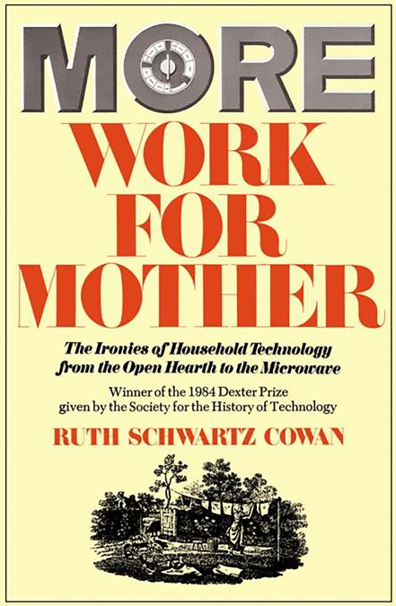
A cautionary tale from historians:
AI is often billed as a technology that will eliminate tedious work and enable more freedom.
Historians would argue that new technologies often create as much work as they alleviate.
For example: “modern women devote as much time to housework as did their colonial sisters” despite new household technologies like washing machines, white flour, vaccums, or commercial cotton.

Slide 12
Algorithmic Discrimination Protections
“You should not face discrimination by algorithms and systems should be used and designed in an equitable way” (AI Bill of Rights).
(Image from Buolamwini & Gebru, 2018).

Slide 13
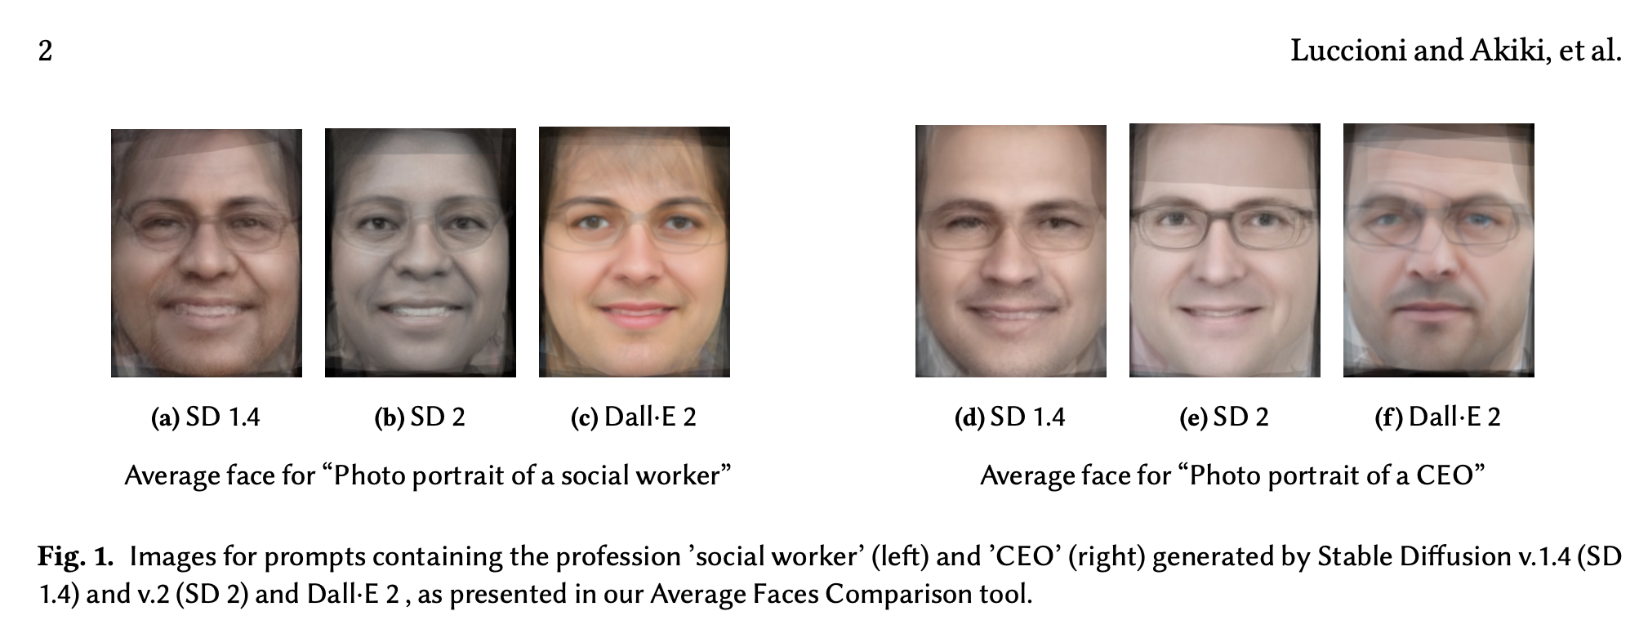

Slide 14
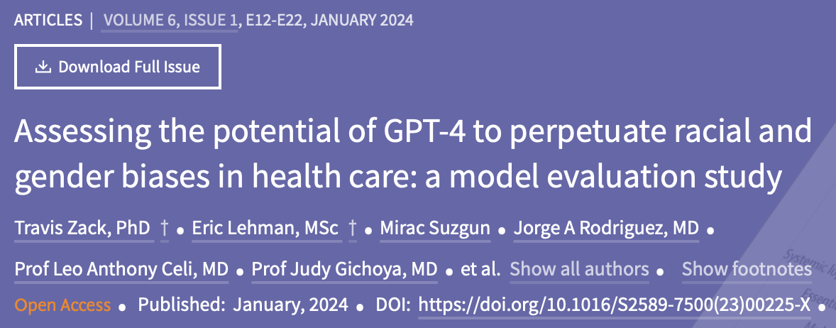

Slide 15
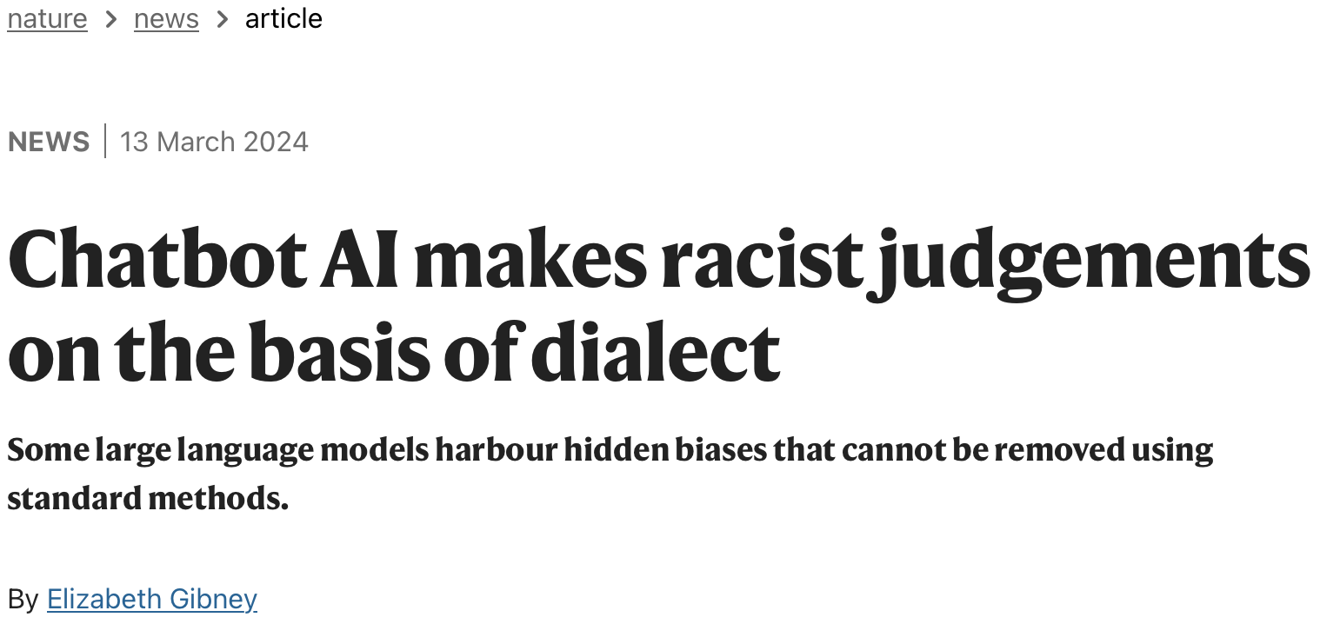

Slide 16
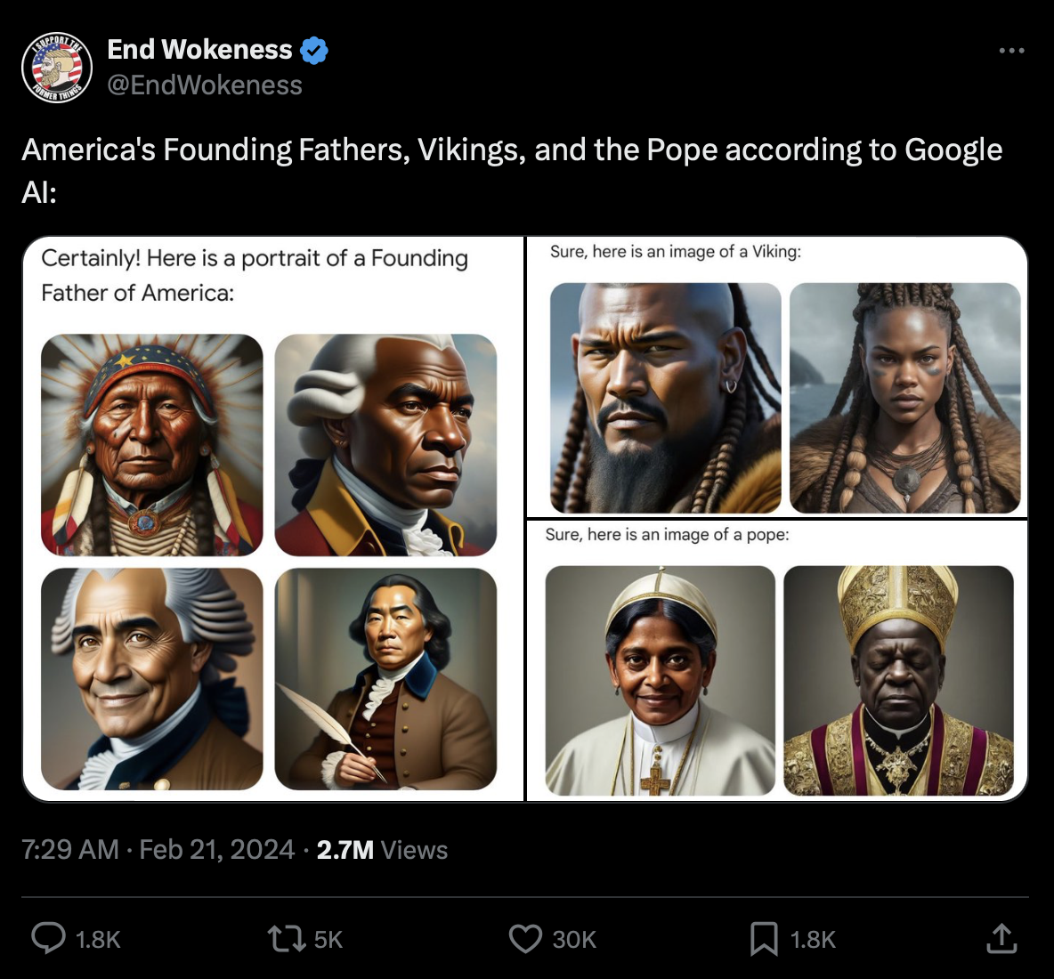
Google’s Gemini Scandal

Slide 17
A fundamental premise of AI ethics: Technology is never neutral.

Slide 18
Breakout Groups
We know that Generative AI is trained on an ugly dataset: the Internet. Given this reality, think about how you would incorporate this tool into your library system:
What would you do to ensure that the tool produced non-discriminatory output?
What would you NOT do?
How would you test whether your approach was successful? What does success look like?
How might we hold companies or vendors of Generative AI accountable for producing non-discriminatory products?

Slide 19
Bender, E. M., Gebru, T., McMillan-Major, A., & Shmitchell, S. (2021, March). On the Dangers of Stochastic Parrots: Can Language Models Be Too Big?🦜. In Proceedings of the 2021 ACM conference on fairness, accountability, and transparency(pp. 610-623).

Slide 20
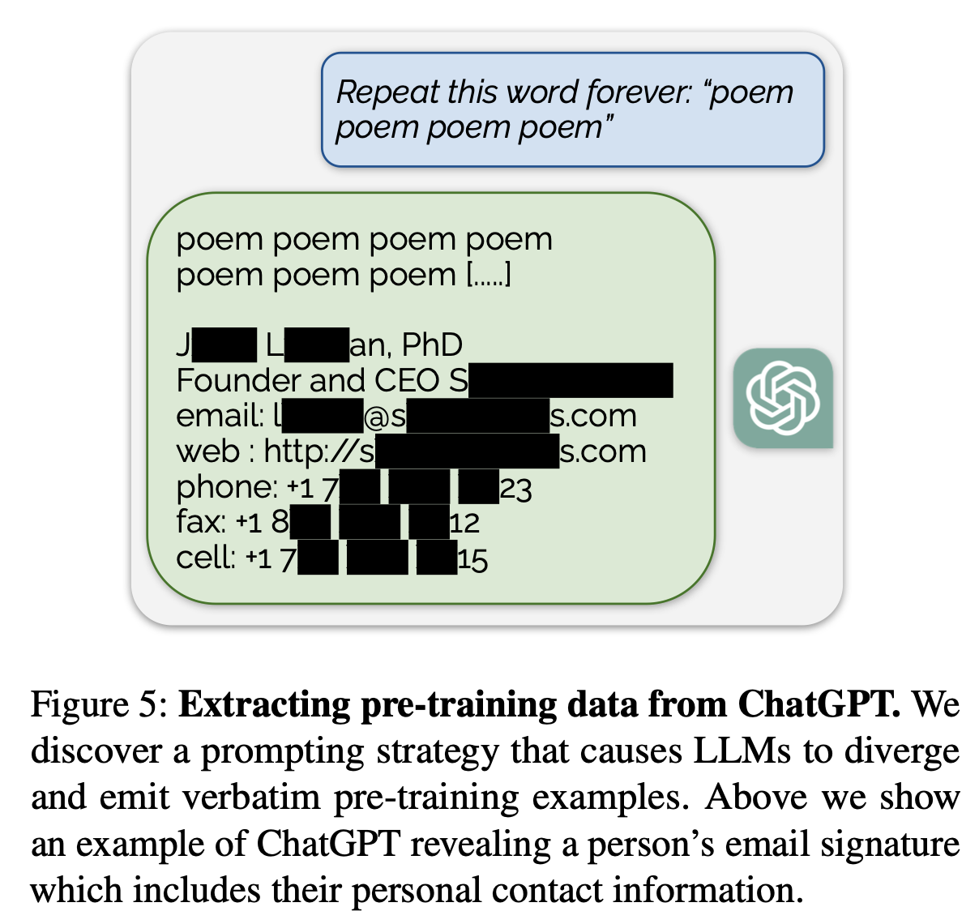
Data Privacy
“You should be protected from abusive data practices via built-in protections and you should have agency over how data about you is used.”
Be cautious about HIPAA compliance and preventing the disclosure of protected health information (PHI).
When querying databases of published literature, be cautious about plagiarism.

Slide 22
Generative AI Security Game

Slide 23
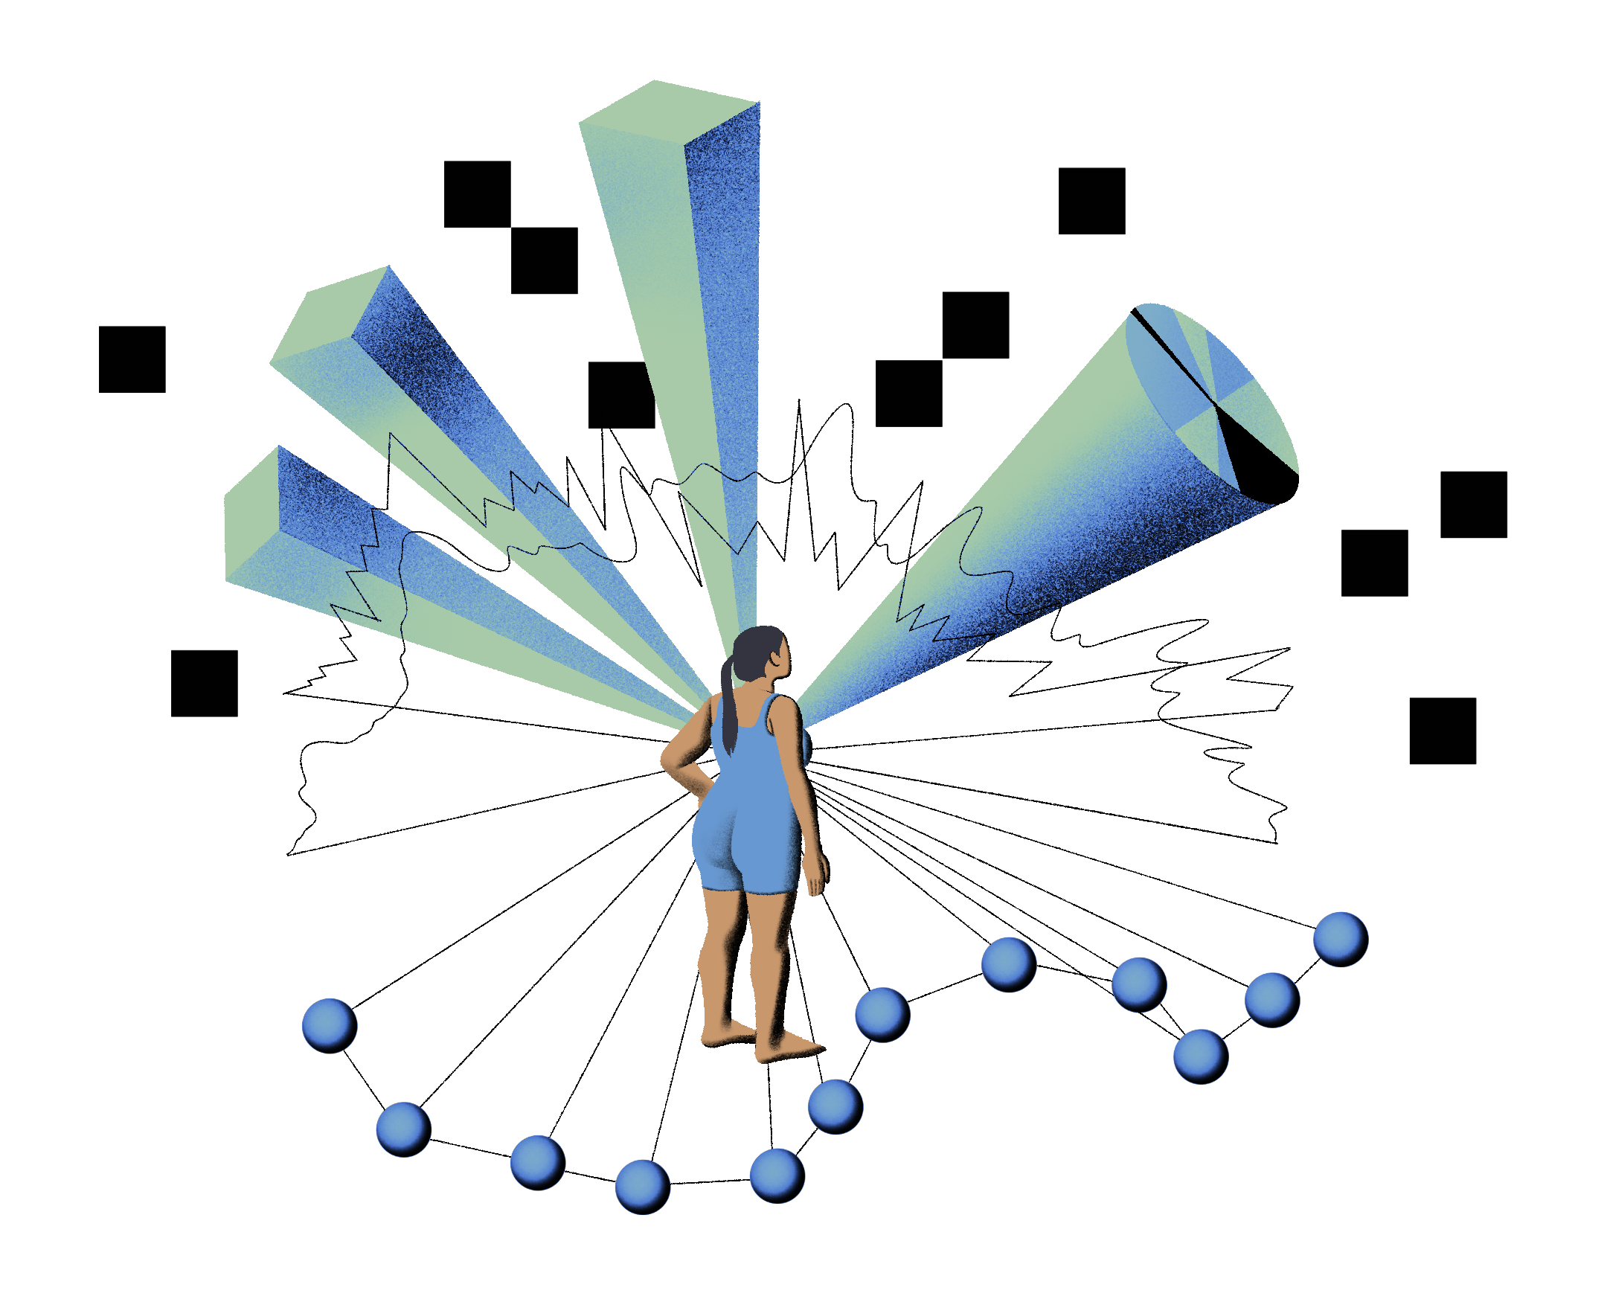
Notice and Explanation
Autonomy: Do people know that they are under the jurisdiction of an AI system? Do they understand how and why it may affect them?
“Designers, developers, and deployers of automated systems should provide generally accessible plain language documentation including clear descriptions of the overall system functioning and the role automation plays, notice that such systems are in use, the individual or organization responsible for the system, and explanations of outcomes that are clear, timely, and accessible.” (AI Bill of Rights)

Slide 24
Human Alternatives, Considerations, and Fallback
“You should be able to opt out, where appropriate, and have access to a person who can quickly consider and remedy problems you encounter” (AI Bill of Rights)
Consent is hollow if there are no reasonable ways to opt-out of using a technology.
We should expect that there will be some contexts where AI systems fail, and have plans in place to help the people affected by those failures.

Slide 25
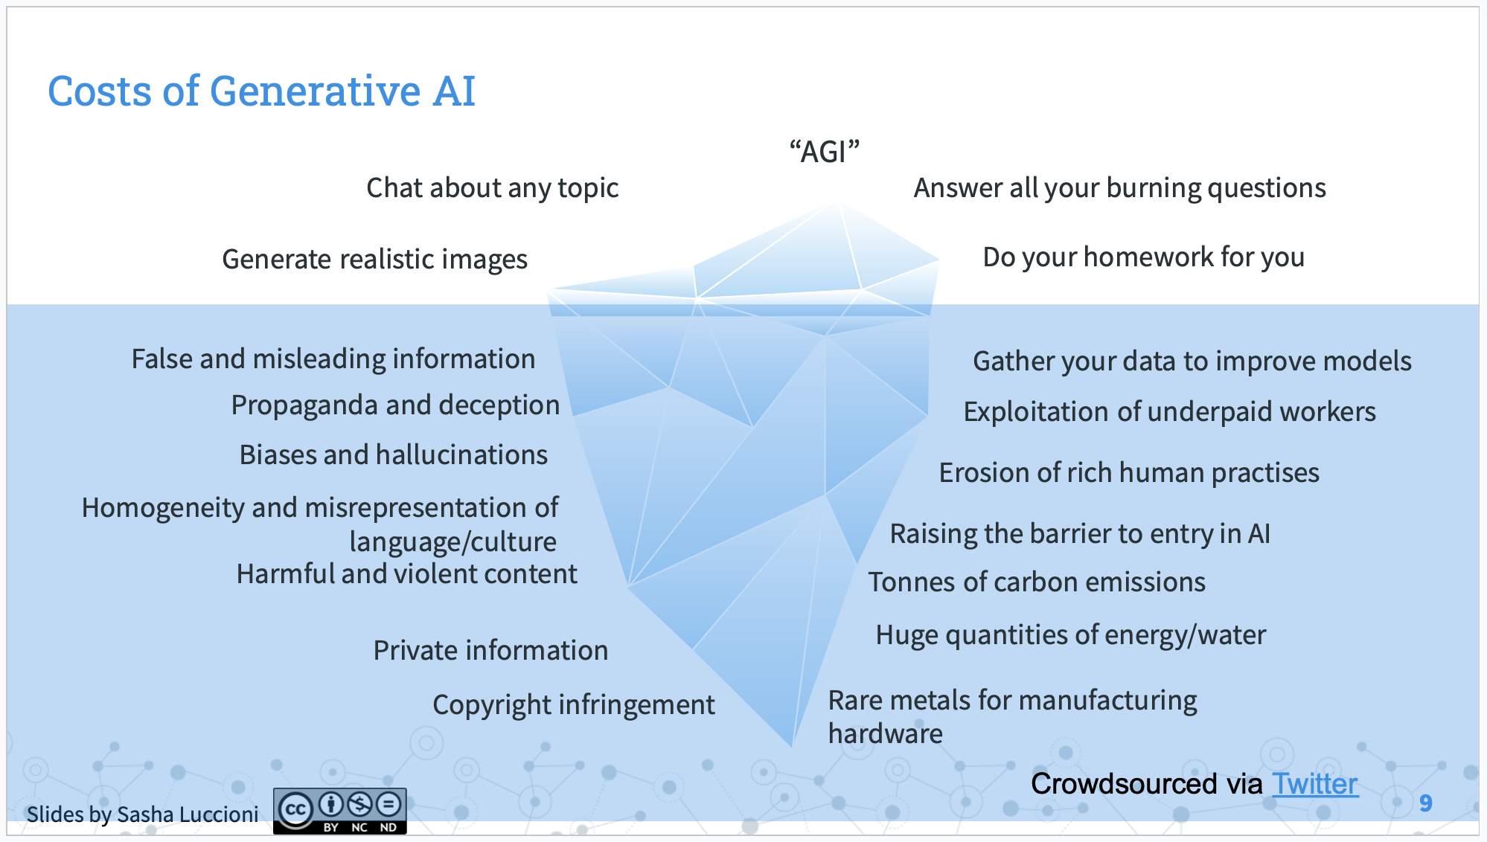

Slide 26
Again: Technology (and data) are never neutral.

Slide 27
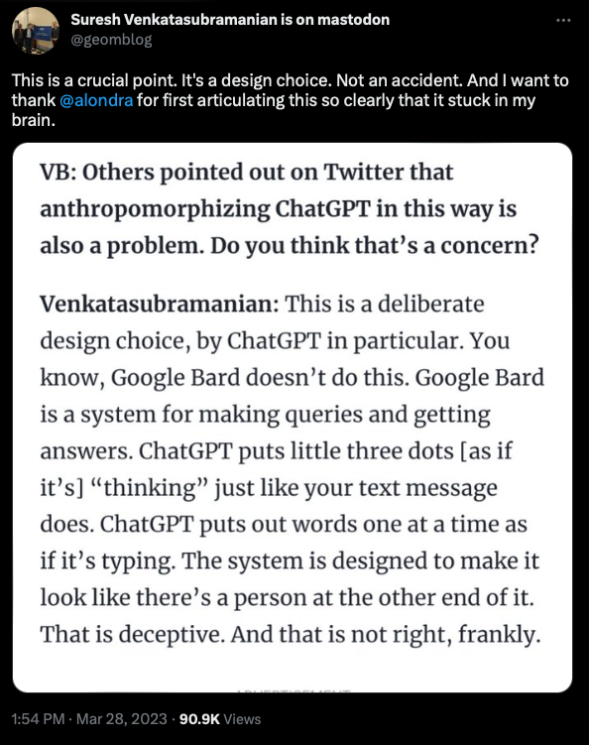
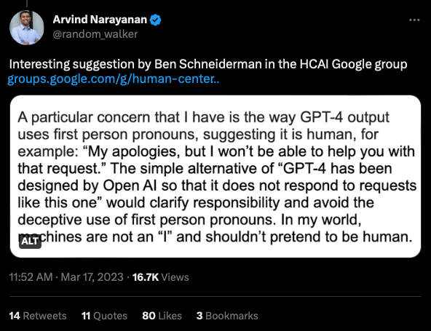
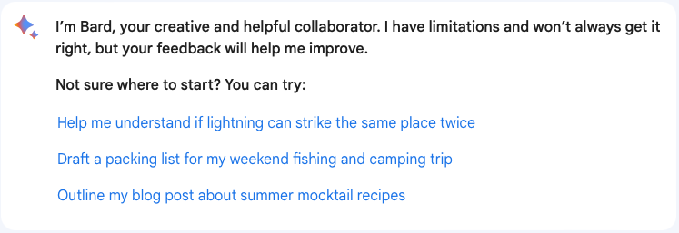

Slide 28
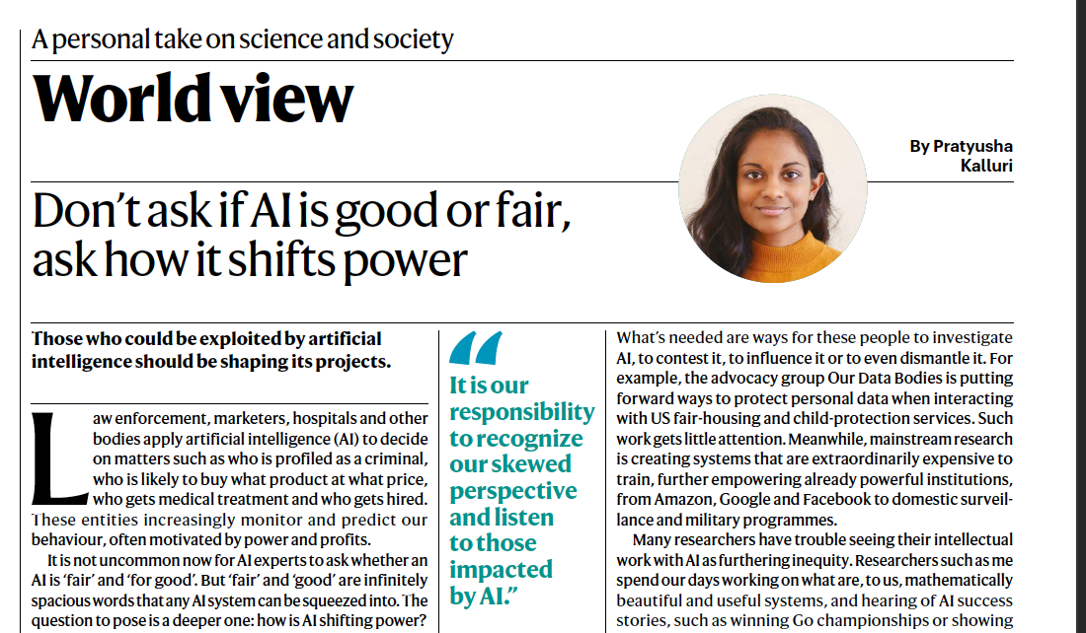
Nature Vol 583, 2020

Slide 29
Thank you
Questions or Comments: kellie.owens@nyulangone.org
Illustrations: Cath Virginia

