Slide 1
Health Disparities & Affirming Interactions
Support LGBTQ+ Patients…

Slide 2
Discussion points from last module
How can we be more inclusive of people who are non-binary and/or gender non-conforming?

Slide 3
Objectives
By the end of the program, participants will:
Identify health disparities specific to LGBTQ+ communities
Interact in affirming ways with members of the LGBTQ+ community
Notes:
(Note: Read the material from the slide) Ask by a show of hands, how many of you have heard of or read something about cultural humility? (If hands are raised, ask people to please share their knowledge and perspectives as we go through the training.) (If no hands are raised, say that you hope they will find this to be a valuable and interesting topic.)

Slide 4
What do you think?
What do you think are some health disparities that affect members of the LGBTQ+ community?
What is one way to genuinely welcome LGBTQ+ community members to your practice?
Notes:
[NOTE to Facilitator: Ask the questions and give the audience a short time to respond before moving on]. Some answers to the first question include higher rates of substance abuse, higher rates of mental health issues including depression, anxiety, and suicide ideation and attempts, higher rates of disordered eating, higher rates of breast cancer, etc. Some answers to the second question are forms that are inclusive, poster and magazines that are representative of LGBTQ+ communities, calling patients by their chosen name and pronouns, etc.

Slide 5
Overview
Health disparities faced by sexual orientation and gender identity minorities are linked to stigma, discrimination, and denial of civil and human rights¹
Discrimination is associated with high rates of psychiatric disorders, substance abuse, and suicide¹
Personal, family, and social acceptance affects the mental health and personal safety of LGBTQ+ individuals¹
Notes:
We are going to review health disparities experienced by the LGBTQ+ community. However, it is important to note that health disparities faced by sexual orientation and gender identity minorities are linked to stigma, discrimination, and denial of civil and human rights¹. Discrimination is associated with high rates of psychiatric disorders, substance abuse, and suicide¹. Personal, family, and social acceptance affects the mental health and personal safety of LGBTQ+ individuals¹.
I do want to recognize that in the cultural humility modules, there was a strong emphasis on avoiding the generalizations that often go along with the cultural competence model. However, these modules present some facts here about LGBTQ health disparities in an effort to highlight the need for affirming and supportive health care for these individuals that is also highlighted. Principles of cultural humility should still apply here as we interact with out LGBTQ patients and no assumptions should be made about the mental health, substance use or other lifestyle choices when it comes to working with LGBTQ patients.

Slide 6
Mental Health
Sexuality
Gender
Lesbian and bisexual women who are out are2- 2.5 times more likely to experience suicidal ideation¹
Depression and anxiety affect gay men at higher rates and are more severe for men who are “in the closet”¹
Harassment, negative experiences, substance use, and isolation all contribute to higher rates of suicide and suicide attempts among gay men and youth¹
39% of transgender respondents were currently experiencing serious psychological distress²
40% of transgender respondents had attempted suicide at some point in their lives²
Notes:
There are documented disparities in the LGBTQ community when it comes to mental health. A 2012 report from the Substance Abuse and Mental Health Services Administration reported that: Lesbian and bisexual women who are out are 2 to 2.5 times more likely to experience suicidal ideation and more likely to have attempted suicide in the past 12 months when compared to heterosexual women¹. Similarly, depression and anxiety affected gay men at higher rates than the general population and were more severe for men who are “in the closet”¹. One of the contributors to suicide and suicide attempts among gay men when compared to other populations is verbal and physical harassment, negative experiences related to coming out, substance use, and isolation¹. Similar disparities are documented based on gender. In the 2015 Transgender Survey, 39% of transgender respondents were currently experiencing serious psychological distress, which is nearly 8x the rate in the U.S. population². A similar 40% of transgender respondents had attempted suicide at some point in their lives compared to 4.6% of the U.S. population².

Slide 7
Substance Abuse
Lesbians are 1.5 to 2x more likely to smoke than heterosexual women. Gay men use tobacco at much higher rates than straight men – almost twice as likely¹
Some studies show that gay men use substances, including alcohol and illicit drugs at higher rates than the general population, and not just in larger communities like New York, San Francisco, and Los Angeles¹
29% of transgender respondents reported illicit drug use, marijuana consumption, and/or nonmedical prescription drug use in the past month, nearly three times the rate in the U.S. population²
Notes:
There are also disparities when it comes to substance abuse. Lesbians are 1.5 to 2 time more likely to smoke than heterosexual women. Similarly, gay men are almost twice as likely to use tobacco than straight men¹. Lesbians are significantly more likely to drink heavily than heterosexual women and bisexual women report more hazardous drinking than heterosexual or lesbian women¹. Similarly, some studies show that gay men use substances, including alcohol and illicit drugs at higher rates than the general population, and not just in larger communities like New York, San Francisco, and Los Angeles¹. These disparities also appear to affect people who are transgender. In the 2015 Transgender Survey, 29% of transgender respondents reported illicit drug use, marijuana consumption, and/or nonmedical prescription drug use in the past month, nearly three times the rate in the U.S. population².
[NOTE TO FACILITATOR: When it comes to substance abuse, ask the participants to think about where LGBTQ+ socialize together. The most common answer will be gay bars. There are so few alcohol and substance-free spaces specific to the queer community. Ask the participants to name some LGBTQ+ specific spaces that are alcohol and substance free. Some places include LGBTQ+ Community Centers, Gay Straight Alliances in high schools and middle schools, some Pride events have alcohol and smoke-free spaces, and some queer cafes are popping up. Anything else?]

Slide 8
Weight Concerns
Gay men are more likely to experience an eating disorder such as bulimia or anorexia nervosa¹
Higher prevalence rates of obesity have been found among lesbians who are African-American; live in rural or urban areas; have lower levels of education; and are from a low socio-economic status¹
Notes:
Gay men are more likely to experience an eating disorder such as bulimia or anorexia nervosa¹ The pressures of being a gay man, often seen as effeminate no matter how masculine a gay man may be, in a masculine heteronormative society, sometimes leads gay men to feel like they need to be muscular or fit a certain norm to fit in, to feel better about themselves, and/or to protect themselves if they were to be attacked or to prevent an attack. Higher prevalence rates of obesity have been found among lesbians who are African-American; live in rural or urban areas; have lower levels of education; and are from a low socio-economic status¹. Notice there is no information on transgender or gender non-conforming people and cancer. That’s because there isn’t enough data yet on this issue.

Slide 9
Cancer
Gay men (or anyone who has receptive anal sex) are at higher risk for anal cancer¹
Lesbians are at significantly higher risk for developing breast cancer than heterosexual women. Risk factors include fewer full-term pregnancies, fewer mammograms, and being overweight¹
Notes:
There are also disparities when it comes to certain types of cancer. Gay men (or anyone who has receptive anal sex) are at higher risk for anal cancer¹. HPV is the culprit. Screening for anal cancer is not yet routine, although it’s easier than a cervical pap smear. Lesbians are at significantly higher risk for developing breast cancer than heterosexual women. Risk factors include fewer full-term pregnancies, fewer mammograms, and being overweight¹. Not enough research exists for data on cancer rates among transgender adults, however, some factors make trans people more susceptible to cancer such as higher rates of smoking and alcohol use, sexual risks, hormone use socio-economic marginalization, and late diagnosis³.

Slide 10
What can we do?
Notes:
So what can we do to make spaces more affirming for our patients who are members of the LGBTQ community? [NOTE TO FACILITATOR: If you have the time, you can let the group offer ideas or things they already do in practice. If you do not have time, just use this as a intro slide and move on to the content.]

Slide 11
Interact in Affirming Ways
Pronouns Matter
State your own pronouns before asking them theirs
They/them/Theirs are acceptable singular pronouns
Chosen name
Ask them what name they would like you to use
Look them in the eye
Look up from your computer when interacting with patients
Mirror their language
Ask them what they call their body parts and mirror that language
Notes:
One thing that we can do is ensure that we use our transgender patients’ preferred pronouns. State your own pronouns before asking them theirs. Remember that people do not have to choose just “he” or “she”. They/them is an acceptable singular pronoun. While the most common pronouns are he/him/his, she/her/hers, and they/them/theirs, although many other pronouns exist. It is also affirming to use a transgender patient’s chosen name. Ask them what name they would like you to use, even if that’s not their legal name. Only use someone’s legal name when absolutely necessary, including on forms. Only ever say their chosen name out loud; never say their legal name out loud. Similar to some of our other communication trainings, it is affirming to look up from your computer when interacting with all patients. It shows a level of respect. Ask them what they call their body parts and mirror that language. If it’s necessary to talk about a patient’s chest or genitals, for example, (and only if it’s necessary to discuss as part of the appointment), ask them what they call that body part and then mirror that. Mirroring their language is also important when it comes to their identity. If someone identifies as pansexual and gender non-conforming, it’s okay to identify them that way, too. But be sure to ask first.

Slide 12
Visible Signage
Hang the trans flag and/or pride flag in your office
Have books/magazines on display that are inclusive to the LGBTQ+ community
Include pronouns on your name tag and in your email signature, as well as on each of the staff biographies on your website
Notes:
Another way to make your location affirming is to hang the trans flag and/or pride flag in your office. The pink, blue and white flag is the transgender flag. The rainbow flag with the black and brown stripes is the pride flag. The black and brown stripes were added to be more inclusive to LGBTQ+ people of color. Have books/magazines on display that are inclusive to the LGBTQ+ community. Some magazines include Advocate, FTM, and Poz magazine. Include pronouns on your name tag and in your email signature, as well as on each of the staff biographies on your website.

Slide 13
Forms
Intake forms should ask for all this information:
Sexual Orientation
Gay, Straight, Lesbian, Bisexual, Pansexual, Asexual, Queer, Write-In
Sex assigned at birth
Male, Female, Intersex, Write-in
Current Gender Identity (Check all that apply)
Man/Male, Woman/Female, Trans man/FTM, Trans woman/MTF, Gender non-conforming, Non-binary, Genderqueer, Write-in
Chosen Name
If different from legal name
Be sure to only ever say their chosen name aloud and only use their legal name when absolutely necessary
Pronouns
He/him/his, she/her/hers, them/they, ze/zir
Notes:
Intake forms should ask for all the information you see here. Sexual orientation, as we have discussed previously, could be gay, straight, lesbian, bisexual, pansexual, asexual, queer, or a write-In. Sex assigned at birth could include male, female, intersex, or a write-in. Current gender identity should include check all that apply and give options of Man/Male, Woman/Female, Trans man/FTM, Trans woman/MTF, Gender non-conforming, Non-binary, Genderqueer, or a Write-in. Chosen Name, if different from legal name should also be included- be sure to only ever say a patient’s chosen name aloud and only use their legal name when absolutely necessary. Forms should also ask for pronouns such as He/him/his, she/her/hers, them/they, or ze/zir. More information about how to create intake forms that are inclusive, can be fond in a guide from the Fenway Institute titled, How to Gather Data on Sexual Orientation and Gender Identity in Clinical Settings. I can send a link to this guide out in the next week [NOTE TO FACILITATOR: only say this if you are going to send the ‘useful links’ e-mail for this module]

Slide 14
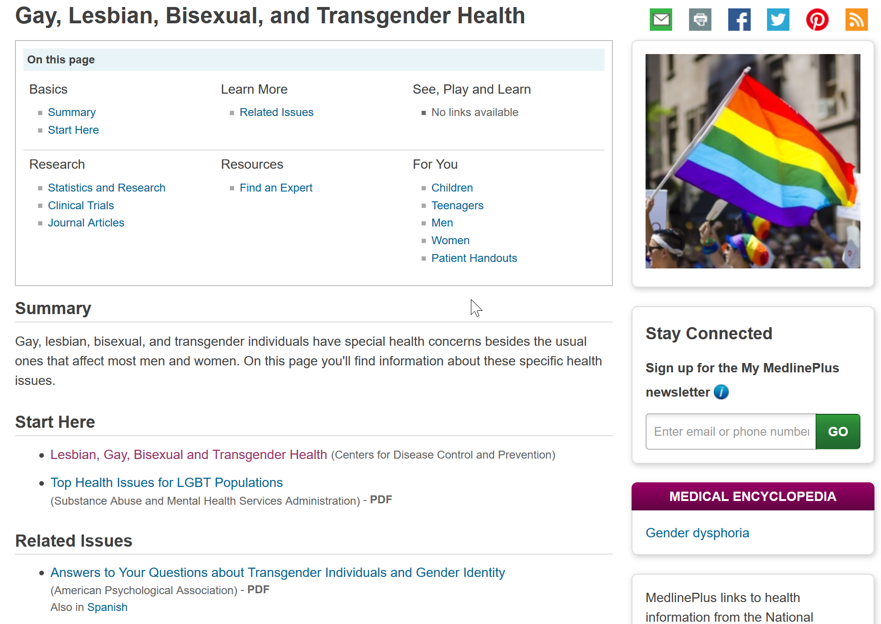
LGBT Topic Page- MedlinePlus
Notes:
A great place to learn more about LGBTQ+ health is MedlinePlus. The MedlinePlus topic page titled Gay, Lesbian, Bisexual and Transgender Health links to quality information on this population. You can also use this MedlinePlus topic page to find recent journal articles relating to the care of LGBTQ+ patients. You can find these by scrolling down to “Journal articles” and selecting “see more articles”.

Slide 15
Take home message
Consider:
How could your office be more inclusive and affirming to members of the LGBTQ+ community?
Remember:
Being a member of the LGBTQ+ community doesn’t automatically mean that LGBTQ+ people are more prone to specific health issues, but marginalization, discrimination, and stigma can lead to greater health disparities
Developed resources reported in this presentation are supported by the National Library of Medicine (NLM), National Institutes of Health (NIH) under cooperative agreement number UG4LM012342 with the University of Pittsburgh, Health Sciences Library System. The content is solely the responsibility of the authors and does not necessarily represent the official views of the National Institutes of Health.
Notes:
(Note: read the Take home message from the slide) Then say, please think about these two questions. This is where we are going to start at our next session. Please be prepared to share why you agree or disagree with the questions.

Slide 16
Please complete the post-test questions
Notes:
[NOTE TO FACILITATOR: if you choose not to have participants complete the knowledge assessment questions, delete this slide.]

Slide 17
References
Substance Abuse and Mental Health Services Administration, Top Health Issues for LGBT Populations Information & Resource Kit. HHS Publication No. (SMA) 12-4684. Rockville, MD: Substance Abuse and Mental Health Services Administration, 2012.
James, S. E., Herman, J. L., Rankin, S., Keisling, M., Mottet, L., & Anafi, M. (2016). The Report of the 2015 U.S. Transgender Survey. Washington, DC: National Center for Transgender Equality.
Ashbee, Olivia, and Joshua Mira Goldberg. “Trans People and Cancer.” LGBT Cancer Information, National LGBT Cancer Network, 2019, http://cancer-network.org/wp-content/uploads/2017/02/Trans_people_and_cancer.pdf

