Slide 1
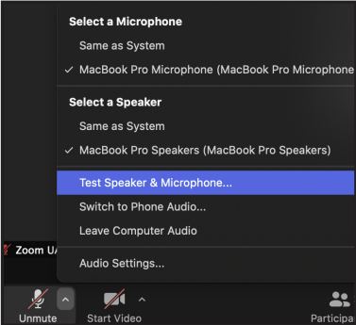
WELCOME
If you are unable to hear:
Select the small up arrow next to Audio controls to adjust settings.
Select a speaker or test your audio.
Captions are turned on. Select the Captions button to hide or show captions.
Notes:
If you are unable to hear, select the small up arrow next to audio controls to adjust settings. Select your audio source, or select Test Speaker & Microphone.
Respond to the questions that pop up and Zoom should guide you through selecting the appropriate speaker.
Captions are turned on. Select the Captions button to hide or show captions.
In the meeting controls toolbar, click the Captions icon, indicated by a gray box with the letters CC, to show or hide captions.

Slide 2
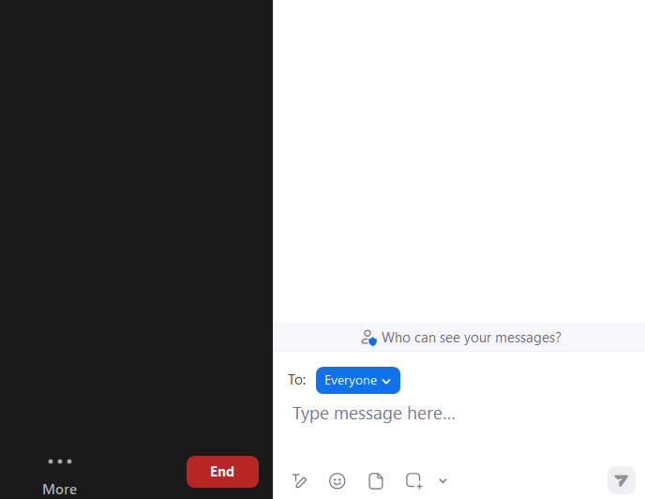
Chat Your Questions
Chat box located in the lower right hand corner
Notes:
If you have any questions or comments, please enter them into the chat, located on the lower right hand corner of your screen. Also, remember to select “Everyone” in the chat for comments intended for everyone. Finally, this webinar offers closed captioning.

Slide 3
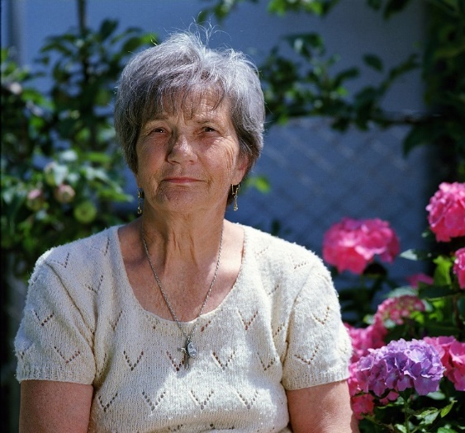
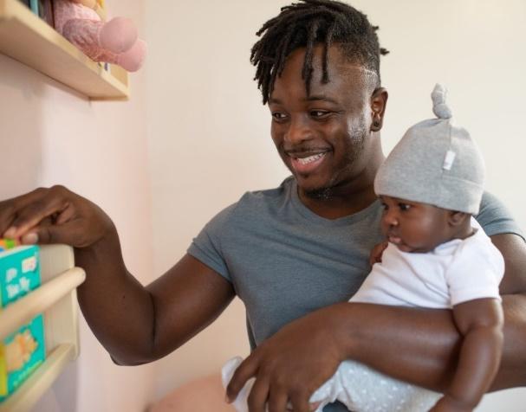
NNLM
Notes:
NNLM
Before we get into our class today, I’d like to take a minute to share a few words about who we are!

Slide 4
NNL..huh?
NIH
NNLM
RMLs
NLM
National Institutes of Health
Nation’s research agency
27 institutes and offices
National Library of Medicine
World’s largest biomedical library
Network of the National
Library of Medicine
Program of the NLM comprises 7 Regional Medical Libraries (RMLs), Offices and Centers
Education and Funding Opportunities
Supports equal access to biomedical information
Notes:
The National Institutes of Health is the nation’s leading medical research agency. The National Library of Medicine is an institute at the NIH. NLM is the world’s largest biomedical library which produces information resources such as PubMed, ClinicalTrials.gov, and MedlinePlus. NNLM is the Network of the National Library of Medicine. We are the outreach program of NLM. The Network operates out of seven regional medical libraries, or RMLs. The RMLs offer training and funding opportunities to support equal access to biomedical information, supporting the mission of NNLM.

Slide 5
Network of the National Library of Medicine
Notes:
The NNLM is made up of 7 geographic regions.
Here is a map of RML service areas. We cover the US states and territories including Puerto Rico, US Virgin Islands and Freely Associated States of the Pacific, you can visit nnlm.gov to find your RML.

Slide 6
What NNLM Does
Offers free webinars & classes to librarians, health professionals and the general public
Access to a network of libraries and other organizations
Funding for health information outreach, digital equity, and data services projects and even professional development.
Notes:
The NNLM provides
funding for health outreach projects,
free webinars and classes, and
access to a network of public and academic libraries, community- and faith-based organizations, and universities.

Slide 7
Today’s agenda:
Describe how the PATIENTS Program’s 10-Step Continuous Engagement Framework aligns evidence-based engagement methods throughout and across research projects
Explain patient-centered outcomes research (PCOR) and distinguish between patient-centered and patient-targeted practices
Identify and value the contributions of credible messengers and community-based research partners
Notes:
For today’s agenda we will:
Describe how the PATIENTS Program’s 10-Step Continuous Engagement Framework aligns evidence-based engagement methods throughout and across research projects
Explain patient-centered outcomes research (PCOR) and distinguish between patient-centered and patient-targeted practices
Identify and value the contributions of credible messengers and community-based research partners

Slide 8
Today’s Presenters
Hillary Edwards, PATIENTS Program
Tanisha Armstrong, PATIENTS Professor
Jennie Flanagan, PATIENTS Professor
Brian Gutierrez, PATIENTS Professor
Donald Young, PATIENTS Professor
Notes:
It is my pleasure to welcome our featured speakers.
Hillary A. Edwards, MPH, is a director of research with the University of Maryland, Baltimore PATIENTS Program, with expertise in continuous patient engagement and leads several capacity building and training initiatives at the university, including the PATIENTS Professors Academy.
Tanisha Armstrong is Patients Professors, educator, advocate, and leader who has found health advocacy to truly be the difference between life and death for herself and loved ones.
Jennie Flanagan is Patients Professor, registered nurse and working as a Clinical Research Nurse Coordinator. Jennie actively participates as an Advisory Member with the University of Maryland through the Patient Centered Outcomes Research Institute network.
Brian Gutierrez is a PATIENTS Professor, patient advocate and serves on the Spina Bifida Association Adults’ Healthcare Advisory Committee and Research Advisory Council. In that role, he collaborates and engages with community members, including patient advocates, in identifying essential health services and decreasing health information deficits through advocacy, education, and research for adults living with Spina Bifida.
Donald Young is a Baltimore City Native, a US Navy Veteran and Certified Community Health Worker. He’s currently employed by Johns Hopkins Institute for Clinical & Translational Research and serves on the Board of Directors for Historic East Baltimore Action Coalition.
Thank you all, I’ll turn it over to you!

Slide 9
The PATIENTS 10-Step Framework as a Community Engagement Tool NNLM Region One Insights Webinar Series January 30, 2024, 1:00 PM - 2:00 PM ET
Speakers:
Hillary Edwards, PATIENTS Program
Tanisha Armstrong, PATIENTS Professor
Jennie Flanagan, PATIENTS Professor
Brian Gutierrez, PATIENTS Professor
Donald Young, PATIENTS Professor
Notes:
It is my pleasure to welcome today’s speakers.
Hillary A. Edwards, MPH, is a director of research with the University of Maryland, Baltimore PATIENTS Program, she has expertise in continuous patient engagement and leads several capacity building and training initiatives at the university, including the PATIENTS Professors Academy.
Tanisha Armstrong is Patients Professors, educator, advocate, and leader who has found health advocacy to truly be the difference between life and death for herself and loved ones.
Jennie Flanagan is Patients Professor and registered nurse working as a Clinical Research Nurse Coordinator. Jennie actively participates as an Advisory Member with the University of Maryland through the Patient Centered Outcomes Research Institute network.
Brian Gutierrez is a PATIENTS Professor, patient advocate and serves on the Spina Bifida Association Adults’ Healthcare Advisory Committee and Research Advisory Council. In that role, he collaborates and engages with community members, including patient advocates, in identifying essential health services and decreasing health information deficits through advocacy, education, and research for adults living with Spina Bifida.
Donald Young is a Baltimore City Native, a US Navy Veteran and Certified Community Health Worker. He’s currently employed by Johns Hopkins Institute for Clinical & Translational Research and serves on the Board of Directors for Historic East Baltimore Action Coalition.
Thank you all, I’ll turn it over to you!

Slide 10
Voice of the PATIENTS Professor

Slide 11
Welcome and Learning Objectives
This webinar focuses on how to increase health equity through community engagement and the NNLM initiative of environmental determinants of health. Together, we will increase knowledge and skills for fostering authentic community engagement.
Learning Objectives:
Describe how the PATIENTS Program’s 10-Step Continuous Engagement Framework aligns evidence-based engagement methods throughout and across research projects
Explain patient-centered outcomes research (PCOR) and distinguish between patient-centered and patient-targeted practices
Identify and value the contributions of credible messengers and community-based research partners
Please share in the chat what you hope to learn!

Slide 12
Our Agreements
By registering for this class, you have agreed to the NNLM Code of Conduct
We are committed to learning from each other in the PATIENTS Professors Academy. We all have wisdom we can share, and we are experts of our own experiences. To help us all learn, we agree to the following:
Show courtesy and respect towards community members
Be respectful of different viewpoints and experiences
Use welcoming and inclusive language
Gracefully accept constructive criticism

Slide 13
Notes:
Need to transfer content to new slide deck template

Slide 14
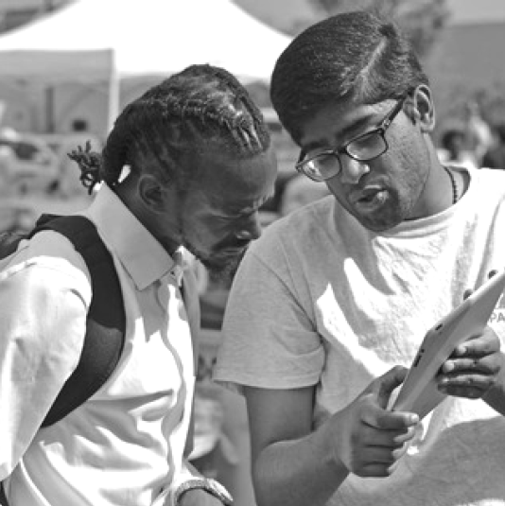
Who We Are
Initially funded by $5M grant from Agency for Healthcare Research and Quality (AHRQ), PATIENTS encourages patients, caregivers and other stakeholders to be involved in every aspect of research studies:
The study design (planning it)
The study conduct (doing it)
The study results (sharing it)

Slide 15
Vision and Mission
Our Vision
Patients and stakeholders are heard, inspired, and empowered to co-develop patient-centered outcomes research (PCOR).
Our Mission
The PATIENTS Program partners with patients and care providers to answer questions about the best treatment options to improve health and quality of life. We engage people from all communities, especially those from underserved and minority populations, in every step of the patient-centered outcomes research (PCOR) process. Through our collective efforts, we create an effective learning health care community.
We listen to patients’ voices so that we ask relevant and meaningful questions
We align research priorities with the values of patients and communities
We transform research to make it more relevant and patient-centered
We train patients, stakeholders, and researchers to co-develop of PCOR

Slide 16
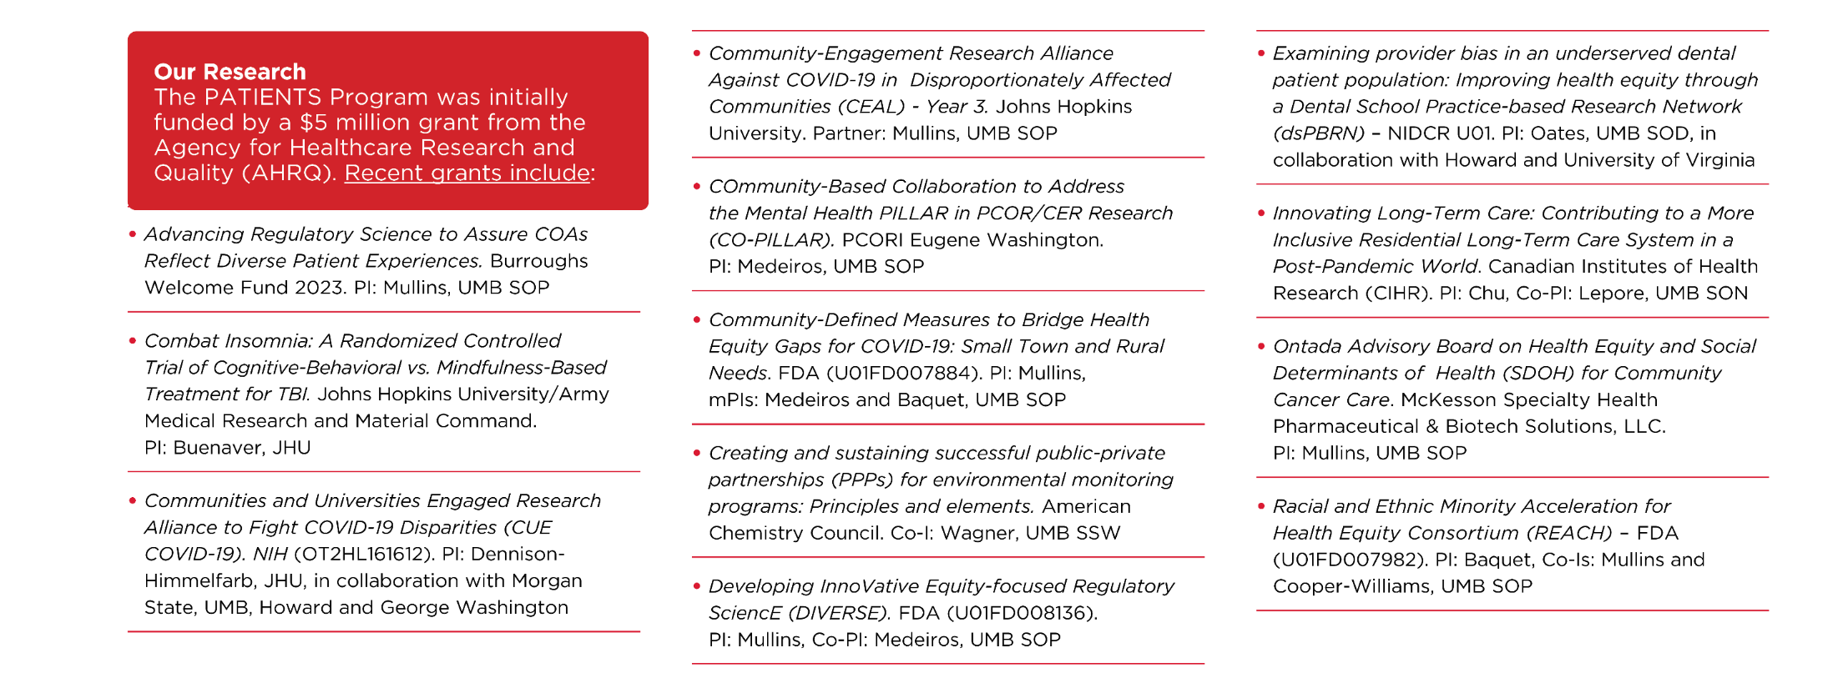
Our Research
Our 10-Step Framework is the baseline across all our funded research and programs

Slide 17
Our Academy
The 2024 PATIENTS Professors Academy is a free five-week, virtual program that brings together patients, caregivers, government representatives, researchers, industry representatives, and others to learn these patient-centered and community-engagement research skills together.
The Academy is produced by PATIENTS in shared governance with a Steering Committee
The Academy grew out of the desire to build upon the PATIENTS Program’s success in authentically and continuously engaging patients and other stakeholders in conducting patient-centered and community-engaged research.

Slide 18
Who Are PATIENTS Professors?
They are patients, caregivers, and community leaders who instruct researchers on:
What is important to patients
How best to engage patients and communities
How to translate and disseminate critical information to patients
Graduates of the Academy earn the title of PATIENTS Professor because they teach us how to be better researchers.

Slide 19
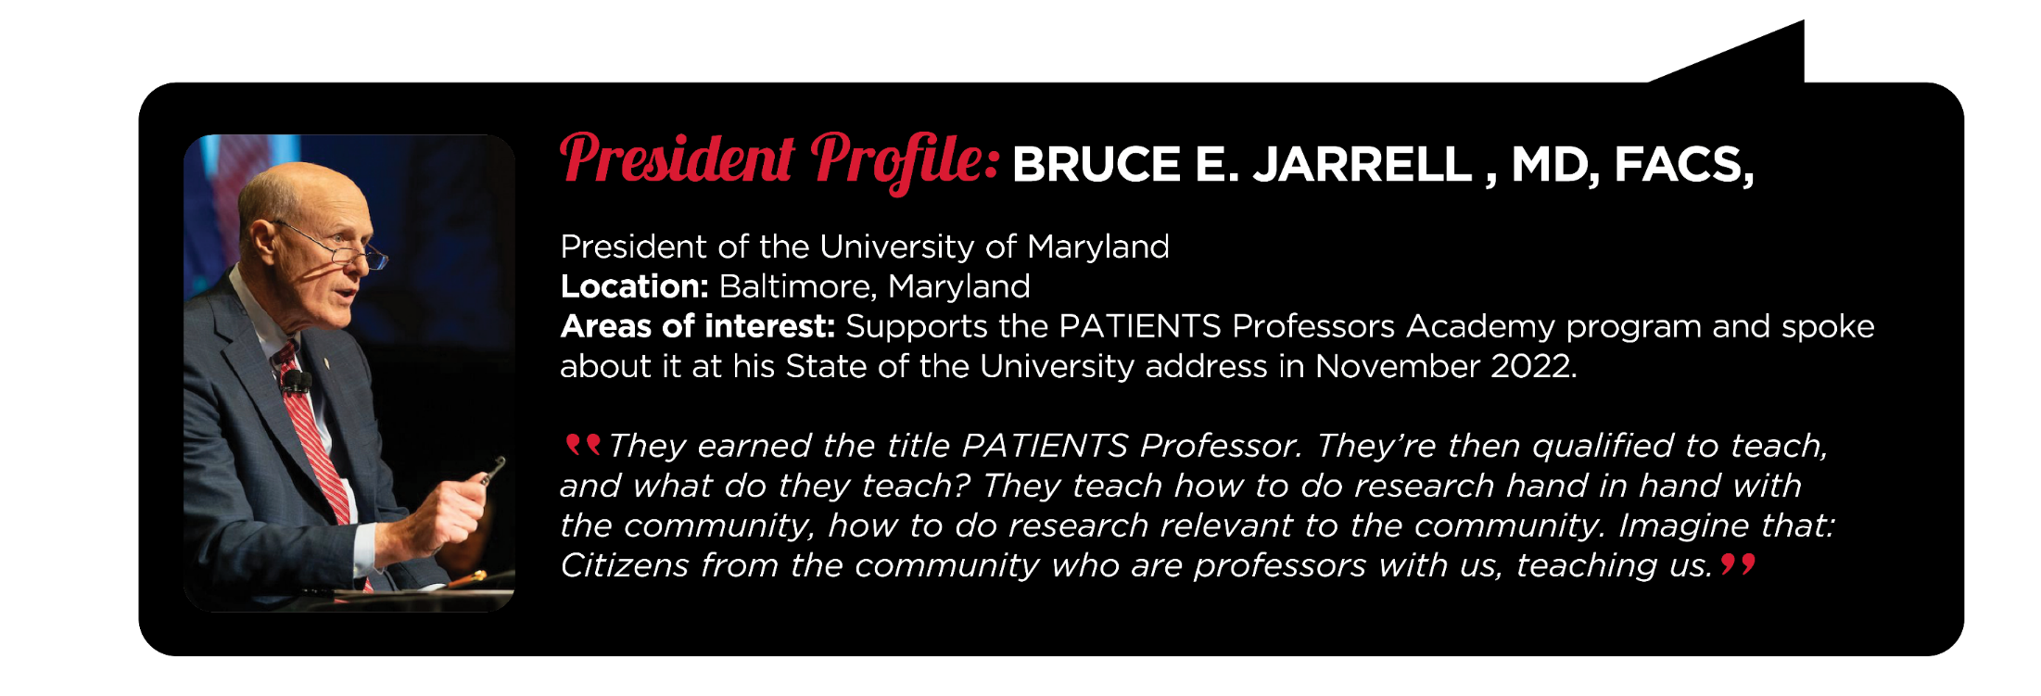

Slide 20
Part I: 10-Step and PCOR
Describe how the PATIENTS Program’s 10-Step Continuous Engagement Framework aligns evidence-based engagement methods throughout and across research projects
Explain patient-centered outcomes research (PCOR) and distinguish between patient-centered and patient-targeted practices

Slide 21
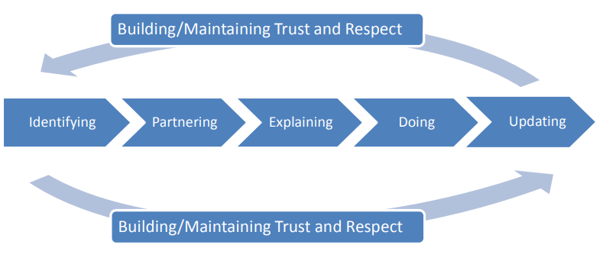
Trust Must be Built
Community-academic partnerships need to build and maintain trust, achieved through pre-engagement and then through continuous community partnering
The goal is to foster full and meaningful partnering between researchers and participants (i.e. patients and their communities and health care providers) throughout the research process

Slide 22
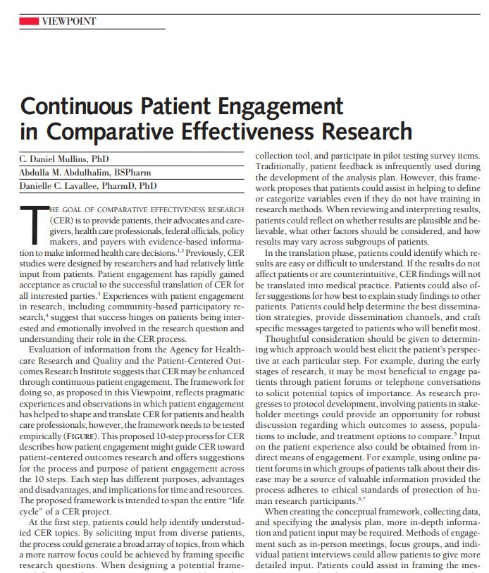
The 10-Step Framework
In 2011, PCORI awarded C. Daniel Mullins one of their first contracts, Integrating patients’ voices in study design elements with a focus on hard-to-reach populations
In 2012, Dr. Mullins and colleagues published the 10-Step Framework in the Journal of the American Medical Association (JAMA)
Notes:
Describe the 10-Step Framework developed by C. Daniel Mullins for patient and stakeholder engagement in research
Explain the steps taken to develop the framework

Slide 23
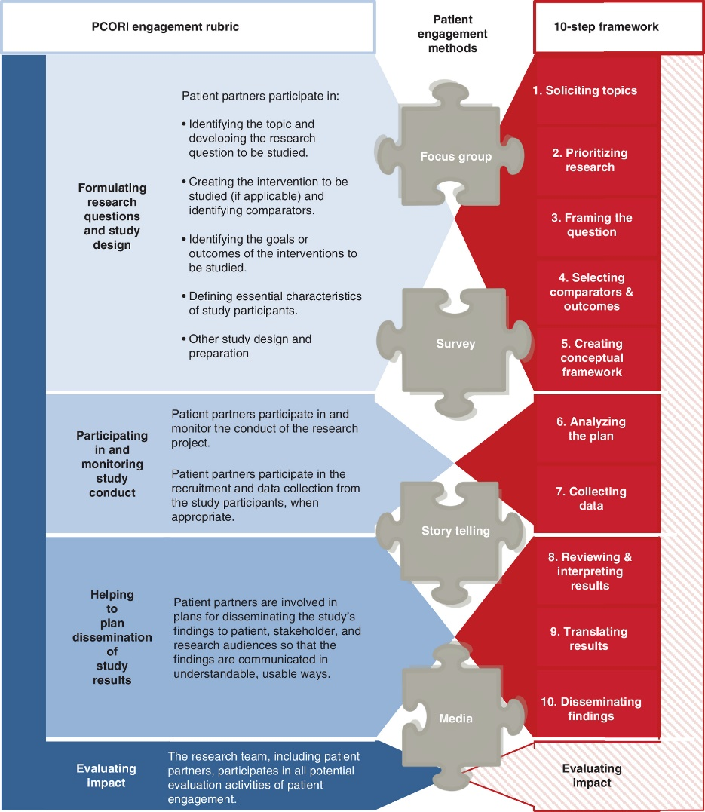
Patient Engagement as the Guide
The framework spans the entire “life cycle” of a research project
Each step has different purposes, advantages and disadvantages, and implications for time and resources
Stakeholder engagement is critical at every step
Notes:
Make sure to highlight patients AND stakeholders when speaking about this slide

Slide 24
Planning it

Slide 25
Doing it

Slide 26
Delivering Solutions

Slide 27
10-Step Framework = Transformational Change: Caring
Meeting people where they are
Physically: both geography and health-wise
Emotionally: ready v. not ready for participation
Spiritually: ready v. not ready to trust
Being there
Not just for your project
Being there for what is important to the community, what your partners care about
Examples of “being there”
Coming back to share results
Supporting community activities and events
Introducing partners to your network

Slide 28
10-Step Framework = Transformational Change: Meaningfulness
Framing the question so it is understood
Framing the answer so it is understood
Framing for cultural resonance and appropriateness

Slide 29
10-Step Framework = Transformational Change: Authenticity
No helicopter research!
Authentic partnerships, not check-the-box application of the 10-Step Framework

Slide 30
Discussion
What are the differences between patient-centered and patient-targeted practices?
What are the similarities?

Slide 31
Part II: Credible Messengers and Community Partners
Identify and value the contributions of credible messengers and community-based research partners

Slide 32
Who are Credible Messengers?

Slide 33
Making your Research Relevant and Mutually Beneficial

Slide 34
The Credibility Challenge
Scenario: A credible messenger says that the benefit isn’t relevant or beneficial to their community
Question: "How do you respond as a researcher?"
Emphasize the need for adaptability and flexibility in research protocols

Slide 35
Research Adaptability
Importance of willingness to change research protocols based on community feedback
Case study example where a change in protocol led to better community outcomes
Question: "How adaptable is your research plan?"

Slide 36
Towards Mutually Beneficial Research
Discuss the value of collaboration between researchers and communities
Highlight the importance of bi-directional communication for successful, beneficial research
Call to action: Strive to make research more beneficial, relevant, and adaptable to community needs.

Slide 37
Discussion
How can credible messengers help identify importance of research benefiting the community?
What role can credible messengers play in determining these benefits?
What if the research is not beneficial from a community’s perspective?

Slide 38
Concluding Thoughts
Engage community partners early and continuously and do it for mutually beneficial reasons
Credible messengers are critical to build relationships over time and improving research, trustworthiness, and outcomes for community partners
Emphasize the importance of research that is adaptable and mutually beneficial
Encourage open-mindedness towards feedback and the need for creating true value for the community
Other thoughts?

Slide 39
Open Discussion
Where do we go from here?

Slide 40
Wrap Up
Join us next month for the second half of this NNLM Region One Insights Webinar Series!
PATIENTS Program Part 2:
Continuous Engagement after the PATIENTS Professors Academy: Methods and Pathways
February 27, 2024, 1:00 PM - 2:00 PM ET
Register here

Slide 41
Thank You
Thank you to the NNLM and especially Tony and Faith for having us today!
Thank you to today’s PATIENTS Professors: Tanisha Armstrong, Jennie Flanagan, Brian Gutierrez, and Donald Young
Thank you to our participants for joining and engaging in today’s session!

Slide 42
For more information, contact the PATIENTS Program at patients@rx.umaryland.edu

Slide 43
Evaluation Surveys for Continuing Education
Please use the following link to access the MLA Survey: If you would like an MLA CE certificate, it will be available after you finish the survey https://www.nnlm.gov/roi-jan30

