Slide 1
Writing and Submitting Your NNLM Proposal for Region 1 Grants
Part 2: Set…
September 27, 2022
Nancy Patterson
Outreach Librarian
Tony Nguyen
Executive Director
Notes:
Nancy

Slide 2
Agenda
2023-2024 Grant Opportunities
* Data Science and Services
* Health Information Outreach
* Technology Improvement
Funding Process and Timeline
Pre-writing Nitty Gritty
Examples of Strong Proposal Sections
Q&A
Notes:
Nancy
Handout: https://lor.nnlm.gov/op/op.Download_Share.php?documentid=4499

Slide 3
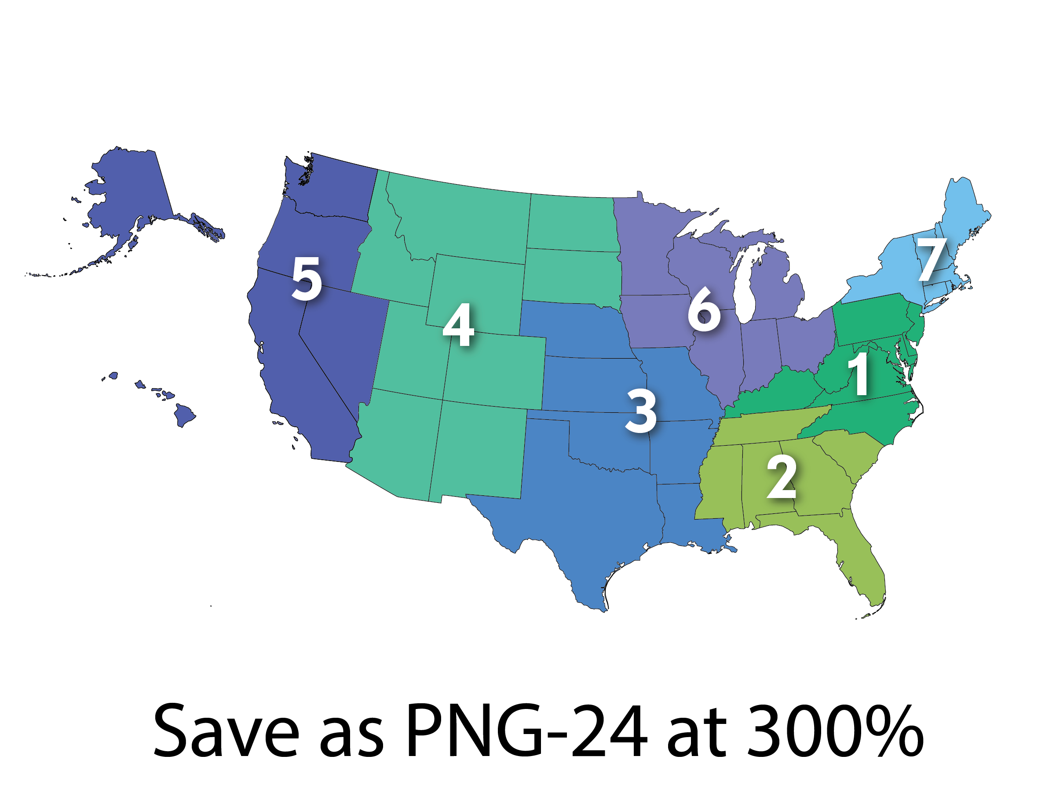
Regions, Offices and Centers (ROC)
Regional Medical Libraries: 1-7
Offices:
Office of Engagement and Training (OET)
Public Health Coordination Office (PHCO)
Training Office (NTO)
Web Services Office (NWSO)
Centers:
National All of Us Program Center (NAPC)
Center for Data Services (NCDS)
Evaluation Center (NEC)
About Us: https://nnlm.gov/about/about-nnlm
Notes:
Nancy
https://allofus.nih.gov/

Slide 4
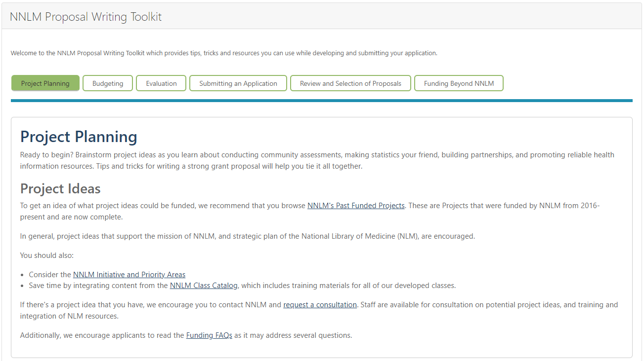
NNLM Proposal Writing Toolkit
https://nnlm.gov/guides/nnlm-proposal-writing-toolkit
Notes:
Nancy

Slide 5
Data Science and Services Project - $30K (1) Health Information Outreach Project - $30K (3) Technology Improvement Project - $30K (1)
Grants for the 23-24 Cycle
All projects awarded are cost-reimbursable to an institution, not an individual.
Notes:
Tony
Data: The award’s primary aim is to focus on projects that stimulate innovations in biomedical knowledge collection, organization, and management or data science, information, or research services
Health Outreach: The purpose of the Health Information Outreach Award is to provide support for projects that improve health information literacy and increase the ability of patients, family members, students, and members of the public to find and use health information; or improve health professionals’ access to, awareness of, and skills for locating high-quality biomedical and health information.
Tech Improvement: The Purpose of the Technology Improvement Project Award is to deliver technology improvement and health and digital equity to underserved communities impacted by the digital divide via technology funding and online resource training.

Slide 6
Data Science and Services
Focus on projects that stimulate innovations in biomedical knowledge collection, organization, and management or data science, information, or research services.
Incorporate one or more of the following:
Increase awareness of and skills for locating high quality biomedical and health data information
Promote data literacy in health and science education
Increase data management skills and awareness
Encourage interdepartmental partnerships, including clinical and translational science research departments.
Recent & Past Projects Funded
Utilize AI to analyze health status and literacy of Chronic Kidney Disease patients to identify gaps in evidence-based care.
Develop a program to teach data literacy through an escape room.
Provide a training symposia covering topics related to research data management.
Develop a data catalog to improve research data discoverability
Notes:
Tony
Does anyone have a question about this RFA?
Consult with us in advance with your idea!

Slide 7
Health Information Outreach
Support projects that:
Improve health information literacy and increase the ability of patients, family members, students, and members of the public to find and use health information
Improve health professionals’ access to, awareness of, and skills for locating high-quality biomedical and health information.
Focus on building partnerships to reach underserved populations in the region with health information outreach projects.
Recently Funded Projects
Design and implement training on the CDC’s updated guidance on PrEP with inclusive and affirming practices for treating LGBTQ+ patients
Determine the underlying causes for post-traumatic stress in college students & develop a curriculum utilizing the Trauma Symptom Checklist
Increase access to health and human services for patrons by installing telehealth booths in rural public libraries
Launch a “healthy garden to market” program for your youth to provide nutrition education, gardening and plant-based cooking skills, and commerce at farmers markets.
Notes:
Tony
Does anyone have a question about this RFA?

Slide 8
Technology Improvement
Deliver technology improvement and health and digital equity to underserved communities impacted by the digital divide via technology funding and online resource training.
Partnering with diverse organizations are encouraged to provide internet access across populations.
Supports the purchase, installation, and upgrading of hardware or software
Provides trainings to find, retrieve, evaluate, interpret, utilize, and share reliable online health information and understand related issues such as personal privacy online and the stewardship of health information.
Past Project Ideas
Enable experiential health sciences education and well-being through virtual reality Programming
Provide new computers to a community center in a medically underserved community to access online health information
Provide technology to a library following a natural disaster to allow the community to access health information and communicate with others
Provide technology to support in the development of a health and wellness podcast series for underserved population
Notes:
Tony
Does anyone have a question about this RFA?

Slide 9
Consult with Us on Your Ideas!
Notes:
Nancy

Slide 10
Awards Process and Timeline
Date | Activity
2022
9/12 – 11/4 | Application for awards on NNLM.gov
11/7 – 11/11 | Region 1 staff reviews applications for completeness and eligibility
11/14 – 12/9 | Peer review period
12/12 – 12/23 | Regional Medical Library (RML) staff synthesizes peer review feedback RML Executive Director makes final decisions
2023
1/9 – 1/13 | RML notifies all applicants of funding decisions RML provides review feedback to applicants
1/16 - 1/31 | Awardees complete required UMB documents
2/1 – 4/30 | RML begins IRB process through UMB and obtains approval from NLM. RML works with UMB to process administrative paperwork
5/1 | RML informs Awardee when they will be able to begin project
2024
4/30 | Awarded project is completed and all expenses must be completed
5/31 | Final Invoice and Final Report are submitted to RML
6/30 | Accounting financial records close and awarded projects are marked as complete
Notes:
Nancy -
In February Academic Institutions may need to get IRB determination if awarded.

Slide 11
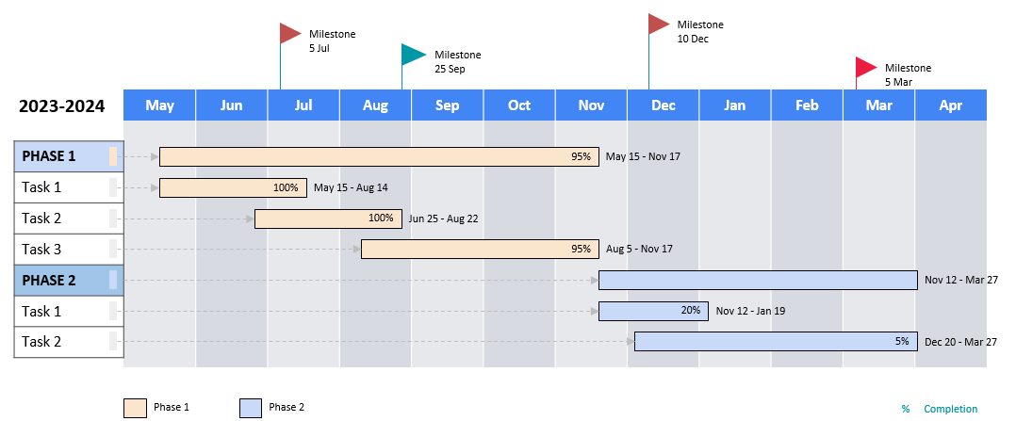
Draft a Project Timeline

Slide 12
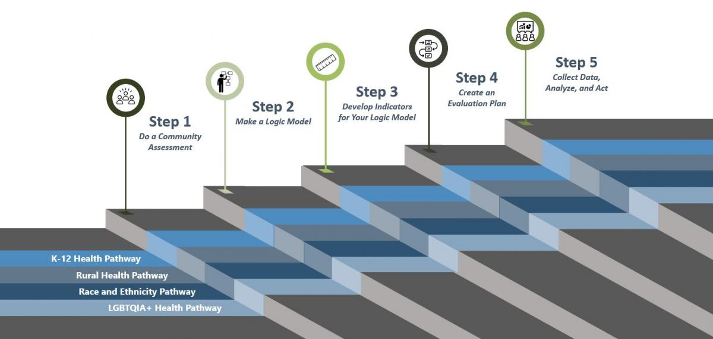
Evaluation Resources
https://nnlm.gov/nec/evaldesign
Notes:
Tony
Quick Intro - More detail next week
Covering SMART Goals and Logic Models

Slide 13
Health Statistics
National Center for Health Data Statistics from the Centers for Disease Control (CDC)
Reports and Data Resources from the National Institute on Minority Health and Health Disparities
Census Data from the U.S. Census Bureau
State Health Facts from the Kaiser Family Foundation
City Health Dashboard from the Robert Wood Johnson Foundation
County Health Rankings & Roadmaps from the Robert Wood Johnson Foundation
Rural Health Information Hub (RHIHUB), supported by the Health Resources and Services Administration (HRSA)
Local Departments of Health (Health, Public Health, Rural Health)
Notes:
Nancy
2-5 (based on time)

Slide 14
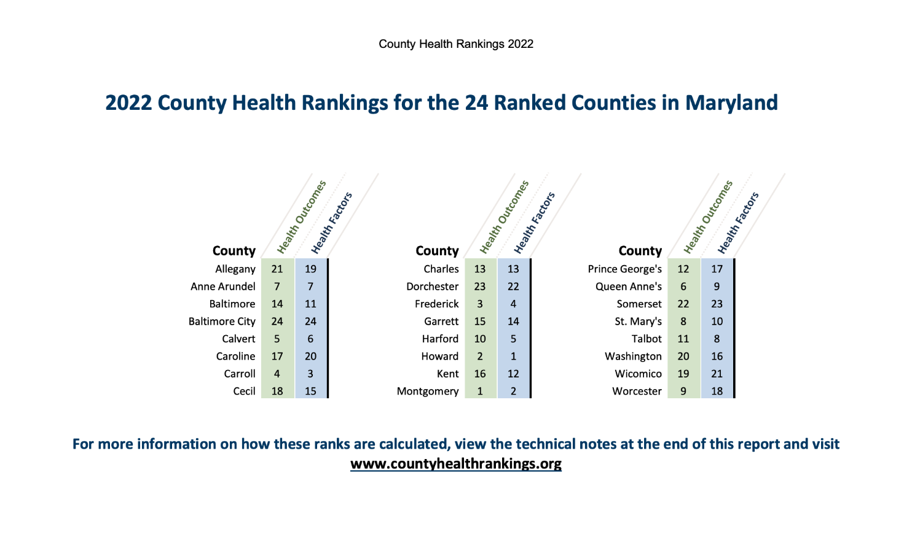
County Health Rankings and Roadmaps
Notes:
Nancy

Slide 15
County Health Rankings and Roadmaps 2
Notes:
Nancy

Slide 16
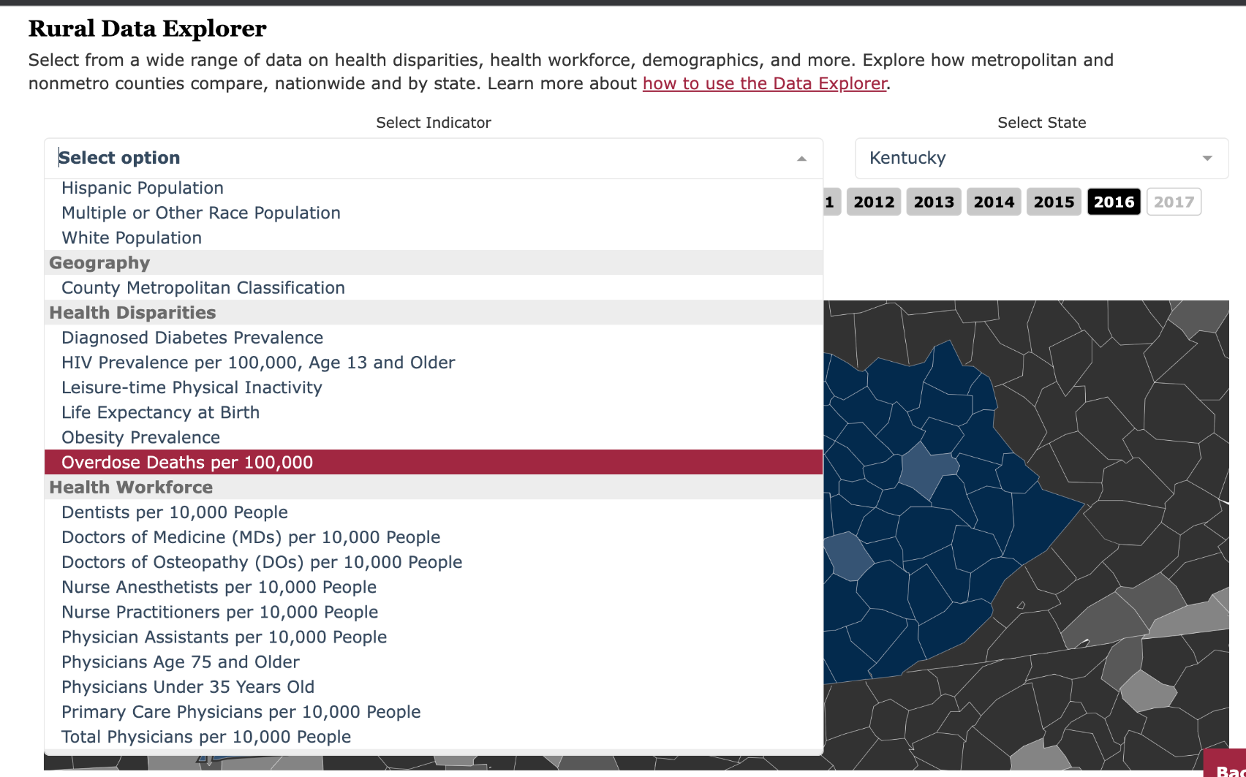
Rural Health Information Hub (RHIhub)- Rural Data Explorer
Notes:
Nancy

Slide 17
NIH>NLM>NNLM Resources
Health Information from the National Institutes of Health (NIH)
NIH Institutes Directory
Library Carpentry
All of Us Research Program
NNLM Informational and Printed Materials: order or download free materials from your Regional Medical Library
NNLM Training Workshops PPT, Scripts, and Handouts
Products and Services from the National Library of Medicine
MedlinePlus for consumer health information resources
PubMed.gov
ClinicalTrials.gov
NLM Learn Database
Cite Your References, Statistics, etc.
Notes:
Nancy
2-4
https://learn.nlm.nih.gov/documentation/training-packets/T0042010P/

Slide 18
Update Your Resume or CV
Notes:
Nancy

Slide 19
Exemplary Proposal Sections
https://nnlm.gov/guides/nnlm-proposal-writing-toolkit
Notes:
Tony
Significance
Methodology/Approach
Evaluation
Project Staff
Budget
Diversity, Equity and Inclusion

Slide 20
Part 3 of this Webinar Series: “Go…”
October 4, 2022, 12 PM ET
Register: https://nnlm.gov/training/schedule
Watch Part 1
Agenda
Telling the Story
Logic Models
SMART Goals
Connections
Tying it All Together
Notes:
Nancy
https://nnlm.gov/training/class-catalog/nnlm-region-1-4-part-funding-webinar-series
https://nnlm.gov/training/class/nnlm-region-1-funding-webinar-part-3-go

Slide 21
Questions?
Nancy Patterson​
Outreach Librarian
npatters@hshsl.umaryland.edu
https://www.calendly.com/nancy-nnlm
Tony Nguyen​
Executive Director
ttnguyen@hshsl.umaryland.edu
https://calendly.com/ttnguyen-1
Notes:
Nancy
Handout: https://lor.nnlm.gov/op/op.Download_Share.php?documentid=4499

