Slide 1
The Role of Libraries in an Aging Society: A Social Justice Imperative
Joseph Winberry, Ph.D.
University of North Carolina at Chapel Hill
Notes:
Thank you for being here.

Slide 2
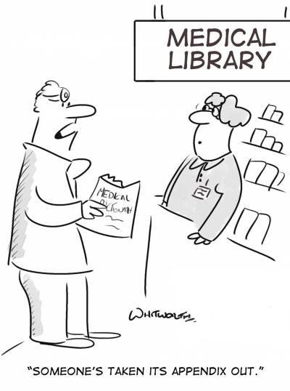
Outline
Who I Am (5 Minutes)
The Problem (5 Minutes)
The Research (20 Minutes)
The Recommendations (15 Minutes)
Q& A (10 Minutes)
Notes:
This slide gives us some structure and reminds me. A version of this presentation was delivered on July 1st at the American Library Association annual conference in San Diego. The outline here reflects some of the particular needs of the R4 Connections and provides me some additional time to expand on the medical library applications of my research and recommendations.

Slide 3
Who I Am
Notes:
But first if you are going to dedicate an hour of your time to listening to me, I feel it right to share a bit more about who I am and what I have to offer you.

Slide 4
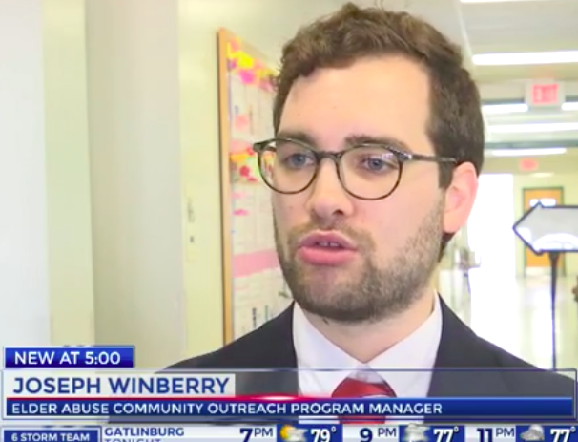
Who I Am
Professionally
Assistant Professor
UNC School of Information and Library Science (SILS)
Former Aging Services Practitioner
Knox County, TN on Aging
Notes:
To start, I want to share elements of my background that shapes my approach to our topic today.

Slide 5
Who I Am
Personally
Notes:
My approach to this topic is shaped in part by my relationships with my grandparents. I like these images which show my Granny and I from my high school graduation in 2009 through my Ph.D. graduation in 2023. We’ve moved across the life span together and now that she’s 94 Granny would love to go skydiving again…something we did for her 80th birthday.

Slide 6
Who I Am
Holistically
Notes:
I am also someone who believes in justice for all. When a county commissioner in the East Tennessee county I was living in mocked then presidential candidate Pete Buttigieg for being gay, I wanted to show that people like my husband and I were residents of the county just as much as him. Librarians (and library professors) are humans too. Inevitably we bring our identities into the work we do.

Slide 7
Bringing Elements Together
Aging
Social Justice
Libraries
Notes:
Those elements of my identity and life experience brought me to be interested in today’s topic and perhaps it does the same for you.

Slide 8
The problem
Notes:
Older adults are not a problem. The system we have built around them, however, often is.

Slide 9
Social Justice Proliferation
Defined as the process and results of addressing gaps between marginalized and privileged groups (Winberry, 2023)
“Social justice” in LIS rising, but not for older adults (Winberry and Bishop, 2021)
Notes:
Who has worked in libraries for 10 years? 20 years? More? Have you noticed an increase in reference to social justice during this time? If so, your experience is backed by the literature. Since 2000, social justice has been increasingly visible in library and information science research. For the sake of time, I suggest a definition for social justice which will guide our discussion. My research has indicated that despite social justice references increasing in LIS, one major gap has been around older adults.

Slide 10
Elder Justice
Ageism
Elder Abuse
Intersectional Discrimination
Notes:
Going back to our definition, what makes older adults a marginalized group who deserve social justice?
First, ageism which is stigma and/or discrimination against someone because they are older. Research shows that women experience ageism in the workplace as young as 35. You don’t have to be a media or economics scholar to see that our society champions youth in advertisement, in entertainment, and in the marketplace. Many older people report feeling “invisible” in society. Ageism is one reason why we need social justice for older adults.
A second reason is elder abuse which is harm that might be physical, emotional, financial, and sexual among other forms perpetuated because of hatred of or perceived vulnerability among older adults. Studies indicate that about 1 in 10 people 60 and older have experienced some form of elder abuse. Other research has indicated that ageism may be a precursor to elder abuse. As someone who has worked on these issues as a practitioner, I can say that a society protects what it values. In many countries around the world, elder abuse is not the issue that it is here.
Some of you may be familiar with the work of Professor Kimberlé Crenshaw on intersectionality. She argued that people might have multiple elements of their identity which are marginalized. An older adult who is also a person of color or has a disability may experience both ageism and racism or ableism. This idea is also recognized in gerontology research as double jeopardy. Not sure how Alex Trebek or Ken Jennings would feel about that, but these are some of the key reasons that social justice is needed for older adults.

Slide 11
By the Numbers
National Center on Elder Abuse, 2020
Notes:
Despite these issues, there will be some who do not think addressing marginalization among older adults is important. If you are a numbers person you can see that in this chart from the National Center on Elder Abuse that over the next few decades, the number of people 65 and older are going to grow precipitously. The share that people 65 and older make up of the population will also rise. People 65 and older are already the fastest growing population in the US and people 85 and older are the fastest growing sub-group. Worldwide, the United Nations found that in 2018 for the first-time people 65 and older outnumbered those 5 and younger. The numbers of older adults will grow and by reality their needs will become more and more the responsibilities of libraries. It is better to start early than for our field to be caught behind.

Slide 12
The research

Slide 13
Project 1
Winberry, J., & Mehra, B. (2021). The ivory tower’s gray library: Evaluating services for older adult students in academic libraries. In J. Skinner & M. Gross (Eds.). Underserved patrons in university libraries: Assisting students facing trauma, abuse, and discrimination. Santa Barbara, CA: Libraries Unlimited. https://www.abc-clio.com/products/a6054p/

Slide 14
Older Students in Academic Libraries
Personal gratification in retirement
Career Change
Economic Necessity
Financial need to work longer
Ageism in the workplace
Notes:
There are various reasons that someone may go to college later in life.

Slide 15
Research Question
How are older adults represented in academic library websites?

Slide 16
Methods
Content analysis of websites of academic libraries in 25 land grant universities with highest number of students 50+
Newest IPEDS data at the time
Considering information sources, information policies, and external/internal connections

Slide 17
Findings: Themes
Broad Inclusion
Community Engagement
Older Adult Representation

Slide 18
Theme: Broad Inclusion
Older adults, older students in collections
Older adult collections not spotlighted
Age and diversity statements, committees
Notes:
The first theme is broad inclusion. As expected, all of the institutions had some collections related to older adults; several of them even had resources for older adult students specifically. But very few institutions “spotlighted” collections on older adults, meaning that patrons already looking for these resources could find them in the catalog but patrons who may unknowingly benefit from the information were less likely to stumble upon any examples on the website. In the same way, many of the institutions did have a diversity committee or participated in a university-wide diversity committee. Some, such as the University of Missouri, mention age in their diversity statement. However, there was no identification of purposeful representation of older adults in diversity committees.

Slide 19
Theme: Community Engagement
Health literacy programming
Health Information Reference
Notes:
The second theme is community engagement. There were several examples of engagement with internal and external audiences on aging issues. [Note the pictures.] This includes examples like the University of Minnesota’s Bio-Medical Library which provided a health literacy program for Minnesota seniors or the University of Rhode Island Libraries which hosted a panel on health and libraries which included at least one representative who provides health information services to older adults. These examples reinforce the role that land grant institutional libraries can and do play as centers of civic engagement and discussion, a trait essential for public libraries but important for publicly funded academic libraries as well.

Slide 20
Theme: Older Adult Representation
Notes:
A third theme is older adult representation. The researchers agreed that certain resources such as libguides or databases are more specifically curated as they require more human and financial capital to produce or obtain than individual books. A search of internal resources suggested that materials on older adults are available in the library. However, these are often related to the health of older adults and the role of students in caring for them. The University of Florida had a few examples of these. These are important tools for students of all ages. There were also resources in which older adults were represented as students rather than patients, such as Texas A&M’s libguide on education for older adults or as part of a larger social justice effort in the libguides of institutions like Purdue University. The representation of older adults as patients as well as students and as members of marginalized populations provides a more diverse and complex representation of the role of older adults in society.

Slide 21
Project 2
Lenstra, N., Winberry, J., & Oguz, F. (2022). Finding new ways to support social connections for older adults: Rural public libraries innovate during the pandemic. In Chakraborty, M., Harlow, S., Moorefield-Lang, H. (Eds.). Sustainable Online Library Services and Resources: Learning from the Pandemic. Santa Barbara, CA: ABC-CLIO. https://www.abc-clio.com/products/a6464p/

Slide 22
Older Adults and COVID-19
Increased Health Risks
Isolation: Social and Digital
Libraries as Senior Centers in Rural Areas
Notes:
COVID-19 brought major risks to everyone and additional risks to older adults. Social isolation was compounded by the pandemic and those without digital access which included many older adults could not transition to the “Zoom economy” to the degree that many others did during this period. Up to this point, many libraries—especially public libraries in rural communities—have served as de facto senior centers for older adults.

Slide 23
Research Question
How did rural and small libraries innovate to better serve older patrons during the pandemic?
Notes:
Libraries had to consider to what degree and what ways it could continue to serve during COVID via innovation. It’s important to note that innovation is a library-to-library phenomenon. In other words, what is innovative for one library, might be routine for another.

Slide 24
Methods
Qualitative responses from a mixed-methods survey
Sample drawn from the IMLS Fiscal Year 2018 Public Libraries Survey (PLS) dataset using a cluster sampling method
Analyzed responses from 173 librarians in sampled rural and public libraries

Slide 25
Findings: Examples of Innovation
Creating and Hosting website for community response group
Partnerships with aging services providers
Expanded online programming
Check-In Calls
Notes:
Here were some of the key innovations that came up.

Slide 26
Project 3
Winberry, J. (2023). “People have died to get us to where we are”: Combating aging services information marginalization alongside LGBT+ older adults. [Doctoral Dissertation, University of Tennessee-Knoxville]

Slide 27
Aging While LGBT+
Information Marginalization
LGBT+ and Non-LGBT+ Older Adults
Older Americans Act and LGBT+ Aging
“What is going to happen to me as I get old?”

Slide 28
Methods
Community-Based Participatory Research project with LGBT+ older adults and community organizations in Knoxville, TN
Interviews, surveys, focus groups, etc.
Participation from academic, not public librarians

Slide 29
Findings
“We do not have that population in our community.” – Rural Library Director
“I am E. TN, but probably should not share [where] - my open mindedness is not shared by coworkers...” – Frontline Worker
“Thank you for this survey. It has not occurred to our staff that there are specific needs of the older LGBT+ that we should be attempting to meet.” – Frontline Worker

Slide 30
Ongoing research
Aging Rainbow Coalition continues
Institute of Museum and Library Services Study

Slide 31
Future research ideas
Medical Library Ideas
Audit of serving older adults in medical libraries
Information needs of older adults in medical libraries
Interviews of medical librarians on their experiences with older adults
Notes:
Here are some other research studies which could emerge at the intersection of older adults and medical libraries. There are various ways to identify the social justice connection in these.

Slide 32
Recommendations

Slide 33
Recommendation 1: work a Plan!
Winberry and Mehra, 2021
Notes:
Library staff have finite resources. However, if the cause of elder justice is one that has gotten your attention, you create and act on a plan to implement it in your library. Depending on your library, it might make sense to make the case first with administration or by engaging with older adults directly. Let’s talk through these components.

Slide 34
Recommendation 1: Con.
Survey: Older Patron Ages, Interests, and Recommendations
Community Event Based on Recommendations
Report of findings submitted to leadership with next steps listed
Notes:
Let’s talk about one bottom-up plan you could implement.

Slide 35
Recommendation 2: Innovate?
Some examples:
Older Adult Librarian Position
Long Term Care/Homebound Outreach
Intergenerational Programming
Demographic Responsive Funding
Artificial Intelligence and Other Technology
Notes:
Here are just some innovations you could consider in your library. Let’s go through them in more details. I ask innovate as a question because innovation is different for each library.

Slide 36
Recommendation 2: Con.
Medical Librarian Pop Ups at Independent Living/Long Term Care Facilities
Database Training Sessions
Workshops for clinicians on how to explain medical info to older adults

Slide 37
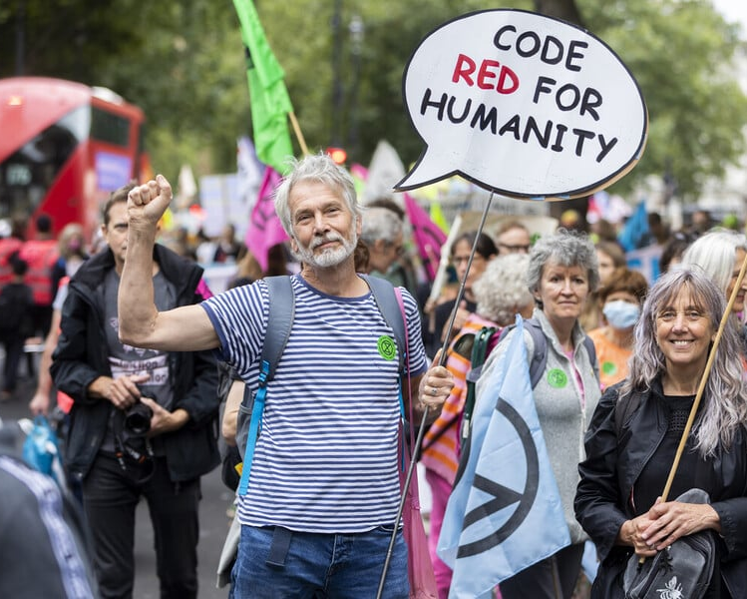
Recommendation 3: Change the System From Within!
Library Boards, Staff
ALA
ODLOS Interest Group: Dementia/Alzheimer’s
RUSA Library Service to Aging Population
Social Responsibilities Round Table – Elder Justice Task Force
Notes:
If we want to bring more attention to the needs of older adults, we will have to engage—even change—the systems we work within. This means bringing these issues to the administration, making them evident in our day-to-day work, and challenging library boards where necessary.
Within the ALA, there exists already a few groups who focus on older adults. I believe there is an opportunity to do a wider analysis of what the ALA has to offer for serving the needs of older adults. Perhaps they would be better served by a united entity within the organization or perhaps focusing on different aspects (such as dementia, older adults as users in general, etc.) But either way, I think we need to do more investigation to know. I propose a task force on elder justice under the Social Responsibilities Round Table. The SRRT has been the leading entity for social justice issues in the ALA going back to the late 1960s. We should do more to focus on the needs of older adults as a social justice imperative. If you agree and want to be part of those efforts, please take a moment to click on the QR code or write down the tiny URL to fill out the survey later.
ALA Office for Diversity, Literacy, and Outreach Services ODLOS Interest Groups | ALA
RSS: Library Service to Aging Population | Reference and User Services Association (ala.org)

Slide 38
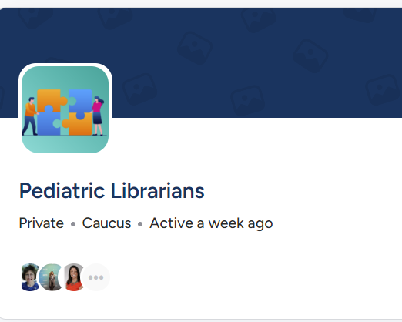
Recommendation 3: Con.
Pediatric Librarians group in the Medical Library Association
Other identity groups present
Much research indicates lack of older adult focus because of lack of examples than interest
Notes:
Within the Medical Library Association there is an interest group for those who are pediatric librarians. This is important and valuable. It would also be important and valuable to see a group serving the need of older people. The term “geriatrics” is outdated and doesn’t center the person, but you often still see it in clinical spaces. But apparently not within the Medical Library Association interest groups. There are other identity-based groups visible such as those serving LGBT+ and Black communities. I am working on a paper right now on how which shows how there is much less professionals (librarians or clinicians) saying they like to work with older people over children. However, the literature suggests this is because of a lack of avenues for learning about the needs of older people and the related career opportunities less than disinterest in serving them.

Slide 39
References
Centre for Ageing Better. (2023). Age-positive image library. Retrieved from https://www.agewithoutlimits.org/image-library
Winberry, J. (2023). “People have died to get us to where we are”: Combating aging services information marginalization alongside LGBT+ older adults. [Doctoral Dissertation, University of Tennessee-Knoxville]
Winberry, J., and Bishop, B. W. (2021). “Documenting social justice in library and information science research: A literature review.” Journal of Documentation, 77(3), 743-754. https://doi.org/10.1108/JD-08-2020-0136
National Center on Elder Abuse (2020). America's Growing Elderly Population: Population Aged 65 and Over: 1900 to 2050. Retrieved March 1, 2020 from https://ncea.acl.gov/About-Us/What-We-Do/Research/Statistics-and-Data.aspx#population

Slide 40
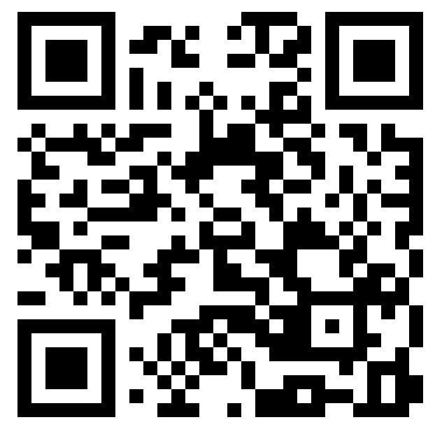
Discussion (and keeping it going!)
Want to organize for older adults? Follow the link!
https://go.unc.edu/ALA
What are your comments, thoughts, and ideas?
Share now or contact me jwinber@unc.edu
Learn more: https://sils.unc.edu/people/joseph-winberry/

