Slide 1
Numeracy
Communicate the numbers better…

Slide 2
Discussion points from last module
How do you already use teach back and where can you apply it more?
If you don’t already use teach back regularly, try adding it to your last appointment of the day
Notes:
[NOTE TO FACILITATOR: If you are completing these modules in an order other than suggested in the facilitation guide, you may need to adjust these discussion points.]

Slide 3
Objectives
By the end of the program, participants will:
Be able to describe best practices for communicating numerical data to patients

Slide 4
What is Numeracy?
“…the ability to comprehend, use and attach meaning to numbers.”³
Notes:
We’re moving on to another topic related to health literacy, which is numeracy. So that we’re all on the same page, a very basic definition of numeracy is, “the ability to comprehend, use and attach meaning to numbers.”³ I’m sure that we can all think of times when our patients have made errors with numbers that have affected their understanding of their health or treatment plan. From our perspective, it’s easy to assume understanding of basic numerical concepts, but what we really see in the general population is different from what we may assume.

Slide 5
Health Literacy in the U.S.
The National Assessment of Adult Literacy measured health literacy in adults 16+ in 2003⁸
Looked at health literacy tasks in clinical, prevention and health care system domains⁸
22% of English-speaking adults in the United States had below basic quantitative skills⁶
Notes:
The 2003 National Assessment of Adult Literacy measured health literacy in those 16 and over⁸. The assessment looked at health literacy tasks in different clinical, prevention and health care system domains⁸. In terms of numeracy, this assessment found that 22% of English-speaking adults in the U.S. had below basic quantitative skills⁶. Below basic is described as the ability to perform mathematical operations, such as addition, when the formula was concrete⁸. The next step up, basic, was defined as locating numerical information and using it to solve one-step problems when the formula was inferred⁸. When thinking about these definitions, it is easy to see how the 22% of people at the below basic level could struggle with clinical recommendations that seem very simple.

Slide 6
Why is Numeracy Important?
Low numeracy makes it difficult for a person to read, use and evaluate numerical information¹
Those with low numeracy may not understand risks and benefits - and therefore their treatment options¹
Those with low numeracy may have trouble following treatment plans, leading to poorer health outcomes⁶
Notes:
Why is this important? Numeracy is part of health literacy and, therefore, limitations in this area are linked to similar health outcomes as health literacy as a whole. Low numeracy makes it difficult for someone to read, use and evaluate numerical information, and it is easy to understand how this may limit them from understanding concepts such as risk and benefit, meaning that they also do not understand their treatment options¹. In addition, when receiving treatment, someone with low numeracy may have more trouble following their treatment plans, which can lead to poorer health outcomes⁶. Think about telling someone to limit their sodium intake to 2,000mg per day. If they can’t understand the fractions on a nutrition label to measure portion sizes, it is going to be difficult for them to follow this recommendation.

Slide 7
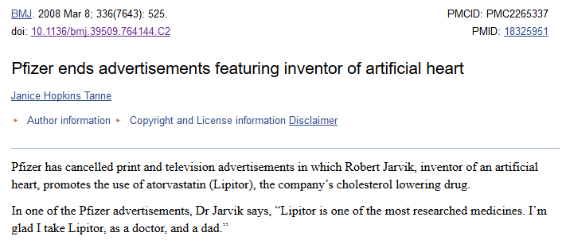
Example
A 2007 television drug ad stated, “In patients with multiple risk factors for heart disease, Lipitor reduces risk of heart attack by 36%.*”⁶
The asterisk meant that in a large clinical study, 3% of patients taking the placebo had a heart attack compared to 2% of patients taking Lipitor.⁶
Pfizer said in a statement that the advertisements “provided valuable and medically accurate information about the risks of high cholesterol and how Lipitor can help patients reduce their risk of heart attach and stroke” but had “unfortunately led to misimpression and distractions… ^{7”}
Notes:
Here is a real life example of how numbers can make things confusing in the media. In 2007, a TV ad stated that Lipitor reduces risk of heart attack by 36%⁶. This statement was followed by an asterisk that clarified that in a large clinical study, 3% of patients taking the placebo had a heart attack compared to 2% of patients taking Lipitor⁶. How can these be the same? One sounds much more beneficial. The first statement was the relative risk (the difference between the two risks) while the second statement is the absolute risk (the actual number of people experiencing the heart attack in the study). Pfizer ended up pulling the ad stating that while the advertisement was medically accurate, it has led to misimpression and distraction⁷. When considering what we just discussed about numeracy, it’s easy to see why there was confusion. If someone can only perform concrete mathematical calculations, can we expect them to make an informed decision from this information?

Slide 8
What can we do?
“An individual’s ability to understand and use numbers, such as data and risk information, to make health and health care decisions often depends on and can be greatly supported by the way numbers are presented.”⁵
~ National Academy of Sciences
Notes:
What can we do as healthcare providers to make sure patients understand numerical information that they need to improve their health? This quote from the National Academy of Sciences is one way we can think about solving this issue. You can see that they explain that, “An individual’s ability to understand and use numbers, such as data and risk information, to make health and health care decisions often depends on and can be greatly supported by the way numbers are presented.”⁵ We can’t change a patient’s numeracy during a visit, but we can change what we do to help them understand numbers.

Slide 9
Better Ways to Communicate the Numbers (1)
Elaborate by providing estimated numbers
“Studies show that out of every 100 people who have a stent, 1 to 2 people may develop a blood clot at the stent site.”¹
Notes:
To help communicate numbers, we’ll review some tips from the Agency for Healthcare Research and Quality’s SHARE Approach. One way to communicate clearly about numbers to your patients is to elaborate by providing estimated numbers¹. Even though many people have trouble with numbers, it is still suggested that you communicate risk using a number that makes sense to people and avoid using terms such as “low risk” on their own¹. These terms could be interpreted by a patient differently than you mean them⁴. For example, instead of telling a patient they are at low risk for developing a blood clot, this example explains that, “Studies show that out of every 100 people who have a stent, 1 to 2 people may develop a blood clot at the stent site.”¹ It’s not that you can’t use terms such as “low risk,” but that providing an understandable number will help avoid miscommunication⁴. The National Academy of Sciences suggests that a provider “marry words and numbers,” or use both numbers and terms to clarify a message like this one⁴.

Slide 10
Better Ways to Communicate the Numbers (2)
Elaborate by providing estimated numbers
Use frequencies instead of decimals or percentages
“13 out of 100” instead of “.13 or 13%”¹
Notes:
Another tip is to use frequencies instead of decimals or percentages¹. Those with lower numeracy might have trouble understanding percentages^{3,2}. Some research has found that people understand percentage and frequency equally³, while others have found that people seem to find percentages to be more abstract ^{3,2}. Current recommendations from the Agency for Healthcare Research and Quality’s SHARE curriculum suggest communicating through frequency¹.

Slide 11
Better Ways to Communicate the Numbers (3)
Elaborate by providing estimated numbers
Use frequencies instead of decimals or percentages
Keep denominators and timeframes the same when you compare numbers
“About 6 out of 10 women like you, who do not take this medicine will break a bone in the next 10 years. About 3 out of 10 women like you who take this medicine will break a bone in the next 10 years. Taking this medicine can lower your chance of breaking a bone by about half.”¹
Notes:
It can be hard for a patient to compare possible outcomes if they are presented with different denominators, for example, being asked to compare 1 in 25 and 1 in 200⁴. It’s clearer if this information is presented as 40 in 1000 and 5 in 1000⁴. It is also good to keep the timeframe consistent as you see in this example, “About 6 out of 10 women like you, who do not take this medicine will break a bone in the next 10 years. About 3 out of 10 women like you who take this medicine will break a bone in the next 10 years. Taking this medicine can lower your chance of breaking a bone by about half.”¹ It’s easy to imagine how a different timeframe could be confusing for a patient, just like the difference in denominator in the first example.

Slide 12
Better Ways to Communicate the Numbers (4)
Elaborate by providing estimated numbers
Use frequencies instead of decimals or percentages
Keep denominators and timeframes the same when you compare numbers
Give absolute risk instead of relative risk
“3 out of 1,000 nonsmokers may have a stroke in their lifetime and 6 out of 1,000 smokers may have a stroke in their lifetime.”¹
Notes:
The AHRQ also suggests providing patients with absolute risk instead of relative risk¹. Absolute risk is described well by AHRQ as, “the number of health events among individuals in a group, and gives a better sense of personal or individual risk.”¹ Relative risk is a comparison of two risks and does not tell someone their actual risk⁵. When relative risk is presented on its own, patients can interpret risk as larger or treatment as worse⁵. Providing the absolute risk creates less room for error as your patient considers various options⁵. Consider the Lipitor commercial example from earlier - one was absolute risk and one was relative risk. Did one of these seem easier to understand and interpret? You can see another example here of how a provider might explain the connection between smoking and having a stroke using absolute risk. “Three out of 1,000 nonsmokers may have a stroke in their lifetime and six out of 1,000 smokers may have a stroke in their lifetime.”¹

Slide 13
Better Ways to Communicate the Numbers (5)
Elaborate by providing estimated numbers
Use frequencies instead of decimals or percentages
Keep denominators and timeframes the same when you compare numbers
Give absolute risk instead of relative risk
Frame outcomes in both positive and negative terms
“With this treatment, 2 out of 10 people get side effects, and 8 out of 10 people do not get side effects.”¹
Notes:
The last example we’ll discuss today is framing. It is suggested that outcomes are framed to the patient in both positive and negative terms¹. For people with lower numeracy, presenting the information in just one way can influence them in that direction. Therefore, it is suggested that numerical information be presented using both the positive and the negative³, such as “with this treatment, two out of ten people get side effects, and eight out of ten people do not get side effects.”¹

Slide 14
Extra Tips
Universal precaution: even those with high numeracy can benefit from information presented in an easily understandable way⁵
Teach back: check for understanding by asking the patient to restate the numerical information in an easy to understand way¹
“I want to make sure I explained this well, so tell me, which risk did I say was higher of the two risks we’ve been talking about?”⁵
Notes:
Some extra tips draw from the information we have talked about in previous modules. Remember that all of these health literacy concepts eventually link together. When it comes to numeracy, it is good to consider universal precaution just like health literacy. After all, numeracy is part of health literacy. Instead of wondering about which of your patients struggle to understand numbers, it is still good to practice universal precaution by communicating numbers in an easy to understand way to all patients⁵. In addition, it is suggested that you use teach back to confirm understanding of numerical data just like you would to confirm understanding of other information^{1,5}. You can see one example here, “I want to make sure I explained this well, so tell me, which risk did I say was higher of the two risks we’ve been talking about?”⁵

Slide 15
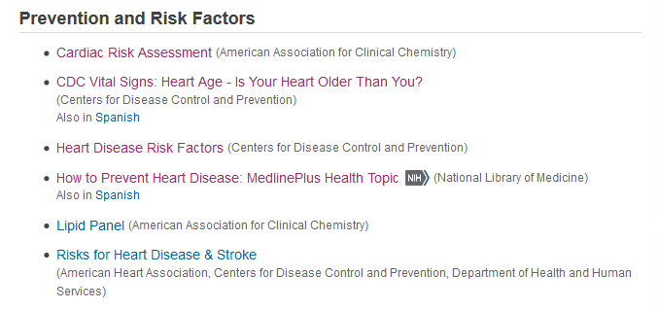
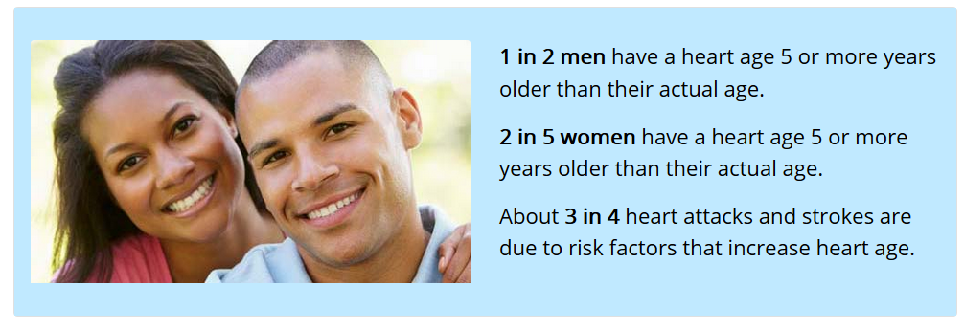
MedlinePlus Example 1
Notes:
Another suggestion for better communicating is to use verbal, written and graphical formats to meet the needs of different learning styles⁴. You can find easy to understand materials using MedlinePlus. For example, on this topic page about heart disease, you can see the section about prevention and risk. One of these links is to the CDC’s page on heart age, which explains what factors make someone’s heart “older” and how people can improve their heart age. You can see that the numbers about heart age are explained using frequencies. Another suggestion from the AHRQ to maximize understanding is to use analogies and comparisons to familiar objects¹. Someone might understand their heart being “older” better than other types of risk.

Slide 16
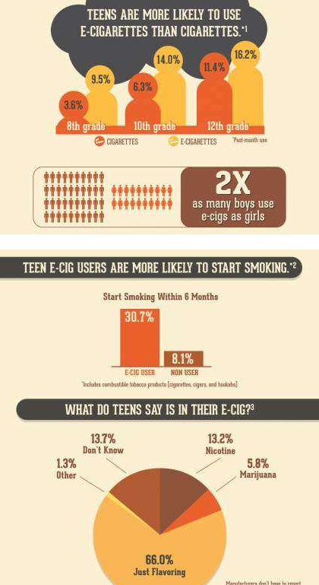
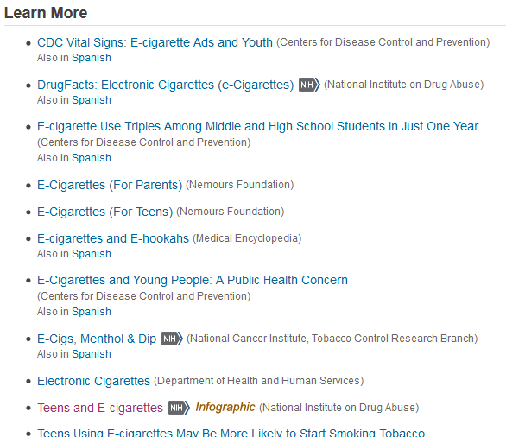
MedlinePlus Example 2
Notes:
Here is another example. You may find MedlinePlus useful for locating infographics that communicate risk, such as this from the E-Cigarette topic page in MedlinePlus. AHRQ also recommends showing graphs, to demonstrate risk¹, and looking for existing tools to get your point across can be a time saver.

Slide 17
Take home message
Consider:
Which numerical messages are hardest to convey to patients?
Can any of these suggestions help?
Practice:
The next time you need to communicate numerical information to a patient, consider which of these suggestions will increase understanding
Developed resources reported in this presentation are supported by the National Library of Medicine (NLM), National Institutes of Health (NIH) under cooperative agreement number UG4LM012342 with the University of Pittsburgh, Health Sciences Library System. The content is solely the responsibility of the authors and does not necessarily represent the official views of the National Institutes of Health.
Notes:
As you move forward in the coming (week/month/etc.) I ask you to consider which numerical messages are hardest to convey to patients and which of the suggestions from today could help in the communication process. In addition, try some of these tips the next time you need to communicate numerical information to a patient.
[NOTE TO FACILITATOR: If you want to complete group discussion immediately following this module content, change the title of this slide to ‘Group Discussion’ and delete the slide with corresponding questions in the next module. If you would like to have discussion take place using your internal LMS system, you can include instructions here for how participants can participate. Then, adjust the slide with the corresponding questions in the next module as needed.]

Slide 18
References
Agency for Healthcare Research and Quality (2016). Communicating Numbers to Your Patients: A Reference Guide for Health Care Providers. Retrieved from: URL to Source
Fagerlin, A, Zikmund-Fisher, J. & Ubel, P. (2011). Helping Patients Decide: Ten Steps to Better Risk Communication. Journal of the National Cancer Institute, 103, 1436-1443. doi: 10.1093/jnci/djr318
Food and Drug Administration (2011). Communicating Risks and Benefits: an Evidence-Based User Guide. Fischhoff, B., Brewer, N., Downs, J. (Eds.). Retrieved from: URL to Source
Paling, J. (2003). Strategies to Help Patients Understand Risks. British medical Journal, 237, 745-748. doi:10.1136/bmj.327.7417.745
Pleasant, A., Rooney, C., O’Leary, L., Myers, L. & Rudd, R. (2016). Strategies to Enhance Numeracy Skills. Discussion Paper, National Academy of Medicine, Washington DC. doi:10.31478/201605b
Reyna, V., Nelson, W., Han, P., Dieckmann, N. (2009). How Numeracy Influences risk comprehension and Medical Decision Making. Psychological Bulletin, 135(6), 943-973. doi:10.1037/a0017327
Tanne, J. (2008). Pfizer Ends Advertisements Featuring Inventor of Artificial Heart. British Medical Journal, 336(7643), 525. doi:10.1136/bmj.39509.764144.C2.
U.S. Department of Education (2006). The Health Literacy of America’s Adults: Results from the 2003 National Assessment of Adult Literacy. Retrieved from: URL to Source

