Slide 1
Improving Health Outcomes:
Utilizing Integrated Behavioral Health and Value- Based Payment Modeling to Transform Healthcare with Older Adults
Elle Markman, PsyD, MPH
Jennifer E. Hubbard, LCSW, LAC
Notes:
5 mins housekeeping
Total = 45 minutes
End = 10 minutes questions/thoughts
Jenny ~20
Elle ~20-25
Regroup Monday re: time split

Slide 2
Disclosures
Both Dr. Elle Markman and Jennifer Hubbard work for One Medical Senior Health, a value-based primary care practice and healthcare subsidiary of Amazon that practices Integrated Behavioral Health.
One Medical has received no financial compensation for this presentation.
Notes:
Jenny

Slide 3
Agenda
Overview of Value-Based Care and payment reform
Introduction to Integrated Behavioral Health and holistic primary care
Discussion of senior care
Notes:
Jenny

Slide 4
Timeline
By March 1, 2023
Professional headshots
Professional bios
Presentation title
Abstract (one paragraph)
2-3 objectives
March 29, 2023
Slide deck
April 3
Health Bytes tech check, practice session
April 12
Health Bytes session at 10am CST

Slide 5
HealthBytes Outline
Section 1: Value Based Care | Purpose, and implementation of value-based care models in the American healthcare system Fee for service VS Value Based Supported outcomes thus far?
Section 2: Intro to Integrated Behavioral Health | Review current practice models of Primary Care Purpose and goals of IBH IBH vs traditional MH Outcomes associated with IBH
Section 3: Senior Care | Specific needs of this demographic/health care utilization? Care for this population within an Integrated and VBC model?

Slide 6
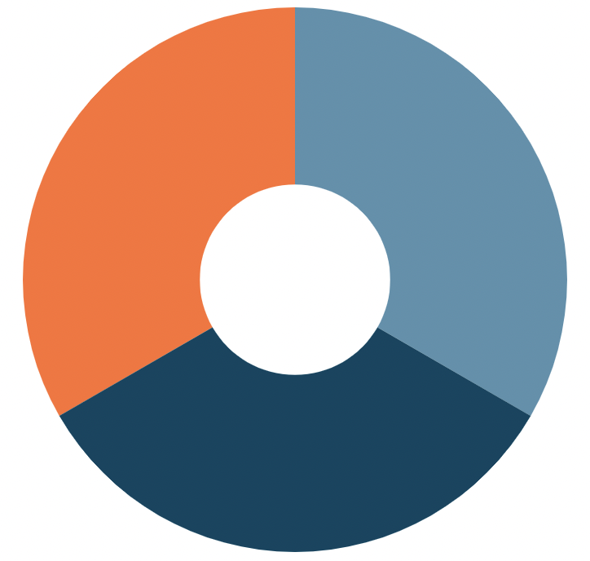
Quality Improvement in Health Systems and Healthcare
Improve the Patient Experience
Improve Health of Populations
Triple Aim
IHI, 2007
Improve Value by Reducing Costs
Notes:
Jenny
Before we introduce concepts of payment reform and integrating behavioral health, we’d like to take a moment to review a concept in health care that describes the goals of healthcare- for individuals and society in America. This is best captured by the Institute for Healthcare Improvement’s (IHI) “Triple Aim”.
[clikc] The first aim is “ Improving the patient experience of care (including quality and satisfaction)”. Up until the introduction of the triple aim in 2007, if you asked many in the field what the goals of healthcare were, they may have referenced the patient experience. In particular, the “Six Domains of Healthcare Quality” as outline by the Institute of Medicine. The six dimensions are: safety, effectiveness, patient-centeredness, timeliness, efficiency, and equity. That is still agreed to be the aim of healthcare in the individual experience of patient care.
[click] The second aim posited that healthcare should also strive to improve the health of populations. Population health is defined as the health outcomes of a group of individuals. This can be across geography as in certain communities, or a group of employees, ethnic groups, prisons, or any defined group of people.
[click] Lastly, the IHI suggested that we should improve patient experience and the health of populations while reducing healthcare costs per capita.
The Triple Aim became a widely adopted approach to optimizing health system performance, proposing that institutions simultaneously pursue 3 dimensions of performance: Improved patient experience, population health, and reduction of healthcare costs.

Slide 7
Quality Improvement in Health Systems and Healthcare
Improve the Clinician Experience
Improve Health of Populations
Quadruple Aim
Improve the Patient Experience
Improve Value by Reducing Costs
Notes:
Jenny
Then in 2014, industry professionals noted the widespread burnout and dissatisfaction of physicians and other members of the healthcare workforce (Bodenheimer & Sinsky, 2014). Burnout is associated with lower patient satisfaction, reduced health outcomes, and it may increase costs; the jeopardizes the each goal of the Triple Aim. Therefore, it was asserted that a fourth aim, improving the work life of health care professionals, must be achieved in order realize better care, better health, and lower costs.

Slide 8
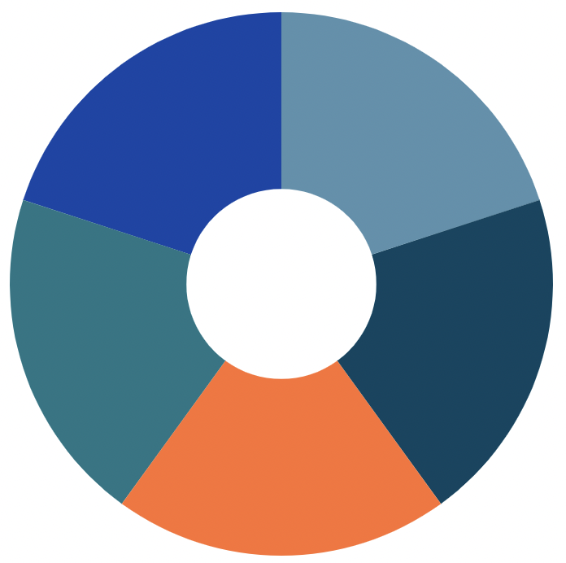
Quality Improvement in Health Systems and Healthcare
Advance Health Equity
Improve Health of Populations
Quintuple Aim
Improve the Clinician Experience
Improve Value by Reducing Costs
Improve the Patient Experience
Notes:
Jenny
And then very recently, the COVID-19 pandemic cast a spotlight on the lack of health equity in the US and around the world (Nundy et al, 2022). The pandemic forced health care leaders and policy makers to grapple with the great health inequities in society currently. Thus, the pursuit of advancing health equity was elevated as the fifth aim for health care improvement.
And now we have the quintuple aim. It’s a like a compass that tells us what success looks like in healthcare and where our “true north” is.
So for today, we’d like to share with you an approach to primary care which seeks achieve the goals of the quintuple aim as we not only aim to improve healthcare, but do our part to transform it.

Slide 9
Section 1
Payment Reform: Value Based Care
Notes:
Jenny
Start with reviewing one of the aims of healthcare- cost reduction

Slide 10
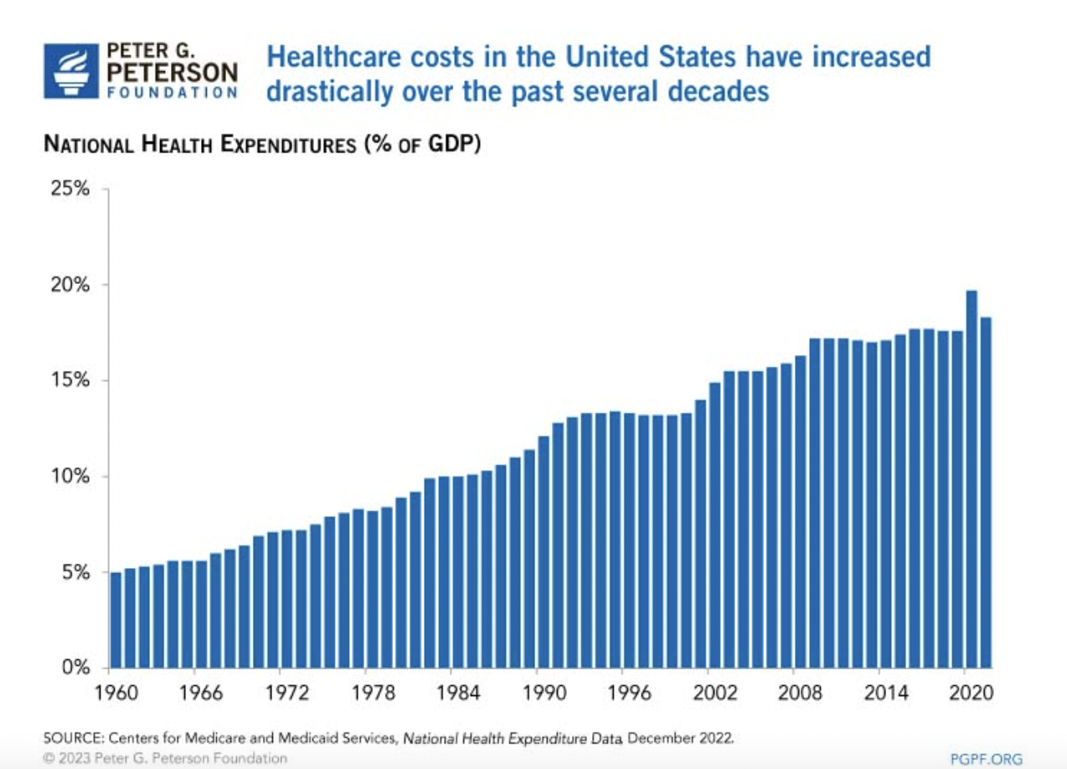
The Problem: Rising Healthcare Costs
Notes:
Jenny
This may not be a surprise to you, but healthcare costs in the United States have been rising for decades and are expected to keep increasing. The United States has one of the highest costs of healthcare in the world. According to a study by the Peterson Center on Healthcare and the Kaiser Family Foundation (KFF), in 2021, U.S. healthcare spending reached $4.3 trillion, which averages to about $12,900 per person. Relative to the size of the economy, healthcare costs have increased over the past several decades, from 5 percent of GDP in 1960 to 18 percent in 2021.

Slide 11
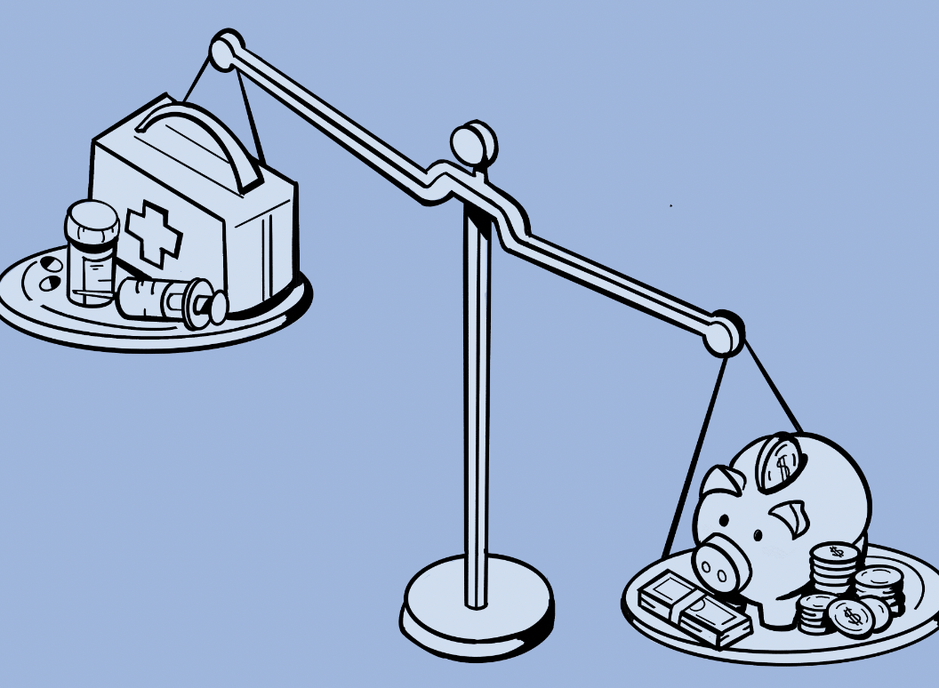
The Problem: Rising Healthcare Costs
Healthcare Costs = $ Service X Amt Services Used
5 key factors (JAMA 2017):
Population growth
Population aging
Disease prevalence
Service price/intensity
Medical service utilization
“Perverse Incentives” for healthcare payment models
Notes:
Jenny
But why are costs rising so much? Generally speaking, healthcare spending can be thought of as an equation of price (how much do we charge for healthcare services) and utilization (the amount of services used) (Peter G. Peterson Foundation, 2023.).
Now here are several underlying factors that can increase both price of services and utilization, which then increase overall spending of healthcare. A 2017 JAMA article investigated 5 key factors associated with those increases:
Population growth-
Population aging
Disease prevalence or incidence
Service price and intensity
Medical service utilization
Some analysts say the debate is ignoring one of the leading causes of rising costs: the way health care providers are paid and potential perverse incentives within payment models

Slide 12
Payment Modeling in Healthcare: Fee for Service (FFS)
The dominant mode of physician payment in the United States
“business as usual”
Patients are a fee for each individual service provided
Advantages:
Flexibility
Few restrictions on care
Enhances patient choice
Notes:
Jenny
The payment model known as fee for service has long been the dominant mode of physician payment in the US. (Berenson). This model has been with us since the 1930s in the US and has been with us ever since. (Magil). In 2010, it represented over 90 percent of primary care practice revenue (Berenson) → [hannah’s presentation says 70%]*****
In this model, doctors charge their patients a fee for each individual service provided. This means that the insurance companies or the government agencies are billed for every test, procedure, and treatment rendered whenever a patient visits the doctor, has a consultation, or is hospitalized. And if there’s no insurance- pay out of pocket for that service. This payment structure is relatively straightforward and allows doctors to earn a living by providing medical care.
Advantages:
Because this model is so widespread, it can offer patients a lot of flexibility when they need care. If their doctor is unable to see them for any reason, then they can schedule an appointment with someone else. Patients also have the freedom to choose the services they receive and the provider they see; some argue that there’s even transparency with the model as a patient may be able to see how much each service costs and make decisions based on the healthcare expense and need.

Slide 13
Payment Modeling in Healthcare: Fee for Service (FFS)
Criticisms:
“Perverse incentive” based on quantity of services
Encourages overutilization
Drives up healthcare costs
Disincentivize preventative care
Little focus on quality
Can contribute to burnout
Notes:
Jenny
Yet this payment model has been the dominant approach for decades, it has come under increased scrutiny in recent years due to concerns about rising healthcare costs, over-utilization of services, and fragmentation of care.
So what’s underpinning this argument? Well, unfortunately the model be based on a perverse incentive- A “perverse incentive” is an incentive that has an unintended and undesirable result that is contrary to the intentions of its designers. So this model is based on quantity of services; it’s right in the name: fee for service. There is a reward for more services, not necessarily better services. Most FFS models are paid simply for each service, regardless of the results of that service.
This can lead to over-utilization of healthcare services, including unnecessary tests, procedures, and treatments. Increased quantity of services and incentive to recommend more expensive care, can be associated with overall increase in healthcare costs. (Berenson & Rich, 2010)
Because the fee-for-service model rewards providers for treating illnesses and conditions rather than preventing them, it can disincentivize providers from investing time and resources in preventive care measures such as health education and screening programs. It also does not directly reward key primary care functions, especially coordination or comprehensive care of patients with multiple chronic conditions.
In many fee for service models, there is little attention on the quality of care provided as the economic incentive is quantity. The means that there isn’t as much incentive to think through if services are effective or necessary.
Lastly, healthcare professionals often are frustrated by a mode of practice which relies on them to generate many brief patient encounters. A 2010 Journal of Internal Medicine article reads “Across the globe doctors are miserable because they feel like hamsters on a treadmill. They must run faster just to stand still…The result of the wheel going faster is not only a reduction in quality of care, but also a reduction in professional satisfaction and an increase in burnout among physicians.”
Many healthcare systems and insurance companies are exploring alternative payment models, such as value-based care, which are intended to incentivize providers to focus on quality of care and better outcomes.

Slide 14
Payment Modeling in Healthcare: Value Based Care (VBC)
In VBC models payment is made based on the quality of care provided, rather quantity of services which can lead to cost savings and improved patient outcomes.
“Quality” is defined in several ways
Use of data to hold healthcare providers accountable
Differing types of VBC models
Accountable Care Organizations (ACO)
Bundled payment plans
Patient Centered Medical Homes (PCMH)
Shared Risk
And more!
Notes:
Jenny
Value-based care is a form of reimbursement that ties payments for care to the quality of care provided and rewards providers for both efficiency and effectiveness. It’s a form of “alternate payment modeling” to the fee for service model.
Quality can be defined in many to determine the overall health of the patient population:
For example, implementation of specific preventative measures like universal depression screens. Review quality of health markers are in range (weight, blood pressure, A1C(. It may include reporting on reduction in hospital admissions. It focuses on improvement of preventative care.
VBC models are also driven by data because providers must report to payers on specific health metrics and demonstrate improvement in their patient’s health. Providers may have to track and report on hospital readmissions, adverse events, population health, patient engagement, and more.
There are several different forms of VBC payment models. There are Accountable Care Organizations, which comprise almost any combination of physician groups, practice networks, hospitals, and other facilities that agree to share responsibility for the quality, cost, and coordination of care for a defined patient population. Comprehensive Primary Care Plus (CPC+) is a multi-payer practice transformation model that offers primary care practices an opportunity to receive enhanced, more flexible payment and participate in a robust learning community to better meet patient needs. Bundled payment, or episode-based payment, is a single payment for services provided for an entire episode of care. Providers are collectively reimbursed for the expected costs to treat a specific condition that may include several physicians, settings of care, and procedures. The patient-centered medical home (PCMH) is a care delivery model that coordinates patient care through a primary care physician. The PCMH is designed to provide patients with a centralized care setting that manages the different needs of a patient.

Slide 15
Potential Benefits of Value-Based Care
Lower doctor panel size (800 vs 2,500) may lead to improved access and lower hospitalization rates (Angstmen et al, 2016)
Longer visit time with provider (typically 30 minutes vs 14.5 minutes for average family medicine doctors; Peckham, 2016)
“Freedom” from the visit structure since there is no fee-for-service (ie text or phone call leads to more efficient touchpoints.)
Can offer wrap-around and preventative services (ie transportation, behavioral health, same-day appointments, health coaching, classes etc.)
One study (Cohen et al, 2022) found compared to FFS, VBC was associated with improvements in all 8 metrics measured including lower rates of inpatient admissions and lowered 30-day readmission rates (large study of 320,000+ participants)
Notes:
Jenny
There are several potential benefits of value-based care. First off, lower doctor panel size may lead to improved access and lower hospitalization rates. Next, value-based primary care is associated with longer visit times with a provider. For example, our typical provider time in the visit is 30 minutes in NC, compared to 14.5 minutes for average primary care doctors. Next, since there is no fee-for-service structure, patient questions can be answered through brief phone calls, text messages, etc. and there is increased efficiency in delivery of care since there is no feeling of being “beholden” to the fee for service structure. In addition, there is reduced economic penalties for no-shows, and especially capitation payment based care can invest in infrastructure up front by offering wrap-around and preventative services. One study (thanks Matt) found that compared to FFS, VBC was associated with improvements in all 8 metrics measured, including lower rates of inpatient admissions and lowered 30-day readmission rates. What I liked about this study was that it had a very large sample size.

Slide 16
Trajectory of Value-Based Care
By 2025, Blue Cross Blue Shield has a goal to have 50% of total payments be value-based.
Private capital inflows to Value-based care companies increased fourfold from 2019 to 2021. (Atme et al, 2021)
2022 AAFP survey states that 49% of practices are receiving some type of value-based payments and another 18% are planning to. (Bendix, 2022)
In its first year, the Direct Contractor program (58 entities) saved Medicare an estimated $70 million dollars and insurance companies an estimated $48 million. The program is set to expand.
Notes:
Jenny
So that is the past of value-based care, but what about the future? The current trajectory of value-based care is one of rapid growth. By 2025, BCBS, one of the largest private insurance agencies, has a goal to have 50% of total payments be value-based. Private capital inflows to value-based care companies increased fourfold from 2019 to 2021. The 2022 American Assocation of Family Practitioners stated that 49% of surveyed practices are receiving some type of value-based payments and another 18% are planning to. In its first year, the Direct Contractor program (58 entities including Iora/OM) saved Medciare an estimated $70 million dollars and saved insurance companies an estimated $48 million dollars. In other words, value-based care is here to stay, and it is growing incredibly rapidly.

Slide 17
Section 2
Integrated Behavioral Health
Notes:
Elle
We’re now going to shift our discuss to an overview of integrated behavioral health within this value-based care model - particular focus on a model that our work at OM is based on, called primary care behavioral health (PCBH)

Slide 18
Primary Care
Primary Care is the “cornerstone for building a strong healthcare system” (Shi, 2012)
Entry point & bridge between patient’s community and the healthcare system
The intersection of medicine and public health, aiming to:
Transform healthcare
Reduce healthcare costs
Reduce health disparities
Improve population health outcomes
Four core functions (4 Cs) set primary care up for success:
First contact - access
[In-scope] Comprehensiveness - prevention, treatment, rehab; mind and body
Coordination - medical care home base
Continuity - relationship and trust over time
Notes:
Elle

Slide 19
Why integrate behavioral health and primary care?
Setting the stage:
~25% of the population is estimated to have a mental health condition, but less than half of this group receives MH treatment. Of those who do, 50% receive their treatment in primary care.
We can tackle a major population health problem: inadequate MH care landscape
Removes barriers to care (transportation, geography, network inadequacy, cost)
Destigmatize mental health care and normalizes it as a routine part of healthcare
We can improve medical health outcomes.
Over half of primary care visits relate to psychosocial concerns.
Management of chronic medical conditions often requires engagement in behavior change that PCPs do not have time or training to navigate with the patients.
We can reduce healthcare costs (Part A and Part B)
Chronic medical + comorbid behavioral health conditions cost 2-3x more than those with only a chronic medical condition alone and are associated with more avoidable hospitalizations/ER visits.
We can improve PCP, patient and caregiver experience
Notes:
Elle

Slide 20
What is integrated behavioral health? GATHER
Generalist: The Behavioral Health Specialist/Consultant (BHS) is able to triage and address any age, any concern within the PCP’s patient panel.
Accessible: The BHS is available to care team and patients throughout the workday for warm handoff or curbside consultation.
Team-based: The BHS is embedded, core member of the health care team and participates in meetings and huddles about patient care.
High productivity: The BHS is able to see both scheduled and same-day/next-day patients each day in addition to care team, care management, and population health activities.
Education: The BHS is a teacher for both patients and the care team.
Routine: When making referrals to the BHS becomes part of the clinic's normal daily workflow, the BHC becomes an integrated part of the team and the normalization of behavioral health care de-stigmatizes the process of working with a behavioral health provider.
Notes:
Elle

Slide 21
How is Integrated Behavioral Health Different?
Traditional Mental Health
Integrated Behavioral Health
Patient is seen in separate office; care is siloed
Separate chart and treatment plan
50 minute visits, defined schedule
Comprehensive BH documentation
Treatment focused on resolution of MH diagnosis
Consultation space, chart and care plan shared with PCP
15-30 minute visits + open access for warm handoffs, care team activities
Brief documentation
Communication and coordination is immediate and ongoing
Treatment focused on functional outcomes - dual emphasis on chronic medical and behavioral health conditions
Notes:
Elle
50 percent direct book/50 percent consult.
BHS care mimics how PCPs provide care. Primary care treats as much as they can in house, but when someone has significant or unique conditions we refer to specialists. BHS treat as much as we can, but for conditions that are severe or require specialist treatment we refer to specialists. - Jenny Hubbard

Slide 22
Section 3
Transformed Healthcare for Special Populations: Senior Care
Notes:
Elle
This section should highlight the needs of an aging population, and how a model that utilizes IBH in combination with VBC is able to meet those needs

Slide 23
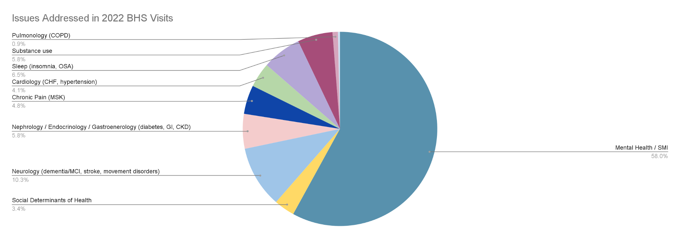
Impact of IBH with Seniors
Key performance indicator = Penetration rate (% PCP-engaged patients with BHS touchpoint that year)
Average IBH program penetration rates fall ~12%
OM SH IBH penetration rates closer to 30%
Why? Higher acuity, higher complexity, higher cost population
More chronic medical conditions (42% BH visits addressed 1+ chronic medical condition)
Chronic pain
Cognitive impairment and dementia
More social determinants insecurities
Social isolation / loneliness
End-of-life issues, advance care conversations
Notes:
Elle

Slide 24
IBH for Seniors as a Population Health Program
How do we scale sustainably and effectively for a growing population?
Integrated Behavioral Health as a population health program
Leveraging the ‘Care Enhancer’ [Health Coach] as a core piece of this program
Specialty Care
Behavioral Health
Specialist
+
Primary Care Team; Health Coach
Notes:
Elle

Slide 25
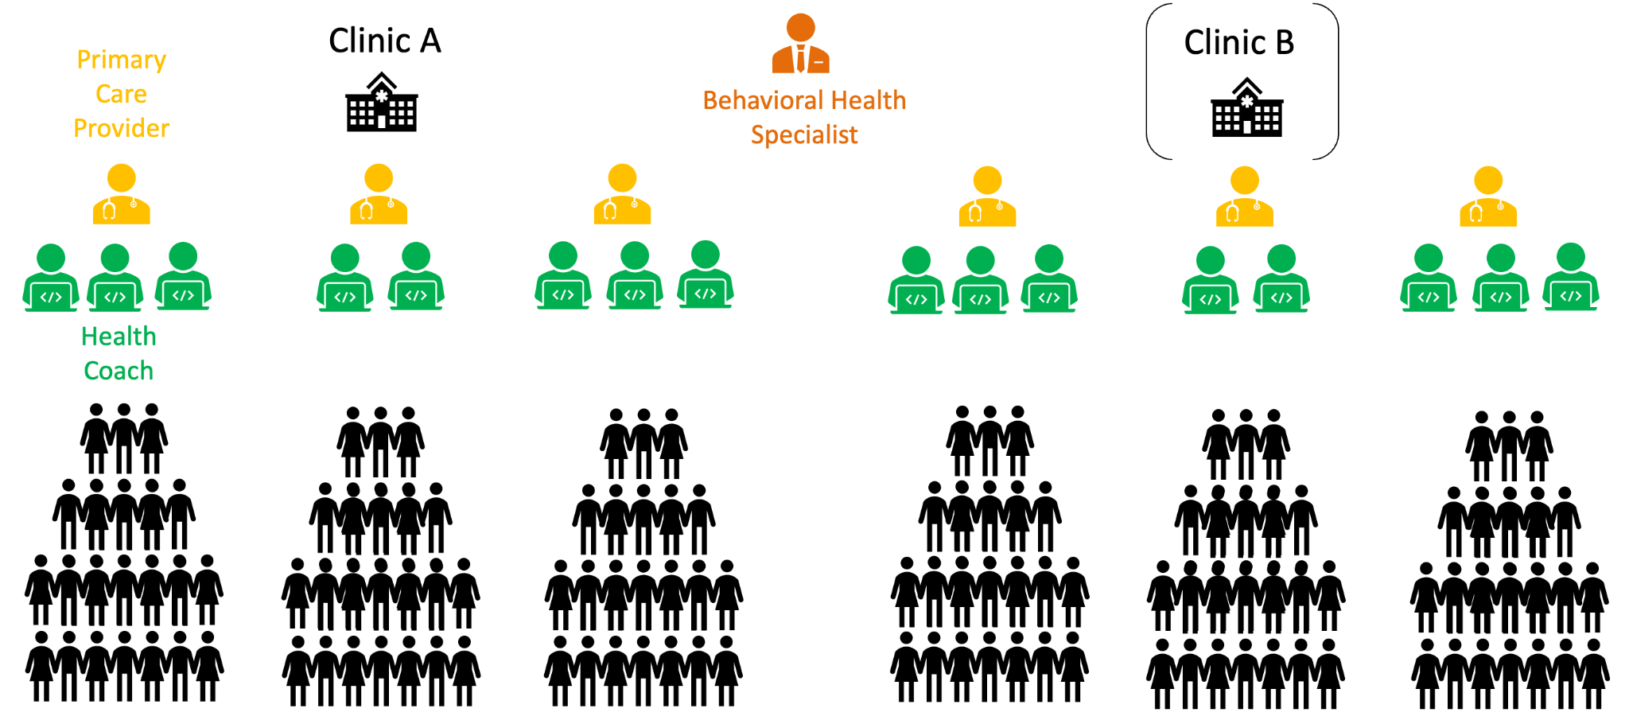
The Care Team
Notes:
Elle
Here’s the challenge, and here’s why population health matters. We have 28 behavioral health specialists and 60,000 patients.
1 BH covers 1-2 clinics; 4-6 PCPs; 2-3 HC per PCP
Being able to impact all of these patients becomes much more feasible via this care enhancer role and the role of BHS as an educator – particularly when we think about 600k or 6m patients
Continuous, cross-functional training
Medical + Nursing
Integrated behavioral health
MoCA administration
Brief action planning, SMART goal setting
Resource navigation
Professional development

Slide 26
Future Directions
How do we scale?
Educating and empowering non-licensed team members [“care enhancers”]
How do we measure impact?
Are we doing what we are setting out to do?
Are we doing it in a way that is equitable?
Is it having the anticipated impact on patient outcomes and cost of care?
How can we continue to innovate?
Striving for health equity
Racial disparities
Social determinants of health
Highest priority: Social isolation + loneliness [“solo seniors”]
Tech literacy and access in the senior population
Building new tools to support and improve upon the work
Notes:
Elle

Slide 27
The Role of Medical Librarians
Champion Integrated Behavioral Health in research and practice
Spread the word and raise awareness
Consider IBH as an integral part of the mission to transform healthcare
Think of us when working on solutions for:
The Mental Health crisis
PCP burnout
Caregiver burnout
Rising healthcare costs
Health disparities
Challenges in Geriatric care
How else? How does this resonate?
Notes:
Elle

Slide 28
Thank You
Notes:
Elle

Slide 29
References
Berenson, R. A., & Rich, E. C. (2010). US approaches to physician payment: the deconstruction of primary care. Journal of general internal medicine, 25(6), 613–618. https://doi.org/10.1007/s11606-010-1295-z
Bodenheimer, T., & Sinsky, C. (2014). From triple to quadruple aim: care of the patient requires care of the provider. Annals of family medicine, 12(6), 573–576. https://doi.org/10.1370/afm.1713
Celli E. Horstman, Sara Federman, and Reginald D. Williams II, “Integrating Primary Care and Behavioral Health to Address the Behavioral Health Crisis” (explainer), Commonwealth Fund, Sept. 15, 2022. https://doi.org/10.26099/eatz-wb65
Dieleman JL, Squires E, Bui AL, et al. Factors Associated With Increases in US Health Care Spending, 1996-2013. JAMA. 2017;318(17):1668–1678. doi:10.1001/jama.2017.15927
Institute for Healthcare Improvement, 2023. IHI.org
Levine DM, Linder JA, Landon BE. Characteristics of Americans With Primary Care and Changes Over Time, 2002-2015. JAMA Intern Med. 2020;180(3):463–466. doi:10.1001/jamainternmed.2019.6282

Slide 30
References
Magill M. K. (2016). Time to Do the Right Thing: End Fee-for-Service for Primary Care. Annals of family medicine, 14(5), 400–401. https://doi.org/10.1370/afm.1977
Nundy S, Cooper LA, Mate KS. The Quintuple Aim for Health Care Improvement: A New Imperative to Advance Health Equity. JAMA. 2022;327(6):521–522. doi:10.1001/jama.2021.25181
Peckham, C. (2016). Medscape physician compensation report 2016. Web site http://www. medscape. com/features/slideshow/compensation/2016/public/overview.
Peter G. Peterson Foundation, 2023. “Why Are Americans Paying More for Healthcare?”. https://www.pgpf.org/blog/2023/01/why-are-americans-paying-more-for-healthcare
Shi L. (2012). The impact of primary care: a focused review. Scientifica, 2012, 432892. https://doi.org/10.6064/2012/432892

