Slide 1
Introduction to
Generative AI Tools
CHRIS GUERRA,
GRANTS CONSULTANT AND STATE DATA COORDINATOR

Slide 2
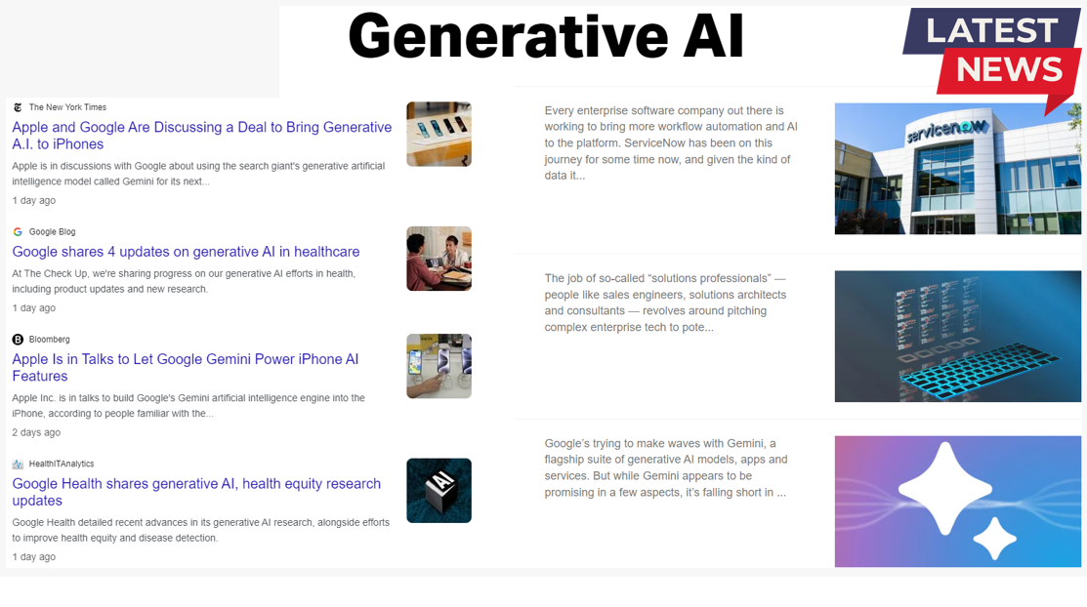
Generative AI

Slide 3
Generative AI
What is the benefit?
What are the risks?
What is the cost?
Is it worth the effort?

Slide 4
Generative AI

Slide 5
Generative AI
Agenda
Foundations of Generative AI
Spotlight on Leading Tools
Generative AI Use-Case Scenarios
Ethical Considerations and Challenges

Slide 6
Foundations of Generative AI

Slide 7
Generative AI

Slide 8
Generative AI

Slide 9
Core Concepts
Generative AI
Machine Learning (ML)
Deep Learning (DL)
Large Language Models (LLM)
Algorithms

Slide 10
Machine Learning (ML)
Machine Learning (ML) is a branch of artificial intelligence (AI) that focuses on creating systems capable of learning and improving from experience without being explicitly programmed for specific tasks.

Slide 11
Deep Learning (DL)
Deep Learning (DL) is a cutting-edge technology within the broader field of artificial intelligence, distinguished by its ability to learn and make decisions by mimicking the way the human brain operates.

Slide 12
Large Language Models (LLM)
Large Language Models (LLMs) are advanced computational systems designed to process, understand, and generate human language in a way that mimics human-like understanding.

Slide 13
Algorithms
Algorithms, in the context of generative AI, are the sets of mathematical instructions or rules designed to enable computers to create content that mimics human-like outputs, such as images, text, music, or even synthetic voices.

Slide 14
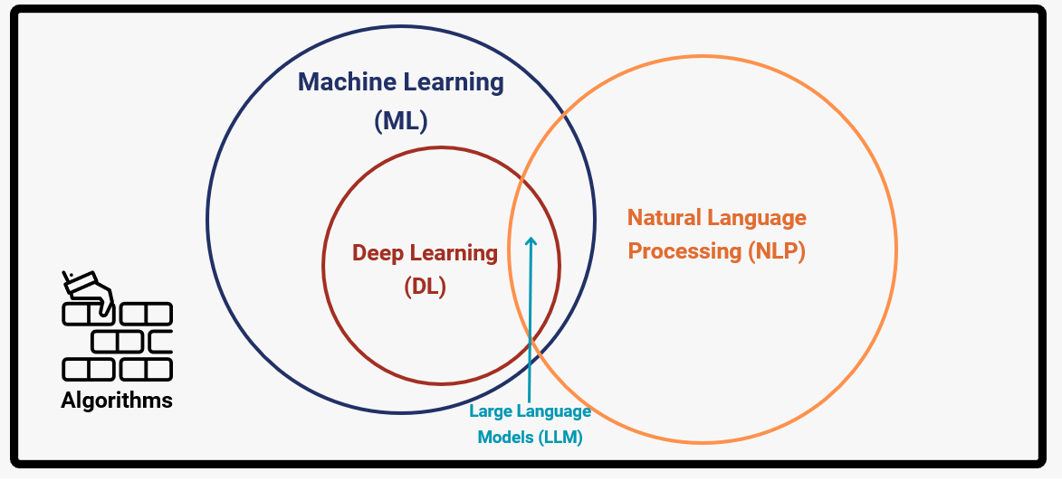
Artificial Intelligence (AI)

Slide 15
Training Data

Slide 16
Common Crawl

Slide 17
Generative Adversarial Networks (GAN)
Generative Adversarial Networks (GANs) operate on the principle of two competing networks – a generator that creates data and a discriminator that evaluates its authenticity – working together to improve the quality of generated outputs.

Slide 18
Variational Autoencoders (VAE)
Variational Autoencoders (VAEs) are based on the principle of encoding inputs into a latent space, and then decoding them to generate new outputs.

Slide 19
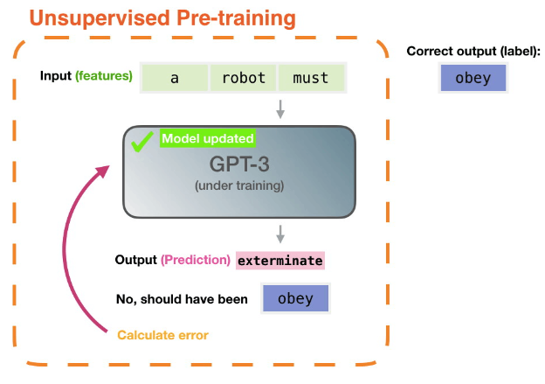
Autoregressive Models
Autoregressive Models -- with one example being Generative Pre-trained Transformers (GPT) -- work by predicting future values in a sequence by learning from previous ones.

Slide 20
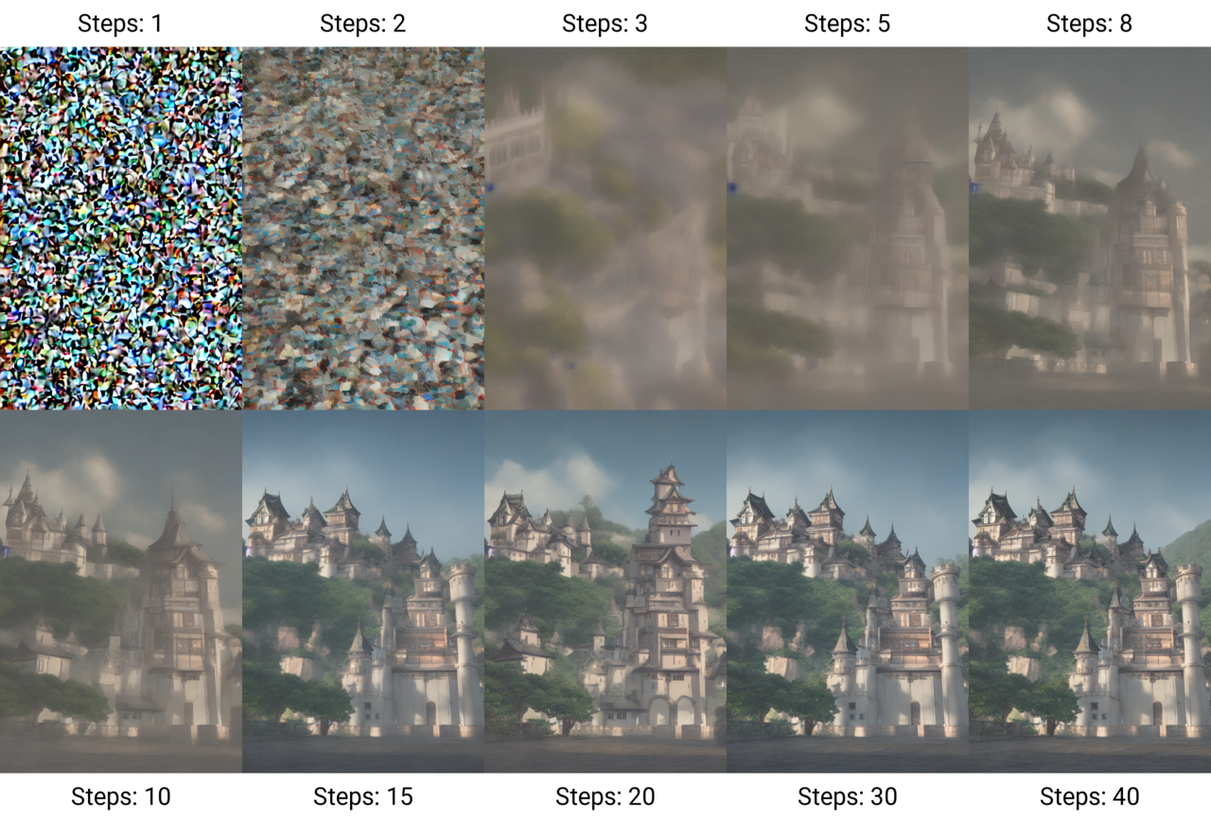
Diffusion Models
Diffusion Models learn to generate data by reversing a diffusion process, that being a process where noise is gradually added to data until it turns into a random noise distribution, and then learning to reverse the process to generate data from noise.

Slide 21
Spotlight on Leading Tools

Slide 22
ChatGPT
November 30, 2022

Slide 23
ChatGPT Screenshot
https://chat.openai.com/

Slide 24
Google Gemini
https://gemini.google.com/app

Slide 25
Text-to-Image
Generative AI

Slide 26
Text-to-Image
Generative AI

Slide 27
Text-to-Image
Generative AI

Slide 28
Stable Diffusion UI

Slide 29
Text-to-Image
Generative AI

Slide 30
Text-to-Image
Generative AI

Slide 31
Generative AI Use-Case Scenarios

Slide 32
Datasets
Generative AI
BioBERT
ClinicalBERT
GPT-3 for Healthcare
BlueBERT
PubMedBERT

Slide 33
Healthcare Use-Case Scenarios
Generative AI
Drug Discovery and Molecular Design - Generative models are being used to design new molecules with desired properties for drug development.
Personalized Medicine and Treatment Plans - By analyzing patient data, generative AI can simulate how different treatments might affect an individual, helping to tailor medical interventions to the patient's unique genetic makeup, lifestyle, and disease state.
Medical Imaging and Diagnosis - Generative AI models are being trained to augment, reconstruct, or generate medical imaging data, as well as to generate synthetic images for training diagnostic models.

Slide 34
Healthcare Use-Case Scenarios
Generative AI
Protein Structure Prediction - AI models are being used to predict the 3D structures of proteins from their amino acid sequences.
Synthetic Data Generation for Research and Training - Generative AI can produce synthetic healthcare data that mimics real patient data, preserving privacy while allowing researchers and healthcare professionals to conduct studies and training without risking patient confidentiality.

Slide 35
Healthcare Use-Case Scenarios
Generative AI
Content Generation for Patient Education and Support - AI can be used to generate personalized educational and support content for patients, including explanations of their conditions, treatment plans, and health management advice.
Enhancing Clinical Decision Support Systems - Generative AI can be used to simulate clinical scenarios based on patient data, assisting in the development of decision support tools that can provide recommendations or predict outcomes of different interventions.

Slide 36
Ethical Considerations and Challenges

Slide 37
Concerns
Generative AI

Slide 38
Concerns for those in Information Sciences
Generative AI
Accuracy and Reliability
Data Privacy and Security
Bias and Ethical Considerations
Misinformation and Content Appropriateness
Dependency and Skill Erosion
Digital Literacy and User Understanding
Intellectual Property and Copyright
Cultural Sensitivity

Slide 39
Final Words
Generative AI

Slide 40
QUESTIONS?

