Slide 1
Transtheoretical Model (TTM)
Address a patient’s stage of change

Slide 2
Discussion points from last module
Where do you already use OARS skills?
Where would these skills fit in to your current patient encounters?
Notes:
[NOTE TO FACILITATOR: If you are completing these modules in an order other than suggested in the facilitation guide, you may need to adjust these discussion points.]

Slide 3
Objectives
By the end of the program, participants will:
Briefly describe the Transtheoretical model and its link to MI

Slide 4
TTM - What is it?
Theory that assumes change progresses over time, with someone going through six stages of change, with different needs based on where they are in the change process^{2,5}
They do not go through these stages linearly², it is more of a cyclical process^{1,4}
Everyone moves through the stages at a different pace⁵

Slide 5
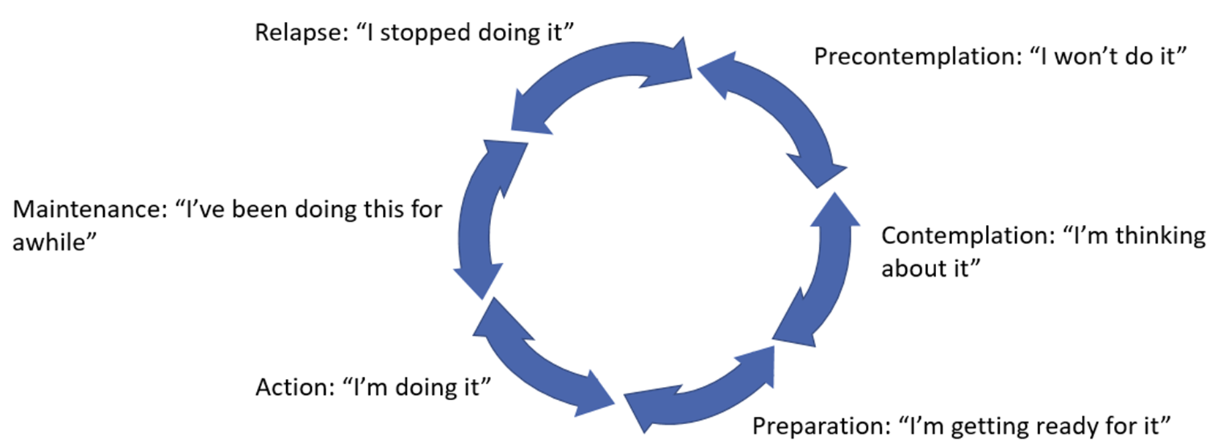
TTM - Cyclical process
Figure 1. adapted from Tuccero, Railey, Briggs & Hull (2016). Behavioral Health in Prevention and Chronic Illness Management, Primary Care: Clinics in Office Practice, 43, 191-102. doi: 10.1016/j.pop.2016.01.006
Notes:
You can see here brief descriptions of the stages of change included in the TTM. We are going to discuss these more in depth as we move forward. As an introduction, precontemplation is when someone isn’t thinking about a behavior or is not interested in changing in the next 6 months^{2,3,4}. Contemplation is when someone is considering change in the next 6 months^{2,3,4}. Preparation is when they are getting ready to make a change, likely within the next month². Action is when they have started engaging in a new behavior², and maintenance is when they have continued the behavior for at least 6 months^{2,3}. This graphic is important to demonstrate that these stages of change are cyclical^{1,4}. This means that someone could, for example, be in preparation but then revert back to contemplation. Or, they could be in action but then revert back to contemplation. Even though relapse is included here, it isn’t a stage itself but when someone is no longer in maintenance and has returned to one of the other stages of change⁸. They could actually return to any of the stages⁸. But, it is included here because later on we will be talking about different MI strategies that relate to relapse.

Slide 6
TTM - Effectiveness and Use
This model was originally developed to work with smokers, but quickly expanded into other health behaviors, including:
Preventive screening⁵
Mental health^{2,5}
Diet^{2,5}
Alcohol use²
HIV/AIDS prevention²
Exercise^{2,5}
Pregnancy prevention^{2,5}
Medication compliance^{2,5}
Over time, researchers worldwide have expanded on and validated this theory^{2,5}
Notes:
The Transtheoretical model has been around since the 1970’s². It was originally developed for the field of psychotherapy² and studied in relation to smoking⁵. The developer, Prochaska, found that the smokers needed different types of support or information at different times, which helped them understand that there were these different stages of change⁵. The theory quickly expanded to other behaviors such as diet, exercise, prevention and others that you see listed here^{2,5}. Over time, researchers across the globe have expanded on and validated the TTM^{2,5}.

Slide 7
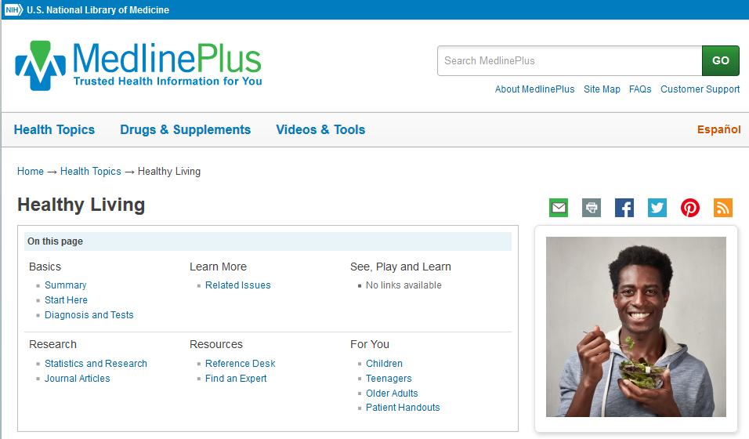
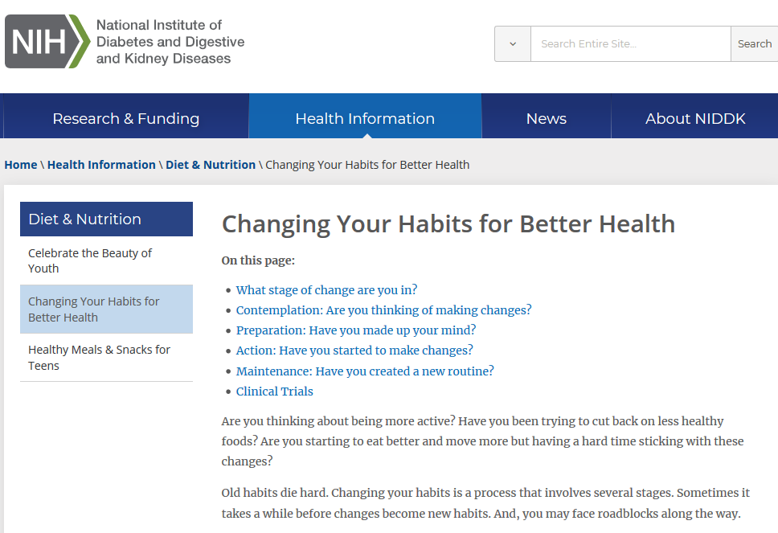
Stages of Change in MedlinePlus
Notes:
If you want to think more about how a patient might fit within the stages of change, this document from the National Institute of Diabetes and Digestive Kidney Disease (NIDDK) outlines characteristics of each stage as they relate to physical activity. It is written for the public, but it can be a good guide for anyone to think about change. This document and others, that can help patients understand the change process, are included on the MedlinePlus topic page, Healthy Living.

Slide 8
TTM - Link to Motivational Interviewing
TTM provides use with a framework for understanding behavior change process^{4,6}
MI is how someone can help another person move through the change process^{4,6}
They are separate entities, but are both patient focused and frequently associated with one another^{3,4}
Notes:
Why are we talking about the TTM as part of our motivational interviewing discussions? These theories are frequently linked together because they are patient focused ways of addressing behavior change^{3,4}. The TTM can be thought of as a framework to help understand where someone is in the change process, and motivational interviewing can be considered the “how”, or the method that can be used to move people from one stage to another^{4,6}.

Slide 9
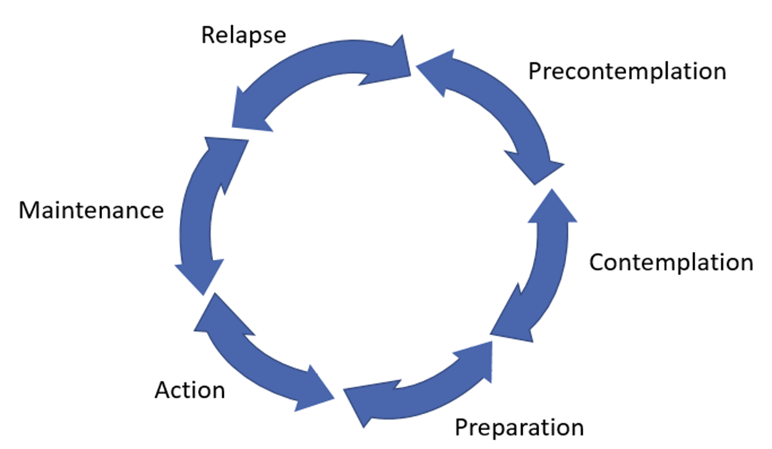
Connecting TTM and MI
Technique
Goal
Description
Stage of Change
Figure 2. Adapted from Tuccero, Railey, Briggs & Hull (2016). Behavioral Health in Prevention and Chronic Illness Management, Primary Care: Clinics in Office Practice, 43, 191-102. doi: 10.1016/j.pop.2016.01.006
Notes:
Each conversation we have moving forward will focus on one stage of the TTM and provide information about the needs of someone in this stage and associated MI goals and techniques that are suggested for someone in this stage.
[NOTE TO FACILITATOR: If you are completing these modules in an order other than suggested in the facilitation guide, you may need to adjust this note.]

Slide 10
Take home message
Consider:
What cues do you currently use to understand your patients’ readiness to change?
How do you try to help them move forward?
Developed resources reported in this presentation are supported by the National Library of Medicine (NLM), National Institutes of Health (NIH) under cooperative agreement number UG4LM012342 with the University of Pittsburgh, Health Sciences Library System. The content is solely the responsibility of the authors and does not necessarily represent the official views of the National Institutes of Health.
Notes:
As we wrap us this discussion about the stages of change, I’d like to know: how do you already recognize the stage of change your patient is in when you discus behavior change? What do you do now to help them move forward?
[NOTE TO FACILITATOR: If you want to complete group discussion immediately following this module content, change the title of this slide to ‘Group Discussion’ and delete the slide with corresponding questions in the next module. If you would like to have discussion take place using your internal LMS system, you can include instructions here for how participants can participate. Then, adjust the slide with the corresponding questions in the next module as needed.]

Slide 11
References
Tuccero, Railey, Briggs & Hull (2016). Behavioral Health in Prevention and Chronic Illness Management, Primary Care: Clinics in Office Practice, 43, 191-102. doi: 10.1016/j.pop.2016.01.006
Glanz, K., Rimer, B. & Viswanath, K. (Eds.). (2015). Health Behavior: theory, research and practice. San Francisco: Jossey-Bass.
Constance, A. & Sauter, C. (2011). Inspiring and Supporting Behavior Change. United States: American Dietetic Association.
Gold, M., Kelly, T., Douihy, A. (2015). Motivational Interviewing : A Guide for Medical Trainees. New York: Oxford University Press.
Prochaska, J. (1997). The Transtheoretical Model of Health Behavior Change. American Journal of Public Health, 12(1), 38-48.
Britt, E., Hudson, S. & Blampied, N. (2003). Motivational Interviewing in Health Settings: A Review, 53, 147-155.

