Slide 1
Mental Health in the Workplace
Network of the National Library of Medicine
Tiffany N. Chavis, MSW, MLIS
January 15, 2025

Slide 2
What will we cover today?
1. Surgeon General’s recommendations for improving mental health and well-being at work.
2. SAHMSA’s Creating A Healthier Life: A Step-By-Step Guide To Wellness for Individuals.
3. NLM, NIH, and other organizations related to mental health and well-being.

Slide 3
Did you know?
81%
of workers reported that they will be looking for workplaces that support mental health in the future.
Source: APA’s 2022 Work and Well-being Survey results
84%
of respondents said their workplace conditions had contributed to at least one mental health challenge.
Source: Mind Share Partners’ 2021 Mental Health at Work Report

Slide 4
Compassion Fatigue
Compassion fatigue is a broadly defined concept that can include emotional, physical, and spiritual distress in those providing care to another. It is associated with caregiving where people or animals are experiencing significant emotional or physical pain and suffering.”
Source: Compassion Fatigue Awareness Project

Slide 5
Emotional Labor
Publicly displaying certain emotions while hiding others
Source: On the costs and benefits of emotional labor: A meta-analysis of three decades of research.

Slide 6
Burnout
Burn-out is a syndrome conceptualized as resulting from chronic workplace stress that has not been successfully managed. Three dimensions characterize it:
feelings of energy depletion or exhaustion
increased mental distance from one’s job
feelings of negativism or cynicism related to one's job
a sense of ineffectiveness and lack of accomplishment
Source: World Health Organization, 2019

Slide 7
Causes of Burn out
1. Workload exceeds capacity
2. Lack of control, lack of autonomy
3. Rewards do not match the effort
4. Supportive community/team
5. Lack of fair and equitable treatment
6. Mismatch of personal and organizational values

Slide 8
Benefits of Improving Mental Health at Work

Slide 9
How do you think mental health impacts the library?

Slide 10
Surgeon General’s recommendations
Protection from harm
Connection & Community
Work-Life harmony
Mattering at Work
Opportunity for Growth

Slide 11
Protection from Harm
Human Needs:
Safety is protecting all workers from physical and non-physical harm, including injury, illness, discrimination, bullying, and harassment.
Security is ensuring all workers feel secure financially and in their job future.

Slide 12
Protection from Harm - Key Components
Prioritize workplace physical and psychological safety
Enable adequate rest
Normalize and support mental health
Operationalize DEIA* norms, policies, and programs

Slide 13
Connection and Community
Human Needs:
Social Support is having networks and relationships that can offer physical and psychological help and can mitigate feelings of loneliness and isolation.
Belonging is the feeling of being an accepted member of a group.

Slide 14
Connection & Community - Key Components
Create cultures of inclusion and belonging
Cultivate trusted relationships
Foster collaboration and teamwork

Slide 15
Work-Life Harmony
Human Needs:
Autonomy is how much control a worker has over when, where, and how they do their work.
Flexibility is the ability of workers to work when and where is best for them.

Slide 16
Work-Life Harmony - Key Components
Provide more autonomy over how work is done
Make schedules as flexible and predictable as possible
Increase access to paid leave
Respect boundaries between work and non-work time

Slide 17
Mattering at Work
Human Needs:
Dignity is the sense of being respected and valued.
Meaning in the workplace can refer to the sense of broader purpose and significance of one’s work.

Slide 18
Mattering at Work - Key Components
Provide a living wage
Engage workers in workplace decisions
build a culture of gratitude and recognition
Connect individual work with organizational mission

Slide 19
Opportunity for Growth
Human Needs:
Learning is the process of acquiring new skills and knowledge in the workplace.
Accomplishment is the outcome of meeting goals and having an impact.

Slide 20
Opportunity for Growth - Key Components
Offer quality training, education, and mentoring
Foster clear, equitable pathways for career
advancement
Ensure relevant, reciprocal feedback

Slide 21
Steps to create a healthier life at work

Slide 22
Creating A Healthier Life: A Step-By-Step Guide To Wellness
Each person has their own unique path towards becoming healthier
Every aspect of wellness relates directly to the quality of a person’s life
Being healthier can happen at a person’s own pace, in their own time and within their own abilities

Slide 23
The Eight Dimensions of Wellness
Emotional
Spiritual
Intellectual
Physical
Environmental
Financial
Occupational
Social
Adapted from: A Wellness Approach

Slide 24
Improving physical wellness
Nutrition
Physical activity
Sleep
Alcohol, tobacco, and other drugs
Medication Safety
Preventive Medicine

Slide 25
Improving intellectual wellness
Personal Interests
Education
Brain Exercise
Conversation

Slide 26
Improving financial wellness
Work/Income
Checking/Savings accounts
Debt
Retirement/Other accounts

Slide 27
Improving environmental wellness
Green living
Change of scenery
Home and work environment

Slide 28
Improving spiritual wellness
Beliefs
Involvement
Time

Slide 29
Improving social wellness
Community
New People
Social Time

Slide 30
Improving occupational wellness
Work relationships
Balance
Accomplishment

Slide 31
Improving emotional wellness
Feelings/emotions
Self-care
Stress

Slide 32
Resources to support mental health and well-being

Slide 33
MedlinePlus.gov
https://medlineplus.gov/

Slide 34
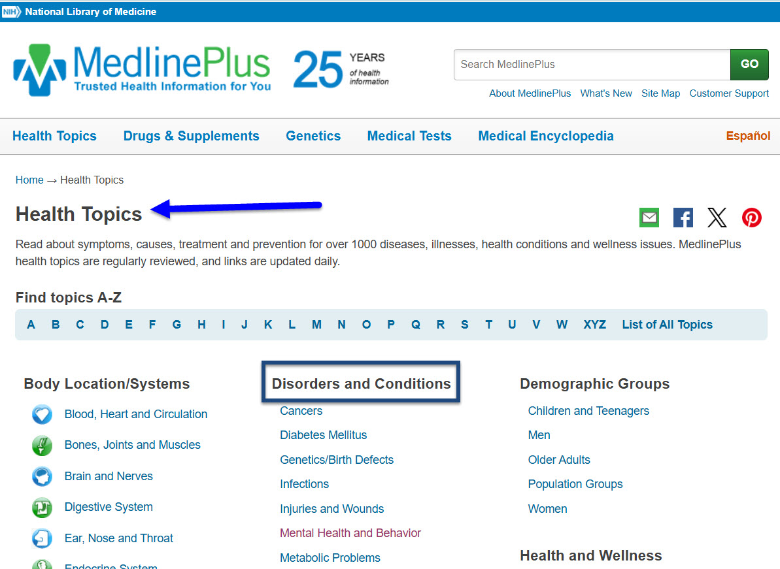
MedlinePlus.gov Website
https://medlineplus.gov/
Notes:
Look under the disorders and conditions section to find information about:
Mental Health and Behavior
Environmental Health
Look under the health and wellness section to find information about:
Fitness and Exercise
Food and Nutrition
Personal Health Issues
Social/Family Issues
Wellness and Lifestyle
Click on Mental Health and Behavior to see a sample of content in these sections.
Scroll down to the link How to Improve Mental Health to explore this topic further.
An alternate way to access this content is to look at the top of the page for the Site Map link.
However you search, MedlinePlus is a free and trusted source for health information.

Slide 35
Suicide prevention number 998
Lifeline provides 24/7, free, and confidential support for people in distress, prevention and crisis resources for you or your loved ones, and best practices for professionals in the United States.

Slide 36
Tiffany N. Chavis, MSW, MLIS Outreach and Education Librarian, Region 1 Network of the National Library of Medicine Health Sciences and Human Services Library University of Maryland, Baltimore tchavis@hshsl.umaryland.edu
THANK YOU!

