Slide 1
Creating Data Management Plans with DMPTool

Slide 2
About us
National Institutes of Health
Nation’s research agency
27 institutes and offices
NIH
National Library of Medicine
World’s largest biomedical library
NLM
Network of the National
Library of Medicine
7 Regional Libraries (RMLs) and 3 offices
NNLM
YOUR REGION
YOUR RESPECTIVE STATES
NNLM Region 2 and 3
Notes:
**Update your region and states in the slide (in red) and in the text below (bold).**
Before we get into our class today, a word about who we are!
Though you may be familiar with some of these acronyms, most people are a little confused about who we are.
The National Institutes of Health is the nation’s leading medical research agency an the National Library of Medicine is one of their 27 institutes and offices.
NNLM is the Network of the National Library of Medicine and is an outreach program of NLM. The NNLM is made up of 7 geographic regions. We are from [Insert Your Region], which serves [Your States], and our office is located at [Your Location].

Slide 3
Overview
Why is data management important?
What is a data management plan?
The DMPTool
Notes:
Today we will be going over the following objectives.
Why is data management important?
What is a data management plan exactly?
And we will finish with information on The DMPTool and do a walkthrough of creating an account and create a practice plan.
Today’s content is meant to be an introduction to the topic.

Slide 4
Why is data management important?
Notes:
Let’s begin by looking at what data management is and why it’s important.

Slide 5
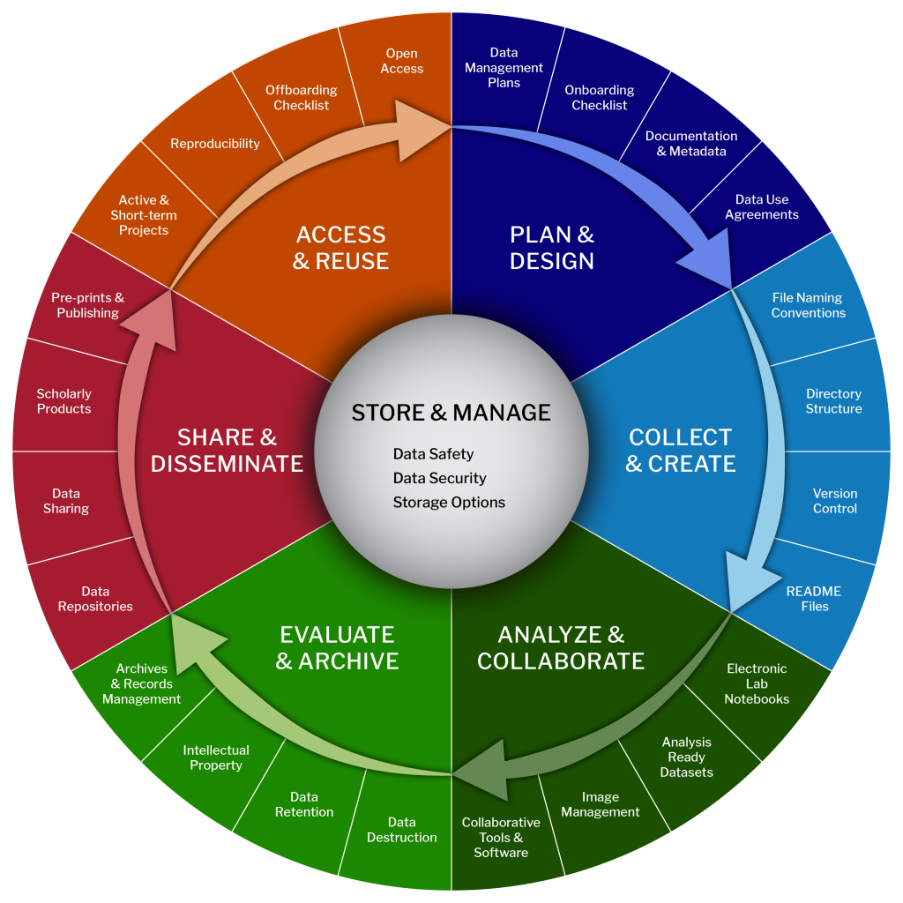
The Research Data Lifecycle
Plan
Collect
Analyze
Archive
Share
Reuse
Notes:
The data lifecycle and the research lifecycle go hand in hand. Any step that involves creating, analyzing or handling the data, then data needs to be managed somehow. Data projects start with planning what data you need, how you’ll get it. Then you collect and analyze that data. This include version control, managing file names and safe, ethical collection methods. You’ll need processes for how data is archived and stored, manage back ups. Lastly you have share and reuse. You have to manage data if you want to possibly reuse it or find a say to share it. Even after a project is done, you may need to keep the data for a period of time.
https://datamanagement.hms.harvard.edu/

Slide 6
Why is Data Management Important?
Reproducibility
Transparency
Data Sharing
Data Reuse
Notes:
So why is data management important?
In short, it’s just good practice. Imagine a file cabinet with labels and an organization system, versus a lopsided stack of unlabeled papers. Which would you rather have? The larger the research project, the more people involved, the longer the project goes on, the more data you create, the more you need good data management practices. Even on smaller, short term projects, keeping well managed data can build those skills and save time and headaches in the long run.
Well managed data aids in reproducibility and transparency. It’s easier for researcher to understand how a research project went and recreate it with well managed data.
Data that’s well organized, labeled, and adequately stored and is easier to reuse or share with other researchers.

Slide 7
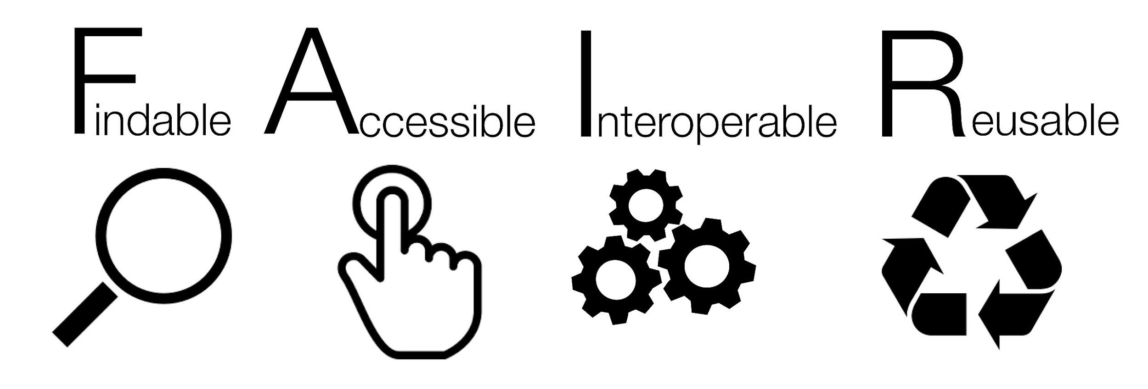
FAIR Principles
Notes:
There is no solid, one size fits all for good data management practices. It various across fields and institutions. The FAIR Principles help offer some clarity. Go FAIR states their principles “emphasize machine-actionability (i.e., the capacity of computational systems to find, access, interoperate, and reuse data with none or minimal human intervention).”
Findable — Can others find the dataset? That includes a persistent, unique identifier, rich metadata and metadata is indexed in a searchable resource or repository somewhere.
Accessible — Is it clear how to access the data? Contact information, authentication or authorization steps, even if the data isn’t available, is the metadata so people know the data set exists.
Interoperable — Can the data work with other applications or tools. Is it proprietary or open source format?
Reusable — Is the data well described? Does it meet domain-relevant, community standards? Is the data licensed for reuse?
Some of these are easier to address than others, but it gives you some points to consider.
https://www.go-fair.org/fair-principles/
Reference:
Wilkinson, M. D. et al. The FAIR Guiding Principles for scientific data management and stewardship. Sci. Data 3:160018 doi: 10.1038/sdata.2016.18 (2016).

Slide 8
Data Management and Sharing Mandates
Journals — PLOS, Nature, JDAP partners
Funders — NSF, NIH
NIH policy for data management and sharing that will go into effect in January 2023
Notes:
Data management is also important because often times it’s required. In order to publish in many science research journals, you will need to also deposit and publish your data. So if publishing is a priority, it is essential to think through how you will manage your data.
Journals like PLOS, Nature require that a paper’s supporting data is archived in an appropriate public archive, such as Dryad and Figshare. Other journals like JAMA, Blood and NEJM ask for statements on how data will be shared.
I’ll focus on the new NIH policy today, but many funders have data planning and data sharing mandates. The NIH announced a new policy for data management and sharing that goes into effect in January 2023. The new policy applies to all research funded or conducted by NIH that results in the generation of scientific data. As we do the walkthrough of the DMPTool, I’ll talk some more about what the NIH is requiring.
https://grants.nih.gov/grants/guide/notice-files/NOT-OD-21-013.html

Slide 9
Why Prepare a DMP?
Saves time
Increases research efficiency
Satisfies funder requirements
Makes reproducibility & sharing easier
Notes:
So why prepare a DMP or data management plan? As you’ve probably guessed by now, there’s quite a bit that goes into data management. It’s an important part of research. It’s easy to get busy, or get pulled onto another project, so having a well laid-out plan avoids confusion as researchers move on or off a project. Taking some time to plan at the beginning will save time and effort of piecemealing something together halfway through.
More funders and journals require it, so it’s better to get ahead of the curve and prepare for it. And again, it’s good practice and helps with reproducibility and sharing.

Slide 10
2. What is a data management plan?
Notes:
So now we know why it is important to manage data, what goes into a data management plan?

Slide 11
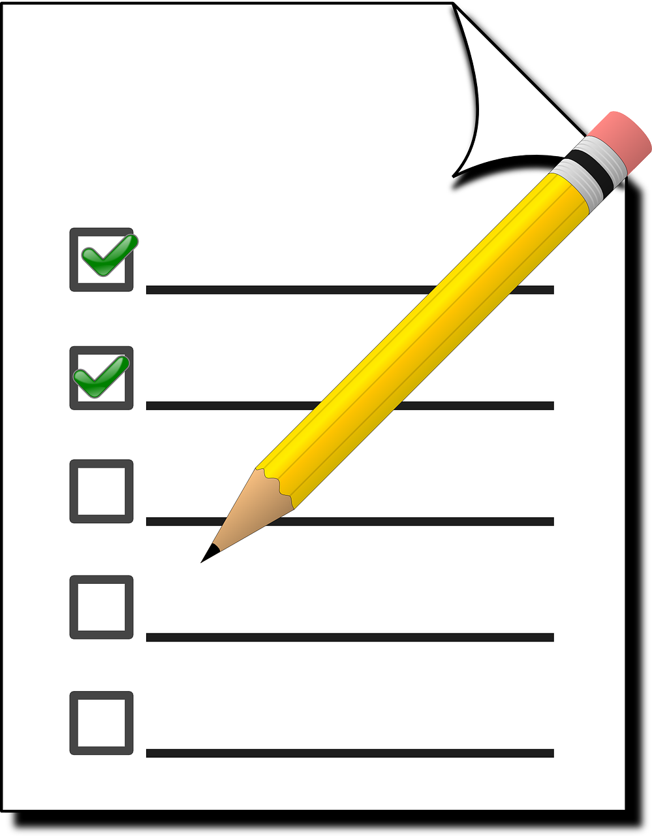
What is a Data Management Plan?
A document that describes what you will do with your data
during your research
and after you complete your project
Notes:
A data management plan is a document that describes what data you will collect or create, procedures for handling data (this also include contingencies for emergencies or disasters) and what will happen to the data after you complete your project. Writing a data management plan will help you think through these things.

Slide 12
A DMP is a living document
Keep your plan current
Incorporate changes
Use as a guide for daily activities
Notes:
Researchers may leave or be brought on to the project. University policies may change. You may find a better way of doing things. Your data plan isn’t stagnant. It’s a living document that can and should be updated as you go along. It’s meant to help you stay on track and organized as you go through research projects.

Slide 13
Where to start
Small & Simple
Document what you know now
Share the plan with your team
Avoid procrastination and immobilization
Notes:
Start with what you know. Maybe you already know what kind of file or format you will be using. Maybe you already have a procedure for saving and backing up research files. Think back to the FAIR principles. Are there any easy fixes to make your data more findable, accessible, interoperable, or reusable?
You’ll want to share the plan with your team. It’s important everyone is one same page. The data plan can help make sure everyone knows procedures and best practices are for the project. We all like to think we will remember all these small details, but that’s rarely how it works out in real life.
Data plans be daunting, but again this is a living, changeable document. Start with what you know and go from there.

Slide 14
Components of a Basic DMP
Types of data
Data & metadata standards
Policies
Plans for preservation and sharing
Budget
14
Notes:
Here are some basic components of a data management plan. And I will touch a little on each of these.
https://cde.nlm.nih.gov/home
https://datacurationnetwork.org/

Slide 15
1. Types of Data
Types of data produced
Relationship to existing data
How/when/where will the data be captured or created?
How will the data be processed?
Quality assurance & quality control measures
Security: version control, backing up
Who will be responsible for data management during/after project?
Notes:
What types of data you will collect? Is this a spreadsheet, video, images? Is this going to be in an open source format? A csv or txt file rather than a Microsoft file. You also need to consider version control and procedures for cleaning data. How often do you need to have your data backed up?
Some of these we don’t think about until we need them, but you can see how having a clear plan outlined ahead of time saves time and avoids confusion or mishaps.

Slide 16
2. Data & Metadata Standards
What metadata are needed to make the data meaningful?
How will you create or capture these metadata?
Why have you chosen particular standards and approaches for metadata?
Notes:
The NIH Common Data Elements Repository is a great resource for creating standardized data elements. The Data Curation Network has resources on creating meaningful metadata to make your data more findable. You also need to look at industry or domain standards you might want to follow.

Slide 17
3.Policies for access, sharing, reuse
Are you under any obligation to share data?
How, when, & where will you make the data available?
What are the copyright and licensing considerations?
Are permission restrictions necessary for ethical or privacy concerns?
Embargo periods for political/commercial/patent reasons?
How should your data be cited?
Notes:
For policies — are there any institutional policies you need to be following? Privacy policies? Tribal or federal considerations? What about embargos or copyright considerations?
When thinking about access and sharing, libraries can really help here. Libraries can offer guidance on finding general or domain specific repositories. We can offer guidance on licensing options and data citations.

Slide 18
4. Plans for archiving & preservation
Where and what data will be preserved for the long term? For how long?
Are the files saved in an open source format (.csv, .txt)?
What metadata will be submitted with the datasets?
Who will be responsible for preparing data for preservation?
Who will be the main contact person for the archived data?
Notes:
For preservation — think about how long you may need to preserve your data. A few years? A few decades? How large are the data files? There are often limits for how much or how long data can be stored somewhere. It’s not infinite.
It’s also important to decide a point of contact. If someone has questions, who should they contact?

Slide 19
5. Budget
Costs of data preparation & documentation
Hardware, software
Personnel
Repository fees
How costs will be paid
Request funding!
Notes:
Of course this stuff isn’t free. Data management takes money too, so include those costs in your grant. Personnel, hardware, storage costs can be included in to your grant proposal too.

Slide 20
NIH Data Management and Sharing Policy:
New policy goes into effect on January 25, 2023
Requires Data Management and Sharing Plan (DMP) for all NIH grants producing data
Extramural grants, contracts, Intramural research projects
All other NIH funding mechanisms
DMPs outline key procedures for the management and sharing of research data
DMPs will not be scored but will be part of review
Notes:
The updated NIH Data Management and Sharing Policy goes into effect on January 25, 2023.
https://sharing.nih.gov/data-management-and-sharing-policy
The new policy requires all grants producing data to create and adhere to a Data Management and Sharing Plan. DMPs will detail procedures for managing and sharing data, and they will be part of the review but will not be scored in the grant review process. If researchers produce data but don’t create or adhere to their plans, they will be ineligible for NIH funding.

Slide 21
Elements of a Data Sharing Plan (2023)
Data type
Related tools, software, and/or code
Data standards
Data preservation, access, and associated timelines
Access, distribution, or reuse considerations
Oversight of data management and sharing
Reference: U.S. Department of Health and Human Services, National Institutes of Health. (2020). Supplemental Information to the NIH Policy for Data Management and Sharing: Elements of an NIH Data Management and Sharing Plan (NIH Notice No. NOT-OD-21-014). Retrieved from https://grants.nih.gov/grants/guide/notice-files/NOT-OD-21-014.html

Slide 22
3. The DMPTool
Notes:
Now, before we dive into the DMPTool demo, I would like to pause to see what questions you have.

Slide 23
DMPTool
Online application from the UC libraries that helps researchers create data management plans.
Provides a click-through wizard for creating a DMP that complies with funder requirements.
Used by many institutions, including Harvard, Johns Hopkins, UPenn, Stanford, and many others.
Current community focus is on the new NIH DMSP Policy
DMPTool. https://dmptool.org/
Notes:
Here is some background and context for the DMPTool.

Slide 24
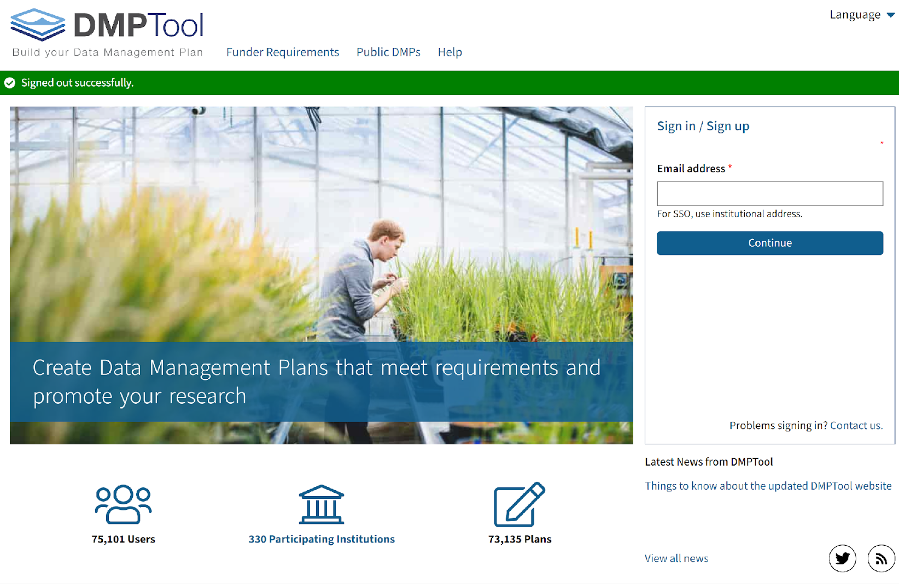
DMPTool.org
Notes:
DMPTool is a free resource that helps researchers create data management plans. I’ll show you how to create a practice plan. You are welcome to follow along at dmptool.org.
https://dmptool.org/

Slide 25
DMP tool help section
Funder Requirements
Public plans
Data management resources
Notes:
Before we get started I want to point out some of the resources and helpful tools that the DMPTool has available.
The funder requirements has details about funder mandates and links to their website and several templates to help you get started.
Public plans have example data management plans from other researchers.
Under Help you can find resources for researchers, administration, data management guidance.

Slide 26
Make a new DMP Tool account
Sign in or Sign up
Find your institution (if applicable)
Notes:
To get started, you’ll want to sign in or sign up for a new account. If you’re creating an account, type in you institution’s name. If your institution isn’t affiliated, don’t worry. You can still set up a free account and create data management plans.

Slide 27
DMP Tool Create a Plan on Dashboard
Create a plan
Notes:
Once your profile is set up, you can get started on your dashboard and create a data management plan. If your institution is affiliated, you might be able to see plans shared by other researchers at your organization. These might be worth looking through to get some ideas and help you shape your plan.
On the left hand side of the page, we are going click to Create Plan.

Slide 28
Create a new plan instructions
Check box below
for practice plans
Enter project title
Select research organization
Select funder
(If a funder has multiple templates) Select template
Notes:
To create a practice plan, select the small box on the right. Then fill out the rest. If you are just doing a practice run, you can title it Test or Practice.
Today we are using a an NIH grant as an example. For the primary funding organization I selected National Institute of Health. They have a couple templates to choose from, but I picked NIH-GEN DMSP which will guide me through the NIH data sharing requirements going into effect in 2023.

Slide 29
Add Collaborators
Invite collaborators to coauthor the plan
Select Roles
Notes:
The next page has you add any collaborators. You can add people from other institutions if you like. You can also control their level of permissions, whether they are a project administrator, investigator, or data manager.
Some institutions have the option of requesting feedback from a designated person, such as a research or data librarian. Even if that’s not an option, you can always send a copy of your plan to them to ask for feedback from a mentor or expert on campus.

Slide 30
Write a plan
Notes:
Now it gets into the heart of things. The Write Plan section is where you’ll begin writing your actual data management plan. This part is the longest, but don’t get discouraged, DMPTool provides guidance along the way. Questions are broken into separate sections helping researchers consider everything from how the data will be accessed, what software or code will be used, if there are any restrictions on the use or sharing of the data, and what financial support they may need to do any of those things.

Slide 31
Leave comments for collaborators
Leave comments for collaborators
Notes:
Under the “Write Plan” section, you have an opportunity to leave comments for grant collaborators.

Slide 32
Get Guidance on left
Get guidance on the questions the funder will ask you to address
Notes:
Each question will have some guidance along the left. There is guidance from both NIH and DMPTool to help answer these questions. It can’t really tell you what to do, but it can tell you what your options are and what factors to consider. So for the question “Briefly describe the scientific data to be managed, preserved, and shared,” the guidance tells you to note things like file formats and why you choose that format.

Slide 33
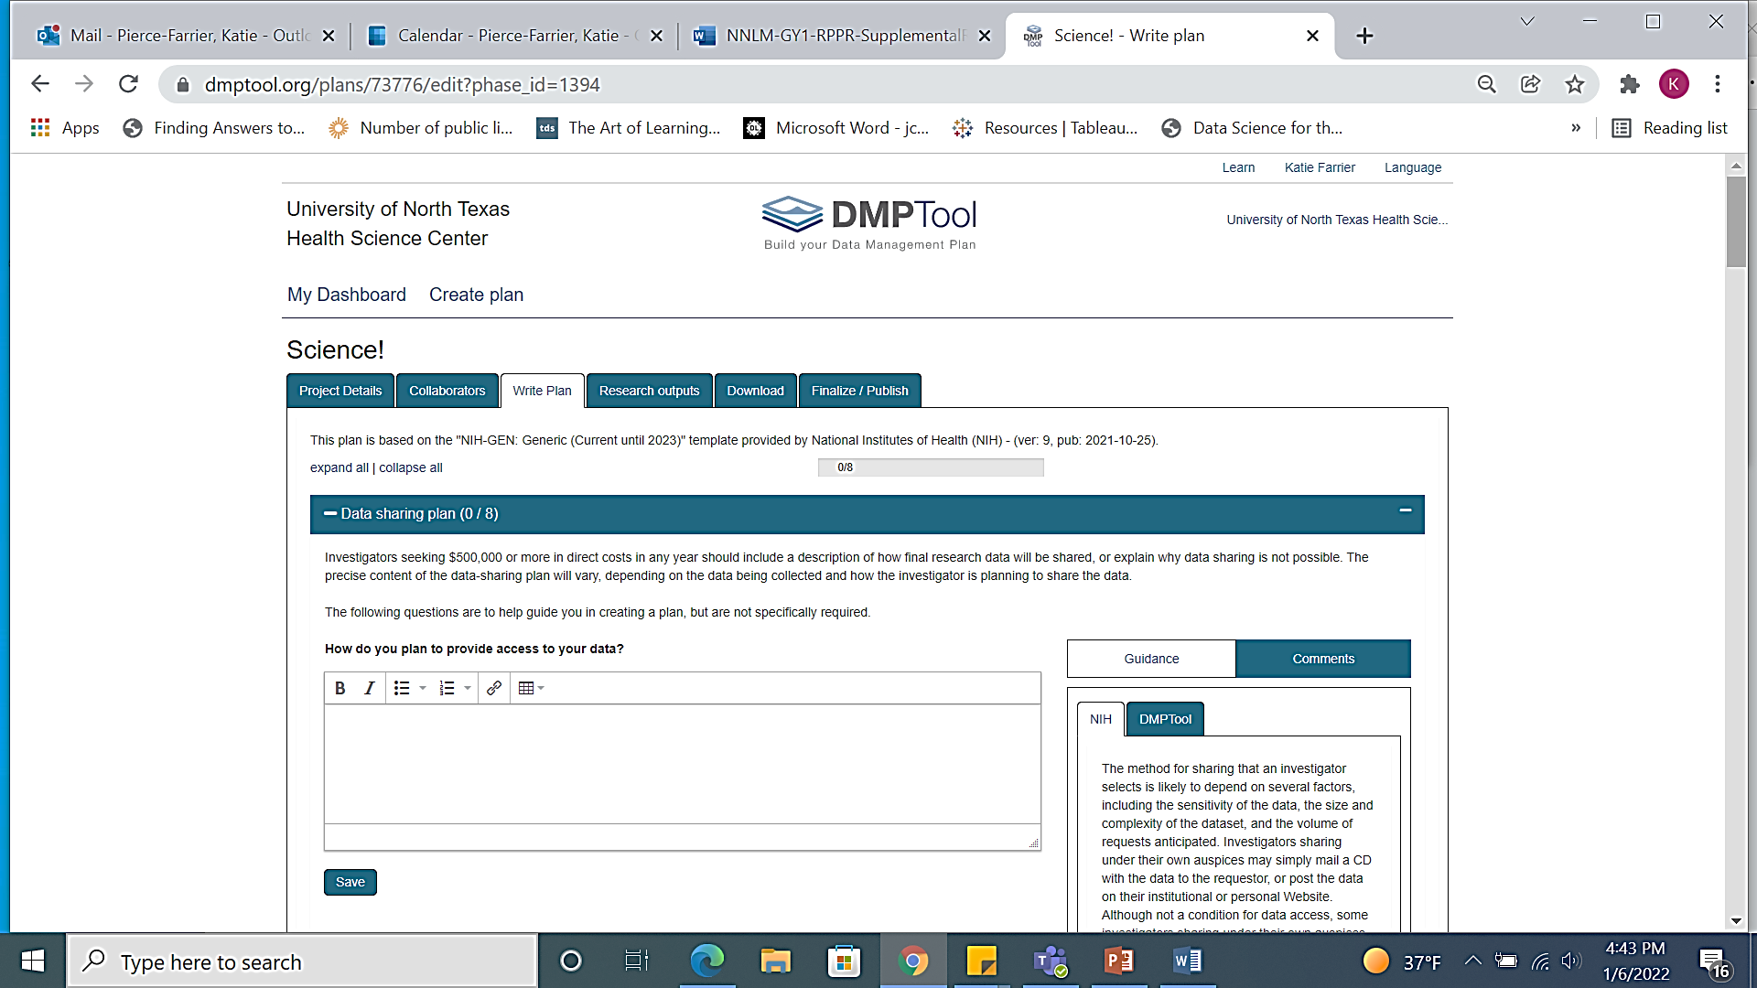
Write your plan
Leave comments for collaborators
Get guidance on the questions the funder will ask you to address
Notes:
The Write Plan section is where you’ll begin writing your actual data management plan. Each box will have some guidance along the left. Earlier, when we looked at options to Select Guidance. Right now I have guidance from both NIH and DMPTool turned on to help me answer these questions. You can go back and select your institution or others and see what their guidance is for each section. It can’t really tell you what to do, but it can tell you your options are and what factors to consider.

Slide 34
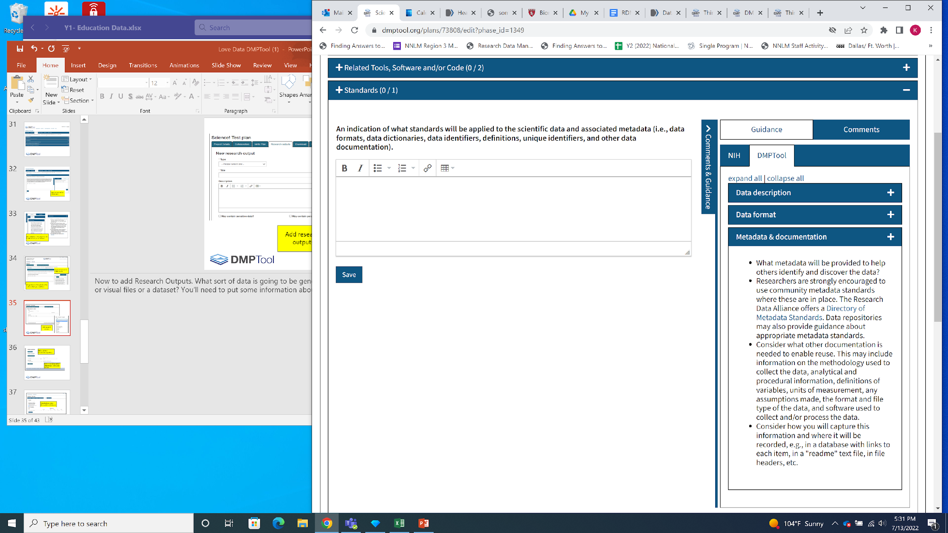
Apply Standards from Guidance
Standards: i.e., data formats, data dictionaries, data identifiers, definitions, unique identifiers, and other data documentation
Notes:
To give you another example. This section asks what standards will be applied. Follow the guidance along the side to make sure you are outlining the necessary information. Here is where you would put information about metadata standards and common data elements you might be using.

Slide 35
Add research outputs
Add research outputs
Privacy or PHI?
Where will data be shared?
Note release date and intended license.
Notes:
Now to add Research Outputs. What will be the sort of end product of this research? Is it private health information? Notate the repositories data will be shared too and under what license.
NIH has a great site on data sharing. There is a list of repositories and tips for how to select the best one for your data.
https://sharing.nih.gov/data-management-and-sharing-policy/sharing-scientific-data/selecting-a-data-repository
https://choosealicense.com/

Slide 36
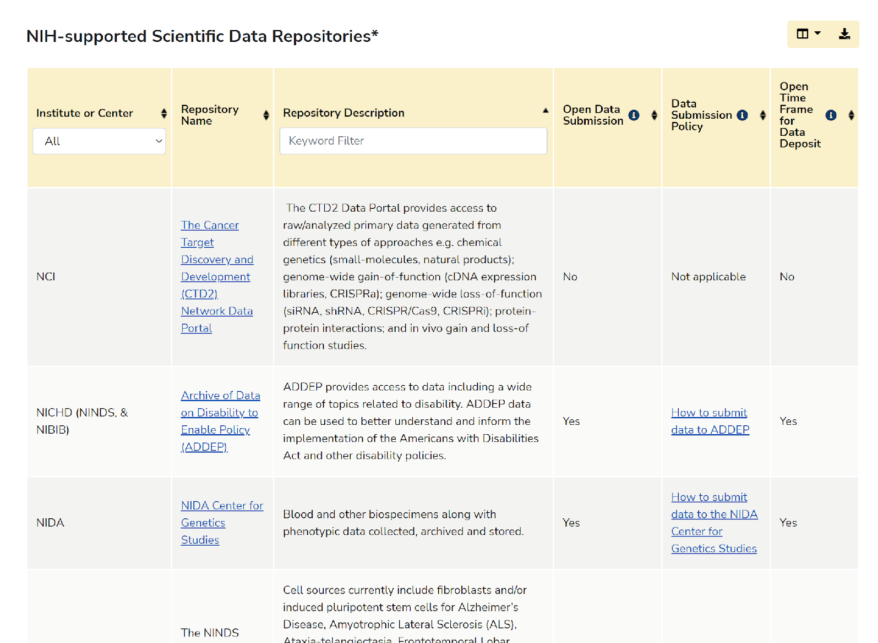
Find NIH-supported Scientific Data Repositories
Notes:
This chart is from the NIH Scientific Data Sharing website and it shows NIH-supported Scientific Data Repositories:
https://sharing.nih.gov/data-management-and-sharing-policy/sharing-scientific-data/repositories-for-sharing-scientific-data
As you can see, each entry shows who owns the repository, a description, and other factors.

Slide 37
Download a copy of your plan
Download your plan
(docx, pdf, txt, html, csv)
Notes:
Alright! We are almost there! We have our plan written. We have shared it and gotten feedback. Now you can download a copy as a pdf, txt, html, or csv file to put with your grant application or keep for your records. We talked about a data management plan being a living document. DMPTool allows you to come back and edit and share this as needed.

Slide 38
Share your plan
Share your plan publicly or within your institution (optional)
Notes:
And last but not least, you can decide if you want to share your plan. Maybe you are now a data management plan wiz and want people at your institution to be able to look at your plan as an example, or maybe you would just like to share your process. You don’t have to, but the option is available. Your data management practice plan is now completed!

Slide 39
blog.dmptool.org
Notes:
Here is one more resource before we wrap up. DMPTool has a blog that you can look through for data planning information in general.
https://blog.dmptool.org/

Slide 40
References
If you would like a copy of this slide deck or have additional questions, email nnlm-ncds@nyulangone.org.
Slides were adapted from DMPTool Generic Slide deck from https://dmptool.org/promote
Notes:
A copy of these slides are available online. Feel free to email for a copy of them. These slides were adapted from DMPTool’s promotion tools. You can find the generic slides on DMPTool’s website.

