Slide 1
Greatest Crimes in Statistics
Marieke Jones, PhD
Senior Biostatistician, University of Virginia

Slide 2
Estimate of studies that cannot be replicated
75-90%
of preclinical results cannot be replicated (estimate)
Begley CG, Ioannidis JP (2015) Reproducibility in Science: Improving the standard for basic and preclinical research. Circ Res 116: 116-126. pmid:25552691

Slide 3
Costs to biomedical industry, per year, in US alone
$28 billion
Freedman LP, Cockburn IM, Simcoe TS (2015) The Economics of Reproducibility in Preclinical Research. PLoS Biol 13(6): e1002165. DOI: 10.1371/journal.pbio.1002165

Slide 4
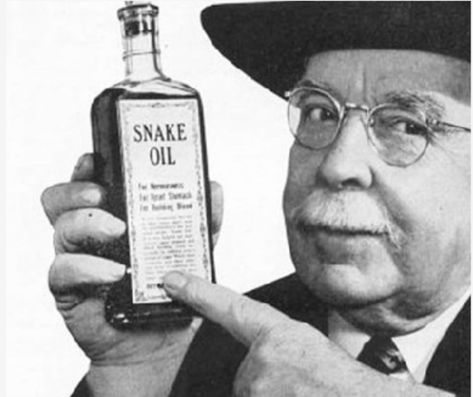
Science is facing a credibility crisis

Slide 5
What are the problems?

Slide 6
What factors could boost reproducibility?
Baker M (2016) 1,500 scientists lift the lid on reproducibility: Survey sheds light on the ‘crisis’ rocking research. Nature 533, 452–454. doi:10.1038/533452a

Slide 7
Questions for learners:
How do researchers learn to carry out correct statistical analyses?
At your institution, how do researchers get help on data analyses?

Slide 8
Today we’ll tackle:
Data Viz
P-hacking
Reporting Results
Pseudoreplication
For a deeper dive into statistics, please see the self-paced NNLM NCDS course “Understand the Methods Section: An Introduction to Statistics”

Slide 9
Data Viz
Show the data!
Maximize information / ink ratio

Slide 10
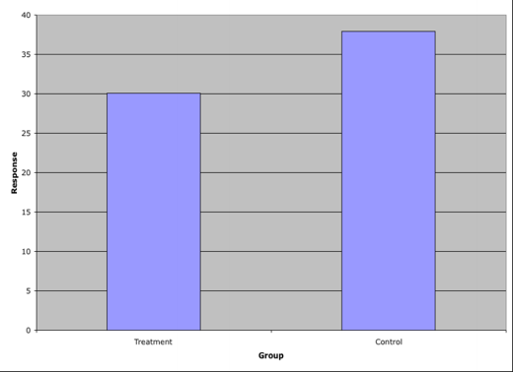
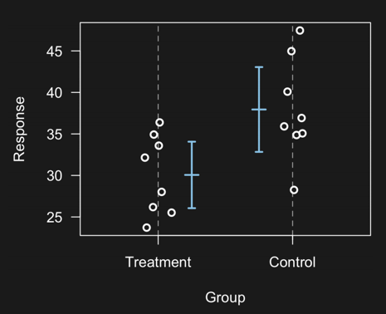
Better 1 or 2

Slide 11
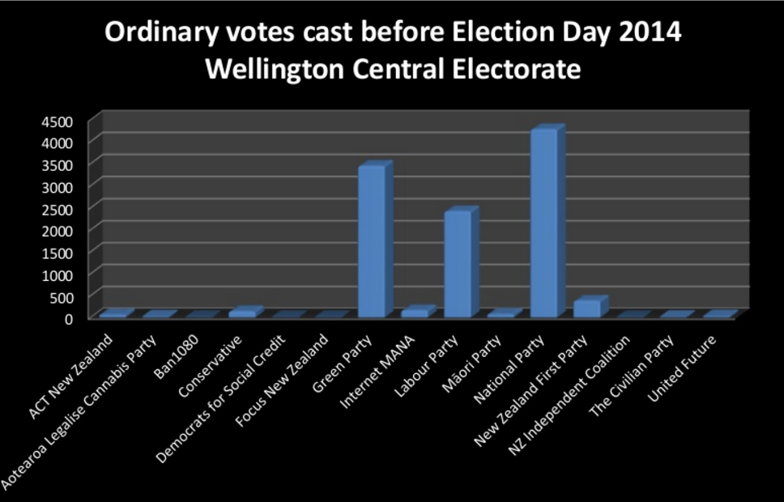
Improve this plot

Slide 12
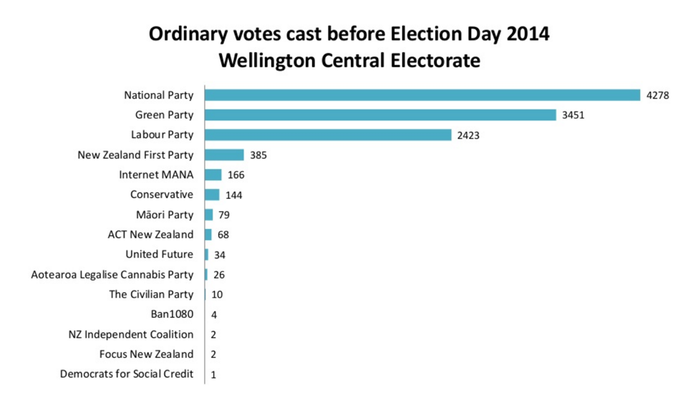
Improved version of the previous graph

Slide 13
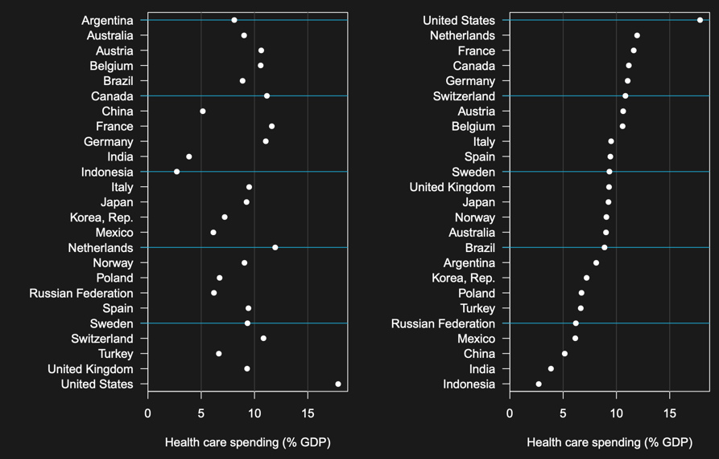
Sort intelligently

Slide 14
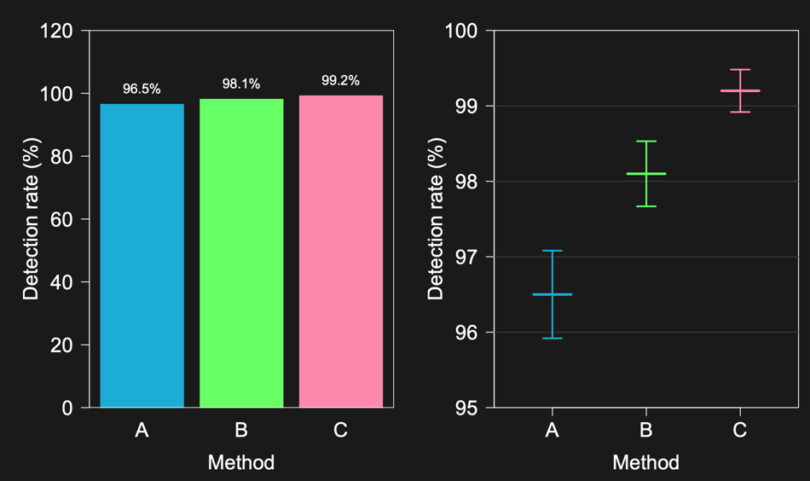
Is zero necessary?

Slide 15
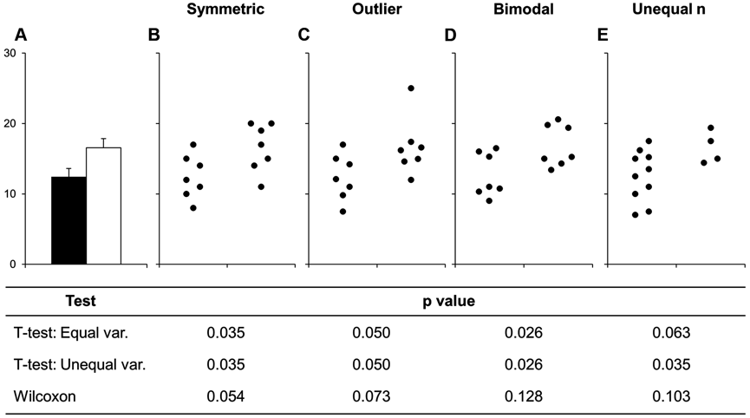
No more bar plots
Summary statistics are only meaningful when there are enough data to summarize
Weissgerber TL, Milic NM, Winham SJ, Garovic VD (2015) Beyond Bar and Line Graphs: Time for a New Data Presentation Paradigm. PLoS Biol 13(4): e1002128. doi: 10.1371/journal.pbio.1002128

Slide 16
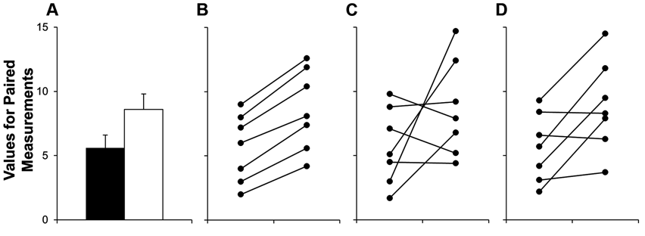
Show paired data as such
Weissgerber TL, Milic NM, Winham SJ, Garovic VD (2015) Beyond Bar and Line Graphs: Time for a New Data Presentation Paradigm. PLoS Biol 13(4): e1002128. doi: 10.1371/journal.pbio.1002128

Slide 17
Let’s talk about p

Slide 18
The magic of 0.05
What is a p-value?
P = probability of observing your result (or something more extreme) given the null hypothesis is true
p > 0.05
p < 0.05
Notes:
P < 0.05 means that the observed difference between two groups would not be seen even 1 in 20 times by chance
But what if 20 comparisons are done and only the one that looks “significant” is presented? Or what if a trend is apparent in the data and samples are dropped or added to achieve this magic number of 0.05?
Article Source: The Extent and Consequences of P-Hacking in Science Head ML, Holman L, Lanfear R, Kahn AT, Jennions MD (2015) The Extent and Consequences of P-Hacking in Science. PLOS Biology 13(3): e1002106.https://doi.org/10.1371/journal.pbio.1002106

Slide 19
What is p-hacking?

Slide 20
P-Hacking
Stop collecting data once p < 0.05
Analyze many outcomes, but only report those with p < 0.05
Collect and analyze many conditions, but only report those with p < 0.05
Add covariates until p < 0.05
Exclude participants until p < 0.05
Add sample size until p < 0.05
Transform the data to get p < 0.05
Notes:
Freakonomics – definition of p-hacking

Slide 21
Ideas for improvement
How do we know researchers are doing ”the correct” data analysis and not just p-hacking?
What makes a data analysis decision acceptable and what makes it p-hacking?
How do researchers maintain scientific integrity but also allow themselves enough flexibility to do “the correct” analysis?

Slide 22
Reporting Results

Slide 23
No more naked p
N = 22000
p < 0.00001
Risk difference = 0.77%
R² = 0.001
“Statistical significance is the least interesting thing about the results. You should describe the results in terms of measures of magnitude – not just, does a treatment affect people, but how much does it affect them.” -- Gene V Glass
“The primary product of a research inquiry is one or more measures of effect size, not P values.” -- Jacob Cohen
Sullivan GM, Feinn R (2012) Using effect size - or why the p value is not enough. Journal of graduate medical education, 4(3), 279-82. PMID: 23997866

Slide 24
What is p? What is effect size?
p = probability that the result is due to chance
p < alpha (usually 0.05) is ”significant”
“significant” means result was likely NOT due to chance
Effect size = magnitude of result
Difference between groups
Risk reduction
Model fit

Slide 25
p needs support

Slide 26
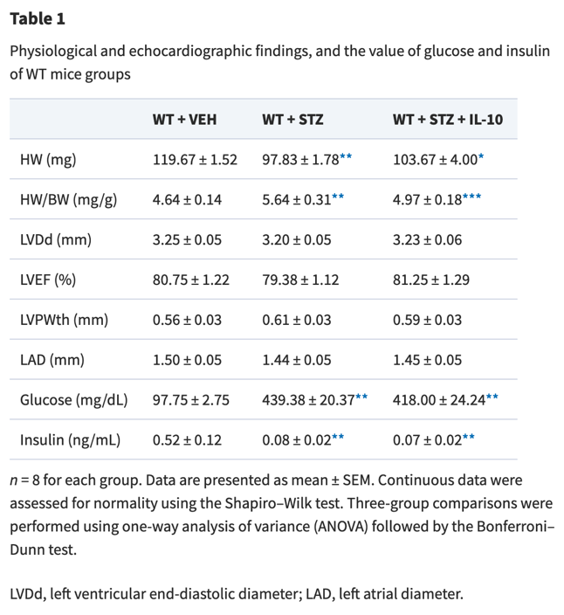
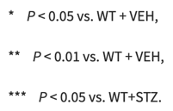
Pair stats with measure of uncertainty
Kondo H, Kira S, Oniki T, et al (2019) Interleukin-10 treatment attenuates sinus node dysfunction caused by streptozotocin-induced hyperglycaemia in mice Cardiovascular Research 115(1): 57–70. doi: 10.1093/cvr/cvy162

Slide 27
Pair stats with measure of uncertainty (continued)
Effect size
Uncertainty

Slide 28
Pseudoreplication

Slide 29
Sample size can be tricky
Hypotheses, experimental manipulations, and measurements may all be at different levels of biological hierarchy
Which level should be used to determine the sample size—is N the number of rats, eyes, cells, or mitochondria?

Slide 30
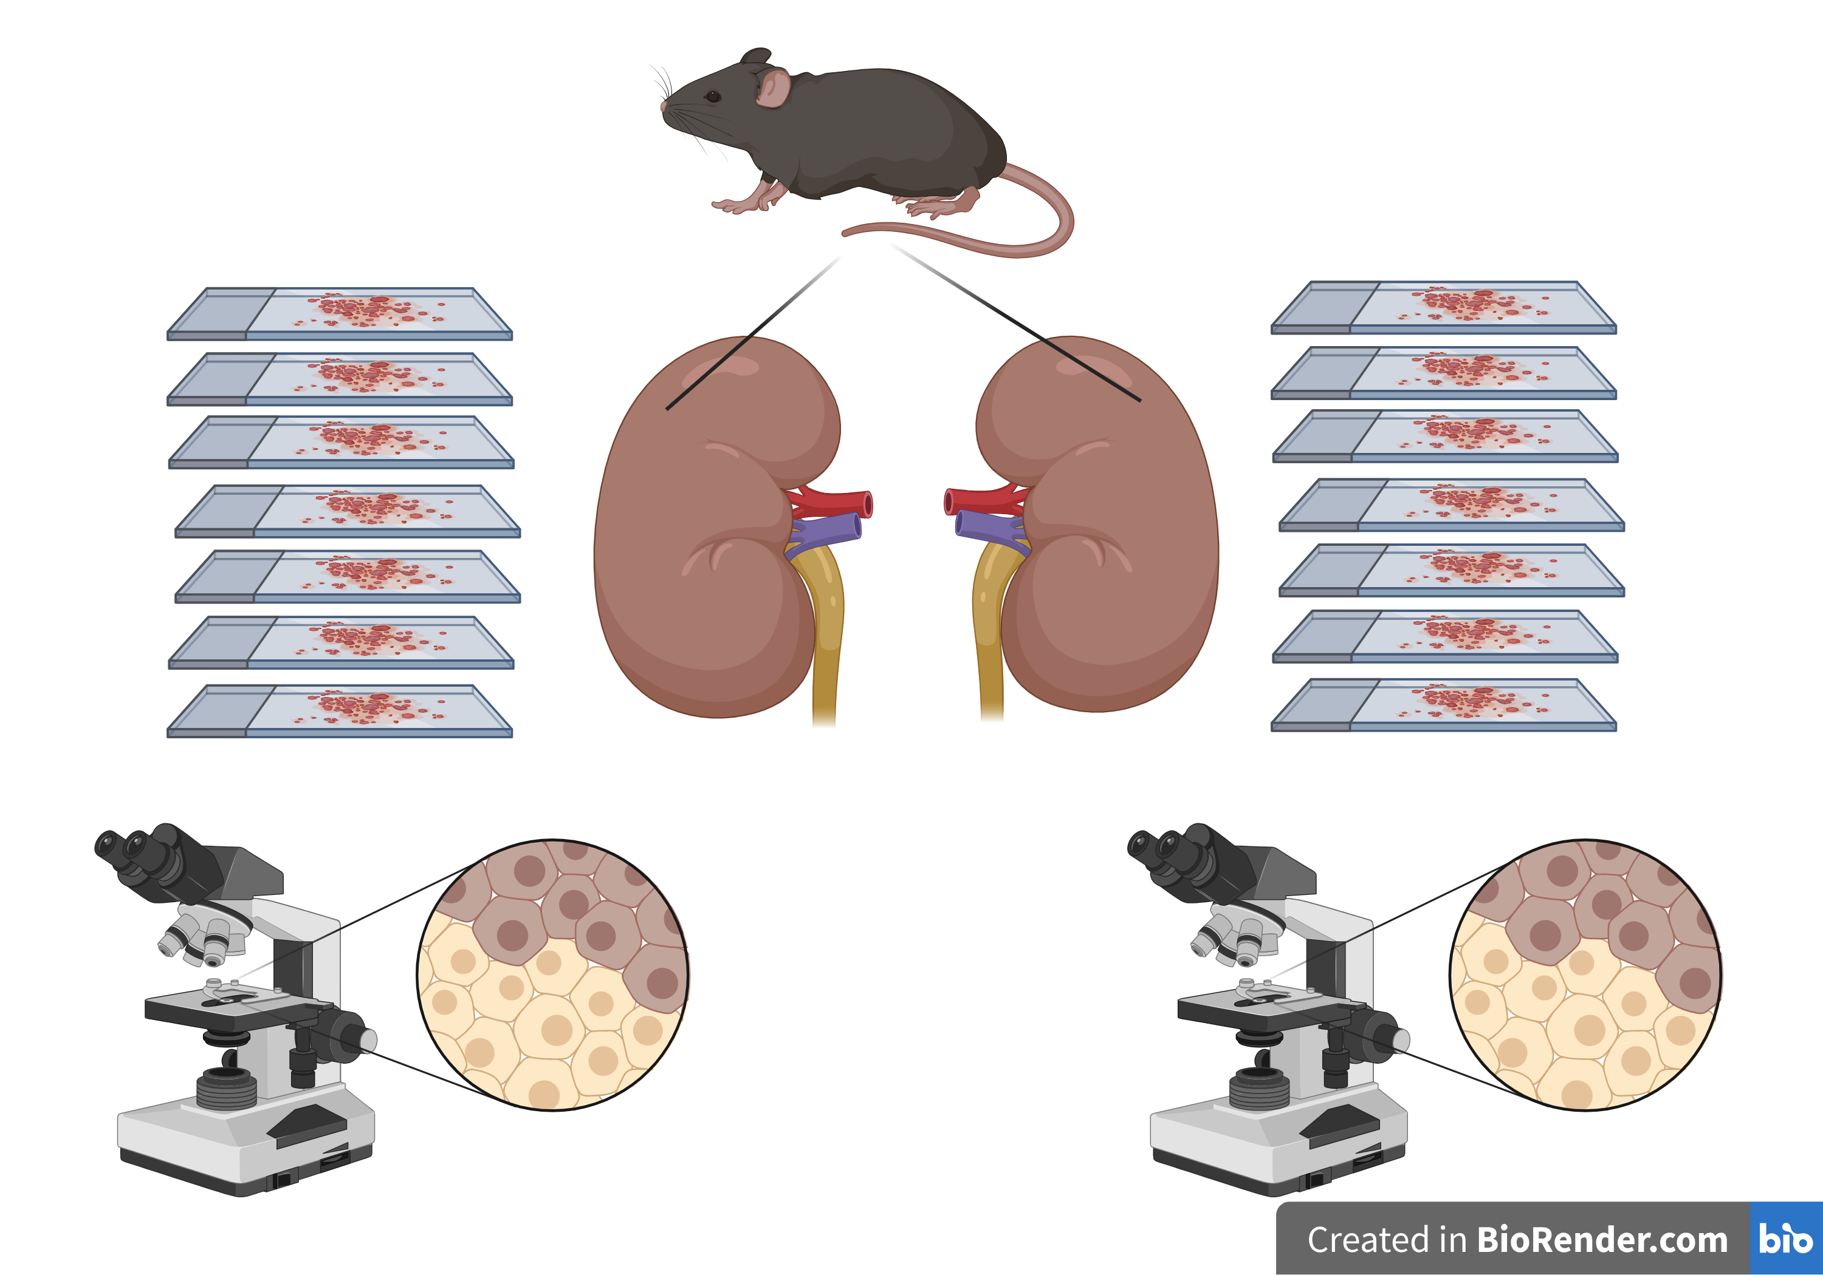
Sample size can be tricky (continued)

Slide 31
Determining Sample Size
N = sample size
N should be independently assigned to the experimental condition
If not → pseudoreplication

Slide 32
Problems of Pseudoreplication
Pseudoreplication → overestimation of sample size, so it looks like there's more data than there is
Sample size overestimation → inflated statistical significance → false positive
Use of statistical tests that assume independence → false positive

Slide 33
Practice – What is the sample size?
Study differences in biomarker levels in urine of wolves that are:
Pregnant and gave birth to live young
Pregnant but pups died
Mated but not pregnant
Single
N = 13 wolves
N = 25 urine samples per wolf, each run in triplicate
N = 961 urine samples total

Slide 34
Practice –What is the sample size?
10 mice
2 kidneys per mouse
7 treated kidney sections per mouse
7 control kidney sections per mouse
~10K cells per slide that are stained for CD8 (marker of T cells)
x10

Slide 35
Use appropriate statistical analyses
Averaging across replicate measurements loses information – there is a better way!
Seek statistical support for complex designs
With nested, clustered, or longitudinal data, ANOVA and t-test are not sufficient
More appropriate techniques: mixed effects models (LMM, LME, GLMM) or generalized estimating equations (GEE)

Slide 36
Recs from ASA
ATOM(IC)
Accept uncertainty
Pair point estimates with uncertainty intervals
Be Thoughtful
Methods are more important than p
Focus on study design
Be Open
Share data, code, and analyses
Pre-register studies to keep honest
p is continuous not dichotomous
Be Modest
…about the role of statistical inference in scientific inference
Encourage replication attempts
Institutional Change
Wasserstein, R. L., & Lazar, N. A. (2016). The ASA Statement on p-Values: Context, Process, and Purpose. The American Statistician, 70(2), 129–133. doi: 10.1080/00031305.2016.1154108

Slide 37
Credits
Garrett Grolemund (https://github.com/garrettgman/rmarkdown-the-bigger-picture)
Karl Broman (https://github.com/kbroman/Talk_Graphs)

