Slide 1
Health Literacy & Medication Adherence
Non adherence or misunderstanding?

Slide 2
Discussion points from last module
Which numerical messages are hardest to convey to patients?
Can any of the suggestions in the last module be of help?
Which of the suggestions do you find most useful?
Notes:
[NOTE TO FACILITATOR: If you are completing these modules in an order other than suggested in the facilitation guide, you may need to adjust these discussion points.]

Slide 3
Objectives
By the end of the program, participants will:
Describe how health literacy affects medication adherence
Discuss NLM medication resources
Notes:
The final module of this track discusses how health literacy relates to medication and treatment adherence.
[NOTE TO FACILITATOR: If you are completing these modules in an order other than suggested in the facilitation guide, you may need to adjust this note.]

Slide 4
Health Literacy and Treatment Adherence
A 2017 meta analysis looked at 220 studies of health literacy and treatment adherence and found:
A “highly significant” correlation between health literacy and patient adherence
A “14% higher risk of nonadherence among patients who have lower health literacy than among patients with higher health literacy”³
Notes:
We’ve talked about the effect health literacy has on health outcomes, but how does it relate to a shorter term concern, treatment and medication adherence? A 2017 meta analysis looked at 220 studies of health literacy and treatment adherence and found a highly significant correlation between health literacy and patient adherence³. There was a 14% higher risk of nonadherence among patients who have lower health literacy than among patients with higher health literacy³.
[NOTE TO FACILITATOR: If you are completing these modules in an order other than suggested in the facilitation guide, you may need to adjust this note.]

Slide 5
Only about 50% of patients take medications as directed⁴
Notes:
Considering what we have discussed about health literacy, how might a patient misinterpret some of these medication directions? These recommendations don’t initially seem that confusing, but what is plenty of water or being in the sun for too long? And does twice a day mean two at once, or should the patient take these medications at specific times? When you think about it, it is easy to understand why it is estimated that only 50% of patients take medications as directed. This is concerning because the CDC estimates that medication adherence is related to between 30% and 50% of chronic disease treatment failures.

Slide 6
How does health literacy affect medication adherence?
Limited health literacy can affect a person’s ability to:
Identify Medications
Interpret Dosing
Take medications correctly
Understand drug labels²
In addition to these direct effects, research has suggested that those with low health literacy had increased fears about side effects, which can decrease adherence¹
Notes:
How exactly does health literacy affect medication adherence? As I am sure you inferred from the picture on the previous slide, it affects a person’s ability to identify medications, interpret dosing and understand drug labels². Research also suggests that health literacy can affect medication adherence indirectly because those with lower health literacy may have more fears about side effects of medication, which can decrease adherence¹.

Slide 7
What to do?
Suggestions to address treatment adherence related to health literacy include:
Using language that patients can understand³
Using teach back^{1,3}
Limiting the amount of information provided¹
Reinforcing messaging over time³
Providing materials for future reference¹
Notes:
The good news about today’s module is that many of the recommendations related to this issue are communication techniques that we have already discussed. Things such as clear communication and teach back are suggested^{1,3} along with reinforcing messaging over time and providing materials for patients to reference^{1,3}.
[NOTE TO FACILITATOR: If you are completing these modules in an order other than suggested in the facilitation guide, you may need to adjust this note.]

Slide 8
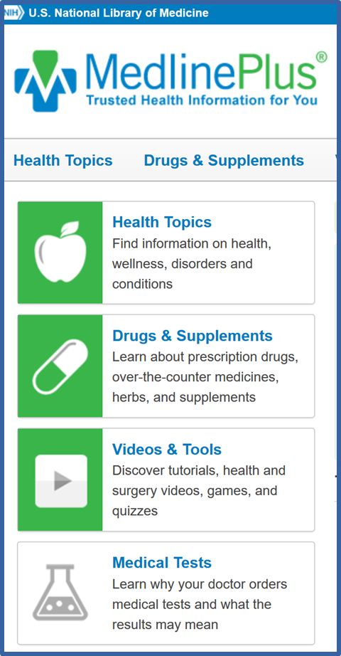
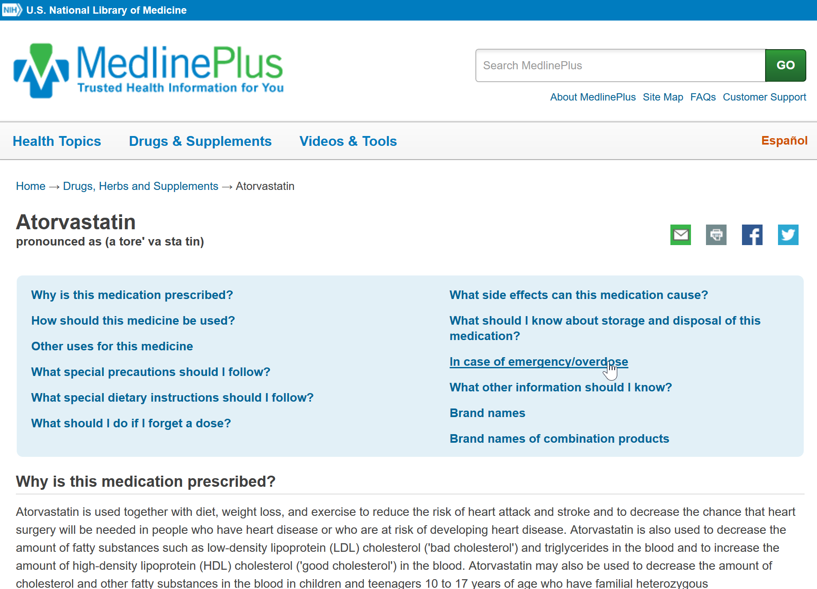
MedlinePlus navigation 1
Notes:
As we discuss materials for someone to refer to, I want to highlight the medication and supplement information that is available in MedlinePlus. You might recognize this from an earlier conversation about MedlinePlus. However, I wanted to provide this in the context of our discussion about medication adherence and health literacy. MedlinePlus has information for the general public about prescription medications…

Slide 9
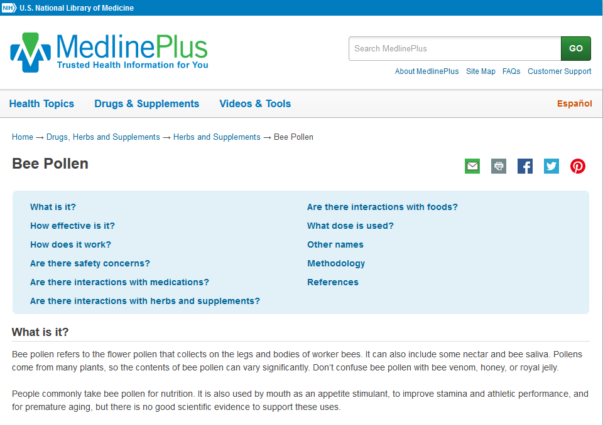
MedlinePlus navigation 2
Notes:
…And supplements. This isn’t included in today’s conversation to suggest that MedlinePlus takes the place of in-person communication, but that it is a trustworthy place where a patient can locate information to refer back to.

Slide 10
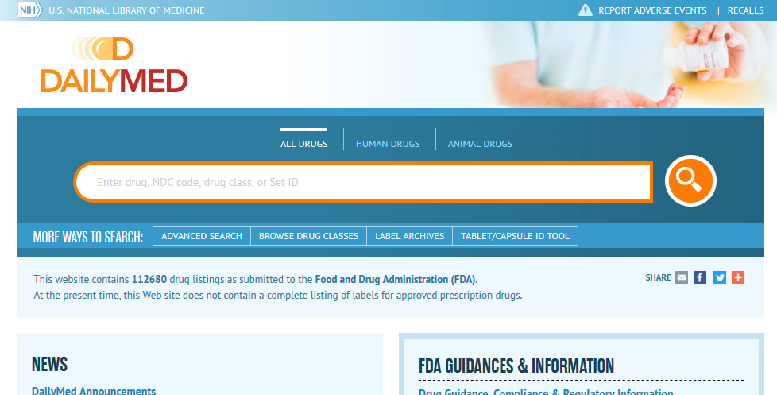
DailyMed
Notes:
Another resources available from the National Library of Medicine you can use to locate medication information is DailyMed. DailyMed provides FDA drug label information, including information about Indications, dosage, side effects and contraindications. This information is the most up to date label information that has been submitted to the FDA but has been reformatted to be easier to read. There are different ways to search for drug information, such as the name of the drug or the NDC code.

Slide 11
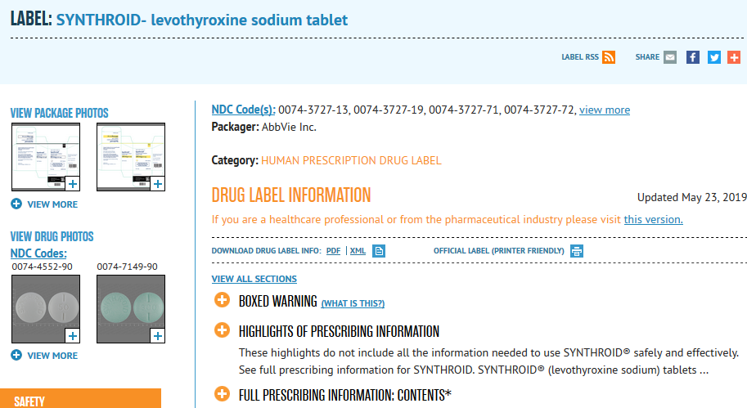
Dailmed (2)
Notes:
You can see the page for Synthroid here. Each plus sign will open up a different category of information.

Slide 12
Dailymed(3)
Notes:
Relevant to today’s conversation is the section on patient counseling information.

Slide 13
Other factors affecting adherence
Health Literacy isn’t the only factor that affects medication adherence⁵
Adherence is also affected by:
Poverty
Unemployment
Social support
Stability of living situation
Cultural beliefs⁵
Notes:
I don’t want to give the impression that health literacy operates independently to affect medication and treatment adherence. As many of you may see among your current patients, adherence is also affected by factors such as poverty, living situation, social support and cultural beliefs⁵. As I mentioned when we started this module, this is the final module in the health literacy track of Clinical Conversations. However, the next two tracks, Social Determinants of Health and Cultural Humility, will address these additional factors.
[NOTE TO FACILITATOR: If you are completing these modules/sections in an order other than suggested in the facilitation guide, you may need to adjust this note.]

Slide 14
Take home message
Consider:
Which types of medications are most likely to cause confusion among patients?
What communication techniques help patients with medication adherence?
Developed resources reported in this presentation are supported by the National Library of Medicine (NLM), National Institutes of Health (NIH) under cooperative agreement number UG4LM012342 with the University of Pittsburgh, Health Sciences Library System. The content is solely the responsibility of the authors and does not necessarily represent the official views of the National Institutes of Health.
Notes:
As you move forward in the coming (week/month/etc.) I ask you to consider which types of medications are most likely to cause confusion among patients and what you already do to promote medication adherence.
[NOTE TO FACILITATOR: If you want to complete group discussion immediately following this module content, change the title of this slide to ‘Group Discussion’. If you would like to have discussion take place using your internal LMS system, you can include instructions here for how participants can participate.]

Slide 15
Please complete the post-test questions
Notes:
[NOTE TO FACILITATOR: if you choose not to have participants complete the knowledge assessment questions, delete this slide.] If you are doing module 8 (optional) move this slide to that section.

Slide 16
References
Soones, T., Lin, J., Wolf, M., O’Conor, M., Martynenko, M., Wisnivesky, J. & Federman, A. (2017). Pathways Linking Health Literacy, Health Beliefs, and Cognition to Medication Adherence in Older Adults with Asthma, 139(3), 804-809.
Hersh, L., Salzman, B., Snyderman, D. (2015). Health Literacy in Primary Care Practice, American Family Physician, 92(2), 119-124.
Miller, T. (2017). Health Literacy and Adherence to Medical Treatment in Chronic and Acute Illness: A Meta-Analysis. Patient Education and Counseling, 99(7), 1079-1086.
U.S. Food and Drug Administration (2016). Why You Need to Take Your Medications as Prescribed or Instructed. Retrieved from URL to Source
Ferdinand, K., Senatore, F., Clayton-Jeter, H., Cryer, D., Lewin, J., Nasser, S…Califf, R. (2017). Improving Medication Adherence in Cardiometabolic Disease: Practical and Regulatory Implications. Journal of the American College of Cardiology, 69(4), 437-451.

