Slide 1
Teach Back
Confirm Understanding

Slide 2
Discussion points from last module
How can you improve your communication with patients?
Practice universal precaution for health communication
Use clear communication strategies with patients
Notes:
[NOTE TO FACILITATOR: If you are completing these modules in an order other than suggested in the facilitation guide, you may need to adjust these discussion points.]

Slide 3
Objectives
By the end of the program, participants will:
Describe the benefits of using teach back in practice
Increase use of teach back methods in their daily work

Slide 4
Strategies for communicating clearly
Invite patient participation
Encourage questions
Apply teach back¹
These will be covered more during future sessions
Notes:
If you remember from our last conversation about clear communication, there are ways that we can address health literacy as healthcare providers, just like everyone has shared. There are a few strategies that were not covered in the last session, and today we will focus on one important strategy: teach back.
[NOTE TO FACILITATOR: If you are completing these modules in an order other than suggested in the facilitation guide, you may need to adjust this note.]

Slide 5
Teach Back
A way of checking a patient’s understanding of information by asking them to state what they heard in their own words¹
Teach back can:
Improve understanding and adherence
Improve satisfaction and outcomes
Reduce callbacks and canceled appointments¹
“Studies have shown that 40-80% of the medical information patients are told during office visits is forgotten immediately, and nearly half of the information retained is incorrect.”¹
~Agency for Healthcare Research and Quality (AHRQ)
Notes:
How many of you have heard about teach back before? How many of you feel like you’re using it as much as you could? For anyone who hasn’t heard of this before, teach back is a way of checking a patient's understanding of information by asking them to state what they heard in their own words. This is a helpful strategy for you because you will know that your patient understands what you want them to understand but can also improve patient satisfaction and reduce callbacks and canceled appointments¹. When people first learn about teach back, I think some may wonder if it is really necessary. This quote from the Agency for Healthcare Research and Quality makes a pretty convincing case for using teach back: “Studies have shown that 40-80% of the medical information patients are told during office visits is forgotten immediately and nearly half of the information retained is incorrect.”¹ It’s clear from this information that anything we can do to improve understanding is needed.
If you remember the H.O.U.S.E. video from the previous module, the recommendation was to show the patient how to do something. Similar to teach back, you can also use the “show me” model, where you ask the patient to show you how they would do something. For example, how they would use their inhaler.
[NOTE TO FACILITATOR: If you are completing these modules in an order other than suggested in the facilitation guide, you may need to adjust this note.]

Slide 6
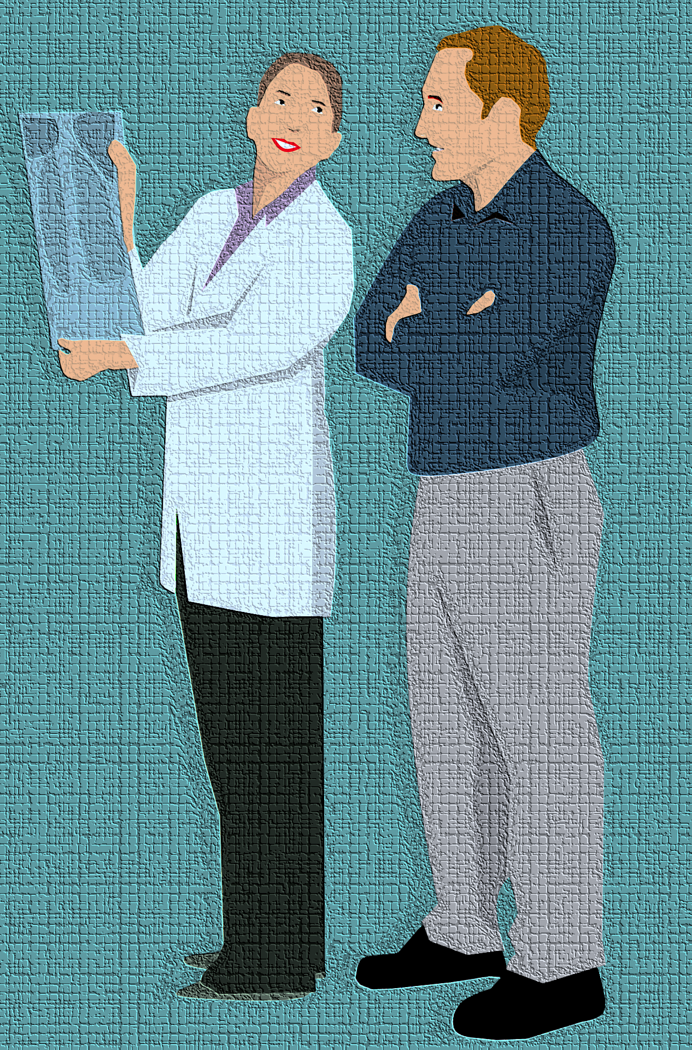
How to Implement Teach Back
Keep in mind this is not a test of the patient's knowledge
Plan your approach
"Chunk and Check"
Clarify and check again
Start slowly and use consistently
Practice ¹
Notes:
So, what are the details of using teach back? To start, keep in mind that using teach back shouldn't be presented as a test for the patient of what they know¹. It is a way that you’re testing yourself to ensure that you explained things correctly¹. This is why it’s a good idea to plan how you will ask the patient to demonstrate understanding¹. An example of a teach back statement is: “This is a new diagnosis for you, so I want to make sure you understand. Will you tell me in your own words what congestive heart failure is?”² Another good example of ensuring the patient doesn’t feel tested is, “Mr. Johnson, as your doctor, one of my top priorities is to ensure I’m explaining things in a way you understand. I want to make sure my instructions about how to take your new medication are clear. Would you mind telling me in your own words how you will take this new medication?”²
"Chunk and Check“ means that it is a good idea to use teach back throughout your conversation with them¹. Don't just use it at the end of the visit¹. After covering one point that you want the patient to understand, you can check for understanding before moving on to another concept¹.
“Clarify and Check again” is referring to the possibility that you may have to explain things again¹. If the patient cannot restate what you wanted them to learn, try explaining it again in another way and check in with them again¹. This is a good time to consider some of the clear communication and plain language techniques that we have already discussed. Did the patient not understand because there were too many acronyms or too much jargon? Something to take note of, however, is if the patient repeats your words back to you exactly, they may not understand¹. This is why it is good to see if they can explain it in their own words¹.
At first, teach back can feel difficult to implement with all patients. The AHRQ suggests trying teach back with your last patient of the day and then increasing your use of teach back as you practice and feel comfortable with the technique¹. Once teach back has become part of your routine, it won’t feel awkward and won’t lengthen the visit¹.

Slide 7
Examples
Teach Back
Show Me
"We covered a lot today and I want to make sure that I explained things clearly. So let's review what we discussed. Can you please describe the 3 things you agreed to do to help you control your diabetes?¹"
"I've noticed that many people have trouble remembering how to take their blood thinner. Can you show me how you are going to take it?¹"
Notes:
Here is another teach back example: “We covered a lot today and I want to make sure that I explained things clearly. So, let’s review what we discussed. Can you please describe the three things you agreed to do to help you control your diabetes?” You can see this teach back example next to an example of the show me method. This is almost the same concept, except the patient is being asked to show how they will do something such as taking a medication. Research shows that even if a patient can say when and how much medication they should take, they still could show lack of understanding when demonstrating how they will do it. Think about the video of the woman using the inhaler in the clip from H.O.U.S.E. we looked at in a previous module. The woman was using the dose prescribed, but she was not doing it in the right way. The show me methods may have been a helpful way for the prescriber to confirm understanding.
[NOTE TO FACILITATOR: If your staff has been exposed to this before, it would be a good time to ask them to share how they have implemented teach back in the past.]
[NOTE TO FACILITATOR: If you are completing these modules in an order other than suggested in the facilitation guide, you may need to adjust this note.]

Slide 8
Using education materials with teach back
Written materials are effective when used as part of an education strategy¹
Don’t assume that a patient will read a document on their own or understand it¹
Best practices:
Circle or highlight information as you speak with the patient
Personalize the materials if possible
Refer to them in follow up calls or conversations¹
Use teach back to confirm understanding of materials¹
Notes:
You can use written health education materials to reinforce your patient’s understanding, but to use these materials effectively, they should be used as part of an overall education strategy¹. This overall strategy is suggested because you can’t assume that a patient will read a document that is given to them or visit a suggested website at home¹. When using written education materials, it is best practice to circle or highlight the information you want the patient to focus on as you speak with them¹. If possible, you can personalize the materials with any specific instructions that you have for that individual and then refer to the materials again in follow ups or give the material to them more than once¹. Finally, still use teach back alongside written materials to ensure understanding¹.

Slide 9
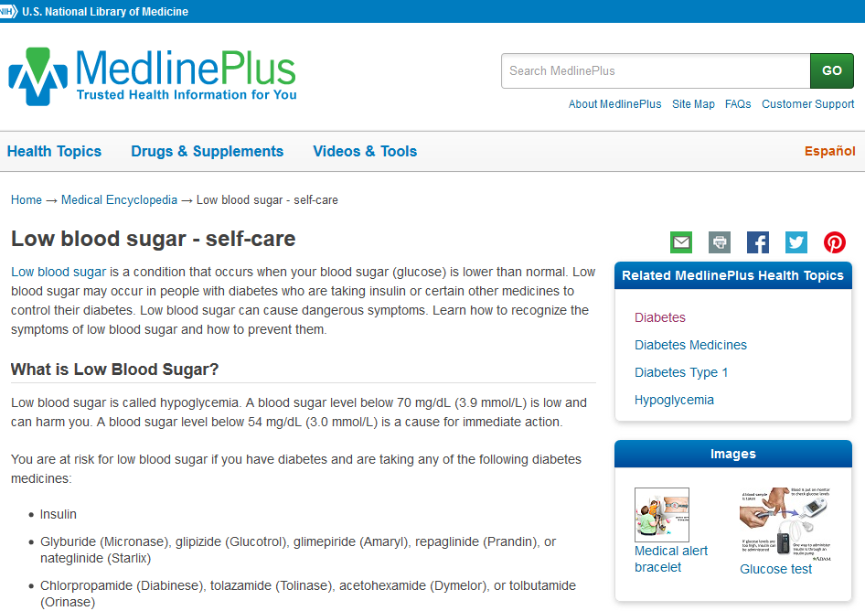
MedlinePlus Example 1
“We talked about low blood sugar today. To make sure I explained correctly, can you tell me what blood sugar number means you have low sugar?”
Notes:
You can see an example here of teach back applied to the self-care instructions for low blood sugar in MedlinePlus: “We talked about low blood sugar today. To make sure I explained correctly, can you tell me what blood sugar number means you have low sugar?”

Slide 10
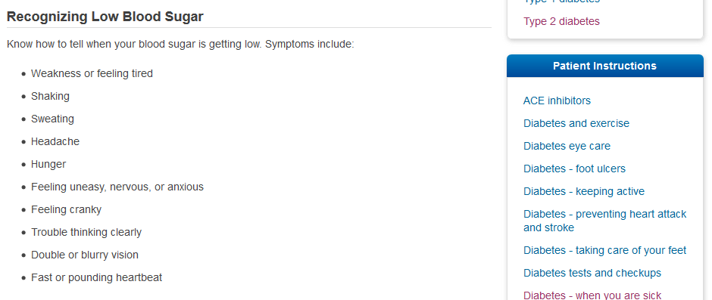
MedlinePlus Example 2
“Now that we have reviewed information about low blood sugar, when you go home today what would you tell your husband about how you might feel or act when you have low blood sugar?”
Notes:
Here is an example of teach back applied to the symptoms of low blood sugar that are listed in the same document. “Now that we have reviewed information about low blood sugar, when you go home today, what would you tell your husband about how you might feel or act when you have low blood sugar?”

Slide 11
Using Teach Back and Educational Materials
Teach Back Video Examples
Notes:
We’ll finish up today by looking at a quick video of a provider using teach back with a patient.
FACILITATOR NOTE: Show the second video on this list that is titled “Teach Back in Cardiology Practice”. This video is 2:40 in length.

Slide 12
Take home message
Consider:
How do you already use teach back and where can you apply it more?
Practice:
If you don’t already use teach back regularly, try adding it to your last appointment of the day¹
Developed resources reported in this presentation are supported by the National Library of Medicine (NLM), National Institutes of Health (NIH) under cooperative agreement number UG4LM012342 with the University of Pittsburgh, Health Sciences Library System. The content is solely the responsibility of the authors and does not necessarily represent the official views of the National Institutes of Health.
Notes:
As you move forward from today’s conversation, consider, how do you already use teach back in practice? How might you apply it more? And practice using teach back if you do no already do it regularly. The AHRQ suggests trying it out with your last patient of the day to familiarize yourself with the technique¹.
[NOTE TO FACILITATOR: If you want to complete group discussion immediately following this module content, change the title of this slide to ‘Group Discussion’ and delete the slide with corresponding questions in the next module. If you would like to have discussion take place using your internal LMS system, you can include instructions here for how participants can participate. Then, adjust the slide with the corresponding questions in the next module as needed.]

Slide 13
References
Brega AG, Barnard J, Mabachi NM, Weiss BD, DeWalt DA, Brach C, Cifuentes M, Albright K, West, DR. (2015). AHRQ Health Literacy Universal Precautions Toolkit, Second Edition. (Prepared by Colorado Health Outcomes Program, University of Colorado Anschutz Medical Campus under Contract No. HHSA290200710008, TO#10.) AHRQ Publication No. 15-0023-EF. Rockville, MD. Agency for Healthcare Research and Quality. Retrieved from URL to Source
Trina, D. (2016). Use the Teach-Back Method to Confirm Patient Understanding. The Hospitalist. 2016(6). Retrieved from: URL to Source

