Slide 1
Citizen Science Empowers Environmental Understanding through Libraries, Community-Based Organizations, and More
Notes:
[share this slide and announce you’ll start at the scheduled start time]
[At the scheduled start time]
Welcome to the NNLM Social Determinants of Environmental Health Webinar Series
We are glad you are able to join us today for the session titled Citizen Science Empowers Environmental Understanding Through Libraries, Community-Based Organizations, and more.
I am Kirsten Crowhurst, Program Innovation Strategist with the National All of Us Program Center and I’ll be your host and chat monitor.

Slide 2
Using Zoom
Closed Caption available
All attendees are muted
Use Chat for questions and comments
Select “Everyone” when posting questions to Chat

Slide 3
Before We Get Started
Session is being recorded
Code of Conduct
Class is eligible for MLA CE
Your feedback matters!

Slide 4
About NNLM / Organizational Structure
The National Institutes of Health is the nation’s leading medical research agency. Many of you might be more familiar with the National Cancer Institute which is one of the many institutes and centers at NIH.
NLM or the National Library of Medicine - is one of the 27 institutes and offices of the National Institutes of Health. It’s the world’s largest biomedical library and produces online resources like PubMed and MedlinePlus.
NNLM - the Network of the National Library of Medicine - is an outreach program of NLM, working to ensure health professionals and the public have equal access to health information.
NNLM is made up of 7 regional medical libraries, 3 national offices, and 4 national centers, all providing training, funding, and engagement opportunities to over 9,000 NNLM member organizations.

Slide 5
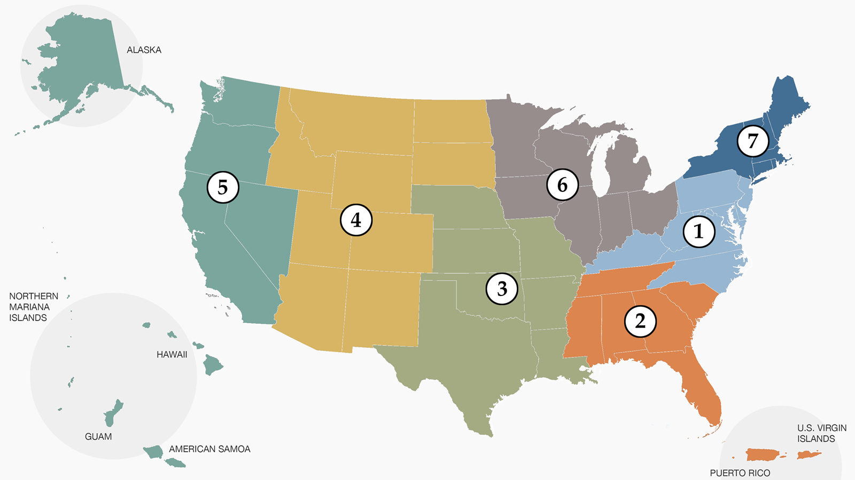
Map of regions
Notes:
Here is a map to show you how our Regional Medical Libraries are geographically divided. If you would like to learn more about your region and how your organization can become part of the network visit our website at nnlm.gov. The link is in the Chat.
Post in Chat: NNLM website https://www.nnlm.gov/

Slide 6
NNLM All of Us Program Center
Notes:
The NNLM All of Us Program Center (NAPC) is a partnership between the National Library of Medicine and All of Us.
The NAPC supports All of Us through two main goals: engagement with public libraries (including training, funding, and partnerships); and providing training for All of Us staff across the US.
The NAPC is based out of the University of Iowa Hardin Library for the Health Sciences, and the University of Pittsburgh Health Sciences Library System.
All of Us is a consortium of engagement and enrollment partners.

Slide 7
What is the all of us research program?

Slide 8
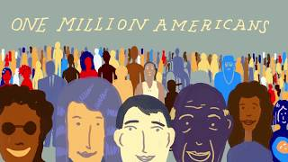
Video: all of us

Slide 9
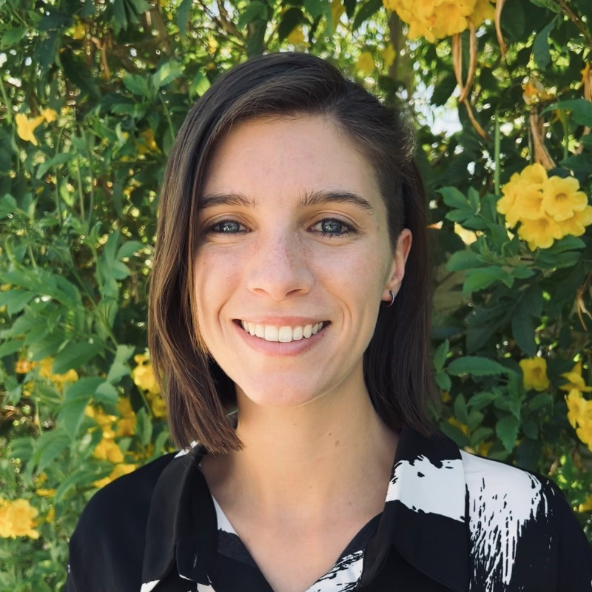
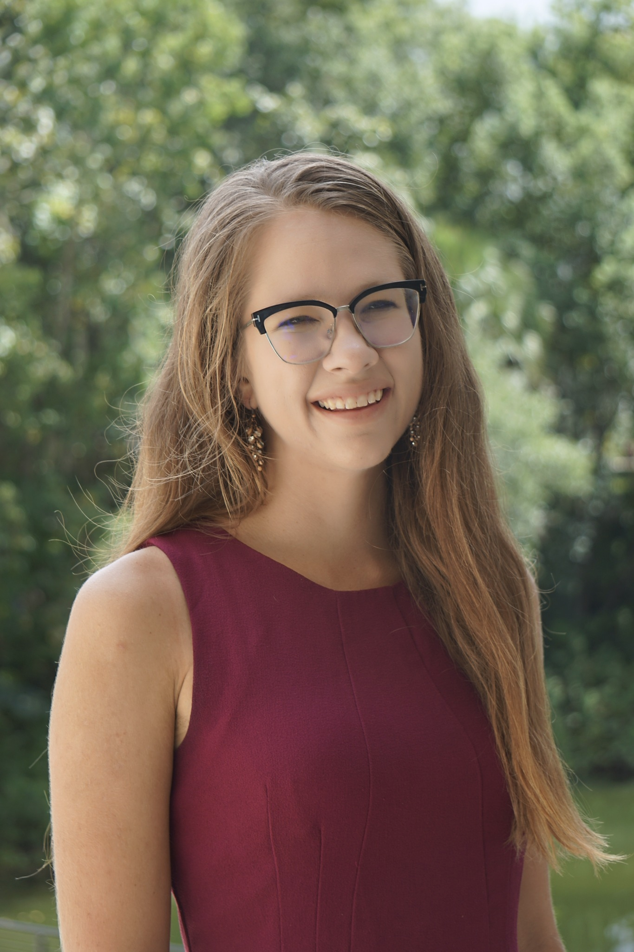
Guest Presenters
Emma Giles
Caroline Nickerson
Notes:
Caroline Nickerson is an advisor at SciStarter, where she assists with the Citizen Science Month Program, SciStarter’s Corporate Volunteer Programs and other programmatic and outreach efforts, including working with SciStarter’s Syndicated Blog Network. Caroline is a Master of Public Policy graduate from American University, where she was a Reilly Environmental Policy Scholar, and is a current PhD student at the University of Florida. Citizen science is a collaboration between scientists and those of us who are curious, concerned, and motivated to make a difference. By engaging with libraries and community-based organizations, SciStarter and its Library Network empowers the public to take part in this real research, resulting in increased awareness and improved data quality.
Emma Giles is a manager of outreach and programs at SciStarter. Emma coordinates team communication and tasks, plans events and manages programs, responds to client and customer questions and concerns, and promotes citizen science through community outreach. Emma earned her undergraduate degrees in business management and Spanish communication and her master’s degree in Science and Technology Policy, all at Arizona State University.

Slide 10
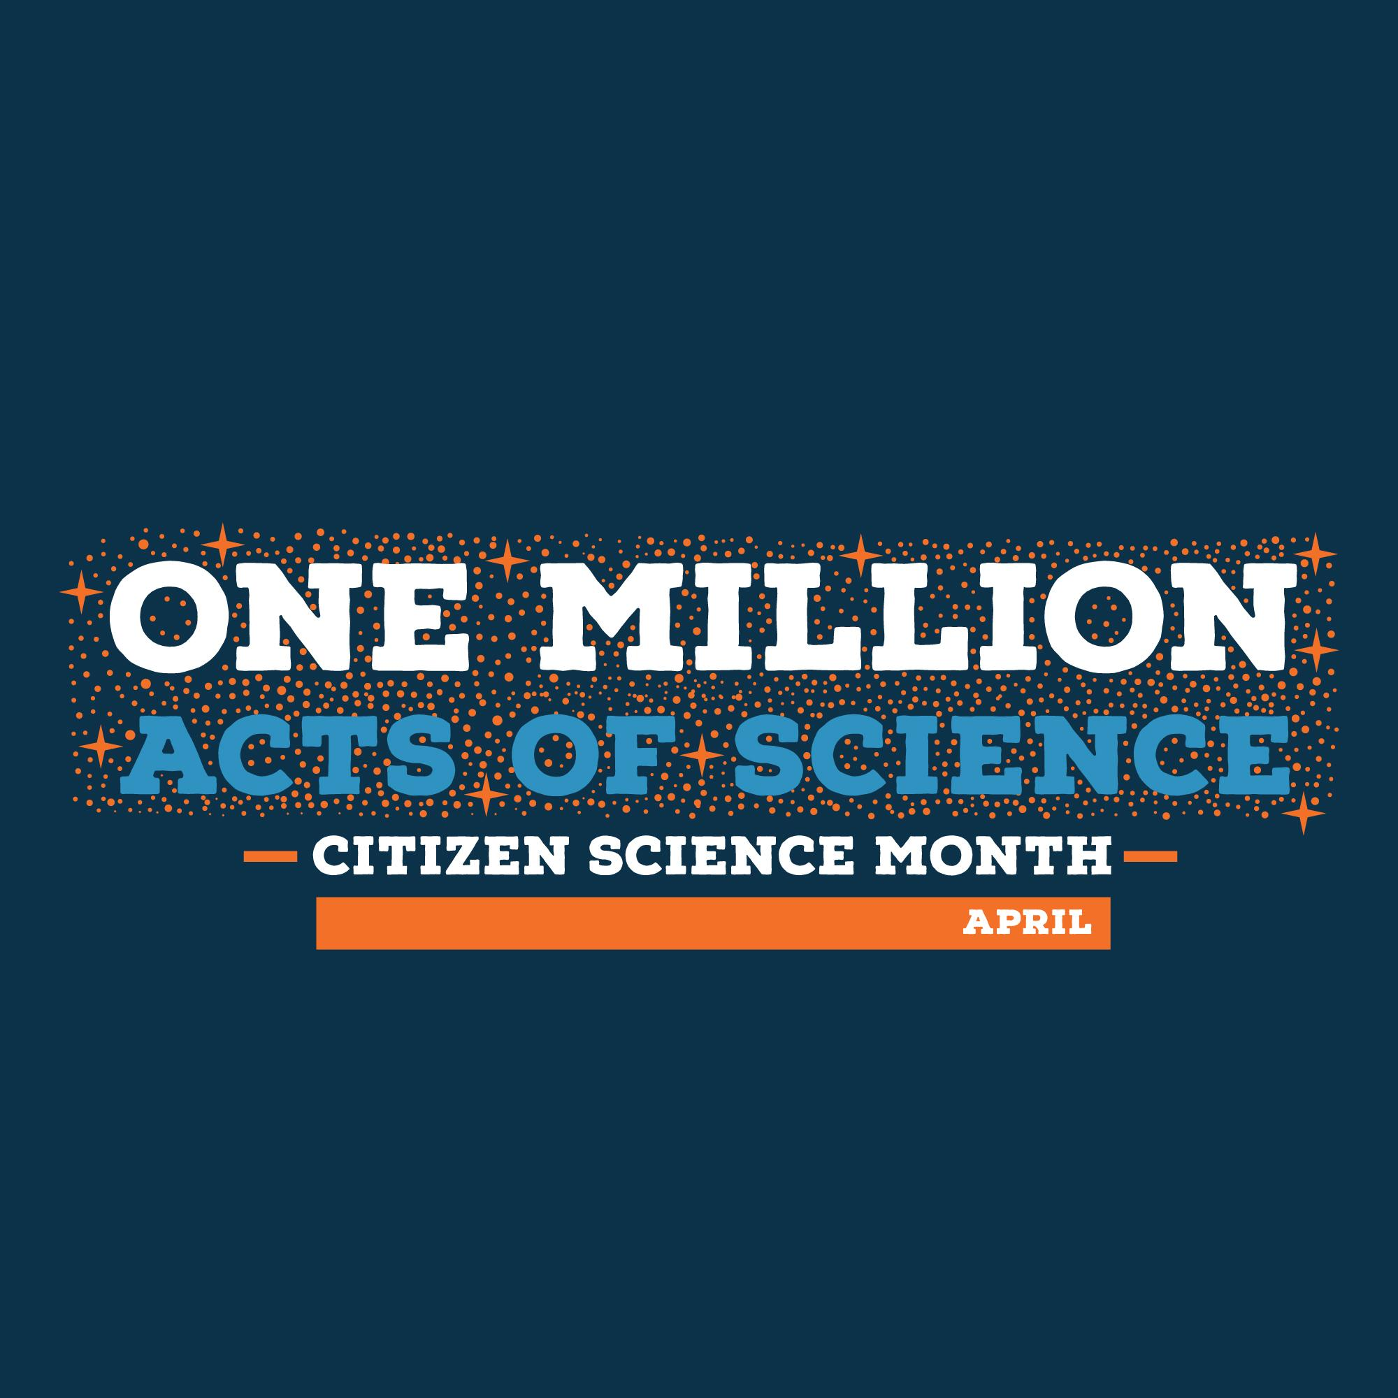
Citizen Science Empowers
Environmental Understanding through Libraries, Community-Based Organizations, and More
SciStarter, One Million Acts of Science, and ISeeChange

Slide 11
Objective 1: Viewers will receive an introduction to Citizen Science, SciStarter and programs through libraries and community-based organizations pertaining to environmental health topics.

Slide 12
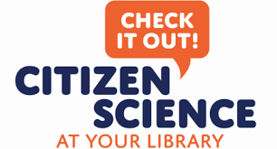
What is Citizen Science?
A global movement that enables people from all walks of life to collaborate with scientists by participating in real scientific research. It’s how people can make an impact on issues they care about!
Notes:
Some of you may be familiar with this and some of you may be completely new to this idea. The big picture is that citizen science is a global movement that enables people from all walks of life to collaborate with scientist by participating in real scientific research. Collecting and analyzing scientific data in a variety of different subjects to advance scientific research. It’s a way for people to make a difference and engage in issues that impact them and their communities.

Slide 13
Benefits to Science & Society
Broadens the scope of who can contribute to science
Enables participants to engage in data collection, analysis, and interpretation.
Enables participants to learn about the nature of science and scientific reasoning.
Accelerates important research and discovery.
Notes:
We also know through evaluating citizen science efforts that it produces considerable benefits to both science and the community beyond one learner. [read through all 4 items: who contributes, skills and research/discovery impact]

Slide 14
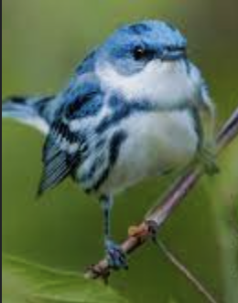
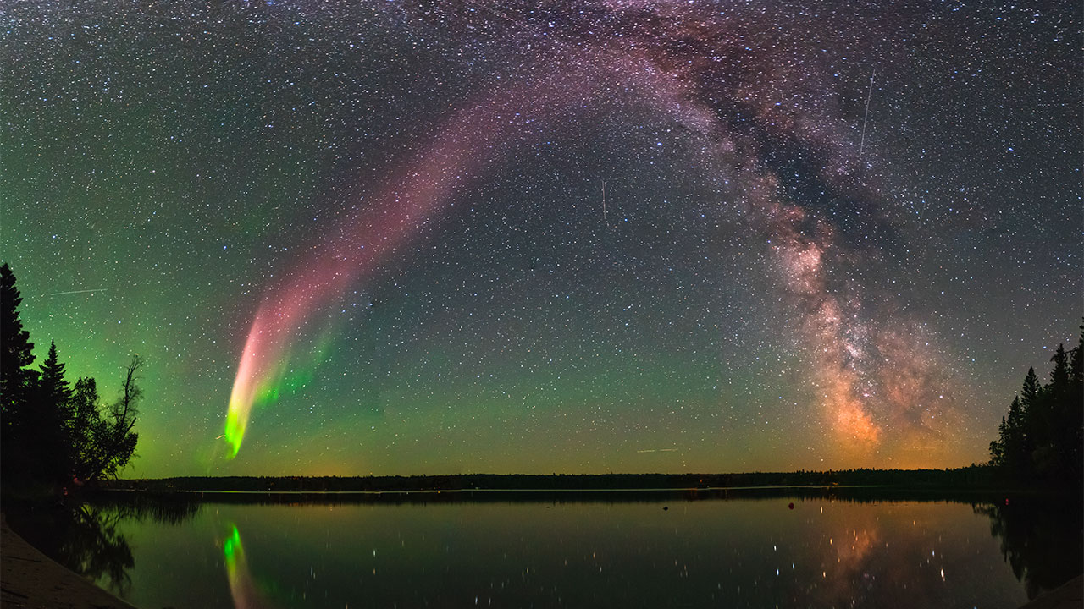
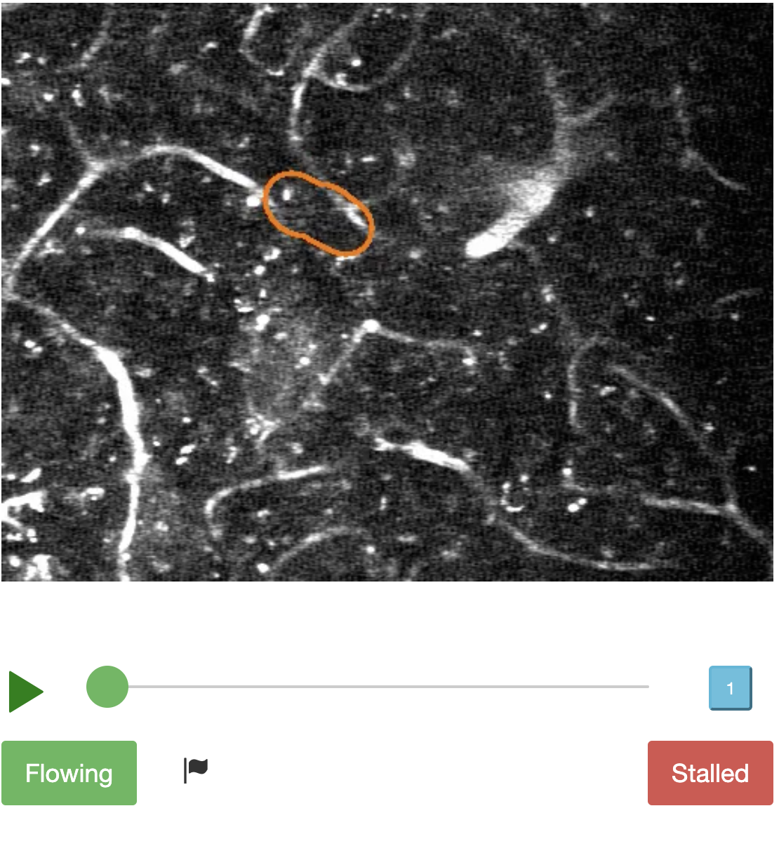
Because of Citizen Science,
we now know…
Bird populations have declined by 50%
Birds are breeding earlier
50+ types of bacteria live in your belly button
The first flowering of 19 species of plants has moved 9 days earlier over the past decade
There’s a new type of aurora in the night sky (and the citizen scientists named it Steve!)
In one weekend, citizen scientists accomplished 2,566 research hours, or 3.5 months of lab-equivalent research time, for an Alzheimer’s research project.
Notes:
Citizen science has led to quite a few tangible results and I’ve gather a few here for you to see.
[read through]
Options to engage attendees with participation: “Any birders here? Guess what?!” “Does anyone here have a pollinator garden?” “Amatuer astronomers?”

Slide 15
Infographic

Slide 16
Anyone can do citizen science!
Retired people
Busy working adults
Youth groups
Community Groups

Slide 17
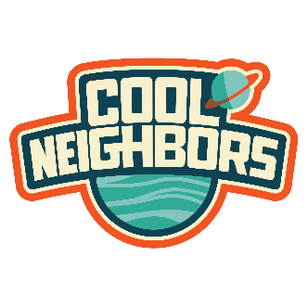
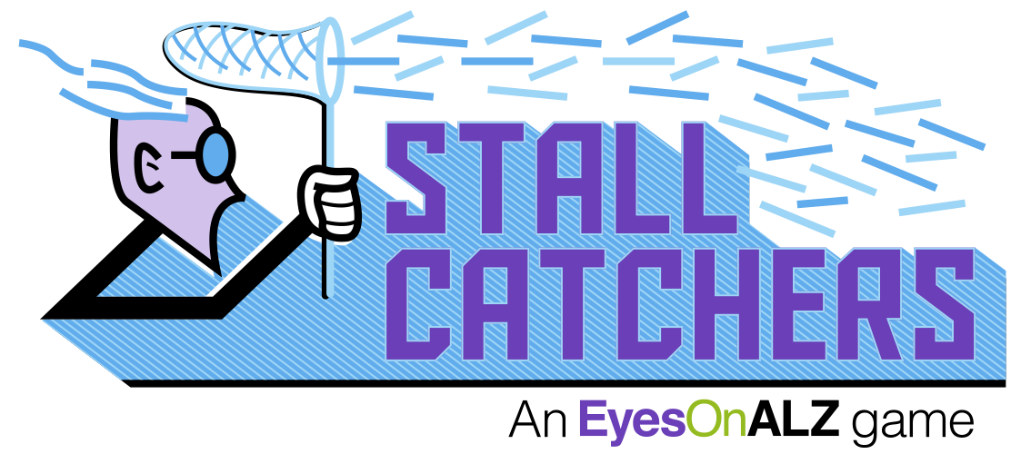
But how?

Slide 18
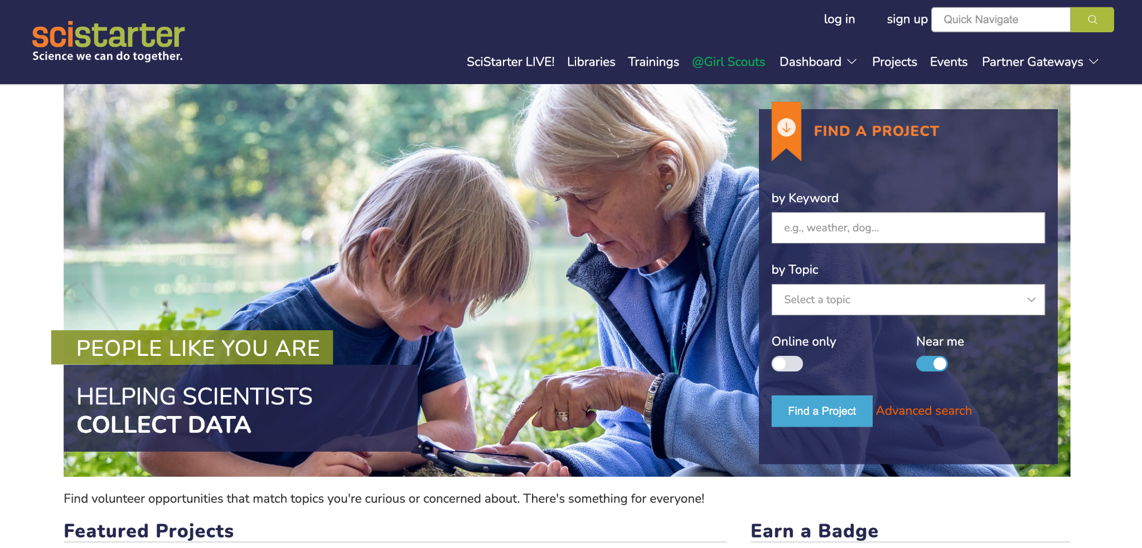
SciStarter connects citizen scientists to over 2,000 projects, events, and tools.
“SciStarter is the Amazon.com of Citizen Science,” Carl Zimmer, Discover Magazine

Slide 19
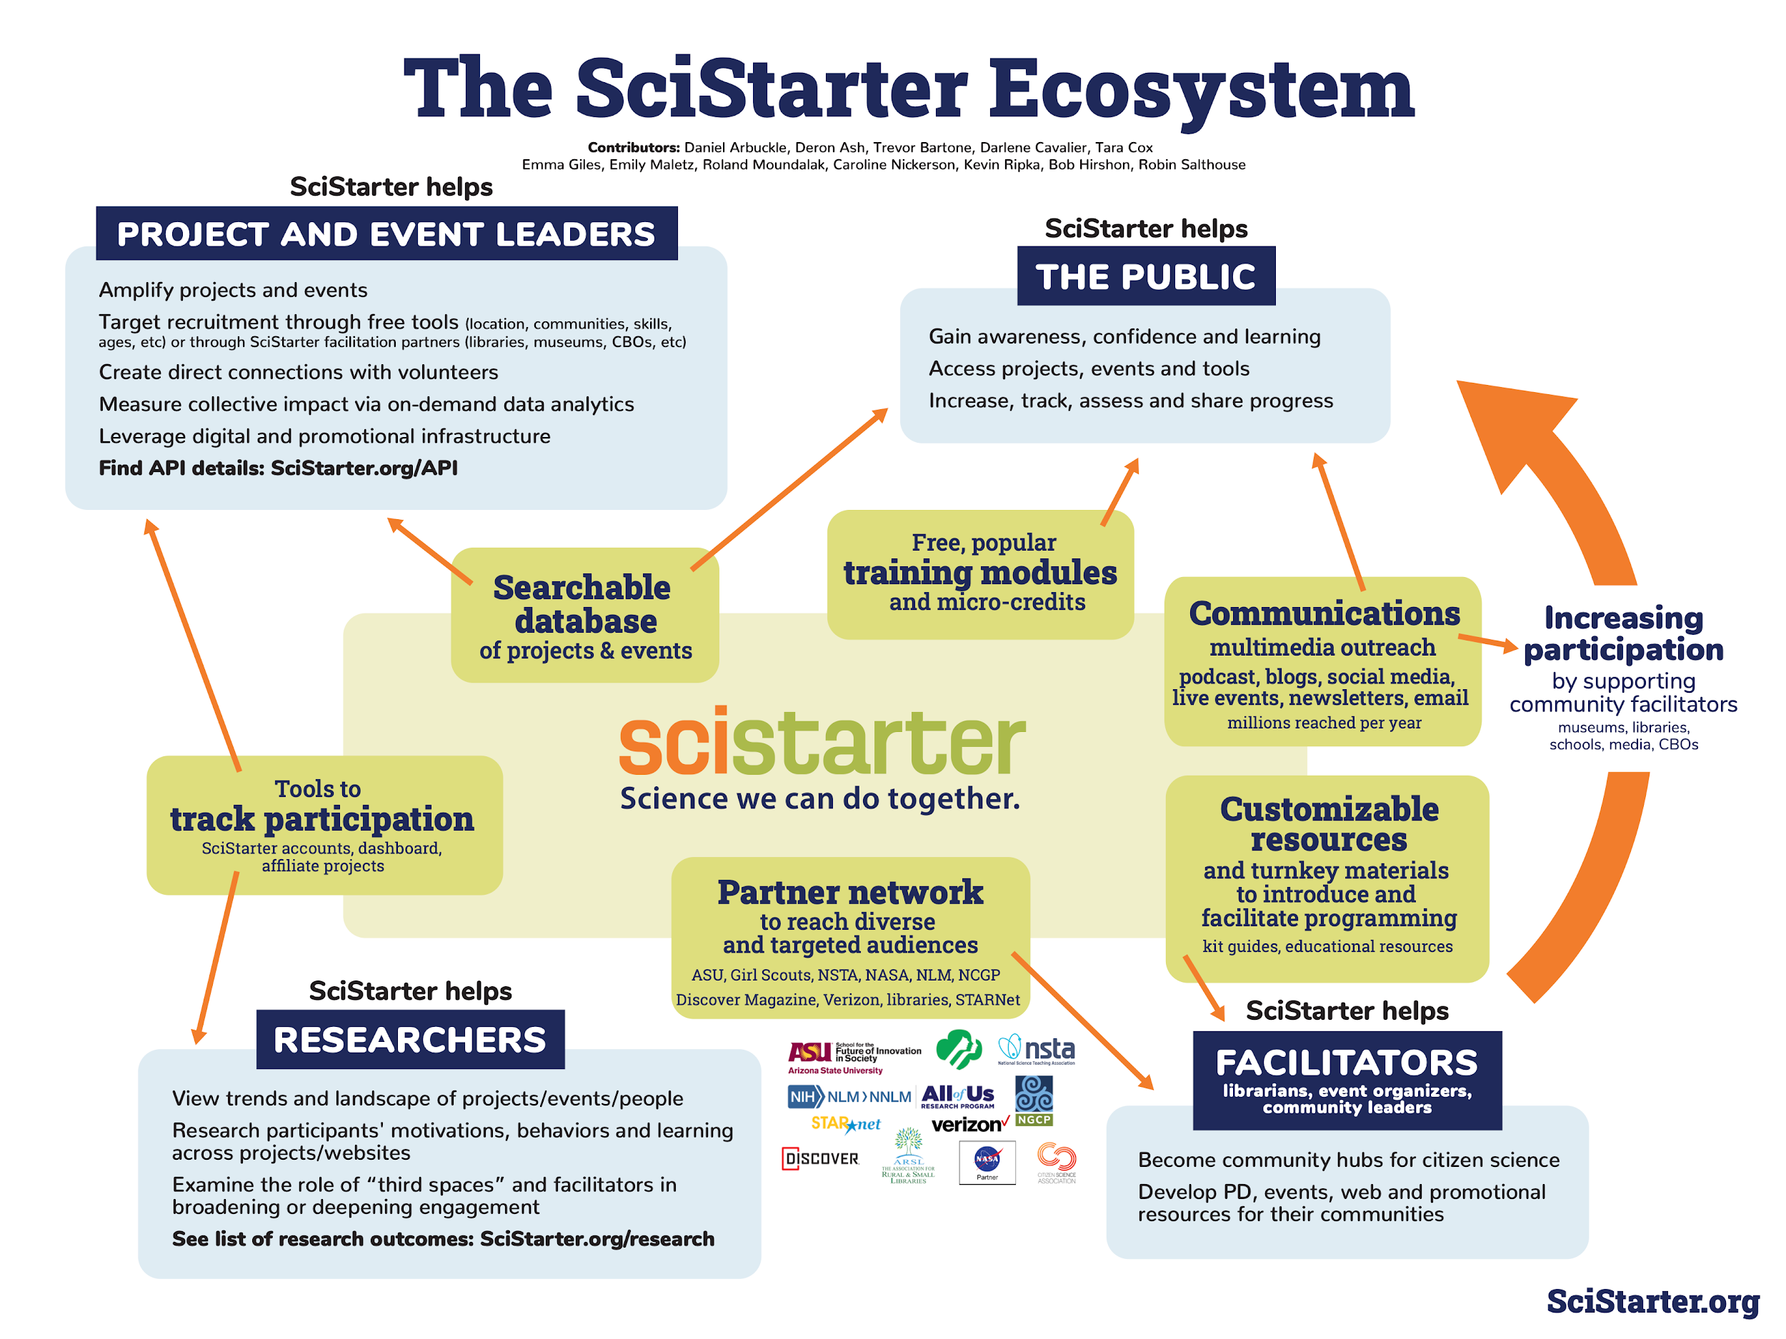
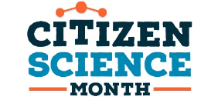
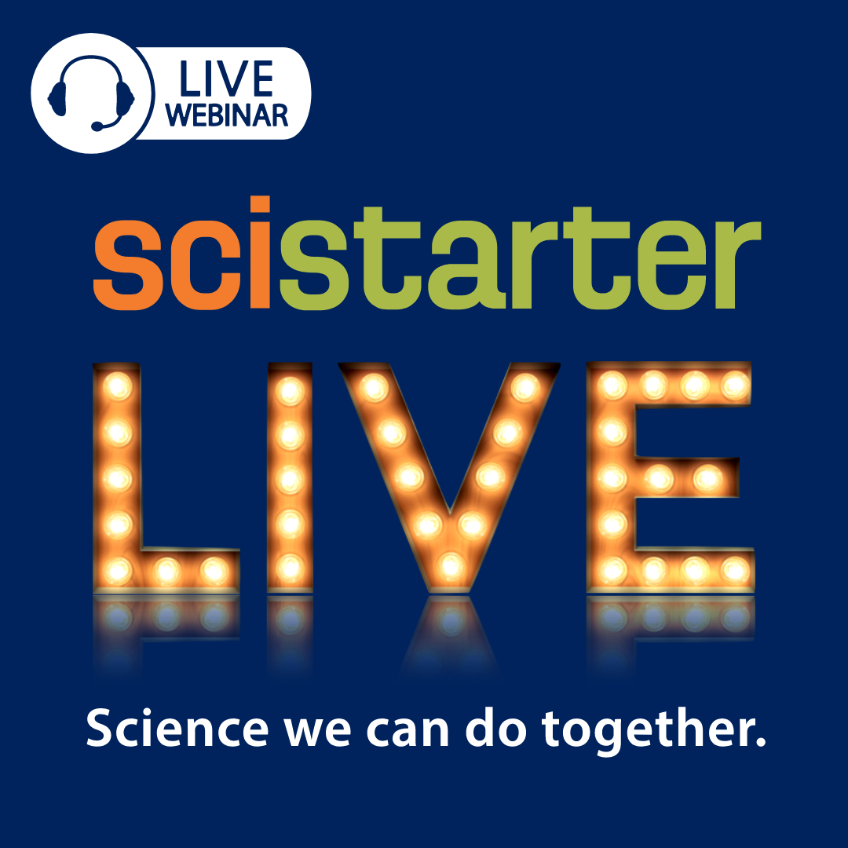
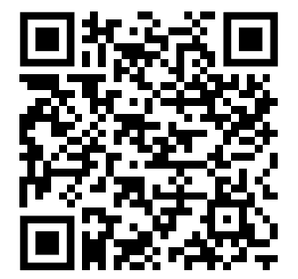
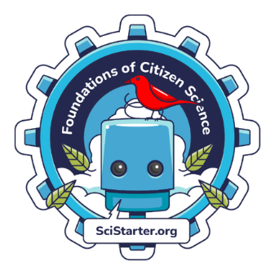
The SciStarter Ecosystem

Slide 20
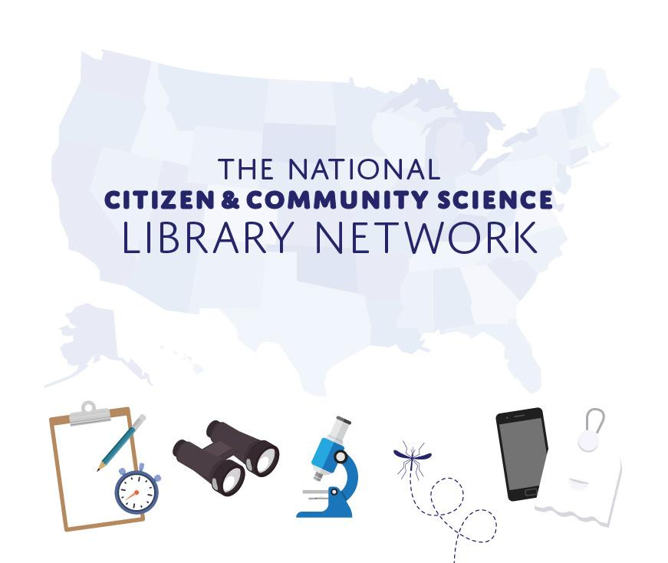
The national citizen and community science library network

Slide 21
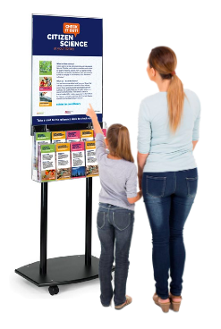
Libraries as Community Hubs
2017 - Phase I begins with six Maricopa County (AZ) libraries
2018 - Citizen Science Day scales to annual Citizen Science Month
2021 - National expansion begins with 10 pilot libraries; community based organizations (Girl Scouts, NASA Night Sky Network, etc.)
2022 National Network already serves over 350 libraries!
2023 - 2026 Plans to scale through Citizen Science Month in libraries is officially funded!
Notes:
In order to explain what a library can do, I’ll walk you through a short history…

Slide 22
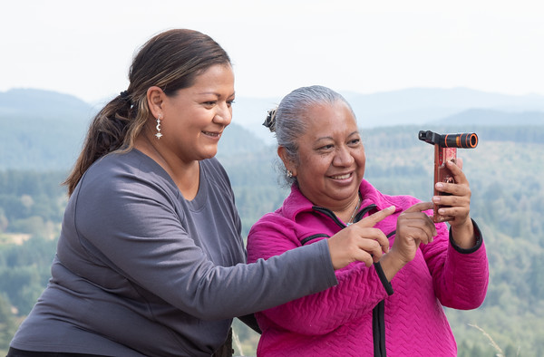
Pilot Project Outcomes
Libraries and patrons reported:
Increased interest and knowledge of citizen science
Greater confidence in their ability to collect and interpret data
92% of participants (the majority were women, underrepresented in STEM) expressed interest in checking out another citizen science kit
Scientists reported a notable increase in data submitted to their projects
Notes:
What did this pilot program do for the communities involved?
[rad through summative results]

Slide 23
Library Network Goals
A growing network of libraries and other community-based organizations dedicated to engaging their communities in citizen science managed by Arizona State University, SciStarter and the National Girls Collaborative Project.
Notes:
And we came up with these goals [read through]

Slide 24
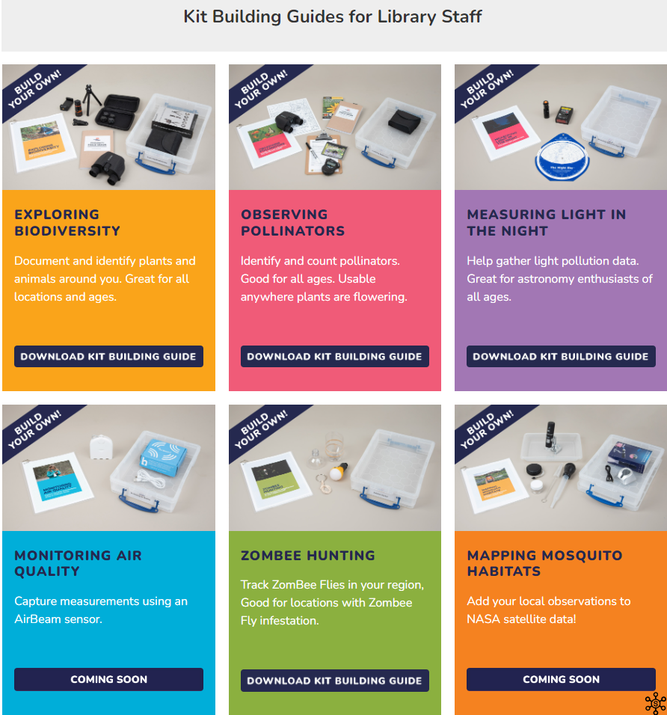
Library Kits Supporting Citizen Science
Measuring Light in the Night
Exploring Biodiversity
Observing Pollinators
ZomBee Hunting
Monitoring Air Quality
Mapping Mosquito Habitats (new!)
Assessing Indoor CO₂ (pilot!)
Notes:
Chino - nature oriented kits
Resources- the instruments that are used to supplement projects, instructions and other engagement activities have been gathered into kits.
This is the list of kits currently available [read]
We supply build-a-kit guides that help libraries get started in circulating kits to patrons.
The Monitoring Air Quality kit has been updated to address the new AirBeam3 that support both Android and iOS devices. The AirBeam2 that only supports an Android app is still good to use for this project.

Slide 25
Why do citizen science to address the environment and climate?
Climate change and environmental problems are hyper-local. Science helps us understand differences street by street, community by community, to better address the problem.
Environmental problems and climate change can make us feel powerless. Citizen science and the data-driven understanding it gives us helps us take that power back.

Slide 26
Citizen science empowers resiliency: Miss Louisiana Earth
In 2020-2021, as Miss Louisiana Earth, my platform was “Citizen Science Empowers Resiliency.” We engaged in online environmental monitoring to help people on the Gulf Coast with the Land Loss Lookout project.

Slide 27
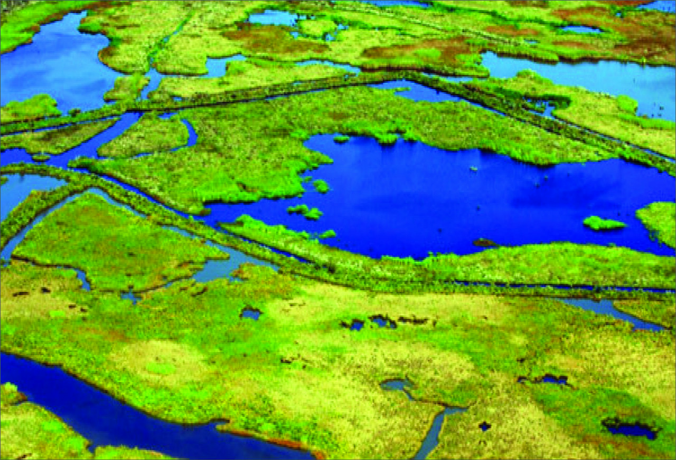
Citizen science empowers resiliency: Miss Louisiana Earth 1
People all over the world were able to engage in the Land Loss Lookout project to classify land loss photos from the Gulf Coast of the US, with Healthy Gulf, Northeastern University, and Cartoscope.

Slide 28
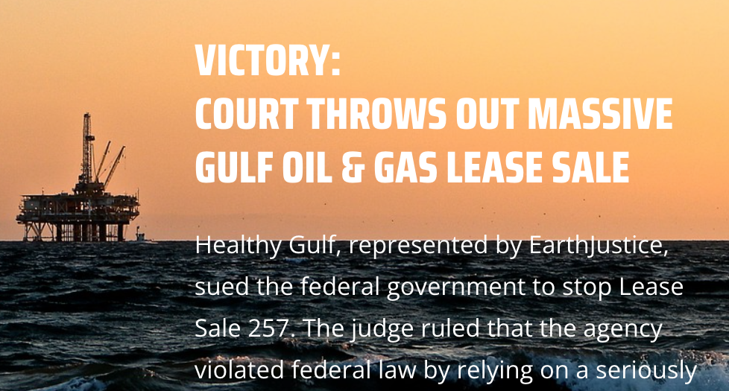
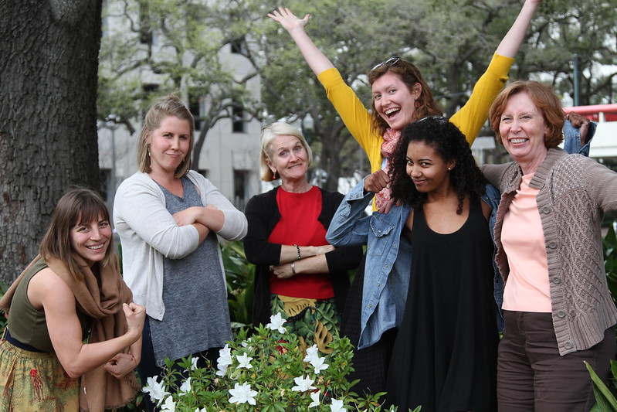
What is Healthy Gulf?
Healthy Gulf’s purpose is to collaborate with and serve communities who love the Gulf of Mexico by providing the research, communications, and coalition-building tools needed to reverse the long pattern of over exploitation of the Gulf’s natural resources.
5 States of wetlands coast of the United States
They don’t take funding from oil and gas
Considered a “sacrifice zone”, with a lack of recognition for indigenous groups and lack of voting rights for African Americans
Citizen science necessary for recognition of damage to natural resources, which are nationally and internationally important
https://healthygulf.org/
Notes:
Scott

Slide 29
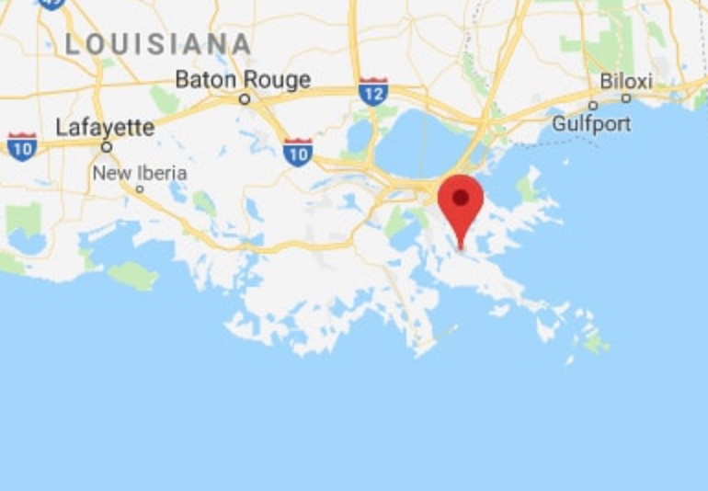
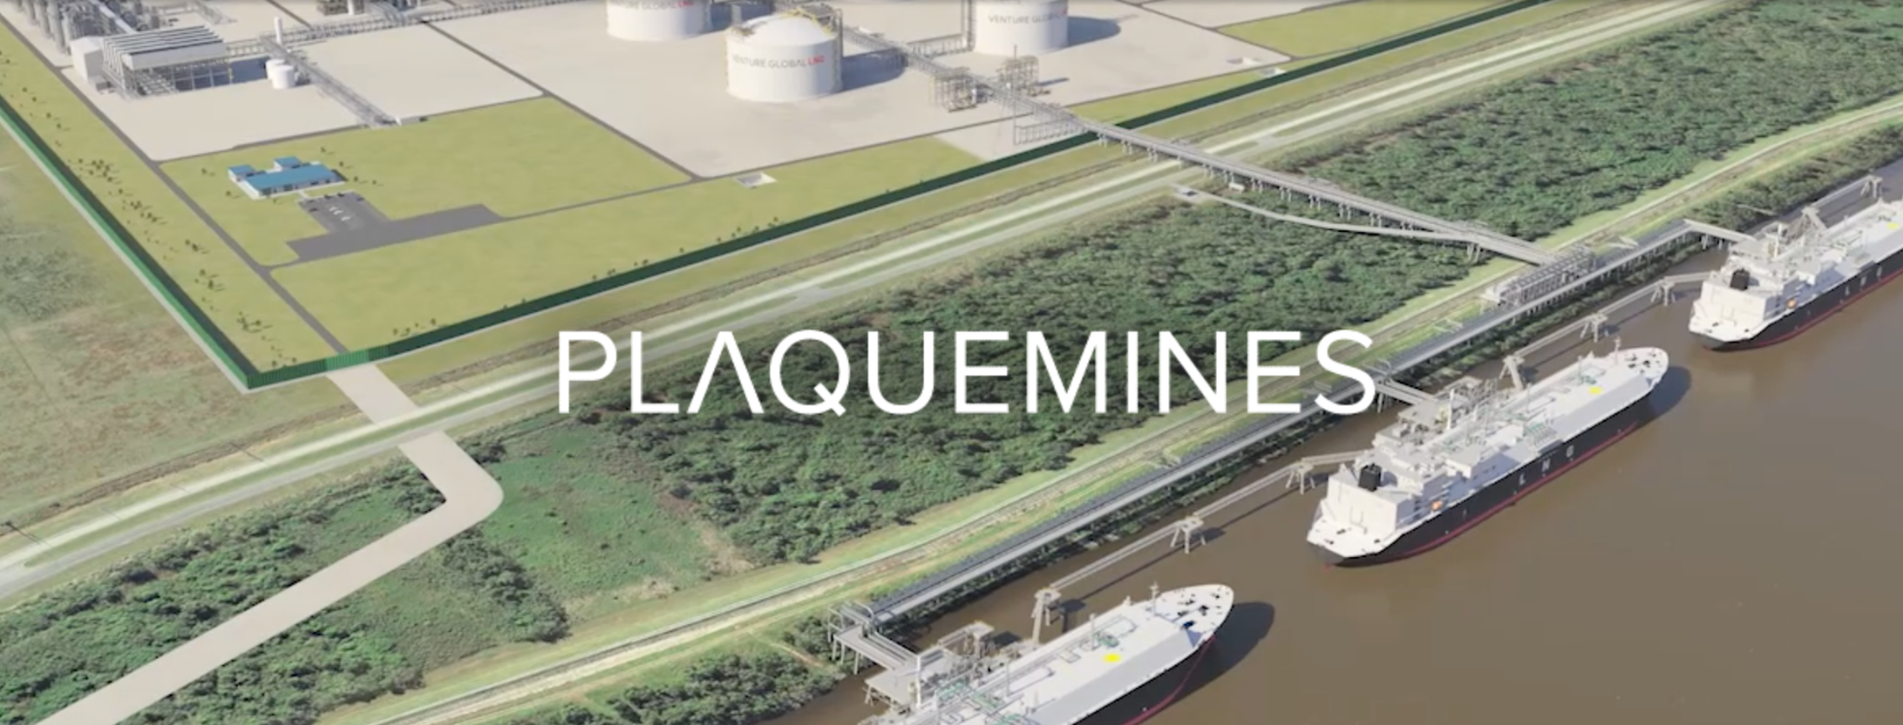
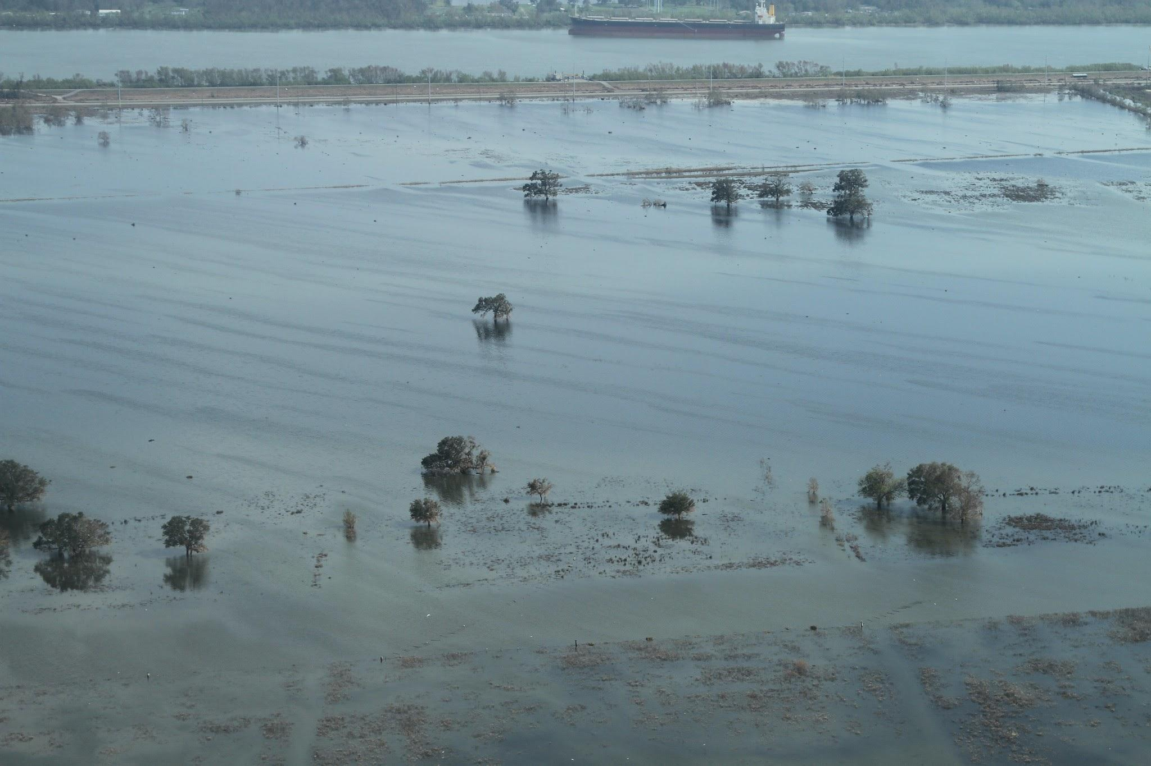
Venture global lng
Venture Global Liquid Natural Gas (LNG), deny their environmental impact on coastal wetlands, claiming there are “no scientifically accepted methods for evaluation of such impacts” and that assertions that their actions cause climate change impacts that affect wetlands is “speculative” (VGLNG Aug 5th, 65 2019).
https://venturegloballng.com/project-plaquemines/
https://healthygulf.org/2021/09/13/plaquemines-lng-export-terminal-as-foolish-as-it-is-dangerous/

Slide 30
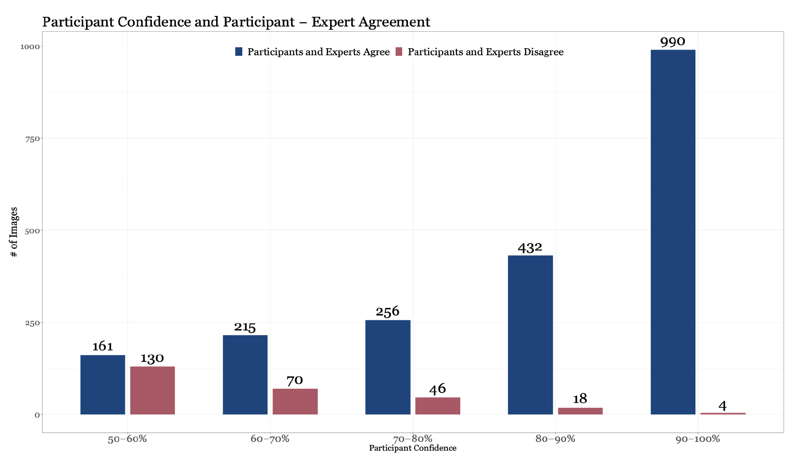
Land Loss Lookout Research Findings
Trained volunteers findings agree with experts:
Experts and participants agreed on classifications at least 83% and at most 94% of the time.

Slide 31
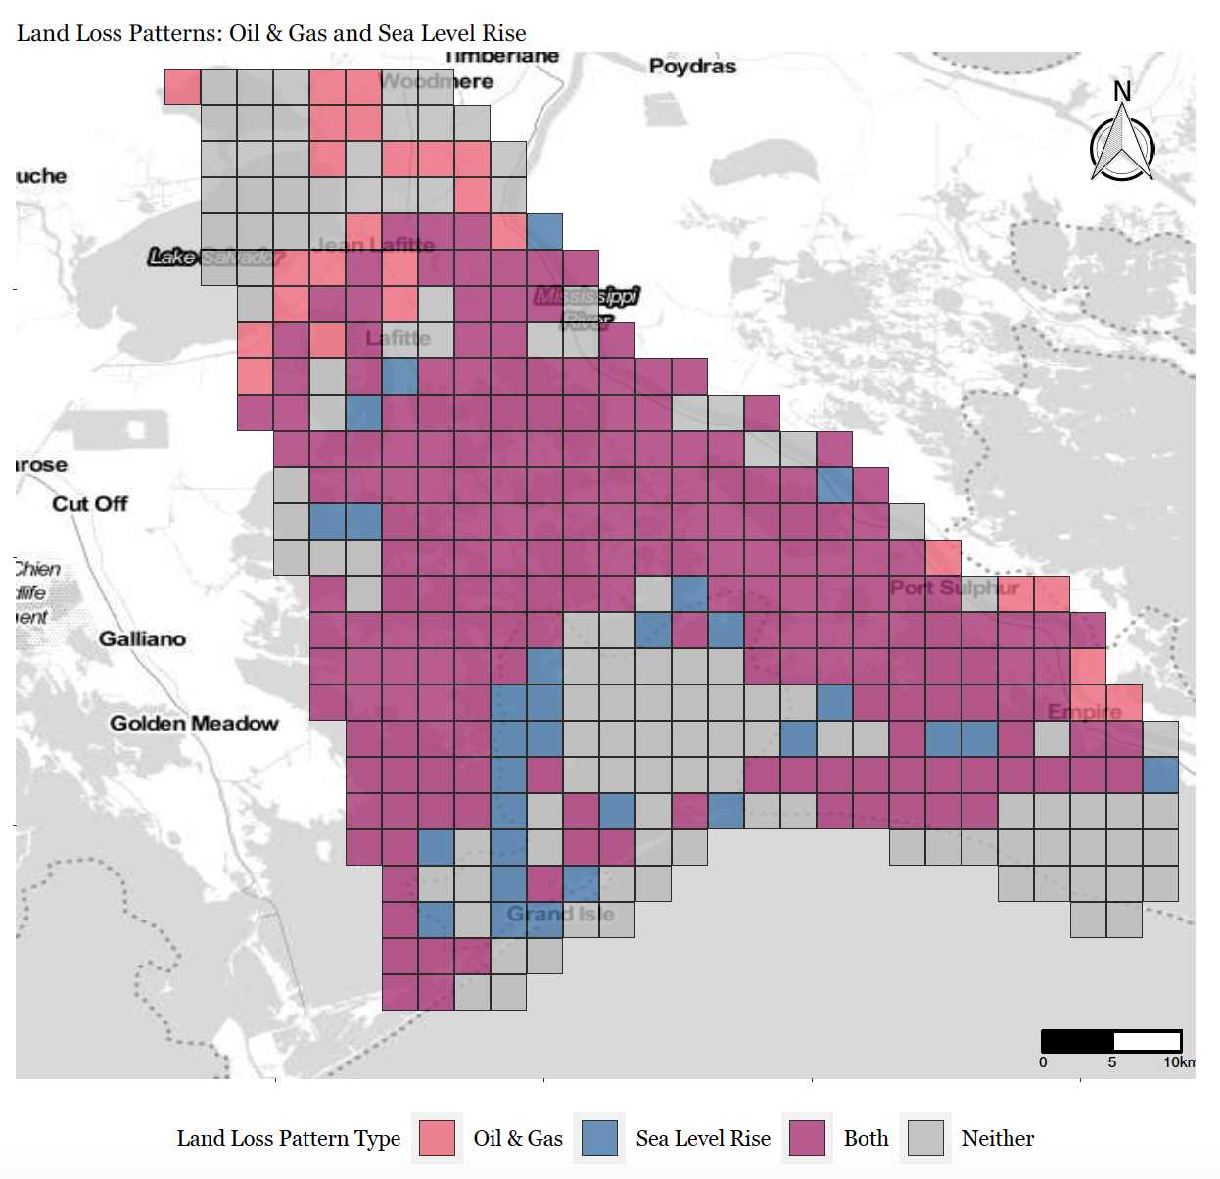
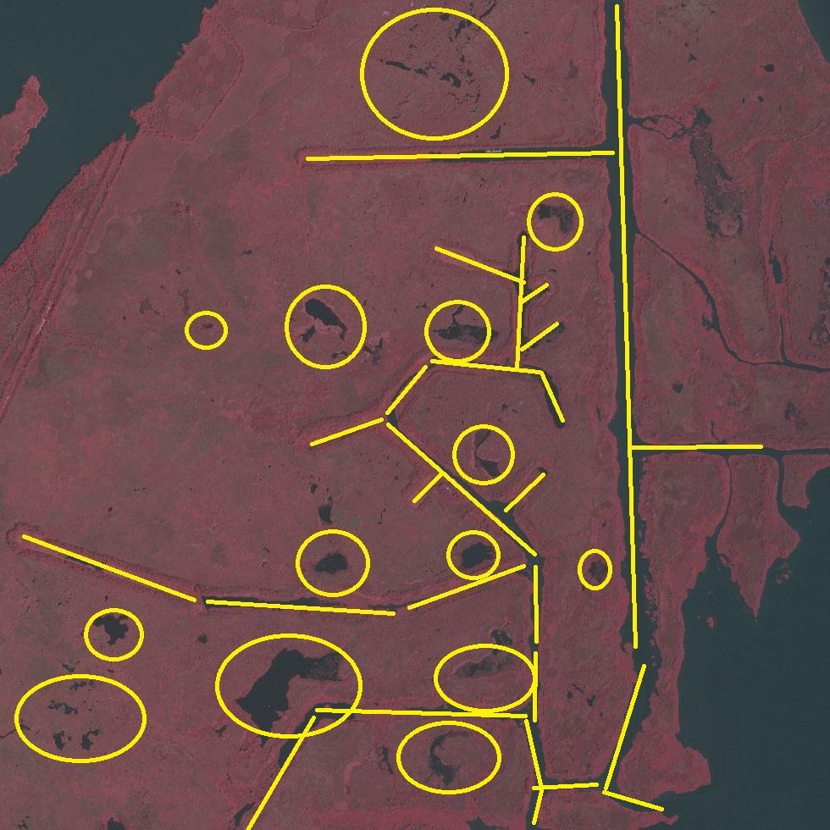
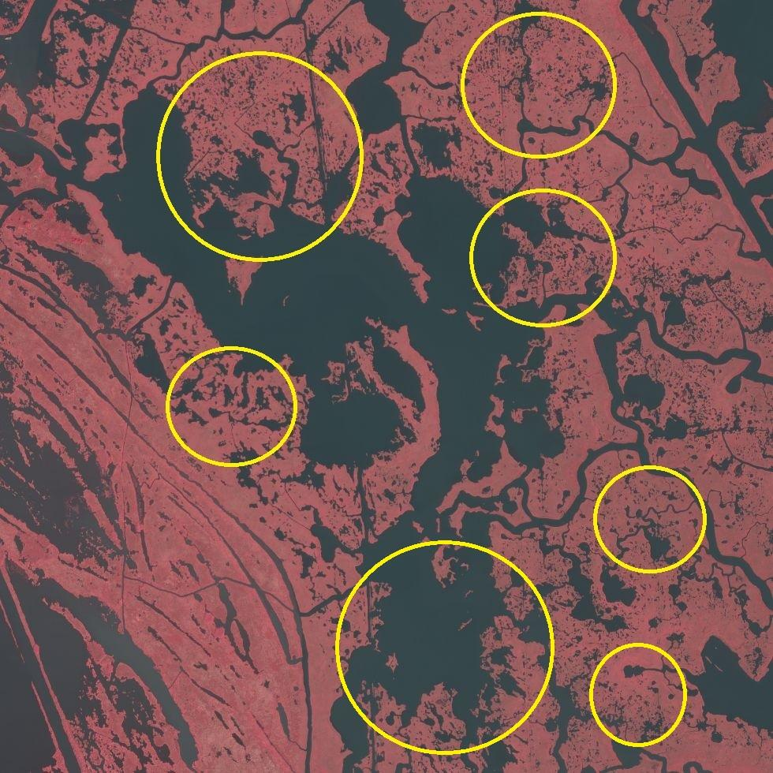
Oil and Gas Extraction and Sea Level Rise were the most common patterns and frequently occur together
Oil & Gas
Sea Level Rise

Slide 32
Citizen science empowers resiliency: Miss Louisiana Earth 2
The Unique Mappers of Nigeria were rockstars and classified more data than anyone else!
Analyzed ~6,000 Images!

Slide 33
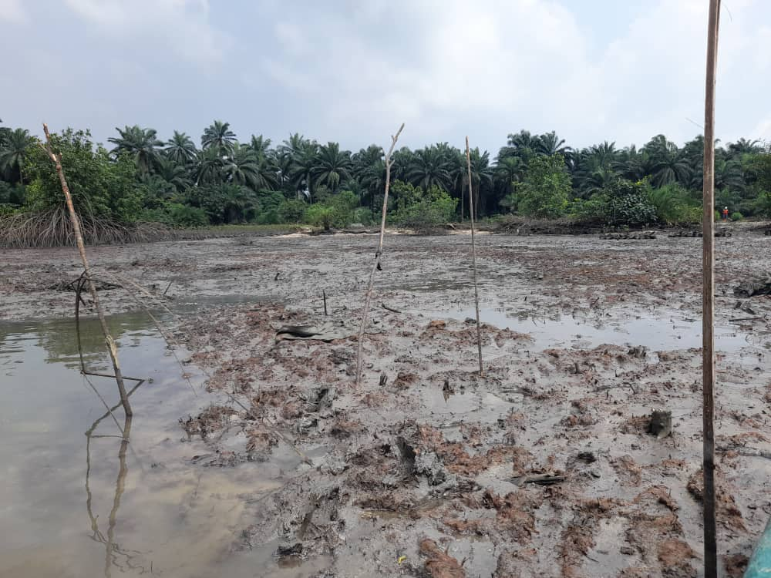
Citizen science empowers resiliency: Miss Louisiana Earth continued
Now, the experts behind Land Loss Lookout created Land Pollution Lookout: Niger Delta, so people from around the world can help the people of Nigeria and the Unique Mappers.

Slide 34
Objective 2: Viewers will receive templates to launch citizen science initiatives in their own communities and organizations

Slide 35
From CitSciDay to CitSciMonth

Slide 36
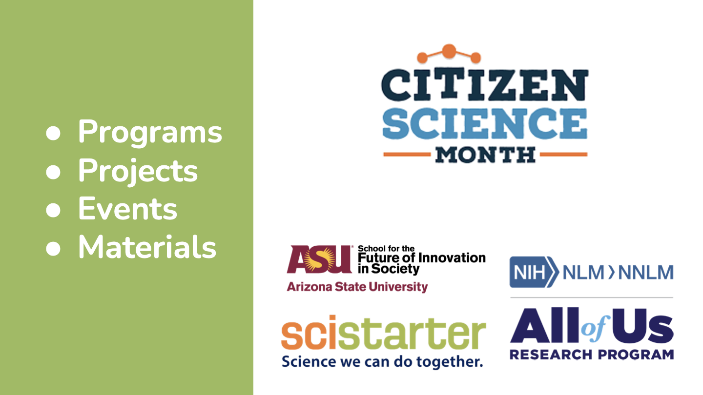
Citizen Science Month

Slide 37
Citizen Science Month Evaluation Outcomes

Slide 38
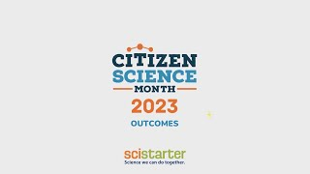
Citizen Science Month 2023 Outcomes

Slide 39
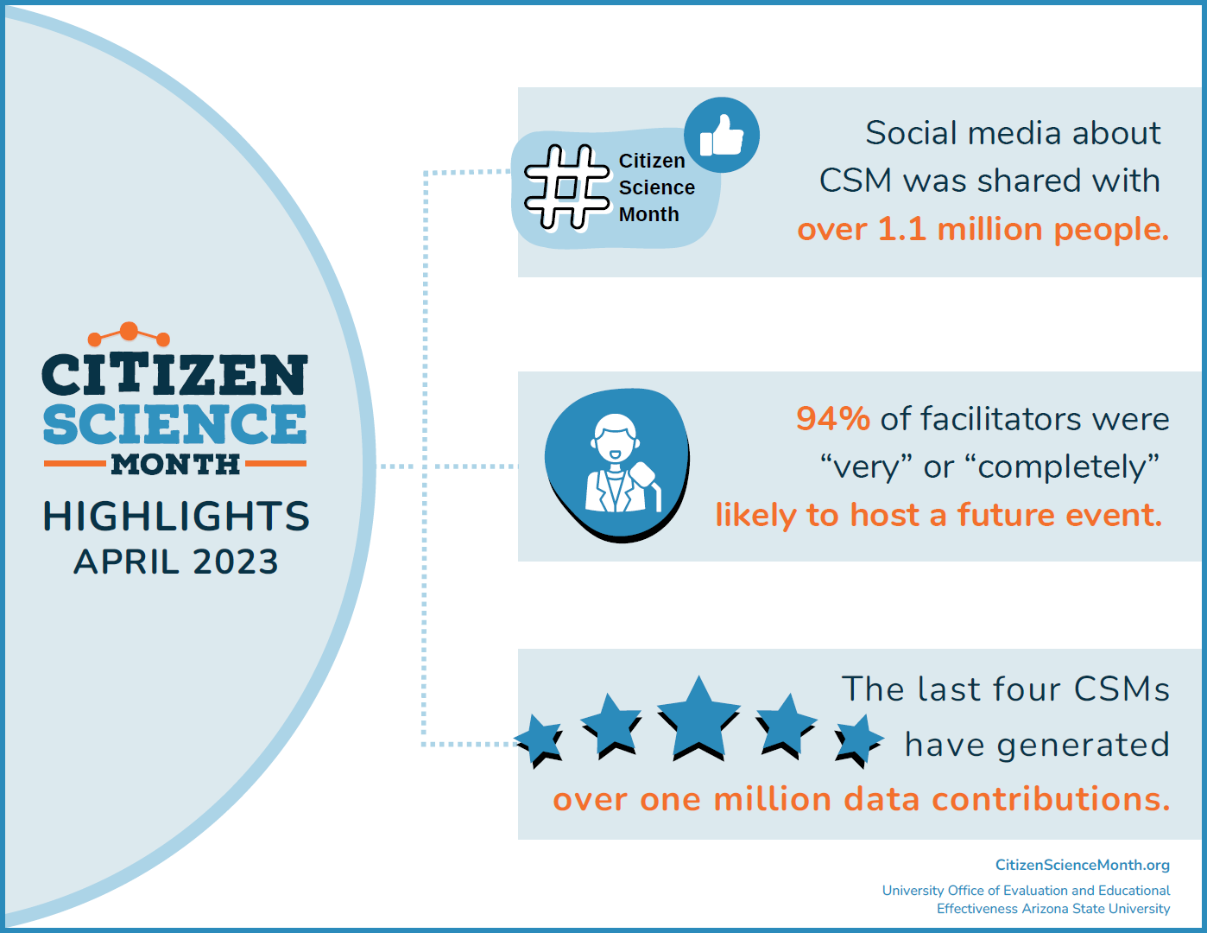
Citizen Science Month Highlights April 2023
In just a few years, Global Citizen Science Month (April) has grown from a single day of events to a coordinated effort supported by SciStarter, the National Library of Medicine (NLM) through the Network of the National Library of Medicine (NNLM), Arizona State University, the Citizen Science Association, Science Friday, National Geographic, and many other collaborators from around the world.

Slide 40
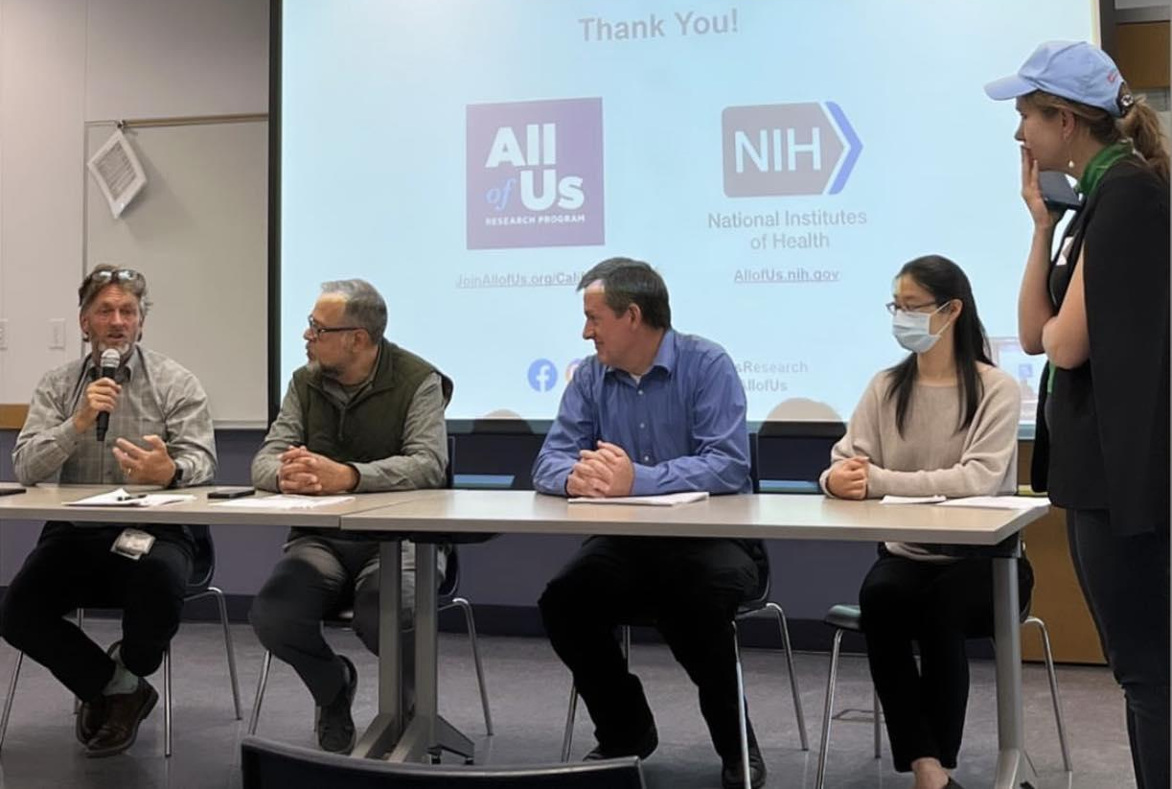
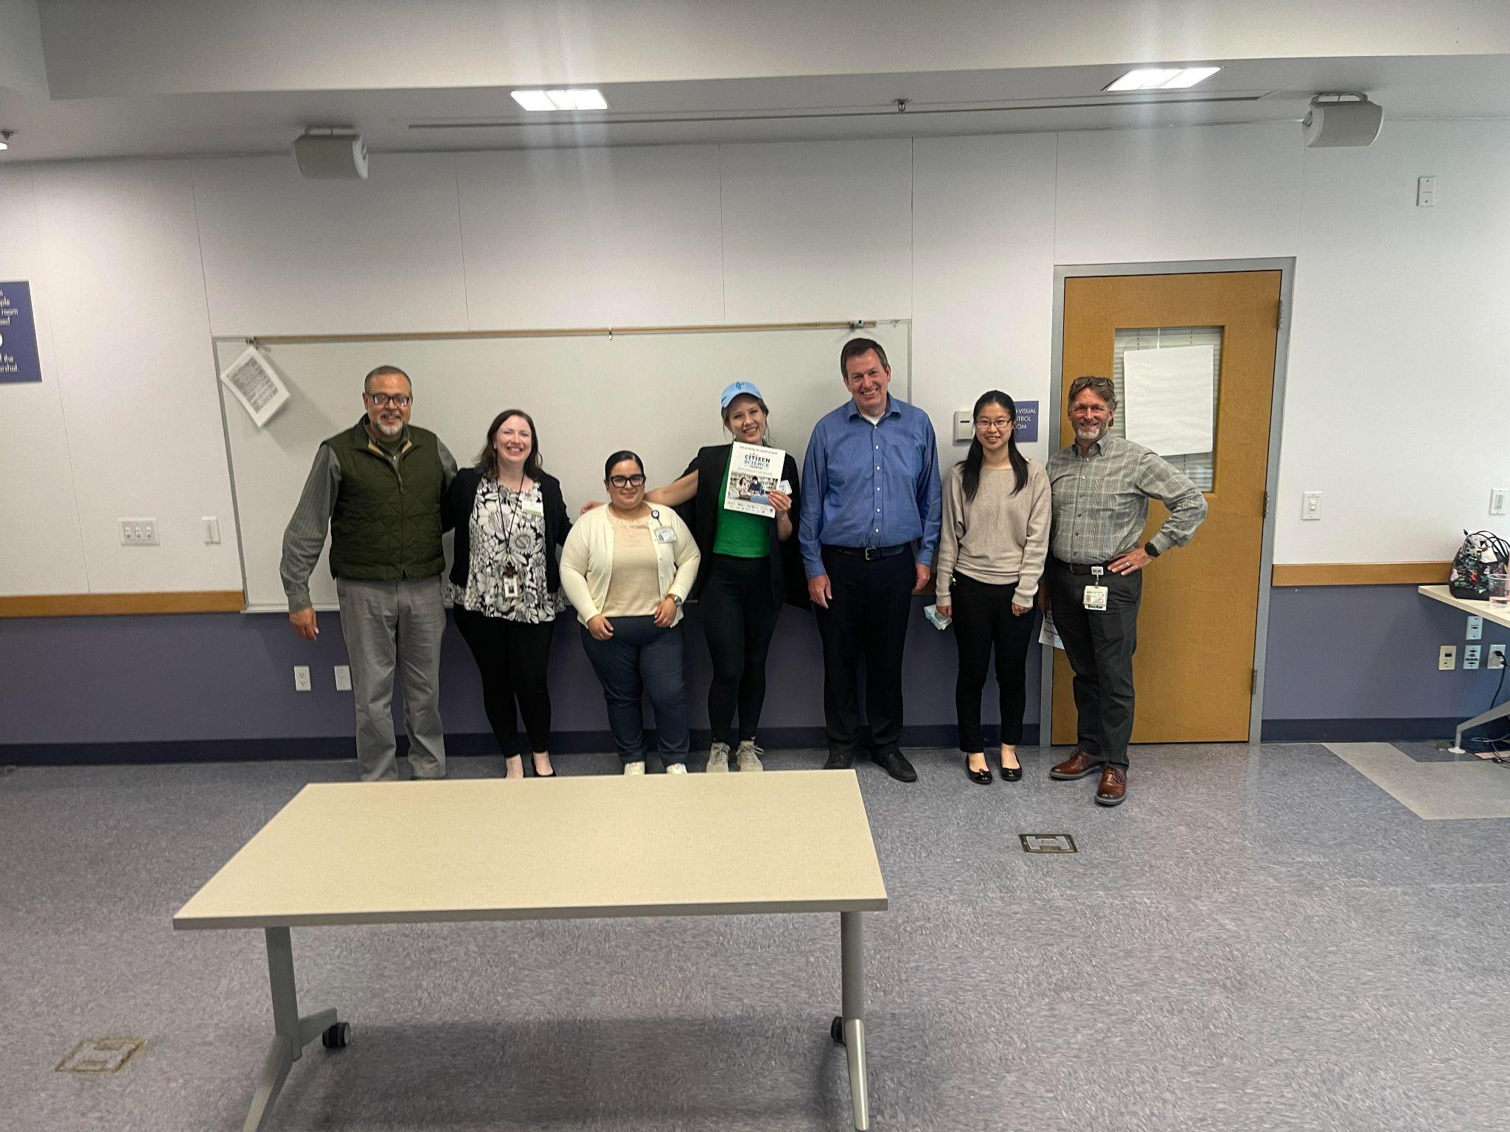
Citizen Science Month & All of Us
Images from All of Us CA, NNLM & SciStarter April 2023 DNA Day Event
Why this partnership?
Each Citizen Science Month, we feature the All of Us Research Program as a keynote project, in addition to other projects that are great fit for libraries and communities to meaningfully engage in science, because it meaningfully engages communities in important health research.
All of Us encompasses environmental health, too!

Slide 41
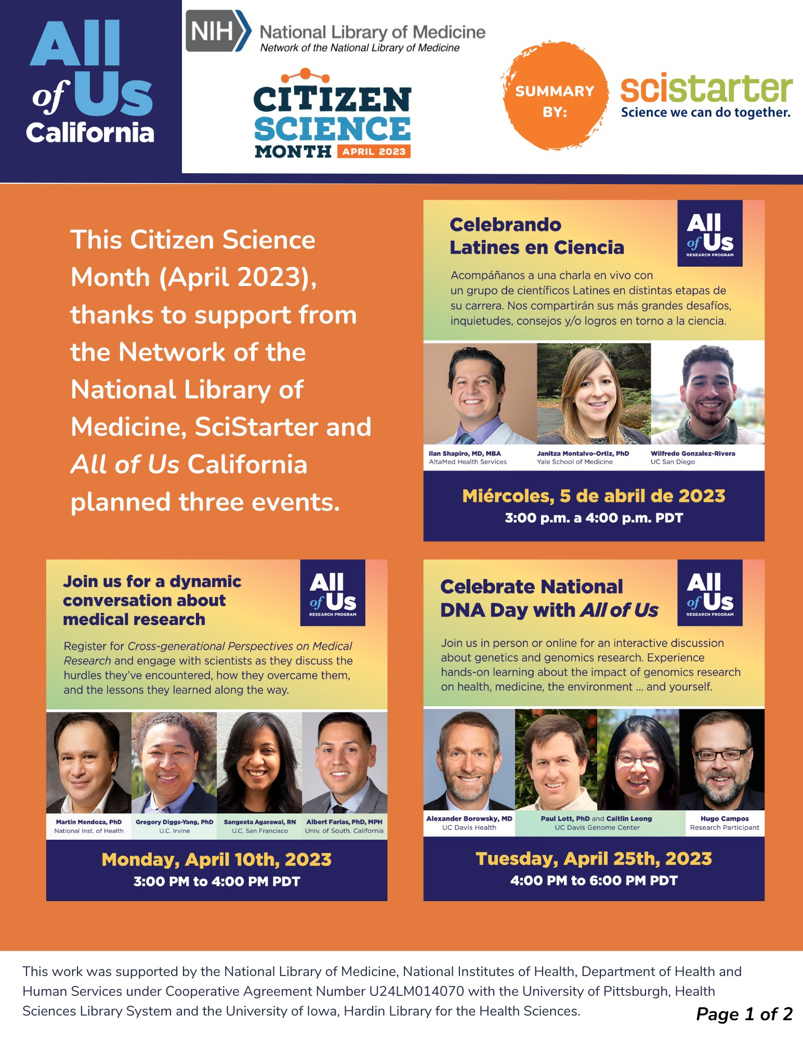
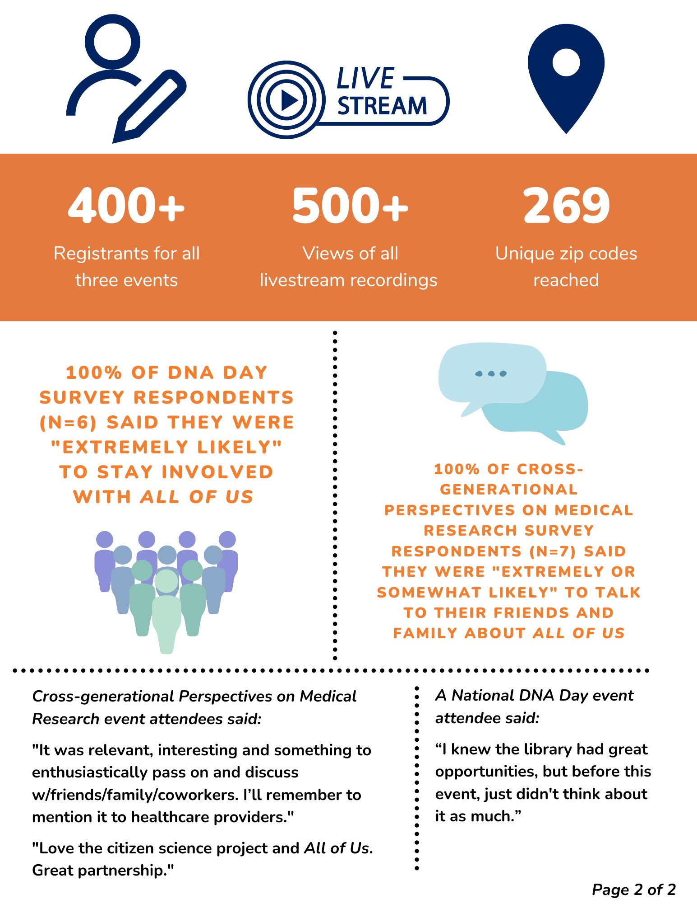
2023 All of Us CA examples
2023
All of Us CA examples

Slide 42
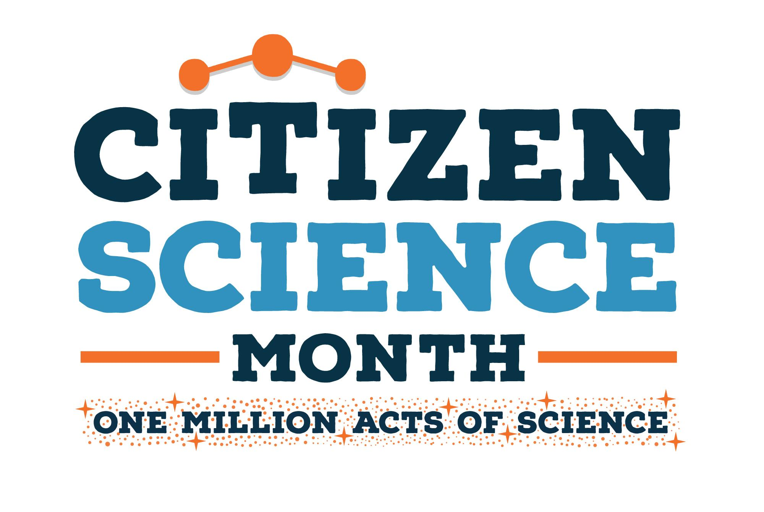
All of Us Programming for Libraries
Purpose: To share community health resources and knowledge with the public. The National All of Us Program Center and SciStarter team up to make this type of an event possible for any library.
Audience: Adults, families
Menu of Options: Events can be:
Asynchronous, involving the use of shelf talkers, fun interactive posters, kits, and more
Synchronous, including a citizen science watch party with other libraries, staffed by All of Us facilitators
Multi-day, including All of Us recruitment events
Credit: All of Us Research Program

Slide 43
How to Leverage to inspire and empower your communities
Citizen Science Month is presented by SciStarter and Arizona State University with support from the National Library of Medicine.
Notes:
Presented by SciStarter and the Association for Advancing Participatory Sciences

Slide 44
One million acts of science
A global, month-long campaign to inspire people to discover and join participatory science projects and collectively generate over one million data points to help accelerate research this April.
Notes:
Tara

Slide 45
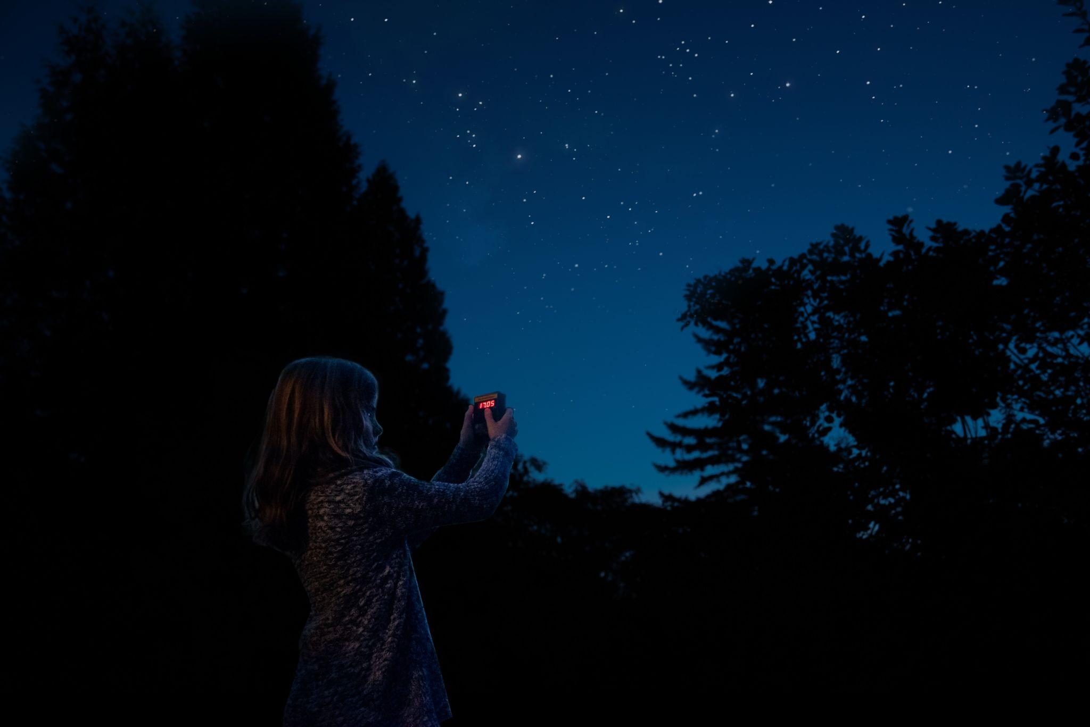
What counts as an act of science?
Attend or host an online or in-person event
Join a project to play games that accelerate medical research
Analyze online images to help make discoveries
Share pictures of nature to help scientists spot biodiversity trends
Use your smartphone to monitor your environment
Notes:
Tara

Slide 46
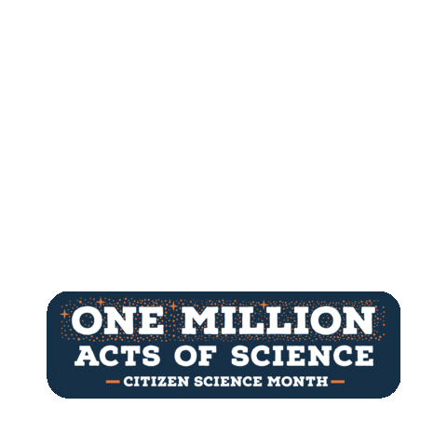
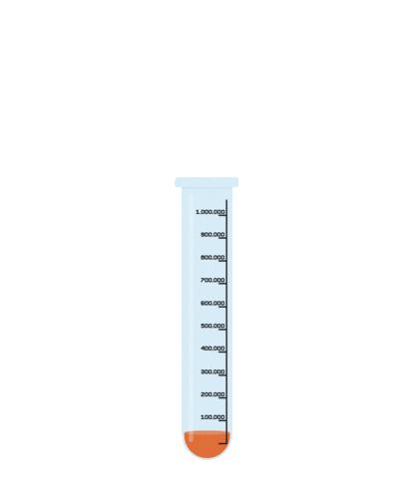
Get your community involved at CitizenScienceMonth.org
Get your community involved: CitizenScienceMonth.org

Slide 47
Objective 3: Viewers will receive a step-by-step introduction to at least one citizen science project.

Slide 48
What can I do?
Featured projects on homepage
Recipe cards to share with your community
Report your efforts with the self-reporting form
CitizenScienceMonth.org

Slide 49
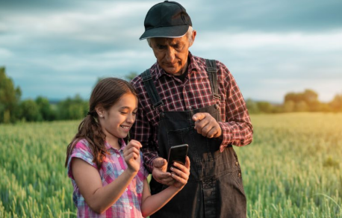
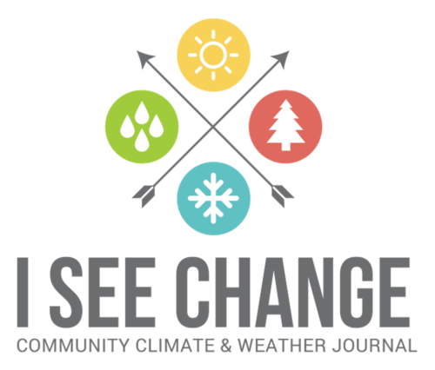
ISeeChange Program
Background: The ISeeChange project is a global community that documents local changes in environment, weather, and climate. Each post is synced with weather and climate data, which is broadcast to the community to investigate bigger picture climate trends. Communities have used ISeeChange to target infrastructure improvements in relation to climate change.
Age group: All ages, children 13 and under will need an adult to help submit data
Event timing and location: 1 hour, indoors or outdoors depending on the climate hazard you would like to document. Prioritize safety when documenting hazards like flooding or extreme heat!
Preparation:
Review the project protocol on SciStarter: https://scistarter.org/Affiliates/iseechange-Affiliates
Be prepared to photograph with a smartphone and/or write down observations about weather and climate, as well as their impact on the community.

Slide 50
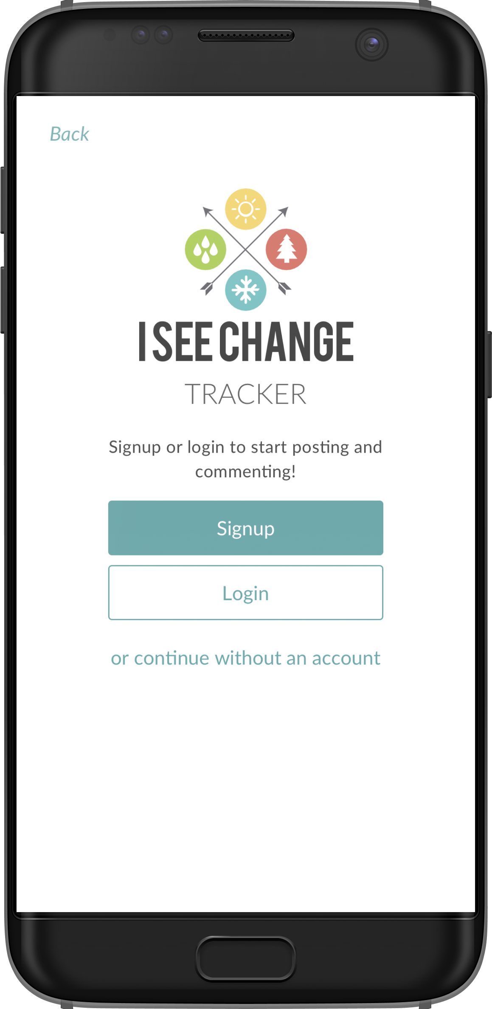
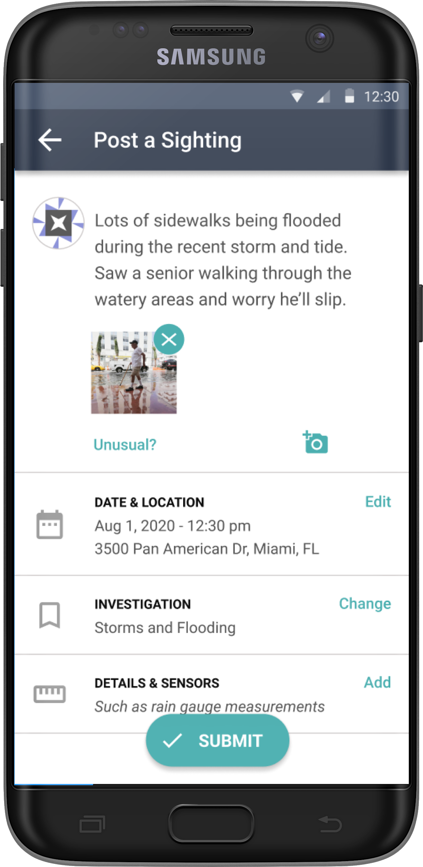
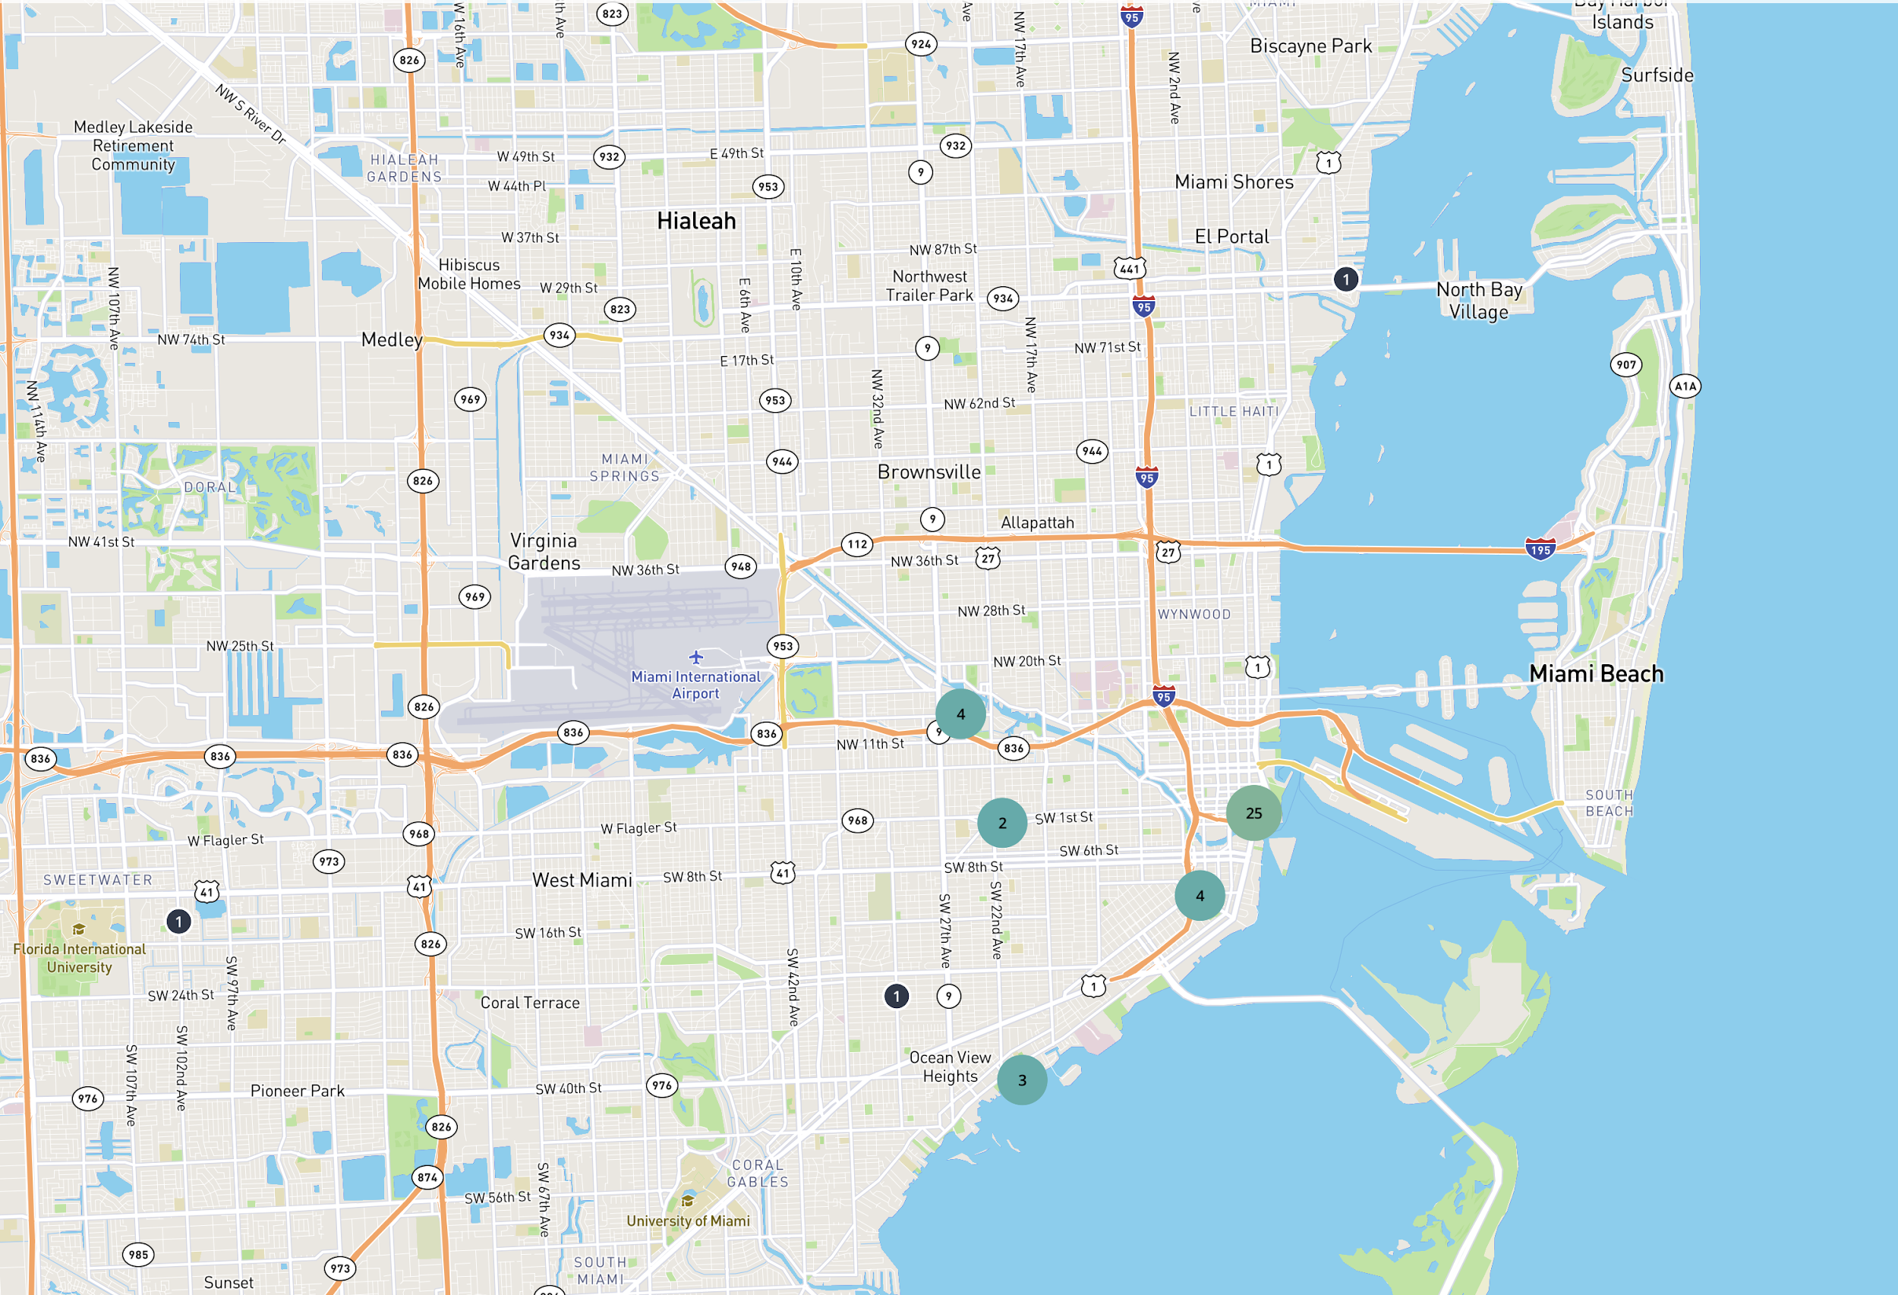
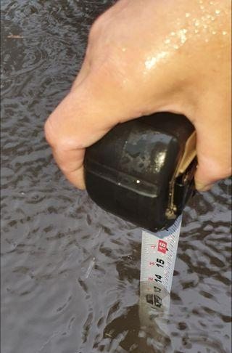
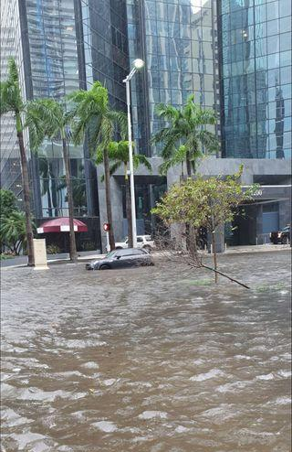
Program Description ISeeChange
Set the Stage
Collect Data
Take Action
Introduce the concept of citizen science using Foundations of Citizen Science facilitator slides and guide.
Have participants create accounts on SciStarter.org.
Discuss differences between weather and climate, and talk about climate hazards in your community. Use the slides from ClimateCast LIVE as inspiration, and contact your local Extension office if you need ideas.
Review the observation and data collection protocols. Allow time for questions.
Have participants write down observations about and/or take pictures of weather and climate impacts.
Encourage participants to give their own lived expertise. What is the impact of, for example, extreme heat on their lives? Do hotter temperatures make them feel worse?
Discuss what you saw as a group.
Add data* on https://scistarter.org/Affiliates/iseechange-Affiliates.
Decide what you’re going to do next, like presenting your findings to community leaders for infrastructure improvements!
* If your participants are under the age of 13, you may need to gather and submit their data.

Slide 51
Globe at Night Program
Background/Talking Points: Light pollution is intrusive artificial (usually outdoor) light. Too much light pollution can wash out starlight, interfere with astronomical research, disrupt ecosystems, and have adverse health effects. Globe at Night is an international citizen science project that involves the public in measuring and collecting night sky brightness observations to help scientists understand the impact of light pollution.
Age group: All ages, children 13 and under will need an adult to help submit data
Event timing and location: 30-45 min at least one hour after sunset, outdoors, preferably on a moonless night.
Preparation:
Review the project protocol:
https://scistarter.org/education/Globe-at-night-education
Gather optional materials*
Sky Quality Meter-L (SQM-L, SQM)
Red LED light flashlight
Planisphere
Download and print the data entry sheet and Sky Quality Meter Instructions.
*These materials are associated with the Measuring Light in the Night Kit. Learn more at SciStarter.org/library-build-a-kit.

Slide 52
Program Description Globe at Night
Set the Stage
Collect Data
Take Action
Introduce the concept of citizen science using Foundations of Citizen Science facilitator slides and guide.
Have participants create accounts on SciStarter.org.
Discuss the problem of light pollution. Find educational materials and discussion prompts on SciStarter & DarkSky.org
Review the data collection protocol on SciStarter: https://scistarter.org/globe-at-night
Assist participants in finding the right constellation to determine level of light pollution. There are mobile apps for this, like “Night Sky.”
If you have the Measuring Light in the Night library kit, help participants use the planisphere to identify constellations and take a light meter reading with the SQM-L.
Tip: Night vision needs to be maintained to find an accurate reading. Use red-light flashlights instead of white light, and avoid phone screens as much as possible during the activity.
Introduce participants to practices, behaviors and lighting methods that limit light pollution. Visit DarkSky.org for information on how to take action.
Have a discussion about what participants can do to practice these low light and intentional light design methods at home, and in the community.
Encourage participants to visit SciStarter.org/darksky for more projects to take action against light pollution.
Programming tips: Make your event a star party by inviting amatuer astronomers to join! Check out NASA’s Night Sky Network to find amateur astronomers in your area. Boost engagement with hands-on STEM activities searchable on STAR Net’s STEM Activity Clearinghouse.
Notes:
Dark Sky example of curriculum: https://darksky.org/what-we-do/advancing-responsible-outdoor-lighting/home/

Slide 53
What can I do? continued
Featured projects on homepage
Recipe cards to share with your community
Report your efforts with the self-reporting form
CitizenScienceMonth.org

Slide 54
One Million Acts of science poster examples

Slide 55
Thank you

Slide 56
Thank you for attending
Notes:
Thank you to Caroline and Emma. Just a few items before we end the session
If you are interested in claiming MLA CE credit [and CHES] for this, the link is in the Chat. As you take the evaluation, if you answer "Yes” to wanting the CE, please make sure to pay close attention as a CE code and additional instructions will appear.
Post in Chat: evaluation link with CE info
If you haven’t already, consider registering for upcoming sessions of this series. The next one is [date and title]. (if this is the last session, say attendees can view the recordings to all the sessions on our accompanying guide)
Don’t forget our accompanying guide. Each session has its own tab with information about the speaker and links to related information resources. The recordings will also be linked there as well as on our YouTube channel. Links for those are in the Chat.
Post in Chat:
•Next NNLM Event: Environmental Chemicals and Breast Cancer: What Do We Know? What Can We Do? https://www.nnlm.gov/training/class/environmental-chemicals-and-breast-cancer-what-do-we-know-what-can-we-do
•Series guide https://www.nnlm.gov/SDOEHguide
•Social media hashtag #SDOEH24
•NNLM YouTube https://www.youtube.com/@NnlmGov
For social media posts about this series please use the hashtag #SDOEH24.
Thank you for attending and participating and to our guest speaker(s) for a wonderful presentation.

