Slide 1
What are SDOH? (and what is their significance?)
Social Determinants of Health

Slide 2
Please complete the pre-test questions
Notes:
[NOTE TO FACILITATOR: if you choose not to have participants complete the knowledge assessment questions, delete this slide.]

Slide 3
Discussion question
How can we be more inclusive of people who are non-binary and/or gender non-conforming?

Slide 4
Objectives
By the end of this track, participants will be able to:
Identify and define SDOH
Describe how SDOH influences health
Notes:
We’re moving on to our series of modules on the social determinants of health. The objectives today are to define the SDOH and describe how they influence health and engagement in healthcare.

Slide 5
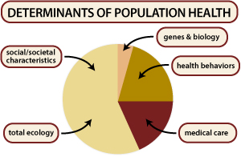
Determinants of Health
Determinants of health are factors that contribute to a person’s current state of health. These factors may be biological, socioeconomic, psychosocial, behavioral, or social in nature. Scientists generally recognize these five determinants of health of a population ^{1,2}
Fig. 1 Centers for Disease Control and Prevention. 2019. What are determinants of health and how are they related to social determinants of health? Available at: URl to Source
Notes:
Before addressing social determinants of health (SDOH) specifically, it’s helpful to look a little broader at the generally recognized determinants of health. You can see a definition of the determinants of health here: they are factors that contribute to a person’s current state of health. There are five generally recognized categories of determinants:
5 Generally Recognized Categories
Genes and biology: for example, sex and age
Health behaviors: for example, alcohol use, injection drug use (needles), unprotected sex, and smoking
Social environment or social characteristics: for example, discrimination, income, and gender
Physical environment or total ecology: for example, where a person lives and crowding conditions
Health services or medical care: for example, access to quality health care and having or not having insurance^{1,2}
Scientists do not know the precise contributions of each determinant at this time. In theory, however, genes, biology, and health behaviors together account for about 25% of population health³. Social determinants of health represent the remaining three categories of social environment, physical environment/total ecology, and health services/medical care³. These social determinants of health also interact with and influence individual behaviors as well³. More specifically, social determinants of health refer to the set of factors that contribute to the social patterning of health, disease, and illness³.
Centers for Disease Control and Prevention. 2019. What are determinants of health and how are they related to social determinants of health? Available at: https://www.cdc.gov/nchhstp/socialdeterminants/faq.html

Slide 6
Social Determinants of Health (SDOH)
“are the complex, integrated, and overlapping social structures and economic systems that are responsible for most health inequities.”³
^{-CDC}
Notes:
Narrowing the scope of the determinants of health to focus more specifically on social determinants of health, this is a definition that encompasses the larger socio-economic-political lens. We can think of this as more of an umbrella under which social determinants exists and the systems that drive and influence them.

Slide 7
Social Determinants of Health (SDOH) (2)
Social determinants of health such as poverty, food insecurity, unequal access to health care, stigma, inadequate education, job security, transportation, social exclusion, and racism are tangible responses of those complex, integrated social structures and economic systems.³⁷
Notes:
Let’s drill down a little more and get specific. You can see several social determinants of health listed here from poverty to food insecurity to education, transportation, and racism. These all influence our health, and I am sure you have seen in some of your patients. We know that poverty limits access to healthy foods and safe neighborhoods, and that more education is a predictor of better health.^{4,5,6} We also know that differences in health are striking in communities with poor SDOH such as unstable housing, low income, unsafe neighborhoods, or substandard education.^{7,8}
[NOTE to Facilitator: brief discussion question]: What other structures/systems, or responses to those systems, can you think of that might fit in this list?
(ex. health systems and services; housing; the physical environment; public safety; the social environment)
Health inequities are the differences in health that are avoidable, unfair, and unjust. As can be seen in this paragraph, health inequities are affected by social, economic, political, and environmental conditions.

Slide 8
The Social Gradient
“The poorest of the poor, around the world, have the worst health. Within countries, the evidence shows that in general the lower an individual’s socioeconomic position the worse their health.” ¹⁴
Life expectancy is shorter and most diseases are more common the further down the socioeconomic ladder in each society¹⁴
This is not limited to only those of low SES¹⁴
Notes:
The social determinants of health as they relate to socioeconomic status run on a type of continuum, called the social gradient. The gradient could be summarized by saying that the worse someone’s socioeconomic status, the worse the outcomes, with even some increase in SES improving outcomes.¹⁴ This gradient “runs from top to bottom of the socioeconomic spectrum”¹⁴. This occurs around the world in countries of all income levels¹⁴. You can see a quote here from the World Health Organization explaining that, “The poorest of the poor, around the world, have the worst health. Within countries, the evidence shows that in general the lower an individual’s socioeconomic position the worse their health.”¹⁴. This concept of the social gradient in health means that health inequities affect all of us¹⁴.
Example
Between 2015-2018, 30.3 million people in the United States (9.4% of the population) had diabetes and 38.1 million people live in poverty. Those who live in the most poverty-dense areas are most prone to obesity, and therein an increased risk for and higher instances of diabetes; within these areas, poverty rates of >35% have obesity rates 145% greater than wealthy areas⁹. While there are numerous reasons for this disparity, including access to nutritious foods, resources that support physical activity, green spaces, and poor housing conditions, LaVeist et al found that the most common SDOH was poverty. When white and black people lived in the same poor neighborhood, the diabetes prevalence for whites rose 3.5% to match that of black residents¹⁰.
There are other health behaviors and outcomes that follow the social gradient, such as smoking and fruit and vegetable consumption³¹. Interestingly, alcohol consumption tends to be higher in those with higher social status, but the negative effects of alcohol consumption do follow the social gradient, with those of lower social position experiencing greater alcohol related harm³¹.

Slide 9
Health Conditions Associated with SDOH
Sexually Transmittable Infections ^{18,22}
Sexual Violence ¹⁶
Teenage Pregnancy ²¹
Traumatic Brain Injury³²
Type II Diabetes ^{17,26}
Youth Violence ³⁴
Cognitive Development ²⁰
Infant Mortality ^{27,28}
Obesity ^{23,29, 31}
Anxiety and Depression
Asthma ^{24,25}
Blood Pressure ³⁵
Cancer ^{30, 31}
Cardiovascular Disease ^{19,35}
Pneumonia ³³
Notes:
There is evidence that specific health conditions are linked to at least one of the social determinants of health. This is by no means meant to be an exhaustive list, and some conditions on this list require community-level intervention as opposed to something that can be addressed in direct clinical care. Let’s take one condition, for example: asthma.
Asthma is the most common chronic lung disease of childhood, affecting approximately 6 million children in the United States. Asthma was more prevalent among boys (9.2%) than among girls (7.4%), children aged ≥5 years (approximately 10%) than children aged <5 years (3.8%), non-Hispanic black (black) children (15.7%) and children of Puerto Rican descent (12.9%) than among non-Hispanic white (white) children (7.1%) and children living in low income families (10.5%) than among those living in families with income ≥250% of the Federal Poverty Level (approximately 7%)¹¹.
Black children are 2.5 times more likely than that of white children to be living in poverty in the United States¹². Poverty also often means compromised living conditions, built environment, and increased chronic stress. Evidence has shown a strong relationship between housing quality and health outcomes, particularly as related to childhood asthma¹³.

Slide 10
Ask One More Question
Understanding a patient’s socioeconomic status, for example, may inform a provider of certain social services that can help the patient (and you) address SDOH influence on health– Have you had any trouble paying your heat/electric bill recently?
Understanding food deserts and challenges in accessing nutritious foods when treatment planning for diabetes – Do you know where to access/find vegetables and fruits?
Notes:
So, what do we do as providers? Asking one more question presents to opportunity to address SDOH in the moment.
Please do not shy away from asking one more question for which you may not have an immediate answer. Far too often the people we care for become stuck in the same unhealthy rut/routine because we do not ask these things.

Slide 11
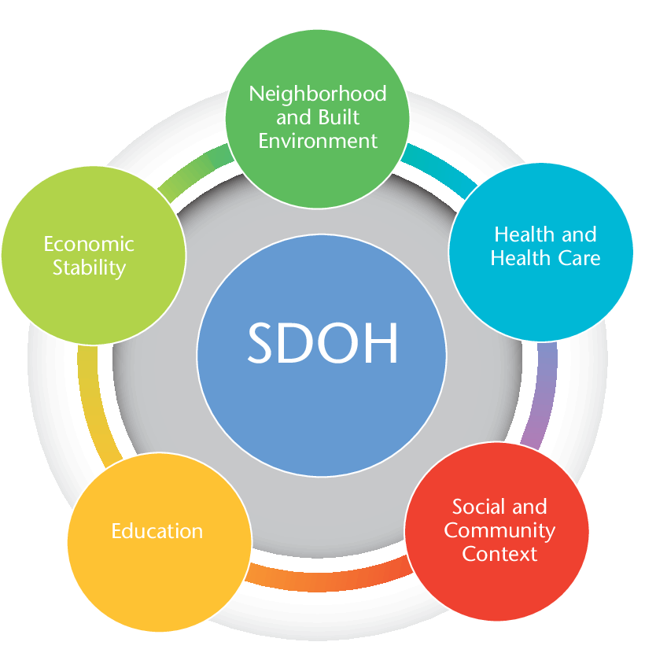
Social Determinants of Health
Fig 1. U.S. Department of Health and Human Services (2019). Social Determinants of Health. Retrieved from: URL to Source
Notes:
To Recap: Social determinants of health are the conditions in which people are born, grow, live, learn, work, worship and age that shape health. For simplicity and perhaps some organization, let’s say social determinants can be grouped into five areas that reflects a number of key issues that make up the underlying factors in the arena of SDOH:
Economic Stability: includes things such as employment status and housing
Education: made up of indicators such as high school graduation, early childhood education, and higher education
Social and Community Context: This could include discrimination and social cohesion of a community
Health and Health Care: includes access to care and understanding of health information and instructions
Neighborhood and Built Environment: Made up of access to healthy food, crime/violence and other environmental conditions¹⁵

Slide 12
Take home message
Consider:
How could attending to SDOH change how you care for your patients?
What challenges might hinder your ability to attend to SDOH issues?
Remember:
Health is the whole-person, not just symptoms in the exam room
Developed resources reported in this presentation are supported by the National Library of Medicine (NLM), National Institutes of Health (NIH) under cooperative agreement number UG4LM012342 with the University of Pittsburgh, Health Sciences Library System. The content is solely the responsibility of the authors and does not necessarily represent the official views of the National Institutes of Health.
Notes:
As you move forward in the coming (week/month/etc.) I ask you to consider how more intentionally attending to SDOH might change how you care for your patients – or, if you already do so, think about what might happen if more of your colleagues did as well. What challenges might or currently do hinder your ability to attend to SDOH issues?
NOTE TO FACILITATOR: If combining modules or using them out of suggested sequence, delete this slide or rearrange for your needs. This is Module 1 of the Social Determinants of Health (SDOH) Track.

Slide 13
References
Preamble to the Constitution of the World Health Organization as adopted by the International Health Conference, N.Y., 19-22 June, 1946; signed on 22 July 1946 by the representatives of 61 States (Official Records of the World Health Organization, no. 2, p. 100) and entered into force on 7 April 1948.
U.S. Department of Health and Human Services, Healthy People 2020 Draft. 2009, U.S. Government Printing Office.
CDC (2018). Social Determinants of Health: Know What Affects Health. Retrieved from: URL to Source
Adler NE, Newman K. Socioeconomic disparities in health: pathways and policies. Health Affairs 2002;21(2):60-76.
Walker RE, Keane CR, Burke JG. Disparities and access to healthy food in the United States: a review of food deserts literature. Health & Place 2010;16(5):876-884.
Saegert S, Evans GW. Poverty, housing niches, and health in the United States. Journal of Social Issues 2003;59(3):569-89.
Braveman P. Health disparities and health equity: concepts and measurement. Annu Rev Public Health 2006;27:167-94.
Norman D, Kennedy B, Kawachi I. Why justice is good for our health: the social determinants of health inequalities. Daedalus 1999;128:215-51.
Gaskin DJ, Thorpe RJ Jr, McGinty EE, et al. Disparities in diabetes: the nexus of race, poverty, and place. Am J Public Health. 2014;104(11):2147–2155. doi:10.2105/AJPH.2013.301420
LaVeist T, Pollack K, Thorpe R, Jr, Fesahazion R, Gaskin D. Place, not race: disparities dissipate in southwest Baltimore when Blacks and Whites live under similar conditions. Health Aff (Millwood) 2011;30(10):1880–1887
Zahran, HS, Bailey, CM. Damon, SA, Garbe, PL, Breysse, PN. Vital Signs: Asthma in Children — United States, 2001–2016. MMWR 2018;67(5):149-155. Retrieved from: URL to Source
KFF. Poverty rate by race/ethnicity, 2017. Retrieved from: URL to Source

Slide 14
References (2)
Krieger JK, Takaro TK, Allen C, et al. The Seattle-King County healthy homes project: Implementation of a comprehensive approach to improving indoor environmental quality for low-income children with asthma. Environ Health Perspect 110(suppl 2):311–322, 2002.
World Health Organization (n.d.). Social determinants of health. Retrieved from: URL to Source
U.S. Department of Health and Human Services (2019). Social Determinants of Health. Retrieved from: URL to Source
Breiding M., Basile K., Klevens J. & Smith SG. (2017). Economic Insecurity and Intimate Partner and Sexual Violence Victimization. American Journal of Preventive Medicine, 53(4), 457-464.
Beckles, G. & Chou, C. (2016). Disparities in the Prevalence of Diagnosed Diabetes- United States 1999-2002 and 2011-2014. Morbidity and Mortality Weekly Report Weekly, 64(45), 1265-1269.
Frew, P., Parker, K., Vo, K., Haley, D., Dixon Diallo, D., Golin, C…Hodder, S. (2016). Socioecological Factors Influences Women’s HIV risk in the United States: Qualitative Findings from the Women’s HIV Seroincidence Study (HPTN 064). BMC Public Health, 16, 803.
Greer, S., Schieb, L., Ritchey, M., George, M. & Casper, M. (2016). County Health Factors Associated with Avoidable Deaths from Cardiovascular Disease in the United States, 2006-2010. Public Health Reports, 131(3), 438-448.
Hahn, R., Barnett, W., Knopf, J., Truman, B., Johnson, R., Fielding, J… Hunt, P. (2016). Early Childhood Education to Promote Health Equity: A Community Guide systematic Review. Journal of Public Health Management and Practice, 22(5), E1-8.
Romero, L., Pazol, K., Warner, L., Cox, S., Kroelinger, C., Besera, G… Barfield, W. (2016). Redued Disparities in Birth Rates Among Teens Aged 15-19 Years- United States, 2006-2007 and 2013-2014. orbidity and Mortality Weekly Report, 65(16), 409-414.

Slide 15
References (3)
Prather, C., Fuller, T. Marshall, K. & Jeffries, W. (2016). The Impact of Racism on the Sexual and Reproductive Health of African American Women. Journal of Women's Health, 25(7), 664-671.
Jin, Y. & Jones-Smith, J. (2015). Associations Between Family Income and Children’s Physical Fitness and Obesity in California, 2010-2012.
Akinbami LJ, Moorman JE, Bailey C, et al. (2012). Trends in asthma prevalence, health care use, and mortality in the United States, 2001-2010. NCHS Data Brief, 94,1–8.
Lewis TC, Robins TG, Joseph CL, et al. (2004). Identification of gaps in the diagnosis and treatment of childhood asthma using a community-based participatory research approach. J Urban Health, 81(3),472–488.
Moonesinghe R, Bouye K & Penman-Aguilar A. (2014) Difference in health inequity between two population groups due to a social determinant of health. Int J Environ Res Public Health, 11, 13074–13083.
Geronimus, A. (1992). The Weathering Hypothesis and the Health of African-American Women and Infants: evidence and speculations. Ethnicity & Disease, 2(3), 207-221.
Willis, E., McManus, P., Magallanes, N., Johnson, S., Majnik, A. (2014). Conquering Racial Disparities in Perinatal Outcomes. Clinics in perinatology, 41(4), 847-875.
Sallis JF, Glanz K. (2009). Physical activity and food environments: solutions to the obesity epidemic. Milbank Q, 87(1), 123–154.
Coughlin, S. (2019). Social Determinants of Breast Cancer Risk, Stage and Survival. Breast Cancer Research and Treatment, 177(3), 537-548.
Marmot, M. (2018). Health Equity, Cancer, and Social Determinants of Health. The Lancet Global Health, 6, S29-S29.
Roach, M. & Einstadter, D. (2018). Archives of Physical Medicine and Rehabilitation. Associations Between Social Determinants of Health and Outcomes for Persons With a Brain Injury, 99(10), e63.

Slide 16
References (4)
Loeb, M. (2004). Use of a Broader Determinants of Health Model for Community-Acquired Pneumonia in Seniors. Clinical Infectious Diseases, 38(9), 1293-1297.
Healthy People 2020 (2019). Crime and Violence. Retrieved from: URL to Source
Havranek, E., Mujahid, M., Barr, D., Blair, I., Cohen, M., Cruz-Flores S… Yancy, C. (2015). Circulation, 132(9), 873-898.
U.S. Department of Health and Human Services (2019). Social Determinants of Health. Retrieved from: URL to Source
Centers for Disease Control and Prevention. 2019. What are determinants of health and how are they related to social determinants of health? Available at: URL to Source
U.S. Department of Health and Human Services (2019). Mental Health. Retrieved from: URL to Source

