Slide 1
Writing and Submitting Your
NNLM Proposal for Region 1 Grants
Part 1: Ready?
September 20, 2022
Nancy Patterson
Outreach Librarian
Tony Nguyen
Executive Director
Notes:
Tony
Link to Resources Referenced: https://lor.nnlm.gov/op/op.Download_Share.php?documentid=4490

Slide 2
Agenda
Welcome
Lingo
Know Your Funder
Know Yourself
Know Your Community
2023-2024 Grants
Deconstructing the RFA/RFP
Q&A
Notes:
Tony

Slide 3
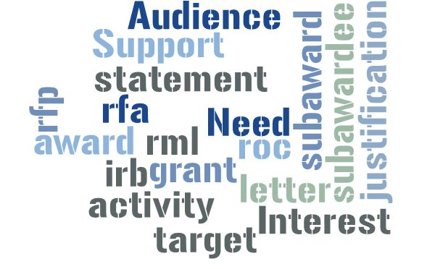
NNLM Grant Lingo
Notes:
Nancy
RML
ROC
Grant
Award
RFA
RFP
IRB
"Activity"
Subaward
Subawardee
Statement of Interest
Letter of Support
Justification of Need
Target Audience

Slide 4
CFA/CFP or RFA/RFP RML & ROC Grant or Award
Subaward Letter of Support Activity F&A
IRB
The Usual Suspects
What else?
Notes:
Nancy
Tony answers F&A and IRB

Slide 5
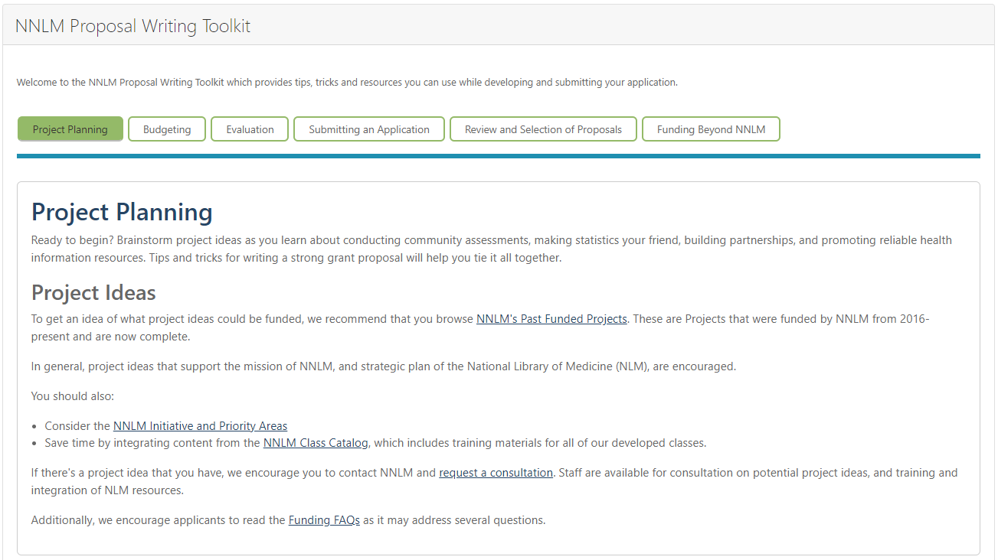
NNLM Proposal Writing Toolkit
https://nnlm.gov/guides/nnlm-proposal-writing-toolkit
Notes:
Tony - Demo the Proposal Writing Toolkit
All non hyperlinked resources in this PPT can be found in this toolkit.

Slide 6
Know Your Funder
Mission
To advance the progress of medicine and improve the public health by providing all U.S. health professionals with equal access to biomedical information and improving the public's access to information to enable them to make informed decisions about their health.
Relationships
NIH > NLM > NNLM
RML - UMB
Notes:
Nancy

Slide 7
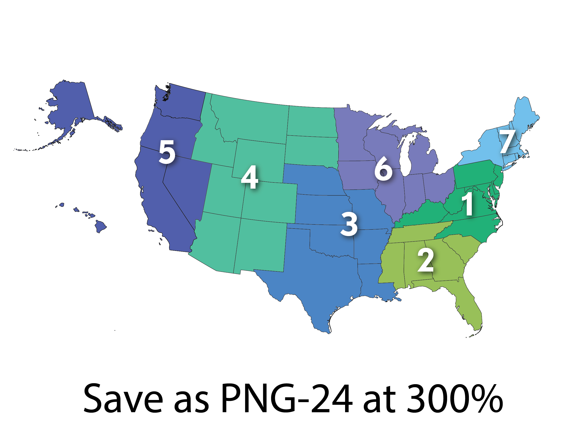
Regions, Offices and Centers (ROC)
Regional Medical Libraries: 1-7
Offices:
Office of Engagement and Training (OET)
Public Health Coordination Office (PHCO)
Training Office (NTO)
Web Services Office (NWSO)
Centers:
All of Us Community Engagement Center
All of Us Training & Education Center
Center for Data Services (NCDS)
Evaluation Center (NEC)
About Us: https://nnlm.gov/about/about-nnlm
Notes:
Nancy
https://allofus.nih.gov/

Slide 8
Areas of Interest
NNLM 2021-2026 Initiatives
Confronting Misinformation
Bridging the Digital Divide
Environmental Determinants of Health
NIH > NLM Priorities
Citizen/Community Science & Crowdsourcing
Data Science
Student Engagement (LIS)
Substance Use Disorders
Notes:
Tony
A NNLM National Initiative is an activity approved by the National Network Steering Committee (NNSC) in which a majority of ROCs (RMLs/Offices/Centers) participates.
A NLM/NIH priority for NNLM represents issues, topics, and activities that are important at NLM and NIH, and that NLM’s Office of Engagement and Training (OET) identifies as a priority for the NNLM program.
Active NNLM Initiatives
Confronting Health Misinformation
Confronting Health Misinformation: The U.S. Surgeon General’s Advisory on Building a Health Information Environment reports that: Misinformation thrives in the absence of easily accessible, credible information. When people look for information online and see limited or contradictory search results, they may be left confused or misinformed. More broadly, misinformation tends to flourish in environments of significant societal division, animosity, and distrust. The NNLM engages with communities to raise awareness of trusted, high-quality, and relevant information and develop strategies to improve health literacy, data literacy, and understand and actively engage in medical research (clinical trials).
Bridging the Digital Divide
The COVID-19 pandemic has highlighted barriers to health and well-being that were increased due to the digital divide. Issues such as decreased internet connectivity, lack of Wi-Fi, and video chat or webcam technology in both urban and rural areas can hinder access to online health and medical information, and telehealth to its fullest capacity, especially to communities of color, the poor, and medically underserved (Clare, 2021). The goal of this national initiative is to promote technology and digital equity, digital literacy, and telehealth through long-term partnerships and collaborations that will bring access to online health information to communities across the United States.
Environmental Determinants of Health
Environmental factors can influence human health, including physical, chemical, and biological factors that are external to a person, and all related behaviors. Collectively, these are referred to as environmental determinants of health (EDHs). Threats to any one of the EDHs can have an adverse impact on the health and well-being of the population. These environmental threats can occur naturally, human-made, or because of social conditions and ways people live. Addressing these EDHs will directly improve the health of the population. The NNLM will establish a baseline of understanding of EDIs for NNLM members. This area will cover a wide-range of topics that include (but are not limited to) socioeconomic factors, natural and built environmental factors, pollution, climate change, disaster information management, mental and emotional health, rural and urban health, tribal health, access to health care, health advocacy, and sustainability.
NLM and NIH Priority Areas for NNLM
Citizen Science and Crowdsourcing: Through the Citizen Science and Crowdsourcing initiative, NNLM engages communities in addressing societal needs and accelerating biomedical science, technology, and innovation.
Data Science: NNLM supports the goals of the NLM Strategic Plan 2017-2027: A Platform for Biomedical Discovery and Data-Powered Health. Activities are guided through OET’s priority areas as outlined in the document Opportunities for Building Capacity in the Library and Information Science Community to Support Data-Driven Research and Health. A key resource to address this priority is the NCDS Guides & Resources maintained by the NNLM National Center for Data Services.
Student Engagement: Through the Student Engagement initiative, NNLM champions health sciences librarianship by developing partnerships with Library and Information Science (LIS) and other graduate programs, and by collaborating with undergraduate programs, professional associations, and other organizations to work toward increasing diversity in the LIS pipeline.
Substance Use Disorders: The NNLM Substance Use Disorders (SUD) initiative aims to raise the awareness of NLM and partner organization's SUD resources, provide educational opportunities for network members and develop strategies to meet national and regional information needs.
Previous Initiatives
All of Us
The NNLM All of Us initiative is a partnership between NNLM and the NIH All of Us Research Program with two main objectives. The first is to facilitate All of Us community engagement through public libraries and other NNLM members. The second objective is to provide training for All of Us program staff and participants. Community engagement activities support and develop the NNLM All of Us Community Engagement Network (CEN). The NNLM All of Us Training and Education Center (TEC) develops training activities and educational content to support community engagement for All of Us.
Public Libraries
The Public Libraries Initiative aims to develop long-term partnerships and collaborations that bring NLM’s information resources to communities across the U.S. The goal of this national initiative is to promote health information literacy by equipping library staff with effective skills and high-quality resources to meet the needs of their patrons.

Slide 9
Know Yourself
Notes:
Nancy

Slide 10
Your Organization
Mission
Vision
Priorities
Initiatives
Assets: staff, partners, equipment, space, resources
Where do your values intersect with NNLM’s?
Notes:
Nancy

Slide 11
Your Community
Resources for Statistics
County Health Rankings and Roadmaps
Community Toolbox
National Center for Health Data Statistics
Reports and Data Resources – NIMHHD
State Health Facts
Rural Health Information Hub (RHIHUB)
Local Departments of Health (Health, Public Health, Rural Health)
Assets
Needs
Partners
Previous outreach projects – successful and unsuccessful
Hyperlinks available on the NNLM Proposal Writing Toolkit:
https://nnlm.gov/guides/nnlm-proposal-writing-toolkit
Notes:
Nancy

Slide 12
Questions to ask
Notes:
Nancy
Who is it you want to reach? How do you plan to reach them? Why – is there justification of need? When and where, exactly, will you do this outreach? What are your assets and strengths? Where do you need help from partners? What partners best complement what you have to offer?
These are some of the things to think over as you plan.

Slide 13
2023-2024 Grants
Good News: The grants are larger this year!
Bad News: There are fewer grants.
The stronger your proposal the higher your chances!
Notes:
Tony

Slide 14
Data Science and Services Project - $30K (1) Health Information Outreach Project - $30K (3) Technology Improvement Project - $30K (1)
Grants for the 23-24 Cycle
All projects awarded are cost-reimbursable to an institution, not an individual.
Notes:
Tony
Data: The award’s primary aim is to focus on projects that stimulate innovations in biomedical knowledge collection, organization, and management or data science, information, or research services
https://nnlm.gov/funding/rfa/data-science-and-services-project-award
Health Outreach: The purpose of the Health Information Outreach Award is to provide support for projects that improve health information literacy and increase the ability of patients, family members, students, and members of the public to find and use health information; or improve health professionals’ access to, awareness of, and skills for locating high-quality biomedical and health information.
https://nnlm.gov/funding/rfa/health-information-outreach-award
Tech Improvement: The Purpose of the Technology Improvement Project Award is to deliver technology improvement and health and digital equity to underserved communities impacted by the digital divide via technology funding and online resource training.
https://nnlm.gov/funding/rfa/technology-improvement-project-award

Slide 15
Awards Process and Timeline
Date | Activity
2022
9/12 – 11/4 | Application for awards on NNLM.gov
11/7 – 11/11 | Region 1 staff reviews applications for completeness and eligibility
11/14 – 12/9 | Peer review period
12/12 – 12/23 | Regional Medical Library (RML) staff synthesizes peer review feedback RML Executive Director makes final decisions
2023
1/9 – 1/13 | RML notifies all applicants of funding decisions RML provides review feedback to applicants
1/16 - 1/31 | Awardees complete required UMB documents
2/1 – 4/30 | RML begins IRB process through UMB and obtains approval from NLM RML works with UMB to process administrative paperwork
5/1 | RML informs Awardee when they will be able to begin project
2024
4/30 | Awarded project is completed and all expenses must be completed
5/31 | Final Invoice and Final Report are submitted to RML
6/30 | Accounting financial records close and awarded projects are marked as complete
Notes:
Tony

Slide 16
Deconstructing the RFP
Notes:
Nancy

Slide 17
Funding timeline? What are the deadlines? Are you eligible? Does your mission align? Target audiences? Format? Templates provided? Recommended references?
Break it Down
Key Words? Budget cap, format, allowed items? Narratives and statistics? Review criteria? Special sections?
Bonus points? Contact person?
… and much, much more!
Notes:
Nancy

Slide 18
North Dakota State University: How to Deconstruct an RFP University of Utah: How to Deconstruct a Funding Opportunity Announcement Carthage University: How to Deconstruct a Funding Opportunity Announcement
More on Deconstructing
Notes:
Tony

Slide 19
Speaking of the Budget…
Can you conduct the project successfully with the amount of money provided?
What are direct and indirect costs?
What is allowable | non-allowable?
Did you get that price quote?
Is your budget reasonable?
Did you justify your budget thoroughly in the narrative?
Does the budget spreadsheet add up?
Did you include fringe benefits?
Did you include Facilities and Administration (F&A)? Can you get a waiver for F&A? (AKA Indirect Costs IDC)
What forms do you need to provide?
Notes:
Tony
Grants generally have a top level amount that is approved for funding. Thoughtfully budget and research costs appropriately.
If you can properly justify your budget, both reviewers and financial auditors will see that.
Does the description of the grant mention direct and indirect (F&A)
Most institutions have an additional percentage of costs tied to grants under Facilities and Administration.
Find out from your grants or sponsored programs office, if required, what the rate is or if it can be waived.

Slide 20
Tip for Academic Institutions
Become Friends with your Office of Sponsored Programs (OSP)
What processes and requirements do they have?
What are their deadlines in comparison to meet the grant submission deadline?
Did your OSP confirm your F&A rate?
Notes:
Tony
If you work at a college, university, or hospital, there may be a grants or sponsored programs office. If there is one, reach out to them in advance to find out what specific requirements exist.
Some grant descriptions, when printed, can be 12 to 30 pages long. Deconstructing the proposal into digestible chunks will help you understand the grant’s requirements.

Slide 21
Brownie Points!
Direct contact – blip on the radar!
All instructions followed
- Deadlines met
- No tables or pictures
Clear and concise
Spell out acronyms
Avoid lingo
Budget adds up
Letters of support
Notes:
Nancy

Slide 22
Part 2 of this Webinar Series: “Set…”
September 27, 2022, 12 PM ET
Register: https://nnlm.gov/training/schedule
Agenda
2023-2024 Grant Opportunities
Funding Process and Timeline
Nitty Gritty
Examples of Strong Proposals
Q&A
Notes:
Nancy
https://nnlm.gov/training/class-catalog/nnlm-region-1-4-part-funding-webinar-series
https://nnlm.gov/training/class/nnlm-region-1-funding-webinar-part-2-set

Slide 23
Questions?
Nancy Patterson​
Outreach Librarian
npatters@hshsl.umaryland.edu
https://www.calendly.com/nancy-nnlm
Tony Nguyen​
Executive Director
ttnguyen@hshsl.umaryland.edu
https://calendly.com/ttnguyen-1
Notes:
Nancy
Link to Resources Referenced: https://lor.nnlm.gov/op/op.Download_Share.php?documentid=4490

