Slide 1
Project Outcome

Slide 2
Programming and Outreach
Notes:
Ask them what programming and outreach they already to and how they decide what to do

Slide 3
Planning
Who
What
Where
How
When
Notes:
For your pre-assignment we asked you to look at the demographics, health issues, and needs of communities. Think about what you discovered, what ideas do you have for programming and outreach in your community?
Programming can range from very simple projects to year-long, recurring sessions. For instance, a bulletin board or book display on a current health topic is easy to do and doesn't require much work or expense.
Questions to ask include:
Which audiences do you want to reach? (an age group? ethnic or language group? other demographic or target population?)
What are the big health issues? (diseases or conditions? social issues? need for multilingual materials or culturally-appropriate materials?)
What types of programs already work well in your library setting? (lecture? participative? special event?)
What has to happen to make your ideas into reality? (Approval from administration, funding, staffing, or other?)
You may or may not have responsibility for planning programming in your current position; regardless, knowing about this topic will be helpful in many ways. You may have the responsibility for creating a handout or designing a bulletin board on a topic. You may be asked to develop a health resource list for a particular user group. You may be in a position to suggest ideas based on needs of users you encounter. You may have connections in the community that are useful for building successful health programming and outreach partnerships. Understanding how to target materials and programs to target audiences and specific groups will always serve you well.
A good place to start is to think about what you have to work with. It could be a computer lab, a meeting room, bilingual staff, volunteers, or good partnerships with others in the community. Maybe you have financial support for programming from a strong Friends of the Library group. Maybe you have simple things, such a display boxes or bulletin boards; these are perfect for highlighting current health topics and related items in the collection.

Slide 4
Nothing about us, without us
Notes:
Nothing About Us Without Us!" (Latin: "Nihil de nobis, sine nobis") is a slogan used to communicate the idea that no policy should be decided by any representative without the full and direct participation of members of the group(s) affected by that policy. This involves national, ethnic, disability-based, or other groups that are often thought to be marginalized from political, social, and economic opportunities.
The saying has its origins in Central European political traditions. It was the political motto that helped establish—and, loosely translated into Latin, provided the name for—Poland's 1505 constitutional legislation, Nihil novi, which first transferred governing authority from the monarch to the parliament. It subsequently became a byword for democratic norms. In this use, it is closely analogous to one of the most familiar slogans of the American Revolutionary War, 'No taxation without representation'.^{[1]} It is also a long-standing principle of Hungarian law and foreign policy,^{[2]} and was a cornerstone of the foreign policy of interwar Poland.^{[3][4]}
The term in its English form came into use in disability activism during the 1990s. James Charlton relates that he first heard the term used in talks by South African disability activists Michael Masutha and William Rowland, who had in turn heard the phrase used by an unnamed East European activist at an earlier international disability rights conference. In 1998, Charlton used the saying as title for a book on disability rights.^{[5]} Disability rights activist David Werner used the same title for another book, also published in 1998.^{[6]}
The saying has since moved from the disability rights movement to other interest group, identity politics, and populist movements.^{[7][8]}

Slide 5
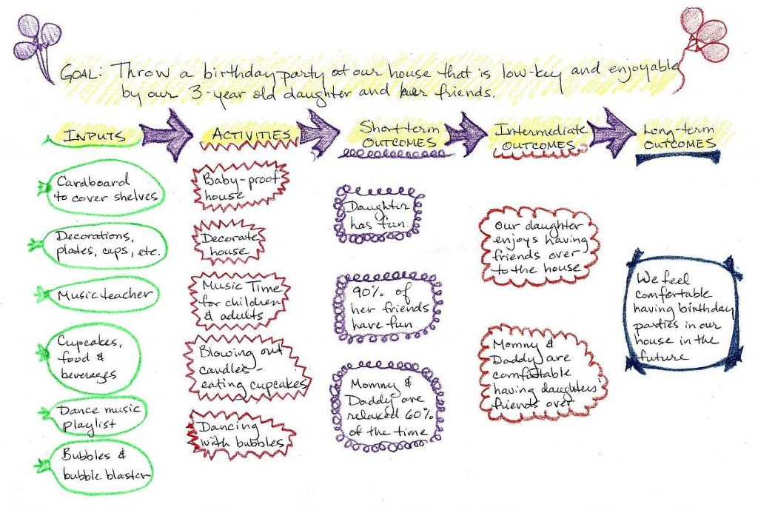
Logic Models
Notes:
https://news.nnlm.gov/neo/2016/02/04/logic-model-for-a-birthday-party/
If you’re new to logic models, they are planning tools that you use from right to left, starting with long-term outcomes (what you hope to see out in the future), intermediate outcomes, and short term outcomes. Then you think of the activities that would lead to those outcomes, and then inputs, the things you need in order to do the activities.

Slide 6
Choosing A Partner
Audience
Publicity
Funding:
People:
Space:
Ideas and know-how:
Presenters and performers
Think inside the library
Notes:
Audience: Do you need help in attracting certain target audiences to your program or to the library in general? Consider a community partner that has connections or influence with your target audience. Think about community leaders.
Publicity: Do you need help publicizing your program?
Approach people with PR and publicity skills who can create press releases/flyers/posters etc.
Get acquainted with your local reporters and media sources. If you have a cordial and established relationship, they are more likely to help out. Find out who has the "library beat" at your local media outlets â€“ who is responsible for covering events at the library? Find out if your local paper will run a public service ad or article for free.
Funding: Do you need additional funds to present your program?\
Offer local businesses the opportunity to sponsor your program. Businesses often set aside funds for community projects since it gives them the chance, and the PR value, to support local causes.
At big events, consider offering local vendors or community groups a chance to have a booth at the event (with a percentage of their profit going to your library). Think about bookstores (chains and local) as well as local specialty stores.
Could a partner raise funds for the program or for the library?
People: Do you need additional people to help you plan and present your program?
Everyone is a potential volunteer! Examples include local businesses with employee volunteer programs; seniors; the library's teen group, or high school teens who need community service hours; parents who want to become involved in the community; civic groups; your friends group; colleges with community involvement programs; family, friends and the neighborhood dog.
Overestimate how many volunteers you need â€” it pays to have too many.
Think about the skills your volunteers might need. Do you need creative people to help decorate the library? People who are detail-oriented? Tech-savvy? Develop an ongoing list of reliable volunteers - they are a valuable and constantly needed resource.
Space: Is your event too large for the library?
Could a partner donate space to hold part, or all, of your event? If not, could your partner assist you in renting more space if needed? Assess your space and staffing needs realistically to see if this is something you need help with.
Try developing ongoing relationships with local theaters or business centers - these relationships can prove useful in many ways, beyond offering potential space.
Ideas and know-how: Has another agency hosted a similar event?
Perhaps a community partner has organized an event similar to the one you are planning and could provide ideas and tell you about potential pitfalls.
They might also be able to put you in touch with partners and resources that they used for their event.
Presenters and performers: Are there local talents?
Utilize your pool of local talent. Everyone is or knows potential talent. Scan the media and keep a list of groups or individuals who appeal to you for future reference.
Build contacts with the local Screen Actors Guild office, school drama departments, and art groups, local authors or celebrities, local dignitaries, media personalities etc. The worst they can do is say no, but quite often they are happy to help libraries, or can point you in the direction of someone who can. Make sure to compile a list of contact names, numbers, and emails for future program use. They might not be able to help with this program, but maybe they can help with another in the future.
Think inside the library: Do library staff have connections?
Here are some questions to ask to help evaluate your needs:
Think inside the library
You don't always have to come up with new and different people to partner with. Look at the partners you currently have to see how you might develop those relationships further.
When considering your choices for community partners, get input from other staff members and groups, such as your teen advisory group or Friends of the Library board members. This can help you to get different perspectives and ensure support from your colleagues and staff.
-California Library Association

Slide 7
Approaching Community Partners
Be clear about what you want from your partner
Think about how the partnership will benefit your community partner
Be prepared
Notes:
Be clear about what you want from your partner
For example, do you need your partner to be actively involved in the planning and/or presentation of the program? Or do you want to develop the program and need them to help provide funds or materials, or to help you promote the event?
Think about how the partnership will benefit your community partner
What's in it for them? A successful partnership will benefit both parties, and a partner is more likely to come on board if they can see those benefits. The PR value of being listed as a sponsor can often mean a heightened local media profile for your partner, and this can make it worth their time and effort to become involved. A successful partnership can also ensure their interest in future projects.
In addition, you can build contacts by offering your library's resources to other community organizations. Meet local PTA/PTO members by volunteering to attend Back to School Nights, or offer your meeting rooms and plan programs to appeal to local college groups and professors.
Be prepared
Have information about your program and the library ready to give to the potential partner.
Be sure to research potential partners and be informed about them. When evaluating a potential partner, it can be helpful to talk to people who may have worked with them before. This may help you decide if they are the right partner for you. You might also find that you have a colleague or friend in common, which can give you more credibility with the potential partner as well.
Copyright © 2014 CLA-NET. All rights reserved.
There are several templates for sample partner letters for invitations to health fairs, request for speakers and a thank you letters for your use on the Health Outreach and Programming Resource guide in the Planning and Evaluation Tools tab.
Also, I encourage you to review the University of Kansas Community Tool Box, there’s great information about partnerships for agencies.

Slide 8
Working with Community Partners
Communicate
Agreements
Be Prepared
Notes:
Be clear about what you want from your partner
For example, do you need your partner to be actively involved in the planning and/or presentation of the program? Or do you want to develop the program and need them to help provide funds or materials, or to help you promote the event?
Think about how the partnership will benefit your community partner
What's in it for them? A successful partnership will benefit both parties, and a partner is more likely to come on board if they can see those benefits. The PR value of being listed as a sponsor can often mean a heightened local media profile for your partner, and this can make it worth their time and effort to become involved. A successful partnership can also ensure their interest in future projects.
In addition, you can build contacts by offering your library's resources to other community organizations. Meet local PTA/PTO members by volunteering to attend Back to School Nights, or offer your meeting rooms and plan programs to appeal to local college groups and professors.
Be prepared
Have information about your program and the library ready to give to the potential partner.
Be sure to research potential partners and be informed about them. When evaluating a potential partner, it can be helpful to talk to people who may have worked with them before. This may help you decide if they are the right partner for you. You might also find that you have a colleague or friend in common, which can give you more credibility with the potential partner as well.
Copyright © 2014 CLA-NET. All rights reserved.
There are several templates for sample partner letters for invitations to health fairs, request for speakers and a thank you letters for your use on the Health Outreach and Programming Resource guide in the Planning and Evaluation Tools tab.
Also, I encourage you to review the University of Kansas Community Tool Box, there’s great information about partnerships for agencies.

Slide 9
Follow up with Community Partners
Thank partner publicly and privately
Keep in Touch
Plan for Future Events
Notes:
Be clear about what you want from your partner
For example, do you need your partner to be actively involved in the planning and/or presentation of the program? Or do you want to develop the program and need them to help provide funds or materials, or to help you promote the event?
Think about how the partnership will benefit your community partner
What's in it for them? A successful partnership will benefit both parties, and a partner is more likely to come on board if they can see those benefits. The PR value of being listed as a sponsor can often mean a heightened local media profile for your partner, and this can make it worth their time and effort to become involved. A successful partnership can also ensure their interest in future projects.
In addition, you can build contacts by offering your library's resources to other community organizations. Meet local PTA/PTO members by volunteering to attend Back to School Nights, or offer your meeting rooms and plan programs to appeal to local college groups and professors.
Be prepared
Have information about your program and the library ready to give to the potential partner.
Be sure to research potential partners and be informed about them. When evaluating a potential partner, it can be helpful to talk to people who may have worked with them before. This may help you decide if they are the right partner for you. You might also find that you have a colleague or friend in common, which can give you more credibility with the potential partner as well.
Copyright © 2014 CLA-NET. All rights reserved.
There are several templates for sample partner letters for invitations to health fairs, request for speakers and a thank you letters for your use on the Health Outreach and Programming Resource guide in the Planning and Evaluation Tools tab.
Also, I encourage you to review the University of Kansas Community Tool Box, there’s great information about partnerships for agencies.

Slide 10
Programming Ideas

Slide 11
Pair and Share

Slide 12
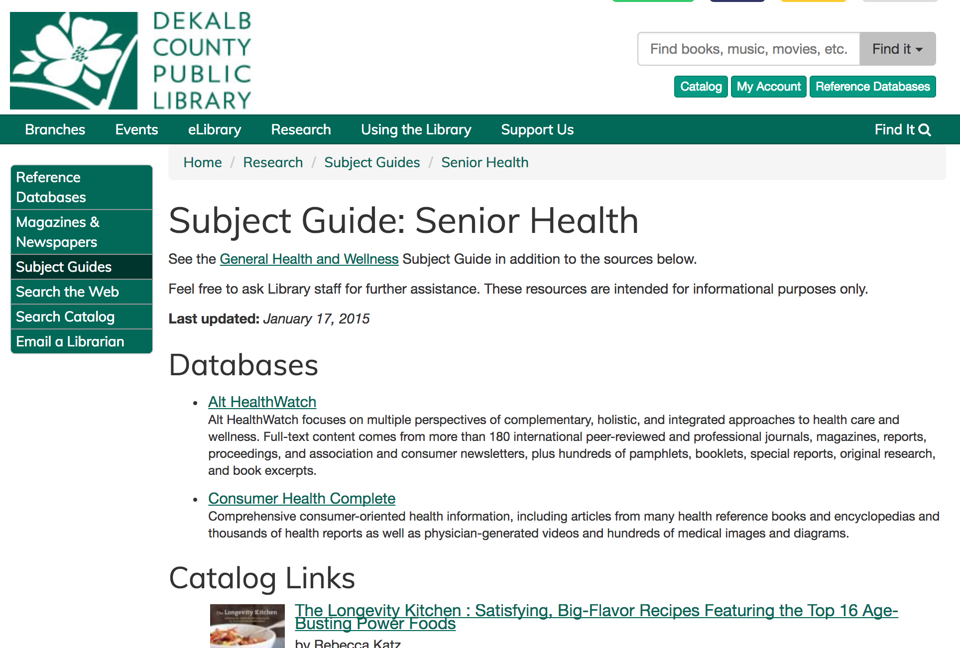
Subject Guides

Slide 13
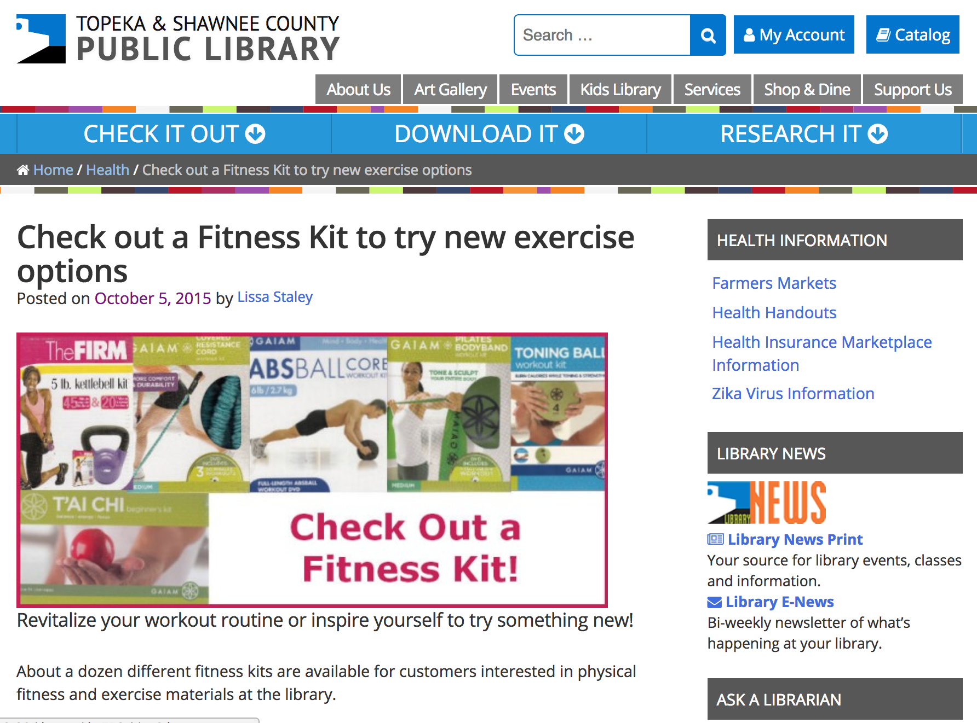
Health And Fitness Kits

Slide 14
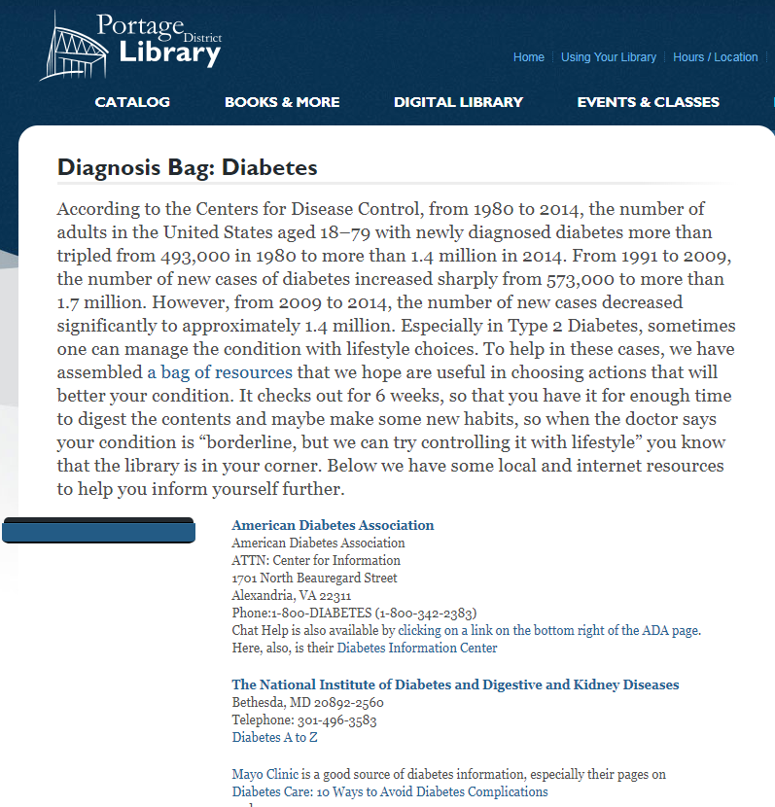
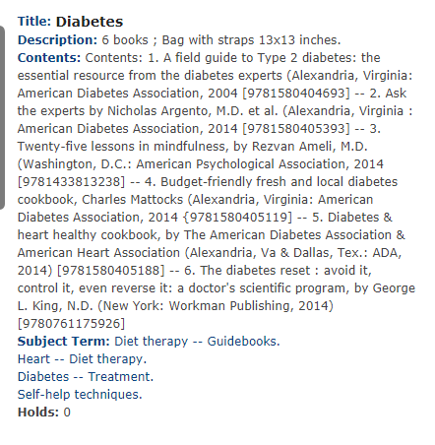
Diagnosis Bags

Slide 15
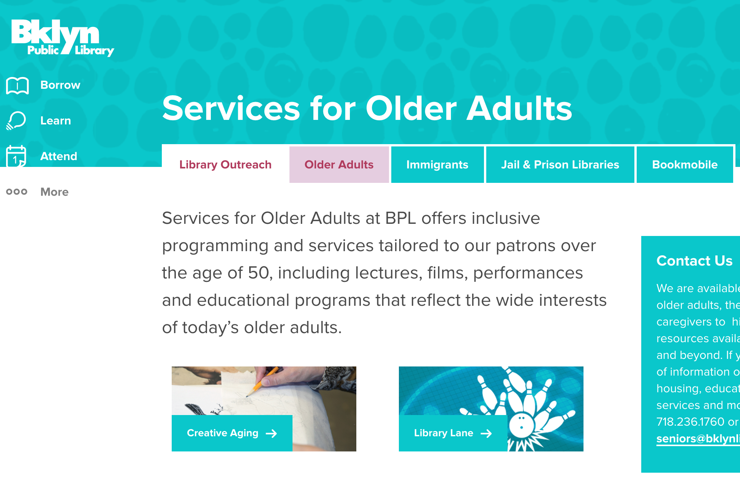
Services To Target Populations
Films
Performances
Education

Slide 16
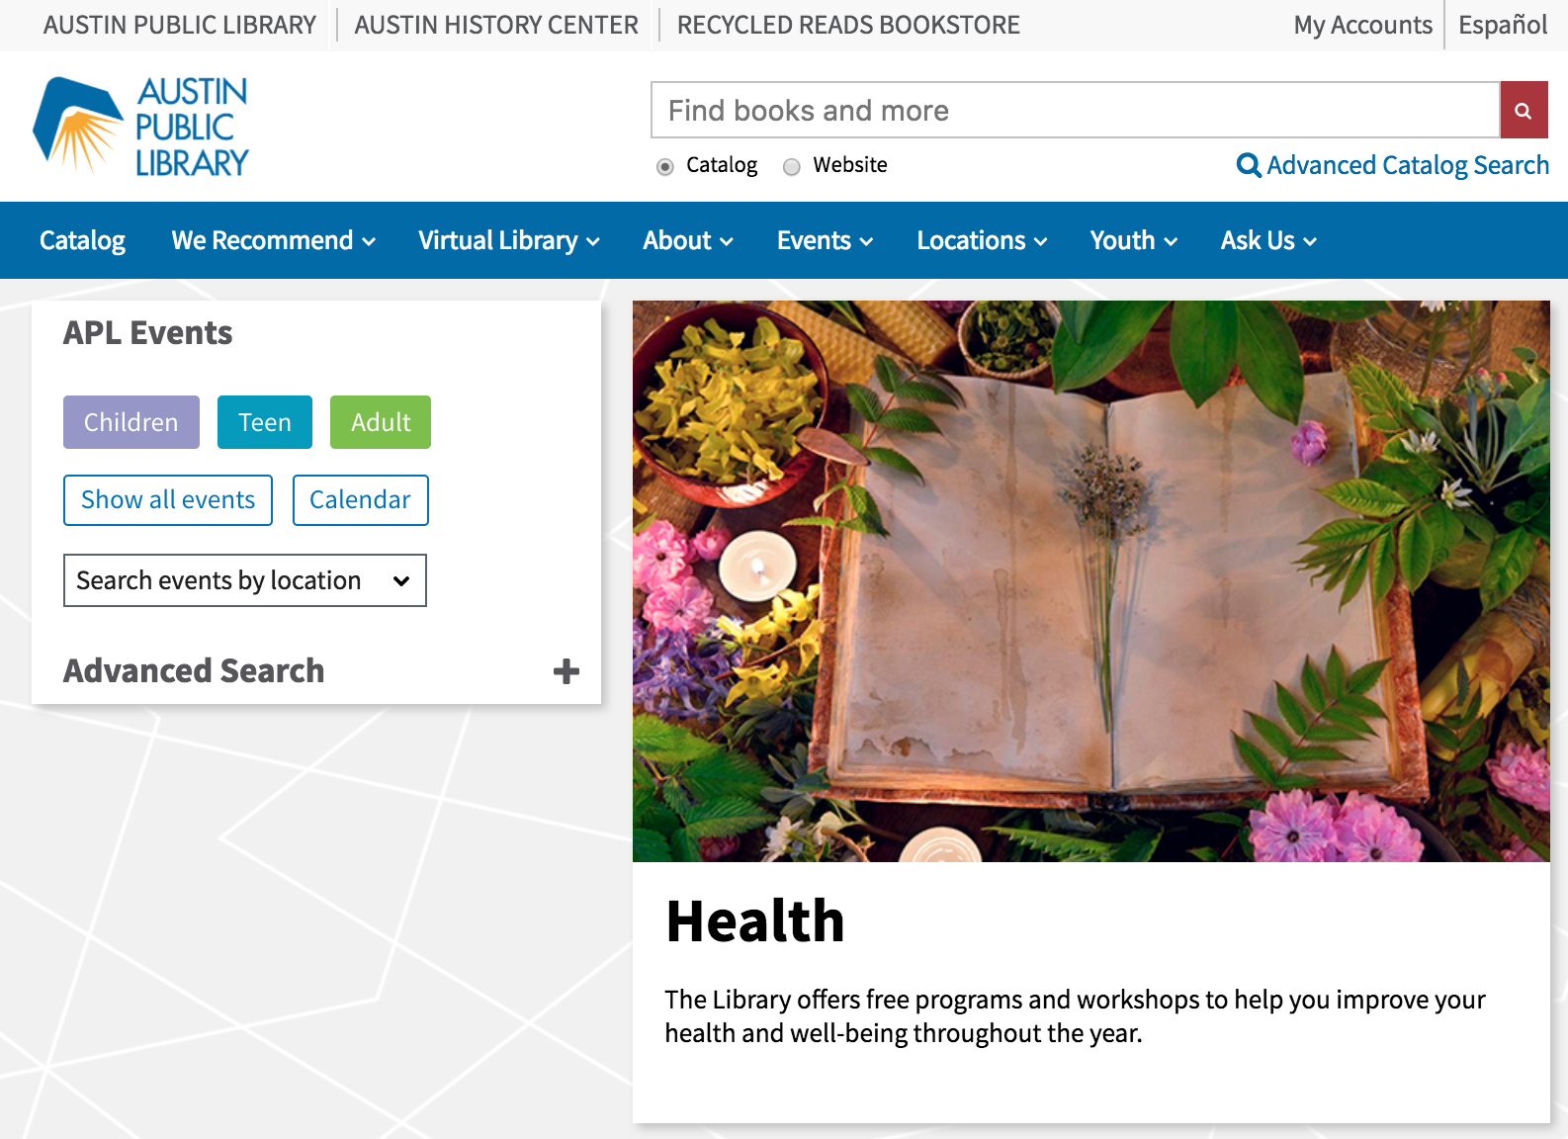
Programs And Workshops

Slide 17
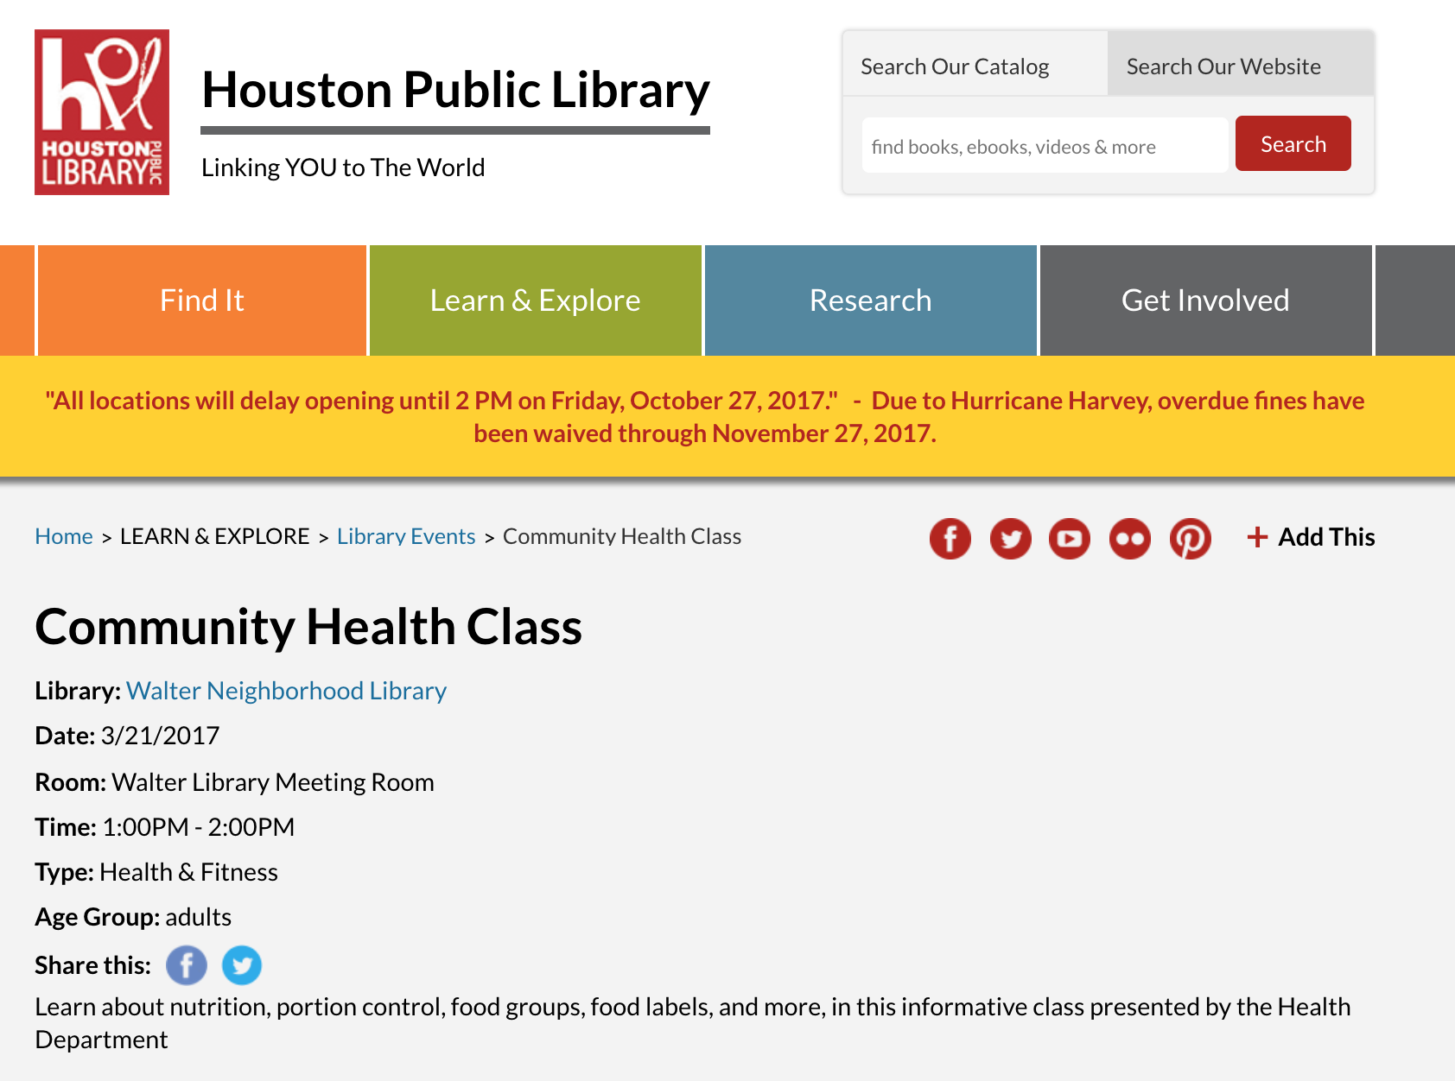
Community Partnerships

Slide 18
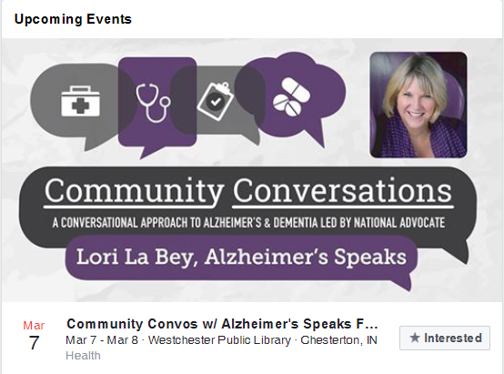
Community Partnerships

Slide 19
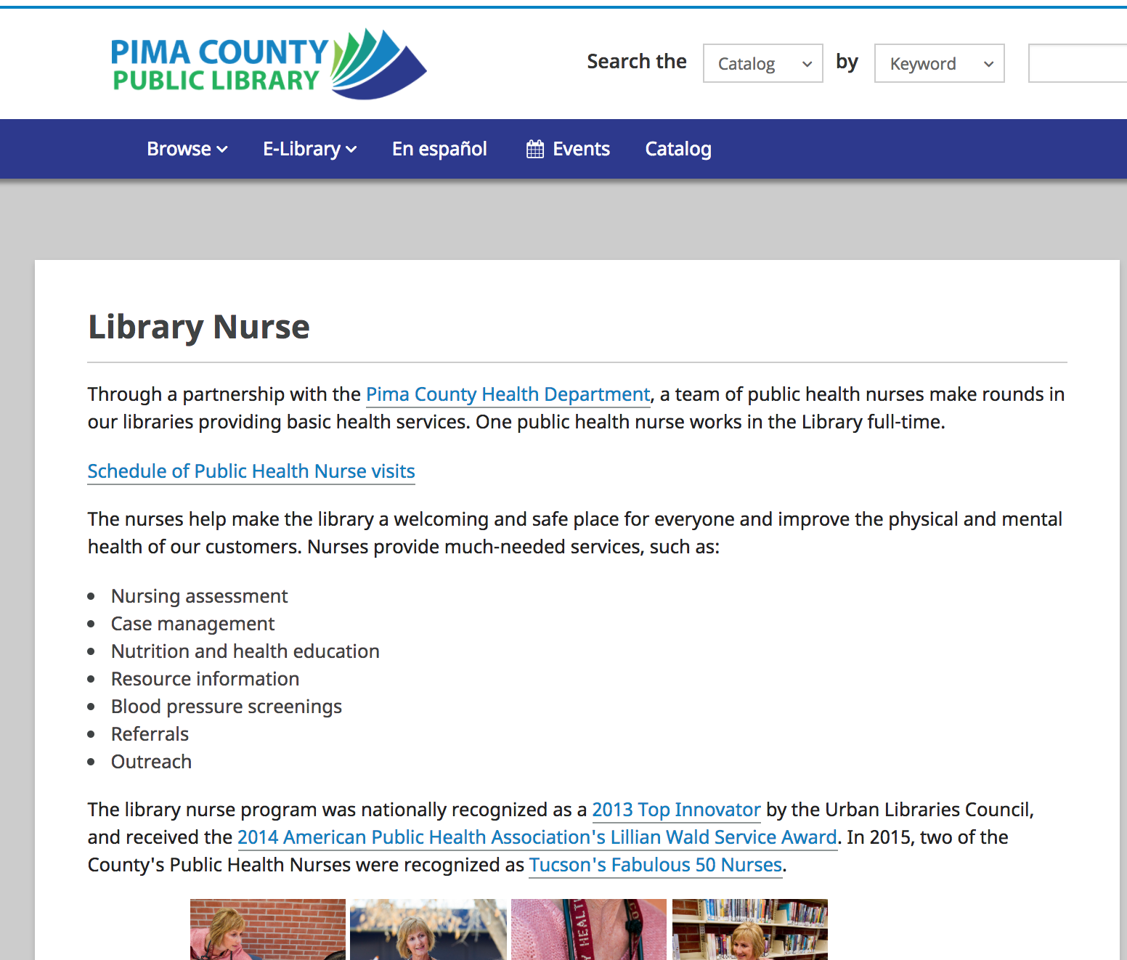
Community Partnerships

Slide 20
Notes:
2017 Library of Congress Best Practices Honoree Tales & Travel
Each one-hour program takes participants on an imaginary trip to another country or region of the United States and includes books, music, objects, folktales, and interesting facts about each destination
http://talesandtravelmemories.com/

Slide 21
Programming Librarian
Notes:
http://programminglibrarian.org/ideas/topic?topic=948

Slide 22
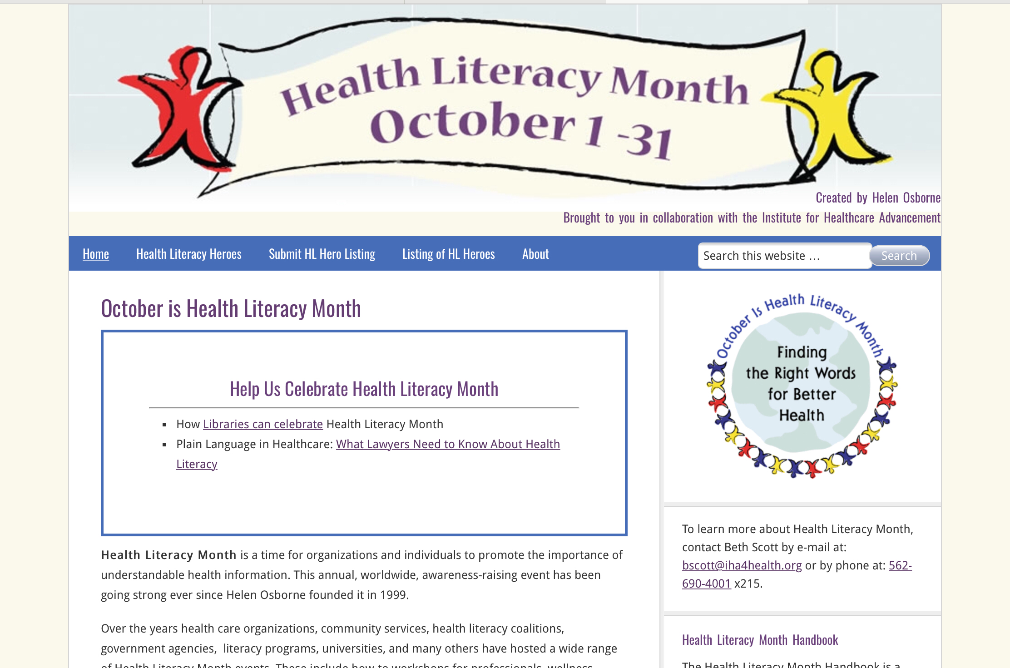

Slide 23
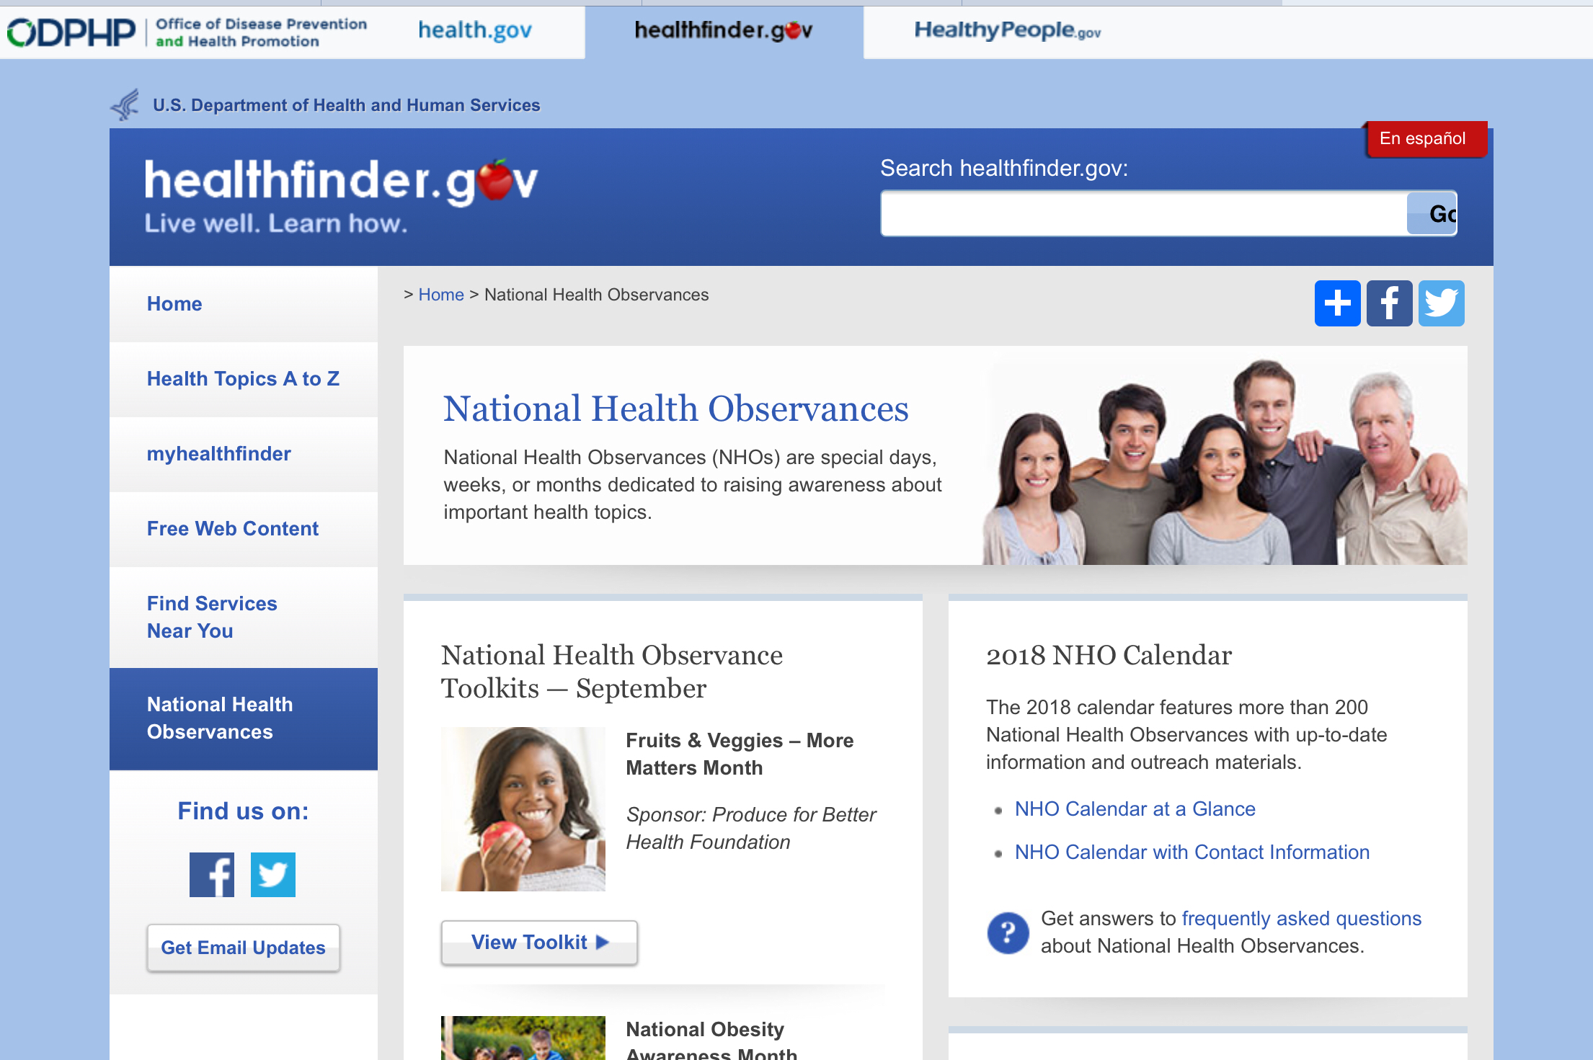

Slide 24
Programming Ideas
Adulting 101
Mental Health Awareness Resource & Family Movie Nights
Washington County Library Health Fair
Bridging Health Information Gaps at the Public Library
Community Engagement: Health & Wellness Backpack Program
Senior Health Outreach
Healthy Living Outreach for Seniors
Public Library Fitness Tracker Cohorts
Notes:
Adulting 101 - The goal of our project is to host a course of classes entitled Adulting 101. These classes will be once a month over a period of nine months. Our objective is to give teens and young adults successful skills to enter adulthood and maintain a healthy lifestyle. The topics that will be covered over the period of the course are emotional wellness, personal hygiene, healthy lifestyles (i.e.- drugs, alcohol. sex. fitness), nutritious meals on a budget, well-rounded relationships, how to find an apartment and maintain a hygienic and sanitary living environment, time organization skills, financial literacy, tips on surviving the first year of college, how to build a resume and effectively interview for jobs. The outcomes we hope to achieve are that the youth that participate will feel more confident as they approach and navigate these new phases in their lives. We hope that by imparting this information to them that they will become productive and successful. They will find a positive mindset toward growth and achievement. We ultimately hope that there will be a trickledown effect to future generations and a raising standard of living, pride and prosperity in the community. Tooele City Library agrees to: 1. Facilitate monthly life skills courses for 100 teens and young adults (September-April 2018). 2. Provide instruction for participants on appropriate health information resources supporting the life skills. 3. Evaluate all activities as to their effectiveness in achieving goals of the project. a. Goals: i. Participants report increased confidence and skills to navigate the next phase of their lives. ii. Participants report resource(s) training improved their ability to find useful online health information.
Mental Health Awareness Resource and Family Movie Nights - Goals: * Create awareness of mental health. * Provide health information resources on mental health. * Raise awareness of community resources for mental health. * Provide a positive atmosphere for families to bond and spend time together. Cedar City Library in the Park agrees to: 1. Take lead on art display highlighting works reinforcing theme of ?How do I remain resilient during hard times?? 2. Publish articles in local weekly newspaper on mental health awareness resources. Promote events in the local weekly newspaper, the Mayor's newsletter, local venues, and posts to social media. 3. Promote and host a Mental Health Resource Fair in the summer of 2017 to raise awareness of mental illness, health information resources, and community organizations. Both English and Spanish language speakers will be accommodated. 4. Host free monthly family movie nights showing movies that offer inspiring or positive messages about mental health. 5. Evaluate all activities as to their effectiveness in achieving goals of the project
Washington County Library Health Fair - Our goal is to inform the community of available access to health resources and information. We will increase community awareness of health information access, issues, and available resources by holding a Health Fair at the Washington County Library, St. George Branch. The objective of the fair is to promote information for healthy living, help expose our community to health resources such as the NNLM, and partner with local health professionals to create an understanding of the community health network. As part of our fair an electronic booth/kiosk area will include a demonstration of NLM resources. After the fair, the flat screen TV used in the booth will be repurposed as an electronic promotional material found on the NNLM website and other pertinent local data. The electronic bulletin board will be located in the lobby of the main branch for high visibility. The health fair will be a one day event with a key-note speaker in the morning and lectures, with handouts, in the afternoon. The event will be held in January o f 2018.This is the ideal month to reach the target group of snowbirds here for the winter and others thinking about changing habits and living healthy for the New Year. Washington County Library-St. George Branch agrees to: 1. Promote and host a health fair for community members 40 years and older. 2. Coordinate key-note and lecturers for the health fair. 3. Promote and teach one class on NIH Senior Health. 4. Create health information content for display on large screen TV. 5. Evaluate all activities as to their effectiveness in achieving goals of the project. a. Goals: i. Promote information for healthy living (via health fair and flat screen TV). ii. Increase awareness of health information resources (via lectures and classes). iii. Increase awareness of the health services and resources available in the community (via health fair vendors and lectures).
Bridging Health Information Gaps at the Public Library - Access to reliable health information for vulnerable populations: Vulnerable populations often reflect diversity from a number of perspectives. Diversity is frequently defined by social and demographic characteristics such as age, gender, race, ethnicity, and socioeconomic status. As PPL considers those segments of our patron and user base who are most vulnerable, we believe this initiative can serve the needs of Portland's teen population, homeless population, and the Immigrant/refugee segments of our community. Health literacy: As an organization that seeks to ?be the civic and cultural center of a dynamic region in which citizens are literate, informed, and engaged,? PPL has placed high organizational value on supporting our patrons and users as they build their health literacy. Health literacy is the degree to which individuals have the capacity to obtain, process, and understand basic health information and services needed to make appropriate health decisions. Because this literacy is dependent on both individual and systemic factors, this project seeks to give individuals practical, easy-to-access tools to build their own health literacy and also to build and strengthen the Library's partnerships with other local resources to ensure a continued high level of attention to the health needs of these particular population groups. Making patrons better-informed patients: Patients should be involved in making decisions about their own health care. We use the term ?informed shared decision making? to describe decisions that are shared by doctor and patient and informed by best evidence, not only about risks and benefits but also a patient's specific characteristics and values. This project will contribute to this dynamic by educating patients so they can exercise these health-related rights and duties more effectively.
Community Engagement: Health & Wellness Backpack Program - The Munson Community Health Library will collaborate with the Grand Traverse Commission on Aging Senior Center Network to develop a health and wellness backpack program. The intent of the program is to strengthen partnerships with community-based organizations as well as reach out to specific populations. This program will promote the role of the health information professional as well as the Munson Community Health Library in the delivery of health information. It will also provide a value added service that supports Munson Healthcare?s strategic priority surrounding population health. The program will provide bundled health information in a pack, to senior citizens in the Grand Traverse region. Backpacks will contain a variety of health resources, aides, and tools, focusing on diseases/conditions that are prevalent in the senior population; as well as identified in Healthy People 2020. Packs will be located at both the Munson Community Health Library and the Grand Traverse County Senior Center Network locations and will be available for internal and external use by community members.
Senior Health Outreach Members of the Library’s Outreach Services Department, visit nine senior facilities, three homecare facilities, and fifteen homebound patrons a month. Outreach Services also provides weekly, biweekly, and monthly programs at seven senior facilities, engaging over two hundred and fifty patrons per month. They have noted a new demand for us to arrange and provide healthcare programming and training sessions at three of our senior independent living facilities. Outreach Services will collaborate with Galter Health Sciences Library, Northwestern University to offer programming to teach seniors how to find high-quality health information on the web. With the assistance of trained library staff, seniors will be able to use laptops to explore healthcare databases and websites suggested by the Medical Library Association’s top health websites for health consumers and patients including MedlinePlus and CDC. The speakers will encourage additional engagement through hands-on-training activities, using authoritative databases and websites to locate quality health information. Our goal is for seniors to discover methods to live healthier lives and take better care of themselves as they age.
Community Engagement: Healthy Living Outreach for Seniors Siouxland Libraries would like to start providing a healthy lifestyles outreach program at Sunnycrest Retirement Village. We would take tablets to the above mentioned location and show the customers how to use them in order to look up health questions, information, and healthy recipes. We would use sites such as MedlinePlus and NIH Senior Health. We would have multiple tablets available at the time we are there for them to privately look up the information for which they seek, and we would be able to help them navigate through these sites.
Public Library Fitness Tracker Cohorts - The Science & Technology Division of the Akron (Ohio)-Summit County Public Library plans to create a multi-week program of loaning wearable fitness trackers to groups of people for the purpose of encouraging a regular and sustained increase in physical activity. We will select groups of people from pre-existing community groups or groups selected for this purpose and treat them as a cohort – having them all at an initial program for instruction both on using the device and locating quality health information in support of increasing their activity levels as well as an initial “weigh-in” provided by students in the University of Akron’s Department of Sport Science & Wellness Education. We will encourage participants to return midway through the program to check their weight, discover some more resources, and provide fellowship, all in order to continue the momentum developed in the initial presentation and increase motivation. We will have a final session to weigh, encourage continued activity, and collect the trackers. We will encourage users to continue their healthy exercise habits and to connect with library staff on a regular basis after the project concludes. We will offer this program to several groups through 2018.

Slide 25
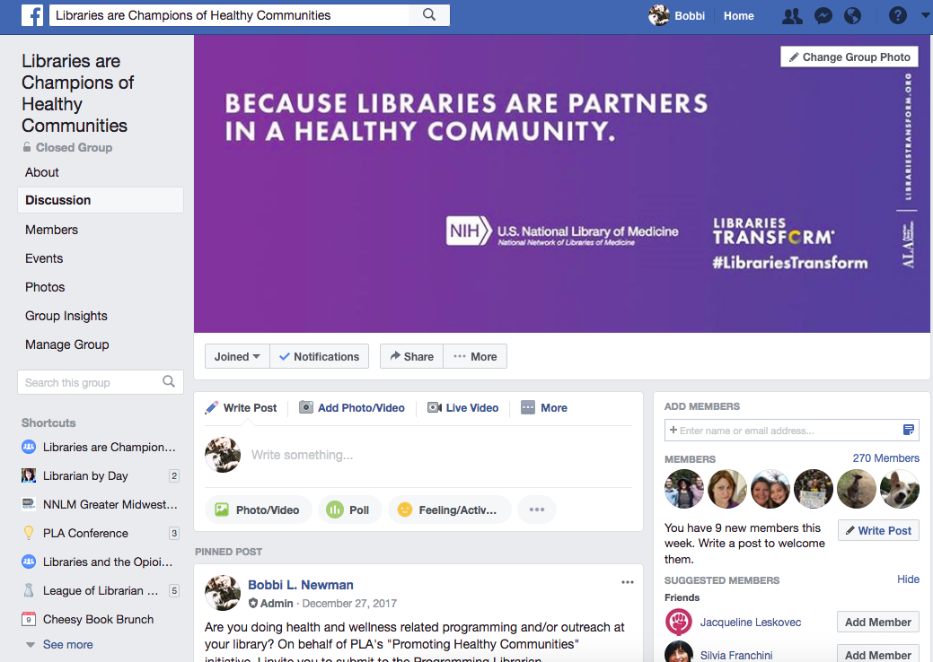

Slide 26
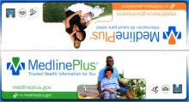
NNLM and NLM Resources
Supplies
Resources – i.e. MedlinePlus
Funding
May 1 through April 30
Regional
In-Person Training

Slide 27
Wrap-Up

Slide 28
Reflect and share
Notes:
First, take about 2 minutes to reflect about what you learned today and write down what was the most useful and what action you’ll take when you get home. After that share with the group

Slide 29
What Next?

Slide 30
Collection Assessment
Purpose: learn if the materials in your collection meet the needs of the community or if there are gaps
How: look at the consumer health materials in your library
The final report should be 2-3 pages max.
Instructions are on your Flash Drive!
Notes:
Only for in-person class of 12 CE that’s provides CE and CHIS

Slide 31
CE and CHIS
Continuing Education (CE) certificate
Complete your assignments
Take the survey (instructor will email)
Consumer Health Information Specialization (CHIS) from the Medical Library Association (MLA)
Instructions will be emailed to you after you claim your CE
Notes:
Only for in-person class of 12 CE that’s provides CE and CHIS

Slide 32
Become An NNLM Member
Institutional, not individual
Free!
Access to:
Funding opportunities
Free resources
Free print outs

Slide 33
Questions?

