Slide 1
What is CHIS?
CHIS stands for Consumer Health Information Specialization, a program the Medical Library Association (MLA) provides.
The MLA Consumer Health Information Specialization (CHIS) offers training in providing health information services to consumers and recognition for the accomplishment of acquiring new health information skills.

Slide 2
Gain skills in areas such as:
Understanding Your Community
Health Literacy
Mental Health Resources
Evaluating Health Information
Health Disparities
Health Equity

Slide 3
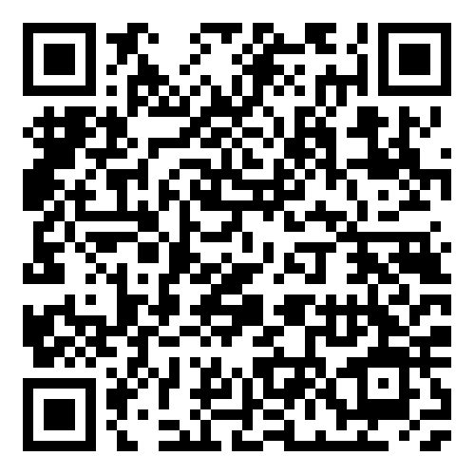
Obtain your CE and use the NNLM sponsorship
Step 1: Earn 12 CE through FREE classes!
Step 2: Apply for NNLM CHIS Sponsorship
Step 3: Receive NNLM sponsored CHIS certification
Learn more by visiting: www.nnlm.gov/FST34 or scanning the QR code

Slide 4
Claim your CE credit – Step 1
PLACE QR CODE HERE
Course evaluation link:

Slide 5
Claim your CE credit – Step 2
Go to MEDLIB-ED website and sign in or create account.
www.medlib-ed.org
Click My Learning on the blue bar near the top of the MEDLIB-ED home page.
Enter the code you were given at the end of the class evaluation, complete the attestation, and claim credit.
If you have questions or run into problems, please email MEDLIB-ED@mail.mlahq.org

