Slide 1
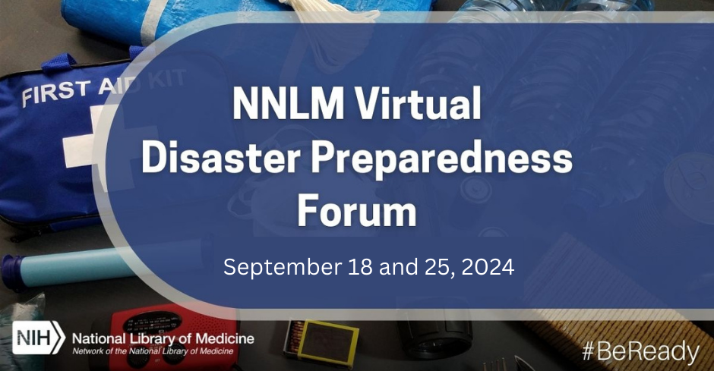
Cybersecurity in the Rural Health Landscape
Cybersecurity in the Rural Health Landscape
September 18, 2024
Speaker: Alan Morgan

Slide 2
Today’s session
Use Chat to share your comments
Use Q&A to submit your questions for our speaker
Closed Caption available
Session is being recorded
Continuing Education credit available

Slide 3
NNLM

Slide 4
Hierarchy of NIH, NLM, and NNLM
National Institutes of Health
Nation’s leading research agency
NIH
NNLM
ROC
NLM
National Library of Medicine
World’s largest biomedical library
Network of the
National Library of Medicine
Outreach program of the NLM
Regions, Offices, and Centers
7 regional medical libraries
3 national offices
4 national centers
NNLM Homepage
nnlm.gov

Slide 5
the NNLM Virtual Disaster Preparedness Forum sept 25
NNLM Training Calendar www.nnlm.gov/training
Notes:
Today’s session is part of the NNLM Virtual Disaster Preparedness Forum with another session, “Climate Resilience Resources from the Office of the Assistant Secretary for Health” happening next week on September 25.
The forum features expert speakers presenting on data tools and resources, disaster planning communication, and institutional preparedness with a focus on greater inclusiveness and community resilience.
You can learn more about the forum and register for the other sessions by checking out the NNLM Training Calendar. We will drop the link for our Training Calendar into the Chat.
https://www.nnlm.gov/training

Slide 6
Today’s Presenter:
Alan Morgan, CEO
National Rural Health Association
Notes:
It’s my great pleasure to introduce our speaker for today’s session.
Recognized as among the top 100 most influential people in healthcare by Modern Healthcare Magazine, Alan Morgan, MPA, serves as Chief Executive Officer for the National Rural Health Association. He has more than 34 years experience in health policy at both the state and federal levels, and he is one of the nation’s leading experts on rural health policy. Mr. Morgan served as a contributing author for the publications “The Handbook of Rural Aging,” “Rural Populations and Health,” and for the publication “Policy & Politics in Nursing and Health Care.” In addition, his health policy articles have been published in The American Journal of Clinical Medicine, The Journal of Rural Health, The Journal of Cardiovascular Management and Laboratory Medicine. Mr. Morgan served as staff for former US Congressman Dick Nichols and former Kansas Governor Mike Hayden. Additionally, his past experience includes tenures as a health care lobbyist for the American Society of Clinical Pathologists, the Heart Rhythm Society, and for VHA Inc. He holds a bachelor's degree in journalism from the University of Kansas, and a master's degree in public administration from George Mason University.
Welcome, Dan!
I am now going to turn off my camera and turn the session over to you.
NOTE ATTENDEE NUMBERS

Slide 7
Cybersecurity for Rural Healthcare 2024
Alan Morgan
CEO

Slide 8
National Rural Health Association
Our mission is to provide leadership on rural health issues.
Notes:
NRHA is a national nonprofit membership organization with more than 21,000 members, made up of a diverse collection of individuals and organizations with the common goal of ensuring all rural communities have access to quality, affordable health care.
Our mission is to provide leadership on rural health issues.

Slide 9
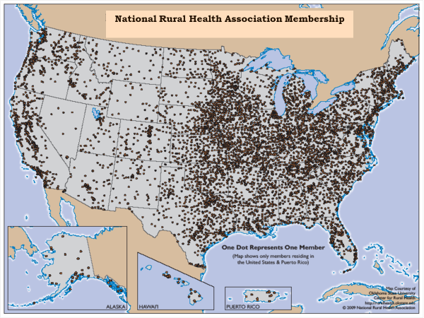
MRHA Membership Map

Slide 10
The State of Rural America
Workforce Shortages
Vulnerable Populations
Chronic Poverty
Notes:
Good news: a lot of eyes on rural health right now
108th closure: Fayette Regional Health System based in Connersville, Indiana announced it will cease operations by July 31st and lay off 437 employees, making it the 108th rural hospital to close since 2010.

Slide 11
Rural has an Older, Sicker and Poorer Population
The median age of adults living in rural areas is greater than those living in urban:
Rural: 51 years
Urban: 45 Years
18.4% of rural residents are age 65+, whereas its 14.5% in urban
Rural areas have higher rates of several health risk factors/conditions:
Obesity
Diabetes
Smoking

Slide 12
Choosing Rural
- University of Minnesota Age Friendly Research
- Appalachian Regional Commission “Bright Spots.”
- Institute of Medicine “Quality through Collaboration.”

Slide 13
Rural Cybersecurity
Healthcare cyberattacks rose 128% from 2022-2023
Rural is an increasing target
High value of medical records on the black market
High cost to remediate a breach
Limited and conflicting guidance from government agencies
Rural facilities face limited funding, infrastructure, resources, and workforce expertise
Notes:
Cybersecurity-
Disruptions of similar magnitudes may be more detrimental in rural areas, given the greater distances patients must travel to receive care and the outsized impact that lost revenue may have on rural hospital finances.
Resources are needed- capital for updated equipment, securities, training

Slide 14
The Rural Provider Environment
-1400 total Federally Qualified Community Health Centers
(600 rural, serve 1 in 5 rural residents)
-5000 Rural Health Clinics
-1300 Critical Access Hospitals
-18 Rural Emergency Hospitals*
-500 Rural Prospective Payment Hospitals

Slide 15
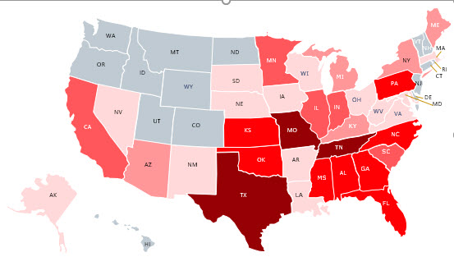
America’s Rural Hospital Crisis
Since 2010, access to care has deteriorated significantly in rural communities across America.
161 rural hospitals have either closed or converted to a model that excludes inpatient care (e.g., REH).
Highest loss of inpatient care tends to be in states resisting (or slow to adopt) Medicaid Expansion.
Closure Source: Cecil B. Sheps Center for Health Services Research, 10/11/23.

Slide 16
What happens to rural hospitals during a ransomware attack?
Disruptions of similar rural and urban magnitudes may be more detrimental in rural
Great distances to alternatives for care
Outsized impact that lost revenues have on rural hospital finances
Medicare data analysis
Inpatient admissions volume decreases 14.7% in rural vs. 16.9 in urban
Outpatient visits fell by 35.3% in rural vs. 22% in urban
Travel time and distance to closest alternative was 4-7 times greater
Source: https://onlinelibrary.wiley.com/doi/10.1111/jrh.12834
Notes:
Evidence of rural hospitals outcomes during a ransomware attack.
The Journal of Rural Health highlights increasing targeting of rural hospital cybersecurity threats, including ransomware attacks. Key findings show that while ransomware attacks disrupted hospital operations in rural and urban areas, disruptions of similar magnitudes may be more detrimental in rural areas, given the greater distances patients must travel to receive care and the outsized impact that lost revenue may have on rural hospital finances. During the first week of the attack, inpatient admissions volume fell by 14.7% at rural hospitals and 16.9% at urban hospitals . Outpatient visits fell by 35.3% at rural hospitals and 22.0% at urban hospitals during the first week. Travel time and distance to the closest non-attacked hospital was 4-7 times greater for rural ransomware-attacked hospitals than for urban ransomware-attacked hospitals.
Cybersecurity-
Disruptions of similar magnitudes may be more detrimental in rural areas, given the greater distances patients must travel to receive care and the outsized impact that lost revenue may have on rural hospital finances.
Resources are needed- capital for updated equipment, securities, training

Slide 17
NRHA Policy Paper: Rural Cybersecurity Needs
Establish regional cybersecurity support centers
Strengthen cybersecurity education and training
Foster collaboration and information sharing
Increase funding and resources
Enhance internet connectivity
Cybersecurity in Rural Health

Slide 18
NRHA Areas of Focus
Alignment of standards, requirements, and resources by Homeland Security/CISA, HHS, Justice, Education, Treasury, and Commerce
Provide rural specific resources like TA, cybersecurity training, and staff augmentation, through programs like SORH, Flex/SHIP.
Support IT workforce development and training for rural settings
Support S1560 Rural Hospital Cybersecurity Enhancement Act
Notes:
Encourage the Department of Homeland Security and Cybersecurity Infrastructure and Security Agency to develop consistent standardized cybersecurity practices and road maps, reporting, and auditing, tailored to rural healthcare, aligning current guidance from the US Departments of Health and Human Services, Homeland Security, Justice, Education, Treasury, and Commence.
Create state offices or enhance current programs such as Flex to assist rural healthcare entities with technical assistance, cybersecurity training, staff augmentation, and breach support.
Support IT workforce development and training with an emphasis on Health IT to improve rural entities’ ability to attract and retain staff. Encourage partnerships with rural community colleges and technical schools.
Update and strengthen dated HIPAA rules and regulations to align with the increased use of technology in the healthcare sector.
Support S.1560, Rural Hospital Cybersecurity Enhancement Act, to develop a comprehensive work plan to be designed to address the staff needs of rural facilities within a year of enactment. A partnership will be developed between rural facilities, the private sector, educational institutions, and non-profits to increase cybersecurity education and teaching.

Slide 19
Existing Fed Cybersecurity Resources
HHS Healthcare and Public Health Cybersecurity Gateway
HHS Office of Civil Rights Cybersecurity Guidance
HHS Office of the National Coordinator for HIT (ONC) HIT Privacy and Security Resources for Providers
CISA Rural Emergency Medical Communications Demonstration Project (REMCDP)
Notes:
HHS Healthcare and Public Health Cybersecurity Gateway website: The U.S. Department of Health and Human services has a number of cybersecurity resources that can support your enterprise in its efforts to build a cyber resilient organization. These resources include best practice guidance, education, threat specific intelligence, and more to ensure you are staying up to date on the most pertinent cybersecurity resources available to support the HPH sector.
HHS Office of Civil Rights Cybersecurity Guidance: educational materials specifically designed to give HIPAA covered entities and business associates insight into how to respond to a cyber-related security incidents. Includes cyber security checklists, ransomware guidance, National Institute of Standards and Technology (NIST) Cybersecurity Framework crosswalk,
The HHS Office for Civil Rights (OCR) recently released a set of frequently asked questions regarding the Change Healthcare cybersecurity incident. Individual provider issues that are a result of the cybersecurity incident should be directed to HHSCyber@hhs.gov. The HHS Healthcare and Public Health Cybersecurity Gateway website helps organizations implement these cybersecurity practices and ease access to the variety of cybersecurity resources that HHS and other federal partners offer.
HHS Office of the National Coordinator for HIT (ONC) HIT Privacy and Security Resources for Providers: Central repository of tools and templates, education and training for providers and professionals, resources for communicating with patients, HIPAA guidance, and other privacy and security resources.
CISA Rural Emergency Medical Communications Demonstration Project (REMCDP): Congress authorized CISA to establish the Rural Emergency Medical Communications Demonstration Project (REMCDP) that leverages existing technologies and engages non-medical professionals to help establish or sustain statewide medical communications systems and use existing infrastructure to improve the delivery of rural medical care.

Slide 20
Cybersecurity Program for Rural Hospitals Public-Private Partnership
Notes:
Recognizing the critical role these hospitals play in the communities they serve, the White House worked with and received commitments from leading U.S. technology providers to provide free and low-cost resources for all 1,800-2,100 rural hospitals across the nation.
“This is great start to a national discussion on rural cybersecurity – Which is a topic flying under the national radar.”
“Rural providers are the week link in the chain in our health system when it comes to cyber attacks.”
“It is great to see big players like Google and Microsoft entering the rural market here.”
“NRHA is in ongoing discussions with Microsoft as this rolls out, and we are working with Administration leadership here too.”
“We have seen a lot of interest from our membership on this offering.”

Slide 21
Microsoft Cybersecurity Program for Rural Hospitals
Affordable Access
Grants and up to a 75% discount on Microsoft security products for Independent Critical Access Hospitals (CAH) & Rural Emergency Hospitals (REH)
Advanced security suite at no additional cost for one year for larger rural hospitals already using eligible Microsoft solutions
Security updates for Window 10 to participating hospitals for one year at no cost
Notes:
Nonprofit grants and discounts to independent Critical Access Hospitals and Rural Emergency Hospitals not owned by, managed by, or affiliated with a multi-hospital system.
New licenses of Microsoft 365 E5 Security, Microsoft's leading security solution, at no cost for one year to hospitals already using eligible Microsoft solutions.

Slide 22
Microsoft Cybersecurity Program for Rural Hospitals – Capacity and Innovation
Cybersecurity Capacity
Free security assessment to evaluate risks within the hospital IT environments and identify an action plan
Free cybersecurity awareness and risk mitigation training
Innovation
Rural Health AI Innovation Lab to rapidly bring AI solutions to market that meet the unique needs of rural hospitals
Notes:
Cybersecurity Capacity
Free security assessment to evaluate risks within the hospital IT environments and identify an action plan to better protect the organizations. These assessments are anchored in health sector best practices and goals.
Free cybersecurity awareness and risk mitigation training for healthcare front line and IT staff.
Innovation
Microsoft is launching a new Rural Health AI Innovation Lab in collaboration with a cohort of rural hospital leaders to rapidly bring AI solutions to market that meet the unique needs of rural hospitals.

Slide 23
Microsoft Cybersecurity Program for Rural Hospitals - Eligibility
Eligiblity
Available for hospitals using the Federal Office of Rural Health Policy definition of rural
Urban hospitals, healthcare networks, health plans, ambulatory/outpatient healthcare organizations, and hospitals located outside the US are ineligible for this program
Individual program element requirements as applicable
Notes:
Am I eligible?
The Microsoft Cybersecurity Program for Rural Hospitals is available to rural hospitals in the United States. Urban hospitals, healthcare networks, health plans, ambulatory/outpatient healthcare organizations, and hospitals located outside the United States are ineligible for this program. Visit Microsoft Healthcare for more information about licensing and support options for ineligible organizations.

Slide 24
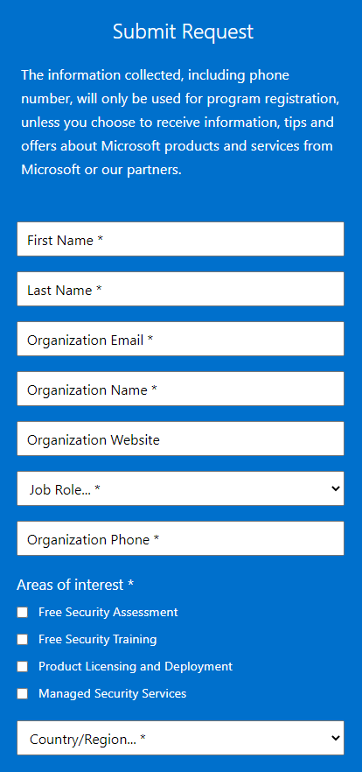
Sign up for Microsoft Cybersecurity Program for Rural Hospitals
https://nonprofits.tsi.microsoft.com/EN-US/security-program-for-rural-hospitals/
Notes:
Please complete the registration form to enroll in the Microsoft Cybersecurity Program for Rural Hospitals. Once we confirm your hospital’s eligibility, our team will help you explore available security offers, help you access the security assessment, and utilize security training resources – all at no cost to eligible hospitals.

Slide 25
Google Program
Offer secure by design technologies and support critical information sharing
Provide endpoint security advice to rural hospitals and non-profit organizations at no cost
Discounted pricing for communication and collaboration tools and security support and a pool of funding to support software migration
Pilot program with rural hospitals to develop a packaging of security capabilities that fit rural hospitals’ unique needs
Notes:
https://cloud.google.com/blog/products/identity-security/cloud-ciso-perspectives-how-google-is-helping-to-improve-rural-healthcare-cybersecurity
Google will provide endpoint security advice to rural hospitals and non-profit organizations at no cost, and eligible customers can get discounted pricing for communication and collaboration tools and security support and a pool of funding to support software migration.
In addition, Google is committing to launch a pilot program with rural hospitals to develop a packaging of security capabilities that fit these hospitals’ unique needs.
Watch for more information on these offerings and how to participate.

Slide 26
Google Products
Offering Chrome Enterprise Browser and ChromeOS for health systems to safely access and use internet-based and internal technology resources to operate their facilities and deliver patient care.
Offering Google Workspace Enterprise Essentials Plus, which supports compliance with HIPAA, is a collaboration platform that pairs productivity, messaging, identity platforms, and data security.
Providing $25 million to 25 U.S. cybersecurity clinics at universities and colleges to support training cybersecurity professionals.
Making courses available from Mandiant Academy program.
To Apply: rural-health@google.com
For more information
Notes:
https://cloud.google.com/blog/products/identity-security/cloud-ciso-perspectives-how-google-is-helping-to-improve-rural-healthcare-cybersecurity
Mandiant Academy program.
Health ISAC 20 on-demand training courses, at no charge, that it can disperse to its members. We will also be giving the Health ISAC credits for 10 public, instructor-led scheduled courses that it can distribute to its members. Members will have the opportunity to earn certifications in incident response and threat intelligence following their training or through their own independent study.
AIM for Health ISAC: In partnership with the Health ISAC, we are offering our Applied Intelligence Mentorship program (AIM). From Mandiant Intelligence, the AIM program is a four-week immersive mentorship designed to develop skilled cyber threat intelligence (CTI) practitioners through direct coaching and practical skills application.
ThreatSpace: Mandiant Consulting is also making its immersive educational experience ThreatSpace available to help incident response teams hone their skills against realistic APT-level attacks in a consequence-free environment.
Digital Forensics and Incident Response Bootcamp: This intensive, 10-day bootcamp teaches the fundamental investigative techniques needed to respond to today’s threat actors and intrusion scenarios. After eight days of classroom learning, students spend two days doing hands-on exercises that take them through adversary activity and the process of responding to a nation-state threat.

Slide 27
End Slide

Slide 28
Thank You!
NNLM Emergency and Disaster Resources Guide
NNLM Rural Health Webinar Series November 2024
You will receive an email with a link to the recording
Funded by the National Library of Medicine. NLM and NNLM are service marks
of the US Department of Health and Human Services. Updated July 2022.

