Slide 1
Create Effective Data Visualizations!
Katie Pierce Farrier, NNLM Region 3
Elizabeth Roth, NNLM Region 2
Notes:
Katie
https://redcap.nubic.northwestern.edu/redcap/surveys/?s=E83MFRPEKW&ct=133&dt=2023-02-13&rmlo=3&code=crdavz23&aou=0
_

Slide 2
Instructors
Katie Pierce Farrier
Data Science Strategist
katie.pierce-farrier@unthsc.edu
Elizabeth Roth
Research and Data Science Strategist
rothel@musc.edu
Notes:
Katie

Slide 3
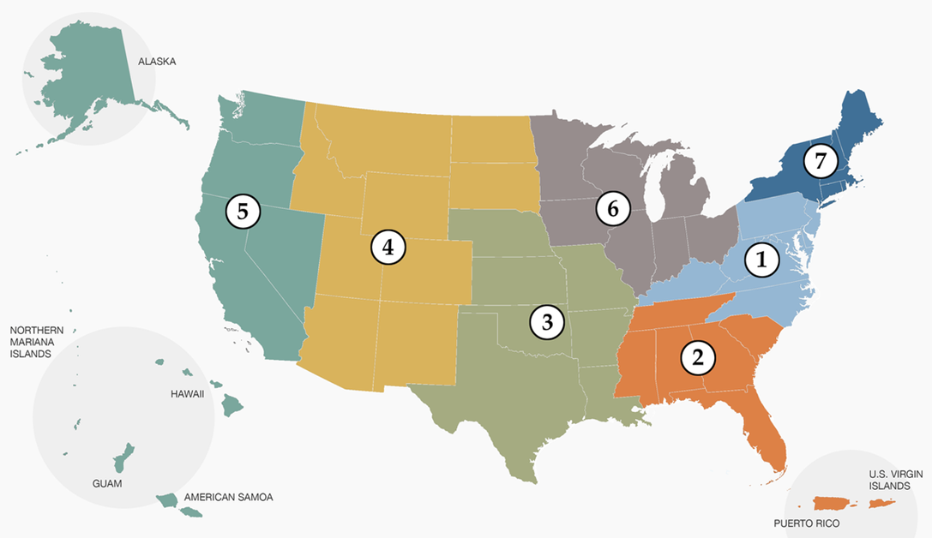
What is NNLM?
In short, the Network of the National Library of Medicine is the field force of the National Library of Medicine
Divided into 7 Regions, each with a Regional Medical Library (RML) that serves as "headquarters" for that region, spearheading and managing outreach efforts
Notes:
Katie
I briefly I wanted to introduce the network of the National Library of Medicine, also known as NLM. As the name suggests, the NLM is part of the National Library of Medicine, which is within the National Institutes of Health. We are the education and outreach arm of the National Library of Medicine, we work regionally, getting to know communities on the ground and helping those communities best serve the people they know best. We aim to advance the health and well being of everyone through access and understanding of how to use health information. This includes worth working with organizations like libraries of all types, schools, health care, and all sorts of community based organizations. We do this primarily through three different methods, funding opportunities, outreach, and education. Like today, we offer a wide range of training and education opportunities. I encourage you all to visit nnlm.gov to learn more.

Slide 4
Agenda
Define Data Visualization
Discuss Design Principles
Explore Common Chart Types and Best Uses
Compare Visualization Examples
Create a Visualization in Tableau Public
Notes:
Katie
This a brief look at our agenda. Elizabeth will go over what a data visualization is, design principles, some common chart types, and then I will demo creating some of those chart types in Tableau Public.
As we go along if you have any questions, please drop them in the chat
So I will now hand it over to Elizabeth to get started.

Slide 5
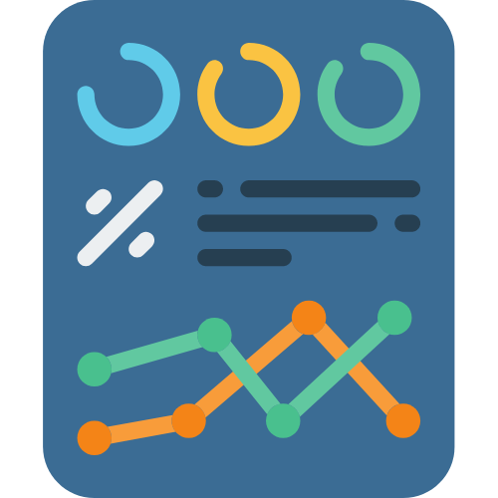
What is data visualization?
The graphical representation of information and data.
Notes:
Let’s begin with a definition – what is data visualization? A simple definition graphical representation of information and data. It is taking raw data and numbers and displaying them in a visual way that exposes trends and relationships. Data visualizations help with both analysis and storytelling.
As we will explore in more detail later, this includes charts, graphs, maps, and even just tables.
Math, statistics, and information science give us the tools to organize and analyze data, but visualization enables us to see data in context and communicate its key aspects more intuitively, persuasively, and memorably.
It is a valuable skill to be able to convey your data and outcomes visually. This way more people understand your work!
It is worth mentioning that while data visualizations should be honest representations of data, it is possible to have biased visuals that leave out some data and overemphasize other data. It is important to be aware of bias in your visualizations and try to reduce it. Additionally, when you view data visualizations, you will want to make sure that the research is cited. Since data visualizations are so effective in helping a viewer understand information, it does open up the door for misinformation to spread when there is bias or misleading graphics.

Slide 6
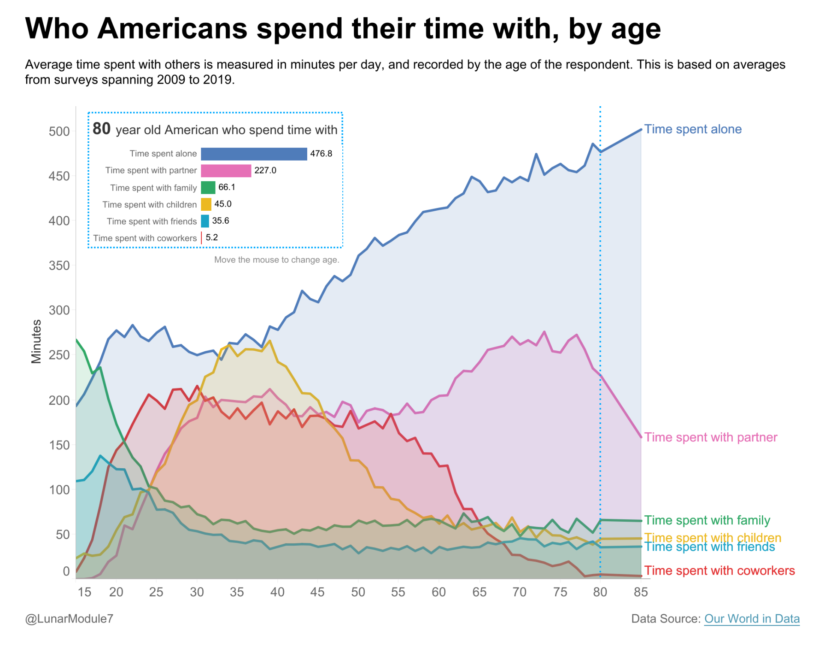
Example
Notes:
Let’s start with a data visualization that is available publicly from Tableau Viz of the Week. Like most quantitative (aka numeric) data, the original format of this data was a bunch of numbers and labels in a spreadsheet. If I displayed the spreadsheet on the screen and asked you to tell me what age group spends teh most time alone, it would take a very long time to figure that out. Instead, by showing you this colorful visual, you can quickly deduce what the data says – older adults spend the most time alone. You could also tell me the average minutes a 40 year old spends with their friends, and if that is more or less than how much time an 18 year old spends with their friends. This visual assists with both the analysis and the storytelling of this data about how Americans spend their time across a lifespan.

Slide 7
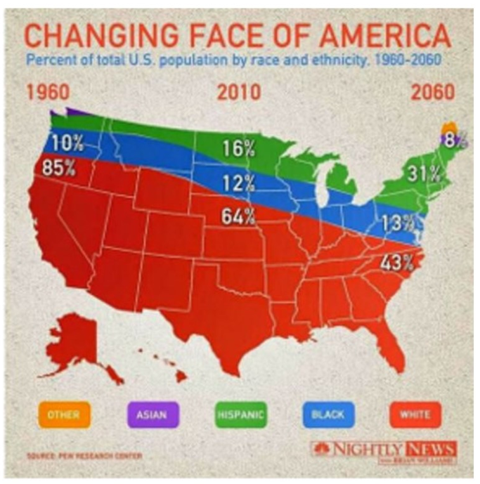
Example
What’s wrong with this visualization?
Put your comments in the chat
Notes:
https://www.jotform.com/blog/bad-data-visualization/
Not all visualizations are created equal, and there is not only room for bias, but also misuse of visual elements that confuse the viewer. What is wrong with this chart?
Some examples:
We associate political parties with red and blue
Our eye wants to associate the shaded area with the geographic area.
Do all Asians live in Maine?
Shows 3 time periods, but no visual delineation

Slide 8
Design Principles
Minimize cognitive load with good design! The viewer should not have to work hard to interpret the data.
Often, “less is more”
Build on pre-existing associations (e.g., green = good) (e.g., dark shade = more important)
Use fewer colors and use them consistently
High contrast colors for accessibility
Gestalt Principles of Visual Perception
Notes:
Becoming familiar with some basic design principles will help you avoid many of the mistakes shown in that last example. The term cognitive load refers to the amount of effort the viewer has to make to interpret your visual. It’s like looking in a disorganized closet and trying to tell me how many sweaters you have. It’s going to feel overwhelming! The goal is minimize cognitive load to make your data visualization easier to understand and for your data points to shine through. Often the saying “less is more” applies to data visualization. Less clutter and more white space / background space. Less words but using the words you do have to make succinct and clear titles. Using colors that build on associations that we already have with them. For example, using the color green when showing and improvement or increase. Similarly, it is effective to use red to show data that is alarming or out of compliance. As we will see later in the example of a heatmap, darker shades of color convey more importance. Even looking at this slide, the first thing you probably see are the words “dark shade.” Imagine if instead I had bolded the word “interpret.” Using dark shades tells our eye exactly where to go. Since we are using colors in data visualizations, it is necessary to consider accessibility as it relates to colorblindness as well as low visibility and the need for high contrast colors. There are some free online tools that we will share at the end to help you when you are choosing colors so that you are inclusive and accessible with your visualizations.
I would like to highlight some of the Gestalt Principles to give additional information about design principles and working with instead of against the way our mind interprets visuals.

Slide 9
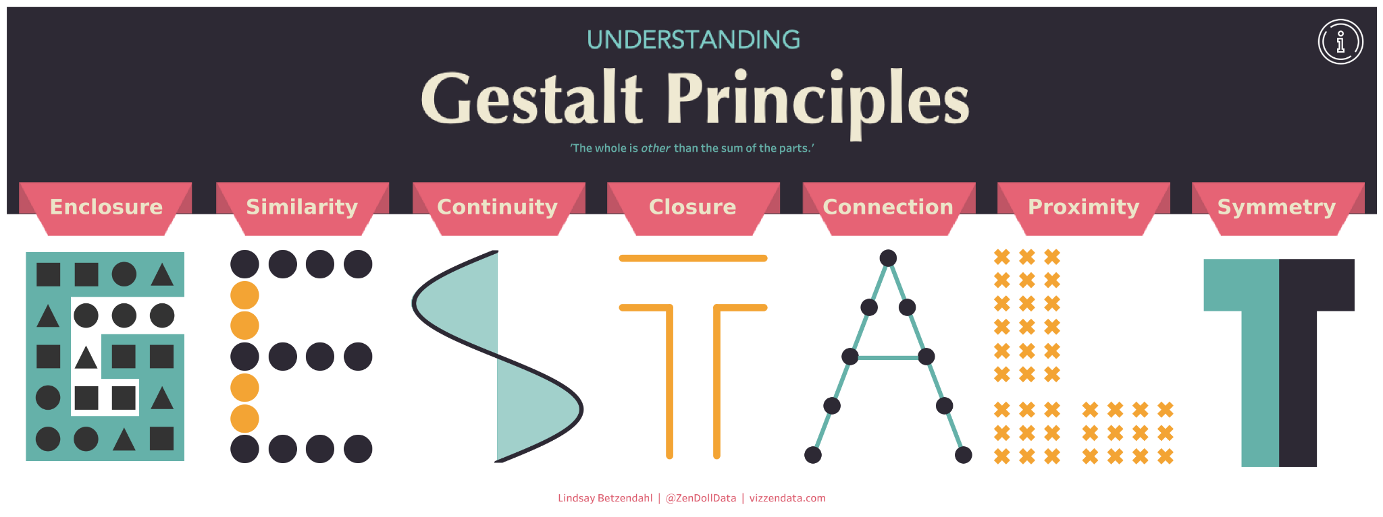
Gestalt Principles
https://public.tableau.com/app/profile/lindsay.betzendahl/viz/UnderstandingGestaltPrinciples/GestaltPrinciples
Notes:
Gestalt, the German word for form, shape, or figure. Gestalt psychology helps us understand the way our eye is always seeking to summarize a bunch of parts into a whole, how we distill visual stimuli into meaningful perceptions. Our brains cannot process a ton of visual stimulation, so it simplifies what it sees. Creating visuals that follow these inclinations will help your viewer understand your data visualizations with more ease, speed, and efficiency. Following these principles will reduce visual chaos.
Our minds have a natural “eye for design.” Visual cues will tell our brains to notice some information over other information. The Gestalt School of Psychology identified 8 principles of visual perception.
Enclosure - when we create a visual border around something, we group those objects. This can be done through drawing a box around objects, or shading behind.
Similarity - Our eye assumes that there must be a similarity of those specific dots, despite the fact that they are in different groups. We infer additional detail and difference, just by the addition of a new color.
Continuity - your eye wants to follow a line. Help the viewer by creating a visual path. Our eyes love arrows!
Closure - This principle explains our tendency to view open structures as closed and complete. For example, when we look at a bar chart later, we know that the objects belong inside, event though there is only a border on the left and on the bottom
Connection - this is the literal connecting of objects with lines
Proximity - when we place objects close together, our mind groups them. Notice how your eye sees the 9 yellow dots as a separate group from each of the 3 yellow dots. This is helped by the presence of white space between the groups. Furthermore, you wouldn’t be the title of a chart on the other side of the page. You would put it right next to the chart.
Symmetry - In data visualization, symmetrical elements are pleasing and feel harmonious.

Slide 10
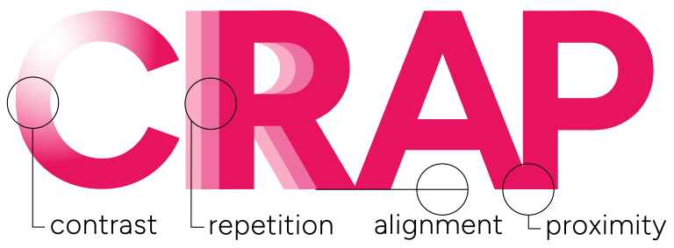
CRAP Design Principles
Notes:
Another common design principle is CRAP. Easy to remember: Make your design look like CRAP which stands for contrast, Repetition, Alignment, and Proximity.
Photo from: https://designlab.wisc.edu/resources/design-tips-and-tricks/crap-principles/

Slide 11
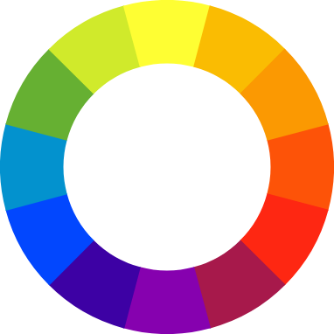
Contrast, Repetition, Alignment, and Proximity
Item 1
REPEAT
REPEAT
REPEAT
REPEAT
Related Item
Less related
Notes:
Contrast- this is mainly talking about color. You want high contrast colors. Black and white, red and blue. The closer the colors are on the color wheel, the lower the contrast. Contrast can also mean font and size. Pairing something larger with something smaller. Bold font next to something cursive.
Repetition- This means use the same colors, same fonts, same design choices throughout. This creates uniformity and lowers the cognitive load when we are looking at visualizations.
Alignment- Line the elements of your design up carefully. The piece that is out of alignment will draw the most attention. Alignment is how you apply Gestalt principles like Closure and Connection.
Proximity- just like Gestalt - proximity indicates relevance. The closer two elements are, the more we automatically assume they are related.

Slide 12
Data Visualization: Common Types

Slide 13
General Types of Visualizations
Text
Scatterplot
Tables
Line Chart
Heatmap
Vertical Bar Graph
Horizontal Bar Graph
Pie Charts
Notes:
Let’s have a look at 7 common types of charts to visualize your data

Slide 14
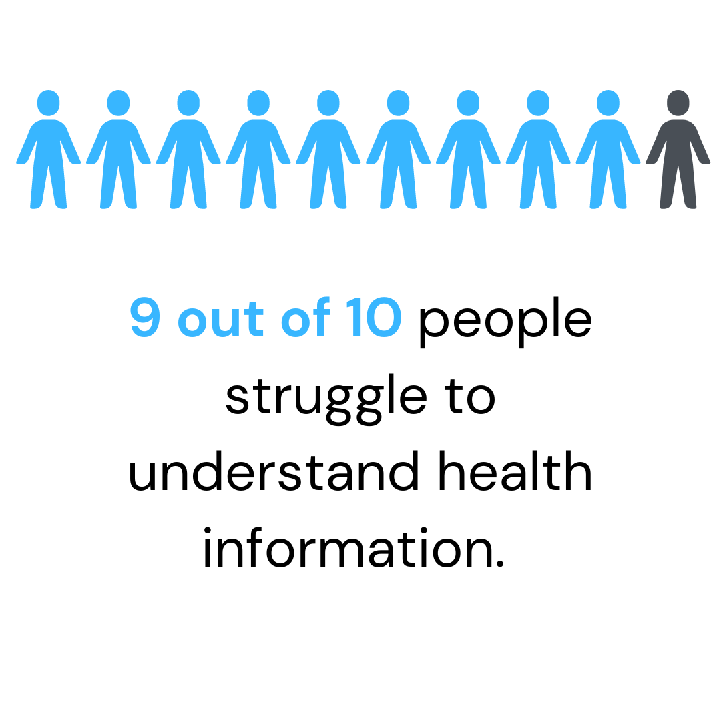
Simple Text
When you have just a number or two to share, simple text is a great way to communicate.
Notes:
The first is simple text. You use simple text when you have one or two numbers to share. Simple text is good to use when you have simple, straight forward facts to share. Smaller numbers are better for this visualization type. For example, 4 out of 5 dentists recommend… that would be good as simple text.

Slide 15
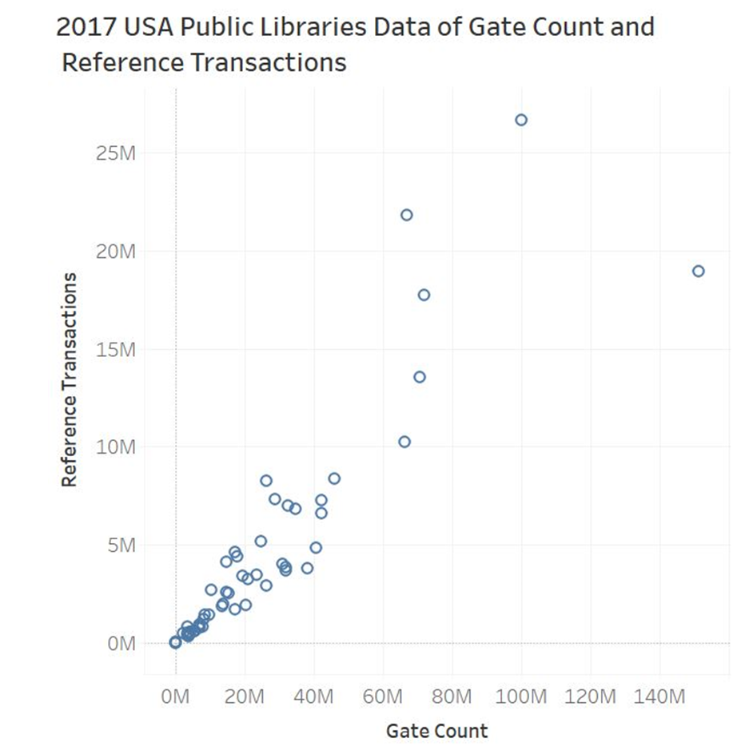
Scatterplot
Useful for showing relationship between two numerical variables and quickly seeing outliers.
Notes:
The second visual display is the scatterplot. Scatterplots are used to show relationships between two numerical variables or things because they allow you to encode data on an independent horizontal x-axis and a dependent vertical y-axis to see whether and what relationships exist. These are good for when you want to look at the relationship between 2 specific data points. For example in this chart, we are comparing the number of reference transactions versus the gate count. Scatterplots make it easy to see outliers like the two dots at the very edges, any groupings like towards the bottom corner of the graph, or upward or downward trends in the data.

Slide 16
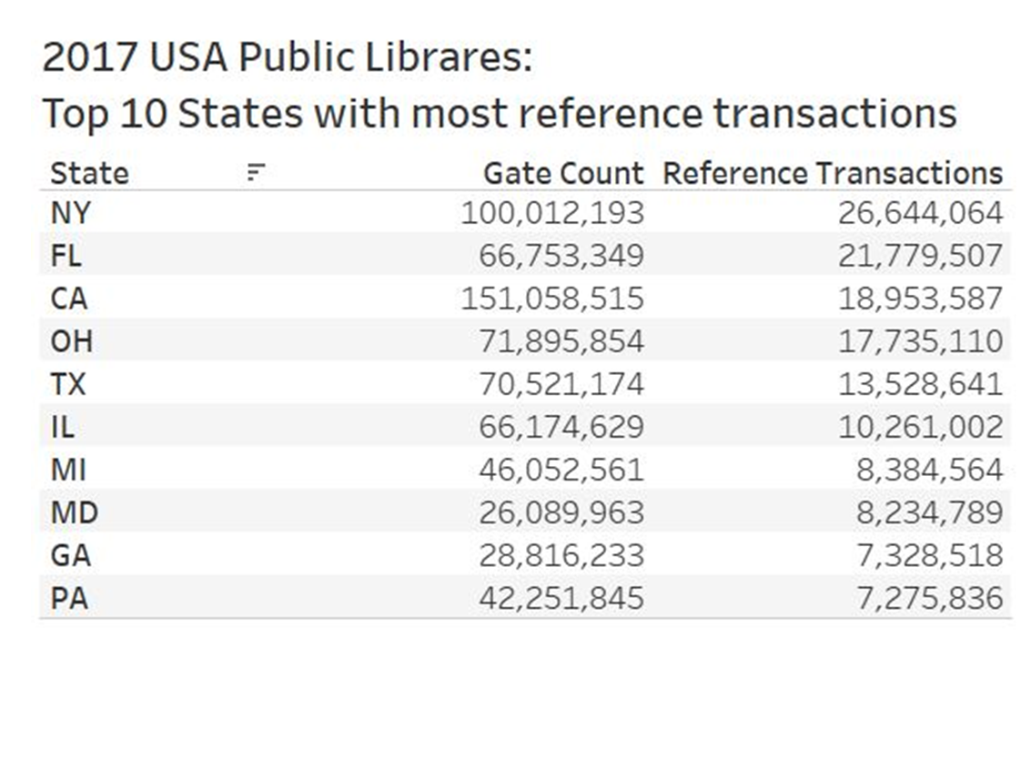
Tables
Useful for individual lookups or comparisons. Not recommended for use in live presentations
Notes:
The third visual display is tables. You use tables when you have individual lookups or comparisons; it is not recommended for use in live presentations. The chart on the right is a table of the top 10 states with the most reference transactions for 2017 in the United States. You want to use tables when you need to know the individual, exact data points. Keep in mind tables can quickly become overwhelming so this works better for smaller chunks of information.

Slide 17
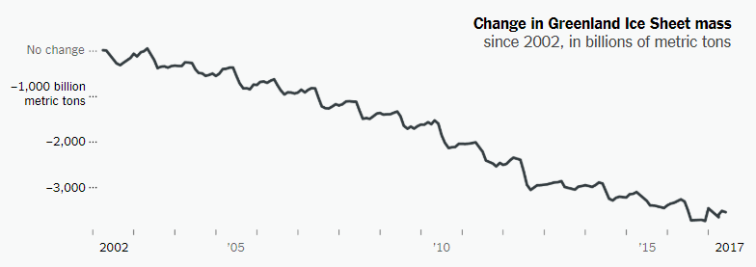
Line Chart
Mostly used to plot continuous, numerical data
Notes:
The fourth visual display is a line chart. You use a line chart to plot continuous data (i.e. data that is measurable and not categorical). The graph is from the European Space Agency Climate Change Initiative. It tracks how the mass of Greenland Ice Sheet has been steadily declining over time. The graph title and axis are clearly labeled and it’s easy to see how the line trends downward. Line graphs are great for data that is looking at years, or decades of worth information. If we looked at just one or two years, we wouldn’t be able to see a trend, but spreading it out over 15 years, you can start to see the pattern.
https://www.nytimes.com/2019/02/28/learning/teach-about-climate-change-with-these-24-new-york-times-graphs.html

Slide 18
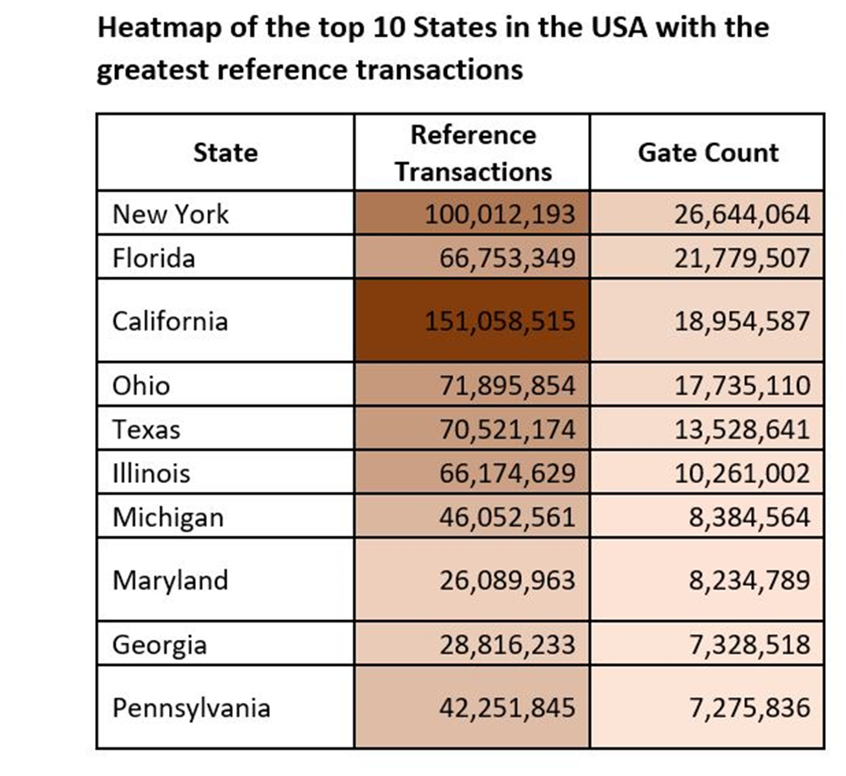
Heatmap
Used to visualize data in a table, where colored cells communicate the relative magnitude of the values.
Notes:
The fifth visual display is a heatmap. You use heatmaps when you need to visualize data in a tabular format, where in place of numbers you have colored cell that communicate the relative magnitude of the numbers. “The darker the shade, the greater the quantity.” The table on the right is a heatmap of the top 10 reference transactions and their associated gate count numbers in 2017 for public libraries in the United States. The darker brown indicates a higher interval of values while the lighter brown indicate a lower interval of values. A heatmap gives your data a boost by helping the viewer’s eye go right to the largest numbers, and using color gradation to show step downs in transactions.

Slide 19
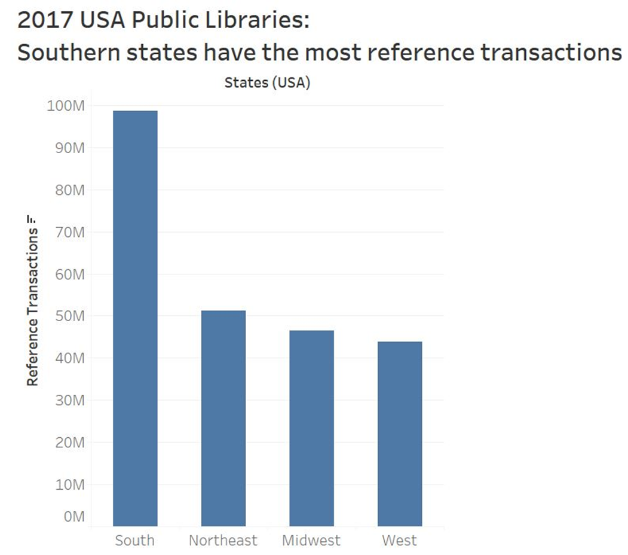
Vertical Bar Graph
Compares qualitative categories with their numerical values, in the form of vertical bars
Notes:
The sixth is the vertical bar chart, and one you are likely very familiar with. This visualization has a labeled xy axis, where the bottom or x axis shows the category, and the side or y axis shows the numerical value associated with each category. In this example, the x axis displays regions in the united state and the Y axis is number of reference transactions. Vertical bar graphs are simple to interpret because you are comparing the end points of bars so it is easy to see quickly which category is the biggest and smallest. The viewer of this sample graph quickly infers that states in the South have the most reference transactions. This is also re-emphasized in the title “Southern states have the most reference transactions.” Which is a best practice for a title. Also note is that all the bars are the same color. This keeps the visual simple and clear. If you gave each of the bars a different color, it would just add clutter and confusion in this instance. The label at the bottom of each bar is sufficient.

Slide 20
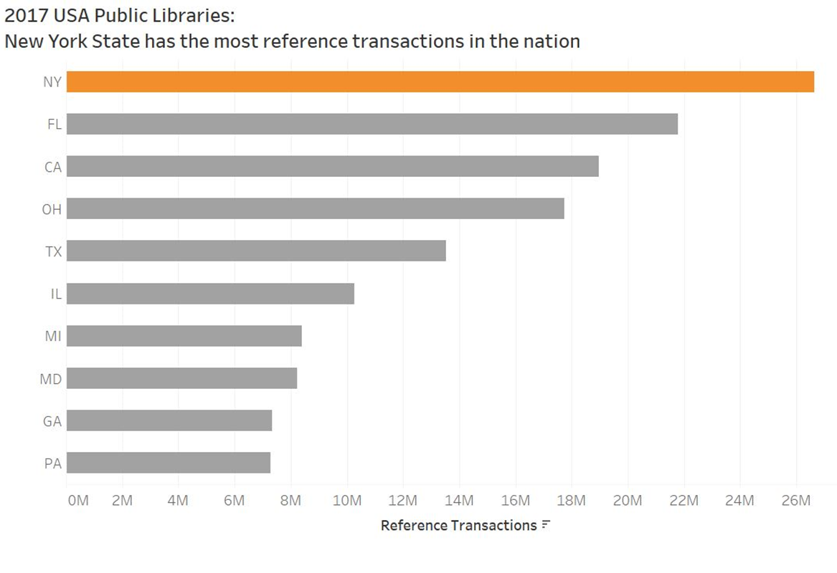
Horizontal Bar Graph
Compares qualitative categories with their numerical values, in the form of horizontal bars
Notes:
The horizontal bar graph is similar to the vertical bar graph, it just uses a different access. The chart here is a horizontal bar graph of the top 10 states with the most reference transactions in the United States for Public Libraries in 2017. The Y axis shows the state names, and the X axis shows reference transactions. The creator of this chart helps the viewer by displaying the bars in order from most transactions to least transactions. The use of color with the orange column isn’t adding much to the visual, and isn’t really necessary, unless your intention was to talk about NY specifically and it just happened to be on the top. We already infer it’s the most transactions, because the bar is the longest. This is another example of a great title because it clearly states what the data shows.

Slide 21
Stacked Horizontal Bar Graph
Similar to the Vertical Bar Graph, comparing the end points of bars so it is easy to see quickly which category is the biggest and smallest.
Notes:
Our final visual is a stacked horizontal bar graph. A stacked bar graph is used when you want to show the proportional contribution of individual data points in comparison to a total. Stacked bar graphs require the use of colors because you need to differentiate between 2 or more variables. This visualization shows the proportion of students in each NNLM class who live in the Region 3 states. So the yellow here adds to the visual because you want to concentrate more on the students in Region 3.

Slide 22
Data Visualization Don’ts
Look at some examples and find ways to improve.

Slide 23
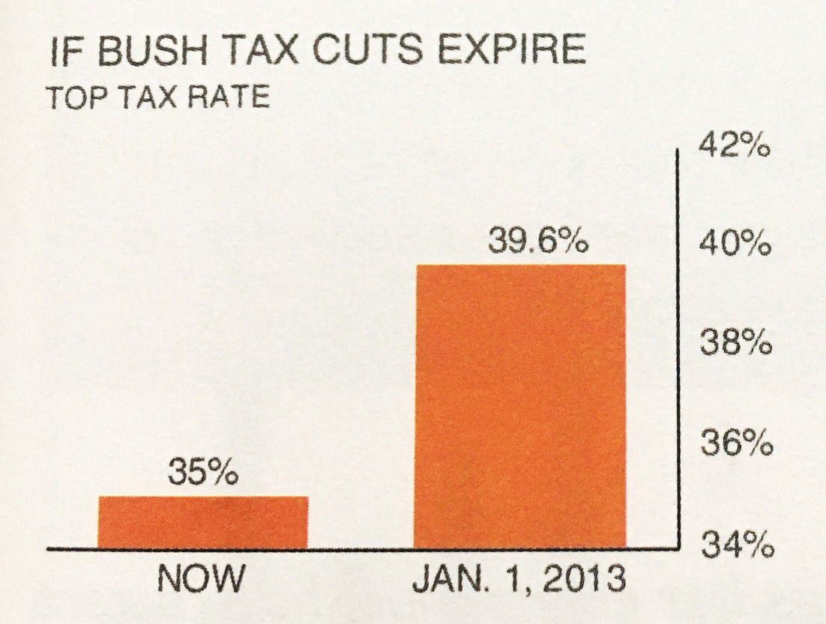
Example 1
Notes:
So this is an example taken from Cole Nussbaumer Knaflic’s book “Storytelling with Data…” What’s wrong with this data visualization?
The bottom number on the vertical y-axis is NOT zero, but rather 34%
In fact, the way this is graphed, the visual increase is exaggerated 4X.
What happens when we graph the bars with a zero baseline so that the heights are accurately represented …GO TO NEXT SLIDE

Slide 24
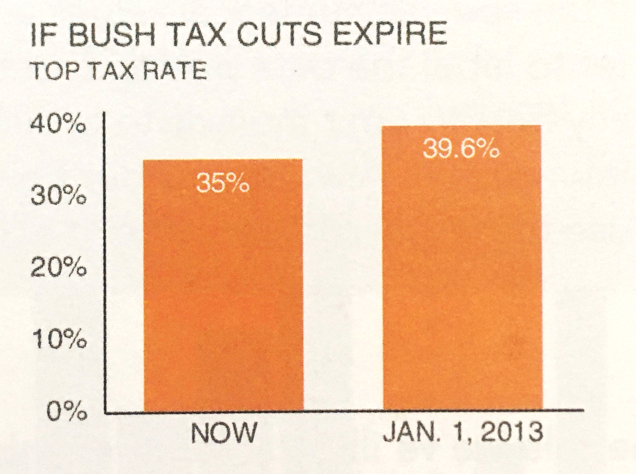
Example 1: Improved
Notes:
So when the visualization is corrected to start at 0%, this is what it looks like. What looked like a huge increase on the left is now reduced when plotted appropriately. THis graph isn’t as worrisome, or at least not as much compared to how it was originally depicted. It’s important to have the context of the entire bar there in order to make an accurate comparison.

Slide 25
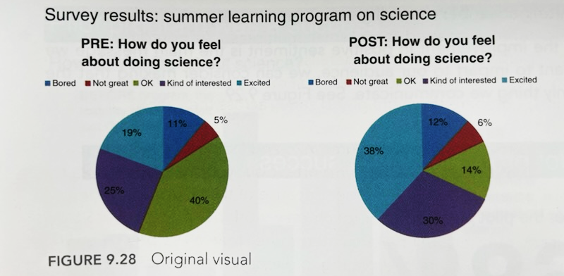
Example 2
Notes:
So this is another example from Cole Nussbaumer Knaflic’s book “Storytelling with Data…” It looks at pre and post test survey data from a summer science class.
What is problematic about this data visualization?
I’m not a huge fan of pie charts. It takes work to decipher the difference in sizes and angles.
The different categories are color coded which is meant to help, but just makes the visualization busy and hard to read.
High Cognitive load to decipher meaning.
Also having two pie charts is even more confusing and exhausting to have to compare and de-code.
Lastly, the use of red-green is not color blind friendly as well.
What could we do to improve this visualization?

Slide 26
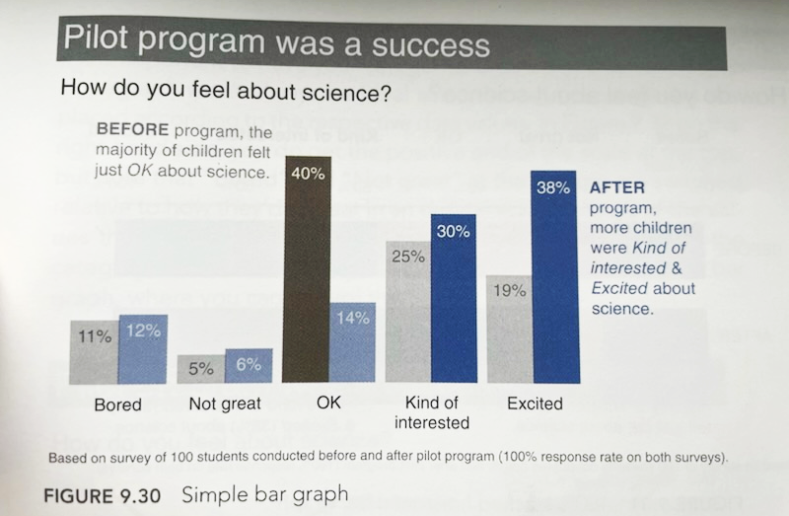
Example 2: Improved
Notes:
We can fix the ugly data visualization by transforming the ugly pie charts into a grouped vertical bar chart. The grouped/two-series vertical bar chart allows for side-by-side comparisons of the before the program to the after the program results. The length of the bars allows for easier comparison between categories than to wedge areas and angles like in the pie chart.
Category labels are nice and big and easy to read; the number of colors used is limited and the use of hue intensity to highlight important figures is helpful and creates a visual hierarchy of information. The color-coded annotations reinforce highlighting the important stuff and active titling makes an active statement of the importance of the chart that the “pilot program was a success” vs. just “survey results”.

Slide 27
Data Visualization Tools and Resources

Slide 28
Alt Text for Accessibility
Used to describe the appearance and meaning of a visual to a screen reader
Example:
“A vertical bar graph of reference transactions in 4 regions of the United States where the South has the most transactions.”

Slide 29
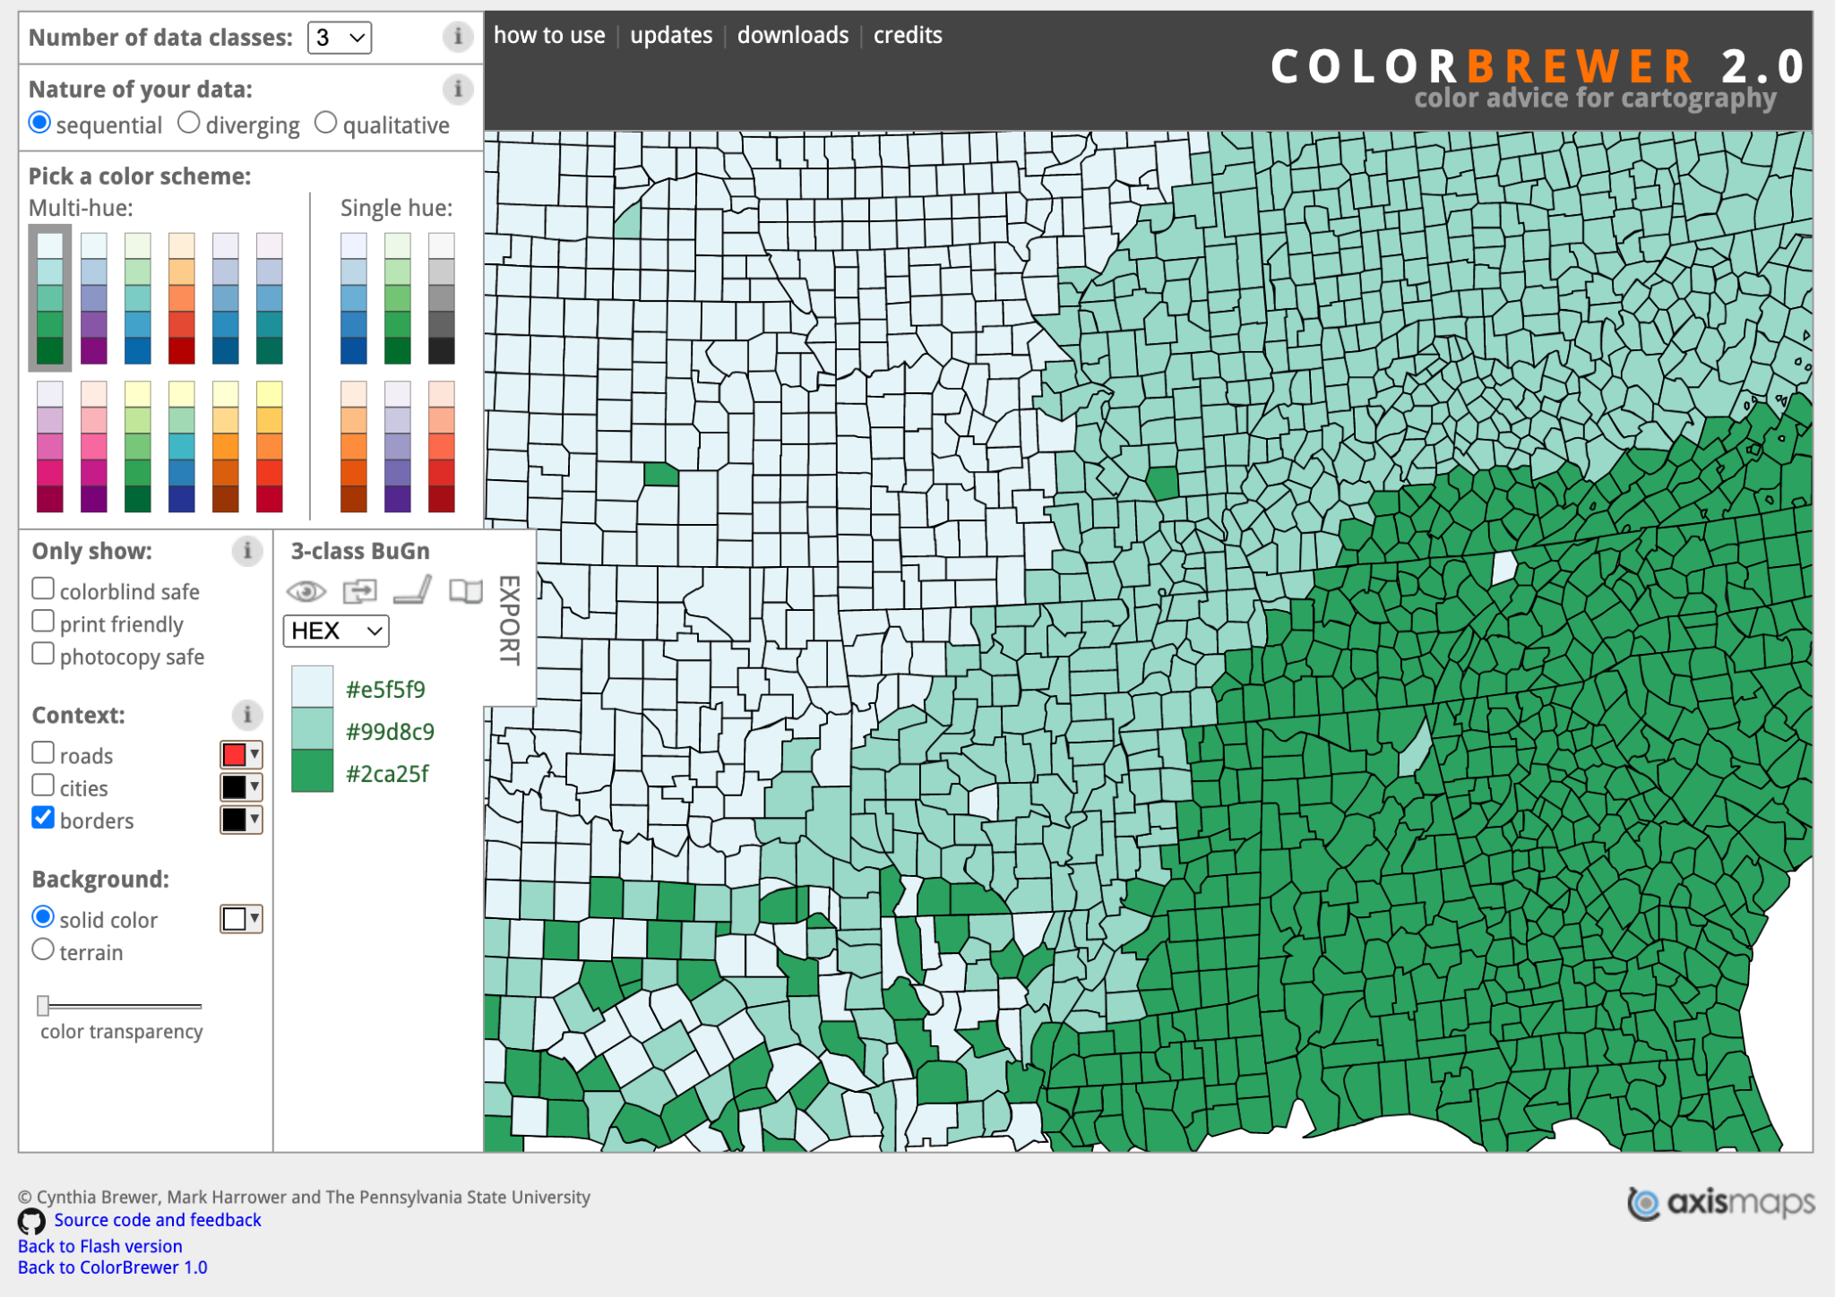
Color Brewer
https://colorbrewer2.org/#type=sequential&scheme=BuGn&n=3
Notes:
This is a free tool that identifies colors that will go well together in a visual. You can choose sequential, diverging, or qualitative. Sequential colors would be on a gradient, such as in the heat map. The tool will tell you the exact color names (listed as HEX codes) that you can then drop into your visualizing software. Hex codes are unique, universal names for colors that are written with a hashtag followed by a unique set of number and letters. There are tools online to convert HEX codes to RGB.

Slide 30
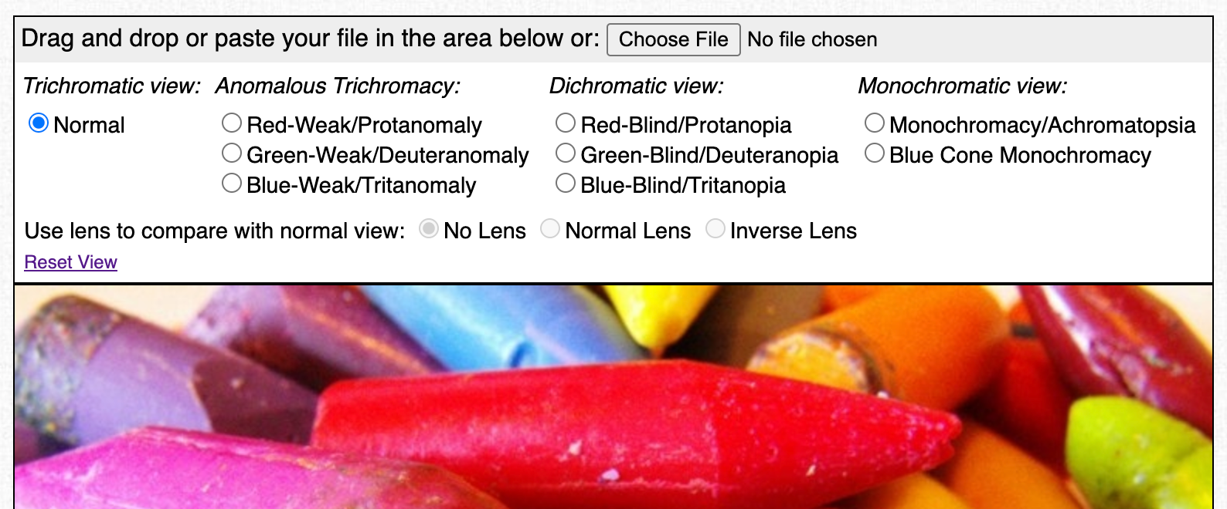
Coblis - Color Blindness Simulator
https://www.color-blindness.com/coblis-color-blindness-simulator/
Notes:
You can upload an image of your visualization and simulate different types of colorblindness to see if there is enough color contrast.
https://www.color-blindness.com/coblis-color-blindness-simulator/

Slide 31
Data Visualization Catalogue
RawGraphs.io
Notes:
Katie
I wanted to point out two resources that I like to use when deciding what kind of visual to make. Data Visualization Catalogue provides information about different graphs and what kind of data to use for each of them. Rawgraphs is a great brainstorming tool. If you’re not sure what to use, or what your data may look like. You can copy/paste a sample of your data into rawgraphs and then see it in multiple kinds a of visuals very quickly.
https://www.rawgraphs.io/
https://datavizcatalogue.com/index.htm

Slide 32
Viz of the Day- Explore, new interesting visualizations
Sample Datasets and Community Resources - Find sample data and learning resources.
Today’s example will use the sample education data set “American University Data”
Notes:
We are going to move into the demo for Tableau. We are using a sample dataset from Tableau. You have the option of following along. It can take some time to upload a data set into Tableau. Hopefully you were able to before class, but you can always watch the recording and start/ stop as needed
We will build a couple charts in Tableau and walkthrough some of the design choices. The free version of Tableau is entirely public facing. Any visualizations you create will be publicly shareable- Just as a forewarning before we get started. I’ll share the link to the created dashboard at the end so you have it as a reference.
https://public.tableau.com/app/resources/sample-data

Slide 33
Additional Reading on Data Visualization
Effective Data Visualization by Stephanie Evergreen
Storytelling With Data: A Data Visualization Guide for Business Professionals by Cole Nussbaumer Knaflic
The Functional Art by Alberto Cairo
The Visual Display of Quantitative Information by Edward R. Tufte
Knowledge is Beautiful by David McCandless

Slide 34
Questions?
Instructors
Katie Pierce Farrier
Data Science Strategist
katie.pierce-farrier@unthsc.edu
Elizabeth Roth
Research and Data Science Strategist
rothel@musc.edu

Slide 35
Upcoming Data Training
Is Seeing Really Believing?: Visual Health Misinformation June 20th at 1pm CT
Health Statistics on the Web July 31st at 1m CT
Notes:
https://www.nnlm.gov/training

Slide 36
Survey
https://www.nnlm.gov/dataviz
_
Notes:
https://redcap.nubic.northwestern.edu/redcap/surveys/?s=E83MFRPEKW&ct=133&dt=2023-02-13&rmlo=3&code=crdavz23&aou=0
https://www.nnlm.gov/dataviz

