Slide 1
Contemplation
“I’m thinking about it”

Slide 2
Discussion points from last module
What shows you that a patient is in precontemplation?
When you notice patients in precontemplation, what strategies discussed last time work best for you?
Notes:
[NOTE TO FACILITATOR: If you are completing these modules in an order other than suggested in the facilitation guide, you may need to adjust these discussion points.]

Slide 3
Objectives
By the end of the program, participants will:
Define the contemplation stage
Discuss MI techniques for patients in contemplation

Slide 4
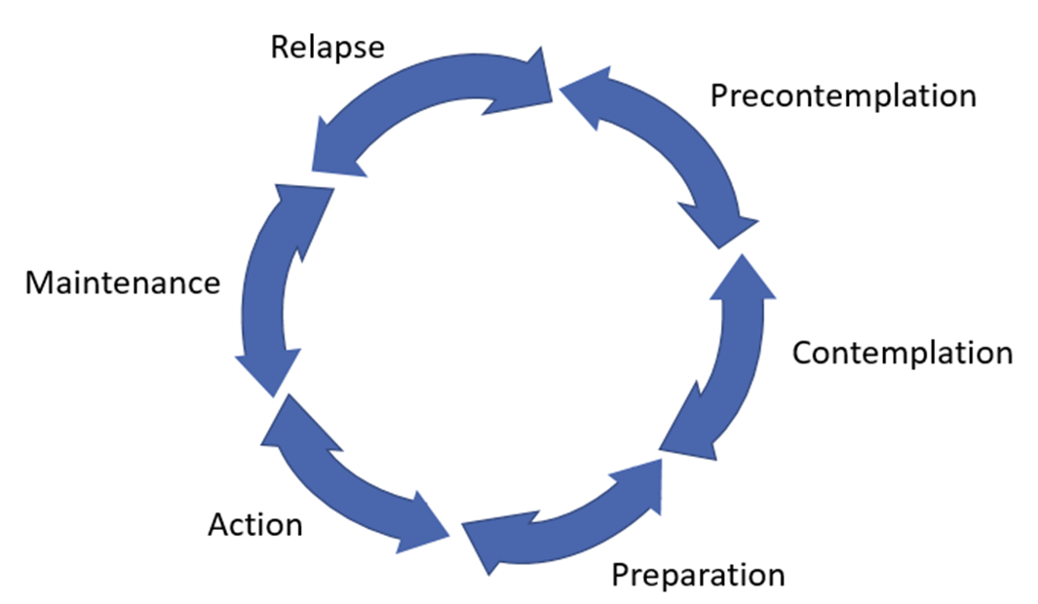
Contemplation (1)
Develop discrepancy & motivate
Increase confidence
Will consider-but ambivalent
Contemplation
Figure 1. Adapted from Tuccero, Railey, Briggs & Hull (2016). Behavioral Health in Prevention and Chronic Illness Management, Primary Care: Clinics in Office Practice, 43, 191-102. doi: 10.1016/j.pop.2016.01.006
Notes:
We’re moving on to the contemplation stage, so the recommendations in this image have been changed. For this stage, the goal is to increase confidence and the core principle suggested is to develop discrepancy¹. This model also suggests motivating¹. Motivation is influenced, in part, by the core principle of self-efficacy along with someone’s belief in the importance of a behavior⁴.

Slide 5
What is Contemplation?
The patient has more awareness of the positive outcomes they will get from change and intends to make a change to their behavior in the next six months²
Experiencing a large amount of ambivalence^{2,3,4}
May not be ready to jump into action right away²
Need to work through their ambivalence first³
Notes:
What is contemplation? This is the stage in the Transtheoretical Model where someone is more aware of why they should make a change when compared to someone in precontemplation because they can see what positive outcomes they will get if they do change². However, a primary characteristic of Contemplation is ambivalence. We discussed this in an earlier module, but as a review, this is… because of the amount of ambivalence someone will be feeling, they are not ready to discuss action right away². First, they need to work through the ambivalence they feel about making a change³.
[NOTE TO FACILITATOR: If you are completing these modules in an order other than suggested in the facilitation guide, you may need to adjust these discussion points.]

Slide 6
Recognizing Contemplation
Patients in contemplation may:
Make statements about their reasons for change followed by “but..”⁴
Say they need to “finish” or “get through” something before they can change³
Ask about “easier” ways to make a change⁴
Notes:
How can you recognize someone in contemplation? They might talk with you about all the reasons they want to change or the benefits to change, immediately followed with “but” and then why they don’t want to change⁴. For example, “I know that losing weight will make me feel better and prevent me from getting diabetes, which runs in my family, but I’ve tried a bunch of diets that never work, and who has time to exercise?” They may also indicate being in contemplation by stating that they just need to finish something or get through something before they can consider change³. For example, saying they will get started with healthier eating after the holidays³. They may also ask about easier ways to make a change⁴. For example, is there a weight loss pill they could use instead of only changing their diet.

Slide 7
Contemplation (2)
The key is to work through ambivalence^{3,4} and increase confidence¹
Develop discrepancy¹
reflective listening⁷
summarizing⁷
Develop discrepancy & motivate
Increase confidence
Will consider-but ambivalent
Contemplation
Figure 1. Adapted from Tuccero, Railey, Briggs & Hull (2016). Behavioral Health in Prevention and Chronic Illness Management, Primary Care: Clinics in Office Practice, 43, 191-102. doi: 10.1016/j.pop.2016.01.006
Notes:
What can you do with a contemplator? The goal is to help them work through their ambivalence^{3,4} and increase their confidence¹. You can think of this as hopefully supporting them so they see the scale tip in the direction of making change.
It is also suggested that we support contemplators by helping them develop discrepancy¹. We talked about this in an earlier session, but to reiterate, decisional balance is when someone considers the gap between their current behavior and their long term goals⁷. Think about a change that you have considered - most likely you did it because you wanted your future self to feel better or be healthier. So, when we connect a behavior to something that is very important in the long term, it puts more weight on making the change. For example, living longer for their children could be a patients final motivation to quit smoking, but sometimes they need to work through this to tip the scale. One way to help someone develop discrepancy is through using the MI techniques of reflective listening and summarizing because it can make the discrepancy more apparent when you state it back to them⁷. This can be used almost like you don’t understand and are trying to make sense of someone’s statements⁷. For example, “So, sometimes when you drink during the week, you can’t get out of bed to get to work. Last month, you missed 5 days. But you enjoy your work, and doing well in your job is very important to you.”⁷
[NOTE TO FACILITATOR: If you are completing these modules in an order other than suggested in the facilitation guide, you may need to adjust this note.]

Slide 8
Contemplation - what to do?
Decisional balance can help them weigh the pros & cons^{3,4,6}
Importance & confidence rulers can increase confidence and motivation^{4,6,7}
 | Not Changing | Changing
Pros | 1 | 4
Cons | 2 | 3
Figure 2. Stewart, E., Taylor-Post, N., Nichols L., Staton E., & Schleuning A. (2014). Community Connections: Linking Primary Care Patients to Local Resources for Better Management of Obesity. Rockville, MD: Agency for Healthcare Research and Quality; AHRQ Publication No. 14-0030-EF. Retrieved from URL to Source
Notes:
One thing that can help is to use something called decisional balance^{3,6}. This is when you ask them to think about the pros and cons of making a change AND the pros and cons of NOT making a change^{3,6}. It may seem tempting to talk about the pros of changing first, but social psychology suggests that a non-confrontational way to get started is to ask them about the benefits and drawbacks of NOT changing first⁶.
Contemplators can also benefit from someone using readiness rulers^{4,6,7}. To feel motivated, someone needs to feel a change is important and feel confident they can make a change. These rulers can help them think about this. This is when a patient is asked to rate how confident they feel or how important a change is to them from 1-10^{4,6,7}. Once they respond, you could ask them why they rated themselves where they did and not at a lower number⁴. Make sure to ask them why they didn’t choose a LOWER number because this will get them to discuss why it is important or what things make them confident⁴. If you ask them why they didn’t choose a higher number, they will state the opposite (why they don’t feel confident or feel something is important)⁴.

Slide 9
Rulers
Q: On a scale of 1-10, how confident do you feel that you could start walking regularly?
A: probably a 5.
Q: Why did you choose 5 and not 2?
A: Well, my friend already walks in my neighborhood and the weather has been nice out…
“What would it take to move you from a 5 to a 7?”
Notes:
You can see an example here of someone being asked how confident they feel about walking more. When asked why they chose a 5 and not a 2, they are gently pushed into stating why they COULD do this. You can follow up by asking an open-ended question^{4,6}. This could be as simple as, “What else?”⁴ or “What would it take to move from a 5 to a 7?”^{4,7}

Slide 10
Take home message
Consider:
What shows you that a patient is in contemplation?
Practice:
If you notice patients in contemplation, what strategies discussed today work best for you?
Developed resources reported in this presentation are supported by the National Library of Medicine (NLM), National Institutes of Health (NIH) under cooperative agreement number UG4LM012342 with the University of Pittsburgh, Health Sciences Library System. The content is solely the responsibility of the authors and does not necessarily represent the official views of the National Institutes of Health.
Notes:
As we wrap up today, some things to keep in mind are: what shows you that a patient is in contemplation and when you notice this, which strategies from today do you think will work the best for you when working with them?
[NOTE TO FACILITATOR: If you want to complete group discussion immediately following this module content, change the title of this slide to ‘Group Discussion’ and delete the slide with corresponding questions in the next module. If you would like to have discussion take place using your internal LMS system, you can include instructions here for how participants can participate. Then, adjust the slide with the corresponding questions in the next module as needed.]

Slide 11
References
Tuccero, Railey, Briggs & Hull (2016). Behavioral Health in Prevention and Chronic Illness Management, Primary Care: Clinics in Office Practice, 43, 191-102. doi: 10.1016/j.pop.2016.01.006
Glanz, K., Rimer, B. & Viswanath, K. (Eds.). (2015). Health Behavior: theory, research and practice. San Francisco: Jossey-Bass.
Constance, A. & Sauter, C. (2011). Inspiring and Supporting Behavior Change. United States: American Dietetic Association.
Gold, M., Kelly, T. & Douihy, A. (2015). Motivational Interviewing : A Guide for Medical Trainees. New York: Oxford University Press.
McGinnis P., Davis M., Howk S., DeSordi M. & Thomas M. (2014). Integrating Primary Care Practices and Community-based Resources to Manage Obesity: A Bridge-building Toolkit for Rural Primary Care Practice Transformation. Rockville, MD: Agency for Healthcare Research and Quality: AHRQ Publication No. 14-0043-EF. Retrieved from URL to source
Stewart, E., Taylor-Post, N., Nichols L., Staton E., & Schleuning A. (2014). Community Connections: Linking Primary Care Patients to Local Resources for Better Management of Obesity. Rockville, MD: Agency for Healthcare Research and Quality; AHRQ Publication No. 14-0030-EF. Retrieved from URL to Source
Center for Substance Abuse Treatment (1999). Enhancing Motivation for Change in Substance Abuse Treatment. Treatment Improvement Protocol (TIP) Series, No. 35. HHS Publication No. (SMA) 12-4212. Rockville, MD: Substance Abuse and Mental Health Services Administration. Retrieved from URL to Source

