Slide 1
The Development of the National Community Health Worker Survey to Advance Professional Identity, Policy leadership and Organizational Capacity

Slide 2
Aurora GrantWingate: (she/her/hers)
Member and Partner Engagement Associate| agrantwingate@hria.org
Mikayla Trujillo, CPSW/CCHW: (she/her/hers) Capacity Building Coordinator | mtrujillo@hria.org |

Slide 3
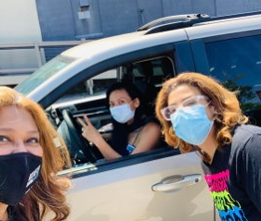
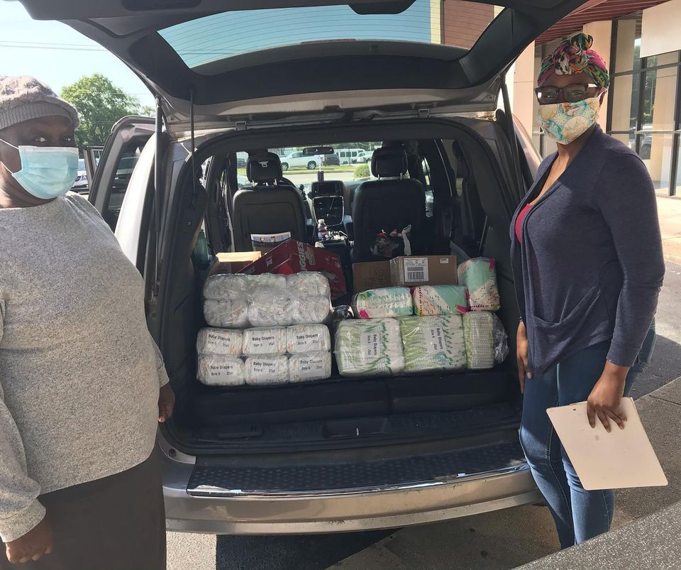
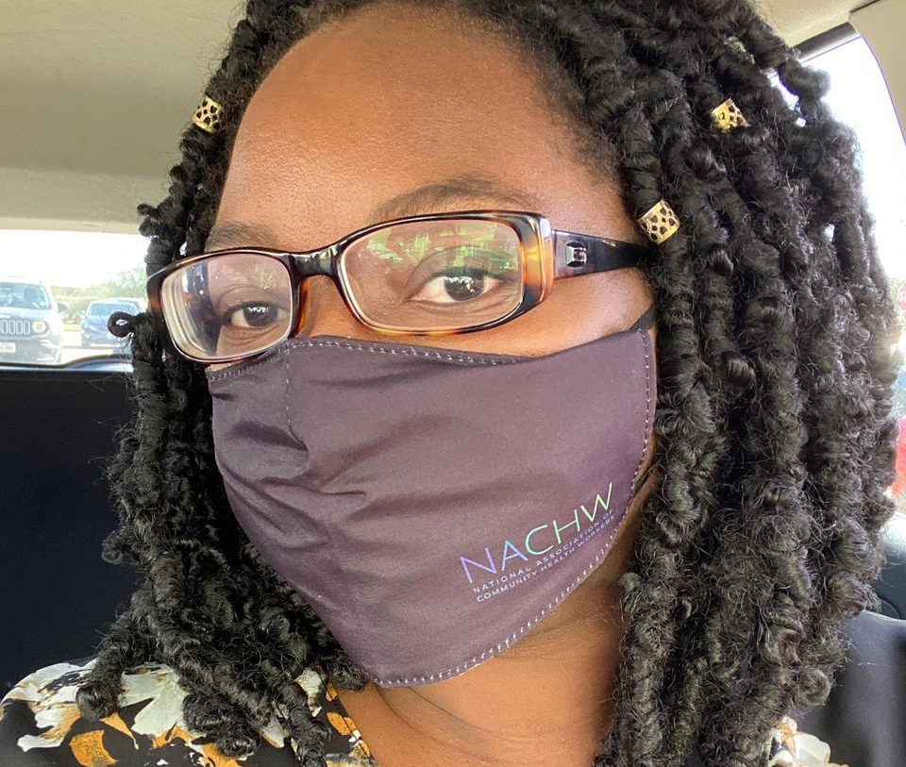
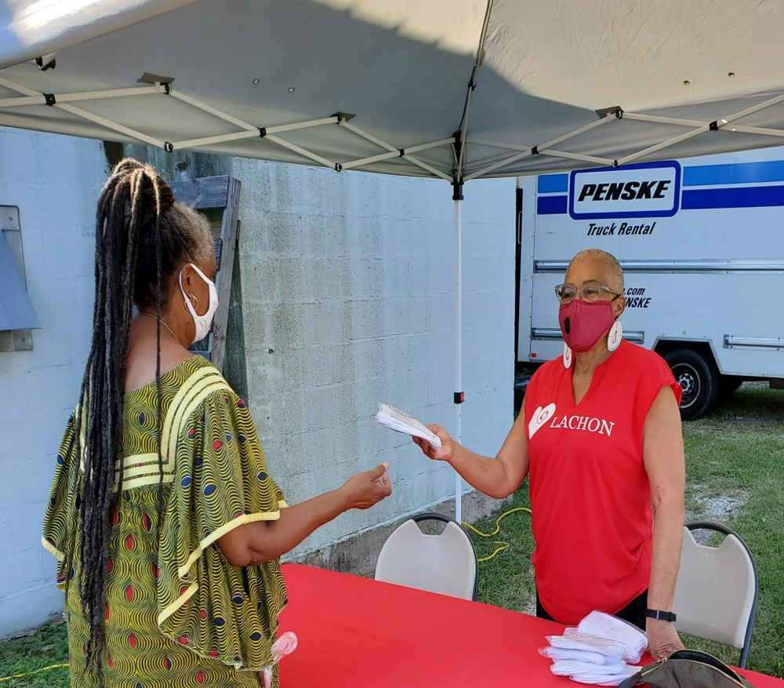

Slide 4
WHY COMMUNITY HEALTH WORKERS?
The National Association of Community Health Workers (NACHW) believes that Community Health Workers must achieve national professional identity, policy leadership and sustainability to:
• address growing U.S. public health worker shortages
• weakness in pandemic readiness - especially at the community level
• reduce cost and disease by prioritizing the social determinants of health
• achieve racial and health equity for marginalized communities

Slide 5
What is a CHW Network?
CHW Network Organizations (including Associations and Coalitions) are defined by NACHW as organizations led by or co-led by Community Health Workers (includes promotoras, CHRs, and other titles/identities within our profession) whose mission and activities focus on CHW membership, networking, policy, advocacy, and workforce development.​
​
As of 2021 there are CHW Networks at the local and/or state level in 40 states. ​
​
Activities of CHW Networks Include: ​
CHW Core Competency Training​ CHW Continuing Education or Trainings ​
Development of CHW State or Local Policy ​ Advocacy for Equitable Pay and Protections
CHW Recruitment and Career Opportunities ​ Annual member conferences and summits ​
CHW Supervisor Training Partnerships with local/state Dept of Health CHW Registry Coordination Direct service, referrals and data collection​
CHW State Certification Advisories CHW Networking and Mentorship
Advocacy for the profession COVID-related direct service and SME role
https://nachw.org/membership/chw-networks-and-certification-programs/ ​

Slide 6
Community Health Workers united nationally to support communities in achieving health, equity and social justice.

Slide 7
ABOUT
NACHW
VISION : Community Health Workers united nationally to support communities in achieving health, equity and social justice.
ENGAGE
CHWs, Allies, Supporters, Partners, Sponsors, and Influencers
EXPAND
Membership, Recognition, Opportunities, and Collective Action
ENHANCE
CHW Leadership Skills and Opportunity
EDUCATE
Stakeholders on the Impact of CHWs
ESTABLISH
National Voice and Sustainable Strategies On Issues Related To CHW Workforce

Slide 8
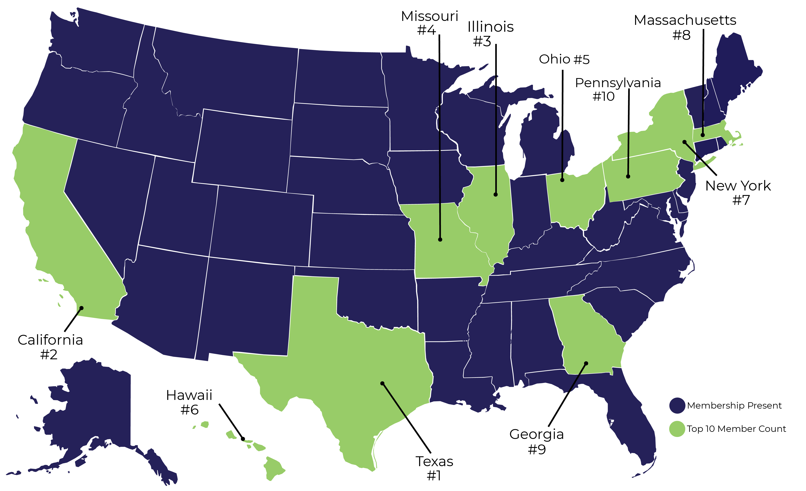
NATIONAL MEMBERSHIP: 50 STATES AND GROWING!

Slide 9
NACHW MEMBERSHIP EMPLOYER DATA 2019-2020
CHW Employers
43% - Allies Employed by Community Based Organizations
10% - All other
62% - CHWs Employed by Community based organizations
10.5% - Allies Employed by Hospitals and Health Systems
Ally
Employers
12.5% - CHWs Employed by Hospital and Health Systems
11% - CHWs Employed by Federally Qualified Health Centers
36.5% - Allies Employed by Universities and Research Institutions
14.5% - All other

Slide 10
NACHW MEMBERSHIP: CROSS SECTOR AND MULTI-DISCIPLINARY WORK
TOP AREAS OF WORK | PRIMARY AREAS OF EXPERTISE
COMMUNITY ORGANIZING + OUTREACH | SOCIAL WELFARE + ECONOMIC OPPORTUNITY
CLINIC/OFFICE | HOUSING + BASIC NEEDS
HEALTH EDUCATION | IMMIGRATION
CARE COORDINATION | DIABETES
HOME VISITING | SPECIAL NEEDS POPULATION
RESEARCH | WOMEN’S HEALTH
 | MEN’S HEALTH
 | MENTAL HEALTH
 | MATERNAL AND CHILD HEALTH

Slide 11
CHW POLICY REPORTS
WWW.NACHW.ORG/POLICIES

Slide 12
The CHW Document Resource Center
A Database for
CHW Leaders, State and Local Government Practitioners, Employers and Payers.
Login and Begin your Search Today!
https://nachw.org/chw-document-resource-center/
The CHW Document Resource Center was developed in collaboration with National Association of Chronic Disease Directors (NACDD) and the Centers for Disease Control Division of Chronic Disease Prevention and Health Promotion.

Slide 13
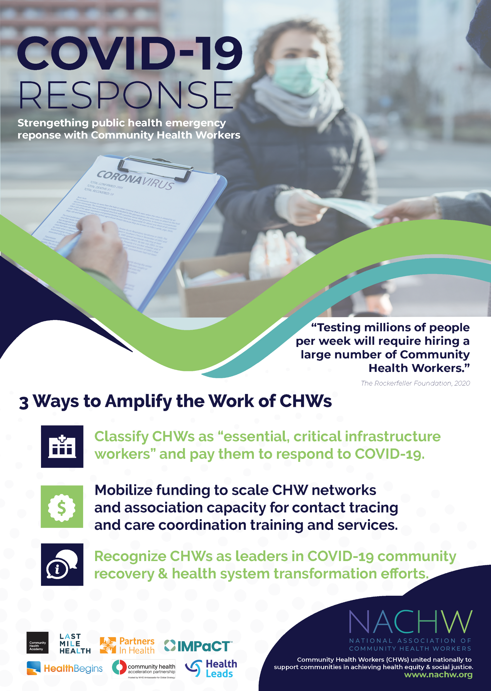
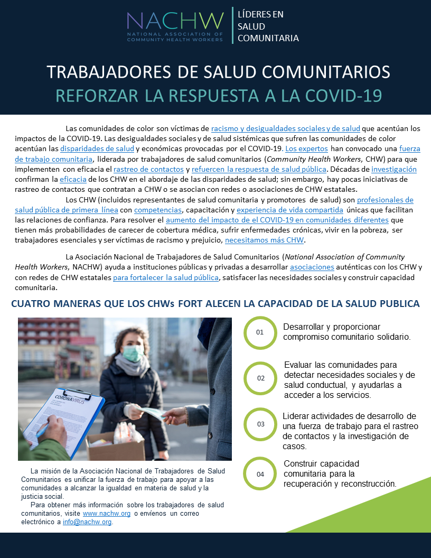
COVID-19 RESOURCES TO AMPLIFY CHWS
DOWNLOAD RESOURCES
TODAY!
Download training materials, view recorded webinars, infographics and
fact sheets at https://nachw.org/covid-19-resources/

Slide 14
CHW Leadership and Capacity Initiative
Our primary focus is to Advance Health Worker Representation and to increase opportunities for people of color to enter and advance in the health care profession through Research & Advocacy while building and disseminating data and insights on health disparities, messaging tools and strategies, and policy recommendations.
We do this by leveraging the national CHW survey data, capacity building series, and key influencer interviews from 2021, NACHW is expanding our CHW leadership advisory, disseminating our national data to over 100 CHW Networks, national partners, state and federal agencies; publishing reports; as well as coordinating 5 national Learning Collaboratives and build tools for advocacy, policy monitoring, and CHW sustainability.
​

Slide 15
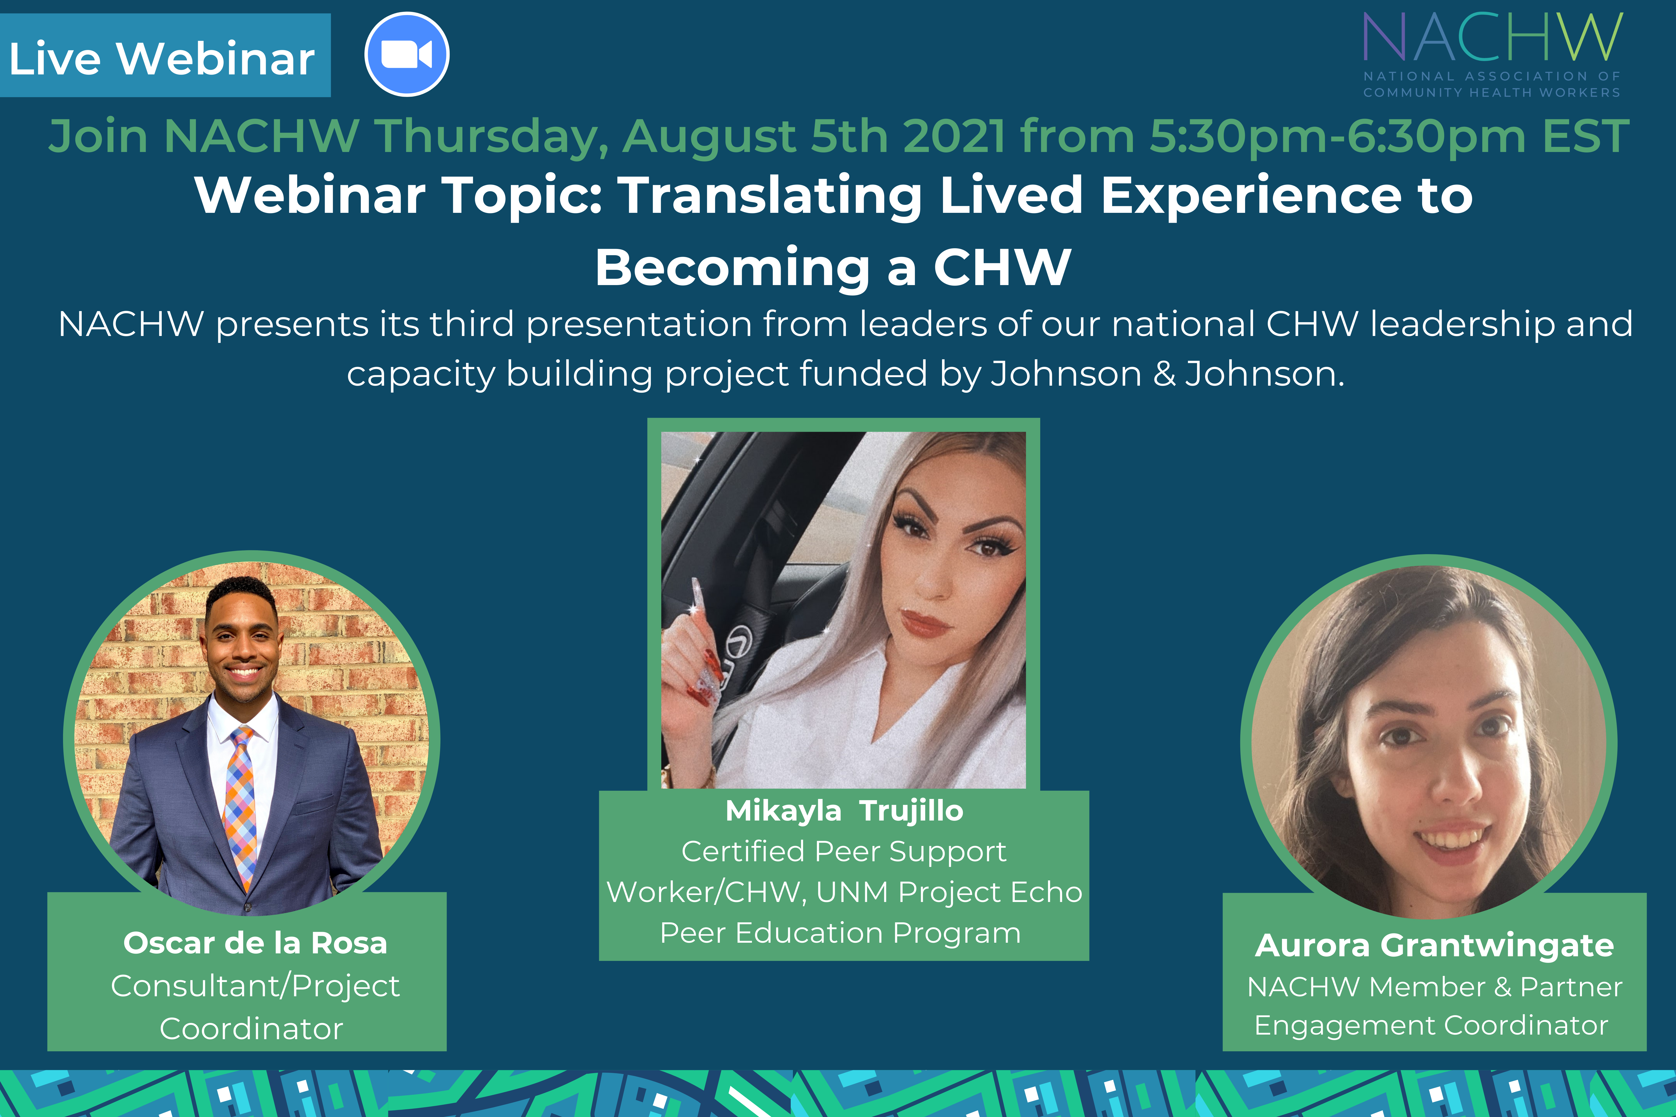
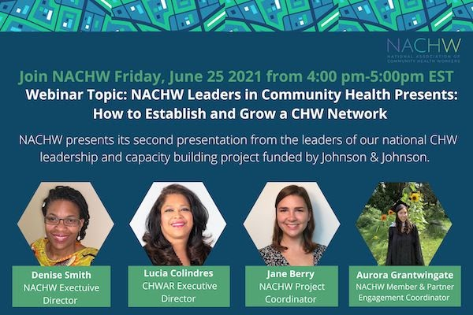
CHW Leaders in Health: Capacity Building Series 2021
Over the previous year, NACHW CHW Leaders in Health hosted Capacity Building Webinars to educate and advance the CHW Profession
Webinar topics included:
CHW Advocacy
Growing a CHW Network
Community Violence Intervention/Prevention
Translating Lived Experience to Becoming a CHW

Slide 16
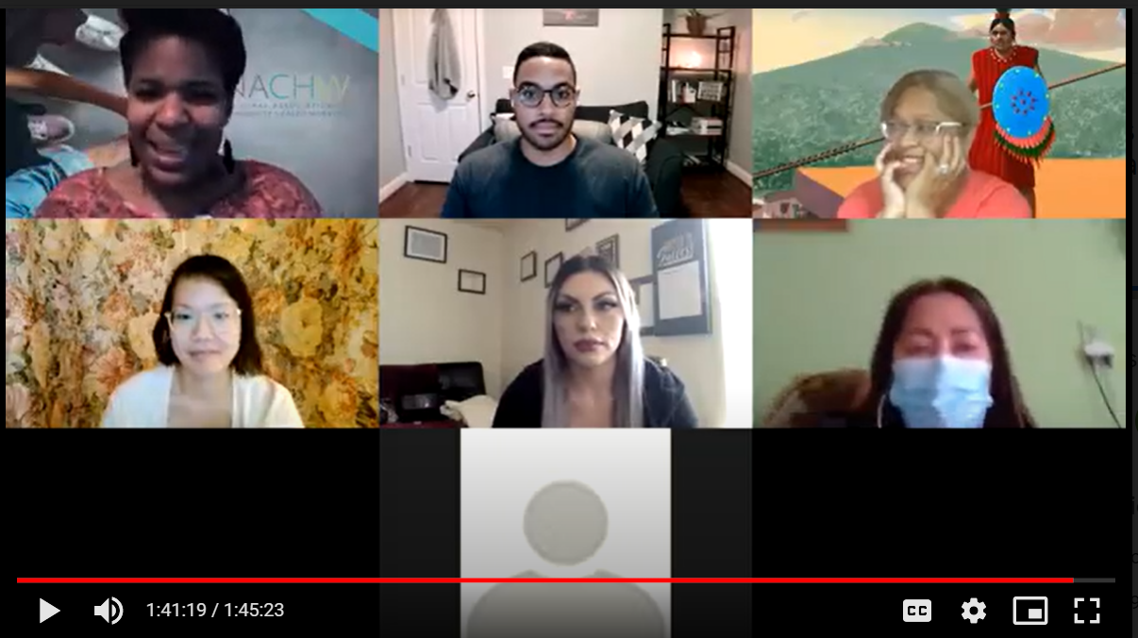
Survey Development
December 2020, NACHW recruited ten CHW Leaders from across the country
Leaders created group norms and assigned project roles they created a community of Leaders in a virtual space
The key piece of this survey development was the authentic identity of those behind beta testing and production, community involved CHW’s first-handedly created this survey from experience and expertise “By CHW’s for CHW’s”
Leaders gathered around to collaborate on what the National Survey data would intend to produce using their professional specialties and culturally diverse backgrounds to recognize the needs of the CHW population
Some of the themes that arose were around; Demographics Personal Identity, Professional Identity, Career Pathways, Leadership, Organizational Capacity,

Slide 17
Survey Implementation
Within 6 months the survey was finalized
It had 51 questions about CHW identity, leadership, and capacity
It took about 25 minutes to complete
We received 772 English surveys + 95 Spanish surveys = 867 total respondents
The timeline of responses was: June 6 through September 24, 2021

Slide 18
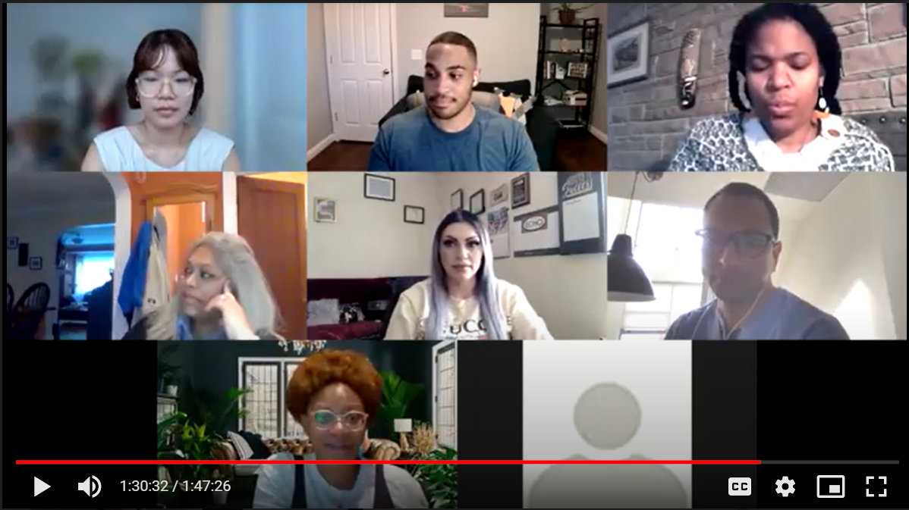
Results and Initial Trends
This data was received, evaluated, and analyzed by Dr. Sanjay Basu MD Ph.D., Head of Clinicals at Waymark
How are CHWs paid? What are CHWs paid?
Data trends for Hispanic vs. non-Hispanic CHWs receiving payment via gift cards or doing this work on a voluntary basis
Respect in the workplace
African American women report feelings of less respect in the workplace
Increase in younger CHWs entering the workforce related to the COVID-19 response
1 year or less experience as CHW
Geography-dependent employers (hospital systems vs. community-based organizations)
Northern region CHWs are largely employed by health systems/hospitals
Southern region CHWs are largely employed by smaller agencies

Slide 19
MEMBERSHIP BENEFIT: UNITY CONFERENCE
The annual meeting and interactive event of the National Association of Community Health Workers (NACHW), designed for our CHW and ally members making a difference. CHWS and allies gather for keynotes, awards presentations, networking, and voting for open board positions.

Slide 20
Thank You
www.NACHW.org
info@nahcw.org
Facebook
LinkedIn

