Slide 1
Maintenance & Relapse
“I’ve been doing this for awhile” Or “I stopped doing this”

Slide 2
Discussion points from last module
What shows you that a patient is in action?
When you notice patients in action, what strategies discussed last time work best for you?
Notes:
[NOTE TO FACILITATOR: If you are completing these modules in an order other than suggested in the facilitation guide, you may need to adjust these discussion points.]

Slide 3
Objectives
By the end of the program, participants will:
Define the maintenance stage and relapse
Discuss MI techniques for patients in maintenance and relapse

Slide 4
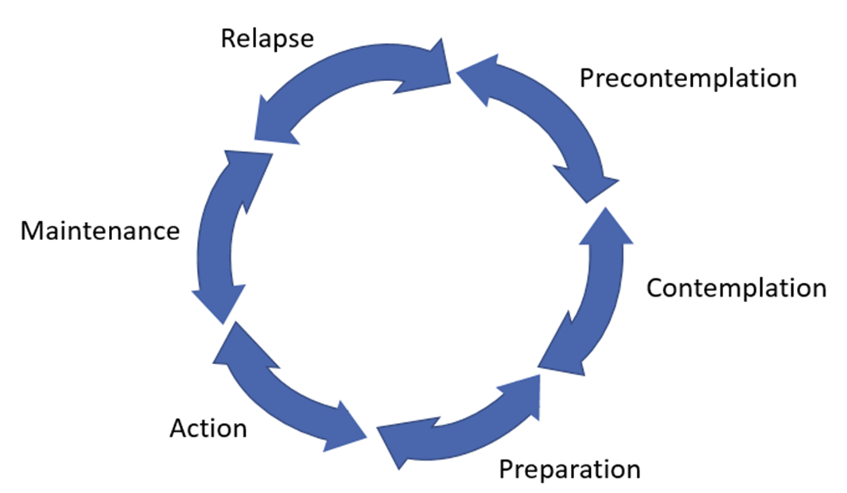
Maintenance
Roll with resistance
Discuss potential roadblocks
Continues change
Maintenance
Figure 1. Adapted from Tuccero, Railey, Briggs & Hull (2016). Behavioral Health in Prevention and Chronic Illness Management, Primary Care: Clinics in Office Practice, 43, 191-102. doi: 10.1016/j.pop.2016.01.006
Notes:
Maintenance is when a person has continued the change but it is recommended to continue to help them plan for possible challenges. However, if someone is resistant that these challenges exist, then the primary technique suggested is rolling with this resistance¹.

Slide 5
Relapse
Support self-efficacy
Help them cope
Resumes old behavior
Relapse
Figure 1. Adapted from Tuccero, Railey, Briggs & Hull (2016). Behavioral Health in Prevention and Chronic Illness Management, Primary Care: Clinics in Office Practice, 43, 191-102. doi: 10.1016/j.pop.2016.01.006
Notes:
We’re discussing relapse alongside maintenance in this conversation, because, as we will discuss in a moment, relapse isn’t necessarily a stage itself, but a return to an earlier stage in the TTM⁸. It is included in this graphic because there are suggested strategies specific to someone who has experienced relapse¹. The main goal for a person who has returned to an old behavior is to help them cope with this by supporting their self-efficacy to resume the healthy behavior that they were engaged with¹.

Slide 6
What are maintenance and relapse?
Maintenance
Relapse
The patient has been successful at behavior change for at least six months^{2,3}
The change has become a part of their lifestyle⁴
Not a stage in itself, but a return to one of the earlier stages⁸
Possibly due to unexpected events or triggers³
Does not mean that they returned to precontemplation⁸
Notes:
Maintenance is the stage where someone has been successful at a behavior change for at least six months^{2,3}. The change has become more of a lifestyle at this point⁴. You might ask why we are discussing relapse alongside maintenance, but we’re doing this because relapse isn’t a stage in itself, but when someone is no longer in maintenance and has returned to one of the other stages of change⁸. This could be for a number of reasons such as unexpected events or triggers in their life³. These triggers or events could be things such as stress from losing a loved one, a job loss or change in financial situation. Even a positive or planned event, such as starting a family, could make it harder for someone to maintain a change such as regular exercise. Relapse does not mean that they are automatically back in precontemplation - most people who relapse are back in contemplation or preparation again⁸.

Slide 7
Recognizing Maintenance & Relapse
Maintenance
Relapse
Continued practice of the behavior
More confidence that they can continue the behavior²
Patient stops engaging in the healthy behavior and resumes the old, less healthy behavior¹
May be feeling upset or frustrated³
Notes:
Maintenance, like action, is probably easy to recognize, because someone can tell you that they’re currently engaging in the behavior and have been for some time. If you spoke with them in the action phase, they will likely seem more confident in continuing the change in maintenance than they did in action². In relapse, the person will have stopped this change¹. They may be feeling upset or frustrated about this³, because it is not likely that they chose to stop doing it but more likely that something “threw them off track”.

Slide 8
Maintenance - what to do?
Help them consider possible roadblocks and plan ahead for them^{3,1}
Roll with resistance¹
Roll with resistance
Discuss potential roadblocks
Continues change
Maintenance
Figure 1. Adapted from Tuccero, Railey, Briggs & Hull (2016). Behavioral Health in Prevention and Chronic Illness Management, Primary Care: Clinics in Office Practice, 43, 191-102. doi: 10.1016/j.pop.2016.01.006
Notes:
In maintenance, it is suggested that you help them still consider and plan for possible roadblocks in order to avoid relapse. You might be surprised to see rolling with resistance listed here as this is also recommended for precontemplation¹. However, it is suggested that you roll with any resistance that a patient may have when you bring up planning for possible challenges¹.

Slide 9
Relapse - what to do?
Help them decide how they would like to proceed³
Identify what stage they seem to be in and address them in this way
Support self-efficacy¹
Support self-efficacy
Help them cope
Resumes old behavior
Relapse
Figure 1. Adapted from Tuccero, Railey, Briggs & Hull (2016). Behavioral Health in Prevention and Chronic Illness Management, Primary Care: Clinics in Office Practice, 43, 191-102. doi: 10.1016/j.pop.2016.01.006
Notes:
When someone has relapsed, it is a good idea to help them decide how they would like to proceed³ and consider what stage of change they are in, in order to support them appropriately. It is suggested that you support their self-efficacy when they have relapsed¹. Sometimes, it can be helpful to do this by focusing on what they were successful doing in maintenance. For example, if someone begins smoking again after a year of quitting, they might need to be reminded that they did actually quit for an entire year and were successful. Sometimes this is hard to see when you’re feeling frustrated by the relapse. If you remember from previous discussions, one OARS strategy suggested for supporting self-efficacy is affirmations⁴.
[NOTE TO FACILITATOR: If you are completing these modules in an order other than suggested in the facilitation guide, you may need to adjust this note.]

Slide 10
Termination
Part of the TTM where there is no temptation to return to an old behavior^{2,8}
For some behaviors, termination may be a goal to strive for
Smoking cessation
Alcohol use⁸
For other behaviors, reaching termination may not be realistic⁸
Exercise
Condom use
Weight loss
Notes:
Termination is a stage of change where someone has no temptation to return to the old behavior and 100% efficacy that they will continue^{2,8}. For some behaviors, such as smoking cessation or abstinence from alcohol for an alcoholic, termination may be a good goal to strive for. However, for other behaviors, termination may not be a realistic goal^{2,8}. Instead, the goal may be staying in maintenance permanently^{2,8}. This is suggested as a possible goal for behaviors such as exercise, condom use and maintaining weight loss^{2,8}. Because of this, there is less research on termination as part of the TTM.

Slide 11
Take home message
Consider:
How would you recognize patients in maintenance or relapse?
Practice:
If you notice patients in these stages, how can you use the information discussed today?
Developed resources reported in this presentation are supported by the National Library of Medicine (NLM), National Institutes of Health (NIH) under cooperative agreement number UG4LM012342 with the University of Pittsburgh, Health Sciences Library System. The content is solely the responsibility of the authors and does not necessarily represent the official views of the National Institutes of Health.
Notes:
As we wrap up today, some things to keep in mind are: what shows you that a patient is in maintenance or has relapsed and when you notice this, which strategies from today do you think will work the best for you when working with them?
[NOTE TO FACILITATOR: If you want to complete group discussion immediately following this module content, change the title of this slide to ‘Group Discussion’ and delete the slide with corresponding questions in the next module. If you would like to have discussion take place using your internal LMS system, you can include instructions here for how participants can participate. Then, adjust the slide with the corresponding questions in the next module as needed.]

Slide 12
Please complete the post-test questions
Notes:
[NOTE TO FACILITATOR: if you choose not to have participants complete the knowledge assessment questions, delete this slide.]

Slide 13
References
Tuccero, Railey, Briggs & Hull (2016). Behavioral Health in Prevention and Chronic Illness Management, Primary Care: Clinics in Office Practice, 43, 191-102. doi: 10.1016/j.pop.2016.01.006
Glanz, K., Rimer, B. & Viswanath, K. (Eds.). (2015). Health Behavior: theory, research and practice. San Francisco: Jossey-Bass.
Constance, A. & Sauter, C. (2011). Inspiring and Supporting Behavior Change. United States: American Dietetic Association.
Gold, M., Kelly, T., Douihy, A. (2015). Motivational Interviewing : A Guide for Medical Trainees. New York: Oxford University Press.
McGinnis P., Davis M., Howk S., DeSordi M. & Thomas M. (2014). Integrating Primary Care Practices and Community-based Resources to Manage Obesity: A Bridge-building Toolkit for Rural Primary Care Practice Transformation. Rockville, MD: Agency for Healthcare Research and Quality: AHRQ Publication No. 14-0043-EF. Retrieved from URL to source
Stewart, E., Taylor-Post, N., Nichols L., Staton E., & Schleuning A. (2014). Community Connections: Linking Primary Care Patients to Local Resources for Better Management of Obesity. Rockville, MD: Agency for Healthcare Research and Quality; AHRQ Publication No. 14-0030-EF. Retrieved from URL to Source
Center for Substance Abuse Treatment (1999). Enhancing Motivation for Change in Substance Abuse Treatment. Treatment Improvement Protocol (TIP) Series, No. 35. HHS Publication No. (SMA) 12-4212. Rockville, MD: Substance Abuse and Mental Health Services Administration. Retrieved from URL to Source
Prochaska, J. (1997). The Transtheoretical Model of Health Behavior Change. American Journal of Public Health, 12(1), 38-48.

