Slide 1
NNLM Series Piecing together reviews: Part 3 Production
Margaret Foster, MS, MPH Evidence Synthesis & Scholarly Communication Librarian

Slide 2
Objectives
Describe standards database searches
Describe evaluation of searches
Describe selection of databases
Describe strategies for translating searches and deduplication
List types of grey literature and additional searches

Slide 3
Phases 1-4
Proposal
Protocol
Production
Paper
Scope of the review?
Output: Proposal to committee, funder
What are the methods for the review?
Output: Consider protocol registration or publication
Completing the searches and other processes
Output: preliminary findings, poster, conference paper
What are the most important findings?
Output: journal article

Slide 4
Phase 3: Production
Plan
Determine output and forum of presenting findings
Identify
Finalize the main database search (feedback from protocol?)
Finalize list of databases to search and translate search (deduplicate results)
Select and run grey literature searches and other search strategies
Evaluate → Extract→ Combine
Complete determined “amount” for preliminary output, otherwise continue….
Conduct synthesis of available results and create visuals of data
Explain → Summarize → Share
Provide context of preliminary findings
Design and deliver poster or conference paper

Slide 5
1 plan
Select potential forum for output
How “much” will be presented
No need to have everything done by the conference
Present what is done at the time

Slide 6
2. Identify All steps involved in identifying the studies to be included
Steps (should finish this in protocol if published)
Develop main search
Evaluate the search
Select databases to search
---------------------------
Translate main search
deduplicate

Slide 7
2-1. Develop main search
MECIR Standards
Case study
Selecting interfaces

Slide 8
MECIR Standards
Methodological Expectations of Cochrane Intervention Reviews (MECIR)
“Searches for studies should be as extensive as possible in order to reduce the risk of publication bias and to identify as much relevant evidence as possible.”
Notes:
A clearly framed research question is important, as it guides you on how to develop the search, select articles, assess and annotate studies, and synthesize the findings.

Slide 9
MECIR Standards for search development
Standard # | Main statement M: Mandatory HD: Highly desired | Cochrane Handbook
C24 M | Databases to search: CENTRAL, MEDLINE, and Embase (if Embase is available). | Section 4.3.1.1
C25 HD | Search appropriate national, regional and subject-specific bibliographic databases. | Section 4.3.1.4
C32 M | Structure of search strategies in bibliographic databases around the main concepts of the review, using appropriate elements from PICO and study design. Maximize sensitivity whilst striving for reasonable precision. | Section 4.4.2
C33 M | Use thesaurus terms and keywords: Identify appropriate controlled vocabulary and free-text terms (spelling variants, synonyms, acronyms, truncation and proximity operators). | Section 4.4.4
C34 HD | Use specially designed and tested search filters where appropriate | Section 4.4.7
C35 M | Justify the use of any restrictions in the search strategy on publication date and publication format. | Section 4.4.5

Slide 10
Case study
Alvarez de Mon MA, Sanchez-Villegas A, Gutierrez-Rojas L & Martinez-Gonzalez MA (2024). Screen exposure, mental health and emotional well-being in the adolescent population: is it time for governments to take action?. Journal of Epidemiology & Community Health, https://dx.doi.org/10.1136/jech-2023-220577 38964781
Ferguson CJ (2021). Links between screen use and depressive symptoms in adolescents over 16 years: is there evidence for increased harm?. Developmental Science, 24(1), e13008. https://dx.doi.org/10.1111/desc.13008 32573926
LeBourgeois MK, Hale L, Chang AM, Akacem LD, Montgomery-Downs HE & Buxton OM (2017). Digital media and sleep in childhood and adolescence.. Pediatrics, 140(Suppl 2), S92-S96. https://dx.doi.org/10.1542/peds.2016-1758J 29093040
Li L, Abbey C, Wang H, Zhu A, Shao T, Dai D, Rozelle S (2022). The association between video game time and adolescent mental health: evidence from rural china.. International Journal of Environmental Research & Public Health [Electronic Resource], 19(22) https://dx.doi.org/10.3390/ijerph192214815 36429534
Santos RMS, Mendes CG, Sen Bressani GY, de Alcantara Ventura S, de Almeida Nogueira YJ, de Miranda DM & Romano-Silva MA (2023). The associations between screen time and mental health in adolescents: a systematic review.. BMC psychology, 11(1), 127. https://dx.doi.org/10.1186/s40359-023-01166-7 37081557
Wang X, Li Y & Fan H (2019). The associations between screen time-based sedentary behavior and depression: a systematic review and meta-analysis.. BMC Public Health, 19(1), 1524. https://dx.doi.org/10.1186/s12889-019-7904-9 31727052
Client wants a search on
screen time and teens and depression (provides list >>)
What is the framework for this question?
What further questions would you ask client?
What databases would you suggest?

Slide 11
Search design: Search concepts- PEO
Population
Exposure
Outcome or Study design
For risk/harm/exposure reviews, the concepts would be:
Population + Exposure + (Outcome or study type)*
*depends on question/evidence
Not discussed in Cochrane as MECIR only refers to effectiveness studies

Slide 12
Each concept needs clear definition Scope of project can drastically change
Population
Teen: adolescen* or teen* or youth* or high school student* or middle school student*
Young adult? Under 13?
Exposure
Screen time: screen time, screen use, screen exposure, video game?, computer? Need more on how far to go?
Outcome
Depression: Definitely need more info here. Include mental health? Emotional health? All types of depression? Depression as symptom?
Databases: Medline, Embase, CENTRAL, APA PsycINFO, ERIC, Compendex?, Academic Search?
Notes:
A scoping search is a quick search to get an idea of what is out there- 10, 100, or 1000s of articles. This especially good when you are not sure if anything has been published or how narrow with population to choose.

Slide 13
Which database, which interface?
Selected MEDLINE to start
My preference is Ovid
More precise searching (only what I ask for)
More options (?,. *, adj) and more fields (KF, floating subheadings)
More efficient- can combine multiple options (wildcards) with proximity
Coverage
“While there is always a 1-day delay in updating Ovid MEDLINE compared to PubMed, Ovid provides the same coverage of
Publisher (Ahead of Print),
In-Process, PubMed-not-MEDLINE and
the fully indexed MEDLINE records.
Ovid MEDLINE also include all PMCbooks references”
Quoted from Ovid: Wolters Kluwer - Ovid online Tools
Site comparing coverage, translating between interfaces of Ovid MEDLINE and PubMed: Ovid's Medline compared to PubMed

Slide 14
Questions?

Slide 15
2-2. Concept building
Term harvesting
Search filters
Limiters

Slide 16
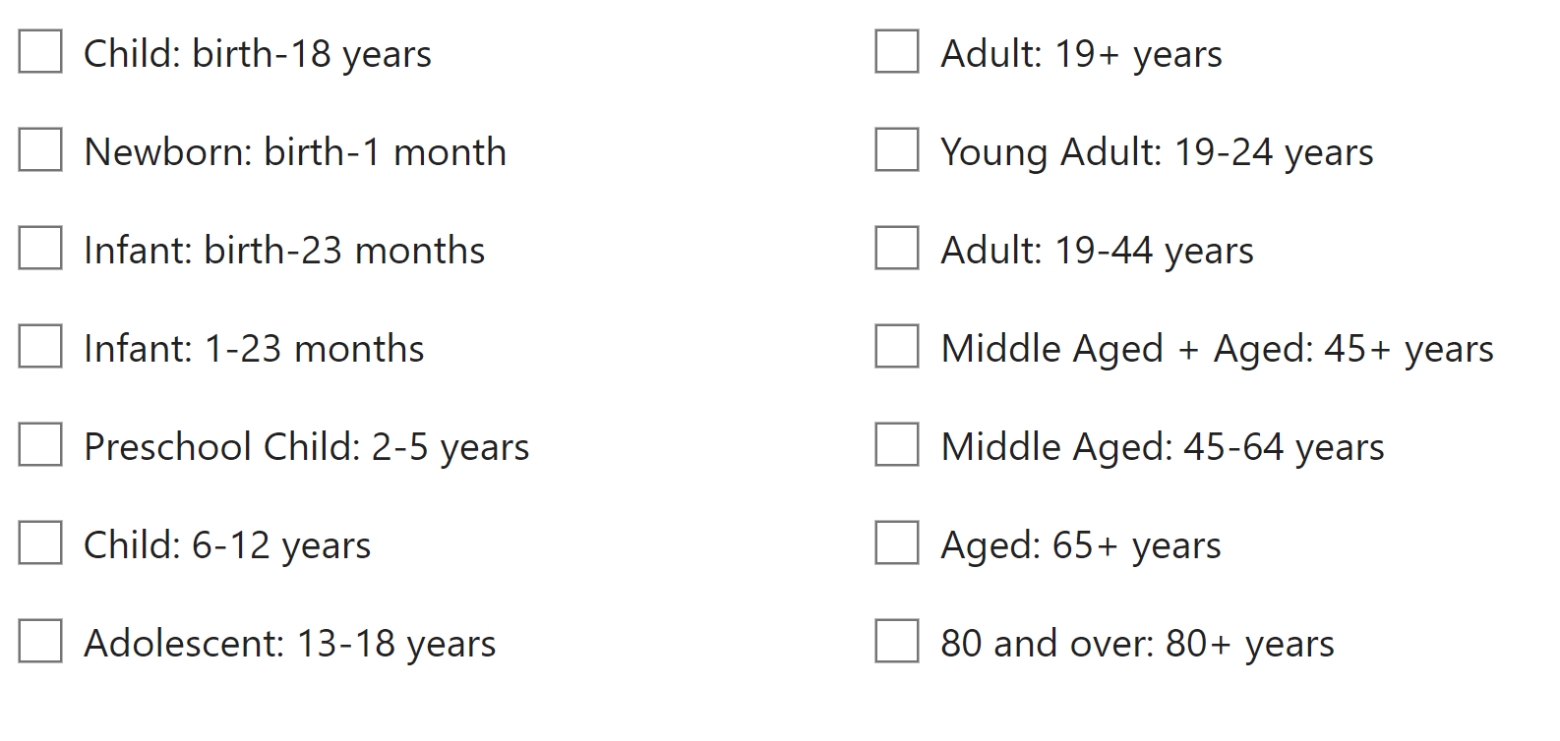
Concept 1: Population
Age can be tricky
Cannot just use checkboxes in Medline
Categories usually do not match up eligibility criteria
>>>>>>>>>>>>>>>>>>
Adults is especially difficult as adults are rarely mentioned in abstract (referred to by age ranges)

Slide 17
Seeking a search filter
Found filter
(teen* OR youth* OR adolescen* OR juvenile* OR (young ADJ2 (adult* OR person* OR individual* OR people* OR population* OR man OR men OR wom#n)) OR youngster* OR first-grader* OR second-grader* OR third-grader* OR fourth-grader* OR fifth-grader* OR sixth-grader* OR seventh-grader* OR highschool* OR college* OR ((secondary OR high*) ADJ2 (school* OR education))).ti,ab. OR adolescent/ OR young adult/
My changes
(teen* or youth* or adolescen* or juvenile* or youngster* or highschool* or ((secondary or high or middle or intermediate) adj2 (school* or education))).ti,ab,kf. Or
Adolescent/
Found this one:
CHLA https://extranet.santecom.qc.ca/wiki/!biblio3s/concepts/adolescents-et-jeunes-adultes
Found through ISSG
Should I add pediatrics? Adolescent medicine? Adolescent behavior?

Slide 18
Search filters: what are they?
MECIR #34
Use specially designed and tested search filters where appropriate
Collection of terms to match specific concept (could include thesaurus terms, keywords)
Designed for specific database & platform
Some have been validated & published
It’s good to choose validated (when available and matches your needs)- RARE!

Slide 19
Search filters: where are they?
Filter source (linked) | Types of filters | Databases covered
ISSG Filter database | study type, geography, age, and many others | Many
Canadian Agency for Drugs and Technologies in Health (CADTH) | Study type; humans | Medline, Embase, CINAHL, Pubmed, PsycINFO, Scopus
BMJ Search filters | SRs, RCTs, cohort, case control, case series | Medline, Embase (Ovid platforms only)
Cochrane search filters | RCTs | Medline (Ovid) Embase (Ovid, .com), Pubmed

Slide 20
Concept 2: Exposure- screen time
Alvarez de Mon MA, Sanchez-Villegas A, Gutierrez-Rojas L & Martinez-Gonzalez MA (2024). Screen exposure, mental health and emotional well-being in the adolescent population: is it time for governments to take action?. Journal of Epidemiology & Community Health, https://dx.doi.org/10.1136/jech-2023-220577 38964781
Ferguson CJ (2021). Links between screen use and depressive symptoms in adolescents over 16 years: is there evidence for increased harm?. Developmental Science, 24(1), e13008. https://dx.doi.org/10.1111/desc.13008 32573926
LeBourgeois MK, Hale L, Chang AM, Akacem LD, Montgomery-Downs HE & Buxton OM (2017). Digital media and sleep in childhood and adolescence.. Pediatrics, 140(Suppl 2), S92-S96. https://dx.doi.org/10.1542/peds.2016-1758J 29093040
Li L, Abbey C, Wang H, Zhu A, Shao T, Dai D, Rozelle S (2022). The association between video game time and adolescent mental health: evidence from rural china.. International Journal of Environmental Research & Public Health [Electronic Resource], 19(22) https://dx.doi.org/10.3390/ijerph192214815 36429534
Santos RMS, Mendes CG, Sen Bressani GY, de Alcantara Ventura S, de Almeida Nogueira YJ, de Miranda DM & Romano-Silva MA (2023). The associations between screen time and mental health in adolescents: a systematic review.. BMC psychology, 11(1), 127. https://dx.doi.org/10.1186/s40359-023-01166-7 37081557
Wang X, Li Y & Fan H (2019). The associations between screen time-based sedentary behavior and depression: a systematic review and meta-analysis.. BMC Public Health, 19(1), 1524. https://dx.doi.org/10.1186/s12889-019-7904-9 31727052
Screen time is the concept I am most concerned about missing terms
many different ways to express this concept
Has changed over time
Could be narrow or broad depending on variety of options

Slide 21
Spreadsheet with Search Results

Slide 22
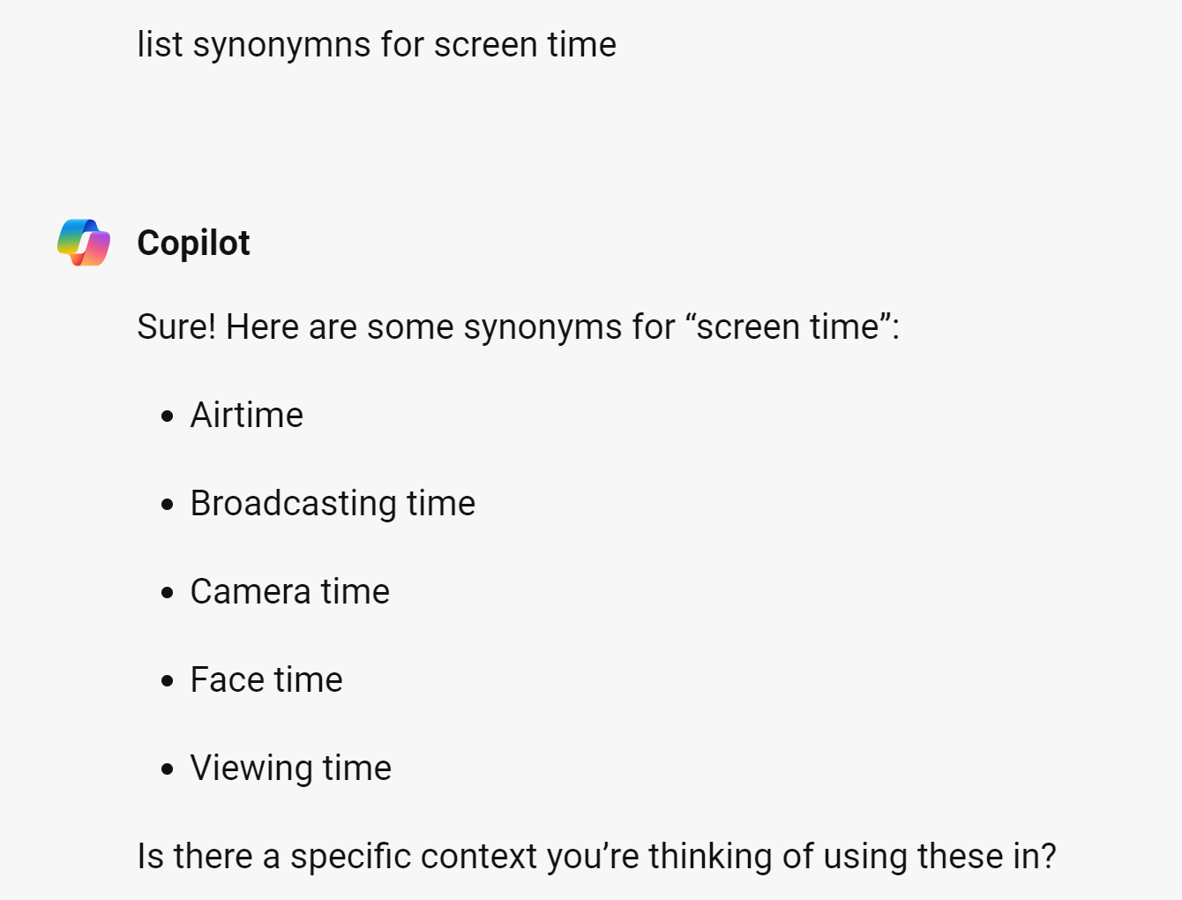
Term harvesting

Slide 23
Concept 3: Outcome depression
Depression- as a diagnosis
Depression as a symptom
Discuss scope of terms with clients, options to add:
Psychological well-being?
Mental health?

Slide 24
MECIR Standards- limiters
Standard # | Main statement M: Mandatory HD: Highly desired | Cochrane Handbook
C35 M | Justify the use of any restrictions on publication date and publication format. Date restrictions in the search should only be used when there are date restrictions in the eligibility criteria for studies. They should be applied only if it is known that relevant studies could only have been reported during a specific time period, for example if the intervention was only available after a certain time point. Publication format restrictions (e.g. exclusion of letters) should generally not be used in Cochrane Reviews, since any information about an eligible study may be of value. | Section 4.4.5
Remember- this is for Cochrane reviews- scoping reviews, and others may have different sampling needs of the literature.

Slide 25
Limits to search: geography/humans
Limiters such as geography, age, and humans seem easy to mark in Medline
Geography is difficult (especially US only)
Most of the time, you should seek studies from anywhere
Not considered for this case study
Example of human filter (see CADTH limiters for Humans)

Slide 26
Combining terms
Still at developing stage
Enough to get group started- wait for more of protocol
I search ti,ab,kf fields
Can add synonyms as needed
Need to evaluate

Slide 27
Choose your tool
Try the ISSG site for search filters
Explore by selecting topic on right
Or search topic in top right corner
Results are organized by database
Build a better prompt for AI
Choose your favorite AI tool
Build a prompt for synonyms
Can you get a better response?

Slide 28
2-3. evaluation of search
Does it include x?
Measures of search performance
Sorting first 100
Peer review of search

Slide 29
Search evaluation: clients sorting first 100 results
Retrieved
Relevant
Background article
Potential studies
Relevant review

Slide 30
Updated search
1 | adolescent/ | 2268205
2 | exp Adolescent Health/ or exp Adolescent Behavior/ | 37962
3 | (teen* or youth* or adolescen* or juvenile* or youngster* or highschool* or ((secondary or high or middle or intermediate) adj2 (school* or education))).ti,ab,kf. | 620310
4 | exp Screen Time/ | 1368
5 | (screentime or "screen use" or (screen adj2 (exposure or time))).ti,ab,kf. | 6102
6 | ((digital media or video game) adj2 (time or exposure)).ti,ab,kf. | 177
7 | exp Depression/ or exp Depressive Disorder/ or exp Mental Health/ or exp Psychological Well-Being/ | 328824
8 | depress*.ti,ab,kf. | 605470
9 | ((mental or emotion* or psycholog*) adj2 (health* or wellbeing or "well being" or wellness)).ti,ab,kf. | 300730
10 | (or/1-3) and (or/4-6) and (or/7-9) | 636

Slide 31
What about article x?
Copilot prompt: design a poster with tag line “only you can prevent scope creep”
The team will bring you studies from time to time to ask “why aren’t these in the search?”
First check retrieved articles, sometimes they were marked excluded early in the process
Sometimes from a different databases not searched yet
Sometimes they don’t match the criteria- remind them to watch out for scope creep
Sometimes the search is missing a key term

Slide 32
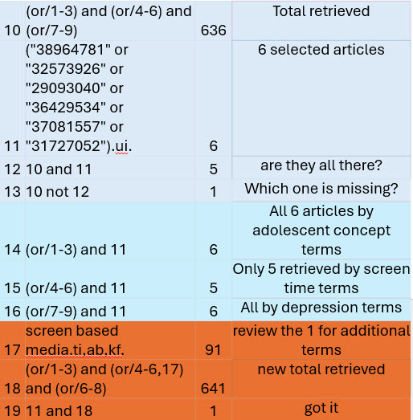
Search evaluation: does it include x?
Locate known articles within database
Search by PMID
AND with results
Determine which concept is the issue
If still missing, could be limiters (years, language, human?)

Slide 33
Search evaluation: Measures of search performance
“Each can be limited by sensitivity or specificity or can be optimized. A sensitive search attempts to retrieve all relevant documents by using a broad search. A specific search attempts to retrieve only relevant documents in a small precise search. Optimized is considered a happy medium between sensitivity and specificity.”
Acquiring evidence-tips for effective literature searching.
Evaluation of methodological search filters--a review.

Slide 34
Search evaluation: peer evaluation
Translation of research question
Boolean & proximity operators
Subject headings
Text words
Spelling, syntax, and line numbers
Limits and filters
Overall assessment
Having many eyes on searches helps to catch mistakes and can enhance list of additional terms
PRESS (Peer Review of Electronic Search Strategies) provides a framework
Could go beyond this to look at MECIR standards or other standards as well
Canadian Agency for Drugs and Technologies in Health
PRESS Peer Review of Electronic Search Strategies | CDA-AMC (cadth.ca)

Slide 35
What questions do you have?

Slide 36
2-4. Identify translating
Manage results
Select databases
Translating
Deduplicating

Slide 37
Tips for managing results
More on documentation with PRISMA-S next time
Elements required to document:
For each resource
Database name
Database host
Date of search
Copy and paste search
Limiters
Years covered by search
Language restrictions
Any other limiters/checkboxes
Cite any filters or other searches utilized
Have a convention for naming files
Client_Project_Database_Platform_Date_batch#
Example
DrB_VitD_Medline_Ovid_08072024_batch1
Save search within interface whenever possible
Have a naming convention, database/vendor/date/project
Copy paste search also- just in case!!

Slide 38
How to select databases
MECIR C24
Ensure that
CENTRAL,
MEDLINE (e.g. via PubMed) and
Embase (if Embase is available to either the CRG or the review author), have been searched (either for the review or for the Review Group’s Specialized Register).
See Cochrane Handbook Section 4.3.1.1
MECIR C25
Search appropriate national, regional and subject-specific bibliographic databases.
See Cochrane Handbook Section 4.3.1.4
Select those closest in topic coverage
Consider Cochrane MECIR standards if topic in clinical medicine
Add in all other relevant databases (MECIR 25 calls for more)
Check out Smart Search

Slide 39
Smart search- tool to support database selection
Designed to help in selection of databases
Compares # of records and relative # within the database
Search Smart Website

Slide 40
Example of smart search
Marked 6 databases for comparison on Psychology subject
Example:
APA PsycInfo compared to
Academic Search Elite

Slide 41
Smart search- select psychology, and mark 6 databases

Slide 42
Translating
When moving to next database, consider
Keep keywords the same, as much as possible
Search all the databases within one platform then move to the next (not at the same time
Check syntax twice
Find and replace
Consider using Polyglot SRA
Kung JY. Polyglot Search Translator. J Can Health Libr Assoc. 2022 Apr 1;43(1):35–9. doi: 10.29173/jchla29600. PMCID: PMC9359691.

Slide 43
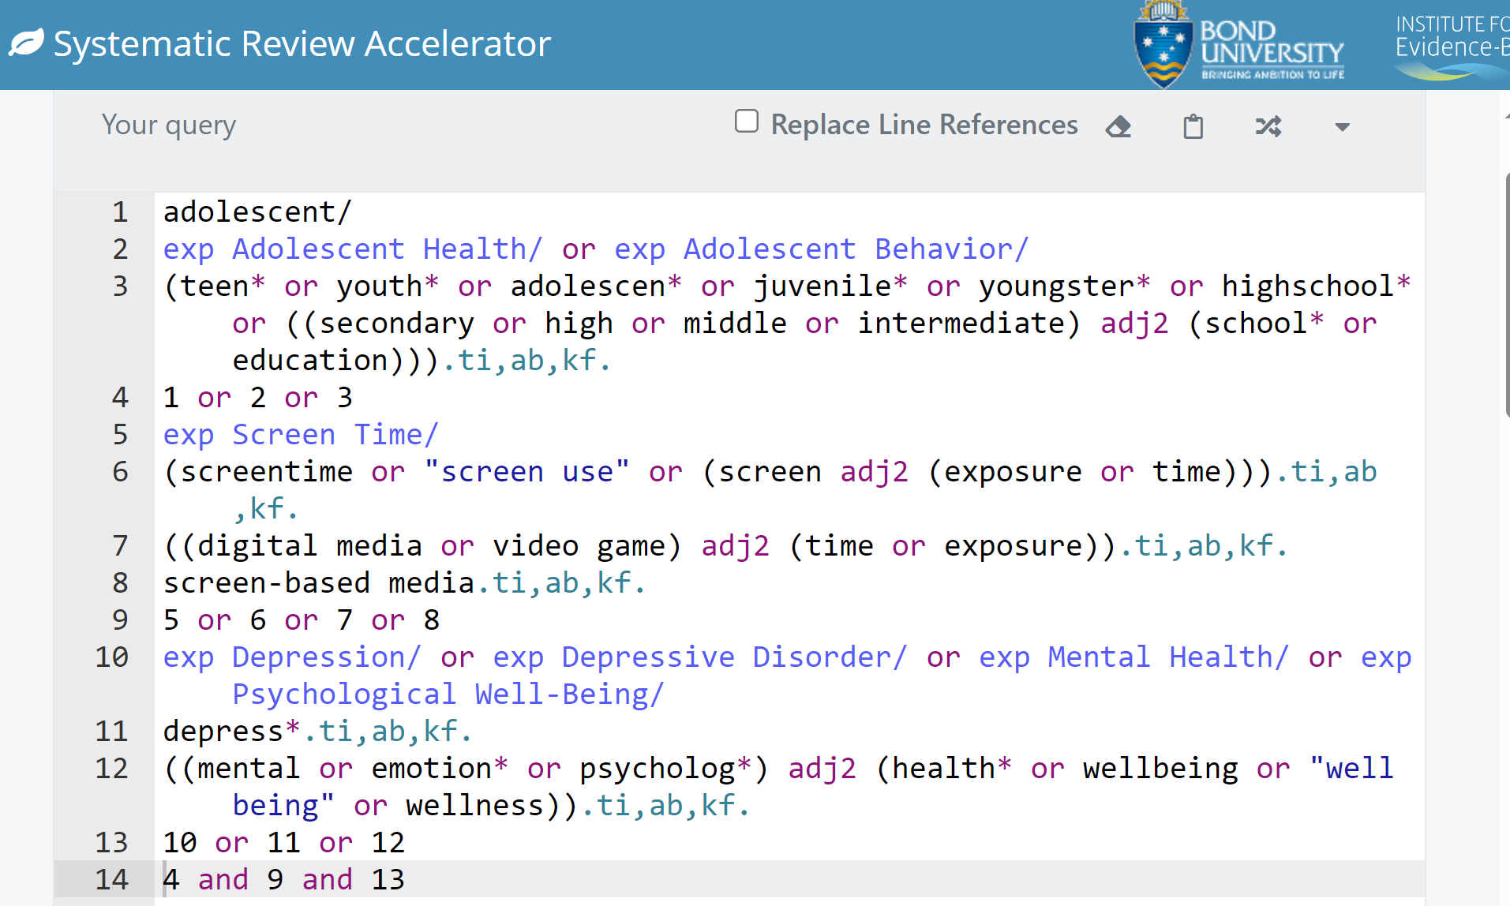
Example- polyglot SRA Medline (Ovid)
1 adolescent/
2 exp Adolescent Health/ or exp Adolescent Behavior/
3 (teen* or youth* or adolescen* or juvenile* or youngster* or highschool* or ((secondary or high or middle or intermediate) adj2 (school* or education))).ti,ab,kf.
4 1 or 2 or 3
5 exp Screen Time/
6 (screentime or "screen use" or (screen adj2 (exposure or time))).ti,ab,kf.
7 ((digital media or video game) adj2 (time or exposure)).ti,ab,kf.
8 screen-based media.ti,ab,kf.
9 5 or 6 or 7 or 8
10 exp Depression/ or exp Depressive Disorder/ or exp Mental Health/ or exp Psychological Well-Being/
11 depress*.ti,ab,kf.
12 ((mental or emotion* or psycholog*) adj2 (health* or wellbeing or "well being" or wellness)).ti,ab,kf.
13 10 or 11 or 12
14 4 and 9 and 13

Slide 44
Scroll down to see translations: Example- Cochrane library

Slide 45
Deduplication the options
“We found that the most accurate methods for identifying duplicate references were Ovid, Covidence, and Rayyan. Ovid and Covidence possessed the highest specificity for identifying duplicate references, while Rayyan demonstrated the highest sensitivity.” Considerations for conducting systematic reviews: evaluating the performance of different methods for de-duplicating references.
“Describes a series of steps to use Endnote for deduplicating articles” De-duplication of database search results for systematic reviews in EndNote. Erratum
“study examined the performance of default de-duplication algorithms in EndNote 20, EndNote online classic, ProQuest RefWorks, Deduklick, and Systematic Review Accelerator's new Deduplicator tool. On most accounts, systematic review software programs outperformed reference managers. ..Systematic Review Accelerator's Deduplicator tool is free to use and demonstrated the highest accuracy and sensitivity, while also offering user-mediation of detected duplicates to improve specificity” From: Considerations for conducting systematic reviews: A follow-up study to evaluate the performance of various automated methods for reference de-duplication.

Slide 46
What we found
Compared:
Endnote with enhanced steps
SR accelerator deduplicator
Covidence
Covidence was easiest, fastest, and most accurate
Automation of duplicate record detection for systematic reviews: Deduplicator.

Slide 47
Choose your tool Part 2
Polyglot for translations
Step 1:
Copy a search you already have
(Or perhaps write a quick search in your favorite database)
Step 2:
Then paste into Polyglot SRA to view the different options
Search Smart
Select a topic
Mark options
Review the results

Slide 48
2-5 Grey literature and other strategies
Grey lit
Other strategies
When to stop searching

Slide 49
MECIR Standards for additional searching
Standard # | Main statement M: Mandatory HD: Highly desired | Cochrane Handbook
C27 M | Search trials registers and repositories of results, where relevant to the topic, through ClinicalTrials.gov, the WHO International Clinical Trials Registry Platform (ICTRP) portal and other sources as appropriate. | Section 4.3.3
C28 HD | Search relevant grey literature sources such as reports, dissertations, theses and conference abstracts. | Section 4.3.5
C29 HD | Search within previous reviews on the same topic. | Section 4.3.5
C30 M | Searching reference lists: Check reference lists in included studies and any relevant systematic reviews identified. | Section 4.3.5
C31 HD | Searching by contacting relevant individuals and organizations | Section 4.3.2

Slide 50
Challenges
Lack access
Lack time
Cannot export to citation tool
Documenting the search?
When do you stop?

Slide 51
When to stop searching…
Have you..
..identified and searched all of the reference databases that are likely to contain significant numbers of relevant citations?
..verified that there are no systematic biases of omission- such as non-English language sources or grey literature?
..conducted author searches on 3-4 of the most prolific authors on your topic?
..modified your search strategy by adjusting search terms as you identified and examined citations highly relevant to your topic?
Reference: Cooper HM, Hedges LV, Valentine JC. The handbook of research synthesis and meta-analysis. 2nd ed. New York: Russell Sage Foundation 2009.

Slide 52
Modifying the search
Screen what was found
If new studies are found which are in previously searched databases, then you to determine why it was missed
Need to update searches

Slide 53
5. beyond the search
Research team continues to process as citations are retrieved (no need to wait)
Consider presetting preliminary results (formerly or informerly)

Slide 54
Summarize & share
Be reasonable in amount
Whatever is done by the conference/deadline for putting everything together
Sometimes people submit abstract with unrealistic expectations of things be done by that time- rarely happens!
Guidelines
PRISMA-Abstract
Cochrane guide and templates for posters

Slide 55
Question Time

