Slide 1
Providing Multilingual Health Information
Your name, region and date goes here.
Notes:
Hi everyone!
Welcome to Providing Multilingual Health Information. My name is Bennie Finch and I am one of the Education and Outreach Coordinators for Region 7 of the Network of the National Library of Medicine. Thank you so much for joining this webinar.
1) Before we start, I would like to go over a few items. First, we will be using the chat box during our session today, so you might want to locate and open the chat box. It’s closed by default. Look for the chat bubble icon on the bottom of your screen. Please feel free to add questions to the chat throughout the presentation.
2) This presentation is eligible for MLA CE or Certified Health Education Specialist credit – We’ll provide a link to the evaluation at the end of the session. Completing the evaluation is the first step to claiming MLA CE or Certified Health Education Specialist credit.
3) We have live captioning available today. You can find it in the Multimedia panel located near the Chat panel. You may need to scroll down in the box and click on continue to start the live caption stream.
4) We are recording today’s session. It takes up to 30 days to edit and caption the video. We’ll send the link to the recording to all registrants when it’s available.
The slides and recording will also be made available on our class page. In addition, there is a link to the class handout on the class page.
Links to all of the resources shared today are provided in the class handout.
Link to class page:
Providing Multilingual Health Information | NNLM https://www.nnlm.gov/training/class/providing-multilingual-health-information-0

Slide 2
NNLM
Trainings
Funding
Educational materials
Community outreach
Notes:
I briefly wanted to introduce the Network of the National Library of Medicine, also known as NNLM. As the name suggests, the NNLM is part of the National Library of Medicine, which is within the National Institutes of Health. We are the education and outreach arm of the National Library of Medicine. We work regionally, getting to know communities and helping those communities serve the people they know best.
We are also present across the entire country, and we work to advance the health and well being of everyone through access and understanding of how to use health information. This includes both working with organizations like libraries of all types, schools, health care, and all sorts of community-based organizations.
We do this primarily through three different methods: 1) providing funding to organizations so that they can work within their own communities; 2) other forms of outreach and engagement; And then like today, we offer a wide range of training and education opportunities.
You might also be interested in one of our new offerings. We recently launched the NNLM Discovery podcast. Podcasts are available wherever you get your podcasts or on nnlm.gov/podcast
I encourage you all to visit nnlm.gov to learn more.
Connect With Your Region: https://www.nnlm.gov/about/regions

Slide 3
Agenda
Explore immigration and language usage data at the national and state level.
Identify reliable websites for quality health information in multiple languages.
Explore NNLM Funded Multilingual Projects
Notes:
Here are our learning objectives for the next hour.
I think that if you chose to attend this webinar, then you are probably already in agreement that We all need health and medical information in language that we can understand.
To that end, We will start with some brief background information and describe statistics related to immigrants in the United States; we’ll review some websites to show you how to access data when planning for the language needs in your community; I will provide some demonstrations of a few websites that offer free, reliable health information in multiple languages. And finally we will review a few projects that have been funded by the Network of the National Library of Medicine to support multilingual health information access.

Slide 4
Question: Languages in Your Community
What are the most common languages you encounter in your community or at your library?
Notes:
Tell us about your experience. What are the most common languages other than English you run into in your community or at your library? If you are unsure, you can put that in the chat.
My experience of working with information in multiple languages is primarily Spanish as there are a lot of people who speak Spanish in my community. So often if I am looking for documents to share, I want to make sure there is also a version in Spanish that I can also share.
Rebecca, are there any responses in the chat?
Thanks for sharing about your community.

Slide 5
Background Data
Notes:
The first section that we’ll cover gives some general statistics about immigrants and language usage in the United States.

Slide 6
2022 Data on Immigrants
46 Million Immigrants
13.9 % of U.S. Population
Sources: https://data.census.gov/table/ACSDP1Y2022.DP02?g=010XX00US
https://data.census.gov/profile/United_States?g=010XX00US
Notes:
What do we mean by immigrants or foreign born? I am using the Definition used by the US Census. The term "foreign born" refers to people residing in the United States who were not U.S. citizens at birth. This population includes naturalized citizens, lawful permanent residents, certain legal nonimmigrants such as persons on student or work visas who are temporary migrants, those admitted under refugee or asylee status who are humanitarian migrants, and unauthorized migrants residing in the United States.
I do want to point out that this is not “new arrival” data but those included as foreign born may have lived in the United States for 75 years and been naturalized citizens for much of their lives.
According to US Census data for 2022, there are about 46 million immigrants in the United States which represents 13.9% of the overall population. (The whole u.s. population is around 331 million).
Sources:
Top Immigrant Populations by U.S. State | migrationpolicy.org https://www.migrationpolicy.org/programs/data-hub/charts/us-immigrant-population-state-and-county
Https://www.census.gov/topics/population/foreign-born/about.html#par_textimage About the Foreign-Born Population (census.gov)
DP02: Selected Social ... - Census Bureau Table https://data.census.gov/table/ACSDP1Y2022.DP02?g=010XX00US
United States - Census Bureau Profile https://data.census.gov/profile/United_States?g=010XX00US

Slide 7
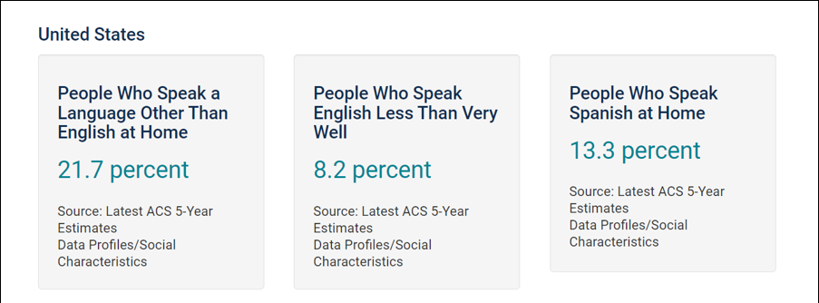
Language Usage in the United States
https://www.census.gov/acs/www/about/why-we-ask-each-question/language/
Notes:
The graphic on the slide is a screenshot from a Census tool using data from 2015, but this is still fairly consistent with data from 2022.
Almost 22 percent of people in the United States speak a language other than English at home, and 8 percent have limited English proficiency (LEP). For the Census data this means people who speak English less than very well.
This tool is included in the handout and from this page, you can also search for the same data by state and county for your area using the 2015 data.
Sources:
2015 Data - People That Speak English Less Than "Very Well" in theUnitedStates (census.gov)
https://www.census.gov/acs/www/about/why-we-ask-each-question/language/
DP02: Selected Social ... - Census Bureau Table https://data.census.gov/table/ACSDP1Y2022.DP02?g=010XX00US

Slide 8
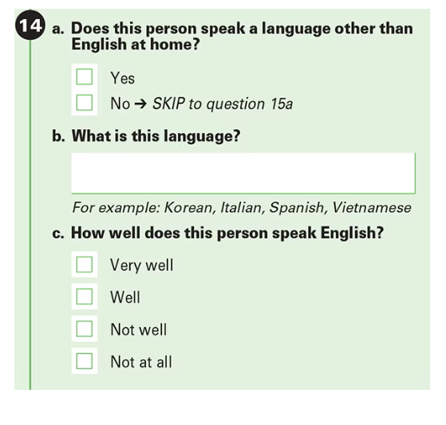
Census Question
Notes:
Where does this data come from? On the census, the following question is asked about if the person speaks a language other than English at home, if so, the language, and a self-report question asking how well does this person speak English, with the following choices, very well, well, not well and not at all. When it is reported, all the choices except very well are reported as “Less than very well”
Source:
Language Use in the United States: 2019 (census.gov) https://www.census.gov/content/dam/Census/library/publications/2022/acs/acs-50.pdf

Slide 9
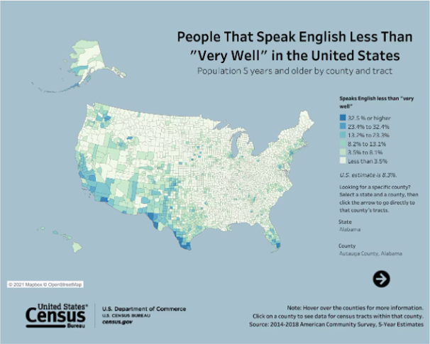
English Proficiency Levels
Source: www.census.gov/library/visualizations/interactive/people-that-speak-english-less-than-very-well.html
Notes:
I just wanted to quickly point out this tool for future reference and the link is on the class handout. The US Census Bureau has created an interactive map which shows percentages of people who indicated that they speak English less than very well on the US Census. This is displayed by color coding. You can also hover over areas and the data is displayed at the county level.
Source:
Interactive Tool People That Speak English Less Than "Very Well" in the United States (census.gov)

Slide 10
Top Languages spoken at home in the United States (2019)
Spanish……………….42 million
Chinese……………….3.5 million
French…………………2 million
Filipino/Tagalog…..1.8 million
Vietnamese………….1.6 million
Arabic…………………..1.2 million
Korean………………….1 million
Source: www.census.gov/content/dam/Census/library/publications/2022/acs/acs-50.pdf
Notes:
This is a list of the primary languages spoken other than English by people over 5 years old at home in the United States. Of the 21.7% of people over 5 years old who speak a language other than English at home, the majority speak Spanish. The next most spoken languages are Chinese, French, Tagalog, Vietnamese, Arabic and Korean.
Sources:
Most Americans Speak Only English at Home or Speak English “Very Well” (census.gov) https://www.census.gov/newsroom/press-releases/2023/language-at-home-acs-5-year.html
What Languages Do We Speak in the United States? (census.gov) https://www.census.gov/content/dam/Census/library/publications/2022/acs/acs-50.pdf

Slide 11
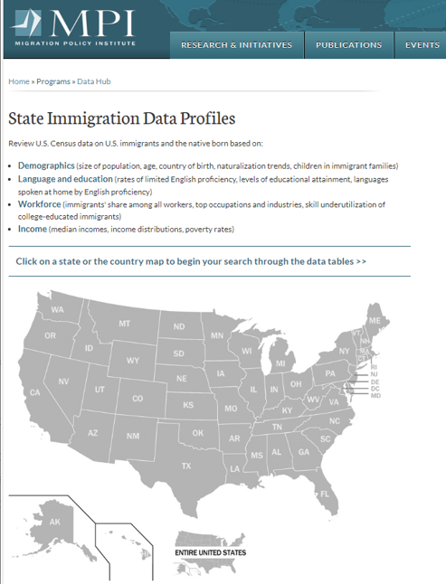
Languages Spoken at Home by State
www.migrationpolicy.org/programs/data-hub/state-immigration-data-profiles
Notes:
The most spoken languages vary by state however.
The Migration Policy Institute or MPI is a great place to start to find data for your state. Founded in 2001, the Migration Policy Institute (MPI) has established itself as a leading nonpartisan, evidence-informed institution in the field of migration policy and as a source of authoritative research.
MPI has created the State Immigration Data Profiles tool using the U.S. Census Bureau’s American Community Survey (ACS) and Decennial Census data. The image on this slide is a screenshot of the interactive map. The image on this slide is a screenshot of the interactive map. You can hover over each state and click on the link to a table with demographics and other language usage data.
During the demonstrations, we are going to review this tool. When we get to the demonstration portion, as I mentioned we will start by searching for data for local language needs. Obviously, there is no better way to know your community than being engaged and involved with community members and partner organizations, but there are lots of good reasons to look at data as well. This can help you explain why you need resources in languages other than English and provide some insight into communities that you may be missing.
Sources:
Language Use in the United States: 2019 (census.gov) https://www.census.gov/content/dam/Census/library/publications/2022/acs/acs-50.pdf
People That Speak English Less Than "Very Well" in the United States (census.gov) https://www.census.gov/library/visualizations/interactive/people-that-speak-english-less-than-very-well.html
B16001 search by state 2020 acs 5 year estimates is a good choice….some data is suppressed if you enter your state and you don’t get the table, it may be that the data has been suppressed
Program: State Immigration Data Profiles | migrationpolicy.org https://www.migrationpolicy.org/programs/data-hub/state-immigration-data-profiles

Slide 12
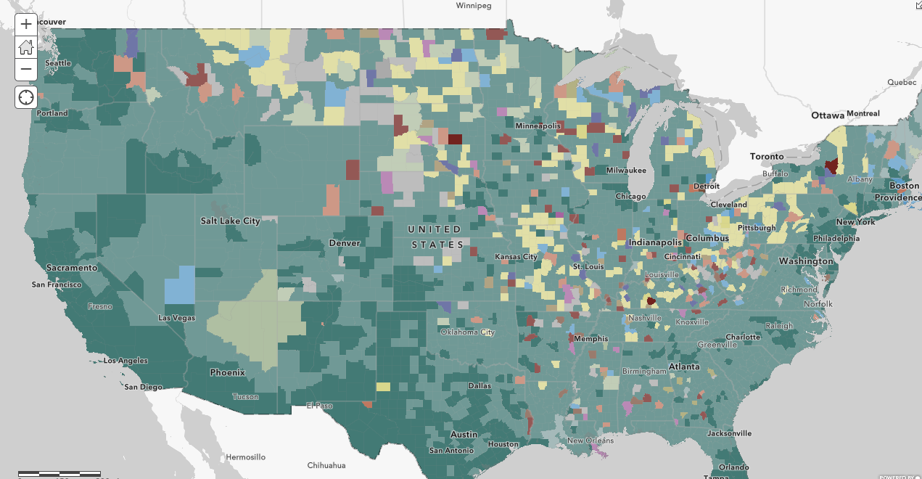
ArcGIS
12 different languages
Data points:
State
County Effect
County
Tract
Notes:
Sometimes it is necessary to drill down to the county level and ArcGIS has the perfect tool to find out what languages are spoken by people who have limited English ability.
This interactive map shows the predominant language(s) spoken. There are 12 different languages included at the state, county and tract-level.
This is shown using American Community Survey data from the US Census Bureau by state, county, and tract. This map contains layers using the most current release of the U.S. Census Bureau's American Community Survey (ACS) 5-year estimates. The layers are updated annually to reflect the most current data values and geographical boundaries. This image was created in April of 2023 and updated in May of 2023.
The American Community Survey (ACS) is an ongoing survey that provides vital information on a yearly basis about our nation and its people. Information from the survey generates data that help determine how more than $675 billion in federal and state funds are distributed each year.
This map uses a feature effect to identify the counties with either 10,000 or 5% of the population having limited English ability. We will take a tour of this tool too.

Slide 13
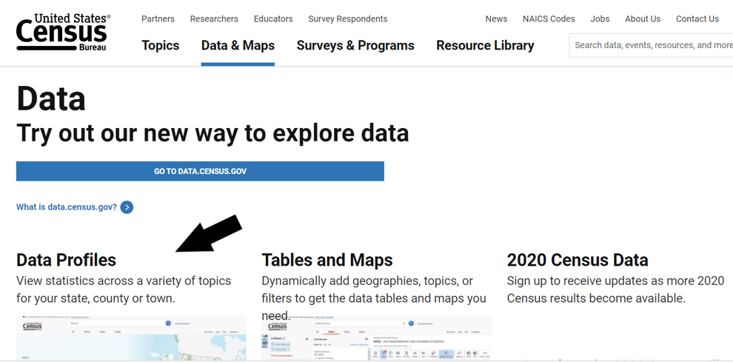
Locating Census Data
Notes:
I am including this slide for later reference. On this slide, I have a screenshot of the United States Census Data page with an arrow pointing to data profiles. This is a helpful tool for getting an overview of your local area and is included in the class handout.
Census.gov/data.html

Slide 14
Considerations when Providing Health Information
Plain language
Preferred Language
Notes:
We all need health and medical information in language that we can understand. We also know that health information can often use medical jargon that we may not be familiar with even if it is in our preferred language. Under stress it is particularly difficult to process information. So regardless of language, we want to have information written in plain language. For people whose primary language is not English, even if the person is fluent in English, there may still be a preference for information in their native language.
I’ll be demonstrating some sites that include plain-language material as well as materials in languages other than English.

Slide 15
Information Resources
Notes:
One of the ways we support our communities is through information access. We will now transition to the demonstration section of the presentation. As I mentioned we will quickly review some data tools, and then I will share a few free resources that are good sources of information in languages other than English, as well as information that can help us learn about the countries, health conditions, and experiences of refugees and asylees.

Slide 16
Health Information Resources in Languages other than English
Notes:
We are going to review four key resources. In addition to these resources, I want to point out that many state health departments also have resources specific to new arrivals such as refugees and asylees, as well as information in multiple languages, so that is another place to start when searching for information.
******Considering Removing Office of Minority Health and replacing with a different resource********
Information sources
MedlinePlus: https://medlineplus.gov/
Office of Minority Health: https://www.minorityhealth.hhs.gov/
CDC Refugee Health Profiles: https://www.cdc.gov/immigrantrefugeehealth/profiles/index.html
EthnoMed: https://ethnomed.org/

Slide 17
NNLM Funded Projects
Notes:
Many of you may be serving multilingual communities in a variety of ways. Perhaps you are bilingual or multilingual or your library has multilingual staff. Or maybe your library has worked with other organizations that serve multilingual community members. I hear about wonderful programming in our regional libraries frequently, and I am sure that many of you are involved in interesting projects in your libraries already.
I want to end with a plug for NNLM funding. Each NNLM region offers funding for special projects. If you’ve been thinking about a project that would serve your non-native English-speaking community, this might be an avenue to explore. If you’re interested, I’ve included a link to the current open funding opportunities on the handout. Funding is offered by regions. You can apply on behalf of your organization and your organization would have to be an institutional member, which is free.
We also offer a class X times per year called How to Apply for NNLM Funding. We have a link on the handout for that as well.
For this section, I will share some examples of projects that have been funded by the NNLM.
You are hopefully aware that NNLM supports communities through funding projects at the local level to support health information access. If you are interested in learning more about applying for NNLM funding, please take a look at our class page: How to Apply for NNLM Funding | NNLM https://www.nnlm.gov/training/class-catalog/how-apply-nnlm-funding If there are no upcoming classes listed, you can click on the previous classes page and follow these to get recordings of previously offered webinars.
******Can add locally funded projects from your region or other NNLM funded projects. Best to stick with projects that have deliverables and static content****************

Slide 18
Thank you!
Your name, region, email
Notes:
Thank you so much for your time and attention today. Please reach out with any questions or to your regional office to learn more about what NNLM offers. I believe that Rebecca will share the Evaluation Link at this time. I am happy to answer any questions you might have.

