Slide 1
Creating Data Management Plans with DMPTool
Jim Martin, University of Arizona, Research Services Librarian
Betsy Gunia, Johns Hopkins University, Data Management Consultant
Members of the DMPTool NIH Working Group

Slide 2
DMPTool NIH Working Group
Duke University Medical Center
George Washington University
Iowa State University
Johns Hopkins University
NNLM National Center for Data Services
Saint Louis University
Temple University
The Rockefeller University
University of Arizona
University of California, Irvine
University of Maryland, Baltimore
University of Pittsburgh
Virginia Commonwealth University
Washington University School of Medicine in St.Louis
A newly formed working group consisting of data librarians from across the US. The main focus of this WG is to build and update the NIH DMSP templates. Additional work is being done by an education sub-committee that is producing associated educational resources.
Blog about the NIH Working Group: https://blog.dmptool.org/2022/08/18/supporting-the-upcoming-nih-data-sharing-requirements-with-the-dmptool/

Slide 3
Objectives
Understand why data management and sharing are important
Know what an NIH data management and sharing plan is
Learn about the DMPTool
What it is
How to use it
How to advertise it to researchers

Slide 4
Why is data management and sharing important?
Notes:
Let’s begin by looking at what data management is and why it’s important.

Slide 5
Why are Data Management and Sharing Important?
Required for reproducibility
Facilitates data reuse
Helps Make Data FAIR

Slide 6
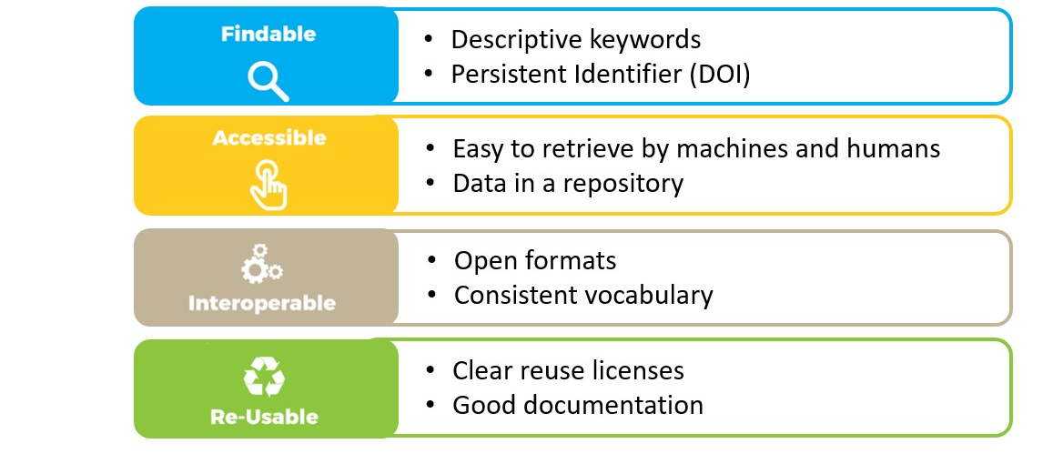
FAIR Principles

Slide 7
Data Management and Sharing Mandates
Journals — PLOS, Nature, JDAP partners
Funders — NSF, NIH
Home institutions

Slide 8
2. What is an NIH data management and sharing plan?

Slide 9
NIH Data Management and Sharing Policy:
New policy went into effect on January 25, 2023
Requires Data Management and Sharing Plan (DMSP) for all NIH-funded research that results in the generation of scientific data
NIH requires that researchers discuss 6 elements around how they will manage and share their data
Expectation to maximize data sharing with caveats​
Expectation that data are of sufficient quality to validate and replicate research finding​
Not training grants, fellowships, conferences (see specific activity codes)​
NIH Program staff will assess DMS Plans, but not part of overall impact score
Go to https://sharing.nih.gov/data-management-and-sharing-policy for more information
Notes:
T

Slide 10
Elements of an NIH Data Management Sharing Plan (2023)
Data type
Related tools, software, and/or code
Data standards
Data preservation, access, and associated timelines
Access, distribution, or reuse considerations
Oversight of data management and sharing
U.S. Department of Health and Human Services, National Institutes of Health. (2020). Supplemental Information to the NIH Policy for Data Management and Sharing: Elements of an NIH Data Management and Sharing Plan (NIH Notice No. NOT-OD-21-014). Retrieved from https://grants.nih.gov/grants/guide/notice-files/NOT-OD-21-014.html
10

Slide 11
3. The DMPTool

Slide 12
DMPTool:https://dmptool.org/
Free, online application managed by the California Digital Library that helps researchers create data management plans specific to their funder’s requirements.
Provides a click-through wizard for creating a DMP that complies with funder requirements.
Used by many institutions around the world (82,235 users).
The DMPTool has funder-specific templates for both private and public funders; current community focus is on the new NIH DMSP Policy

Slide 13
Why should researchers use the DMPTool
Guidance: Quick links to relevant resources; both from funder and from your institution.
Receive Feedback: from collaborators or your institution’s DMPTool administrators
View Example Public Plans: List of Plans that creators chose to make public, including featured plans
Machine actionable DMP - allows for automated exchange of information about your research. Also known as networked DMP
Connect to ORCID iD- has the ability to automatically add your DMP to your profile

Slide 14
Machine-actionable DMPs
A vehicle for reporting on the intentions and outcomes of a research project that enable automated information exchange across relevant parties and systems. They contain an inventory of key information about a project and its outputs (not just data), with a change history that stakeholders can query for updated information about the project over its lifetime.
Ensures compliance
Promotes research integrity
Tracks research outputs

Slide 15
Machine-actionable DMPs in the DMPTool
Current features
In development
The use of identifiers within a DMP and for the DMP itself (DMP-ID).
Ability to link a plan to research outputs the project has generated– such as journal articles, preprints, datasets, data papers, and software.
Ability to export DMPs as structured JSON files complying with the RDA Common Standard Metadata Scheme for DMPs.
Ability to upload externally created DMPs into the tool.
New administrator dashboard to track research outputs associated with DMPs.
Further developments to the API to facilitate integrations with RDM services & tools.

Slide 16
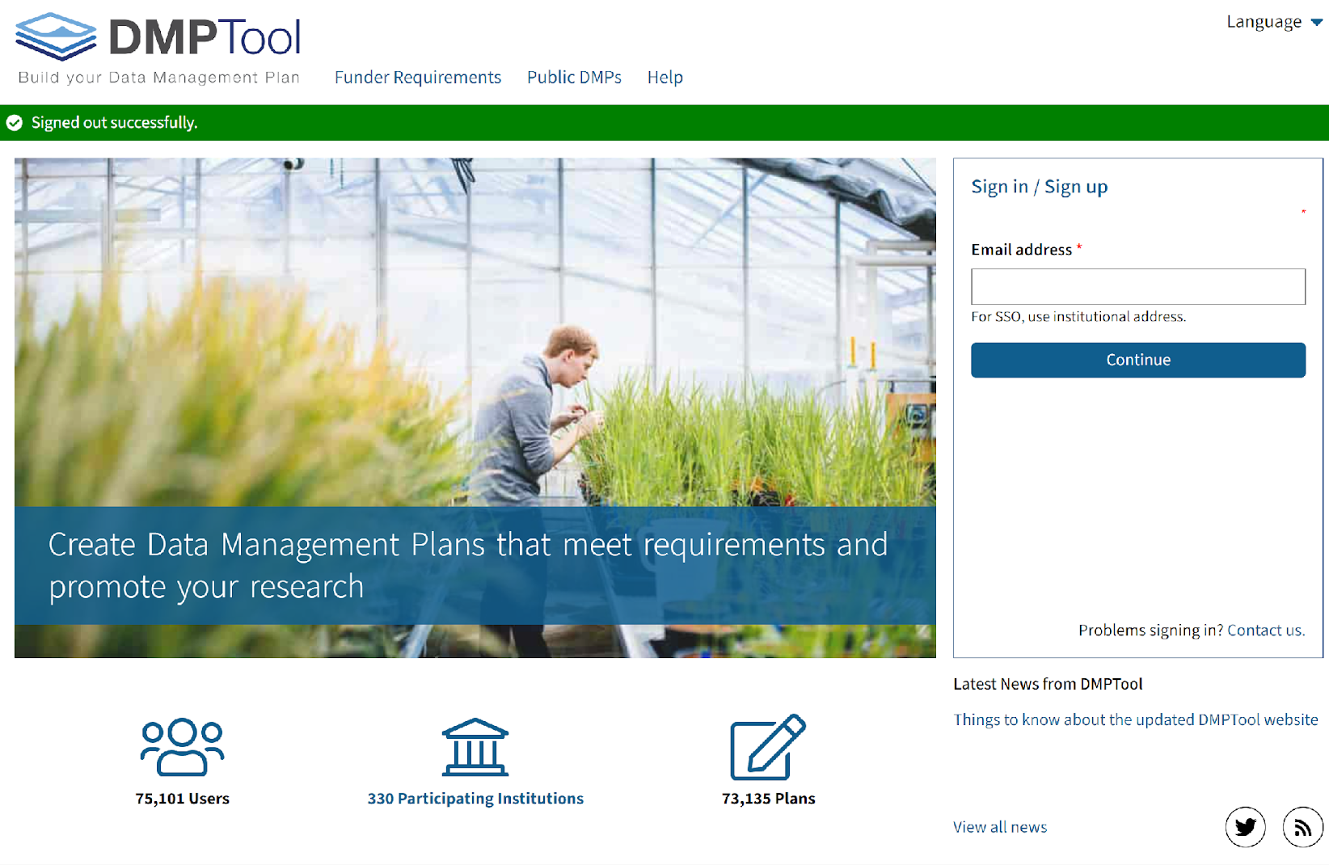
DMPTool

Slide 17
NIH DMPTool template update plans
DMPTool currently has a template designed to match the NIH-supplied DMSP template. This template includes:
NIH supplied guidance & links corresponding to each question
Additional explanatory text when necessary
Example fill-in-the blank answers that users can modify as needed
REMINDER: only NIH resources provided here; Additional Guidance contains related resources and definitions when necessary.
Additional clinical and basic science sample answers and guidance
Genomic data guidance from NIH

Slide 18
blog.dmptool.org

Slide 19
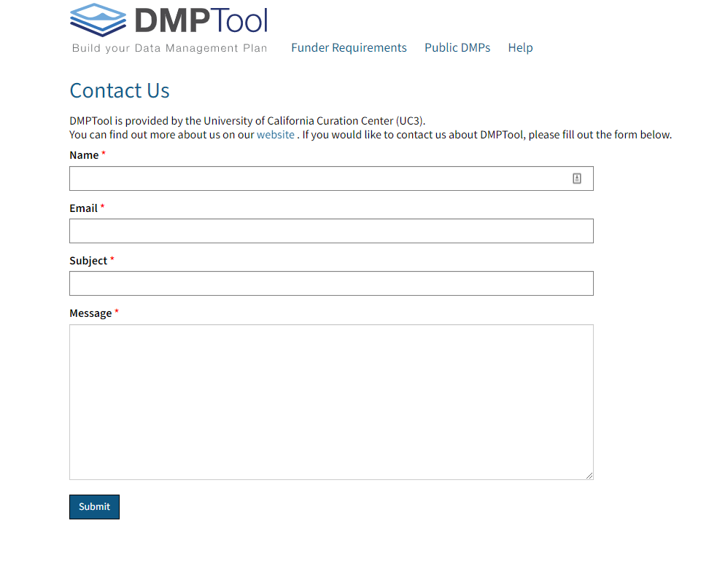
Become a Participating Institution
Why
It is free!
You can customize guidance
Researchers can request feedback from the DMPTool admin
You can join a community of other (awesome) librarians
How
It is easy. Simply email the DMPTool team at dmptool@ucop.edu or fill out the Contact Us form.

Slide 20
How to advertise the DMPTool to your community
Connect with
Office of Sponsored Programs Administration
IRB and Office of Research Ethics
Grant administrative support staff (the people who help write and manage funded projects)
Faculty at department faculty meetings
Run trainings
New open deck for promoting the DMPTool: tinyurl.com/DMPToolSlides
DMPTool Flyers
Advertize the DMPTool at your institution: tinyurl.com/DMPToolFlyers

Slide 21
References
The DMPTool administrative user guide is here:
https://github.com/CDLUC3/dmptool/wiki
Keep up to date with DMPTool news and announcements via the blog: https://blog.dmptool.org/.
Reach the DMPTool team at dmptool@ucop.edu.

