Slide 1
Piecing Together Systematic Reviews Series Phase 2: Protocol what are the methods for the review?
July 24, 2024
Sponsored by NNLM Region 3
Margaret J. Foster, MS,MPH
Center for Systematic Reviews and Research Syntheses
Medical Sciences Library, Texas A&M University
https://library.tamu.edu/reviews/

Slide 2
Objectives
After attending this session, participants will be able to:
Define the requirements of the protocol
Detail reasons and how to register a protocol
Describe how to select databases to search
Discuss development of the main search
Describe the evaluation- screening, data extraction, and quality appraisal process

Slide 3
Agenda
Big Picture
Planning the protocol
Identifying citations
Evaluating
Collecting data
Bringing it together

Slide 4
Part 1 Big Picture Quick recap Phase 2 (Protocol) Planning the protocol

Slide 5
Review Project Cycle
Notes:
The PIECES Cycle is designed to:
organized model of 8 phases & 8 processes
encourages planning and testing of processes
demonstrates multiple outputs that can be produced, encouraging scholarly communication
highlights most important aspects of the phase
The cycle is not designed:
For narrative reviews that are more exploratory in nature- these projects generally do not have an a priori process
To replace the need for more detailed guides, standards, and consulting experts
The 8 phases of a review project can overlap, can have multiple outputs, which can be published or informal. And of course, some phases are optional. The phases also connect together in a cycle, for when the updating algorithm says its time to update, you then move back into the proposal phase. Now let's look at each phase separately.

Slide 6
Phase 1: Proposal steps
Plan
Determine review type and purpose
Frame the question
Identify>Evaluate> Collect> Combine
3. Find related reviews
4. Scoping search for studies
Explain, Summarize, Share
5. Rationale
6. Proposal outline

Slide 7
Systematic review frameworks
Review type | Framework
Effectiveness | PICO: Population, Intervention, Comparator(s), Outcomes
Etiology/ Risk/ Benefit | PEO: Population, Exposure(s), Outcomes
Prevalence/ Incidence | PCS: Population, Condition, Setting or context
Scoping review | Population; Concept; Context
Munn, Z., Stern, C., Aromataris, E. et al. What kind of systematic review should I conduct? A proposed typology and guidance for systematic reviewers in the medical and health sciences. BMC Med Res Methodol 18, 5 (2018). https://doi.org/10.1186/s12874-017-0468-4

Slide 8
Results of review search
Consider 3 options after collecting related reviews-
A- already review(s) same as proposed question
B- found reviews close to proposed question
C. Found no reviews
What to do with reviews:
Screen references
Look at methods
evidence tables
Done well-change question
Conducted in last 5 years
Not done well, conduct a better review
Reviews(s) exactly the same research question as proposed
Not in last 5 years
Updated review
Close to proposed question but not the same
No reviews on proposed question
Expand search
Integration of existing systematic reviews into new reviews: identification of guidance needs

Slide 9
Table on differences with proposed review
Provision and uptake of routine antenatal services: a qualitative evidence synthesis.

Slide 10
Is it feasible?
Did the question change? Did the criteria change?
Write out the finalized question & eligibility criteria
Keep this in mind throughout the process- it should guide everything

Slide 11
Part 2 Blueprint Planning the protocol Registry

Slide 12
Phases 1-4
Proposal- What is the review type? Scope of the review? Is the question feasible?
Protocol- What are the methods for the review?
Production- Designing and running all searches? When to stop searching?
Paper- What are the most important findings and where do they fit into previous research?

Slide 13
Phase 2: Protocol steps
Plan
Select reporting standard
Identify
Develop and pilot data extraction; Determine syntheses type
Explain, Summarize, Share
Evaluate
Collect> Combine
Design main database search
Screen articles
Develop and pilot quality appraisal
Write up protocol
Consider registration
Get feedback- even if not formally publishing
List databases to search

Slide 14
Protocol
methods of the review
No matter the form or type of review a protocol is a must!
can be
informal
published
registered
presented at conferences

Slide 15
Options
Prospero
Joanna Briggs Institute
Campbell Collaboration
Cochrane Collaboration
BEME: Best Evidence Medical and Health Professional Education
OSF Registry
Protocols.io

Slide 16
Prospero
When to register
If the review has an outcome involving human health
Must be a systematic review (no scoping accepted)
Not supposed to be in coding/data extraction phase
What you will need
question
eligibility criteria
description of methods
best to type up answers in shared doc- only one person can see online

Slide 17
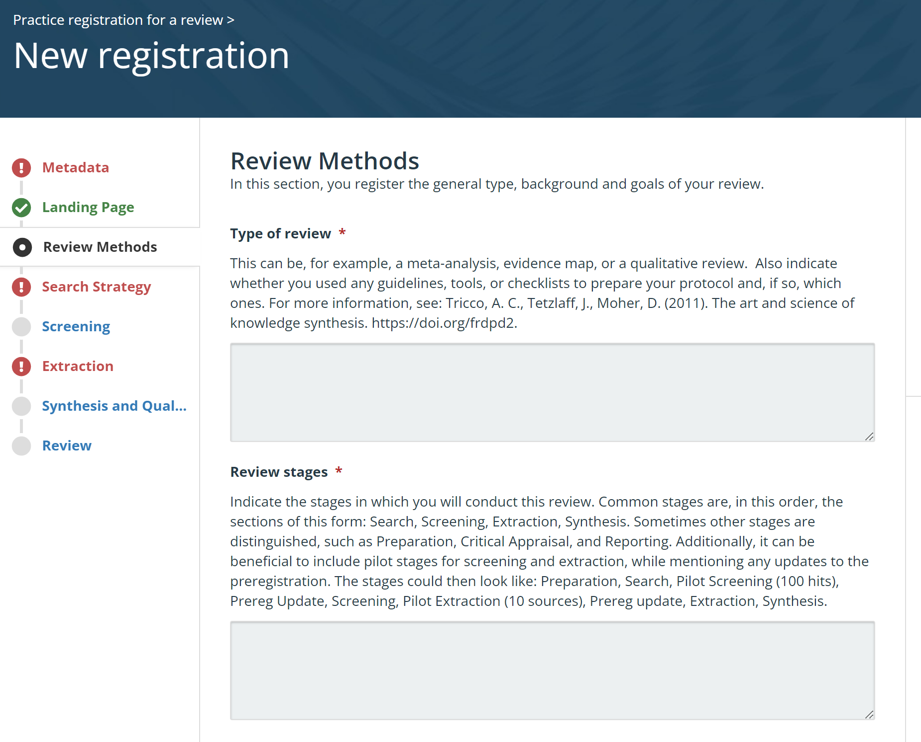
OSF Registries
Free
Format is up to you
A few templates are available
Cannot edit (the registry, original project continues to be edited)
Can also search for protocols- 1000s posted

Slide 18
Myths about registering protocols
You can’t change anything once it is submitted (It can be updated)
Other researchers will steal the idea (I haven’t heard of someone this happened to and many journals have policies)
If someone publishes a review on your topic, you cannot (happens a lot, you can continue)

Slide 19
Part 3 Identifying Selecting databases Designing search Evaluating search Case study

Slide 20
What makes this search different?? Or Why do I need to work with the librarian??
Bias during the search is one of the biggest threats to the review
It will be evaluated by many
All articles the search retrieved must be labeled
comprehensive
Search one database at a time
Balance sensitivity with specificity
Document the search
“Searches for studies should be as extensive as possible in order to reduce the risk of publication bias and to identify as much relevant evidence as possible.”
Methodological Expectations of Campbell Collaboration Intervention Reviews (MECCIR)

Slide 21
1 Determine databases
Consider
Scope of database
Journal title indexed
Other Formats: theses/dissertations, books, research in progress
Interface differences
Updating schedule
Start with best/most relevant databases
Then list others in order of relevance/size
Where to look
Database list from previous searches
List from standards/guides

Slide 22
Some specifics…
Cochrane Handbook suggests:
Medline
Embase
Cochrane CENTRAL
ClinicalTrials.gov
WHO
AND
any other relevant resource…
Additional
Nursing/rehab/allied health:
CINAHL
SportDISCUS
Economics/Business
EconLit
Business Source
Agriculture/nutrition
Agricola
Cab Abstracts (also veterinary)
ERIC (education)
APA PsycINFO (psychology)
Compendex (engineering)

Slide 23
2 Designing a search in main database
Population
Intervention/ exposure
Type of study
Creating a Venn Diagram
Helps to establish main criteria of search
Aids in clients’ understanding of how things will be combined.
Color code with sections of search
Notes:
A scoping search is a quick search to get an idea of what is out there- 10, 100, or 1000s of articles. This especially good when you are not sure if anything has been published or how narrow with population to choose.

Slide 24
Standards of searching
Concepts to search
population terms
AND
intervention or exposure or concept
AND
study type (if appropriate)
For the most part, outcomes should not be in the abstract. (there are exceptions!)
fields to search concepts:
title/abstract
or
subject headings (MeSH, emtree)
Or
Author or journal applied keywords​
or
other fields

Slide 25
Keywords and thesaurus terms
Standards call for combining keywords + thesaurus terms
Keywords- title/abstract (selected by authors
Thesaurus- index terms available in some database which increases discoverability
Keywords
All articles on that concept
OR
Thesaurus terms

Slide 26
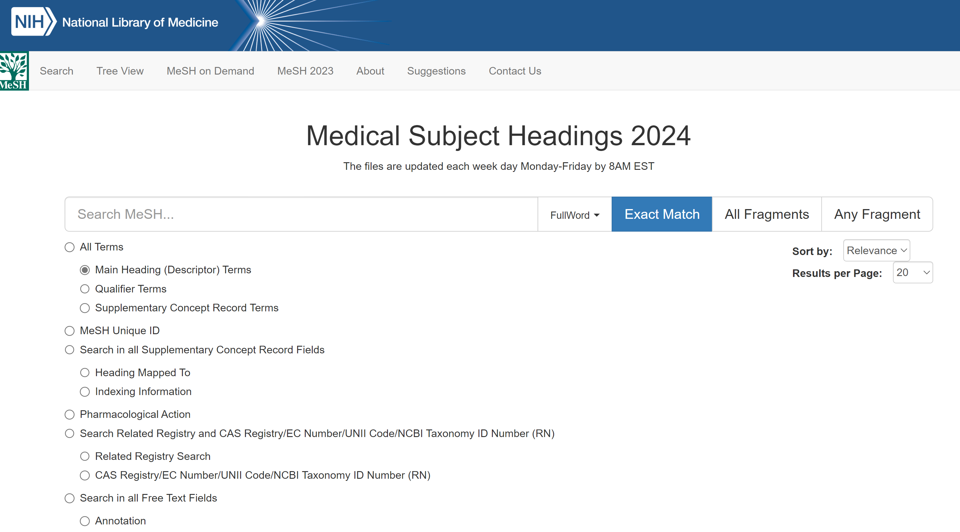
Find MeSH terms
In Ovid:
Map Term to Subject Heading browser in Ovid (default)​
Ovid’s Term Finder feature​
MeSH Browser
Look up known articles​ for their headings (Yale MeSH Analyzer)
Determine if term should be exploded (or not) by reviewing tree
Subheadings are best left out of the search- although could be searched with floating subheading as appropriate
MeSH Browser

Slide 27
Assistance with search: Yale MeSH Analyzer
By: Yale University
Using the tool:
Paste in PMIDs
Select options
Click Go!
Cost: free
Example: Searched for articles on cataract surgery for dogs
Yale MeSH Analyzer
Notes:
Also provides a bookmark, mark items in Pubmed and click bookmark for instant chart

Slide 28
Collect terms
Consider
Articles published internationally for variations of terms
Variations between disciplines for the concept
Historical changes
Also consider most common misspellings of word?
Related reviews
Look at related reviews
Search filters (especially for age, study types, geography)
Cochrane or other reviews about the overall topic

Slide 29
Advanced keyword searching techniques
Use as appropriate:
Truncation
Wildcards (behavo*r)
Proximity searching
Phrase searching
Other punctuation
Examples
Computer$ adj2 addict$
Inform* w2 consent
Pe?diatric*

Slide 30
Limits
Age- adults difficult to search for​
Geography- rarely in title or abstract; too much variation when U. S.​
Humans- tags not added correctly​
Study types- tags not correct ​
Years- ability to narrow by published date, entry date, others varies by database/interface
Use filters from validated sources​
(this will be covered in 3rd session)

Slide 31
Documenting and Saving the search
Elements required to document:
Database name
Database host
Date of search
Years covered
Search terms
Language restrictions
Copy and paste search
Save within databases
Set up log ins for database whenever possible
If cannot save within database:
Print Screen
Within Excel spreadsheet
Record # of duplicates
Cochrane Handbook for Systematic Reviews of Interventions
Finding what works in health care: Standards for systematic reviews.

Slide 32
Peer-review: PRESS Evaluation
PRESS: Peer Review of Electronic Search Strategies
Developed by the Canadian Agency for Drugs and Technologies in Health
Translation of research question
Boolean & proximity operators
Subject headings
Text words
Spelling, syntax, and line numbers
Limits and filters
Overall assessment
Canadian Agency for Drugs and Technologies in Health.
https://drive.google.com/file/d/1N8vVfelPCHJSDleRy3qafhfjQFvAklpE/view?usp=sharing
Full description: https://www.cadth.ca/sites/default/files/pdf/CP0015_PRESS_Update_Report_2016.pdf

Slide 33
Discussion: Case study
Client wants a search on
screen time and teens and depression (provides list >>)
What is the framework for this question?
What further questions would you ask client?
What databases would you suggest?
Perhaps try Yale MeSH Analyzer
Screen exposure, mental health and emotional well-being in the adolescent population: is it time for governments to take action?
Links between screen use and depressive symptoms in adolescents over 16 years: is there evidence for increased harm?.
Digital media and sleep in childhood and adolescence.
The association between video game time and adolescent mental health: evidence from rural China.
The associations between screen time and mental health in adolescents: a systematic review.
The associations between screen time-based sedentary behavior and depression: a systematic review and meta-analysis.

Slide 34
Sample spreadsheet of terms
PMID | 38964781 | 32573926 | 29093040 | 36429534 | 37081557 | 31727052
MeSH Headings |  | Adolescent Adolescent Behavior* | Adolescent | Adolescent Adolescent Behavior* Adolescent Health | Adolescent | Adolescent Adult Aged
 |  | Computers | Child Child Development / physiology* Circadian Rhythm / physiology* Computers / trends Cross-Sectional Studies | Child China / epidemiology |  | Computers* Cross-Sectional Studies
 |  | Depression |  |  | Depression | Depression / etiology* Depressive Disorder / etiology*
 |  |  |  |  |  | Exercise / psychology*
 |  |  | Female |  | Female | Female
 |  | Humans | Humans | Humans | Humans | Humans
 |  |  | Internet / statistics & numerical data*
 |  |  |  | Male Mental Health | Mental Health* | Male Mental Health Middle Aged
 |  |  | Observational Studies as Topic / methods |  | Psychological Well-Being
 |  | Risk-Taking
 |  | Suicide* | Sleep / physiology* Social Media / statistics & numerical data* Social Media / trends |  | Screen Time* Smartphone | Screen Time* Sedentary Behavior*
 |  | United States |  | Video Games* / psychology |  | Television*
 |  |  |  |  |  | Young Adult
Author Assigned Keywords | BEHAVIOR, ADDICTIVE DEPRESSION SEX EDUCATION SUICIDE | adolescences depression screen time screens |  | adolescent health developing countries mental health rural China video game time | Adolescents Media Mental health Screen time | Depression Mental health Odds ratio Sedentary behavior

Slide 35
Case study
Population
Teen: adolescen* or teen* or youth* or high school student* or middle school student*
Young adult? Under 13?
Exposure
Screen time: screen time, screen use, screen exposure, video game?, computer? Need more on how far to go?
Outcome
Depression: Definitely need more info here. Include mental health? Emotional health? All types of depression? Depression as symptom?
Databases: Medline, Embase, CENTRAL, APA PsycINFO, ERIC, Compendex?, Academic Search?
Teens
Screen time
Depress*
Notes:
A scoping search is a quick search to get an idea of what is out there- 10, 100, or 1000s of articles. This especially good when you are not sure if anything has been published or how narrow with population to choose.

Slide 36
Some hints for Ovid Medline
Reserve words
Reserve words (and, or, not, use, adj, add, sub, scope) are processed as operators when entered as part of a query. When enclosed in quotes, the system treats the reserved word as a literal term.​
​For example, the word scope is an advanced search syntax command that automatically opens scope notes from the command line..​
To search for scope of nursing practice, you must type “scope of nursing practice” in the command line.​
​Reserve words apply across all databases in Ovid
So for screen use, it will need to be in quotation marks.

Slide 37
Part 4 Evaluating Screen Select Sort Appraise

Slide 38
Evaluation steps
Screen
Select
Out by title/abstract
Looking at relevance
abstracts
Sort
Out by full text of report
Looking to match by all criteria
reports
Appraise
Sort into studies
Sort by study type
studies
Evaluate risk of bias
Some choose to kick out articles based on appraisal
Many conduct during coding step
studies
Retrieved citations

Slide 39
Screening
Screen
Select
Sort
Appraise
Methods to determine
How many people will be involved?
How will citations/studies be divided?
What software will be used?
How will disagreements be settled?
Pilot methods
Test criteria (screen small amount)
Train the team
Determine how often to meet about disagreements
Looking for reasons to kick it out, not to keep it

Slide 40
Potential tools
Screen
Select
Sort
Appraise
Citation tools
Can be done, but more difficult as not designed for this
Sorters
Designed for decisions, but will need additional tool for next steps
Review software
Can have a cost, need time to learn; increased convenience and efficiency
Citation tools
Endnote
Refworks
Sorters
Rayyan
Abstractr
Review software
Covidence
DistillerSR
SRDR+

Slide 41
Steps of selection
Screen
Select
Sort
Appraise
Same methods and process to determine as screening
can have different methods
Additional issues to consider-
Read enough to find out if it matches all criteria
Some articles will not be located- this is ok

Slide 42
Sorting
Screen
Select
Sort
Appraise
In SRs you are really looking for studies, not reports
If more than 1, use all reports to code
All included articles
Studies listed, numbered, with citations
Study | Citations | Study type
1 | Article 1 | survey
2 | Article 2 and 3 | cohort
3 | Article 4 | Focus group
Sort by study type (if not just one)

Slide 43
Evaluating Risk of bias
Screen
Select
Sort
Appraise
Select critical appraisal tools
What role will the appraisal play in
Assessment is also known as:
Appraisal
Critical appraisal or assessment
Risk of Bias assessment
If more than 1 study type, will need more than 1 appraisal tool
Each study should be appraised by 2 independent
Sections in Cochrane Handbook:
8.5 Randomized control trials
13.5 Non-randomized studies
16.3.2 cluster-randomized trials
Others:
Joanna Briggs Institute
Lattitudes website (has Cochrane tools)

Slide 44
Critical Appraisal checklists
Latitudes Network
Joanna Briggs Institute
Analytical Cross-Sectional Studies
Case Control Studies
Case Reports
Case Series
Cohort Studies
Diagnostic Test Accuracy Studies
Economic Evaluations
Prevalence Studies
Quasi-Experimental Studies
Randomized Controlled Trials
Systematic Reviews
Text and Opinion
Qualitative Research

Slide 45
Part 5 Collecting Develop coding form Pilot Evaluate Determine synthesis

Slide 46
Coding steps
Draft
Develop
List characteristics to be coded
Consider how each will be code
Pilot
Select software
Develop the form
Determine methods
Complete
Test form with a few included articles
Edit as needed
Code all studies
Check on differences between coders

Slide 47
Draft
Draft
Develop
Pilot
Complete
List out characteristics
Determine how each char. Will be coded- open coding, categories?
How many people will be involved?
How will citations/studies be divided?
What software will be used?
How will disagreements be settled?
Equator Network
Characteristics to consider
Methods
Method type
Population
Number
Demographics
Intervention
setting
Timing
See full list on Cochrane Handbook
Other study types- use Equator for reporting standard

Slide 48
Select software
Draft
Develop
Pilot
Complete
Spreadsheet (not recommended but commonly used)
Survey tools
Google Form
Qualtrics
Review software
Covidence
Distiller
SRDR+
Consider
Ease of use
Summaries provided
Think about tables/graphs you want in the end

Slide 49
Pilot
Draft
Develop
Pilot
Complete
Tips for piloting
Test the form with 1 study and all who will code
Looking for info that is in the report and there is not place to add the info to the form
Consider
Some info maybe important but not reported
Form needs to be flexible for this situation
Add other and notes sections as needed

Slide 50
Discussion
What were the methods?
_____________________
What type of survey was used?
online
telephone
paper based
qualitative
quantitative
mixed-methods
List behaviors covered in survey:_________________________________
How were those giving survey trained?
____________________________________
Example form
Study ID: select from dropdown
Aim of study:_____________
Age groups (pick one)
18-24
25-44
45-64
65+
Geographic location: _________________________
Number of participants:_______________________

Slide 51
Evaluate
Draft
Develop
Pilot
Complete
Number items in extraction form
Add not reported, n/a as appropriate
Have as few open blanks as possible, add categories even if just a few and then other
Fill in for a few studies, then look at table
Consider
Meeting on a regular basis to work on discrepancies between coders

Slide 52
Part 6 Bringing it together Summarizing and Sharing the protocol

Slide 53
PRISMA-P
Guidelines for conducting:
Cochrane Collaboration
Joanna Briggs Institute
Campbell Collaboration
and many others..
Standard for reporting not conducting
Designed for protocols
Does not include results
Provides items and order for information to be provided
See PRISMA-P explanation article for examples of items

Slide 54
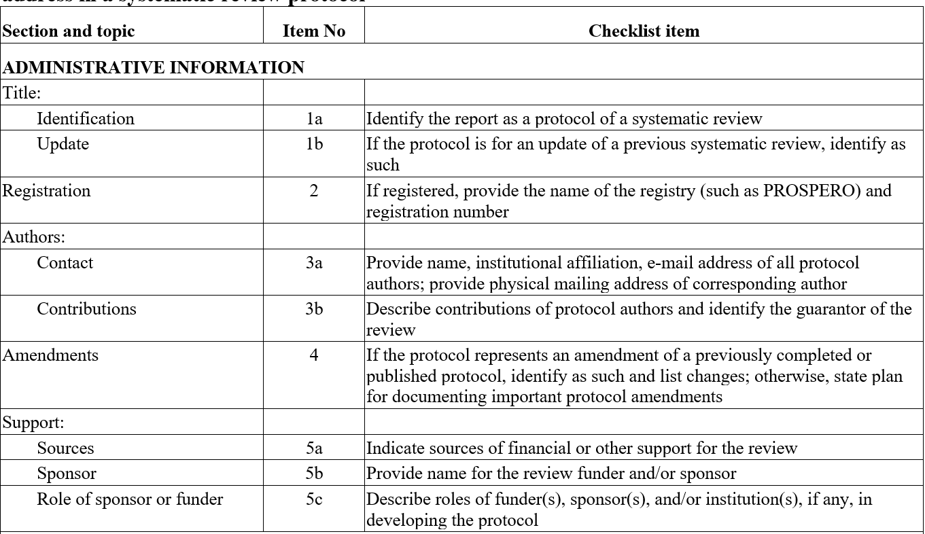
PRISMA-P Administrative (1-5)

Slide 55
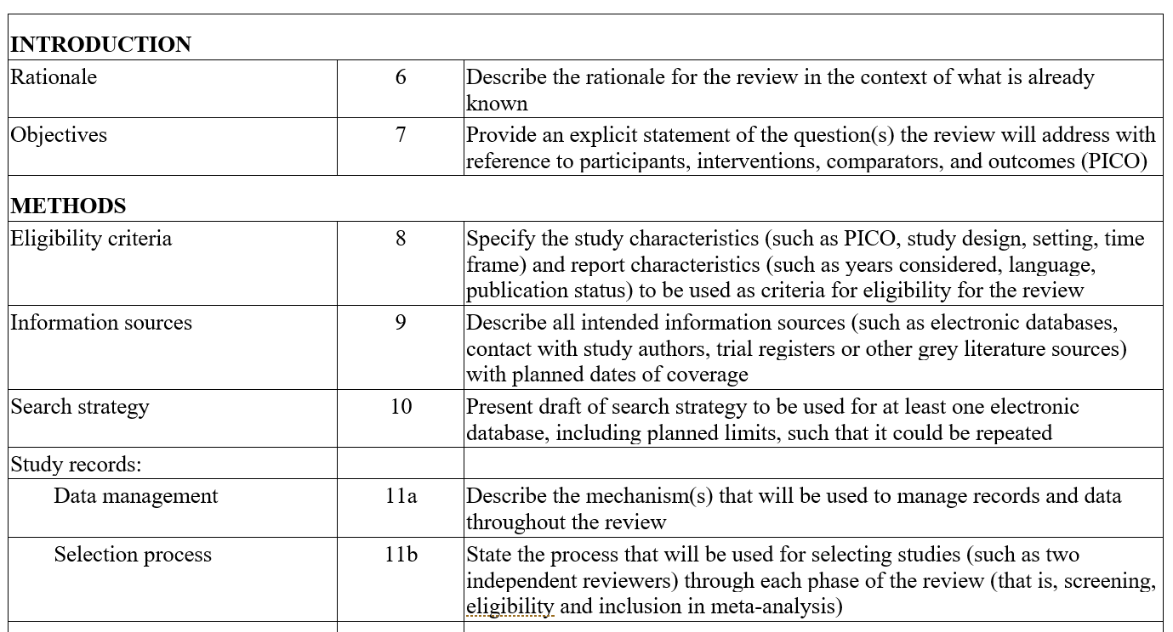
PRISMA-P Intro/Methods (6-11)

Slide 56
Item 6: Rationale
Organize related reviews
Review authors need to:
Consider making a table
look at years covered by search
look at conclusions
Describe related reviews in introduction
findings of previous reviews should be compared review in discussion
Integration of existing systematic reviews into new reviews: identification of guidance needs

Slide 57
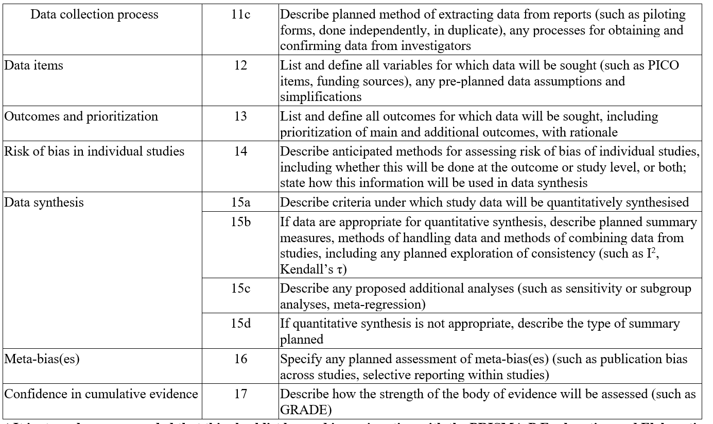
PRISMA-P Methods (11c-17)

Slide 58
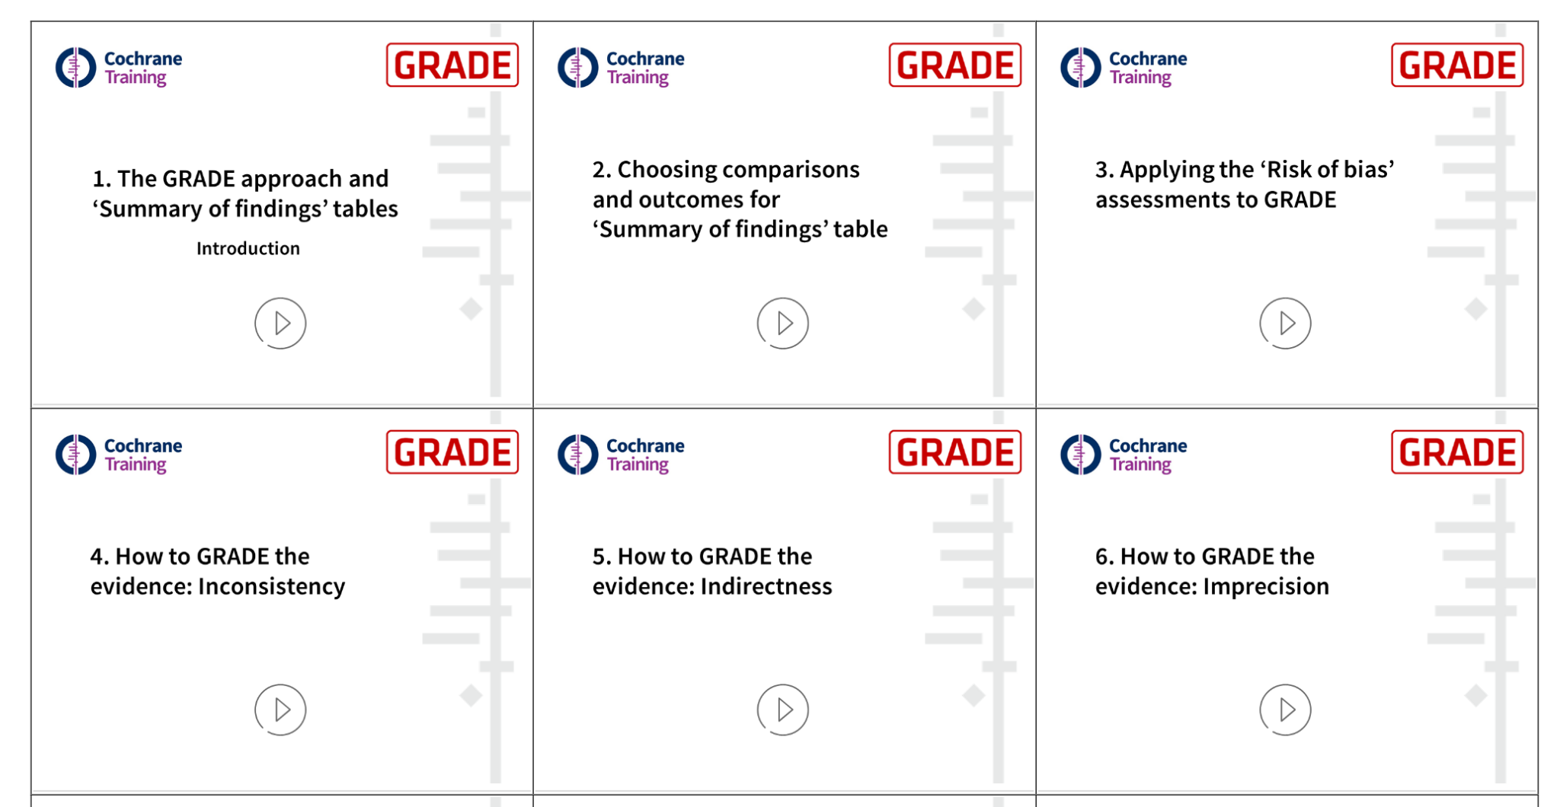
Item 17: GRADE
systematic approach to rating the certainty of evidence in systematic reviews and other evidence syntheses
More than just appraisal of each article
Several free resources

