Slide 1
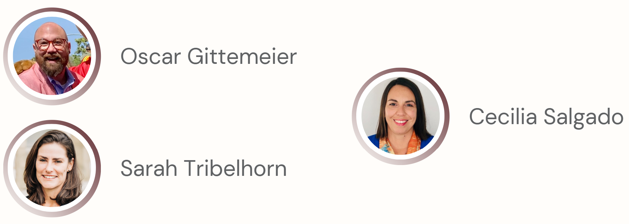
SOCIAL DETERMINANTS OF ENVIRONMENTAL HEALTH WEBINAR SERIES
Advancing Climate Resilience, Sustainability, and Environmental Justice: A Public and Academic Libraries Partnership in San Diego County
MARCH 27, 2024
#SDOEH24
Notes:
[share this slide and announce you’ll start at the scheduled start time]
[At the scheduled start time]
Welcome to the NNLM Social Determinants of Environmental Health Webinar Series
We are glad you are able to join us today for the session titled Advancing Climate Resilience, Sustainability, and Environmental Justice: A Public and Academic Libraries Partnership in San Diego County
I am Stefania Acosta and I’ll be your host.
Assisting with technical aspects is Molly Knapp from the NNLM National Training Office, and our Chat monitors are Michael and Linda.

Slide 2
Using Zoom
Use Chat for questions and comments
Select “Everyone” when posting questions to Chat
All attendees are muted
Closed Caption available
Notes:
We have just a few technical items to cover before we get started:
We do have a live captioner today and Closed Caption has been enabled and it’s available by selecting Show Captions at bottom menu. Depending on size of your screen you may need to click on the three dots where it says “More” and then select Captions.
All attendees have been muted, but we welcome your questions and comments in the Chat anytime, but we will have some time for questions at the end of the presentation.
Please be sure to select “Everyone” from the drop-down menu when posting your questions and comments in Chat so everyone can see them.

Slide 3
Before We Get Started
Class is eligible for MLA CE [and CHES]
Your feedback matters!
Code of Conduct
Session is being recorded
Notes:
We’re recording today’s session and will be available at various places including the accompanying series guide in about a month.
As a reminder, by registering for this webinar, all attendees have agreed to abide by the NNLM Code of Conduct. It’s a reminder that we are all here together professionally and we want to be inclusive and respectful. Your cooperation is appreciated. The Code of Conduct is also available on our website and the link is in the Chat
Post in Chat: NNLM Code of Conduct https://nnlm.gov/about/code-of-conduct
This class is eligible for 1.5 Medical Library Association Continuing Education credits, which you’ll be able to claim though the evaluation link that will have the MLA CE code. We will be shared at the end of the session.
[The session is also eligible for Competencies for Health Education Specialists or CHES. Just know that you will need your CHES ID to complete the evaluation. The session CE is also eligible towards the Consumer Health Information Specialization or CHIS through MLA.]
And speaking of that evaluation, your feedback matters to us, and helps us improve future events, so please take a moment to complete it whether you want the CE or not.

Slide 4
About NNLM / Organizational Structure
National Institutes of Health
Nation’s leading research agency
NIH
NNLM
ROC
NLM
National Library of Medicine
World’s largest biomedical library
Network of the
National Library of Medicine
Outreach program of the NLM
Regions, Offices, and Centers
7 regional medical libraries
3 national offices
4 national centers
Notes:
I know some of you are already familiar with us but for those who aren’t I’d like to share a little about who we are.
The National Institutes of Health is the nation’s leading medical research agency. Many of you might be more familiar with the National Cancer Institute which is one of the many institutes and centers at NIH.
NLM or the National Library of Medicine - is one of the 27 institutes and offices of the National Institutes of Health. It’s the world’s largest biomedical library and produces online resources like PubMed and MedlinePlus.
NNLM - the Network of the National Library of Medicine - is an outreach program of NLM, working to ensure health professionals and the public have equal access to health information.
NNLM is made up of 7 regional medical libraries, 3 national offices, and 4 national centers, all providing training, funding, and engagement opportunities to over 9,000 NNLM member organizations.

Slide 5
The Regions of NNLM
Notes:
Here is a map to show you how our Regional Medical Libraries are geographically divided. If you would like to learn more about your region and how your organization can become part of the network visit our website at nnlm.gov. The link is in the Chat.
Post in Chat: NNLM website https://www.nnlm.gov/

Slide 6
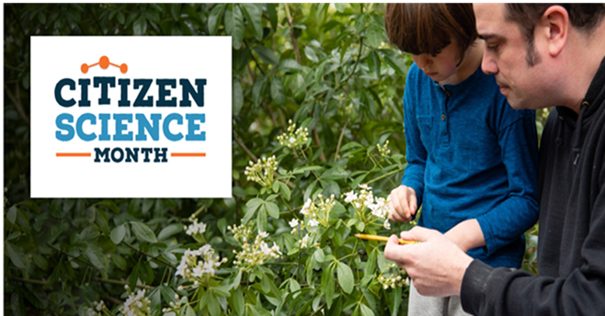
NNLM All of Us Program Center (NAPC)
The NAPC supports partnerships between public libraries and their local All of Us partners.
Notes:
The NNLM All of Us Program Center (NAPC) is a partnership between the National Library of Medicine and All of Us.
The NAPC supports All of Us through two main goals: engagement with public libraries (including training, funding, and partnerships); and providing training for All of Us staff across the US.
The NAPC is based out of the University of Iowa Hardin Library for the Health Sciences, and the University of Pittsburgh Health Sciences Library System.
All of Us is a consortium of engagement and enrollment partners.
Sharing: Current and past projects, list of engagement and enrollment partners (which includes All of Us PA – where Lori works!

Slide 7
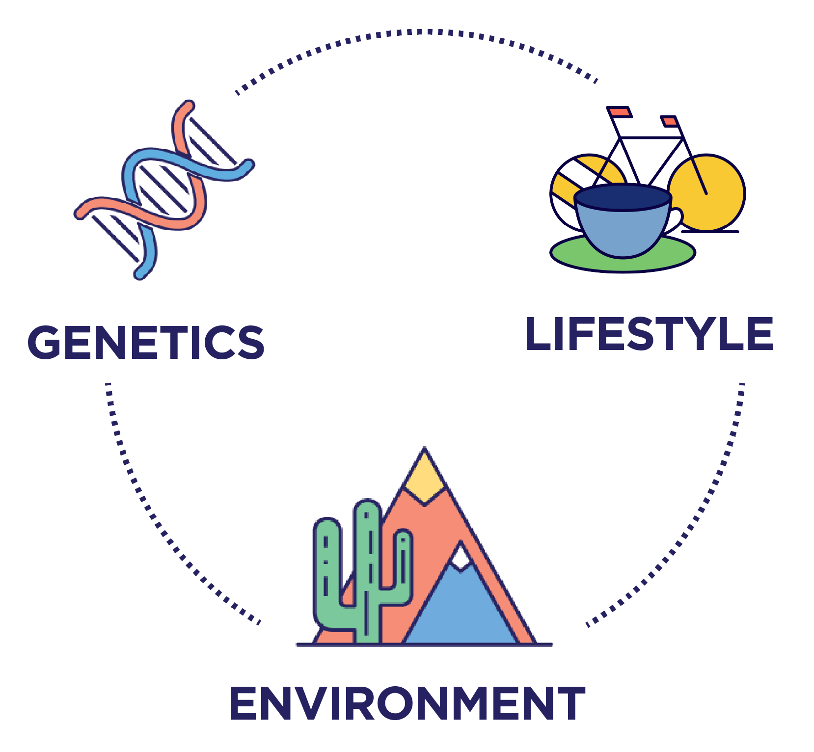
What is the All of Us Research Program?
The All of Us Research Program, led by the National Institutes of Health, is building one of the nation’s largest biomedical data resources. The program collects and stores health data from a diverse group of participants across the United States.
Registered researchers can access All of Us data and tools to conduct a wide variety of studies that may help improve our understanding of human health.
The All of Us Research Program aims to recruit 1 million or more participants that reflect the diversity of the United States.

Slide 8
About All of Us

Slide 9
Advancing Climate Resilience, Sustainability, and Environmental Justice: A Public and Academic Libraries Partnership in San Diego County

Slide 10
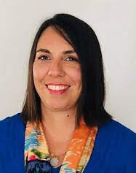
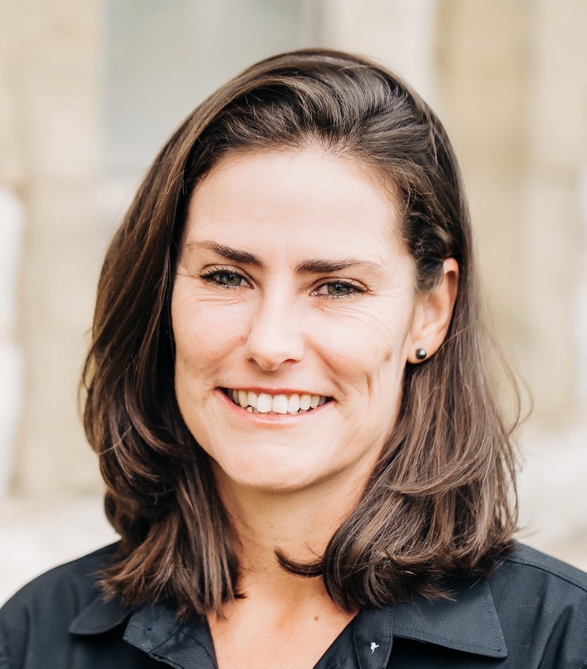
WHO WE ARE:
CIRCUIT INFORMATION ISSUES FOR SOCIAL IMPACT SPEAKERS
Oscar Gittemeier, San Diego Public Library, Program Manager, Division of Innovation and Engagement
Cecilia Salgado, San Diego County Library, Adult Services Manager, Learning, Marketing, & Engagement
Sarah Tribelhorn, San Diego State University Library, Sciences Librarian

Slide 11
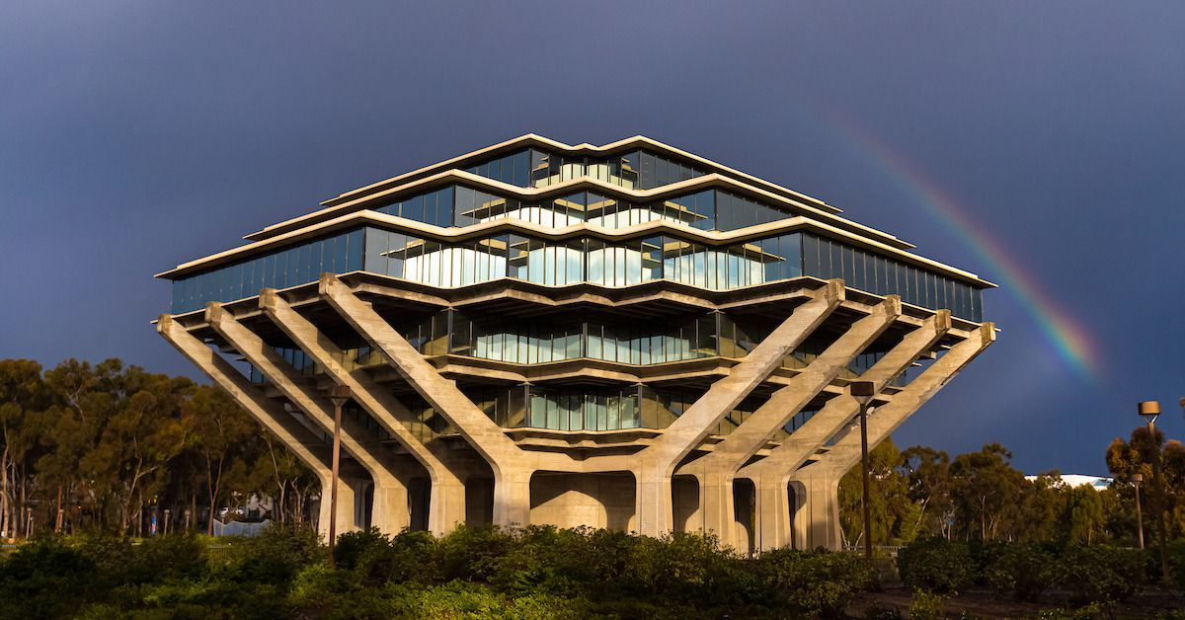
WHO ARE YOU?
Where do you work?
Please share in the chat!
This Photo by Unknown Author is licensed under CC BY-SA-NC
Notes:
Special Library, Public, Academic, Medical?
Bonus Points if you can name the library in the photo.
Clue (Dr Seuss) - UCSD Geisel Library

Slide 12
AGENDA
Sarah - Objective 1
Who we are / Goals / Process
Cecilia - Objective 2
What we’ve done / Equity / Accessibility
Oscar - Objective 3
Outcomes / Challenges / What’s Next
Notes:
Here is a quick agenda for our talk this morning:
I will start off by talking about who we are, the goals of our collaboration, and our collaborative process.
I will hand it off to Cecilia who will talk about projects that we have done, social equity in our projects, as well as accessibility.
Cecilia will then be followed by Oscar who will talk about the outcomes of our most recent project that we are discussing today, the challenges in this, and what we have planned

Slide 13
WHO WE ARE:
CIRCUIT INFORMATION ISSUES FOR SOCIAL IMPACT
What is Circuit?
Consortium of 6 public and academic libraries serving communities across San Diego County
CIISI Mission
Support the County campaign to counteract health misinformation and support climate resilience
Advance health information literacy support at Circuit libraries
Build health misinformation and climate resilience in San Diego County communities
CIISI Initiatives
Address health and climate misinformation in San Diego County, focusing on underrepresented communities
Notes:
Circuit is a consortium of 6 public and academic libraries serving communities across San Diego County. The Circuit libraries include California State University San Marcos Library, San Diego County Library, San Diego Public Library, San Diego State University Library, the University of California San Diego Library, and the University of San Diego Libraries. Since 1997, we have provided a service for library users to borrow print books from other San Diego Circuit libraries quickly. More recently, we have collaborated on strategic information initiatives in the San Diego County region, including the Circuit Information Issues for Social Impact Team or CIISI, which is what we will be talking about today.
The original mission of the CIISI included supporting the County campaign to counteract health misinformation and support climate resilience, advancing health information literacy support at Circuit libraries, and building health misinformation and climate resilience in San Diego County communities. This mission has grown to advancing climate Resilience, sustainability, and environmental justice, focusing on the impact of climate change on health.
To this end the CIISI initiatives have addressed health and climate misinformation in San Diego County, focusing on underrepresented communities.
Why is this important?
Health misinformation is a public health crisis. Furthermore, libraries can build our communities’ resilience to climate change and health misinformation. We collectively see responding to users’ health and climate questions in the library as an opportunity to combat misinformation.
Responding to users’ health and climate questions in the library is an opportunity to combat misinformation

Slide 14
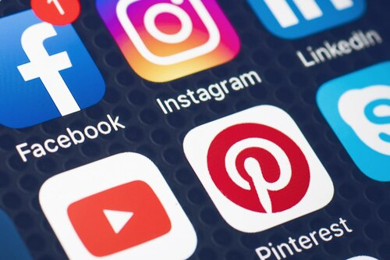
QUESTIONS
Have you seen examples of health or climate misinformation in your work with patrons or students?
Please share in the chat!
Notes:
We would love your input now…
Have you seen examples of health or climate misinformation in your work with patrons or students?

Slide 15
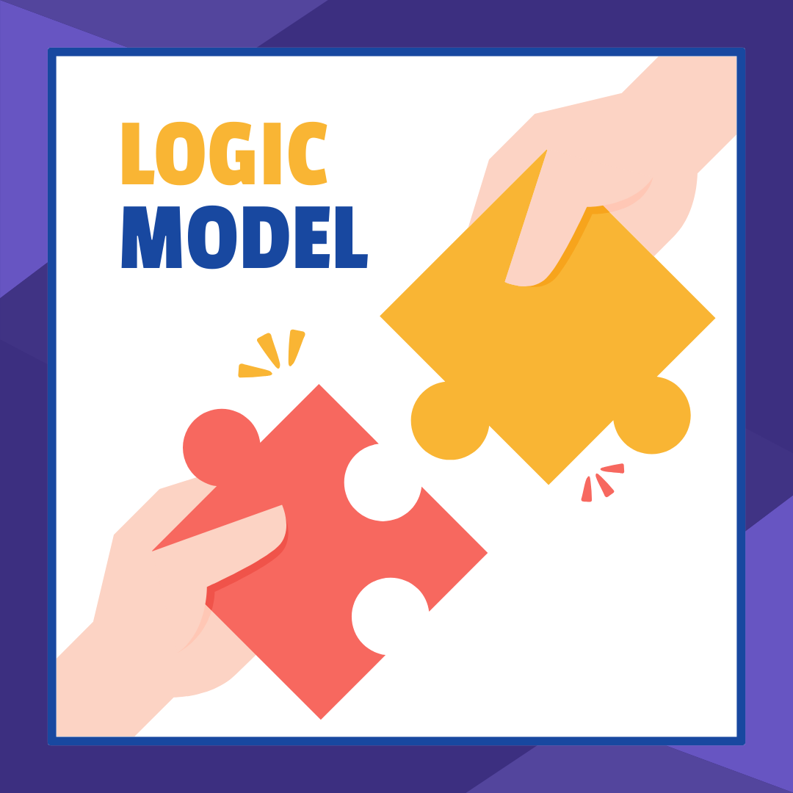
COLLABORATION:
LOGIC MODEL APPROACH
What is the logic model and why does it work for us?
Collaboration between public and academic libraries
Original goal
Build resilience to health misinformation in San Diego
County communities
Strategy
Share reliable health and climate information
Support health and climate information literacy
Multi-pronged approach
Information sharing
Training and events
Strategic partnerships
Community engagement
Notes:
I am going to discuss how we have strategically organized our collaborative efforts. This has primarily been based on the logic model approach. So, what is the logic model and why does it work for us?
As mentioned, this is a collaboration between public and academic libraries in our county. The original goal was to build resilience to health misinformation in San Diego County communities.
Our strategy has been to share reliable health and climate information while supporting health and climate information literacy. This model includes a multipronged approach of information sharing, training and events, strategic partnerships, and community engagement.
For the collaboration, we used an inclusive, participatory process to design work for broad impact, coordinate expertise and resources, and aligned our different institutional missions and services. We established an advisory team with representation from all Circuit libraries (originally the Circuit Health Advisory Committee, now the Circuit Information Issues for Social Impact Team.
For the Health Misinformation Campaign we analyzed authentic recommendations and identified four action areas:
Information sharing
Educational services
Community engagement
And strategic partnerships
We then brainstormed amongst us to accommodate the different organizational values. Based on this we prioritized high-impact initiatives with high ease-of-doing, and then collaboratively drafted project plans for review and approval by circuit library directors. Regarding the health misinformation campaign, 8 health initiatives were identified in 2022, and a logic model approach was used to prioritize these in alignment with the San Diego County’s health campaign and recommendations.

Slide 16
COLLABORATION:
LOGIC MODEL DETAILS
Logic model:
Resources
Activities
Outputs
Impact areas
Community or practice
Strategic partnerships
Current campaigns:
Health Misinformation Campaign
Impact of Climate Change on Health, Climate Resiliency, and Environmental Justice
Notes:
The logic model shows relationships among resources, activities, outputs, and impact areas.
For our original project, the resources included the advisory team and circuit members; funding (which has been achieved through grants so far); technology; organizational support; and our community networks. Activities included promoting health information sources, building reference skills and referral guides, developing a library network, conducting instruction and events, as well as engaging with public officials, community advocates, and inviting participants to work with libraries, and training health workers.
We have used this model to build a community of practice and forge strategic partnerships for larger-scale work. Our Health Misinformation Campaign has been very successful, and we are now using the same approach while focusing on the impact of climate change on health, climate resiliency and environmental justice.

Slide 17
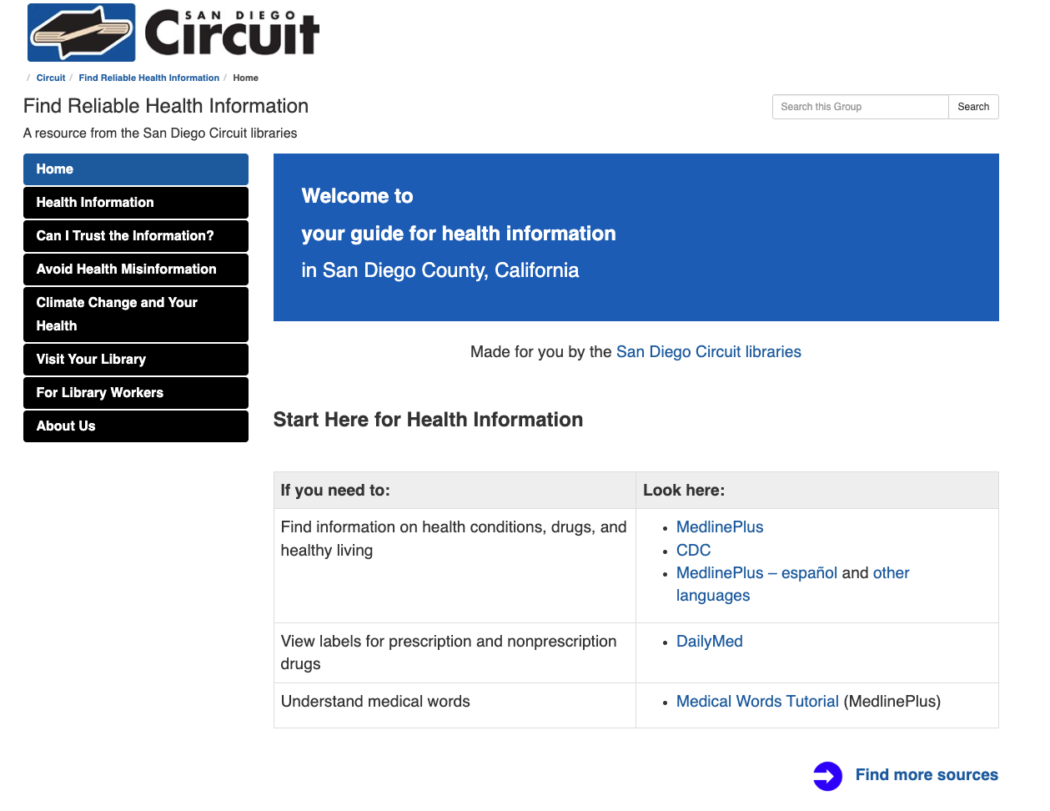
WHAT WE’VE DONE:
HEALTH MISINFORMATION & CLIMATE RESILIENCE
Distributed COVID Test Kits
Hosted COVID related programming
Created a Health Information Guide
Promoted health information sources
Hosted a health reference training for library workers
Hosted sustainability resource fairs and author talks
Notes:
Cecilia:
Since 2022, Circuit has achieved the following:
Distribution of COVID Test Kits: In response to the ongoing COVID-19 pandemic, our circuit libraries have played a crucial role in distributing COVID test kits to the public. By providing easy access to testing resources, we contribute to the containment and management of the virus, prioritizing the health and safety of our community members.
Hosting of COVID Related Programming: Our circuit libraries have organized and hosted various COVID-related programming initiatives, including informational sessions, webinars, and workshops. These events cover a range of topics such as pandemic protocols, mental health support, vaccine education, and coping strategies, catering to the diverse needs of our community during these challenging times.
Creation of a Health Information Guide: Our circuit libraries have developed a comprehensive Health Information Guide, serving as a reliable resource for patrons seeking information on various health topics. This guide consolidates accurate and up-to-date information on wellness, diseases, treatments, and preventive measures, empowering our community to make informed decisions about their health.
Promotion of Health Information Sources: Through targeted promotion and outreach efforts, our circuit libraries have actively promoted trusted health information sources, including reputable websites, databases, and literature. By directing patrons to reliable sources, we ensure that individuals have access to accurate health information, thereby fostering a healthier and better-informed community.
Health Reference Training for Library Workers: Recognizing the importance of equipping library staff with the necessary skills and knowledge, our circuit libraries have conducted specialized health reference training sessions. These training programs ensure that library workers are proficient in assisting patrons with health-related inquiries, thereby enhancing the quality of service and support offered to the community.
Hosting of Sustainability Resource Fairs and Author Talks: In addition to health-focused initiatives, our circuit libraries have organized sustainability resource fairs and author talks, highlighting the intersection between environmental health and personal well-being. These events showcase eco-friendly practices, sustainable living tips, and insights from renowned authors, inspiring individuals to adopt healthier and more environmentally conscious lifestyles.

Slide 18
QUESTIONS
How do you address misinformation in your institutions?
Please share in the chat!

Slide 19
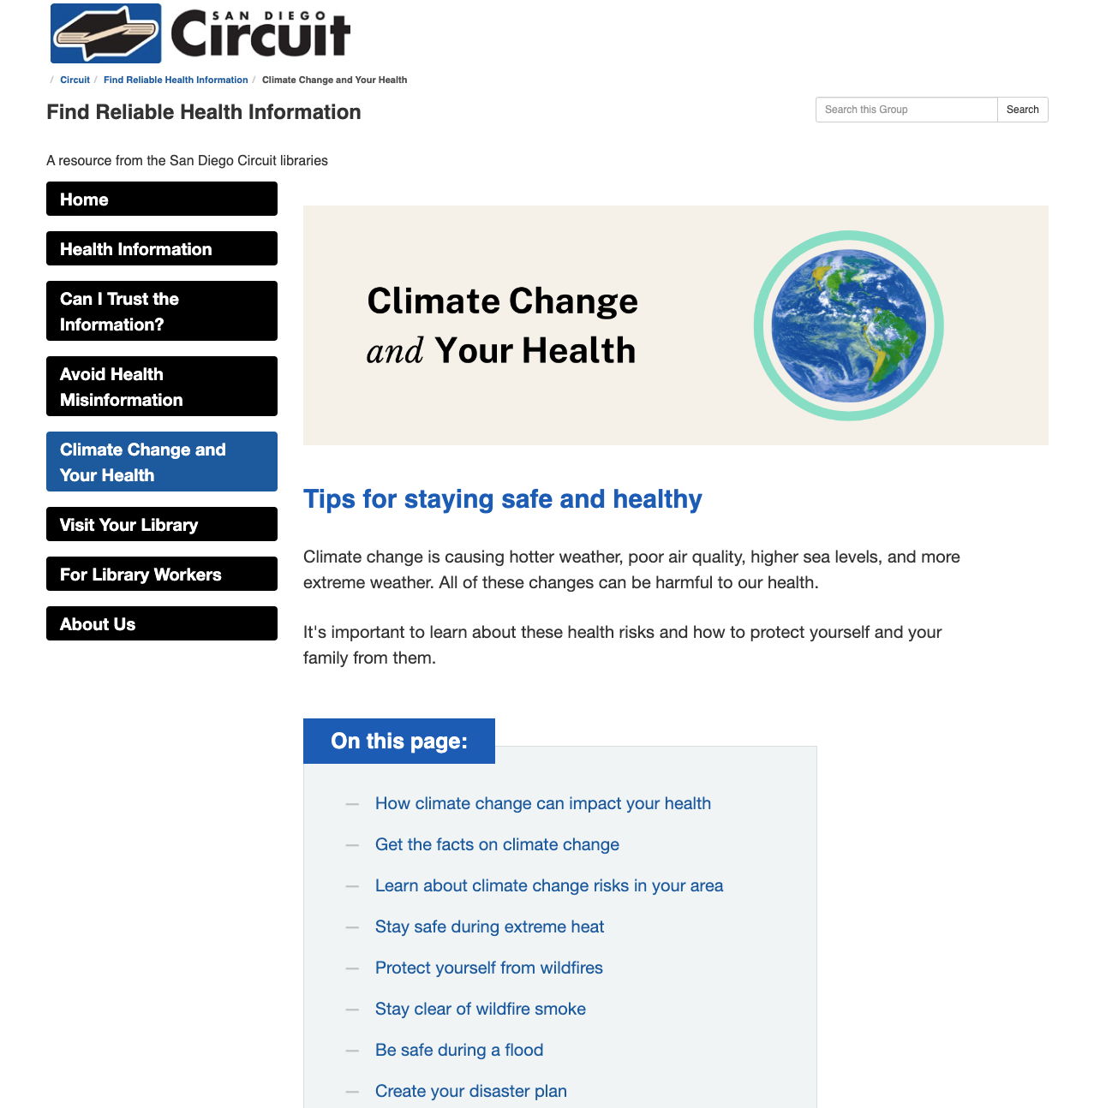
WHAT WE’VE DONE:
GUIDES WITH LOCAL INFORMATION AND RESOURCES
Addressed misinformation
Provided evaluation techniques
Find Reliable Health Information
Sustainability, Climate Change, and Social Justice Resources for San Diego
Toolkit for library workers
Notes:
Local Information and Resource Guides: Our circuit librarians have diligently curated guides containing local information and resources tailored to the specific needs and interests of our community members. These guides serve as invaluable tools for individuals seeking to explore and engage with the esources available in our locality.
Understanding Misinformation: In an age inundated with information, our circuit libraries recognize the critical importance of distinguishing between factual information and misinformation. It's crucial for individuals to develop the skills to identify misinformation and critically evaluate the credibility of sources. Fact sheets identify health misinformation, evaluate credibility, get information you can trust and put a stop to misinformation.
Evaluation Techniques: To empower our patrons with the skills to discern reliable information from misinformation, our circuit libraries offer training and workshops on evaluation techniques. These sessions equip individuals with practical tools and strategies for critically assessing the accuracy, credibility, and bias of information sources, enabling them to make informed decisions and avoid falling prey to misinformation.
Managing Misinformation: In addition to evaluation techniques, our circuit libraries provide guidance on managing misinformation effectively. This includes strategies for fact-checking, cross-referencing multiple sources, and verifying information before sharing it with others. By promoting responsible information consumption and dissemination practices, we help mitigate the spread of misinformation and promote a more informed and resilient community.
Finding Reliable Health Information: Amidst the abundance of health information available online, our circuit libraries serve as trusted gateways to reliable and evidence-based resources. We offer guidance on where to find credible health information, including reputable websites, databases, and healthcare institutions. By facilitating access to reliable health information, we empower individuals to make informed decisions about their health and well-being.
Sustainability, Climate Change, and Social Justice Resources for San Diego: Circuit libraries have compiled a wealth of resources specifically tailored to local, regional, and state resources. These resources encompass US/Global/oPen Access books resources, informational toolkits, energy transition resources, and advocacy platforms focused on promoting sustainability, combating climate change, and advancing social justice causes.
Toolkit for Library Workers: To further support library workers in their role as information stewards, our circuit libraries offer a comprehensive toolkit. This toolkit includes resources, guidelines, and best practices for effectively finding, evaluating, and disseminating health information, empowering library staff to fulfill their vital role in promoting health literacy and community well-being.

Slide 20
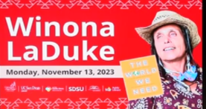
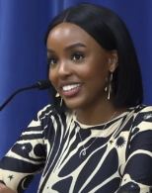
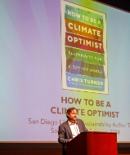
WHAT WE’VE DONE:
PROGRAMMING
Author Talk Series
Winona LaDuke, San Diego Public Library
Live Attendance - 140, Online Attendance - 265
Wawa Gatheru, Spring Valley East Community Center
Live Attendance - 41, Online Attendance - 52
Chris Turner, San Diego State University
Live Attendance - 76, Online Attendance - Just Posted
*Recordings are now live*
Notes:
Grant funded through NNLM the Circuit Libraries hosted 3 author talks focused on advancing climate resilience, sustainability, and environmental justice. Authors were selected based on recommendations from subject matter experts and community partners. Funding for this program was provided by the National Library of Medicine, National Institutes of Health, Department of Health and Human Services, under Cooperative
Winona LaDuke, Wawa Gatheru, and Chris Turner are all speakers whose work intersects with climate resilience and sustainability in various ways:
Winona LaDuke: As an environmentalist, economist, and writer, Winona LaDuke has focused much of her work on issues related to indigenous rights, sustainable development, and environmental justice. She is known for advocating for sustainable practices that respect and honor the earth, including renewable energy solutions, sustainable agriculture, and the protection of natural resources. Her book talks often address the intersection of indigenous wisdom, environmental stewardship, and climate resilience.
Wawa Gatheru: Wawa Gatheru is an environmental activist and scholar whose work emphasizes the importance of environmental justice and equity in addressing climate change. She is known for her advocacy for racial and social justice within the environmental movement. Gatheru's book talks often explore the ways in which marginalized communities are disproportionately affected by climate change and the importance of inclusive and equitable approaches to sustainability and resilience.
Chris Turner: Chris Turner is a Canadian author and journalist whose work focuses on sustainability, renewable energy, and the transition to a more environmentally conscious society. His book talks often delve into innovative solutions to climate change, such as renewable energy technologies, sustainable urban planning, and green economic initiatives. Turner's work highlights the importance of taking action to mitigate climate change while also creating resilient communities that can adapt to environmental challenges.
By engaging with the perspectives and insights of these authors through book talks, audiences can gain a deeper understanding of the complex issues surrounding climate resilience and sustainability, as well as potential pathways toward a more sustainable and equitable future.
Promotion within libraries and community through social media and partners.
Recordings are now live on Youtube for viewing: Author Talk Series
https://www.youtube.com/results?search_query=San+diego+public+library+and+Sd+Circuit

Slide 21
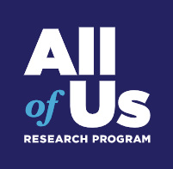
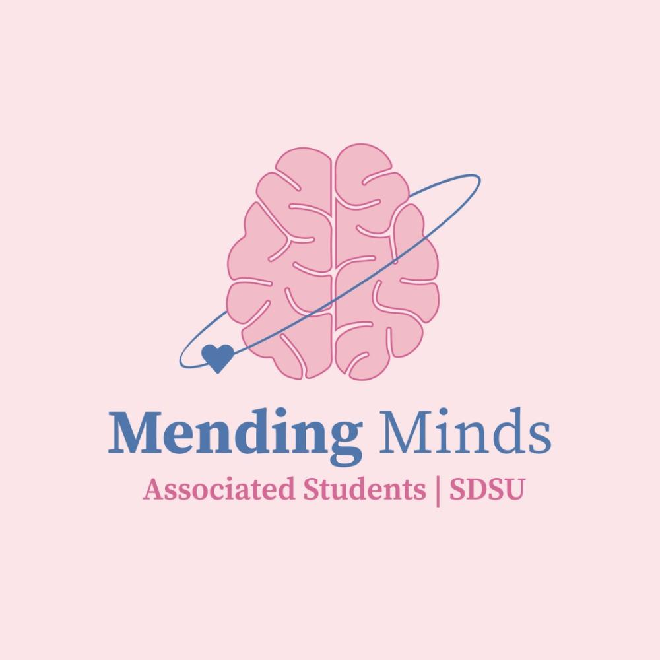
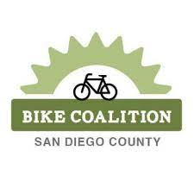
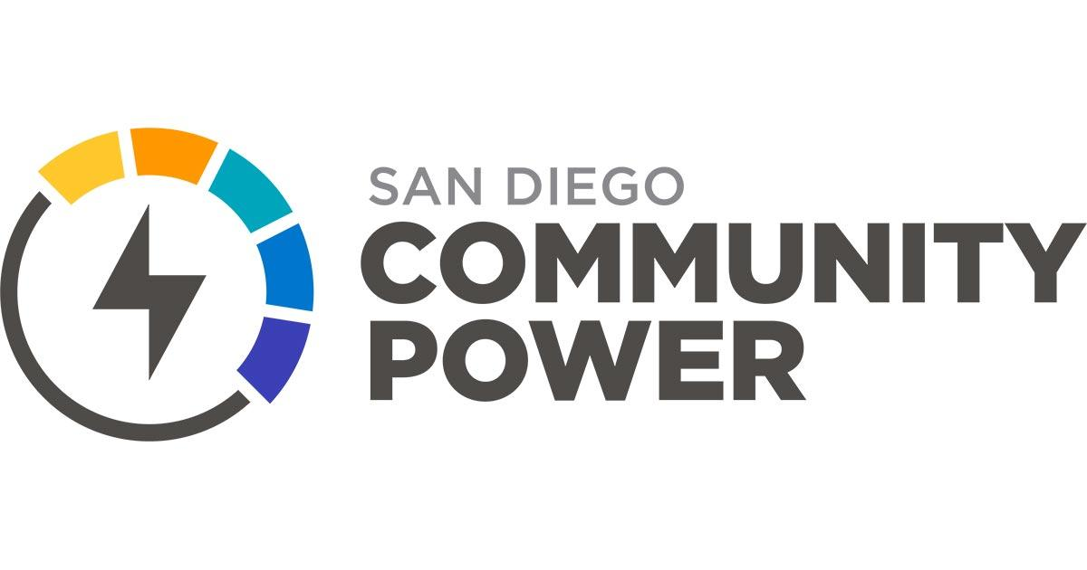
PARTNERS
Sustainability & Health Information Tables
UCSD All of Us
SANDAG
Tree San Diego
Solana Center
SD Bike Coalition
SD Environmental Services
CERT San Diego
Community Power
SDSU AS GreenLove
SDSU Mending Minds
Notes:
For the Author Talk Series, we partnered with All of Us, UCSD to promote enrollment, retention, and engagement by sharing All of Us information at tabling opportunities throughout the year, sharing flyers in each of our library locations, and linking to All of Us on the climate resilience health guide.
In addition to the All of US, additional partners included:

Slide 22
Video from Wawa Gatheru
Notes:
Now you get a inside peek of Wawa Gatheru and Sustainable partners.

Slide 23
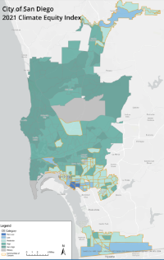
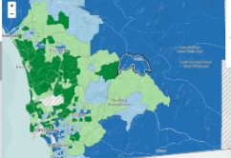
ENGAGEMENT:
EQUITY AND ACCESSIBILITY
Climate Equity Index, CEI
Healthy Places Index
Notes:
The intended audience for the author talks includes residents in communities of concern that scored low on the the San Diego Climate Equity Index and San Diego County Health Places Index, and those most impacted by climate change, including low income residents, those with limited English speaking, immigrants, people of color, rural and urban populations, and the library staff that serve these populations.
In 2019, the City of San Diego developed the first-of-its-kind Climate Equity Index (CEI), in partnership with several community-based organizations representing communities of concern or advocating for environmental justice policy development.
The goal of the Climate Equity Index, CEI is to measure the level of access to opportunity residents have within a census tract and assess the degree of potential impact from climate change to these areas. The CEI is the first tool in the country that considers the effects of climate change, environmental pollution, and vulnerable populations. With the CEI, the City has better identified Communities of Concern to include census tracts with Very Low, Low, and Moderate Access to Opportunity, outlined in the included map
The California Healthy Places Index, developed by the Public Health Alliance of Southern California and visualized by Axis Maps, is a powerful tool to explore the community conditions that impact life expectancy. The HPI was created to disrupt structural inequities by using data to create change. The HPI helps prioritize public and private investments, resources, and programs in neighborhoods where they are needed most.
The author talk locations selected were based on local community strengths and challenges identified from the two indexes: climate equity index and healthy paces index

Slide 24
ENGAGEMENT:
EQUITY AND ACCESSIBILITY
Translation - Spanish
ASL Interpretation
Health Misinformation guides translated into multiple languages
Notes:
Cecilia ends
Each talk included a virtual component and onsite translation.
The author talks and resource guide fill a language gap in climate resilience resources by promoting science-based information in multiple languages.
7 minutes total

Slide 25
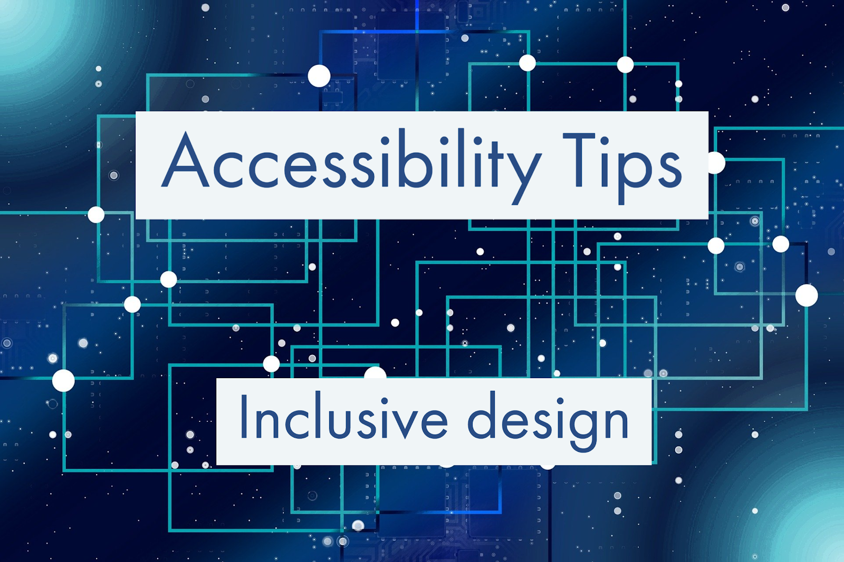
ENGAGEMENT:
WHAT YOU’VE DONE?
How do you ensure equity and accessibility in your institution?
Please share in the chat!
This Photo by Unknown Author is licensed under CC BY-SA-NC

Slide 26
Outcomes and Outputs: Project Outcome Surveys
Notes:
We utilized a free resource from the Public Library Association Project Outcome. Free for public and academic libraries.
-ProjectOutcome.org
-FREE online toolkit designed to share the impact of essential library programs and services for measuring and analyzing outcomes.
-Survey Templates
-You can add up to 3 of your own questions (Home Zip code, How did you hear about this program, etc.)
-Surveys translated into Spanish & French.
-Great infographics generated in PLA Project Outcome
-Free mapping tools (using Census Data)

Slide 27
Outcomes and Outputs: Project Outcome Surveys
Speakers | Survey Responses Collected | Felt more knowledgeable about health topic presented | Felt more confident about taking care of their family’s health | Intend to apply what they learned to adopt or maintain a healthier lifestyle | Were more aware of health-related resources and services provided by library
Winona LaDuke | 81 surveys | 95% | 89% | 94% | 81%
Wawa Gatheru | 7 surveys | 100% | 71% | 100% | 100%
Chris Turner | 7 surveys | 86% | 57% | 86% | 71%
Notes:
Oscar
Project Outcome Survey - 81 Surveys
For these three talks we used researched the zip codes identified in the climate equity and health places indices that Cecilia spoke about.
For our author talks we used Project Outcome for the analyses. Project Outcome is a FREE online toolkit designed to share the impact of essential library programs and services for measuring and analyzing outcomes.
As you can see from the results, from results, the Winona LaDuke talk hosted by the San Diego Public Library Central Branch, we had 81 surveys returned. For Wawa Gatheru hosted by the San Diego County Library in Spring Valley, we had 7 surveys, as well as for the Chris Turner talk, hosted by San Diego State University. There was a large variation in the results of the questions asked in the surveys, as shown in these results.
A possible reason for the Winona LaDuke talk having so many more surveys completed was that swag was offered on return of the surveys, which was not offered at the other two events, and some incentive should be considered for future events.

Slide 28
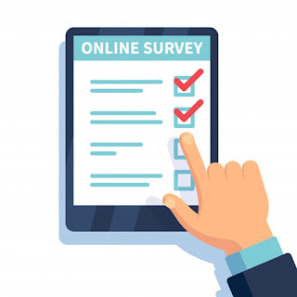
WHAT YOU’VE DONE?
What assessment tools does your institution utilize?
Please share in the chat!

Slide 29
CHALLENGES AND OPPORTUNITIES
Challenges:
San Diego flooding
Low attendance and survey response
Language accommodations
Logistical challenges
Opportunities:
Networking
Sites
Partners
Wide range of audience
Notes:
Opportunities: Networking, sites, partners, wide range of audience
Challenges: San Diego Flooding specifically in the Spring Valley region, low attendance and survey response, Language accommodations, Logistical challenges
Other challenges faced was the extreme flooding in San Diego at the time of the talks, which may have deterred or inhibited people from attending - also highlighting the reasons for this this programming, specifically in the Spring Valley region. The County and University Libraries also do not have a history of this kind of programming, which could account for lower numbers in both attendance and survey response.
Additional challenges included logistics around the language accommodations. We aimed to make these events as inclusive as possible, and organized Spanish language translation as well as ASL interpretation.For the ASL interpretations,the company required needed preemptive information including if the event was going to be recorded. This information dictated whether more than one interpreter was required, and also their dress code. For the second talk the ASL interpreter would not have worn black if she had know that it was going to be be recorded. If it is going to be recordings.
For the Spanish translation - contractors did not specify that headsets or not, and we did not know to request these, so that is something that would need to be included going forward.
Opportunities included networking with partners and different organizations, the talks being hosted at different sites to reach different demographics identified through the indices, strengthening relationships with community partners and a wide range of audience.

Slide 30
TAKEAWAYS & FUTURE PLANS
2024-2025 Health & Climate Resilience
Author Talks
Resource Fairs
Continue updating Resource Guide
Circuit library educational webinars
Promoting All of Us data collection
Notes:
Tools for success
Logic model - project management tool
Libguides
Survey
Indexes

Slide 31
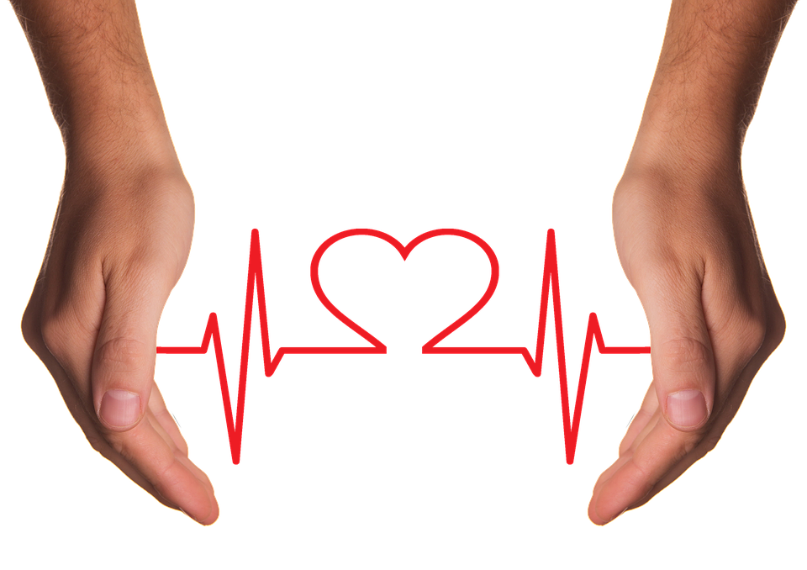
FUTURE PROJECTS
What other types of initiatives could be supported by a cross-library group such as the San Diego Health Information Partnership?
Please share in the chat!
Notes:
What types of cross library collaboration would you like to see in your community?
What projects would you like to see happen in your community?

Slide 32
HOW CAN YOU HELP
Share the Health Information and Sustainability, Climate Change, and Social Justice Resources for San Diego guides
Connect CIRCUIT to community groups and health related organizations
Send program suggestions to:
circuit-hiat-g@gcloud.ucsd.edu

Slide 33
THANK YOU!
OSCAR GITTEMEIER
SAN DIEGO PUBLIC LIBRARY,
OGITTEMEIER@SANDIEGO.GOV
CECILIA SALGADO
SAN DIEGO COUNTY LIBRARY CECILIA.SALGADO@SDCOUNTY.CA.GOV
SARAH TRIBELHORN
SAN DIEGO STATE UNIVERSITY LIBRARY STRIBELHORN@SDSU.EDU
CIRCUIT - INFORMATION ISSUES FOR SOCIAL IMPACT TEAM
CIRCUIT-HIAT-G@GCLOUD.UCSD.EDU
Notes:
If you would like to reach out to us individually you can find our contact info here to email us directly.
We’d like to open it up for your questions and comments.

Slide 34
Additional Activity [if not breakout rooms]
[provide information for attendees about the activity here]
[for an activity that does NOT have breakout rooms]

Slide 35
Thank you for attending
Evaluation link is in the chat. Follow instructions in the evaluation to claim MLA CE and CHES
SDOEH Series Guide
Hashtag is #SDOEH24
Join us for the next session on April 2nd
Notes:
Thank you to Oscar, Sarah and Cecilia. Just a few items before we end the session
If you are interested in claiming MLA CE credit and CHES for this, the link is in the Chat. As you take the evaluation, if you answer "Yes” to wanting the CE, please make sure to pay close attention as a CE code and additional instructions will appear.
Post in Chat: evaluation link with CE info https://www.nnlm.gov/SDEH-mar27
If you haven’t already, consider registering for upcoming sessions of this series. The next one is [date and title]. (if this is the last session, say attendees can view the recordings to all the sessions on our accompanying guide)
Don’t forget our accompanying guide. Each session has its own tab with information about the speaker and links to related information resources. The recordings will also be linked there as well as on our YouTube channel. Links for those are in the Chat.
Post in Chat:
Next session https://www.nnlm.gov/training/class/social-and-economic-determinants-and-environmental-health
Series guide https://www.nnlm.gov/SDOEHguide
Social media hashtag #SDOEH24
NNLM YouTube https://www.youtube.com/@NnlmGov
For social media posts about this series please use the hashtag #SDOEH24.
Thank you for attending and participating and to our guest speaker(s) for a wonderful presentation.

Slide 36
SOCIAL DETERMINANTS OF ENVIRONMENTAL HEALTH WEBINAR SERIES
Citizen Science Empowers Environmental Understanding Through Libraries, Community-Based Organizations, & More
APRIL 2, 2024
#SDOEH24
Notes:
If you want to learn more about how to engage your community library in Environmental health, join us on April 2nd to the webinar Citizen Science Empowers Environmental Understanding Through Libraries, Community-Based Organizations, & More

