Slide 1
Sexual Orientation
Definitions…

Slide 2
Please complete the pre-test questions
Notes:
[NOTE TO FACILITATOR: if you choose not to have participants complete the knowledge assessment questions, delete this slide.]

Slide 3
Discussion points from last module
What do you intend to do to continually engage in the process of cultural humility?

Slide 4
Objectives
By the end of the program, participants will:
Understand the concept of sexual orientation
Recall who makes up sexual orientation minorities

Slide 5
What do you think?
Who has a sexual orientation?
Who makes up the members of the community, “sexual orientation minorities”?
Notes:
Facilitator: Ask the discussion questions: “Who has a sexual orientation?” (The answer is everyone!) and “Who makes up the members of the community “sexual orientation minorities?” (The answer is people who identify as lesbian, gay, bisexual, asexual, pansexual, queer, etc.). Give the audience a short amount of time to answer.

Slide 6
What is Sexual Orientation?
Sexual orientation describes a person’s emotional, romantic or sexual attraction to other people.¹
EVERYONE has a sexual orientation, not just gay and lesbian people!
Notes:
Sexual orientation describes a person’s emotional, romantic, or sexual attraction to other people¹. In addition, everyone has a sexual orientation, not just people who identify as gay or lesbian. Sexual orientation is more complicated than simply being attracted to one gender or another. It’s possible to be sexually attracted to a gender but not romantically attracted to that gender. Sexual orientation is not fixed, either. It’s possible to be more fluid. For example, to come out as a gay man but also have sex with people who don’t identify as men.

Slide 7
Some Examples
Gay: a person who is emotionally, romantically, or sexually attracted to some members of the same gender. Usually used by people who identify as male, although it can be used to describe anybody attracted to the same gender as themselves ¹
Lesbian: a person who identifies as a woman who is emotionally, romantically, or sexually attracted to other people who identify as women¹
Bisexual: a person of any gender who is emotionally, romantically, or sexually attracted to people of more than one sex, gender expression, or gender identity, though not necessarily simultaneously, in the same way, or to the same degree¹
Straight (also known as heterosexual): a person of any gender who is emotionally, romantically, or sexually attracted to people of a different gender¹
Notes:
Here are some examples of sexual orientations. Gay is defined as a person who is emotionally, romantically, or sexually attracted to some members of the same gender. Usually used by people who identify as male, although it can be used to describe anybody attracted to the same gender as themselves¹.
Lesbian is a person who identifies as a woman who is emotionally, romantically, or sexually attracted to other people who identify as women^{1.}
Bisexual refers to a person of any gender who is emotionally, romantically, or sexually attracted to people of more than one sex, gender expression, or gender identity, though not necessarily simultaneously, in the same way, or to the same degree. This is also known as bi.¹
Straight (also known as heterosexual) is a person of any gender who is emotionally, romantically, or sexually attracted to people of a different gender¹. You’ll notice that these definitions state “ a person who identifies as…” in the definitions. If a trans man identifies as a man and is attracted to other people who identify as men, whether those men are cisgender or trans, he is a gay man.

Slide 8
More Examples
Pansexual: Someone of any gender who has the potential for romantic, emotional, or sexual attraction to people of any gender, though not necessarily simultaneously, in the same way, or to the same degree. Acknowledges the existence of more than two genders.¹
Asexual: A person of any gender who lacks sexual attraction or desire for other people¹
Queer: A term some people use to identify themselves with a flexible and inclusive view of gender and/or sexuality. Can also be used as an umbrella term for the entire LGBTQ+ community. Historically, it has been used as a negative term for LGBTQ+ people.
This is NOT a comprehensive list. There are many different terms to describe various sexual orientations.²
Notes:
Here are more examples of sexuality. Pansexual is someone of any gender who has the potential for romantic, emotional, or sexual attraction to people of any gender, though not necessarily simultaneously, in the same way, or to the same degree¹. This acknowledges the existence of more than two genders¹. The difference between bisexual and pansexual is that people who are pansexual are attracted to more than just masculine or feminine people. However, many bisexual people can also be attracted to more than just the two binary genders, but may choose to identify as bisexual for a variety of reasons, including reclaiming the word. For example, a cisgender female identifies as bisexual instead of pansexual even though she has dated people who fall outside the traditional bi gender identities. She identifies as bisexual because she feels that the word bisexual and people who identify as bisexual have received a negative reputation – for being promiscuous, for not being able to choose sides, etc. By claiming bisexuality, she hopes to bring back the more positive aspects of the identity.
Asexual refers to a person of any gender who lacks sexual attraction or desire for other people¹. People who are asexual do not lack the ability to become sexually aroused. People who are asexual may still experience attraction and may or may not act on that attraction. [NOTE to FACILITATOR: if the audience wants more information on this topic, one suggestion is http://www.whatisasexuality.com/intro/]
Queer is a term some people use to identify themselves with a flexible and inclusive view of gender and/or sexuality¹. Can also be used as an umbrella term for the entire LGBTQ+ community¹. Historically, it has been used as a negative term for LGBTQ+ people¹. Some people, especially those of older generations, still find the term offensive while others embrace the term as an identity and a reclaimed and empowered word¹. Please be aware that this is NOT a comprehensive list². There are many different terms to describe various sexual orientations. Some other terms include demisexual, demiromantic, same-gender loving, allosexual, aromantic, androsexual, gynesexual, skoliosexual, etc. You can find the definitions for all these terms at the website that is listed as the second reference in this module.

Slide 9
People of All Genders have a Sexual Orientation
A trans man who is attracted exclusively to other people who identify as male is gay.
A gender non-conforming person attracted to feminine people may identify their sexual orientation as queer.
Notes:
People of all genders have a sexual orientation. A trans man who is attracted exclusively to other people who identify as male is gay. A gender non-conforming person attracted to feminine people may identify their sexual orientation as queer. You’ll notice on the previous two slides that some of the definitions are specific to certain genders and some are not. This slide helps us define exactly what that means for people of various genders. It’s all about how someone identifies, not what their body is.

Slide 10
Sexual Orientation Identity vs. Sexual Behavior
Some people will identify as one sexual orientation but their behavior doesn’t match³
For example, a man who identifies as straight may have sex with other men
WSW – a clinical term for women who have sex with women who may not identify as bisexual or lesbian
MSM – a clinical term for men who have sex with men who may not identify as gay or bisexual
Notes:
Sexual orientation identity could be different from sexual behavior. Some people will identify as one sexual orientation but their behavior doesn’t match³. For example, a man who identifies as straight may have sex with other men. WSW is a clinical term for women who have sex with women who may not identify as bisexual or lesbian and MSM is a clinical term for men who have sex with men who may not identify as gay or bisexual. This is why it’s important that we ask about sexual behavior and not just assume someone’s sexual behavior based on their identity.

Slide 11
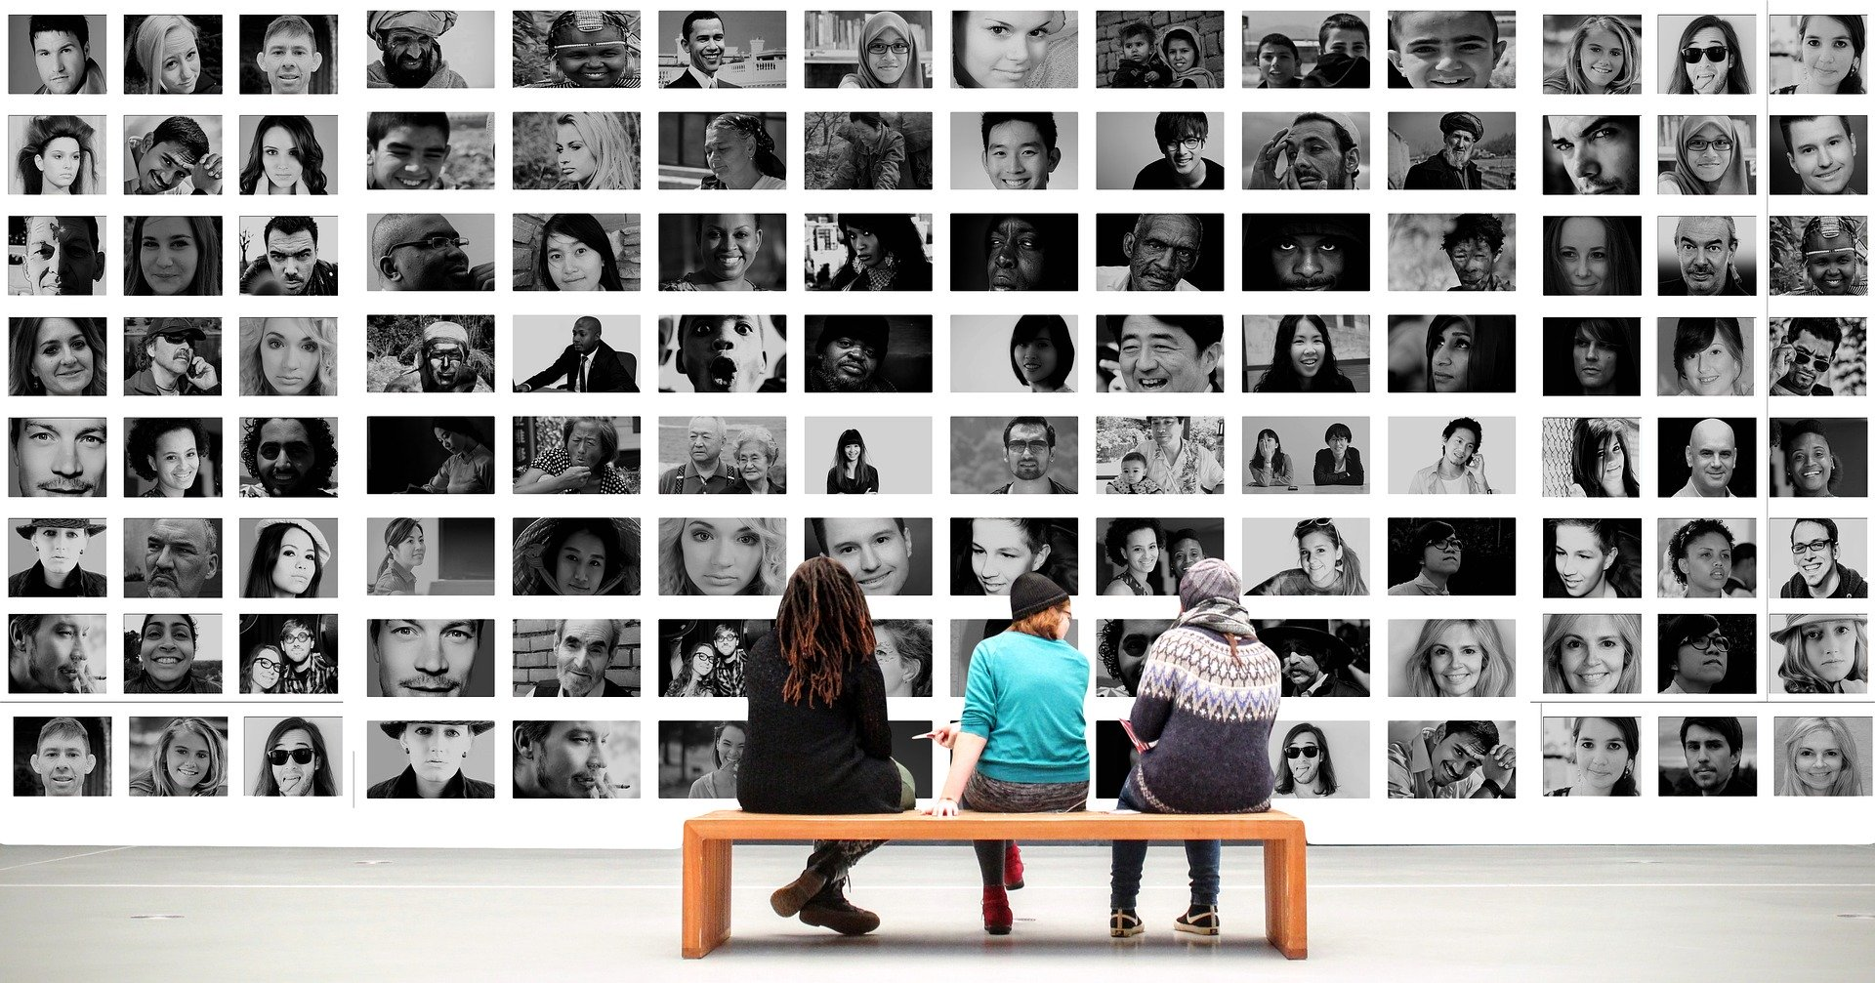
Sexual Orientation & Gender
Treating “everyone the same” erases the different needs of members of the LGBTQ+ community
Sexual orientation & gender identity and expression are interrelated concepts but are not the same or a cause-and-effect relationship
Notes:
Now that we understand sexual orientation, it is important to consider the focus of our next topic, which is gender identity and expression. Sexual orientation and gender identity and expression are interrelated concepts but are not the same or a cause-and-effect relationship. Often we think of masculine women as lesbians or feminine men as gay but this is not always the case and is not fair to assume someone’s sexual orientation based on gender expression. If we treat “everyone the same,” it actually defaults to the norm, which is cisgender and heterosexual and can cause us to miss important information.

Slide 12
Take home message
Consider:
What role does gender play in sexual orientation identity?
Remember:
Treating “everyone the same” erases the different needs of members of the LGBTQ+ community
Sexual orientation & gender identity and expression are interrelated concepts but are not the same or a cause-and-effect relationship
Developed resources reported in this presentation are supported by the National Library of Medicine (NLM), National Institutes of Health (NIH) under cooperative agreement number UG4LM012342 with the University of Pittsburgh, Health Sciences Library System. The content is solely the responsibility of the authors and does not necessarily represent the official views of the National Institutes of Health.

Slide 13
References
Human Rights Campaign. “LGBTQ Definition for Adults: Welcoming Schools.” Human Rights Campaign, URL to Source
Brawbaw, Kasandra. “Allosexual, Demisexual, Bicurious - & Other Sexualities You Need to Know.” Refinery 29, 18 June 2019, URL to Source
Brown, Eliza and Paula England. “Sexual orientation versus Behavior – Different for Men and Women?” Contexts.org, 29 February 2016, URL to Source

