Slide 1
SDOH & Health Disparities
Social Determinants of Health

Slide 2
Discussion points from last module
How could attending to SDOH change how you care for your patients?
What challenges might hinder your ability to attend to SDOH issues?
Notes:
Discussion question: In what ways have you noticed social determinant of health factors influencing the health of the patients you care for?

Slide 3
Objectives
By the end of this track, participants will be able to:
Describe the connection between health disparities and the social determinants of health

Slide 4
Health Disparities
“…differences that exist among specific population groups in the United States in the attainment of full health potential that can be measured by differences in incidence, prevalence, mortality, burden of disease, and other adverse health conditions”²
Notes:
We talked about health disparities as they relate to cultural humility and the care of LGBTQ+ patients. They also relate to the social determinants of health. You can see health disparities defined here as, “…differences that exist among specific population groups in the United States in the attainment of full health potential that can be measured by differences in incidence, prevalence, mortality, burden of disease, and other adverse health conditions”².
[NOTE TO FACILITATOR: If you are completing these modules in an order other than suggested in the facilitation guide, you may need to adjust this note.]

Slide 5
Examples of Health Disparities
People with lower socioeconomic status (SES) have disproportionately higher cancer death rates than those with higher SES, regardless of demographic factors such as race/ethnicity.³
In Rural America, incidences of heart disease is 56 percent higher than in metropolitan areas. Chronic lower respiratory disease, 75 percent higher.⁴
Discrimination against LGBT+ persons has been associated with high rates of psychiatric disorders, substance abuse, and suicide.⁵
In 2017 in the United States, infants of non-Hispanic black women had the highest mortality rate, followed by infants of non-Hispanic AIAN, non-Hispanic NHOPI, Hispanic, non-Hispanic white, and non-Hispanic Asian women.⁶
AIAN – American Indian/Alaskan Native.
NHOPI – Native Hawaiian/Other Pacific Islander
Notes:
Here, there are four examples of health disparities:
People with lower socioeconomic status (SES) have disproportionately higher cancer death rates than those with higher SES, regardless of demographic factors such as race/ethnicity.^{3​}
In Rural America, incidences of heart disease is 56 percent higher than in metropolitan areas. Chronic lower respiratory disease, 75 percent higher.⁴
Discrimination against LGBT+ persons has been associated with high rates of psychiatric disorders, substance abuse, and suicide.⁵
In 2017 in the United States, infants of non-Hispanic black women had the highest mortality rate (11.7 infant deaths per 1,000 births), followed by infants of non-Hispanic AIAN (9.4), non-Hispanic NHOPI (7.4), Hispanic (5.0), non-Hispanic white (4.9), and non-Hispanic Asian (3.6) women.⁶

Slide 6
What do you think?
In each of these four examples, what is the health disparity?
Notes:
Facilitator: Ask, “In each of these four examples, what is the health disparity?” It may be helpful to flip back to the previous slide while people answer.

Slide 7
Health Disparity Examples
 | Cancer Death Rate (1) | Heart & Respiratory Disease (2) | Mental Health (3) | Infant Mortality (4)
Health Disparity: | Higher rates of death from cancer | Higher rates of heart and chronic lower respiratory disease | Higher rates of psychiatric disorder, substance use, and suicide | Higher rates of infant mortality within first year of life
Experienced by: | Those Living in Poverty | Rural Americans | LBTQ+ | African American Mothers
Because of [SDOH]:
Notes:
Here are those same four examples divided by the disparity, which is the higher rates of disease or mortality. The population that experiences the disparity is the next level in each column. We’re going to talk about what we think fits in the because of [SDOH] section. Please note that, “Because of…” refers to research that has correlated specific population groups experiencing disparities in connection with specific SDOH factors. Causation has been difficult to pin down via the research. Correlation is important, but not the same as causation, which is good to remember as we discuss this.
With this in mind, what SDOH factors do you suppose influence the health outcome disparities experienced by the different demographic groups in each column? [Note to Facilitator: allow people to offer their thoughts for as long as you believe time will allow]

Slide 8
Health Disparity Examples + SDOH
 | Cancer Death Rate (1) | Heart & Respiratory Disease (2) | Mental Health (3) | Infant Mortality (4)
Health Disparity: | Higher rates of death from cancer | Higher rates of heart and chronic lower respiratory disease | Higher rates of psychiatric disorder, substance use, and suicide | Higher rates of infant mortality within first year of life
Experienced by: | Those Living in Poverty | Rural Americans | LBTQ+ | African American Mothers
Because of [SDOH]: | SES; Education³ | Geographic location; Access to Health Care² | Discrimination; Isolation⁵ | Discrimination; Education; Geographic location; Access; Generational influence⁸
Notes:
Here are some suggestions for the SDOH blanks based on the following research:
SES appears to play a major role in influencing the prevalence of behavioral risk factors for cancer (for example, tobacco smoking, physical inactivity, obesity, excessive alcohol intake, and health status), as well as in following cancer screening recommendations.³
Consider this idea for examples 1 and 2: The National Institute of Health noted that individuals from medically underserved populations are more likely to be diagnosed with late-stage diseases that might have been treated more effectively or cured if diagnosed earlier.²
Research suggests that LGBT individuals face health disparities linked to societal stigma, discrimination, and denial of their civil and human rights... [and] experiences of violence and victimization are frequent for LGBT individuals.⁵
The infant mortality rate—the ratio of infant deaths to live births—is an important indicator of the overall health of a population. Non-Hispanic Black mothers are 2.3 times more likely than Non-Hispanic White counterparts to have received late or no prenatal care.⁸
This doesn’t mean that any other suggestions you made are not contributors- the social determinants of health care complex.

Slide 9
A Note on Health Disparity & Health Inequity
Disparity
“…differences in the presence of disease, health outcomes, or access to health care between population groups”⁷
Inequity
“…unfair, systematic and socially produced injustices that are rooted in social arrangements that disadvantage some groups in the population more than others”¹⁰
Notes:
In conversations like these, the terms ‘health disparity’ and ‘health equity’ are often used, and it can be challenging to distinguish the difference. As a point of consideration, let’s think about two scenarios:
Male babies are generally born at a heavier birth weight than female babies.⁷
Babies born to Non-Hispanic Black women are more likely to die in their first year of life than babies born to Non-Hispanic White women.⁷
Scenario 1 is an example of a health disparity. This difference between males and females in terms of birthweight is rooted in genetics.⁷
Scenario 2 is an example of a health inequity. A higher percent of Black women experience poverty when compared with white women, so some of the difference in scenario two could be attributed to this. However, differences still exist when we compare Black and white women with the same income⁷. Research suggests that this could be due to the stress that Black women experience because of racism. This is a health inequity because the difference between the two populations is “unfair, avoidable, and rooted in social justice”⁷.

Slide 10
Parting Thought
“Over the years, efforts to eliminate disparities and achieve health equity have focused primarily on diseases or illnesses and on health care services. However, the absence of disease does not automatically equate to good health.” ¹¹
Notes:
A parting thought to wrap up our conversation about disparities and social determinants of health is this one, “Over the years, efforts to eliminate disparities and achieve health equity have focused primarily on diseases or illnesses and on health care services. However, the absence of disease does not automatically equate to good health.”¹¹ This is a good summary of today’s conversation because while health care services and treating disease is clearly very important, health is intertwined with many other factors that play a role in our patient’s lives.

Slide 11
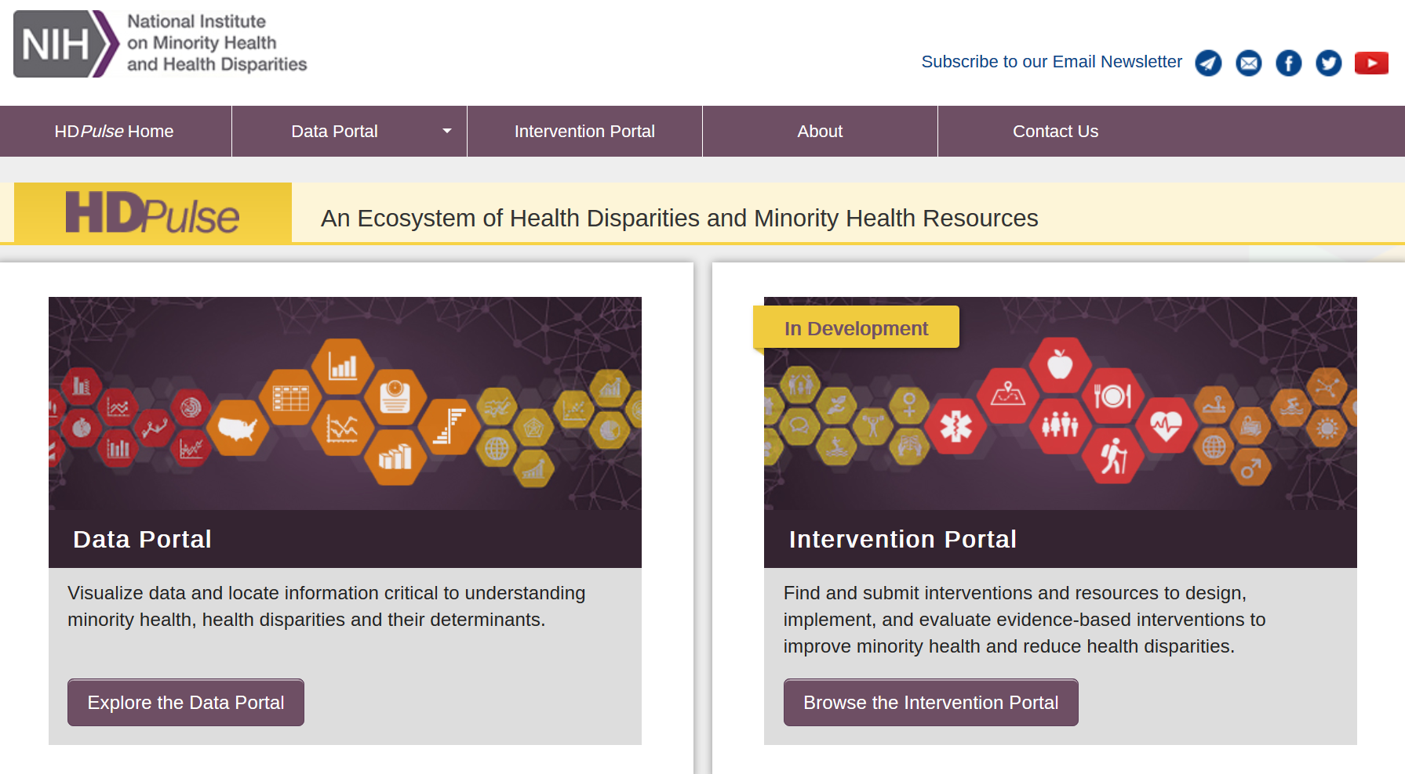
More Information
Notes:
A resource on this topic that you can consider exploring on your own is the HDPulse Data Portal from the National Institute on Minority Health and Health Disparities. This is a resource for finding information about minority health and health disparities.

Slide 12
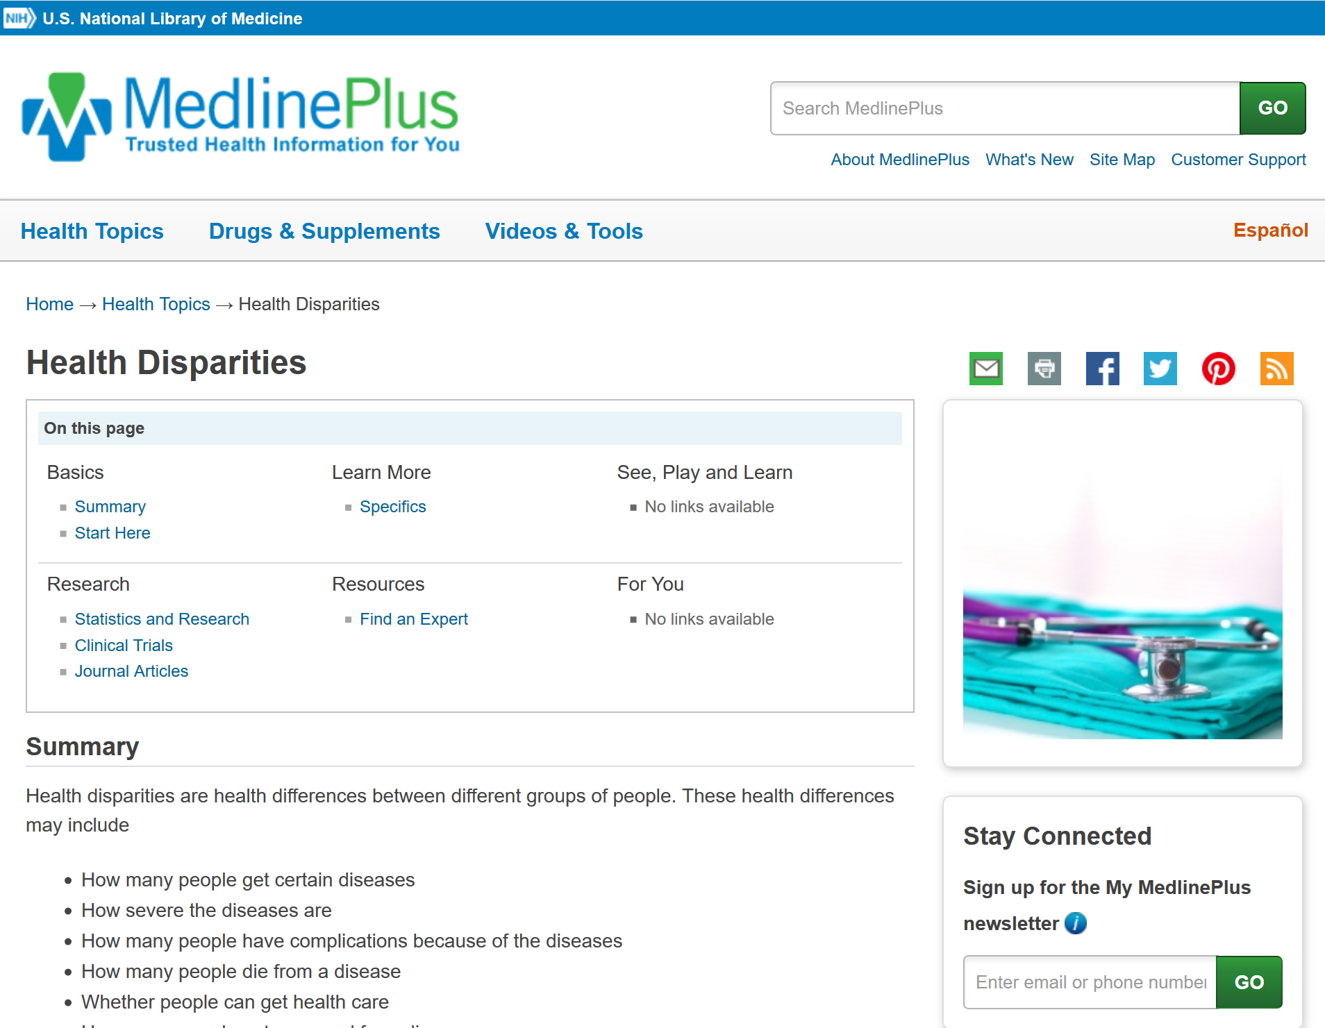
More Information (2)
Notes:
MedlinePlus also has a topic page on Health Disparities that will link you statistics, clinical trials and journal articles on this topic. I will send you links to these resources after our session today. [NOTE TO FACILITATOR: only say this if you plan to send e-mail follow up #2]

Slide 13
Take home message
Consider:
How can an increased awareness of the connection among SDOH-Health Disparities-Health Outcomes influence your interactions with patients?
Remember:
Health is intimately tied to where we live, learn, work, and play
Developed resources reported in this presentation are supported by the National Library of Medicine (NLM), National Institutes of Health (NIH) under cooperative agreement number UG4LM012342 with the University of Pittsburgh, Health Sciences Library System. The content is solely the responsibility of the authors and does not necessarily represent the official views of the National Institutes of Health.
Notes:
‘Consider’ Examples:
Consider the connections between SES and education. Does the person have the reading literacy to understand cancer screening recommendation from written material?
Appropriately inquiring about and being supportive of a patient's sexual orientation and gender identity can enhance the patient-provider interaction and regular use of care

Slide 14
References
The Root Causes of Health Inequity." National Academies of Sciences, Engineering, and Medicine. 2017. Communities in Action: Pathways to Health Equity. Washington, DC: The National Academies Press. doi: 10.17226/24624.U.S. Department of Health and Human Services, Healthy People 2020 Draft. 2009, U.S. Government Printing Office.
National Academies of Sciences, Engineering, and Medicine; Health and Medicine Division; Board on Population Health and Public Health Practice; Committee on Community-Based Solutions to Promote Health Equity in the United States (2017). Baciu A., Negussie Y., Geller A., et al. (eds). Washington DC: National Academies Press.
National Cancer Institute. 2019. Examples of Cancer Health Disparities. Available at: URL to Source
Singh, GK et al. Widening Rural–Urban Disparities in Life Expectancy, U.S., 1969–2009. American Journal of Preventive Medicine, 2014;(46)2:19-29. doi: URL to Source
Healthypeople.gov. 2019. Lesbian, Gay, Bisexual, and Transgender Health | Healthy People 2020. [online] Available at: URL to Source
Centers for Disease Control and Prevention. 2019. Infant Mortality | Maternal and Infant Health | Reproductive Health | CDC. [online] Available at: URL to Source
Boston Public Health Commission. 2019. Health Disparities vs. Health Inequities. Available at: URL to Source
Child Trends Databank. 2015. Key facts about late or no prenatal care. Available at: URL to Source
National Academies of Sciences, Engineering, and Medicine. 2017. “The State of Health Disparities in the United States.” Communities in Action: Pathways to Health Equity. Washington, DC: The National Academies Press. doi: 10.17226/24624. Available online at: URL to Source
Pauly BM, Shahram SZ, Dang PTH, Marcellus L, MacDonald M. Health Equity Talk: Understandings of Health Equity among Health Leaders. AIMS Public Health. 2017;4(5):490–512. Published 2017 Nov 15. doi:10.3934/publichealth.2017.5.490
U.S. Department of Health and Human Services (2019). Disparities. Retrieved from: URL to Source

