Slide 1
Shared Decision Making
The basics

Slide 2
Discussion points from last module
How do you think shared decision making could have been applied to the case examples described in the last module?
Notes:
[NOTE TO FACILITATOR: If you are completing these modules in an order other than suggested in the facilitation guide, you may need to adjust these discussion points.]

Slide 3
Objectives
By the end of the program participants will:
Define the responsibilities of the physician as they relate to SDM
Discuss the need for SDM to be used in conjunction with clear communication and cultural humility
Notes:
The focus of today’s session is to define the responsibilities of the provider when it comes to shared decision making as to discuss the need for using it alongside the other skills we reviewed in previous modules such as clear communication and cultural humility.
[NOTE TO FACILITATOR: If you are completing these sections in an order other than suggested in the facilitation guide, you may need to adjust this note.]

Slide 4
Responsibility of the Patient
A patient must be willing to share their concerns, goals and questions¹
Some may not want or be ready to participate²
Notes:
There are also some responsibilities of the patient, such as being willing to share concerns and goals and ask questions¹. The Agency for Healthcare Research and Quality’s Shared Decision Making curriculum, which we will be referring to throughout these modules, suggests that patients should be invited to participate using a conversation starter such as, “There is good information about how these treatments differ that I'd like to discuss with you before we decide on an approach that is best for you.”² However, this curriculum does note that some patients may not want, or be ready, to participate². They suggest that while it is important to attempt to engage them in decisions, that the choice not to participate should be respected². While the suggestion is to respect someone’s decision not to participate, it is worth noting that evidence shows that many patients want more information about their conditions and prefer a more active role in discussions about their health^{2,3}.

Slide 5
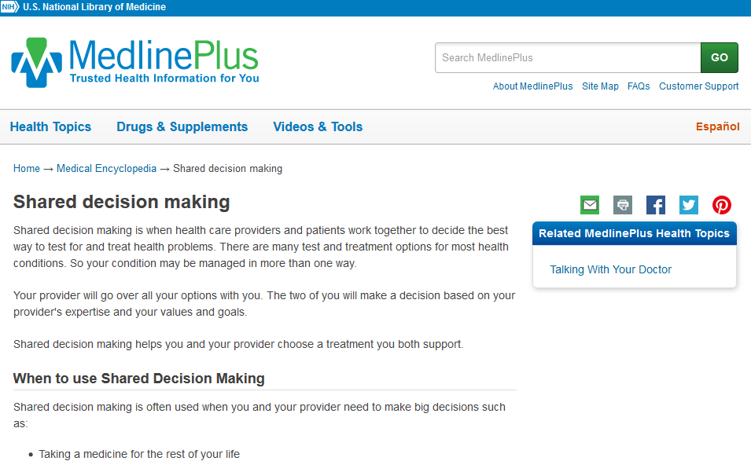
MedlinePlus – Shared decision making
Notes:
Patients could be initially confused by their patient presenting choices⁴. We will discuss communication strategies in the future to help with this, but another good thing to know is that MedlinePlus has an easy to understand page about shared decision making that can also help a patient understand the process.

Slide 6
Responsibility of the Provider
Agree with the guiding principles of shared decision making⁴
Build a good relationship so that patients feel supported to deliberate⁴
Recognize patients’ ability to participate in decision making¹
Ability to elicit patients’ preferences and communicate information about health meaningfully⁵
Notes:
There are, of course, also responsibilities of a provider engaging in shared decision making. These include accepting the idea of shared decision making as a whole and building a relationship with a patient where they feel supported enough to think over their options⁴. It is also suggested that providers recognize a patients’ ability to participate in decision making¹ and be able to elicit a patients’ preferences and communicate in a meaningful way⁵. This connects with several of the other concepts discussed in Clinical Conversations…

Slide 7
SDM and Health Literacy
Low health literacy and struggles with numeracy are barriers to shared decision making⁴
For this reason, it is suggested that shared decision making be built on good clinical communication skills⁴
Notes:
In an earlier set of modules, we discussed health literacy and its impact on health and healthcare. It is important to note that shared decision making can be impeded by low health literacy and low numeracy, and, for this reason, it is important that shared decision making is built on other clinical communication skills⁴. It can be difficult for a patient to truly understand their treatment options unless they are communicated clearly.
[NOTE TO FACILITATOR: If you are completing these sections in an order other than suggested in the facilitation guide, you may need to adjust this note.]

Slide 8
SDM and Communication Recommendations
AHRQ’s SHARE curriculum highlights the importance of the following communication strategies within the context of SDM:
Universal precaution
Avoiding medical jargon
Providing information in small segments
Using teach-back
Communicating numbers clearly
Summarizing options
Open-ended questions
Showing empathy regarding the condition²
Notes:
These are all strategies that are suggested in the Agency for Healthcare Research and Quality’s curriculum on shared decision making². These were all discussed in some way throughout the previous Clinical Conversations modules. Within the health literacy track, we talked about universal precaution as it relates to health literacy as well as clear communication, teach-back and the communication of numbers. Other communication suggestions align with the principles discussed during the track about motivational interviewing.
NOTE TO FACILITAOTR: If time allows, this would be a good time to ask participants to state what they remember about these concepts from the Health Literacy track and how they think these communication points are useful for shared decision making.
[NOTE TO FACILITATOR: If you are completing these sections in an order other than suggested in the facilitation guide, you may need to adjust this note.]

Slide 9
SDM and Culture
It is important to consider how a patient’s culture could influence shared decision making^{4,6}
Culture may affect a patient’s values or priorities⁶
The SDM process can be affected when a provider makes assumptions about what they think a patient knows, understands or prioritizes⁶
Cultural humility is especially important in the context of shared decision making⁶
Notes:
We also previously discussed the importance of cultural humility. It’s important to note that cultural humility it just as important in the context of shared decision making. A patient’s culture can affect their values, opinions, or priorities⁶. This is an important part of a SDM discussion, and a provider should not make assumptions about what they think a patient knows, understands, or prioritizes⁶. This is why cultural humility is especially important in shared decision making - recognizing individual beliefs and values and how they are influenced by culture will ensure providers support well-informed decisions through the process⁶.
[NOTE TO FACILITATOR: If you are completing these sections in an order other than suggested in the facilitation guide, you may need to adjust this note.]

Slide 10
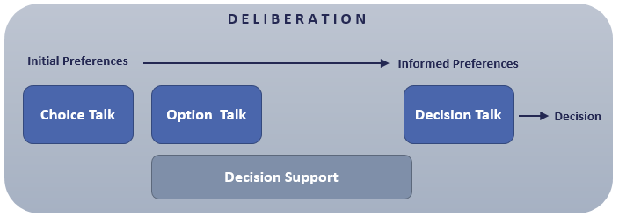
Elwyn, et al. (2012) SDM Framework
Fig 1. Elywn,G., Frosch, D., Thomson, R., Joseph-Williams, N., Lloyd, A., Kinnersley, P.,… Barry, M. (2012). Shared Decision Making: A Model for Clinical Practice, Journal of General Internal Medicine, 27(10), 1361-1367.
Notes:
So, what does shared decision making “look” like when you get into it? This is an image from a 2012 article by Elwyn, et al. that focused on breaking the research behind shared decision making down into steps that could be taken in clinical settings⁴. Here, you can see an image that represents their model. Deliberation is what they call the process of a patient being made aware of the need for a choice, their options, and being given time to consider what route they’d like to take⁴. Choice talk is the first step, which is when someone learns that there is a choice to make⁴. This is followed by option talk, which is when patients learn more details about the treatment options that are available to them⁴. Decision talk is third, which is when patients explore their personal values after being informed about their options⁴. You can see that this model spaces the decision talk farther away from the earlier steps⁴. This is because patients likely need time to deliberate and consider options⁴. This is also when decision support can be used, which you see on the bottom of the diagram⁴. This is also a time when a patient may want to discuss the options with others⁴. It’s important to note that while this model provides a simple way to understand SDM, that it is still a process with psychological, social and emotional factors that influence this process, meaning that these need to be managed with dialogue between the clinician and patient⁴.

Slide 11
Take home message
Consider:
What do you think the most important communication strategies are when it comes to shared decision making?
Developed resources reported in this presentation are supported by the National Library of Medicine (NLM), National Institutes of Health (NIH) under cooperative agreement number UG4LM012342 with the University of Pittsburgh, Health Sciences Library System. The content is solely the responsibility of the authors and does not necessarily represent the official views of the National Institutes of Health.
Notes:
As we finish up this discussion today, I ask you to consider what you think the most important communication strategies are when it comes to shared decision making.
[NOTE TO FACILITATOR: If you want to complete group discussion immediately following this module content, change the title of this slide to ‘Group Discussion’ and delete the slide with corresponding questions in the next module. If you would like to have discussion take place using your internal LMS system, you can include instructions here for how participants can participate. Then, adjust the slide with the corresponding questions in the next module as needed.]

Slide 12
References
Agency for Healthcare Research and Quality (2019). The CAHPS Ambulatory Care Improvement Guide: Practical Strategies for Improving Patient Experience. URL to Source
Agency for Healthcare Research and Quality (2018). The SHARE Approach. URL to Source
Legare, F. & Thompson-Leduc, P. (2014). Twelve Myths About Shared Decision Making. Patient Education and Counseling, 96, 281-286.
Elywn,G., Frosch, D., Thomson, R., Joseph-Williams, N., Lloyd, A., Kinnersley, P.,… Barry, M. (2012). Shared Decision Making: A Model for Clinical Practice, Journal of General Internal Medicine, 27(10), 1361-1367.
Therialult, G., Bell, N., Grad, R., Singh, H. & Szafran, O. (2019). Teaching Shared Decision Making. Canadian Family Physician, 65, 514-516.
Derrington, S., Paquette, E., Johnson, K. (2018). Cross-cultural Interactions and Shared Decision-making. Pediatrics, 143(s3), s187-s192.

