Slide 1
Race & Ethnicity Pathway
22 January 2021
Notes:
Lisa

Slide 2
Introductions
Lisa Zook
Director of Research & Impact
Billi Shaner
Sr. Monitoring, Evaluation, and
Learning Advisor
Becky Romasco-Kelly
Monitoring & Evaluation Specialist
Notes:
Lisa

Slide 3
Time for a Poll
Notes:
Want to know more about you

Slide 4
agenda
Project overview
Review the pathways project goals and objectives
Orientation to 5 Steps to Evaluation
What is it?
What does it tell me?
Most importantly, how do I use these steps?
Orientation to the Race & Ethnicity pathway
Walk through the pathway and resources on the NEO website
Demonstration/Apply
Demo Race & Ethnicity pathway
Question & Answer
Notes:
agenda

Slide 5
Objectives
Walk away with an understanding of the pathways project
Understand how to use the Race & Ethnicity Pathway
Learn evaluation considerations for programs sensitive to race and ethnicity
Notes:
objectives

Slide 6
Evaluation pathways Project overview

Slide 7
Pathways Project overview
Goal: "Enable grant recipients to pursue a particular interest and to develop evaluation plans and evaluation skills specifically tailored to their project"
Create 4 pathways walking through the evaluation process
K-12
Rural Health
Race & Ethnicity
LGBTQIA+
Notes:
The Evaluation Pathways project was initiated to ‘enable grant recipients to pursue a particular interest and to develop evaluation plans and evaluation skills specifically tailored to their project’. 4 populations were identified, each of which had a pathway developed for it.
You may be wondering: why topic specific pathways? When developing the pathways we had the goal of highlighting resources, methods, and approaches that enable one to effectively and sensitively carry out evaluations of common programs funded by NNLM-grants. So, based on this, NNLM selected pathways for K-12 health, rural health, and programs sensitive to race & ethnicity, and LGBTQIA+ populations.
Each pathway covers evaluation that is responsive to the needs of programs in that topic area.

Slide 8
Project Overview: Steps
Step 1
Document Review & Planning
Step 2
Pathway Design
Step 3
Website Integration
Step 4
Step 5
Training & Marketing
5 In-Depth Webinars
December 18
January 8, 15, 22, 29
Finalization & Handover
March 2021
Reviewed by: EWG members, CHAT, HSL members at UW, reviewers at PSR region, and other volunteers.
Notes:
We carried out a document review and planning process, developed the pathways, and are in the process of integrating with the website. At this point, many parties have reviewed the pathways including: EWG members, CHAT, HSL members at UW, reviewers at PSR region, and other volunteers.
We are currently in the training and marketing phase which is meant to socialize the pathways – to ensure that everyone is oriented to the pathways and knows that they are available.

Slide 9
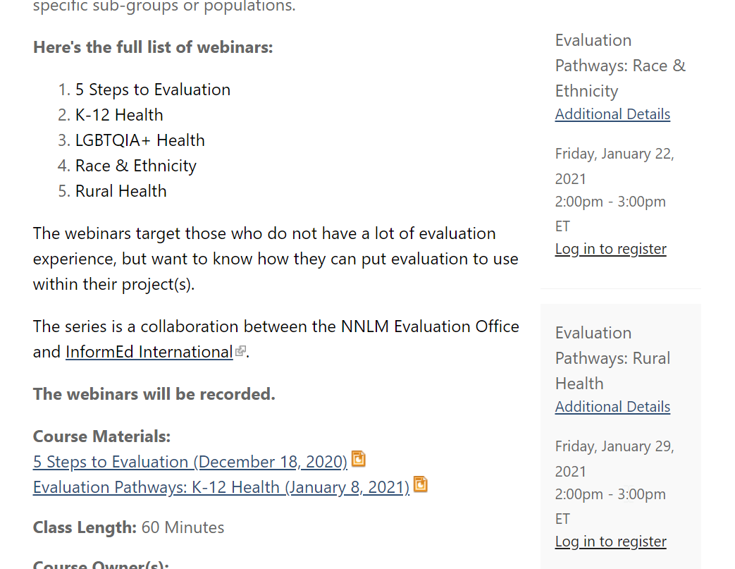
Webinars
https://nnlm.gov/classes/evaluation-pathways-webinar-series
Notes:
Previous webinars can be found under the classes section of the NNLM website- the URL address listed here

Slide 10
Evaluation Background

Slide 11
What is Evaluation?
Evaluation uses a systematic process to judge quality, combining evidence and values. Good evaluation helps people make better decisions for better outcomes. Different types of evaluation can be done throughout a program or policy cycle, before implementation, during implementation, or after implementation.
-Better Evaluation
Notes:
What is evaluation? Can mean different things to different people, but it is essentially a “systematic process to judge quality, combining evidence and values”

Slide 12
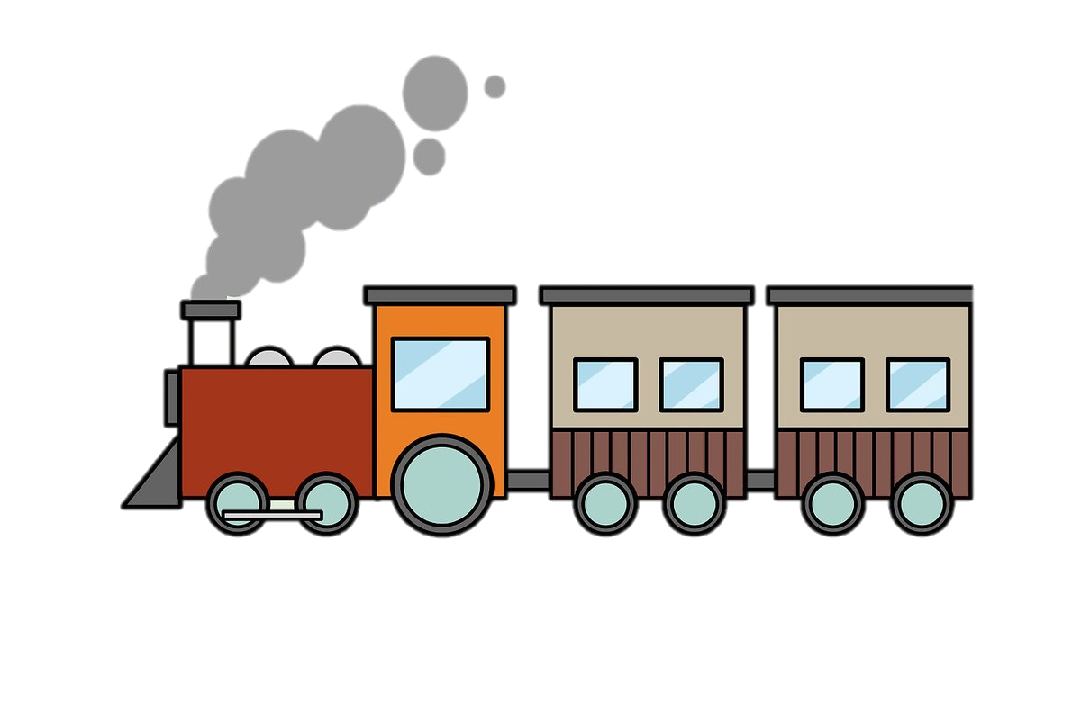
Evaluation Station
Evaluation
Information & Data
Results
Surveys
Interviews
Program documents
Budget/Expense reports
Monitoring data
Previously collected data
Reports
Graphs
Briefs
Presentations
Decisions
Notes:
I like to think of evaluation like a train station. Take in information and data, the evaluation is organized and processes are completed at the station, and out come the evaluation results

Slide 13
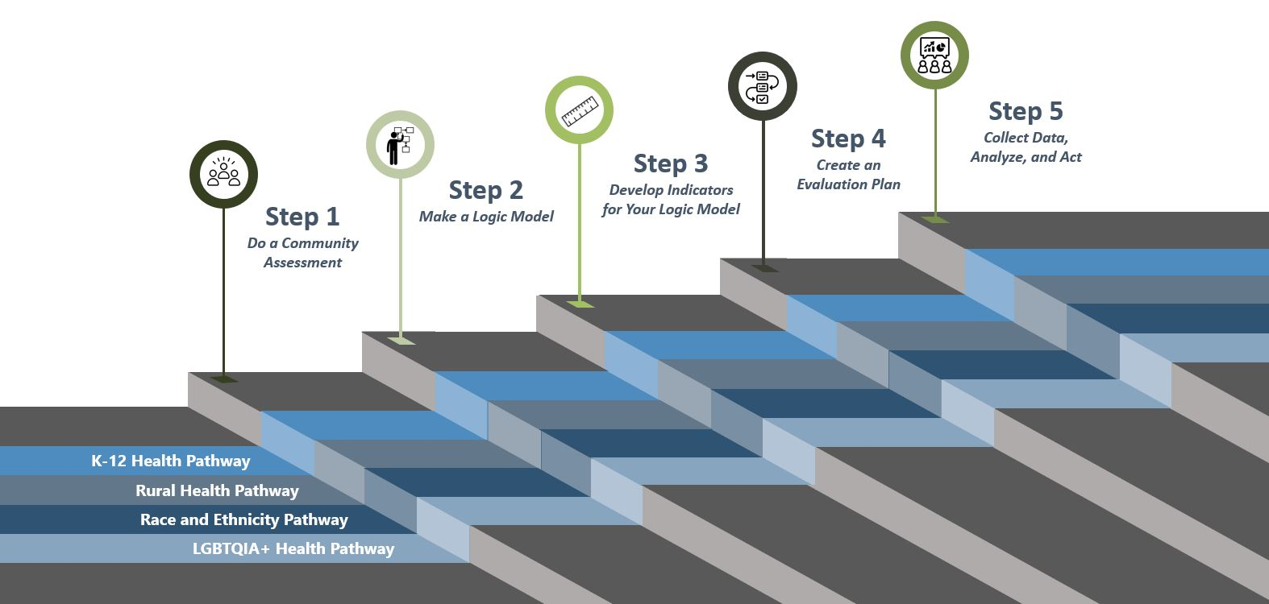
What happens at the station?
https://nnlm.gov/neo/guides/pathways
Notes:
What happens at the station? There are different ways of approaching evaluation, but in this case, we developed 5 steps- things that happen in the station.
In our review of existing resources, we found NNLM’s 4 steps to evaluation. We wanted to build the pathways along these 4 steps to ensure that we are building upon the strong evaluation foundation that has already been built by NNLM and NEO. However, the 4 steps presented on the NEO website ended with an evaluation plan. After discussing with Serene, we added a 5th step: Collect data, analyze, and act. Then you’ll see the pathways along the steps. Each pathway, which focuses on the unique evaluation needs/considerations for a population, follows the 5 steps.

Slide 14
Build your station
Everyone builds their “Station” differently
What we cover here are some of the many techniques one can use to evaluate a program.
Evaluation techniques used can depend on:
Length of program
Number of program participants
Funding
Resources available
Generalizable results
Creating a toolkit of recommended evaluation practices for small grants
Evaluation

Slide 15
Why should we evaluate?
Are you writing a proposal or working on a project? Incorporating an evaluation into project design and implementation is essential for understanding how well the project achieves its goals.
Why evaluate?
Data gathered through evaluation ensures that we are creating the best possible programs
Learn from mistakes
Identify ways to improve
Inform changes/modifications
Monitor progress toward goals
Allows us to reflect upon the success of a program as defined by short-term, intermediate, and long-term outcomes.

Slide 16
Race and Ethnicity Pathway

Slide 17
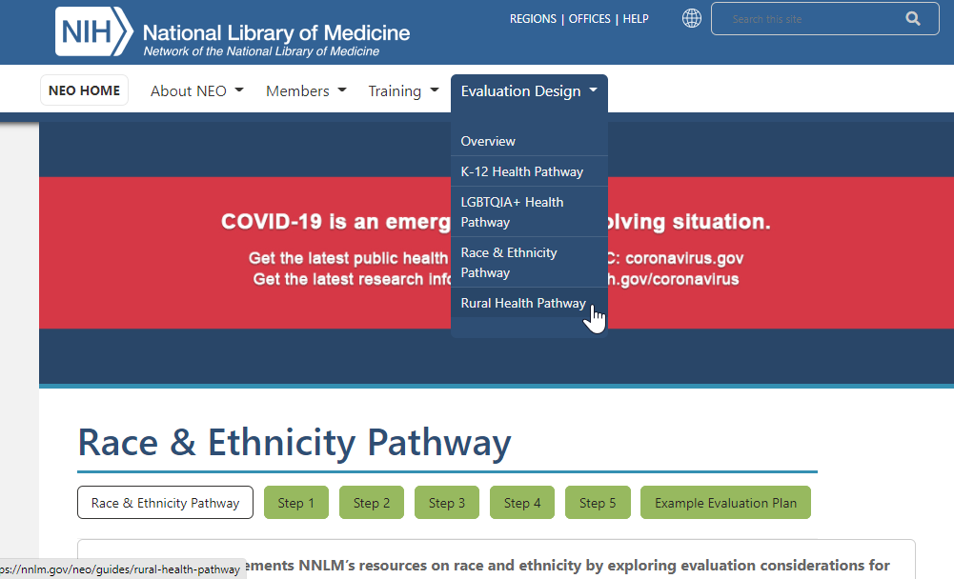
Website
https://nnlm.gov/neo/guides/race-ethnicity-pathway
Notes:
Each of the pathways includes topic-specific information, so I will highlight those elements before moving to the website. If you’d prefer to follow along on the site, Billi will share the link in the chat.

Slide 18
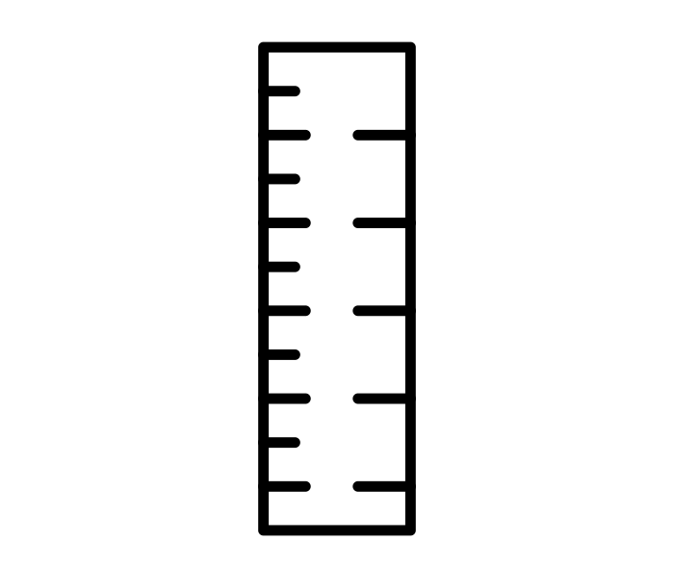
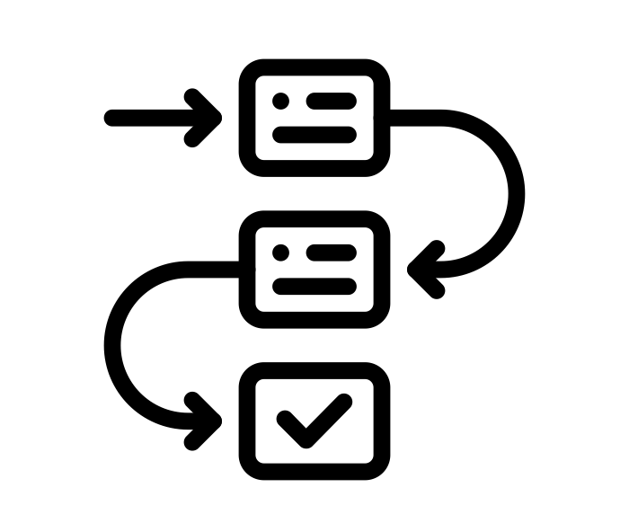
5 Steps to Evaluation
Step 1:
Do a Community Assessment
Step 2:
Make a Logic Model
Step 3:
Develop Indicators for your Logic Model
Step 4:
Create an Evaluation Plan
Step 5:
Collect Data, Analyze, and Act
Notes:
Evaluation design is broken down into 5 steps, which you can explore in detail using NEO’s Evaluation Booklets. Basic steps and worksheets are presented in the tabs above. While you are developing your evaluation plan, it is important to consider the context of your program. The context can change how your evaluation is designed and implemented, because different settings and populations have different needs and abilities to participate in evaluations. Considering this, the 5 steps are applied across 4 common populations (K-12 Health, Rural Health, Race & Ethnicity, and LGBTQIA+ Health) in pathways.

Slide 19
Special Considerations part 1
Introduction
Special Considerations
Racism
Understand how racism can change the context of your evaluation
Take a stance of anti-racism
Equity and Equality
Clarify the definition of success
Intersectionality
Measure multiple dimensions of discrimination
Consult an intersectionality chart
Implicit Bias
Consider how your unconscious behavior can change how you approach your evaluation
Test for your biases
Distrust of research
Know why there may be resistance to evaluation
Ensure the safety and security of the community
Notes:
nderstand how racism can change the context of your evaluation. Racism in the United States has a complex, and often controversial, history. As the Annie E. Casey Foundation(link is external) states, “the concept of racism is widely thought of as simply personal prejudice, but in fact, it is a complex system of racial hierarchies and inequities."
NNLM has compiled common microaggressions, organized by themes that can be reinforced or minimized by the methodology and conclusions of your evaluation.
NNLM Microagressions Table
Take a stance of anti-racism. A stance of anti-racism actively opposes racism, in all forms at all levels. It includes working against racism on a personal level and working against racism on a structural or institutional level.
In program evaluation, this includes designing evaluations to accurately capture the lives of the program participants, and clearly calling out and communicating racism when it is encountered.

Slide 20
Special Considerations part 2
Introduction
Special Considerations
Racism
Understand how racism can change the context of your evaluation
Take a stance of anti-racism
Equity and Equality
Clarify the definition of success
Intersectionality
Measure multiple dimensions of discrimination
Consult an intersectionality chart
Implicit Bias
Consider how your unconscious behavior can change how you approach your evaluation
Test for your biases
Distrust of research
Know why there may be resistance to evaluation
Ensure the safety and security of the community
Notes:
Clarify the definition of success. Programs (and evaluations) can define activities and outcomes from an equity and/or an equality perspective. It is important to understand the differences between equity and equality, as they are often used interchangeably but are defined by different concepts and have correspondingly different criteria for success.

Slide 21
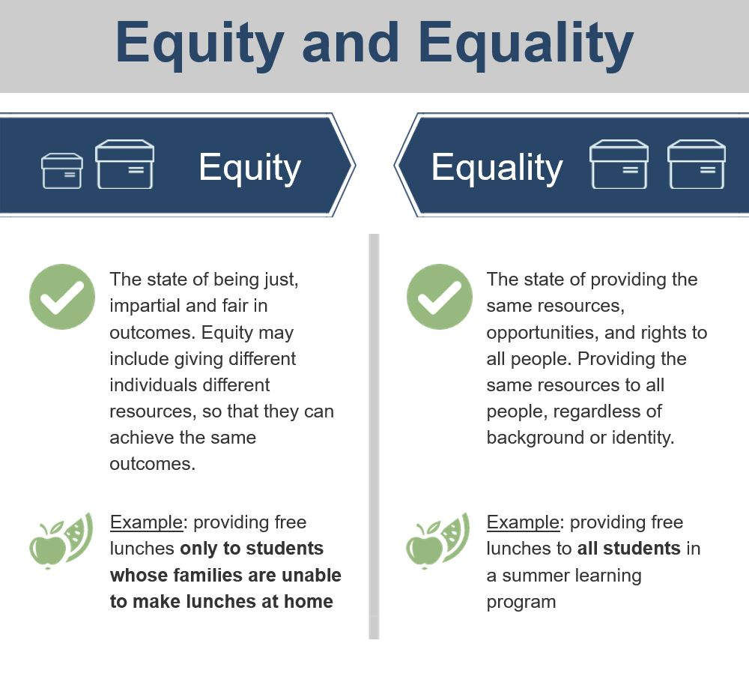
Introduction part 1
Introduction
Notes:
Equity and equality diagram from the website seen here.

Slide 22
Introduction part 2
Introduction
Special Considerations
Racism
Understand how racism can change the context of your evaluation
Take a stance of anti-racism
Equity and Equality
Clarify the definition of success
Intersectionality
Measure multiple dimensions of discrimination
Consult an intersectionality chart
Implicit Bias
Consider how your unconscious behavior can change how you approach your evaluation
Test for your biases
Distrust of research
Know why there may be resistance to evaluation
Ensure the safety and security of the community
Notes:
Measure multiple dimensions of discrimination. Kimberlé Crenshaw's Intersectionality framework(link is external) states that people experience multiple, overlapping, and cumulative forms of discrimination, such as racism, sexism, classism, and ableism.
Crenshaw recognized that programs have failed to address the experiences of Black women by focusing on only one dimension of their identity - either being Black or being female - rather than the intersection of those dimensions.
These different forms, or dimensions, of oppression intersect in complex ways, so that individuals who identify with multiple dimensions of oppression experience discrimination in different ways.
This may justify the collection of additional data related to the needs of specific communities within your group of program participants.
More information on intersectionality(link is external)
Consult an intersectionality chart. When thinking through your evaluation, it may be beneficial to consult an intersectionality chart, like the one below, to think through how different groups may experience your program differently, and effective ways of measuring the experiences of all groups.

Slide 23
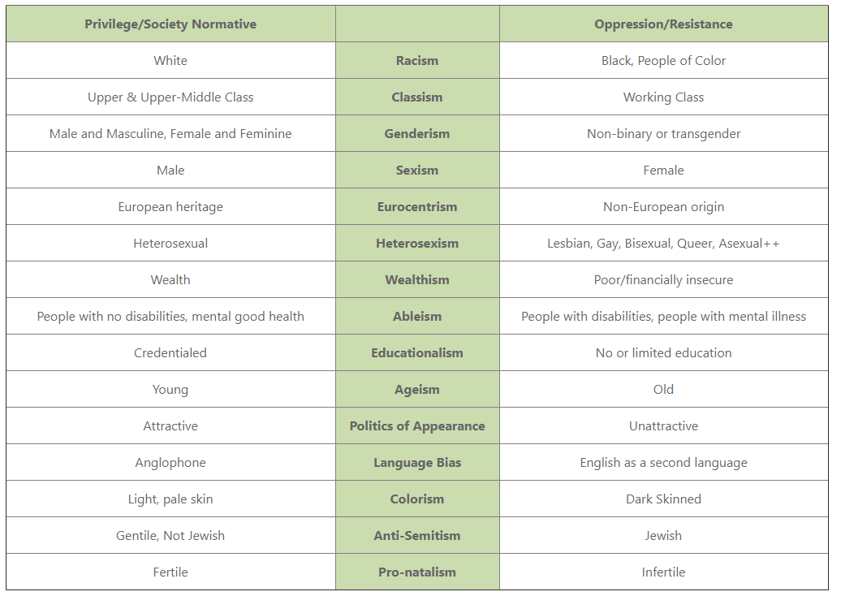
Introduction part 3
Introduction
Special Considerations
Notes:
We include an example of an intersectionality chart- a screen shot seen here- to help you think through the different ways privilege and oppression may exist in your program

Slide 24
Introduction part 4
Introduction
Special Considerations
Racism
Understand how racism can change the context of your evaluation
Take a stance of anti-racism
Equity and Equality
Clarify the definition of success
Intersectionality
Measure multiple dimensions of discrimination
Consult an intersectionality chart
Implicit Bias
Consider how your unconscious behavior can change how you approach your evaluation
Test for your biases
Distrust of research
Know why there may be resistance to evaluation
Ensure the safety and security of the community
Notes:
Consider how your unconscious behavior can change how you approach the evaluation. Implicit biases(link is external), unconscious associations between groups of people and certain characteristics or behaviors, affect how we view other races, ethnicities, genders, abilities, etc.
In evaluation implicit biases can change how we perceive the success of outcomes, how we collect and share information, how we form conclusions, and can also inform decision making processes.
Test for your biases. Project Implicit has a free and publicly available Implicit Association Test(link is external) that can assist in identifying unconscious biases so they can be more easily recognized and addressed.

Slide 25
Introduction part 5
Introduction
Special Considerations
Racism
Understand how racism can change the context of your evaluation
Take a stance of anti-racism
Equity and Equality
Clarify the definition of success
Intersectionality
Measure multiple dimensions of discrimination
Consult an intersectionality chart
Implicit Bias
Consider how your unconscious behavior can change how you approach your evaluation
Test for your biases
Distrust of research
Know why there may be resistance to evaluation
Ensure the safety and security of the community
Notes:
Know why there may be resistance to evaluation. Scientific and academic institutions have not always approached research ethically and equitably.
Some research has targeted Black, Indigenous and People of Color as research subjects or models, without considering the wellbeing or harm the study could cause.
The findings of research have been used to incorrectly declare the superiority of Caucasians, and the results have caused significant and lasting damage to communities.
Despite the progress the field of research ethics has made, the wide variety of research failures have, rightfully, led to the distrust of research by many communities, races, and ethnicities.
Ensure the safety and security of the community. Your evaluation should consider the distrust of research by clearly defining the ethics and ethical processes your evaluation will take.
Actively developing relationships will build the trust of the community you are working with.

Slide 26
5 Steps to Evaluation: Do a Community Assessment
Step 1:
Do a Community Assessment
Notes:
Evaluation design is broken down into 5 steps, which you can explore in detail using NEO’s Evaluation Booklets. Basic steps and worksheets are presented in the tabs above. While you are developing your evaluation plan, it is important to consider the context of your program. The context can change how your evaluation is designed and implemented, because different settings and populations have different needs and abilities to participate in evaluations. Considering this, the 5 steps are applied across 4 common populations (K-12 Health, Rural Health, Race & Ethnicity, and LGBTQIA+ Health) in pathways.

Slide 27
Step 1: Do a Community Assessment part 1
Step 1:
Do a Community Assessment
WHAT: A community assessment is a study of the community
WHY: helps you determine the health information needs of the community, the community resources that would support your project, and information to guide you in your choice and design of outreach strategies.
Get Organized
Gather Information
Assemble, Interpret, and Act on your findings
Ultimately:
Learn about the community, key stakeholders, and their needs.
Notes:
Get Organized
This phase includes outreach, background research, networking, reflecting on the evaluation and program goals, and formulating evaluation questions.
Conduct a stakeholder analysis to identify individuals or groups who are particularly proactive or involved in the community. Find out why they are involved, what is going well in their community, and what they would like to see improved.
Community - Organizations providing enrichment activities, workplaces for youth, places of worship, libraries, etc.

Slide 28
Step 1: Do a Community Assessment part 2
Step 1:
Do a Community Assessment
Get Organized
This phase includes outreach, background research, networking, reflecting on the evaluation and program goals, and formulating evaluation questions.
Cultural humility respects the practices and boundaries of a community’s methods of doing and being.
Culture is always changing and adapting, so cultural humility is an iterative and ongoing process.
Cultural responsiveness incorporates cultural humility into the practice of evaluation.
Actions for incorporating cultural humility into your evaluation such as:
Develop specific cultural knowledge
Define and measure race and ethnicity in a meaningful way
Explicitly examine the theoretical framework that is the foundation of your research
Choose culturally appropriate measures
Interpret results to reflect the lives of people studied
Notes:
Get Organized
This phase includes outreach, background research, networking, reflecting on the evaluation and program goals, and formulating evaluation questions.
Conduct a stakeholder analysis to identify individuals or groups who are particularly proactive or involved in the community. Find out why they are involved, what is going well in their community, and what they would like to see improved.
Community - Organizations providing enrichment activities, workplaces for youth, places of worship, libraries, etc.

Slide 29
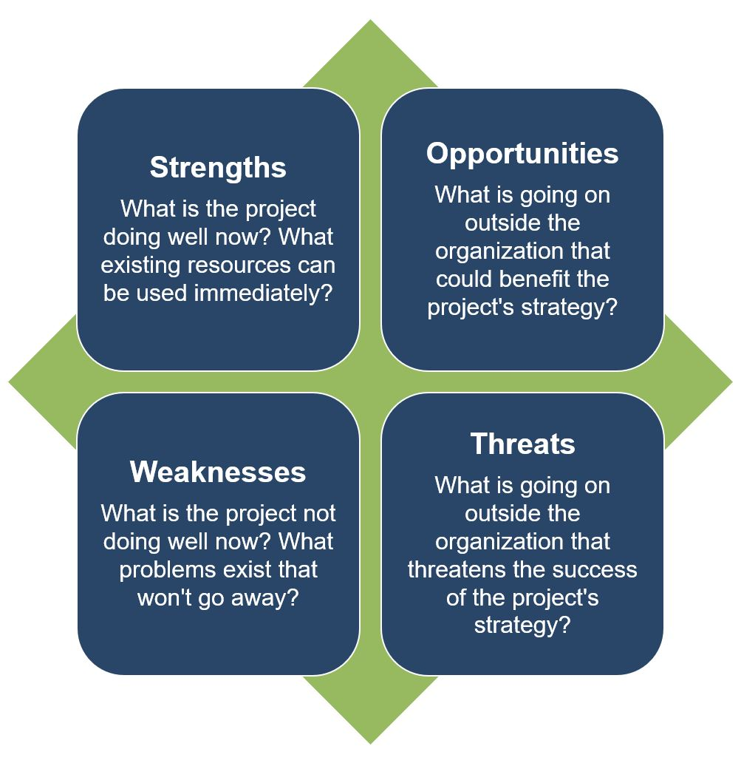
Step 1: Do a Community Assessment part 3
Step 1:
Do a Community Assessment
Get Organized
Stakeholder analysis
‘positive deviance’ methodology
SWOT analysis
For the foundation or organization, with relation to the community a program is working in
For the program
Notes:
Use the Positive Deviance (PD) (link is external) approach to identify these early adopters.
More information on Positive Deviance
Please note this process is time and labor intensive and requires a skilled facilitator comfortable with ambiguity and uncertainty. This process may not be feasible within the time constraints of the typical NNLM-funded project.

Slide 30
Step 1: Do a Community Assessment part 4
Step 1:
Do a Community Assessment
Gather Information
This phase includes gathering data from different external and internal sources to inform the development of your program and evaluation plan.
Listening sessions
Community listening sessions are semi-structured group gatherings that prompt discussion on a wide variety of topics
Open two-way dialogue
Learn about what the community views as being important
Group facilitator monitors the dynamics
Create space and time to freely discuss topics
Notes:
Listening Sessions. Community listening sessions are semi-structured group gatherings that prompt discussion on a wide variety of topics.
Listening sessions can begin an ongoing dialogue between the evaluation team, program team and members of the community the program works with.
Facilitators of the listening sessions can use a facilitation guide to drive discussion, with key questions and topics to discuss.
Participants in the listening session should be allowed the space and time to freely discuss topics without judgement or fear of retribution. An important role of the facilitator is to monitor group dynamics, to ensure that all individuals who have thoughts are heard, and to moderate any unsafe situations.
Analysis of qualitative methods, including listening sessions, should include member checking, whereby a member of the participants reviews the interpretations and results of the data collector, to ensure that the data collector does not negatively influence the findings or miss the priorities and voices of the listening session participants.

Slide 31
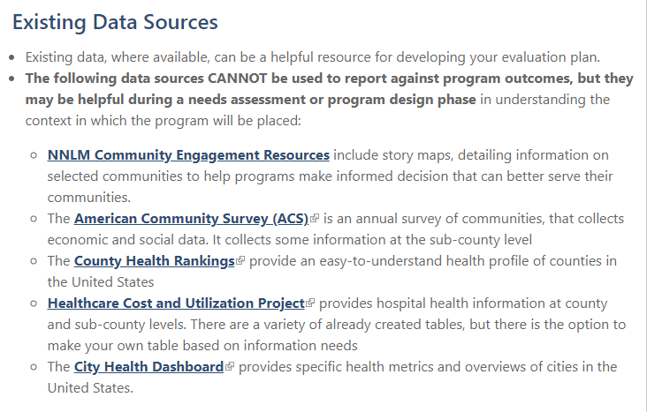
Step 1: Do a Community Assessment part 5
Step 1:
Do a Community Assessment
Gather Information
Existing Data Sources – useful for needs assessment or program design phase
The data sources CANNOT be used to report against program outcomes
They may be helpful during a needs assessment or program design phase
Example: Want to learn more about the races & ethnicities of people living in Seattle, WA
City Health Dashboard
Notes:
Existing data, where available, can be a helpful resource for developing your evaluation plan.
The following data sources CANNOT be used to report against program outcomes, but they may be helpful during a needs assessment or program design phase in understanding the context in which the program will be placed:
You can see here we have several listed, but say we are working on a community assessment for a program in Seattle, and we wanted to learn more about the races & ethnicities of people living in seattle, we could use the city health dashboard

Slide 32
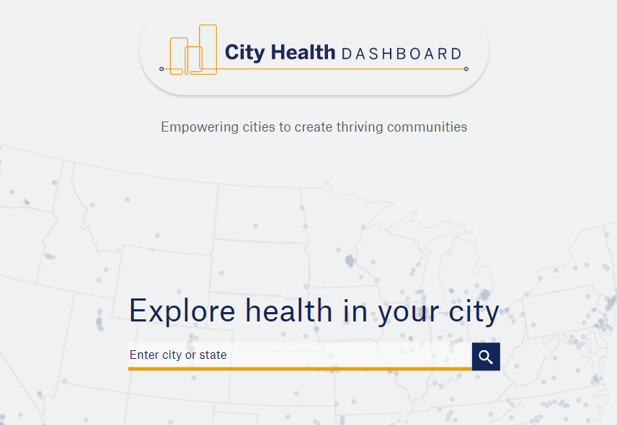
Step 1: Do a Community Assessment part 6
Step 1:
Do a Community Assessment
Gather Information
Existing Data Sources – useful for needs assessment or program design phase
The data sources CANNOT be used to report against program outcomes, but they may be helpful during a needs assessment or program design phase in understanding the context in which the program will be placed
Example: City Health Dashboard
Notes:
Which will look like this when we pull it up. We would type in Seattle, WA

Slide 33
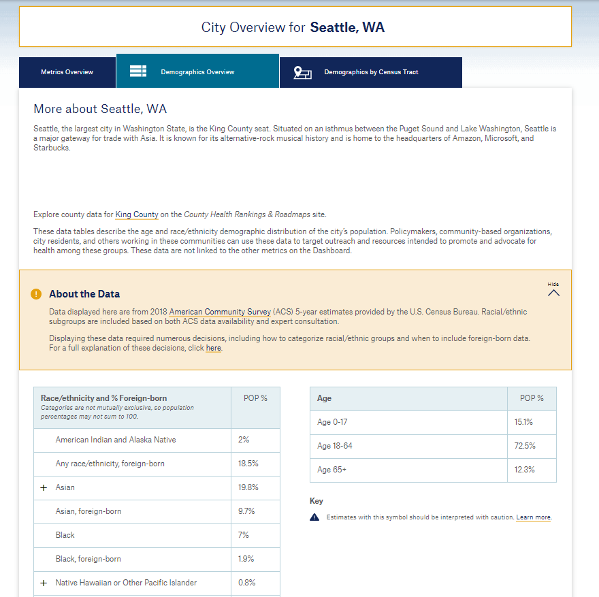
Step 1: Do a Community Assessment part 7
Step 1:
Do a Community Assessment
Notes:
And look for information about the different races and ethnicities of people living in Seattle. Knowing this information can help us be more sensitive to the unique needs a program may have that takes place in Seattle

Slide 34
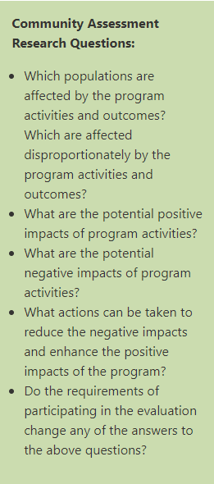
Step 1: Do a Community Assessment part 8
Step 1:
Do a Community Assessment
Assemble, Interpret, Act
This phase includes processing the information gathered into understandable takeaways that can be used for the program and the evaluation.
The interpretation and representation of findings should be completed collaboratively
The results of the assessment can help to determine the potential benefits for and burdens of the program.
Define concrete ways that the program will advance equity or equality
Notes:
This phase includes processing the information gathered into understandable takeaways that can be used for the program and the evaluation.
When working on community assessments as part of a larger evaluation to advance racial equity and/or equality, the results of the assessment can help to determine the potential benefits for and burdens of the program. After assembling the findings, check for ways that the program will harm or help the community you are working with.
Defining concrete ways that the program will advance equity or equality clarifies how your program approaches issues of racism.
The interpretation and representation of findings should be completed collaboratively with members of the community you are working with, so that decision-making authority and engagement are not siloed to only program and evaluation staff.
Reporting the findings and interpretations from the community assessment back to the community you are working with ensures transparency and accountability from the very start of your evaluation.

Slide 35
5 Steps to Evaluation: Make a Logic Model
Step 2:
Make a Logic Model
Notes:
Evaluation design is broken down into 5 steps, which you can explore in detail using NEO’s Evaluation Booklets. Basic steps and worksheets are presented in the tabs above. While you are developing your evaluation plan, it is important to consider the context of your program. The context can change how your evaluation is designed and implemented, because different settings and populations have different needs and abilities to participate in evaluations. Considering this, the 5 steps are applied across 4 common populations (K-12 Health, Rural Health, Race & Ethnicity, and LGBTQIA+ Health) in pathways.

Slide 36
Step 2: Make a Logic Model part 1
WHAT: a diagram detailing how change occurs in the program/project
WHY: helpful for planning a program, implementing a program, monitoring the progress of a program, and evaluating the success of a program.
Step 2:
Make a Logic Model
Ask stakeholders and community members to review your logic model
Consider how change occurs across the logic model
Be careful of assumptions that blame a person or community, and don’t account for structural or systemic issues
Notes:
Consider how the program's logic model will assist in determining what is, or is not, working in the program's design to achieve the desired results.
Be open to new and alternative patterns in your logic model. Have stakeholders and community members review your logic model, paying particular care to how change occurs across the logic model. Listen to voices who can say whether the strategies are beneficial, and whether strategies could be successful.
When using available evidence about how change happens, consider who the study included. Evidence that focuses on one race or ethnicity may not apply to another race or ethnicity, and evidence may not capture the complete diversity of experiences within race or ethnicity.
For cultures that face oppression and discrimination, be careful of biases that interpret program participants as responsible for issues in their community (victim blaming), and not structural or systemic explanations for the issues.
More information on Logic Models
Example Logic Model for program working with underrepresented population

Slide 37
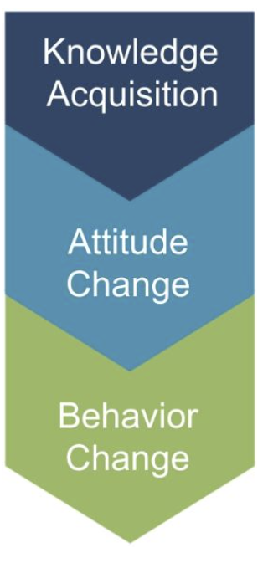
Make a Logic Model part 2
Step 2:
Make a Logic Model
The logic model:
knowledge, attitudes, and behaviors
Knowledge Acquisition
What is the program trying to teach or show program participants?
What understanding would a program participant gain over the course of the program? Often knowledge acquisition occurs as a short-term outcome of the program.
Be sure to examine not only what is learned, but where, when, and how program participants will learn it.
Notes:
Programming should consider improvement in the knowledge-attitude-behavior continuum among program participants as a measure of success. The process of influencing health behavior through information, followed by attitude changes and subsequent behavior change, should be documented in the logic model.
Knowledge acquisition:
Be sure to examine not only what is learned, but where, when, and how program participants will learn it.
Attitude change:
To what extent do participants agree with statement related to the new material presented?
Behavior change:
Are the new behaviors in alignment with the expectations of the program?

Slide 38
Make a Logic Model part 3
Step 2:
Make a Logic Model
The logic model:
knowledge, attitudes, and behaviors
Knowledge Acquisition
Attitude Change
What mindsets or beliefs are the program seeking to build or change? Be sure to consider cultural differences in attitudes in the community you are working with.
Make sure that the attitudes you are seeking to change are not rooted in a white supremacy model and are consistent with cultural practices and beliefs.
To what extent do participants agree with statements related to the new material presented?
Notes:
Programming should consider improvement in the knowledge-attitude-behavior continuum among program participants as a measure of success. The process of influencing health behavior through information, followed by attitude changes and subsequent behavior change, should be documented in the logic model.
Knowledge acquisition:
Be sure to examine not only what is learned, but where, when, and how program participants will learn it.
Attitude change:
To what extent do participants agree with statement related to the new material presented?
Behavior change:
Are the new behaviors in alignment with the expectations of the program?

Slide 39
Make a Logic Model part 4
Step 2:
Make a Logic Model
The logic model:
knowledge, attitudes, and behaviors
Knowledge Acquisition
Attitude Change
Behavior Change
Are the actions of program participants different than what would have been expected without the program?
It can be important to examine how power structures could alter or change the predicted outcomes.
If an outcome is targeting a change in behavior, but power structures prohibit the behavior change, it would be important to note the influences of the power structures to achieving the goals of the program. See the contextual factors section for more information.
Notes:
Example: in a program seeks to present health information in a series of seminars, and attendance in the seminars is low, it could be caused by disinterest or it could be caused by limited transportation options for the community.
Programming should consider improvement in the knowledge-attitude-behavior continuum among program participants as a measure of success. The process of influencing health behavior through information, followed by attitude changes and subsequent behavior change, should be documented in the logic model.
Knowledge acquisition:
Be sure to examine not only what is learned, but where, when, and how program participants will learn it.
Attitude change:
To what extent do participants agree with statement related to the new material presented?
Behavior change:
Are the new behaviors in alignment with the expectations of the program?

Slide 40
Make a Logic Model part 5
Step 2:
Make a Logic Model
Contextual Factors and Assumptions
Influences that underlie your logic model and could act on or change the logic model
Assumptions could also underlie how one expects certain groups to behave or act
Clarifying assumptions and having them checked by community members allows the assumptions to be discussed and reviewed
Example: if a program is seeking to improve a low-resource community’s health behaviors one might assume:
Individuals have no knowledge of health information
Individuals currently do not have access to health information.
Notes:
Contextual factors are the influences that underlie your logic model and could act on or change the model described.By noting the contextual factors, the program can plan for ways to reduce external factors that could negatively alter the desired outcomes.Clarifying assumptions allows for evaluators to reflect on their influence, biases, and connections to the communities in which they work. By making assumptions explicit, you can identify and discuss the assumptions made, allowing for open dialogue and review.Assumptions could also underlie how you expect certain groups behave or act. It is important to define, discuss, check, and correct these assumptions before deciding evaluation and program design. Example: If a program is seeking to improve a low-resource community’s health behaviors, one might assume that currently individuals have no knowledge of health information or that individuals currently do not have access to health information.

Slide 41
5 Steps to Evaluation: Develop Indicators for your Logic Model
Step 3:
Develop Indicators for your Logic Model
Notes:
Evaluation design is broken down into 5 steps, which you can explore in detail using NEO’s Evaluation Booklets. Basic steps and worksheets are presented in the tabs above. While you are developing your evaluation plan, it is important to consider the context of your program. The context can change how your evaluation is designed and implemented, because different settings and populations have different needs and abilities to participate in evaluations. Considering this, the 5 steps are applied across 4 common populations (K-12 Health, Rural Health, Race & Ethnicity, and LGBTQIA+ Health) in pathways.

Slide 42
Step 3: Develop Indicators for your Logic Model part 1
WHAT: An indicator is a marker of accomplishment and/or progress- a way of measuring changes made by your program
WHY: To understand the way that change is happening, across your logic model from inputs to impact
Step 3:
Develop Indicators for your Logic Model
How do you develop appropriate indicators?
Involve your program stakeholders in indicator development.
Review your logic model as a template to develop indicators.
Review indicators to ensure they are specific, observable, and measurable.
Include baseline data for inputs and outcomes if you are trying to measure change.
Determine whether indicators:
Provide useful information
Are feasible in terms of data availability and timely data collection
Notes:
indicators

Slide 43
Step 3: Develop Indicators for your Logic Model part 2
Step 3:
Develop Indicators for your Logic Model
Indicators are observable signs of your outcomes and will help you measure your achievement. Identify indicators that align to the outcomes in your logic model. Tracking these indicators over time will help you reflect upon your progress and help you collect and show results.
Key Elements of an Indicator | Example
Specific | Youth who make healthy choices Youth aged 13-18 who report including vegetables as part of at least one meal daily
Observable | Library staff who can identify health protective factors The proportion of library staff who can list at least two health protective factors
Measurable | Quantifies change and generally reported in numerical terms, such as counts, percentages, proportions, or ratios
Notes:
When developing indicators, seek to accurately capture the experiences of the people that you are working with. Consider the applicability of the indicators, and the way biases, assumptions, and discrimination may alter how they reflect reality.
Indicators examining changes from programs working with specific races or ethnicities should consider that an individual’s perception of race can change how they report on specific indicators.
When developing indicators, try to avoid wording indicators in a way that prompts implicit biases.
Think through if there are multiple ways to measure the indicator, and avoid indicators that require people to rate or describe other people, including their intelligence or abilities.
Use lessons learned from the community assessment to make indicators respectful and mindful of the dynamics of race and ethnicity.
Standard assessments of mental or physiological state may not accurately reflect the experiences of Black, Indigenous and People of Color. Do not assume cross-cultural relevance of indicators, without checking the research or discussing your indicators with the community you are working with.
Programs seeking to cause social change should consider that changes to norms, structures, and systems takes considerable time. Consider how to measure incremental change, capturing a step towards a more wide-spread outcome.

Slide 44
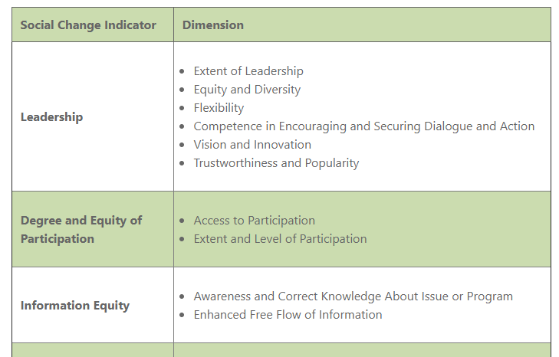
Step 3: Develop Indicators for your Logic Model part 3
Step 3:
Develop Indicators for your Logic Model
Rockefeller Foundation Social Change Indicators
Change is incremental- instead of measuring only large social changes, think of how you can measure incremental change
Notes:
The Rockefeller Foundation suggests measuring indicators of different social change outcomes. Screen shot of how the indicators appear on the website.
Indicators on: leadership, degree and equity of participation, information equity, collective self-efficacy, sense of ownership, social cohesion, and social norms.
The dimensions listed are the ways in which the indicator could be operationally defined or measured, and included in your evaluation plans.

Slide 45
Step 3: Develop Indicators for your Logic Model part 4
Step 3:
Develop Indicators for your Logic Model
Demographic Data
Collect data on demographics
During analysis, compare differences in backgrounds against outcomes results
Source: City Health Dashboard
Notes:
Collect data on demographics as part of your survey process. It is important to understand your participants' backgrounds and how that may affect their engagement with your program.
During analysis, compare differences in backgrounds against outcome results. If there are gaps identified in reaching certain populations, consider adjustments to program implementation to serve all participants equitably.
For example, we can look at the city health dashboard for the % of people who are uninsured in seattle. Here we see it is about 5.2%

Slide 46
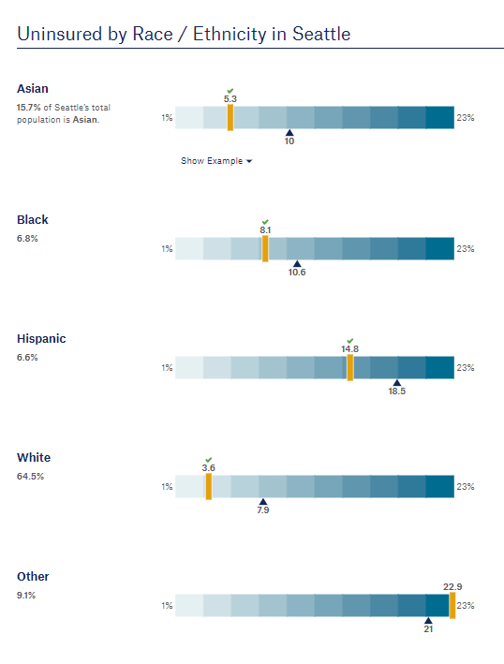
Step 3: Develop Indicators for your Logic Model part 5
Step 3:
Develop Indicators for your Logic Model
Source: City Health Dashboard
Notes:
However if we look at the % uninsured by race/ethnicity, we see a very different picture. We see that white individuals have a lower uninsured rate, while Asian individuals have around the same rate at the overall city rate, while Black and Hispanic individuals have a higher rate, and “other” (which I recommend further breaking down other into the races or ethnicities that it represents) is even higher.

Slide 47
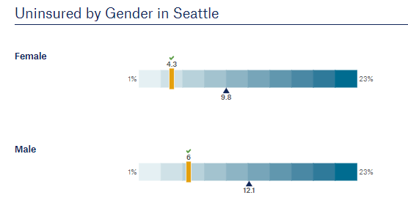
Step 3: Develop Indicators for your Logic Model part 6
Step 3:
Develop Indicators for your Logic Model
Source: City Health Dashboard
Notes:
We can also see differences if we look at uninsured by gender, here defined as female and male (female lower, male higher)

Slide 48
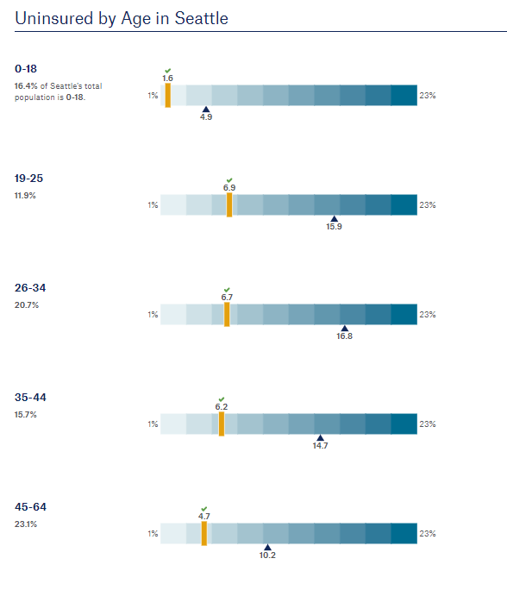
Step 3: Develop Indicators for your Logic Model part 7
Step 3:
Develop Indicators for your Logic Model
Source: City Health Dashboard
Notes:
And even differences when looking at different age groups

Slide 49
5 Steps to Evaluation: Create an Evaluation Plan
Step 4:
Create an Evaluation Plan
Notes:
Evaluation design is broken down into 5 steps, which you can explore in detail using NEO’s Evaluation Booklets. Basic steps and worksheets are presented in the tabs above. While you are developing your evaluation plan, it is important to consider the context of your program. The context can change how your evaluation is designed and implemented, because different settings and populations have different needs and abilities to participate in evaluations. Considering this, the 5 steps are applied across 4 common populations (K-12 Health, Rural Health, Race & Ethnicity, and LGBTQIA+ Health) in pathways.

Slide 50
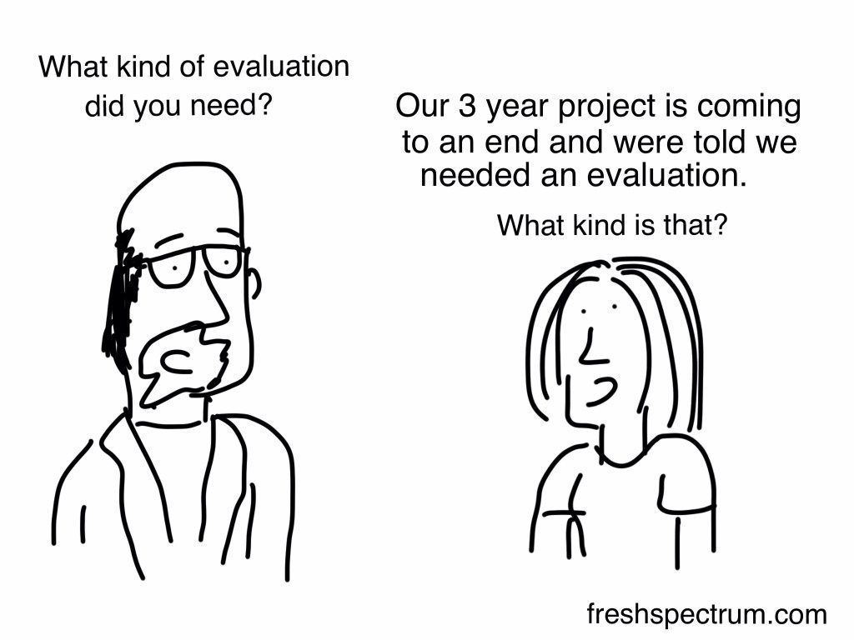
Step 4: Create an Evaluation Plan part 1
Step 4:
Create an Evaluation Plan
WHAT: An evaluation plan describes how the project will be evaluated. It articulates the purpose of the evaluation, evaluation questions, timetable, data collection tools, analysis framework, and a section articulating how data will be used and disseminated.
Define evaluation questions
Develop the evaluation design
Participatory Evaluation approach
Conduct an ethical review

Slide 51
Step 4: Create an Evaluation Plan part 2
Step 4:
Create an Evaluation Plan
Define evaluation questions
Process questions:
Did we do what we said we were going to do?
Ex: Were all 6 computers and associated hardware set up by the deadline?
Who, what, when, and how many related to program inputs, activities and outputs.
Ex: Were the races/ethnicities of the attendants present at the seminars reflective of the community-at-large?
Outcome questions:
Are we accomplishing the WHY of what we wanted to do?
Did we achieve the changes or impact we wanted to see?
Ex: By the end of the program, did library staff's knowledge of health information resources and ways to serve their community change?
Ex: By the end of the program, did library patrons' use of health information resources at the library change?
Notes:
Evaluation questions help define what to measure and provide clarity and direction to the project.
Process questions relate to the implementation of the program and ask questions about the input, activities, and outputs columns of the logic mode
Outcome questions relate to the effects of the program and relate to the short, intermediate, and long-term columns of the logic model.
Culturally responsive evaluation questions value a diversity of perspectives. Inclusion of a diversity of perspectives in your evaluation questions help to drive your evaluation towards a fair assessment of the program.
Try to anticipate how the answers to your questions will be utilized and interpreted, and whether the answers to your questions will best reflect the lives of the participants in your program. Avoid phrasing questions in a way that compares groups to a single cultural standard.
Since culture is responsible for interpreting what is “normal,” a question that seeks to measure and normalize a pattern or behavior should include the racial and/or ethnic perspectives of your program participants.

Slide 52
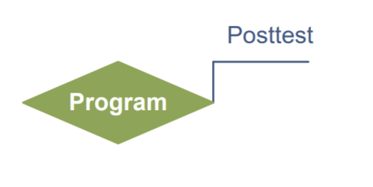
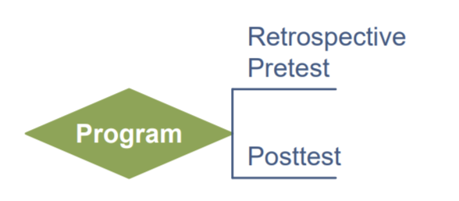
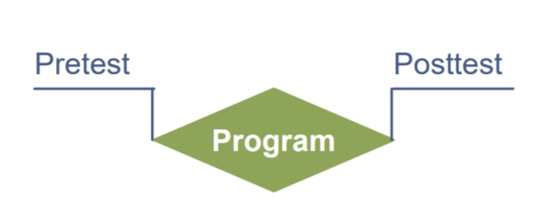
Step 4: Create an Evaluation Plan part 3
Step 4:
Create an Evaluation Plan
Evaluation Design
How an evaluation will gather data to answer the evaluation questions
Posttest only
Retrospective Pre & Posttest
Pre & Posttest
Notes:
Evaluation design influences the validity of the results. Most NNLM grant projects will use a non-experimental or quasi-experimental design. Quasi-experimental evaluations include surveys of a comparison group - individuals not participating in the program but with similar characteristics to the participants - to isolate the impact of the program from other external factors that may change attitudes or behaviors.
Non-experimental evaluations only survey program participants.
If comparison groups are part of your quasi-experimental design, use a 'do no harm' approach that makes the program available to those in the comparison group after the evaluation period has ended.
Our implicit biases can change how we design evaluations because they influence our fundamental beliefs of society and what is of value. Examining our internalized biases(link is external) can help clarify evaluation goals, indicators of change, and put into sharper focus what we perceive to be the dominance or inferiority of the communities we are working with.

Slide 53
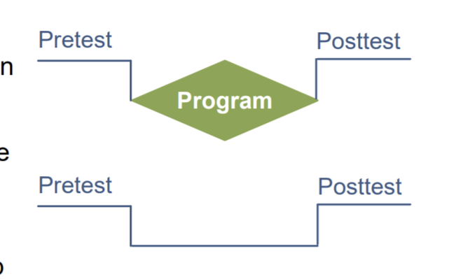
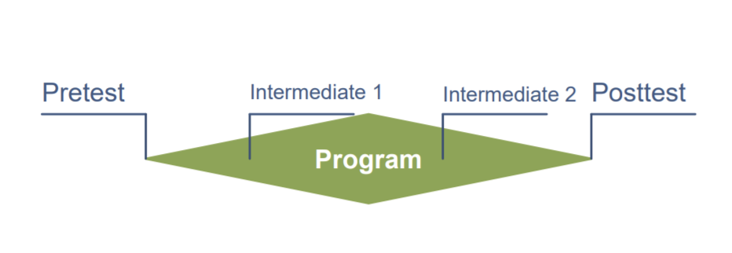
Step 4: Create an Evaluation Plan part
Step 4:
Create an Evaluation Plan
Evaluation Design
Pre & Posttest with Comparison Group
Pre & Posttest with Follow-up
Intermediate Testing & Posttest
Notes:
Evaluation design influences the validity of the results. Most NNLM grant projects will use a non-experimental or quasi-experimental design. Quasi-experimental evaluations include surveys of a comparison group - individuals not participating in the program but with similar characteristics to the participants - to isolate the impact of the program from other external factors that may change attitudes or behaviors.
Non-experimental evaluations only survey program participants.
If comparison groups are part of your quasi-experimental design, use a 'do no harm' approach that makes the program available to those in the comparison group after the evaluation period has ended.
Our implicit biases can change how we design evaluations because they influence our fundamental beliefs of society and what is of value. Examining our internalized biases(link is external) can help clarify evaluation goals, indicators of change, and put into sharper focus what we perceive to be the dominance or inferiority of the communities we are working with.

Slide 54
Step 4: Create an Evaluation Plan part 5
Step 4:
Create an Evaluation Plan
Evaluation Design
Notes:
This is a great opportunity to talk about another feature we have worked into the website. Throughout the pathways you will see the red pdf icons next to underlined text. This is where we have linked to pdfs that help to further explain concepts, like here for evaluation design.

Slide 55
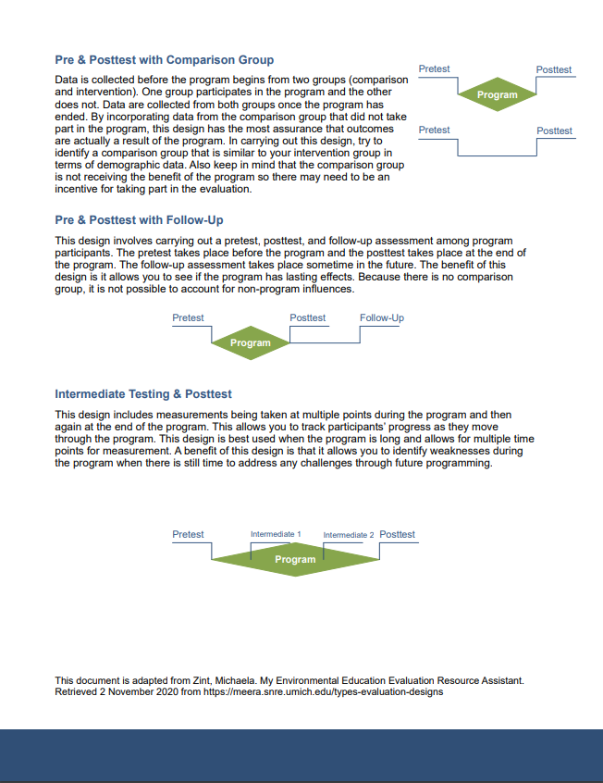
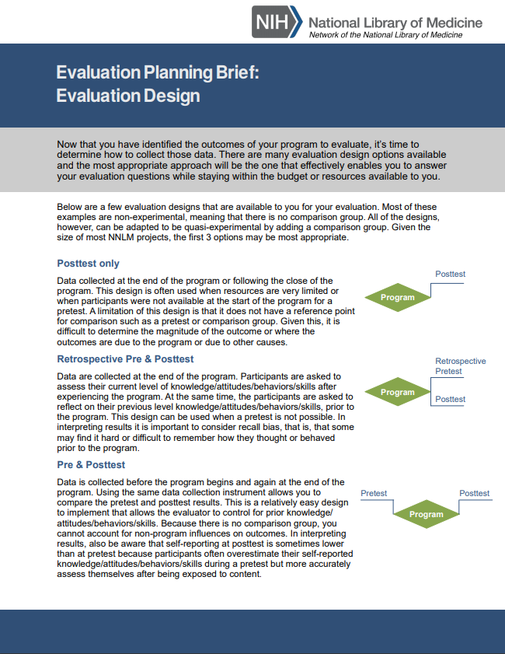
Step 4: Create an Evaluation Plan part 6
Step 4:
Create an Evaluation Plan
Notes:
This is a great opportunity to talk about another feature we have worked into the website. Throughout the pathways you will see the red pdf icons next to underlined text. This is where we have linked to pdfs that help to further explain concepts, like here for evaluation design.
We created a series of briefs on evaluation planning, like the one seen sere on evaluation design. It covers in more detail the information we just covered here on the presentation- you don’t have to read the content of the brief, this is more to note that they are available to you

Slide 56
Step 4: Create an Evaluation Plan part 7
Step 4:
Create an Evaluation Plan
Participatory Evaluation Approach
The approach or framework of an evaluation can help to clarify the process and design.
grounds your evaluation in underlying principles and theories
Can be used as an internal check and guide for decision making
Participatory evaluation shifts the typical power dynamics of evaluations
Program participants have a stake in decision making and planning processes
Involves program participants in all stages of planning and decision making, from start to finish of the program.
Should be used for all member programs.
Notes:
The approach or framework of an evaluation can help to clarify the process and design. Using an approach grounds your evaluation in underlying principles and theories, which can be used as an internal check and guide for decision making.
Participatory evaluation shifts the typical power dynamics of evaluations so that program participants have a stake in decision making and planning processes. Participatory approaches should be used in all NEO-member programs.
Participatory approaches focus on involvement of program participants in all stages of planning and decision making, including the evaluation.

Slide 57
Step 4: Create an Evaluation Plan part 8
Step 4:
Create an Evaluation Plan
Ethical Review
Consider the Belmont Report principles:
Respect for Persons
When involving community members in the evaluation or obtaining consent for your evaluation, try to minimize the pressures
Allowing anonymous decision making and feedback, when possible, can reduce the pressures individuals feel to behave in one way or another.
Beneficence
Research Fatigue changes the benefits one can receive from participating in an evaluation
Consider how to increase the benefits individuals receive from participating in the evaluation.
Justice
Justice can be difficult to assess as it is entrenched in the systems, structures, and norms of society
Consider that there may be groups that are less visible in a community than others (those who do not speak English, older adults, people with disabilities, low-income households, and medically vulnerable people)
Consider how your evaluation would exacerbate or improve the distribution of benefits.
Notes:
Consider the Belmont Report principles (link is external)
Respect for Persons:
When evaluating programs with participants who are facing racism, discrimination, or oppression, consider the effect that power can have on a person’s ability to make decision for themselves.
If a person does not have relative power or feels as though they do not have relative power, they can be coerced into making decisions that they would not have otherwise made for themselves.
When involving community members in the evaluation or obtaining consent for your evaluation, try to minimize the pressures individuals feel to act one way or another.
Allowing anonymous decision making and feedback, when possible, can reduce the pressures individuals feel to behave in one way or another.
Beneficence
How will your evaluation balance the burden that participants take to complete the evaluation, with the benefits of completing the evaluation? In the process of completing the evaluation, are you asking your participants to do things or use resources that they might not have easy access to?
Black, Indigenous and People of Color have felt a disproportionate burden of research; they are more commonly researched than other populations.
The more frequent research leads to research fatigue, where a population, community, or individual tires of engaging in research. Research fatigue can make it challenging to participate in evaluation or research, meaning that the burden of your evaluation is greater.
To better balance the burdens, consider how to increase the benefits individuals receive from participating in the evaluation. Benefits can include improved programming, or gifts or stipends for participating in the evaluation.
Justice
Consider how your evaluation would exacerbate or improve the distribution of benefits.
In a society with racism, discrimination and oppression, justice can be difficult to assess as it is entrenched in the systems, structures, and norms of the society.
Try to assess how the program affects different groups of people withing your program.
Consider that there may be groups that are less visible in a community than others, including those who do not speak English, older adults, disabled individuals, low-income households, and medically vulnerable people.
Understanding how the Belmont report applies to racial equity(link is external) can help you to analyze how to improve the ethical standings and considerations your program takes and can improve the accessibility of the program.

Slide 58
Step 4: Create an Evaluation Plan part 9
Step 4:
Create an Evaluation Plan
Ethical Review
Consider the Belmont Report principles:
Respect for Persons
Beneficence
Justice
Trauma-Informed Evaluation
If necessary for the evaluation to ask questions about potentially traumatic events, incorporate a trauma-informed approach.
Institutional Review Board
Administrative body established to protect the rights and welfare of human research subjects recruited to participate in research activities
Notes:
Asking someone about trauma is asking that person to recall potentially difficult events from their past.
If absolutely necessary for the evaluation to ask questions about potentially traumatic events, incorporate a trauma-informed approach to collect data in a sensitive way.
The Institutional Review Board (IRB) (link is external) is an administrative body established to protect the rights and welfare of human research subjects recruited to participate in research activities. The IRB is charged with the responsibility of reviewing all research, prior to its initiation (whether funded or not), involving human participants.
The IRB is concerned with protecting the welfare, rights, and privacy of human subjects.
The IRB has authority to approve, disapprove, monitor, and require modifications in all research activities that fall within its jurisdiction as specified by both the federal regulations and institutional policy.
Contact information to locate local IRB on website

Slide 59
5 Steps to Evaluation: Collect Data, Analyze, and Act
Step 5:
Collect Data, Analyze, and Act
Notes:
Evaluation design is broken down into 5 steps, which you can explore in detail using NEO’s Evaluation Booklets. Basic steps and worksheets are presented in the tabs above. While you are developing your evaluation plan, it is important to consider the context of your program. The context can change how your evaluation is designed and implemented, because different settings and populations have different needs and abilities to participate in evaluations. Considering this, the 5 steps are applied across 4 common populations (K-12 Health, Rural Health, Race & Ethnicity, and LGBTQIA+ Health) in pathways.

Slide 60
Step 5: Collect Data, analyze, and act part 1
Step 5:
Collect Data, analyze, and act
This is the time to reflect upon what you have learned, gather insights, and inform programming improvements.
Collect data according to your evaluation design (before, during, and/pr after your program has completed)
Complete analysis after the completion of data collection
Act upon your analysis by sharing evaluation results with stakeholders, and if needed, adapt future iterations of your program to address gaps identified through the evaluation.

Slide 61
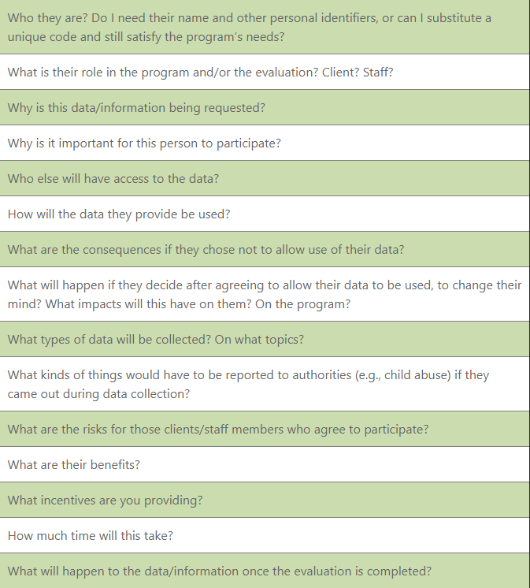
Step 5: Collect Data, analyze, and act part 2
Collect Data
Ensure the privacy and confidentiality of all participants
In systems of inequality, confidentiality is important to ensure because the data collected could be used in a harmful manner to perpetuate stigmas against individuals or groups of people.
Step 5:
Collect Data, analyze, and act
Notes:
Ensure the privacy and confidentiality of all participants. For
Select a sampling strategy that will allow for reporting on program outcomes.
Consider whether quantitative and/or qualitative data collection methods are appropriate for reporting on program outcomes.
Privacy and confidentiality of collected data should be ensured.
Seek consent from all participants, or the guardians of participants, in your evaluation.
Consider how you will secure data collected to protect sensitive information.
Data stored electronically should, at minimum, be password-protected.
In systems of inequality, confidentiality is important to ensure because the data collected could be used in a harmful manner to perpetuate stigmas against individuals or groups of people.

Slide 62
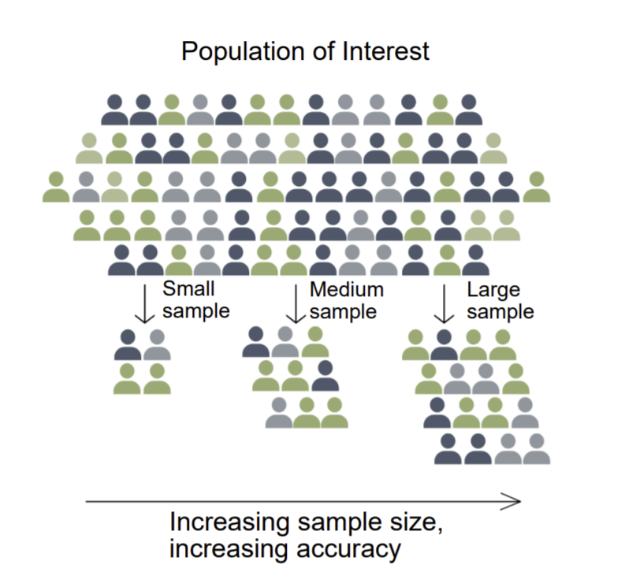
Step 5: Collect Data, analyze, and act part 3
Step 5:
Collect Data, analyze, and act
Collect Data-Select a sampling strategy
Is a sample necessary?
For a small program, the total number of participants is small enough that it is likely more work to create a truly representative sample.
If a program is operating across an entire region, collecting data from a sample of students will likely save time and money and produce similar results as surveying all members of the region.
Is probability (statistical) sampling necessary?
Need a list of all individuals to be sampled.
Less important if you do not intend to generalize
Non-probability samples may provide enough information and are less cumbersome to select
Notes:
It can be helpful to have a community representative, who moderates and works with the evaluation team, that is able to assess and communicate the community’s history and concerns when choosing a sampling strategy.
Care should be given to ensure that the individuals located through sampling are safe and secure, and that power structures are recognized.

Slide 63
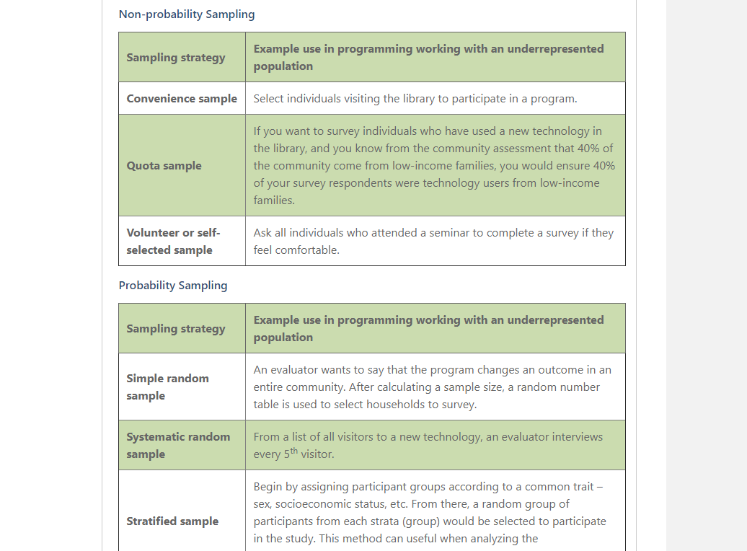
Step 5: Collect Data, analyze, and act part 4
Step 5:
Collect Data, analyze, and act
Notes:
Examples use of different sampling strategies, along with overview document on sampling, available on website

Slide 64
Step 5: Collect Data, analyze, and act part 5
Step 5:
Collect Data, analyze, and act
Collect Data
Ensure the privacy and confidentiality of all participants
Select a sampling strategy
Consider whether quantitative and/or qualitative data collection methods are appropriate for reporting on program outcomes
Using pre-designed data collection instruments can save time and provide results that are more generalizable to the population.
However, pre-designed instruments may not work the same way and measure the same things across different populations - a design element named cross-cultural equivalence.
Field testing all data collection instruments can help to improve the information collected.
Notes:
Data that reflect cultural humility can accurately collect information on the real-life experiences of the program participants.
Using pre-designed data collection instruments can save time and provide results that are more generalizable to the population. However, pre-designed instruments may not work the same way and measure the same things across different populations - a design element named cross-cultural equivalence.
To determine cross-cultural equivalence, find studies using and validating the data collection instruments for cross-cultural equivalence, or studies that have the same or similar population context as your evaluation.
Field testing all data collection instruments- that is practicing using the instrument in a real-life setting, and altering the instrument based on feedback and preliminary analysis- can help to improve the information collected.

Slide 65
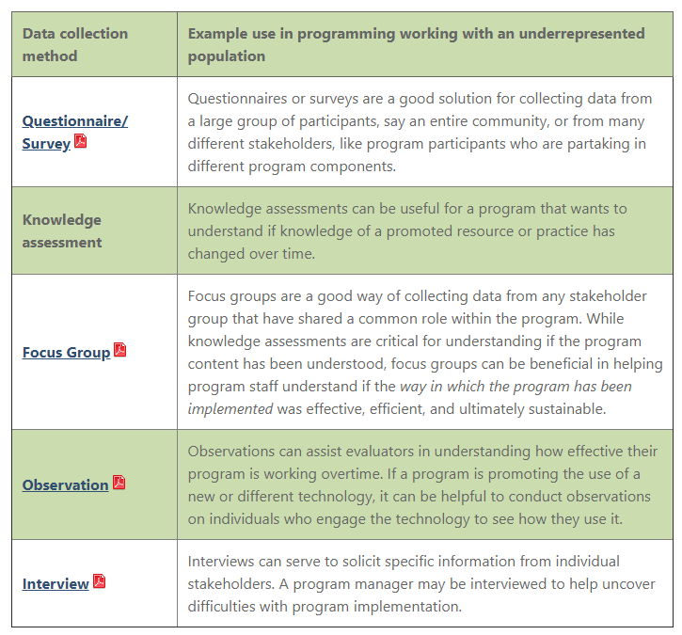
Step 5: Collect Data, analyze, and act part 6
Step 5:
Collect Data, analyze, and act
Collect Data
Ensure the privacy and confidentiality of all participants
Select a sampling strategy
Consider whether quantitative and/or qualitative data collection methods are appropriate for reporting on program outcomes
Using pre-designed data collection instruments can save time and provide results that are more generalizable to the population.
However, pre-designed instruments may not work the same way and measure the same things across different populations - a design element named cross-cultural equivalence.
Field testing all data collection instruments can help to improve the information collected.
Notes:
Briefs from CDC explaining each data collection method in greater detail are available on the website

Slide 66
Step 5: Collect Data, analyze, and act part 7
Step 5:
Collect Data, analyze, and act
Analyze Data
Quantitative
Qualitative
“The setting of the workshop as well as the opening activities made me feel comfortable to share my story with the group.”
Notes:
Quantitative data are information gathered in numeric form.
Analysis of quantitative data requires statistical methods.
Results are typically summarized in graphs, tables, or charts.
More information on quantitative analysis
Qualitative data are information gathered in non-numeric form, usually in text or narrative form.
Analysis of qualitative data relies heavily on interpretation.
Qualitative data analysis can often answer the 'why' or 'how' of evaluation questions.
More information on qualitative analysis.

Slide 67
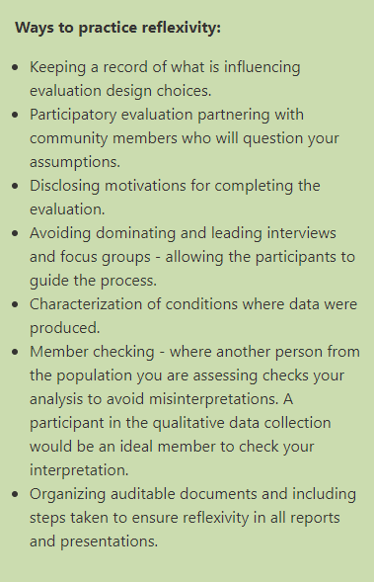
Step 5: Collect Data, analyze, and act part 8
Step 5:
Collect Data, analyze, and act
Analyze Data
Notes:
One thing we talk about on the race and ethnicity pathway in particular is the practice of reflexivity when analyzing qualitative data- it allows an analyst to minimize their influence over the data
Qualitative analysis is inherently more subject to the influences of the participants and the evaluator.
Reflexivity, the self-awareness of the degree of influence an evaluator exerts over findings, is particularly important for evaluating programs that take place within power structures, where racism can consciously or subconsciously influence an evaluator’s findings.
Member checking, where a participant in the qualitative data collection process reviews notes and findings, helps to ensure conclusions are fair representations of the situation.

Slide 68
Step 5: Collect Data, analyze, and act part 9
Step 5:
Collect Data, analyze, and act
Act: Data Visualization and Communication
Identify your audiences for your evaluation findings.
For each audience or stakeholder group, determine what they want or need to know.
Consider the best way to engage each audience or stakeholder group.
All outcomes found should be placed in a larger context, including the influence of structural and systemic issues like government policies, resource allocation, intergenerational wealth and education, and racism.
Responses to the outcomes found in the evaluation should include the direct involvement and decision making of multiple stakeholder groups and community members.
Create effective data visualization.
Choose the right type of graph or chart.
Simplify your results so that the key message is communicated.
Use colors, sizes, shapes, and labels to direct attention to key messages.
Title the visualization to clearly communicate the purpose/findings.
Notes:
Share information gathered in your evaluation with stakeholders to ensure they understand your program successes and challenges.
Align stakeholders around the program and allow for planning for future iterations or versions of the program.
Evaluations can be summarized as evaluation reports, Power Point Presentations, dashboards, static infographics, and/or 2-page briefs depending on the needs of stakeholders.
More information on data visualization and communication strategies
Evaluations that are working to reduce disparities between one racial/ethnic group and another group or dominant cultural norms, need to be transparent and fully detail their process from start to finish.
All outcomes found should be placed in a larger context, including the influence of structural and systemic issues like government policies, resource allocation, intergenerational wealth and education, and racism.
Creation and review of findings with community members and stakeholders can help ensure that information is presented in a respectful way.
Responses to the outcomes found in the evaluation should include the direct involvement and decision making of multiple stakeholder groups and community members.
Be open to other interpretations or responses to your evaluation findings.
If a program is renewed for subsequent program cycles, then using the findings of the evaluation can improve how responsive the program is to the needs of program participants.
Disseminating information from the evaluation back to the community that you worked with can help ensure accountability and clarify subsequent actions.
It is a sign of respect to include the community that you worked with, and an all too often forgotten piece of evaluation.
One method of sharing findings is to hold a seminar with community members where you go over findings and hand out paper copies of the evaluation report to community members.

Slide 69
Demo & example
Notes:
Becky to share screen and demonstrate the resources available on the Race and Ethnicity Pathway page

Slide 70
Question & Answer
Notes:
At this time we will take any questions that the attendees have.

Slide 71
Next Steps
Upcoming pathway-specific trainings (recorded); all held at 11 am PST/2 pm EST
Rural Health
January 29, 2021
Notes:
To better support the socialization and use of these pathways, we have organized 5 webinars which will be recorded.

