Slide 1
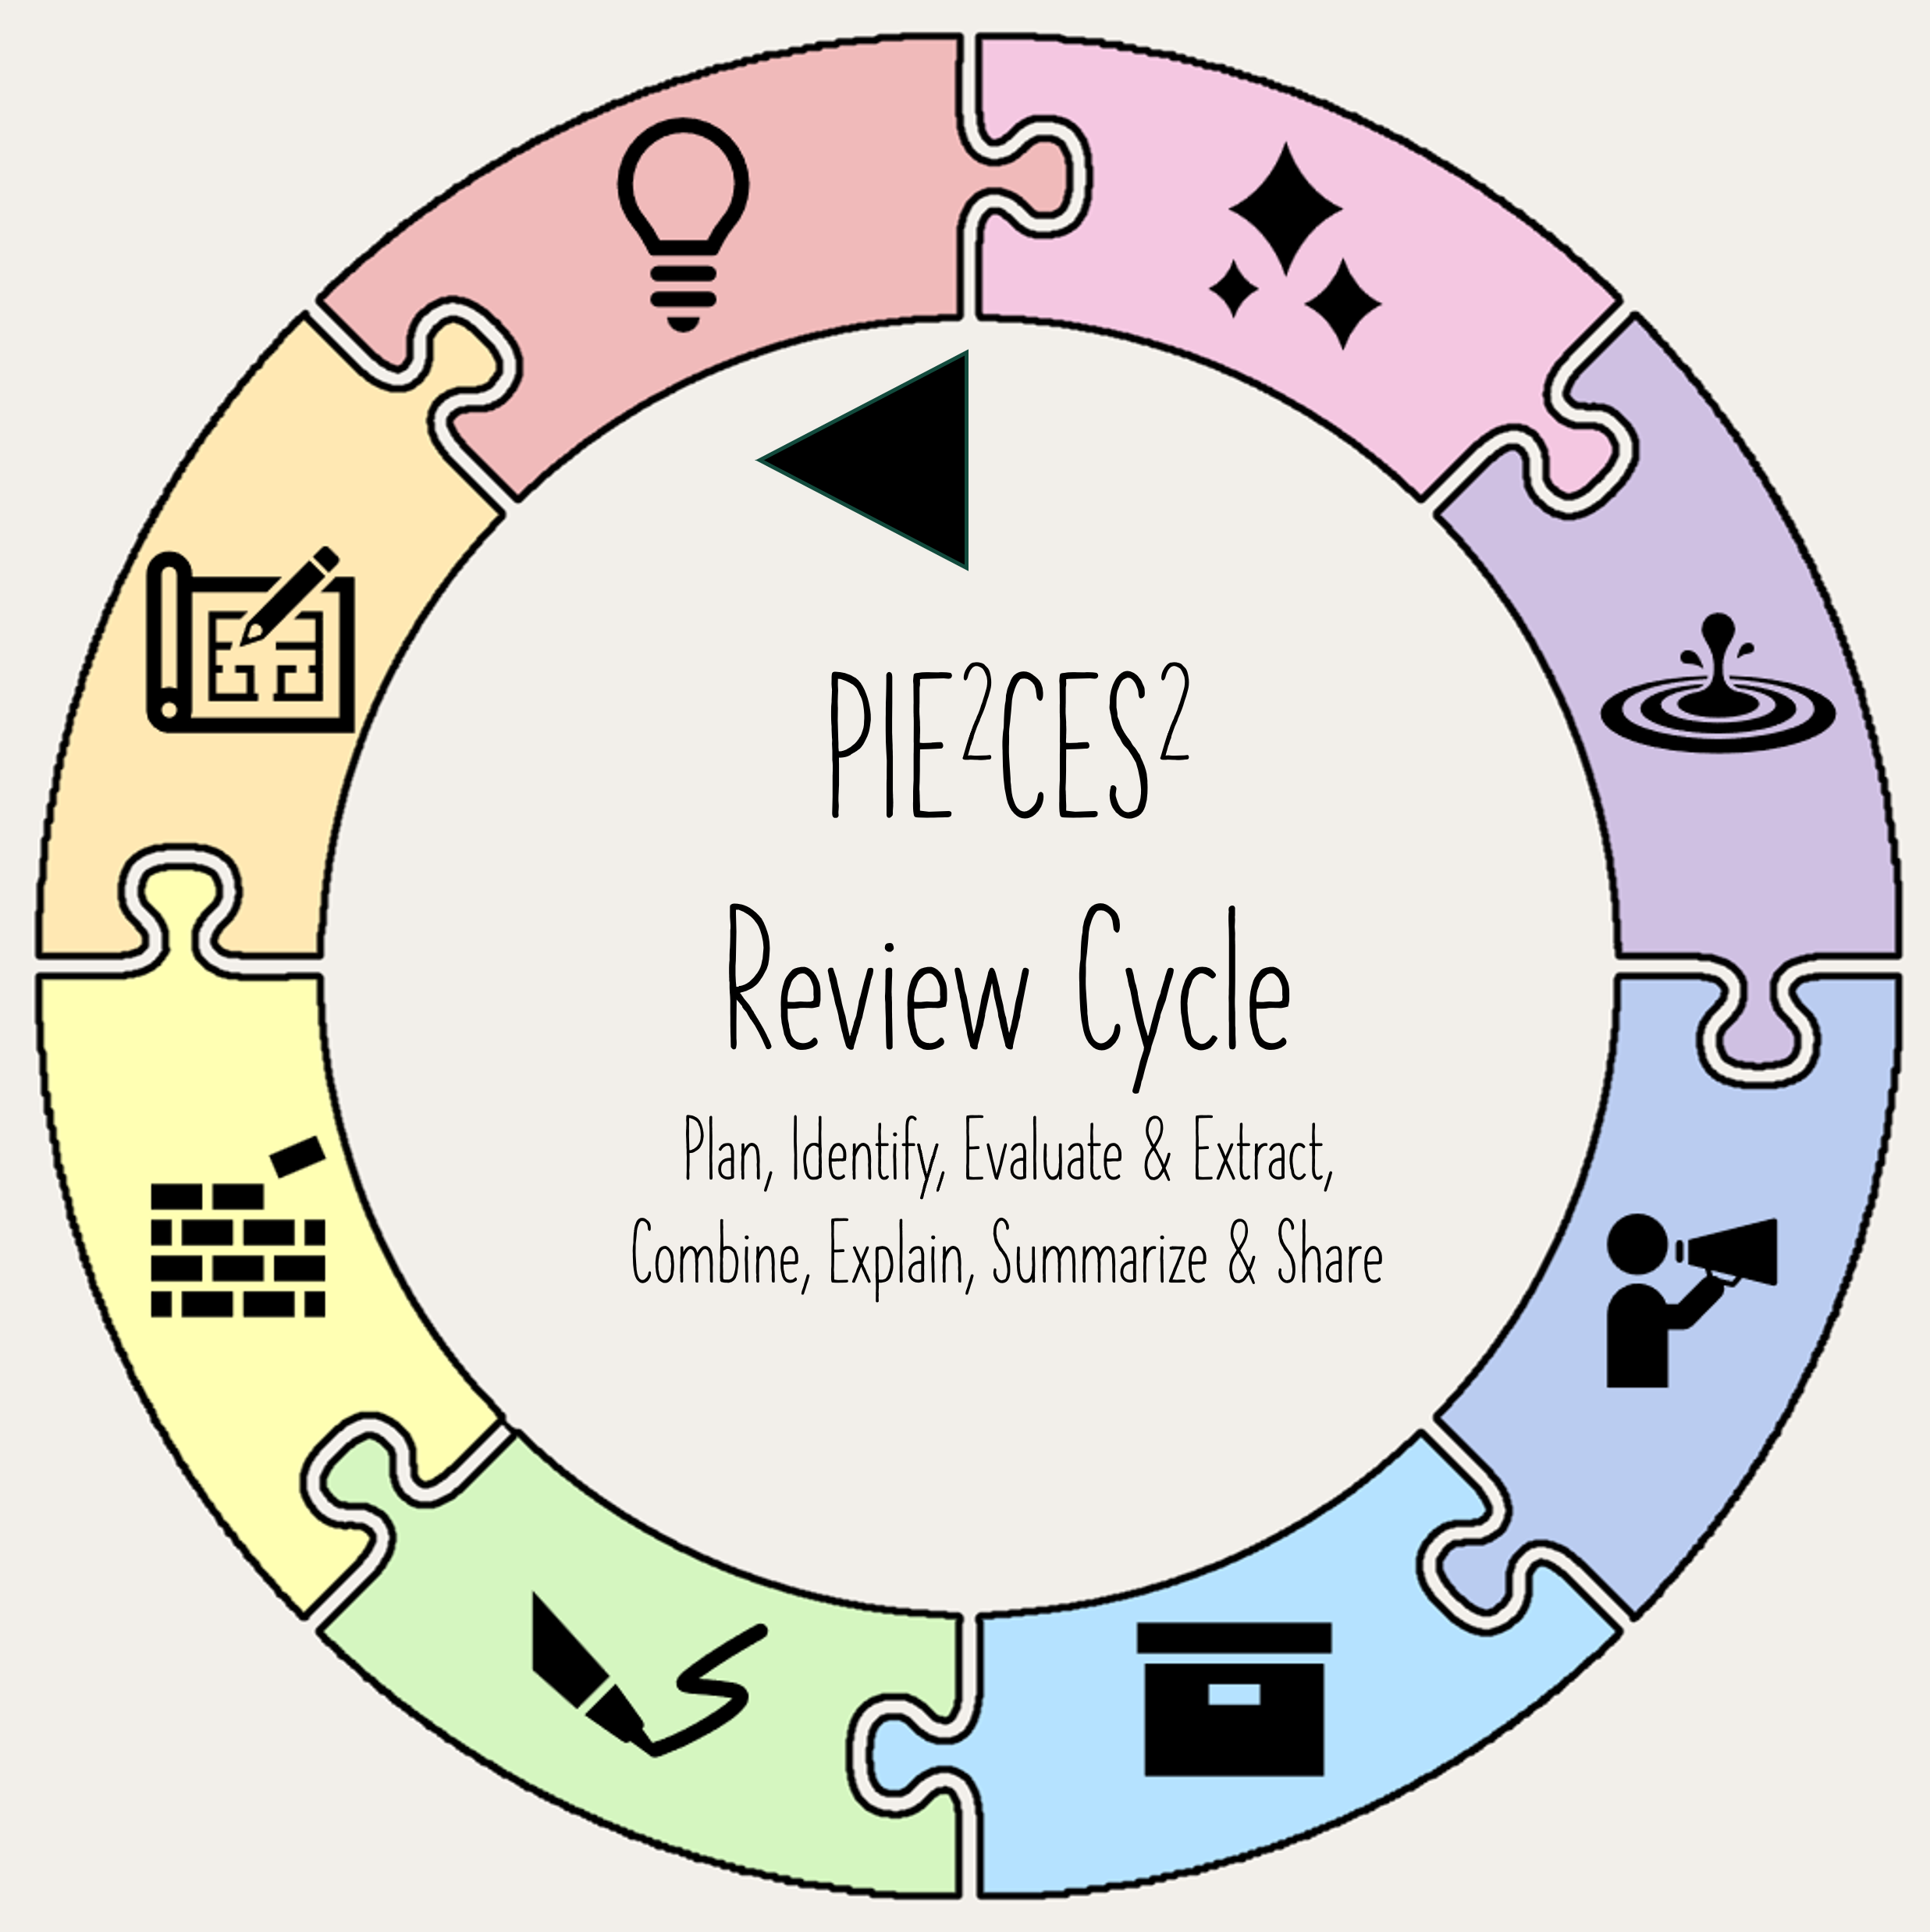
NNLM Series Piecing together reviews: Part 4 Paper
Margaret Foster, MS, MPH
Evidence Synthesis & Scholarly Communication Librarian
Medical Sciences Library, Texas A&M University
September 25, 2024

Slide 2
Objectives
Describe additional searches to database searching
Describe when and how to update searches
Describe standards for reporting searches
List potential options for librarian input into written reports of reviews

Slide 3
Phases of Review
---------
By amount of literature sorted
Proposal: What is the scope of the review?
only 100 articles or so to test feasibility
Protocol: What are the methods of the review?
100-200 articles
just enough to pilot methods
Production: What are the preliminary findings?
some % to see trends or for poster or presentation
Paper: Writing up paper/ what is the context?
all articles processed

Slide 4
Phase 4: paper
1: Plan
Determine how the writing will be done
Consider authorship
Select journals
2: Identify
Run grey lit searches
Additional search techniques
Update searches
3: Evaluate> Extract> Combine
Process all studies
4: Explain> Summarize> Share
Search methods
PRISMA flowchart
Limitations

Slide 5
1 plan
Determine process for writing
Select journal
Negotiating authorship

Slide 6
1-1 process of writing
Timeline?
Where will draft be shared?
Division of writing?
Citation software?

Slide 7
1-2 Selecting a journal
Make potential list of journals
Seek recommendations
Consider journals of included articles
JANE (Journal Author Name Estimator)* limited to Pubmed Journals
Publishers like Elsevier, Wiley, Springer, Taylor & Francis also have journal selection pages

Slide 8
Considerations for selection
Match for Topic Review
Journal Reach
Journal Processes
Consider Open Access
Identify the Scope
Consider the Audience
Evaluate Previous Publications (esp. reviews)
Do they publish SRs?
Check Journal Metrics
Make sure comparisons are appropriate within discipline
Check for Indexing
Indexed in PubMed?
Others?
Review Submission Guidelines
Assess the Review Process
Guidelines specific to SRs? PRISMA?
# of words, tables? How do supplements/ appendices work?
Consider Open Access vs. Subscription
Understand Copyright and Fees
Does the institution have discounts/ negotiated rates? Grants?

Slide 9
1-3 Authorship
ICMJE Criteria
Criteria & SR Librarians
Best practices

Slide 10
Authorship: 4 criteria to meet from ICMJE
Substantial contributions to the conception or design of the work; OR
the acquisition, analysis, or interpretation of data for the work; AND
International Committee of
Medical Journal Editors
Drafting the work or revising it critically for important intellectual content; AND
Final approval of the version to be published; AND
Agreement to be accountable for all aspects of the work in ensuring that questions related to the accuracy or integrity of any part of the work are appropriately investigated and resolved.
International Committee of Medical Journal Editors

Slide 11
Authorship: usual librarian role
Criteria 1
Substantial contributions to the conception or design of the work;
Framing the question, determining review type, eligibility critera, other steps
OR
the acquisition, analysis, or interpretation of data for the work;
Searching, retrieving citations, management of citations
International Committee of Medical Journal Editors

Slide 12
More from guidelines site:
“ The criteria are not intended for use as a means to disqualify colleagues from authorship who otherwise meet authorship criteria by denying them the opportunity to meet criterion #s 2 or 3. Therefore, all individuals who meet the first criterion should have the opportunity to participate in the review, drafting, and final approval of the manuscript.”
Recommendations also describe:
Non-author contributors
AI usage
International Committee of Medical Journal Editors

Slide 13
Best practices
Items to cover in written policies:
Tasks by librarian meeting
author criteria
contribution level
Will librarians cover any part of OA fees?
Have written policies
Discuss in initial meeting
Revisit as needed
May consider order of authorship
Corresponding author?
Alphabetical?
Order by point system?

Slide 14
How do you handle authorship?

Slide 15
2 Identify
Why search beyond databases?
2-1 Grey literature
2-2 Additional searching techniques
2-3 Update/modify searches as needed

Slide 16
Publication bias
Submit your article today!
occurs “when results of published studies are systematically different from unpublished studies”
Significant
results
Other
results
35.7% other
34.5% time/priority
10.2% journal rejection
19.6% unimportant results
Notes:
The reason is publication bias which occurs “when results are published studies are systematically different from unpublished studies” OR when a situation occurs making it more difficult to locate studies due to nature & direction of research findings. It would not be so bad if the reasons you were missing studies was not tied to their results.

Slide 17
Publication bias types
Selective outcome reporting bias
Selective reporting of some outcomes but not others in order to be published
Truncation bias
Study is published in a briefer form with less details
Location bias
journals with different ease of access/levels of indexing in standard databases
Time-lag bias
Delayed publication of findings
Language bias
More likely to be published in English
Multiple (duplicate) publications
Multiple/single publications
Citation bias
Citation/non-citation of research findings
Database bias
Some databases are more likely to index certain languages/journals
Publication Bias in Meta-Analysis. Publication Bias in Meta-Analysis (pp. 1-7)

Slide 18
MECIR Standards for additional searching
Standard # | Main statement M: Mandatory HD: Highly desired | Cochrane Handbook
C27 M | Search trials registers and repositories of results, where relevant to the topic, through ClinicalTrials.gov, the WHO International Clinical Trials Registry Platform (ICTRP) portal and other sources as appropriate. | Section 4.3.3
C28 HD | Search relevant grey literature sources such as reports, dissertations, theses and conference abstracts. | Section 4.3.5
C29 HD | Search within previous reviews on the same topic. | Section 4.3.5
C30 M | Searching reference lists: Check reference lists in included studies and any relevant systematic reviews identified. | Section 4.3.5
C31 HD | Searching by contacting relevant individuals and organizations | Section 4.3.2

Slide 19
2-1 Grey literature
Grey lit types & sources
Study Registers
Searching the internet

Slide 20
Determine types of grey literature
Some databases already include some type of grey literature
Consider searching the internet for wide range grey literature
Conference proceedings
Dissertations
Government Docs
Study Registers
Conference Proceedings Citation Index- Science (Clarivate)
COS Conference Papers Index (Proquest)
Ex: Embase, Compendex
ProQuest Dissertation and Theses Global
Open Dissertations
Ex: CINAHL, APA PsycInfo
GovInfo
FDA
Patents
Laws
Policies
ERIC
ClinicalTrials.gov
WHO ICTRP
List of Registries from National Institutes of Health

Slide 21
Study registers
ClinicalTrials.gov
Use Other terms field instead of “condition” field
AND, OR, NOT needs to be capitalized
Use “” for phrases
Ex: (rheumatism OR arthritis) AND “pain management”
WHO ICTRP
Use Other terms field instead of “condition” field
Two or more words in a row are automatically searched as a phrase
Asterisk (*) works as truncation
Synonyms automatically added to search (except those with *)
Hunter K E, Webster A C, Page M J, Willson M, McDonald S, Berber S et al. Searching clinical trials registers: guide for systematic reviewers BMJ 2022; 377 :e068791 doi:10.1136/bmj-2021-068791

Slide 22
Tips for searching web
Issue with reproducibility is low in web searches¹
Consider searching incognito to remove geographic differences
Consider different types of search engines
Limit search for documents by limiting file type, websites searched (or not searched)
+salt "systematic review" file: .pdf,.doc -https://www.ncbi.nlm.nih.gov/pubmed/
When to stop going through results
Popcorn method- look through until nothing relevant found on a page
Set a limit- only look through first 200 results²
1 Bubble effect: including internet search engines in systematic reviews introduces selection bias and impedes scientific reproducibility.
2 Optimal database combinations for literature searches in systematic reviews: a prospective exploratory study
Tools to consider
Carrot 2
Million Short (free to 100 searches)
DuckDuckGo

Slide 23
2-2 other strategies
Contact
Manual searching
Cited/Citing references
Errata searching

Slide 24
Contact authors/ organizations
Studies wanted!
Population
Intervention
Outcomes
For systematic review
Send to:
Advertise for studies in highly relevant listservs or other formats to professional or other organizations
Email authors known to publish studies on topic, such as those who published included studies, conference papers, or registered a trial

Slide 25
Manual searching?
Also called:
Browsing
Hand-searching
Needed?
Not required by Cochrane Handbook
Could be needed if an important resource is known to be an issue in that it not well indexed

Slide 26
Searching for cited/citing references
Potential steps
Search for each included article/ related review in database
such as Web of Science, Scopus, others?
Will you do this or train SR team?
Option A- export all cited/citing references for sorting
Option B- screen at the moment for potential, then export selected for sorting
Option C- export all cited/citing references to citation software, search within for abstracts matching set of terms, export for sorting

Slide 27
Errata searching
C48: Examining errata (Mandatory)
Examine any relevant retraction statements and errata for information.
Some studies may have been found to be fraudulent or may have been retracted since publication for other reasons. Errata can reveal important limitations, or even fatal flaws, in included studies. All of these may lead to the potential exclusion of a study from a review or meta-analysis.
For all included studies, search for retractions, errata, comments
These can be downloaded from the start
However, if using search filter these maybe excluded
Also be published at a later date.
Cochrane Handbook MECIR Standard C48

Slide 28
2-3 updating & modifying search
Some choose to update along the way with alerts
Others update a key times (at start of writing paper)

Slide 29
Updating search
Limiting Medline (Ovid) by date
limit 8 to (dt="20230101-20240925" or ed="20230101-20240925" or rd="20230101-20240925")
ed: entry date, dt: created date; rd: revision date
Limiting Embase (Ovid) by date
limit 8 to (dd="20230101-20240925" or rd="20230101-20240925")
dd= date delivered, rd= revision date
Within 6 months of publication?
May only need to update main db’s (not every resource)
Limiting searches by time:
By date (Medline, Embase)
Some only by month/date
Others only by year

Slide 30
Modifying the search
New studies found in grey literature or additional search strategies?
Its all relative..
If adjusting the search adds thousands of new citations, may not be worth it.
Discuss options with team
Scroll through potential new citations
Do the new studies have vague abstracts?
Are any of the new studies indexed in databases already search?
May need to modify searches:
Check to see why newly find article did not appear
What happens if you modify search to catch missed articles?
Is it worth it? Too many irrelevant citations?

Slide 31
Try it out! Pick an option below
Carrot2
https://search.carrot2.org/
Try a simple search then add more complexity with more synonymns
Compare Web results to Pubmed results
View options: List, Tree map, Pie Chart
JANE (Journal Author Name Estimator)
https://jane.biosemantics.org/
Paste or type in a title or keywords
Click on hover over an article influence number to get explanation
Click on show articles to see examples

Slide 32
3 Evaluate > Extract> Combine
Team needs to complete processing all citations

Slide 33
4 Explain> summarize> Share
Abstract
Search narrative
Search tables
PRISMA-Flowchart
Limitations

Slide 34
4-1 Abstract Item 4 in PRISMA-Abstract
Title | 1 | Identify the report as a systematic review.
Objectives | 2 | Provide an explicit statement of the main objective(s) or question(s) the review addresses.
Eligibility criteria | 3 | Specify the inclusion and exclusion criteria for the review.
Information sources | 4 | Specify the information sources (e.g. databases, registers) used to identify studies and the date when each was last searched.
Risk of bias | 5 | Specify the methods used to assess risk of bias in the included studies.
Synthesis of results | 6 | Specify the methods used to present and synthesise results.
Included studies | 7 | Give the total number of included studies and participants and summarise relevant characteristics of studies.

Slide 35
Examples of item 4 in abstracts
Example A
“We searched PubMed, Embase, Cochrane and CNKI databases to assess the literature on AI+medical/medical education from 2017 to July 2022. The main inclusion criteria include literature describing the current situation or predicament of "AI+medical/medical education".
Artificial intelligence for healthcare and medical education: a systematic review.
Example B
Data sources: PubMed, PsycINFO, MEDLINE, CINAHL, Cochrane Library, EMBASE, SPORTDiscus, Scopus and Web of Science. Eligibility criteria for selecting studies: Studies published by June of 2016 that addressed clinical recovery from concussion.
Predictors of clinical recovery from concussion: a systematic review.
Example C
Articles were retrieved from PubMed, Scopus, and Cochrane library through a comprehensive search strategy. Studies that included medical, dental, nursing, allied healthcare professional, undergraduates, postgraduates, and interns from the same disciplines who used mobile applications for their academic learning and/or daily clinical practice were considered.
Mobile applications in medical education: A systematic review and meta-analysis.

Slide 36
4-2 search narrative
Covered by PRISMA-2020 and PRISMA-search
2 items in PRISMA-2020
16 items in PRISMA-search
Articles:
Rethlefsen ML, Page MJ. PRISMA 2020 and PRISMA-S: common questions on tracking records and the flow diagram. J Med Libr Assoc. 2022 Apr 1;110(2):253-257. doi: 10.5195/jmla.2022.1449. PMID: 35440907; PMCID: PMC9014944.
Rethlefsen ML, Kirtley S, Waffenschmidt S, Ayala AP, Moher D, Page MJ, Koffel JB; PRISMA-S Group. PRISMA-S: an extension to the PRISMA Statement for Reporting Literature Searches in Systematic Reviews. Syst Rev. 2021 Jan 26;10(1):39. doi: 10.1186/s13643-020-01542-z. PMID: 33499930; PMCID: PMC7839230.

Slide 37
PRISMA 2020 checklist
Section | # | Description
Information sources | 6 | Specify all databases, registers, websites, organisations, reference lists and other sources searched or consulted to identify studies. Specify the date when each source was last searched or consulted. | More details in elaboration document and much of it matches PRISMA-Search
Search strategy | 7 | Present the full search strategies for all databases, registers and websites, including any filters and limits used.

Slide 38
PRISMA-Search
INFORMATION SOURCES AND METHODS
Database name | 1 | Name each individual database searched, stating the platform for each.
Multi-database searching | 2 | If databases were searched simultaneously on a single platform, state the name of the platform, listing all of the databases searched.
Study registries | 3 | List any study registries searched.
Online resources and browsing | 4 | Describe any online or print source purposefully searched or browsed (e.g., tables of contents, print conference proceedings, web sites), and how this was done.
Citation searching | 5 | Indicate whether cited references or citing references were examined, and describe any methods used for locating cited/citing references (e.g., browsing reference lists, using a citation index, setting up email alerts for references citing included studies).
Contacts | 6 | Indicate whether additional studies or data were sought by contacting authors, experts, manufacturers, or others.
Other methods | 7 | Describe any additional information sources or search methods used.

Slide 39
PRISMA-Search 2
SEARCH STRATEGIES
Full search strategies | 8 | Include the search strategies for each database and information source, copied and pasted exactly as run.
Limits and restrictions | 9 | Specify that no limits were used, or describe any limits or restrictions applied to a search (e.g., date or time period, language, study design) and provide justification for their use.
Search filters | 10 | Indicate whether published search filters were used (as originally designed or modified), and if so, cite the filter(s) used.
Prior work | 11 | Indicate when search strategies from other literature reviews were adapted or reused for a substantive part or all of the search, citing the previous review(s).
Updates | 12 | Report the methods used to update the search(es) (e.g., rerunning searches, email alerts).
Dates of searches | 13 | For each search strategy, provide the date when the last search occurred.
PEER REVIEW
Peer review | 14 | Describe any search peer review process.
MANAGING RECORDS
Total Records | 15 | Document the total number of records identified from each database and other information sources.
Deduplication | 16 | Describe the processes and any software used to deduplicate records from multiple database searches and other information sources.

Slide 40
Additional items from PRISMA 2020 elaboration
If natural language processing or text frequency analysis tools were used to identify or refine keywords, synonyms, or subject indexing terms to use in the search strategy, specify the tool(s) used.
If a tool was used to automatically translate search strings for one database to another, specify the tool used.
If the search strategy was validated—for example, by evaluating whether it could identify a set of clearly eligible studies—report the validation process used and specify which studies were included in the validation set.
If the search strategy was peer reviewed, report the peer review process used and specify any tool used, such as the Peer Review of Electronic Search Strategies (PRESS) checklist.
If the search strategy structure adopted was not based on a PICO-style approach, describe the final conceptual structure and any explorations that were undertaken to achieve it (for example, use of a multi-faceted approach that uses a series of searches, with different combinations of concepts, to capture a complex research question, or use of a variety of different search approaches to compensate for when a specific concept is difficult to define).
Page MJ, Moher D, Bossuyt PM, Boutron I, Hoffmann TC, Mulrow CD, Shamseer L, Tetzlaff JM, Akl EA, Brennan SE, Chou R, Glanville J, Grimshaw JM, Hróbjartsson A, Lalu MM, Li T, Loder EW, Mayo-Wilson E, McDonald S, McGuinness LA, Stewart LA, Thomas J, Tricco AC, Welch VA, Whiting P, McKenzie JE. PRISMA 2020 explanation and elaboration: updated guidance and exemplars for reporting systematic reviews. BMJ. 2021 Mar 29;372:n160. doi: 10.1136/bmj.n160. PMID: 33781993; PMCID: PMC8005925.

Slide 41
Example A: search narrative
# | Item
1 | Database name (and platform)
2 | Multi-database searching
3 | Study registries
4 | Online resources and browsing
5 | Citation searching
6 | Contacts
7 | Other methods
8 | Full search strategies
9 | Limits and restrictions
10 | Search filters
11 | Prior work
12 | Updates
13 | Dates of searches
14 | Peer review
15 | Total Records
16 | Deduplication
The search strategy was developed, and search terms were selected through discussions between all authors, as well as consultation with a UCC librarian in January 2023. The first author conducted literature searches relevant to the research question to aid in identifying key terms. The following five databases were searched from 5 April to 8 April 2023: Pubmed, PsycINFO, Scopus, Web of Science, Google Scholar. The first 200 results from Google Scholar were considered as these are likely to be the most relevant to the current review (Bramer et al., 2017). Both backwards and forwards search of relevant papers were completed, whereby the reference lists, as well as lists of studies that have cited relevant papers, were hand-searched to identify relevant papers that may not have been identified on these scholarly databases.
The following search terms were used in order to identify relevant literature: ‘sensory processing’ OR ‘sensory profile’ OR ‘sensory sensitivity’ OR ‘environmental sensitivity’ OR ‘highly sensitive person’ OR ‘HSP’ AND ‘stress’ OR ‘burnout’ OR ‘acute stress’ OR ‘distress’ NOT ‘PTSD’ OR ‘post-traumatic’ OR ‘post traumatic’ OR ‘traumatic’ NOT ‘child*’ OR ‘adolescen*’.
Harrold A, Keating K, Larkin F, Setti A. The association between sensory processing and stress in the adult population: A systematic review. Appl Psychol Health Well Being. 2024 Jun 4. doi: 10.1111/aphw.12554. Epub ahead of print. PMID: 38838078.

Slide 42
Example B: search narrative
# | Item
1 | Database name (and platform)
2 | Multi-database searching
3 | Study registries
4 | Online resources and browsing
5 | Citation searching
6 | Contacts
7 | Other methods
8 | Full search strategies
9 | Limits and restrictions
10 | Search filters
11 | Prior work
12 | Updates
13 | Dates of searches
14 | Peer review
15 | Total Records
16 | Deduplication
Multiple databases were searched for potentially relevant records. These included MEDLINE (via PubMed), Embase (via OvidSP) and PsycINFO (via OvidSP). Grey literature was searched through abstracts on Embase and ongoing studies via the WHO International Clinical Trials Registry Platform. Lastly, a manual reference review of included articles and identified reviews was conducted (full search strategy in Data S1, Supplementary Materials 1). The search was last updated on 25 August 2022.
Supplementary materials 1 – Search strategy (Embase and APA PsycInfo searches also listed)
MEDLINE (COVID-19.mp OR SARS-CoV2.mp OR SARS-CoV-2.mp OR long covid.mp OR persistent covid.mp OR post covid.mp OR post-acute sequelae of SARS-CoV-2.mp OR PASC.mp OR COVID-19 sequelae.mp OR long-haul covid.mp OR long-tail COVID.mp) AND (cognit*.mp OR moca.mp OR ACE-I.mp OR memory.mp OR neurocog*.mp OR MMSE.mp OR executive.mp OR dysexecutive syndrome.mp OR aphas*.mp OR apraxi*.mp OR agnos*.mp OR concentration.mp OR visuospa*.mp OR attention.mp)
Fanshawe JB, Sargent BF, Badenoch JB, Saini A, Watson CJ, Pokrovskaya A, Aniwattanapong D, Conti I, Nye C, Burchill E, Hussain ZU, Said K, Kuhoga E, Tharmaratnam K, Pendered S, Mbwele B, Taquet M, Wood GK, Rogers JP, Hampshire A, Carson A, David AS, Michael BD, Nicholson TR, Paddick SM, Leek CE. Cognitive domains affected post-COVID-19; a systematic review and meta-analysis. Eur J Neurol. 2024 Feb 20:e16181. doi: 10.1111/ene.16181. Epub ahead of print. PMID: 38375608.

Slide 43
Example C: search narrative
# | Item
1 | Database name (and platform)
2 | Multi-database searching
3 | Study registries
4 | Online resources and browsing
5 | Citation searching
6 | Contacts
7 | Other methods
8 | Full search strategies
9 | Limits and restrictions
10 | Search filters
11 | Prior work
12 | Updates
13 | Dates of searches
14 | Peer review
15 | Total Records
16 | Deduplication
To ensure accuracy of the review, a search strategy was developed in collaboration with the Research and Education Librarian at the affiliated institution. The search aimed to identify randomized controlled trials, nonrandomized controlled trials, pre-post studies, and observational studies with quantitative data on the relationship between yoga interventions or practitioners and body image outcomes. Database searches were conducted using Pubmed, Ovid MEDLINE, Embase, Cochrane, CINHAL, and PsycInfo up to 2 December 2023. Computer assisted search protocols used combinations of keywords, free text terms, subsets, and exploded medical subject headings (MeSH). A combination of terms from the following search string was used: "yoga“ AND ("body dysmorphia" OR "body dysmorphic disorder" OR "body image disturbance" OR "appearance concerns" OR "body dissatisfaction“ OR "body perception" OR "body image issues" OR "body image dissatisfaction" OR "Shape concern" OR "drive for thinness" OR "weight concern" OR "body image" OR "body discomfort" or "body appreciation"). Additional searches were conducted using grey literature, theses, dissertations, the reference lists of included papers, and relevant reviews.
Rupani N, Miller J, Renteria JA, Kaliebe KE. The impact of yoga on body image in adults: A systematic review of quantitative studies. Body Image. 2024 Jul 23;51:101772. doi: 10.1016/j.bodyim.2024.101772. Epub ahead of print. PMID: 39047524.

Slide 44
4-3 Prisma flowchart
Updated PRISMA 2020
Many still use old template
Template is just example
Note- the template is just one version- importance is the information
Example- Don’t have to give reasons at title/abstract level but some choose to.

Slide 45
Methods to get flowchart
PRISMA Flowchart generator
Creates flowchart in various forms, pdf, svg, png
PRISMA2020: An R package and Shiny app for producing PRISMA 2020-compliant flow diagrams, with interactivity for optimised digital transparency and Open Synthesis (see handout).
Can also download code to use in R software
Many review software programs provide PRISMA flowchart
Issues arise when
not everything is added to software
duplicates are handled outside the software

Slide 46
Examples of PRISMA flowchart for SRS
Mobile applications in medical education: A systematic review and meta-analysis
Efficacy and Safety of Bromocriptine-QR as an Adjunctive Therapy on Glycemic Control in Subjects with Uncontrolled Type 2 Diabetes Mellitus: A Systematic Review and Meta-analysis

Slide 47
4-4 prisma-2020 limitations
To what extent are you confident that the search identified all potentially eligible studies?
Were there other appropriate resources not searched?
Did any limits potentially block relevant results from being retrieved?
Note- Publication bias is measured by funnel plot, but this only be created if meta-analysis is conducted.

Slide 48
PRISMA Elaboration 23c
Discussing limitations, avoidable or unavoidable, in the review process should help readers understand the trustworthiness of the review findings. For example, authors might acknowledge the decision to restrict eligibility to studies in English only, search only a small number of databases . .
They might also acknowledge that they were unable to access all potentially eligible study reports …
While some limitations may affect the validity of the review findings, others may not.
Page MJ, Moher D, Bossuyt PM, Boutron I, Hoffmann TC, Mulrow CD, Shamseer L, Tetzlaff JM, Akl EA, Brennan SE, Chou R, Glanville J, Grimshaw JM, Hróbjartsson A, Lalu MM, Li T, Loder EW, Mayo-Wilson E, McDonald S, McGuinness LA, Stewart LA, Thomas J, Tricco AC, Welch VA, Whiting P, McKenzie JE. PRISMA 2020 explanation and elaboration: updated guidance and exemplars for reporting systematic reviews. BMJ. 2021 Mar 29;372:n160. doi: 10.1136/bmj.n160. PMID: 33781993; PMCID: PMC8005925.

Slide 49
Example of limitation sections
“This systematic review encountered some limitations which must be considered. The search strategy included only five databases for gathering articles, and only those published in English were included. Only studies with a five-year time span (January 2020 to May 2024) that were free full texts were included, and other studies that may have had relevant information were excluded.”
Sangster E, Lanka N, Acharya P, Virani S, Afreen S, Perthiani A, Nassar ST. Factors Contributing to the Development of Neuropsychiatric Manifestations in Persons With Multiple Sclerosis: A Systematic Review. Cureus. 2024 Aug 8;16(8):e66432. doi: 10.7759/cureus.66432. PMID: 39246867; PMCID: PMC11380372.
“However, this review has a number of limitations that should be considered. Firstly, only papers that were published in English were included. This excludes potential other language studies that may be relevant and may skew the findings towards studies based in WEIRD countries.“
Harrold A, Keating K, Larkin F, Setti A. The association between sensory processing and stress in the adult population: A systematic review. Appl Psychol Health Well Being. 2024 Jun 4. doi: 10.1111/aphw.12554. Epub ahead of print. PMID: 38838078.

Slide 50
Questions on summarizing the search

