Slide 1
How can I save my results or share them with a colleague?
Apply

Slide 2
Discussion question
What types of situations do you think you would prefer to write a very specific search query that returns few results as opposed to writing a broader query that will return numerous results that you can then filter?
Notes:
[NOTE TO FACILITATOR: If you are completing these modules in an order other than suggested in the facilitation guide, you may need to adjust these discussion points.]

Slide 3
Objectives
By the end of the program, participants will:
Describe the use of My NCBI to save searches, create collections, and receive email alerts

Slide 4
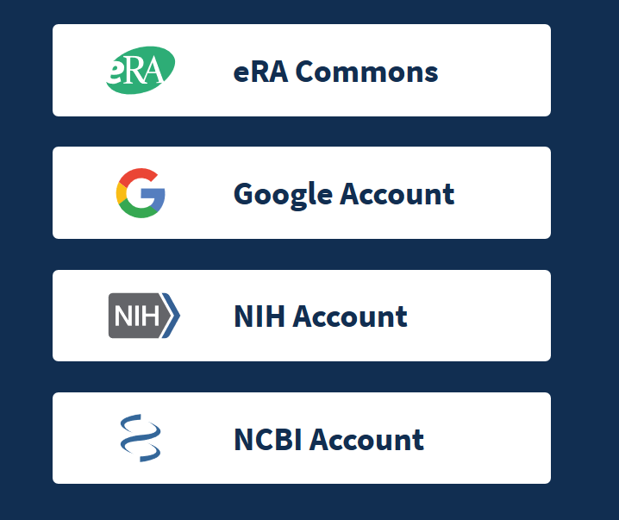
NCBI Account
On the upper right of PubMed, click “Log in.” You can create an NCBI account or log in if you already have one.
Notes:
Although you don’t need an account to use most of PubMed’s features, having one can be helpful if you want to save searches, citations, or filter sets.
To create an account or sign in, click on “Log in” on the very top right of the PubMed page. From here, select “NCBI Account”
NCBI is the National Center for Biotechnology Information, the branch of the National Library of Medicine that produces and maintains PubMed.

Slide 5
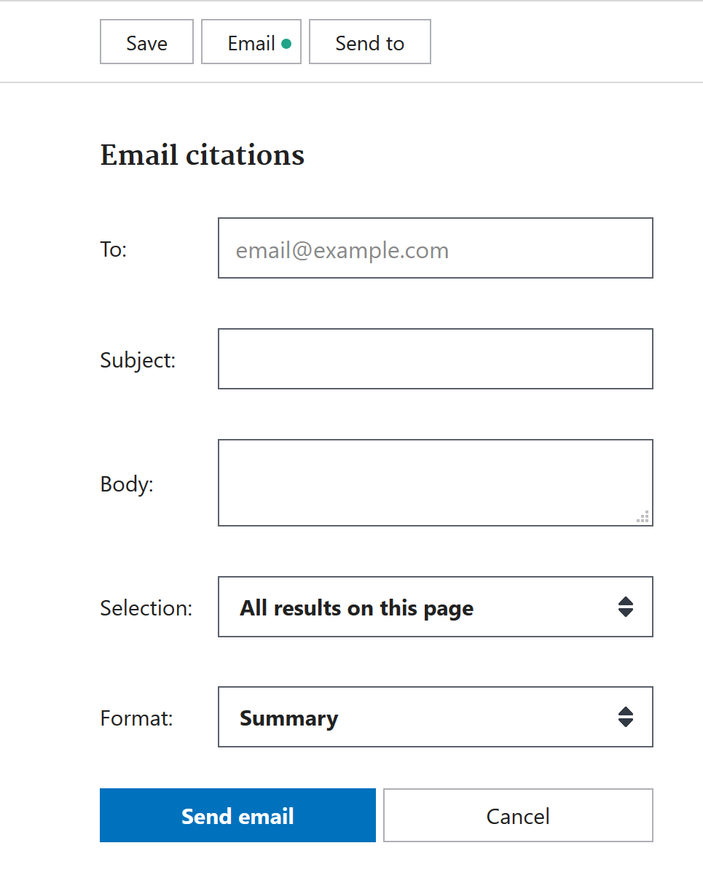
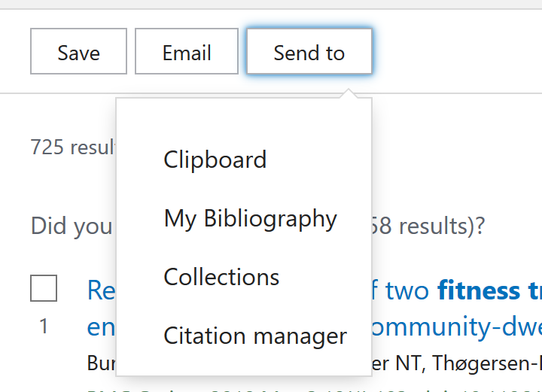
Sharing your results
Notes:
Saving or sharing your searches is very useful if you want to track literature on a topic over time or discuss some research with your colleagues.
One of the simplest ways to save or share your search results is to use the Send To feature directly on the search results page. Here you can select to send your results to a citation manager program or your own collection of citations which you can create and add to. The other option I want to point out it e-mail. E-Mail is pretty self-explanatory – you can send your results or a selection of them to your email or to someone else’s email.

Slide 6
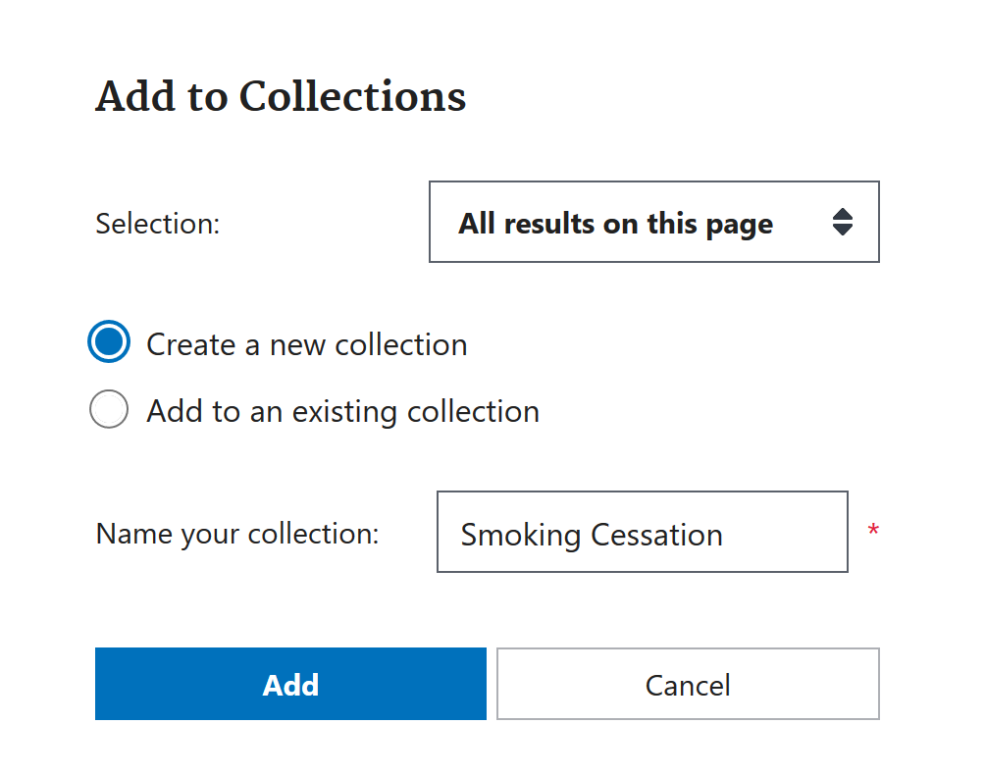
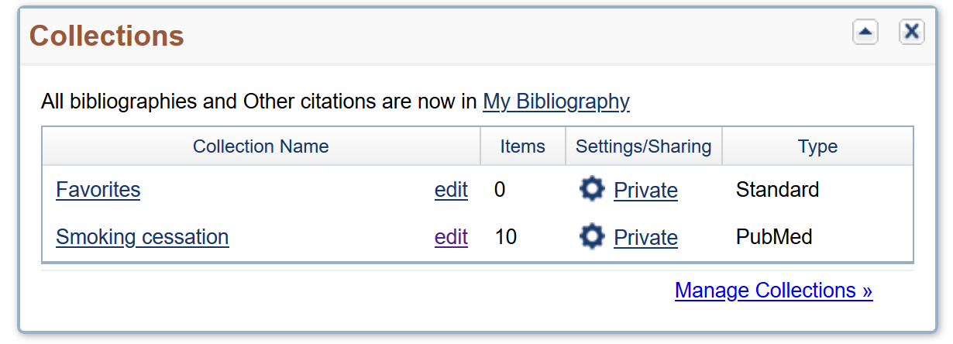
Collections
Notes:
On the previous slide, I mentioned collections under the “send to” option. With Collections, you can build a collection of citations on a particular topic, from a particular author, or however else you want to organize them.
You can either select items using the checkmarks next to the citation in the results list, or you can send up to 1,000 of the results automatically to a collection of your choice.
You will be prompted to either select a pre-existing collection or create a new collection, which you can name.
You can then access your collections through the My NCBI page, which is accessible on the right side of the top blue bar on any PubMed page once you are logged in.
You can adjust the settings on your collections if you’d like to share them. Once you set a collection to public, you’ll be given a direct URL to share with anyone you’d like.

Slide 7
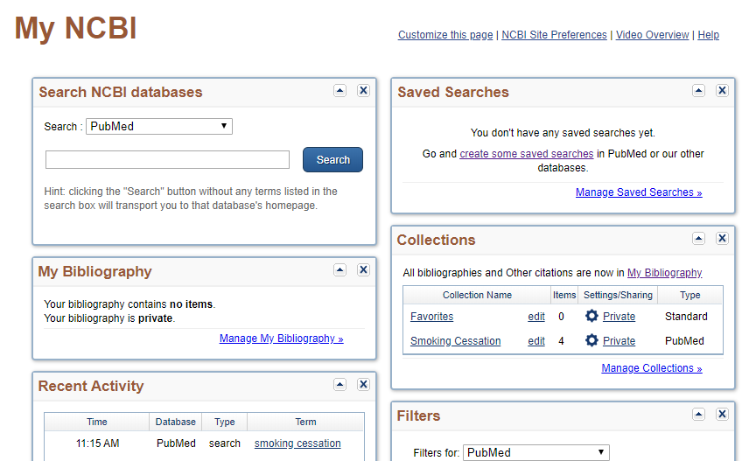
My NCBI (1)
Notes:
The My NCBI page also has some other useful features, besides Collections, which we just looked at, relating to saving and sharing search results.
First, you can access your saved searches.

Slide 8
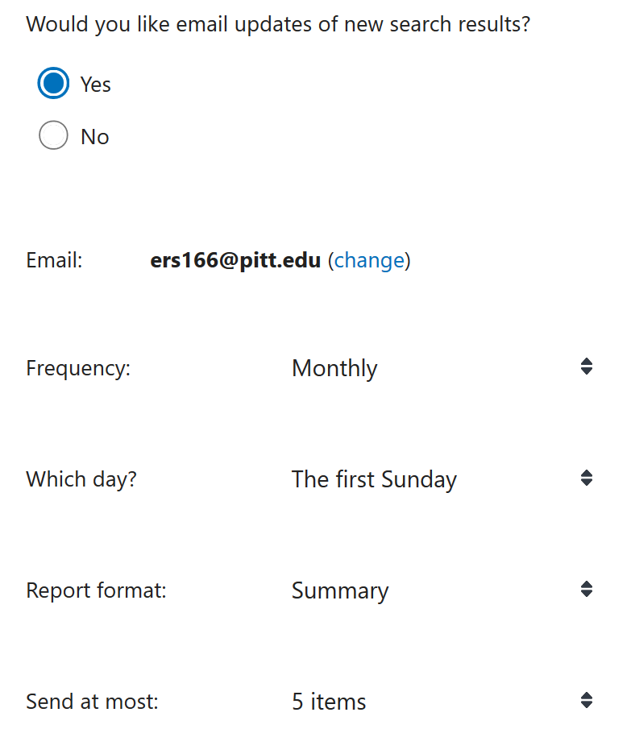
Saved Searches
Notes:
To save a search, click “Create alert” directly under the search bar once you’ve run your search. This will save the search (which you can also edit here if you need to), allow you to name the search, and allow you to sign up for email alerts for new results in this search. You can specify the frequency, format, etc. of the email alerts.

Slide 9
My NCBI (2)
Notes:
Back on the My NCBI page, you can also access a few other handy features. You can access your recent searches and viewed articles. This is handy if you can’t find an article you were just looking at anymore!
You can also create and save custom filter sets for PubMed or some other NCBI databases. If you find yourself frequently looking for articles with the same set of characteristics (for instance, clinical trials reported in English and carried out on adolescents published in the last 5 years), you can create a filter set to apply all these filters at once.

Slide 10
Take home message
Remember:
PubMed provides several easy ways to save and share searches or citations – as well as a few other useful features
If you log in, you can save searches (and set up email alerts), create collections, view your recent activity, and even set up custom filters
Consider:
What do you think are the most useful features of a My NCBI account?
Developed resources reported in this presentation are supported by the National Library of Medicine (NLM), National Institutes of Health (NIH) under cooperative agreement number UG4LM012342 with the University of Pittsburgh, Health Sciences Library System. The content is solely the responsibility of the authors and does not necessarily represent the official views of the National Institutes of Health.
Notes:
The main takeaway from today is that PubMed provides several easy ways to save and share searches or citations – as well as a few other useful features. Without logging in, you can send results via email or with a direct URL to the search.
If you log in, you can save searches (and set up email alerts), create collections, view your recent activity, and even set up custom filters.
[NOTE TO FACILITATOR: If you want to complete group discussion immediately following this module content, change the title of this slide to ‘Group Discussion’ and delete the slide with corresponding questions in the next module. If you would like to have discussion take place using your internal LMS system, you can include instructions here for how participants can participate. Then, adjust the slide with the corresponding questions in the next module as needed.]

