Slide 1
Shared Decision Making
Steps & Tips

Slide 2
Discussion points from last module
What do you think the most important communication strategies are when it comes to shared decision making?
Notes:
[NOTE TO FACILITATOR: If you are completing these modules in an order other than suggested in the facilitation guide, you may need to adjust these discussion points.]

Slide 3
Objectives
By the end of the program, participants will:
Describe recommended communication for shared decision

Slide 4
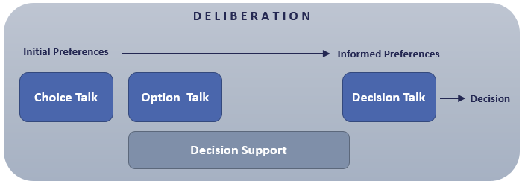
Elwyn, et al. (2012) SDM Framework
Fig 1. Elywn,G., Frosch, D., Thomson, R., Joseph-Williams, N., Lloyd, A., Kinnersley, P.,… Barry, M. (2012). Shared Decision Making: A Model for Clinical Practice, Journal of General Internal Medicine, 27(10), 1361-1367.
Notes:
At the end of the last module we looked at this framework from Elwyn, et al. (2012). This focused on putting the existing research about shared decision making into steps that could be followed by healthcare providers. They split the deliberation process into three types of “talk”: choice talk, option talk, and decision talk¹, with suggestions for what should be discussed during each type of “talk”.
[NOTE TO FACILITATOR: If you are completing these modules in an order other than suggested in the facilitation guide, you may need to adjust this note.]

Slide 5
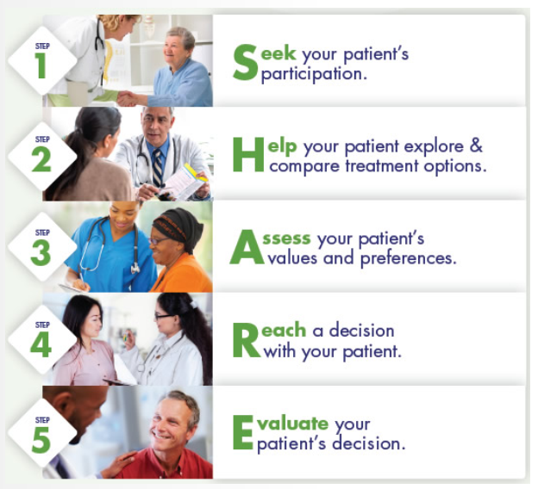
AHRQ SHARE Curriculum
Fig 1. Agency for Healthcare Research and Quality (2018). The SHARE Approach. Retrieved from URL to Source
Notes:
In 2014, the Agency for Healthcare Research and Quality made the SHARE curriculum available. This curriculum is for a 6 hour workshop that supports healthcare providers in communicating about shared decision making. Within this curriculum, there are five suggested steps that make up the process. The recommendations within these steps match the different “talk” options suggested in the Elwyn (2012) model. We’ll talk through an overview of these steps as an introduction to the process of shared decision making, but know that there is more to learn - this is why AHRQ has a 6 hour curriculum! In addition, there are sometimes needs at an organizational level related to shared decision making².
NOTE TO FACILITATOR: If you would like to discuss any organizational support for shared decision making or plans to implement the AHRQ curriculum in the future, feel free to do this here or on the slide that highlights AHRQ recommendations for institutional support.

Slide 6
Step 1: Seek your Patient’s Participation²
Tips:
Summarize the issue^{1,2}
Let them know there are different options^{1,2}
Discuss the importance of participation^{1,2}
Consider including caregivers/ family²
“Now that we have identified the problem, it’s time to think what to do next. There is good information about how these treatments differ that I’d like to discuss with you.”¹
Notes:
Our overview of shared decision will include an introduction to the steps in the SHARE curriculum from the Agency for Healthcare Research and Quality and how they match with previously published recommendations for shared decision making. We’ll also talk about communication tips for each step. Step one is seeking a patient’s participation². As discussed in the last module, some patients may not want to participate, but attempting to engage them is recommended². This step aligns with the idea of choice talk in the model by Elwyn, et al (2012). They explain that patients can sometimes be unaware about uncertainty in healthcare - such as the realities that some treatments may not always work and that side effects vary¹, which is why SDM stresses that patients understand the importance of being involved^{1,2}. Communication suggestions for this step include summarizing the health issue and then letting a patient know that a choice exists¹. You can see an example here, with the statement “Now that we have identified the problem, it’s time to think what to do next. There is good information about how these treatments differ that I’d like to discuss with you.”¹ The AHRQ also suggests considering if a patient’s family or caregivers should be involved².
[NOTE TO FACILITATOR: If you are completing these modules in an order other than suggested in the facilitation guide, you may need to adjust this note.]

Slide 7
Step 2: Help your Patient Explore and Compare Treatment Options²
Tips:
Check current knowledge^{1,2}
List options^{1,2}
Describe options clearly^{1,2}
Use decision tools^{1,2}, when available²
Summarize^{1,2} and check for understanding (teach back)²
“What have you heard or read about the treatment of prostate cancer?”¹
“Let me list the options before we get into more detail.”¹
Notes:
The second step recommended by AHRQ is helping patients explore and compare treatment options². This matches with the idea of option talk that Elwyn, et al. (2012) presented and is where the patient gets more detail about the different options available¹. The first suggestion when communicating about the options is to check the patient’s existing knowledge about the issue^{1,2} like you see in the first word bubble here, which uses the example of prostate cancer: “What have you heard or read about the treatment of prostate cancer?”¹ It is also suggested to list the options for the patient^{1,2} like you see here with the statement, “Let me list the topics before we get into more detail.”¹ It is important that as the options are listed, that clear communication be used so that the risks and benefits are understood². One way to check for understanding is to use teach back², which we discussed during our health literacy section. This is also a place where someone’s understanding of numbers comes into play and is a step where the recommendations about communicating numeracy we discussed in the health literacy section can be useful². This is also a step where a provider can choose to use a decision aid^{1,2}, which we talked about during our last discussion. NOTE TO FACILITATOR: If your organization has decision aids created in house, you can discuss how to access these.
After the options have been reviewed, it is suggested to check for understanding by summarizing the discussion and using teachback^{1,2}. These are communication techniques that were discussed in previous modules.
[NOTE TO FACILITATOR: If you taught these tracks out of sequence, you may want to consider incorporating the referenced modules from the Health Literacy Track in combination with this track.]

Slide 8
Step 3: Assess your Patient’s Values and Preferences²
Tips:
Encourage thinking about what is most important^{1,2}
Elicit a preference¹
Open ended questions²
Active listening²
Empathy²
Acknowledge their values and preferences²
“What, from your point of view, matters most to you?”¹
Notes:
Step three from AHRQ is assessing patient’s values and preferences, which can help guide decision making². This aligns with what Elwyn, et. al (2012) referred to as decision talk, which is when a patient thinks through options after having been informed¹. Suggested communication here includes encouraging a patient to think about what matters most to them^{1,2}. Eliciting a preference is also a suggested step¹. Communication skills to elicit a preference include using open-ended questions, active listening and expressing empathy². These are all techniques that we discussed during the modules on health literacy and motivational interviewing. In addition, AHRQ suggests acknowledging the preferences and values that the patient expresses².
[NOTE TO FACILITATOR: If you taught these tracks out of sequence, you may want to consider incorporating the referenced modules from the Health Literacy Track in combination with this track.]

Slide 9
Step 4: Reach a Decision with your Patient²
Tips:
Ask if they are ready to decide^{1,2}
Ask if they need more time or more information^{1,2}
Confirm the decision²
Schedule necessary follow up²
“Are you ready to decide?”¹
“Do you want more time?”¹
“Are there more things we should discuss?”¹
Notes:
The fourth step is to reach a decision when the patient is ready². This step also matches with the Elwyn, et al. (2012) description of decision talk when they describe the process of moving toward a decision¹. In this step, communication tips include asking a patient if they are ready to decide or if they need more time or information^{1,2}. Once they make the decision, AHRQ suggests confirming and scheduling necessary follow up².

Slide 10
Step 5: Evaluate your Patient’s Decision²
Consider how well the treatment is implemented²
Assist the patient with overcoming barriers to following their treatment decision²
Revisit the decision to discuss other possible decisions²
Notes:
The final step - evaluating the decision - includes revisiting the decision after a period of time². This means monitoring how well the treatment is implemented and helping the patient work through any challenges they have following the treatment decision². AHRQ also suggests revisiting the decision with the patient if needed².

Slide 11
Take home message
Consider:
How do you already use Shared Decision Making?
Practice:
What useful tips from these models would you consider using in practice?
Developed resources reported in this presentation are supported by the National Library of Medicine (NLM), National Institutes of Health (NIH) under cooperative agreement number UG4LM012342 with the University of Pittsburgh, Health Sciences Library System. The content is solely the responsibility of the authors and does not necessarily represent the official views of the National Institutes of Health.
Notes:
This is our final module in the shared decision making track, but I ask you to consider the following: How do you already use shared decision making? What useful tips from these models would you consider using in practice?
[NOTE TO FACILITATOR: If you want to complete group discussion immediately following this module content, change the title of this slide to ‘Group Discussion’ and delete the slide with corresponding questions in the next module. If you would like to have discussion take place using your internal LMS system, you can include instructions here for how participants can participate. Then, adjust the slide with the corresponding questions in the next module as needed.]

Slide 12
Please complete the post-test questions
Notes:
[NOTE TO FACILITATOR: if you choose not to have participants complete the knowledge assessment questions, delete this slide.]

Slide 13
References
Elywn,G., Frosch, D., Thomson, R., Joseph-Williams, N., Lloyd, A., Kinnersley, P.,… Barry, M. (2012). Shared Decision Making: A Model for Clinical Practice, Journal of General Internal Medicine, 27(10), 1361-1367.
Agency for Healthcare Research and Quality (2018). The SHARE Approach. Retrieved from URL to Source

