Slide 1
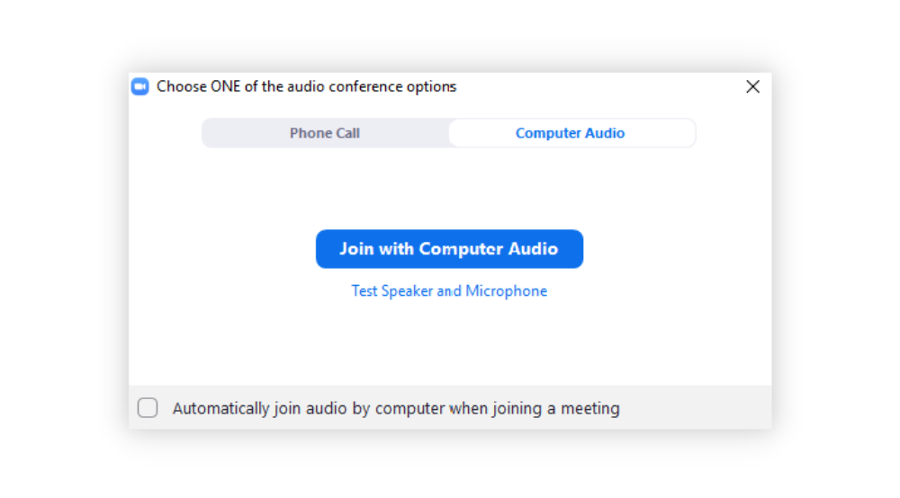
Number 1
Connect Audio
Your audio box will look similar to this
when you enter the Zoom session.
If you want to use your phone for audio, click Phone Call
If you want to use your computer for audio, click
Join with Computer Audio
If you want to automatically use these settings when entering future sessions, click this box before joining
We’ll start at the top of the hour.
NNLM
Region 2 and Region 3
Notes:
Good morning everyone, and welcome to NNLM Grants and Proposal Writing. We will get started in just a few more minutes. In the meantime, we would like to ask everyone to fill out a three-question survey. It’s completely anonymous, but it will help us report out the impact of these webinars. If you have any questions or are having any technical issues, please type them into the chat box.

Slide 2
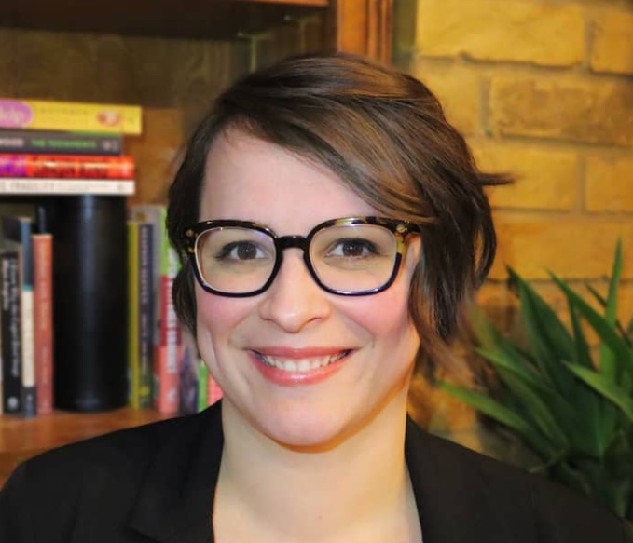
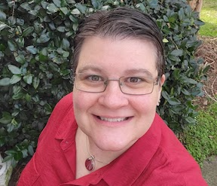
NNLM Grants and Proposal Writing
Network of the National Library of Medicine
July 27, 2023
Bailey Sterling (she/her)
Region 3
Debra Trogdon-Livingston (she/her)
Region 2
Notes:
Hello everyone! Welcome to “NNLM Grants and Proposal Writing”. My name is Bailey Sterling, and my pronouns are she/her. I am the Student Engagement and Marketing Strategist for the Network of the National Library of Medicine (NNLM), Region 3. My name is Debra Trogdon-Livingston and my pronouns are she/her. I am the user experience and Education Strategist for Region 2.
This webinar has closed captioning. All registrants will receive a link to the recording once it’s processed and uploaded to our YouTube channel. All your microphones are muted to cut down on background noise. Please type any questions or comments you have in the chat box – please make sure you’re sending to “all participants.” This webinar grants 1 Medical Library Association Continuing Education credit. To claim the credit, please click on the link that we will share in the chat at the end of the webinar.

Slide 3
Land Acknowledgement
Land acknowledgments are an honest and historically accurate way to recognize native communities of this land by those of us who are not members of those communities. Presenting land acknowledgments recognizes histories that have been systematically erased.
The Region 2 RML recognizes the native communities of the land on which we live and work in Charleston, South Carolina, including the Etiwan, Kiawah, Santee, Edisto, Nachez-Kusso, and Wassamassaw people.
The Region 3 RML recognizes the native communities of the land on which we live and work in Fort Worth, Texas, including the Jumanos, Wichita, Comanche, Kickapoo, and Tawakoni people.
Notes:
Land acknowledgments are an honest and historically accurate way to recognize native communities of this land by those of us who are not members of those communities. Presenting land acknowledgments recognizes histories that have been systematically erased.
The native peoples of this region include the Etiwan, Kiawah, Santee, Edisto, Nachez-Kusso, and Wassamassaw people.
The Region 2 RML recognizes the native communities of the land on which we live and work in Charleston, South Carolina.

Slide 4
Labor Acknowledgement
A labor acknowledgment is a statement that recognizes that much of the economic progress and development in a geographic area or industry resulted from the unpaid labor and forced servitude of People of Color - specifically enslaved African labor.
The R2 and R3 RMLs recognize that the United States as we know it was built at the expense of forcefully enslaved Black people and that it continues to benefit from the labor of oppressed people, including other people of color. We acknowledge that much of what we know of this country today, including its culture, economic growth, and development, has been made possible by the labor of enslaved Africans, their descendants, immigrant workers, impoverished people, domestic workers, and others who have endured tragic circumstances for the economic growth of the country and the privileges enjoyed by few.
This history continues the legacies of intergenerational trauma today. We strive to remain mindful and to use our work to support the health and well-being of all people.
Fitchburg State University: https://fitchburgstate.libguides.com/Fitchburg-State-land-labor-acknowledgements
Loyola University: https://libguides.luc.edu/c.php?g=1238384
Notes:
A labor acknowledgment is a statement that recognizes that much of the economic progress and development in a geographic area or industry resulted from the unpaid labor and forced servitude of People of Color - specifically enslaved African labor.
The Region 2 and Region 3 RMLs recognize that the United States as we know it was built at the expense of forcefully enslaved Black people and that it continues to benefit from the labor of oppressed people, including other people of color. We acknowledge that much of what we know of this country today, including its culture, economic growth, and development, has been made possible by the labor of enslaved Africans, their descendants, immigrant workers, impoverished people, domestic workers, and others who have endured tragic circumstances for the economic growth of the country and the privileges enjoyed by few.
This history continues the legacies of intergenerational trauma today. We strive to remain mindful and to use our work to support the health and well-being of all people.
Fitchburg State University: https://fitchburgstate.libguides.com/Fitchburg-State-land-labor-acknowledgements
Loyola University: https://libguides.luc.edu/c.php?g=1238384

Slide 5
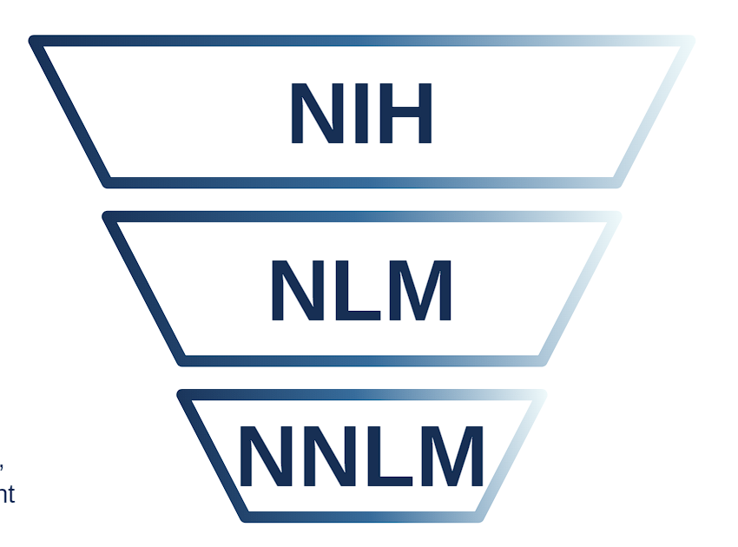
Who are we?
The National Institutes of Health (NIH), a part of the U.S. Department of Health and Human Services, is the nation’s medical research agency, made up of 27 different components called Institutes and Centers.
The National Library of Medicine (NLM) is the world’s largest biomedical library and a leader in research in computational health informatics.
The Network of the National Library of Medicine (NNLM) is the outreach arm of NLM, working to spread awareness and engagement with NLM/NIH resources.
Notes:
Before we get into today’s topic, a word about who we are! The National Institutes of Health is the nation’s leading medical research agency. The National Library of Medicine is an institute at the NIH. NLM is the world’s largest biomedical library which produces information resources such as PubMed. ClinicalTrials.gov, and MedlinePlus. NNLM is the Network of the National Library of Medicine. We are the outreach program of NLM.

Slide 6
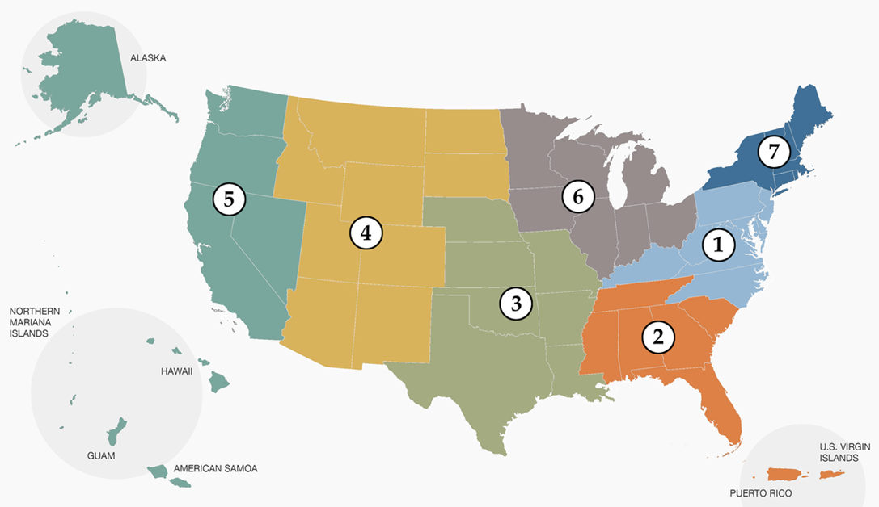
What is NNLM?
Focused on health literacy, progress in the field of medicine, and improving public health
Divided into 7 Regions, each with a Regional Medical Library (RML) that serves as "headquarters" for that region, spearheading and managing outreach efforts
Mission: Advance the progress of medicine and improve the public health by:
Providing all U.S health professionals with equal access to biomedical information.
Improving the public's access to information to enable them to make informed decisions about their health.
Notes:
The Network operates out of seven regional medical libraries, or RMLs. The RMLs offer training and funding opportunities to support equal access to biomedical information. Those are our acronyms! I mentioned in my introduction that I work in Region 7. We will drop the link for where you can find your regional medical library. Contacting your RML is especially important when you are applying for funding. At NNLM, our mission is to provide equal access to biomedical information to health professionals as well as access to quality health information for the general public so they are better able to make informed decisions about their health. We do this through resources on our website, funding of projects, in person trainings, and webinars – just like this one.
Regions Link: https://nnlm.gov/about/regions

Slide 7
Objectives
At the end of the session participants will be able to:
Apply for funding from NNLM
Describe the basic sections of a proposal
Identify types of documents necessary to include with a proposal
Recognize common mistakes of proposal writers
Notes:
This one-hour webinar is designed as an introduction to proposal writing for beginners. We offer this webinar to help prepare you for NNLM funding opportunities. We have seven regions across the country. Each region operates a little differently. We will show you how to check with your region for details about funding opportunities. After this webinar, you should be able to: Apply for funding from NNLM. Describe the basic sections of a proposal. Identify types of documents necessary to include with a proposal. And recognize common mistakes of proposal writers. For additional information, we recommend the NNLM Proposal Writing Toolkit. The link is included on your handout, and we will drop it in the chat now: https://www.nnlm.gov/guides/nnlm-proposal-writing-toolkit I will refer to this Toolkit throughout the webinar.

Slide 8
Have you applied before?
Notes:
Please put in the chat if you have applied for funding from the Network of the National Library of Medicine before, or if this is your first time. (Pause)

Slide 9
Organizational Membership
User account
Organization
Contact person
Directory
Notes:
You all have a NNLM User Account. You needed a User Account to register for this webinar. If you apply for funding with the NNLM, your organization will need to sign up for a Membership Account. This is free. You, or another person at your organization, will need to log into a NNLM User Account to fill out the NNLM member organization form. Each Organizational Member must designate a contact person to receive NNLM communications. This includes communication about funding opportunities and applications. Anyone in the organization can have an individual User Account to participate in training. We need just one contact person for the Organizational Membership. Your Organization will be listed publicly in our Membership Directory. We ask that you keep the Directory up-to-date by reviewing your information annually and whenever organizational changes occur. If you apply with another organization keep in mind that all funding organizations will need some basic similar details.

Slide 10
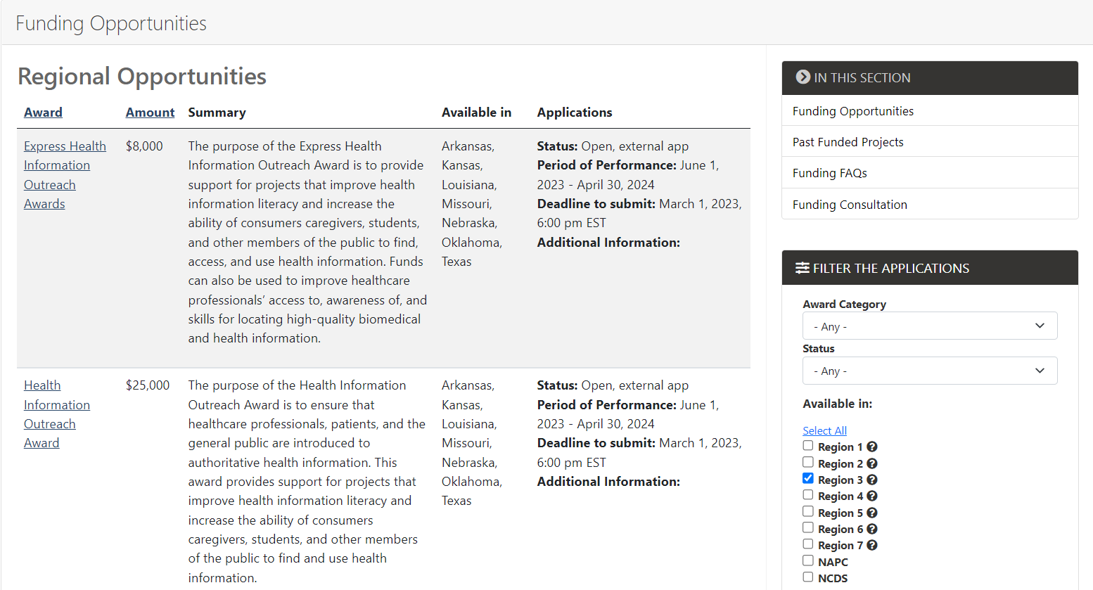
Funding Opportunities
Notes:
Once you join our network, you will have access to our funding opportunities. Being a member allow you to sort through funding opportunities from our regions, and to see national funding opportunities from programs like the All of US program. Please make sure you select the region you're in to find the funding opportunities that's best for you.

Slide 11
Additional Information
Grant Writing Resources
508 Compliance
Reporting Requirements
Application Review and Scoring Criteria
Notes:
Beyond the application overview NNLM grants provide a section called Additional Information. Here you can find grant writing resources, 508 Compliance requirements, reporting requirements throughout the funding cycle and how the proposal is scored.
Now I will pass this over to Jen who will take you through the application overview

Slide 12
Filtering Funding Opportunities
On our website, awards can be filtered by:
Type/Category
Status
Region
Find funding: nnlm.gov/funding/rfa
Notes:
You can search for current funding opportunities at the link we are dropping into the chat. NNLM provides funding for health information outreach, technology improvement, data management and services, and professional development. Funding amounts range from $2000-$20,000 and vary by Region and type of award. On this webpage, you will need to filter to your own region. On this slide is a screenshot of the webpage with all the checkboxes next to the Regions (numbered one through seven) checked. The website is defaulted to all boxes checked. You will need to uncheck all the boxes except for your region to perform your search. Generally, your organization must be based in region where you seek funding, or you are planning to do work in that region. Find Funding Link: https://nnlm.gov/funding/rfa

Slide 13
Health-related Projects
Social determinants of health
Patient engagement
Health promotion
Self-management
Health screenings
Peer support
Notes:
Let’s talk about what type of health-related project you’d like to do. The mission of the Network of the National Library of Medicine (NNLM) is to advance the progress of medicine and improve the public health by providing all United States health professionals with equal access to biomedical information; and to improve the public's access to information to enable them to make informed decisions. We fund organizations to help us accomplish our mission. Maybe you want to support efforts to address the social determinants of health, such as housing or food access in your community. Or you could be looking to bridge the gap between researchers and patients by designing a participation in research project. You could join a community coalition to do a health promotion, such as walkable communities. Or what we commonly see here at NNLM is programs to teach self-management of chronic conditions through offering classes in how to use MedlinePlus. A lot of libraries and community organizations do health screenings, such as screenings for sexually transmitted infections, blood pressure and diabetes. Libraries and community organizations offer peer support/social participation events such as memory cafes for people with dementia, or low-sensory storytimes for people with autism. These are broad categories of ideas.

Slide 14
Past Projects and Current Initiatives
Confronting Health Misinformation
Bridging the Digital Divide
Environmental Determinants of Health
Notes:
If you are curious about what NNLM has funded in the past, please look at the NNLM Proposal Writing Toolkit. There is a link to a listing of Past Funded Projects. You can filter by Organization Type, such as public library or faith-based organization. You might want to align your project with one of our current initiatives such as Confronting Health Misinformation, Bridging the Digital Divide, or Environmental Determinants of Health. More ideas are located on the Toolkit https://www.nnlm.gov/guides/nnlm-proposal-writing-toolkit

Slide 15
Getting Ready
Draft proposal
Keep a copy!
Notes:
We’ve talked about the Network of the National Library of Medicine, our mission, and the types of awards that we fund. Let’s talk about how to get ready to write your proposal. WARNING: The NNLM online application has no "save” feature. You cannot save and return to it later. We recommend that you become familiar with the requirements of the proposal and draft each part in a Word doc or similar program. You can copy it into the online form when you are finished. And keep your copy!

Slide 16
Funders’ Terms
RFP
RFA
CFA
Letter of Intent
Letter of Application
Notes:
You will find the requirements of the proposal in the RFP or RFA. I began this webinar by telling you about our acronyms. Now, I will go over a few terms you will come across when you are looking for funding. RFP is request for proposals; RFA is request for applications and CFA is call for applications. Basically, these terms mean the same thing. I would say that RFP is what you will see more often. The National Institutes of Health prefers RFA, and what I’ve read is that RFA’s have a narrower focus. CFA is what you will see from the Robert Wood Johnson Foundation, which is an organization that funds very large health-related programs. Other terms include letter of intent or letter of inquiry. Not all funders require this, but this is a way for the funder to take the pulse of what applicants are planning on before they submit the full proposal. They will want to know who you are, what population you serve, what your general idea is, and a time frame. Not all funders require this, but if they do… you should provide one. And, then the letter of application is like a cover letter for resume when you are job hunting.

Slide 17
Evidence of Need
Your organization
Public data
Stakeholders
Users and non-users
Notes:
The first item in the proposal is the Evidence of Need. Evidence of need is your community’s need for health-related projects, rather than your need for money! We will get to that later. Funders want to make sure that you are serving the needs of your community. To prepare this part of the proposal, brainstorm about what you are seeing, from your vantage point in your organization. And then you will want to look at publicly available data. I will go through those options in a minute. Next, get up from your desk and talk to other people to learn what they are seeing from their desks, or vantage points. Start with a list of stakeholders in community health. Faith-based organizations, anti-poverty organizations, libraries, YMCAs, educators, food banks. What do they see? Lastly, consider talking with non-users of your organization. It might be interesting to hear from people who do not go to the library. Or people who do not attend health-related programs offered at the Senior Center. Find out their perspective. What are the barriers for them?

Slide 18
Nothing About Us
Without Us
Notes:
Nothing About Us Without Us. Let me know in the chat if you have heard this phrase. (Pause) This phrase is used by disability activists, meaning that plans to address the needs of people with disabilities should include input from… people with disabilities! I am hearing this phrase with regards to all sorts of communities. As you work on your proposal, please consult representatives from the community you hope to serve.

Slide 19
Evidence of Need: Publicly Available Data
Robert Wood Johnson Foundation’s County Health Rankings
United States Census Data
Rural Health Information Hub
Community Health Needs Assessments (nonprofit hospitals)
Pew Research Center Internet Trends
Annie E. Casey Foundation Kids Count Data
Local Urban Planning Organizations
Notes:
Here are some publicly available resources to help you demonstrate evidence of need. These links are on the handout. The first is the Robert Wood Johnson Foundation’s County Health Rankings website, which is an excellent source of county-level health data. (https://www.countyhealthrankings.org/) Next is US Census Data (https://data.census.gov/cedsci/) The Rural Health Information Hub is an excellent resource if you are working in rural America. (https://www.ruralhealthinfo.org/) Community Health Needs Assessments are available from non-profit hospitals. By law, these hospitals need to do an assessment every three years. They are required to share their findings on their websites. Sometimes these assessments are buried in the hospital website, so I recommend googling the hospital or county name and “community health needs assessment”. Usually, that will get you there. The hospitals have done a lot of the groundwork of asking stakeholders and community members about health needs. Really worthwhile to look. For-profit hospitals do not need to do this. The requirement is tied to the non-profit status. If your nearest hospital is for-profit, cast your net wider to the nearest non-profit hospital or search for a county assessment. Pew Research Center studies how Americans are using the Internet, technology and social media. Pew breaks this down by demographics, so you can learn about teens preferences in social media, or trends in older adults using technology. (https://www.pewresearch.org/topic/internet-technology/ If you are thinking about doing a program for youth, or for people working with youth, look at the Annie E. Casey Foundation Kids Count Data. (https://www.aecf.org/work/kids-count/) Look at local urban planning organizations. They are doing some great mapping projects, such as food deserts and pockets of poverty. Let me know in the chat if you use other data resources.

Slide 20
Logic Models
INPUTS | ACTIVITIES | OUTPUTS | SHORT TERM | INTERMEDIATE | LONG TERM
Staff Internal & External partners Time Money | Coordinate staff/partners Develop project Conduct project Evaluate project | # of target population reached | How to… Identify Apply Produce | Training Attendance Technology Purchase Data Services | Improve health
Notes:
Next, the funder wants to read about your goals and objectives. My favorite way to identify Goals and Objectives is through using a logic model. Here is a bare bones logic model. For more information about logic models, please check the link to our National Evaluation Center resources on the handout. https://www.nnlm.gov/nec/evaldesign On this slide is a table with six columns. We will work backwards in the table. For our Goal, we want to think big. For example, “Our goal is to improve health.” The last column in this table is labeled “Long term” and below it says “Improve health.” This is an especially large, sweeping Goal. You might want to work on something a little more specific, but not too specific. Next, we work on our outcomes-based objectives. This gives our project more specificity. Let’s move backwards to the next column labeled “Intermediate”. That column lists Training Attendance as a sample action to get us to improved health. Maybe you are planning to invite community members or your staff to participate in training on accessing reputable health information from the National Library of Medicine. Or maybe (next item in that column) you will be purchasing technology such as hotspots to loan or launching data services for biomedical research. Let’s move backwards to the next column labeled “Short term”. Particularly in a short-term, yearlong project, you want to focus on short term outcomes rather than the broader impact of Improving Health. Who knows if you are will to be able to improve the health of your community within a year? But you could achieve some short-term outcomes. Your community members, or your staff will learn how to… identify, apply, produce. Think through what you are trying to achieve in terms of increased knowledge or skills. If we go backwards again, to the column labeled “Outputs”, this is where we identify our measurable outputs. How many attendees did you reach from your target population? How many staff did you train? How many hotspots did you circulate? How many data projects did you support? Under the column labeled “Activities”, include process activities such as coordinate with staff and/or partners, develop project, conduct project, and evaluate project. Finally, in the first column labeled “Inputs”, we have what we are starting with: staff, internal and external partners, time and money. So, we have our inputs, our activities for getting this project up and running, our measurables or outputs, the short-term knowledge/skills outcomes, intermediate action outcomes, and the long-term impact. In some logic models, we will account for our assumptions. For example, we are assuming that our community partners and our IT personnel will support this effort. We account for external factors, such as weather and (these days, especially) the pandemic. I encourage you not to go crazy with goals and objectives. If you have one sweeping goal and 2-3 objectives, that’s great.

Slide 21
Project Timeline
Kickoff Meeting
Planning Sessions
Project
Evaluation
Final Report
Notes:
You will need to demonstrate your process through a Project Timeline. For example, your proposal states that you will hold a kickoff meeting in May, develop the project over the summer, hold trainings from September to February, and evaluate everything in March. You are letting us know that in March, you will sit down and figure out the extent to which you were able to implement your project as planned, how much community interest you generated, and if there were situational factors (such as IT problems or weather) that impacted your outcomes and how you adjusted for that. At the ended of the project, you will submit a final report.

Slide 22
Additional Documents
Resumes
Letters of support
Budget
Evaluation plan
Continuation plan
Notes:
Additional documents include a resume or curriculum vitae (CV) for each person that is working directly on your project. Those documents will show the funder that the people involved have the skills to implement the project. If you are working with community partners, which we encourage you to do, identify them and get letters of support. You could say that you are going to work with the YMCA, but if the funder doesn’t see a letter of support they might wonder if the YMCA knows that you are planning to work with them. You want to include a detailed budget. You will want to identify what you need and how much you need. I will talk more about that in a minute. You will want a narrative (or justification) of the budget as well as a table of the budget.

Slide 23
Plan to Include
Evaluation plan
Continuation plan
Notes:
You need to include an evaluation plan and a continuation plan. What I mean by continuation plan is: most funders are expecting that they are giving you seed money to try out an idea. But they do not anticipate that they will be able to fund you year after year. They want to see that you are diversifying your funding streams in order to continue this work, or that you will take the results of this work to your organization to make a bid to have it covered in your organization’s budget.

Slide 24
Evaluation Design
nnlm.gov/nec/evaldesign
Notes:
For evaluation planning, I highly recommend that you check out this website from our National Evaluation Center. We do not have time to go into these resources today, but this webpage will go over community assessment, logic models, measurable objectives and how to develop an evaluation plan. There are great ideas for working with specific populations, such as K-12 students, LGBTQIA+ folks, diverse communities, and folks living in rural America.

Slide 25
Budget
Personnel
Consultant Costs
Equipment
Supplies
Travel
Indirect Costs
Notes:
OK, the budget. First thing, look at the RFP/RFA to find out what is allowed and what is not allowed. NNLM does not allow funds to be used for food, furniture or swag (t-shirts, water bottles). We know that food is a big draw for community programs, so please plan on other funds covering that. Other funders might have different restrictions. Make sure you mention the need for the items in your narrative. And please contact the funder with questions. We are happy to answer questions. You want to be thorough when writing your budget. You will want to create a table with line items. This is what we need, and this is how much it costs.

Slide 26
People Costs
Personnel
Consultant Costs
Notes:
OK, the budget. First thing, look at the RFP/RFA to find out what is allowed and what is not allowed. NNLM does not allow funds to be used for food, furniture or swag (t-shirts, water bottles). We know that food is a big draw for community programs, so please plan on other funds covering that. Other funders might have different restrictions. Make sure you mention the need for the items in your narrative. And please contact the funder with questions. We are happy to answer questions. You want to be thorough when writing your budget. You will want to create a table with line items. This is what we need, and this is how much it costs.

Slide 27
Items Costs
Equipment
Supplies
Notes:
OK, the budget. First thing, look at the RFP/RFA to find out what is allowed and what is not allowed. NNLM does not allow funds to be used for food, furniture or swag (t-shirts, water bottles). We know that food is a big draw for community programs, so please plan on other funds covering that. Other funders might have different restrictions. Make sure you mention the need for the items in your narrative. And please contact the funder with questions. We are happy to answer questions. You want to be thorough when writing your budget. You will want to create a table with line items. This is what we need, and this is how much it costs.

Slide 28
Travel and Facilities Costs
Travel
Indirect Costs
Notes:
OK, the budget. First thing, look at the RFP/RFA to find out what is allowed and what is not allowed. NNLM does not allow funds to be used for food, furniture or swag (t-shirts, water bottles). We know that food is a big draw for community programs, so please plan on other funds covering that. Other funders might have different restrictions. Make sure you mention the need for the items in your narrative. And please contact the funder with questions. We are happy to answer questions. You want to be thorough when writing your budget. You will want to create a table with line items. This is what we need, and this is how much it costs.

Slide 29
Five Common Mistakes
Last minute
Purpose
Instructions
Budget narrative
Assumptions
Notes:
So here are the Five Common Mistakes. The first one is waiting until the last minute to gather information. Based upon everything we’ve talked about today, you will see that a good proposal does not happen quickly. I know that it is tempting, when you get an email in your inbox or when someone tells you there’s an opportunity but maybe there is only two weeks until it is due, to really want to throw something together. My advice is to either clear your desk of all other responsibilities so that you can put your full energy into this, or if it is an opportunity that comes up every year, to consider learning about the requirements and waiting until next year to apply. Because it does take some time. The second common mistake that people make is proposing an idea that does not match with the purpose of the award. And some of this is due to your organization’s basic need for funding, and the hope that this source will work. If you read through what the funders are looking for, you might find that your project does not match. Please read the requirements carefully before putting a lot of work into a proposal. The third mistake is similar, and this is ignoring the instructions when writing the proposal. Reviewers are looking at a lot of proposals, so following the instructions goes a long way in helping the reviewers do their job. Fourth is creating a budget that does not match up with the narrative. You want to create line items for what you need for your project, and you want to make sure that those line items are talked about in the narrative of your proposal, so they don’t seem to come out from nowhere. The last common mistake is assuming that the reviewers are experts in your community and field of expertise. Many times, funders will have outside partners help them to review funding proposals. Here at NNLM, we ask previously funded partners, librarians and others working in health-related fields to help us decide if projects have merit and deserve funding. We might already know you, but the other reviewers might not. We recommend that you give basic information about your community, the health needs of your community and how your community will benefit from your project.

Slide 30
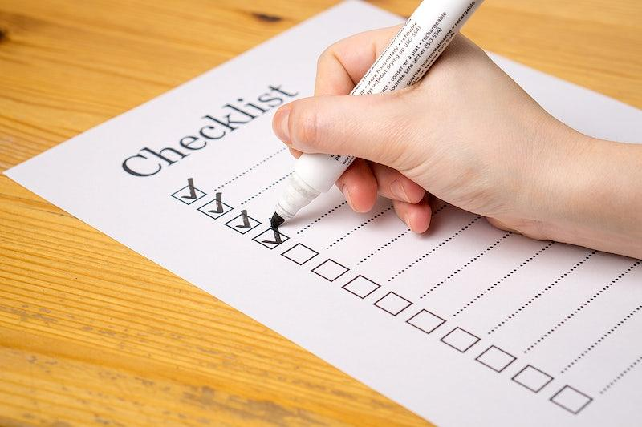
Criteria
NNLM mission
Need
Logical
Feasible
NLM resources
NNLM initiatives
Evaluation
Staff
Budget
Diversity, Equity and Inclusion
Notes:
I encourage you to check the Toolkit for more details on how NNLM rates your proposal. Here are the key elements that we look for: Does the proposed project make a significant contribution to the mission of NNLM? Does the proposal explain the need for the project including demographic information about the target population or geographic area? Does the proposal show the logic and feasibility of the technical approach to reaching the target group or community? Does the proposal include a timeline or implementation schedule for major events and activities? Does the project include National Library of Medicine resources or address NNLM initiatives? Is there an evaluation plan? Does the plan make sense given the goals and objectives? Does the proposal clearly outline the qualifications, roles and time commitment of the project staff? Is the proposed budget within funding limits? Is the budget justification sound? Does the project promote diversity, equity and inclusion? Please check the Toolkit for a list of populations that we hope to serve in terms of diversity, equity, and inclusion. Reviewers are given the opportunity to comment on strengths and weaknesses of the proposal. If your proposal is not accepted, take a look at the comments think how you can rectify the weaknesses for a future submission.

Slide 31
Dementia Friendly Nahant
102 people with dementia
168 caregivers
Nearly 8% population
Nahant Public Library
Council on Aging
Nahant Village Church
Greater Lynn Senior Services
Notes:
I want to end this webinar with a few excerpts from a successful proposal. In 2019, Region 6 funded a project called “Dementia Friendly Nahant.” Nahant is a small town on the Massachusetts coast. Here is the introduction to the proposal: “Dementia Friendly Nahant brings the national Dementia Friendly America model to the local level. Nahant has an aging population, with an estimated 102 people experiencing some form of dementia and an estimated 168 people often family members caring for them. This means dementia impacts nearly 8% of Nahant's population. As the population continues to age, this percentage will continue to rise. The Dementia Friendly Nahant project enlists the services of the Library, the Council on Aging, the Nahant Village Church, and Greater Lynn Senior Services to provide materials, services, and programs for people with dementia and their caregivers. We hope to create meaningful experiences and decrease feelings of isolation in affected families while increasing understanding in the Nahant community.”

Slide 32
Census Data
Based on the 2010 US Census, Nahant is a small community with an aging population. As the Baby Boom generation is expected to live to be 80 years and older, an increased percentage of the population will be experiencing dementia within the next ten years. (citation included)
Notes:
The proposal was supported by three data resources. #1 Census data. Based on the 2010 United States Census, Nahant is a small community with an aging population. As the Baby Boom generation is expected to live to be 80 years and older, an increased percentage of the population will be experiencing dementia within the next ten years. (citation included)

Slide 33
Community Health Needs Data
In the Community Health Needs Assessment by Spaulding Rehabilitation, dementia was mentioned as one of several mental health issues for the Massachusetts North Shore. (citation included)
Notes:
#2 Data from the local Community Health Needs Assessment. In the Community Health Needs Assessment by Spaulding Rehabilitation, dementia was mentioned as one of several mental health issues for the Massachusetts North Shore. (citation included)

Slide 34
Internal Observations
One patron periodically comes to the library, pleasantly asking the same questions of the desk staff at each visit, not remembering that he had asked before.
Notes:
And #3 internal observations: One patron periodically comes to the library, pleasantly asking the same questions of the desk staff at each visit, not remembering that he had asked before. Please comment in the chat, what additional data could the proposal include, from library users or non-users? (Pause)

Slide 35
Objective One
Offer circulating materials in a variety of formats that are easily understood by and inviting to patrons with cognitive difficulties, in order to afford these patrons positive interactions with literature and music, to improve mental health and quality of life.
Notes:
The goal was to support Dementia Friendly Nahant. The proposal included three objectives. What are measurable outcomes for each? Offer circulating materials in a variety of formats that are easily understood by and inviting to patrons with cognitive difficulties, in order to afford these patrons positive interactions with literature and music, to improve mental health and quality of life. How could you measure this? (Pause)

Slide 36
Objective Two
Provide authoritative information on diagnosis, treatment, coping strategies to people with cognitive loss, their caregivers, and the public using the website MedlinePlus.
Notes:
Provide authoritative information on diagnosis, treatment, and coping strategies to people with cognitive loss, their caregivers, and the public using MedlinePlus. How could you measure this?

Slide 37
Objective Three
Host a monthly "Memory Cafe“ for people with cognitive loss and their caregivers and host a town-wide read for the community, to foster meaningful socialization and education, reduce feelings of isolation, and improve social behavior and quality of life.
Notes:
Host a monthly "Memory Cafe“ for people with cognitive loss and their caregivers and host a town-wide read for the community, to foster meaningful socialization and education, reduce feelings of isolation, and improve social behavior and quality of life. How could you measure this?

Slide 38
Letters of Support
Nahant Council on Aging
Nahant Village Church
Greater Lynn Senior Services
Notes:
This proposal included three letters of support. Each letter was written on letterhead and scanned and uploaded as a pdf. The content was very simple, and the purpose is very simple. These partners offered to provide refreshments, give guidance to library staff, and to announce the events through their channels. Based upon these letters of support, we know that these organizations are a true partner of the applicant.

Slide 39
Evaluation and MLA Surveys
Debra Trogdon-Livingston
NNLM Region 2
trogdonl@musc.edu
Bailey Sterling
NNLM Region 3
bailey.sterling@unthsc.edu
Notes:
We would now like to ask everyone to complete the evaluation survey for today’s webinar at the link provided on the screen in the chat: (https://redcap.nubic.northwestern.edu/redcap/surveys/?s=E83MFRPEKW&ct=60&dt=2023-07-27&rmlo=2&code=gran0723&aou=0&ROC-905=ROC-905).
Follow this link, fill out the survey, and make sure to select that you would like CE credit at the end. This will give you instructions and a code to obtain your MLA CE credit.
We have included our contact information above. Please feel free to reach out to us with any question you have.

