Slide 1
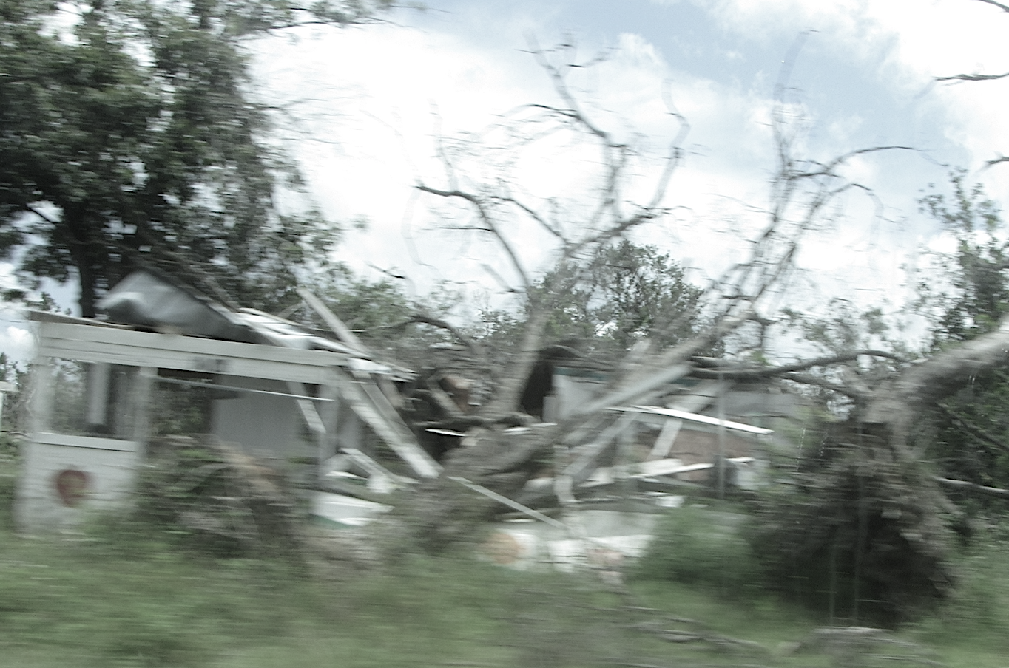
COUNTING EVERY DEATH WHEN EVERY DEATH COUNTS
A Mixed-Methods Study
of Hurricane Michael Excess Mortality
Blake L. Scott, Ph.D., MPH | March 6, 2024

Slide 2
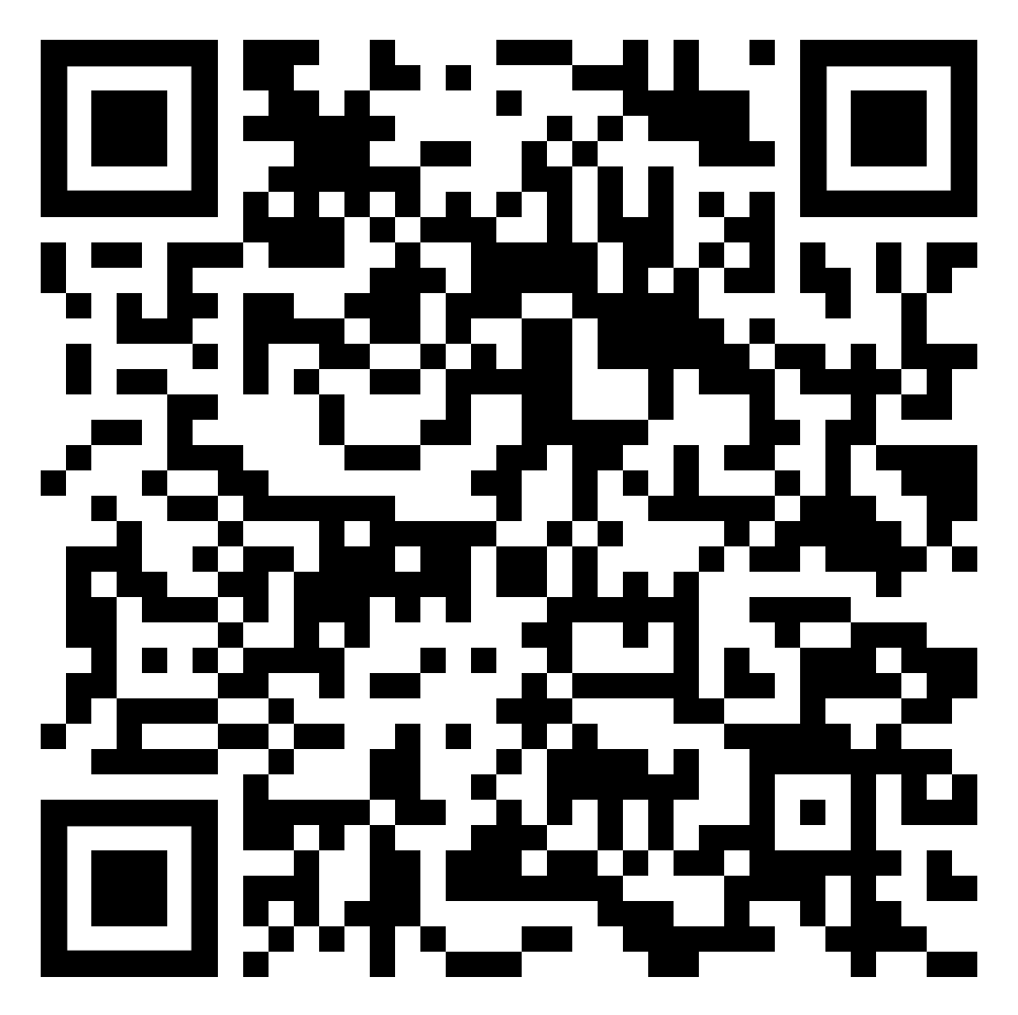
SUMMARY DOCUMENT
Point Your Phone’s Camera and Follow the QR Code

Slide 3
BACKGROUND
Secondary Disasters
Vulnerability
Hurricane Michael

Slide 4
Becoming stronger and causing secondary disasters
EVOLVING DISASTERS
Saffir-Simpson Hurricane Categories
Some Damage (75-95 MPH winds)
Extensive Damage (96-110 MPH winds)
Devastating Damage (111-129 MPH winds)
Catastrophic Damage (130-156 MPH winds)
Catastrophic Damage (>156 MPH winds)
Growing coastal populations
Infrastructure systems are more connected and interdependent on one another
Major
Hurricanes
Secondary disasters lead to more people being impacted
Hurricane Katrina
Hurricane Maria

Slide 5
Secondary disasters occur in vulnerable populations
COMMUNITY FACTORS
Resilience - ability to adapt or recover quickly
Vulnerability - opposite or absence of resilience
Risk = Vulnerability x Hazard

Slide 6
MEASURING VULNERABILITY
Can detect what communities will be more impacted by a hurricane
Socioeconomic Status:
Unemployment, poverty, income, education
Household Characteristics:
Older adults, children, single parents, disability, languages spoken
Racial and Ethnic Minority Status:
Racial and ethnic group identification
Housing Type and Transportation:
Multi-units, mobile homes, group housing, vehicle ownership
Categories within the CDC’s Social Vulnerability Index

Slide 7
HURRICANE FATALITIES
A measure of a storm’s impact that can provide critical insight
Fatality Count
Direct deaths are clearly caused by the disaster
Example: drowning in hurricane storm surge
Indirect deaths are more subjective and the “but for” principle should be used
Example: carbon monoxide poisoning from a generator two weeks after a hurricane
Excess Mortality
An analysis of changes in the trends of mortality rates of a post-disaster area to determine if more deaths overall have occurred than expected
Measuring Hurricane Maria
Fatalities
64
Fatality Count
2,975
Excess Mortality
Sept
Oct
Nov
Dec
Jan
Feb

Slide 8
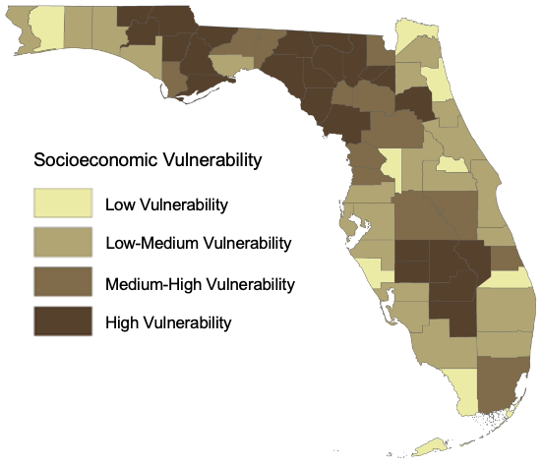
FLORIDA HURRICANES
Experiences more major hurricane and has areas of high vulnerability
U.S. Major Hurricanes
NC - 7
5
MS - 9
TX - 19
LA - 21
5
5
5
FL - 44

Slide 9
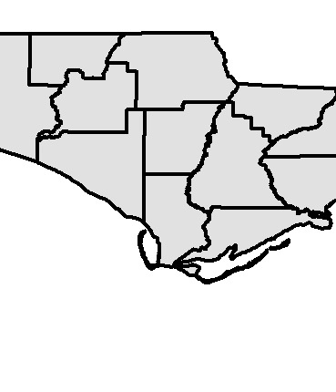
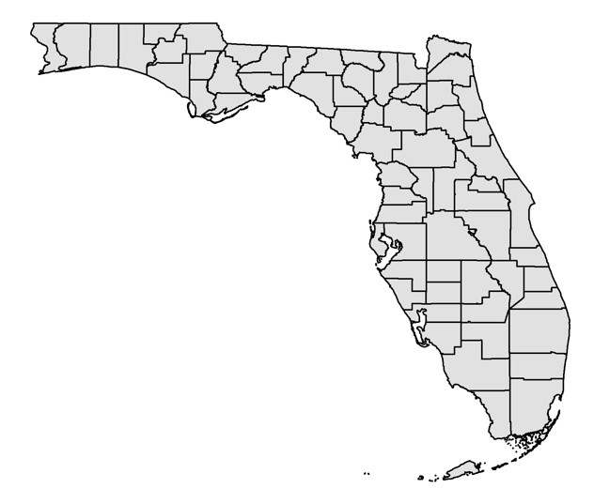
HURRICANE MICHAEL
A once in a hundred-year storm that devastated the Florida Panhandle
50 direct and indirect fatalities
$25 billion in damages
14-foot storm surge
Category 5 (160 mph winds)
Bay
Gulf
Franklin

Slide 10
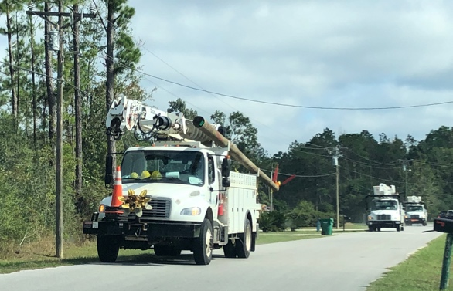
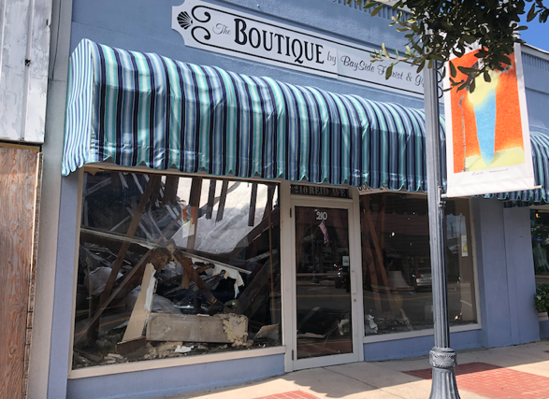
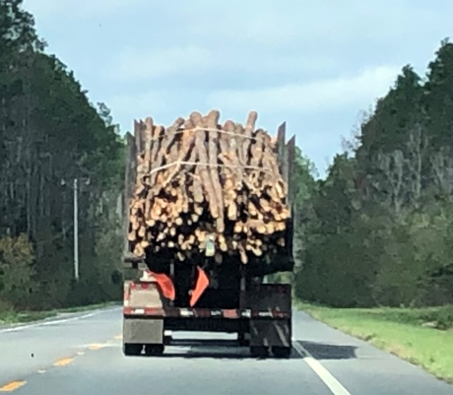
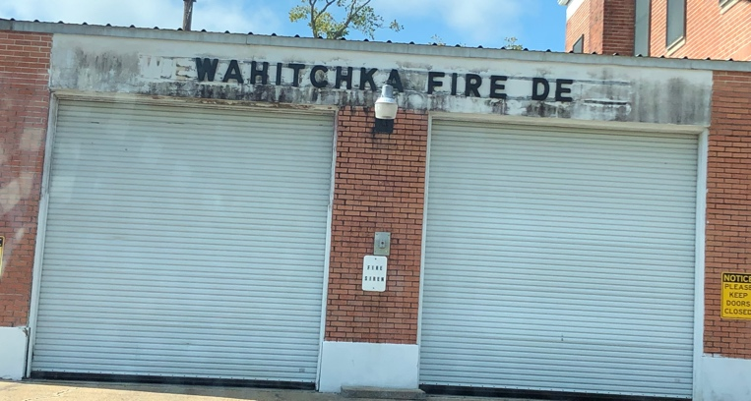
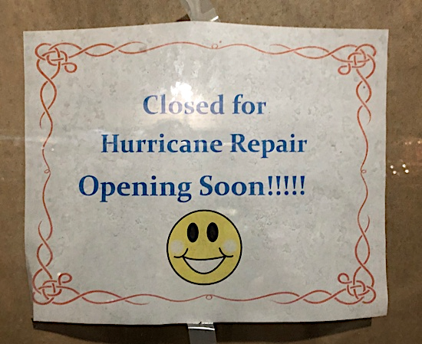
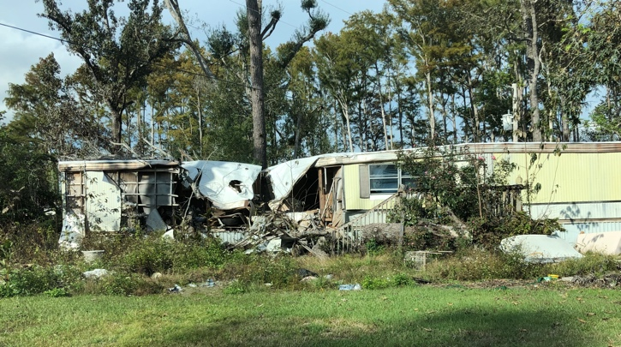
THE AFTERMATH
A long, stagnant recovery
Damage and Impacts
Environmental changes
Basic necessities and services
Trauma Center destroyed
Delays in prenatal care and increase in small for gestational age births
Population changes one year later
Bay County decreased by over 2,300
Community assessment found prolong impacts on mental health
Economic Aid in 2021

Slide 11
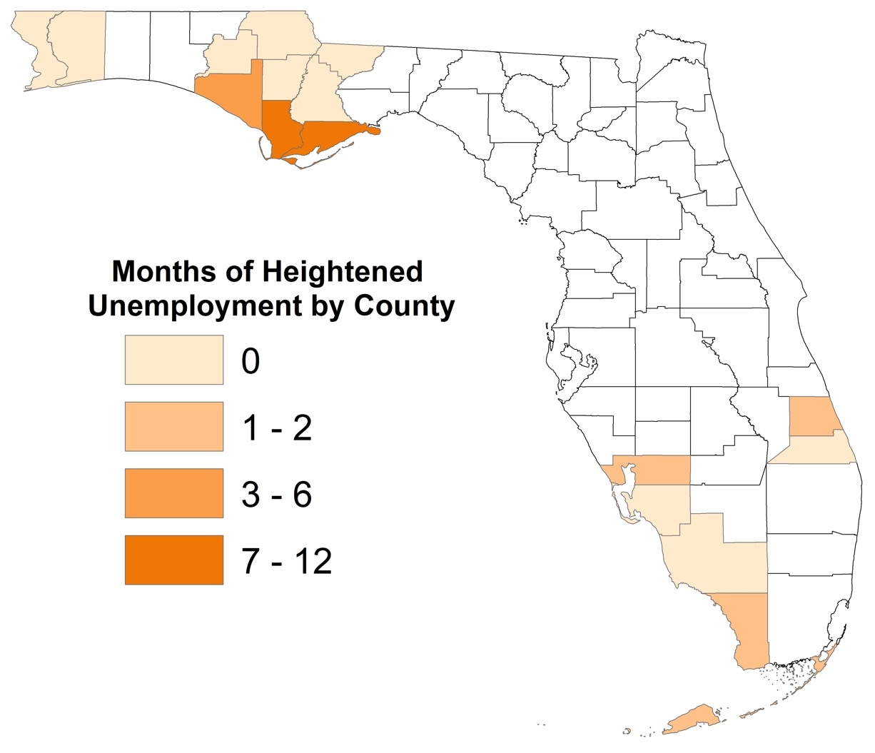
PILOT PROJECT FINDINGS
Prolonged period of high unemployment in Bay, Gulf, and Franklin Counties
Industry Shifts
12
11
2
1
1
0
0

Slide 12
STUDY DESIGN
Purpose
Research Questions
Mixed-Methods

Slide 13
The purpose of this study was to identify if the Florida Panhandle experienced excess mortality in the year after Hurricane Michael and investigate what contextual factors potentially led to that increased mortality.
STUDY PURPOSE & RESEARCH QUESTIONS
What place, sex, race, age group, or causes of death experienced mortality trend changes in the year post-storm?
How do survivors describe changes to health and health care services in the year post-storm?
How do survivors’ accounts of post-storm health conditions and access to health care triangulate with excess mortality findings and the official fatality count?
1
2
3

Slide 14
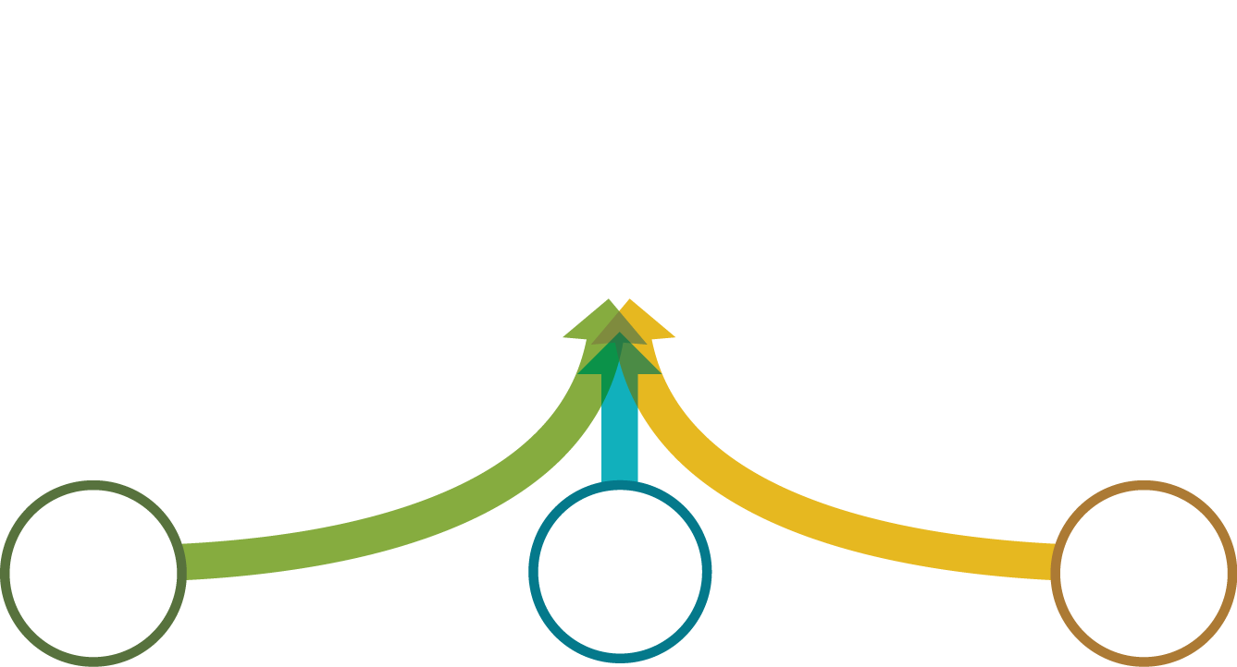
STUDY DESIGN A mixed-methods study in three sequential phases
Phase 1: Excess Mortality
Statistical analysis of changes in mortality trends
Phase 2: Qualitative
Focus groups and interviews on hurricane impacts
Phase 3: Triangulation
Ground-truthing and changes to accessing health care

Slide 15
PHASE 1: EXCESS MORTALITY
Methodology
Total mortality
Demographic groups
Cause of death

Slide 16
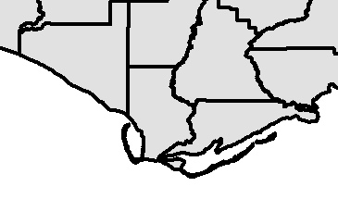
EXCESS MORTALITY MODELING
Using death records of coastal counties for three seasonal ARIMA analyses
Data
Bay
Florida Department of Health vital statistics death records
2013-2019
5 years pre-Hurricane Michael
1 year post-Hurricane Michael
Gulf
Franklin
Time Interval
Annual quarter
Analysis
Seasonally adjusted ARIMA (auto-regressive integrated moving average)
All-cause rate of mortality
Mortality rates by age group, race, and sex
Cause of death
Two Areas
Bay County (182,218)
Gulf and Franklin Counties (28,595)

Slide 17
METHODOLOGY
A time-series analysis using a seasonally adjusted ARIMA (Auto-Regressive Integrated Moving Average)
Seasonality
Allows for more accurate predicted forecasts
Excess Mortality
If the real world, observed mortality is beyond the range of the confidence interval, that is evidence of excess mortality
Seasonality
Confidence Interval
Previous Trend of Regular Interval Points
Forecasted Trend

Slide 18
TOTAL MORTALITY
Excess mortality in Gulf and Franklin Counties
Gulf and Franklin County Results
Gulf
Franklin
Quarter | Forecasted Mortality Rate | Observed Mortality Rate
2018, Quarter 4 | 254.8 (95% CI, 181.7 – 347.6) | 262.3
2019, Quarter 1 | 293.0 (95% CI, 207.2 – 403.2) | 273.3
2019, Quarter 2 | 227.8 (95% CI, 159.8 – 316.0) | 322.5
2019, Quarter 3 | 249.8 (95% CI, 173.5 – 348.7) | 245.4
Estimated 27 additional deaths
*Mortality Rates per 100,000

Slide 19
TOTAL MORTALITY (Cont’d)
No excess mortality in Bay County
Bay
Bay County Results
Quarter | Forecasted Mortality Rate | Observed Mortality Rate
2018, Quarter 4 | 275.9 (95% CI, 241.2 – 314.3) | 249.2
2019, Quarter 1 | 293.7 (95% CI, 255.8 – 333.8) | 252.4
2019, Quarter 2 | 277.7 (95% CI, 242.7 – 316.7) | 227.9
2019, Quarter 3 | 259.1 (95% CI, 226.5 – 295.5) | 234.0
*Mortality Rates per 100,000

Slide 20
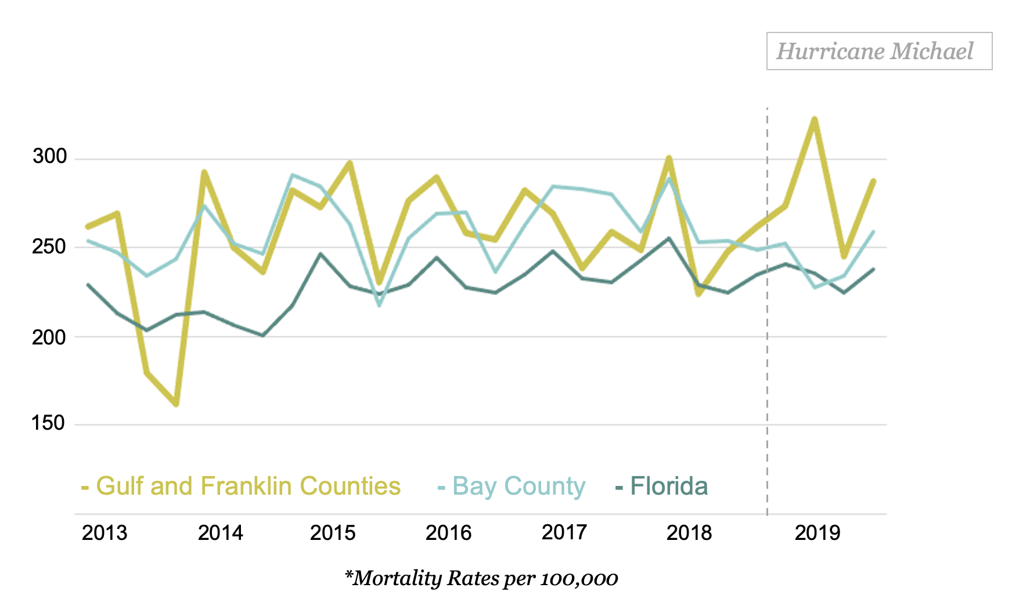
TOTAL MORTALITY (3)
Noticeable spike of mortality in Gulf and Franklin Counties

Slide 21
SENSITIVITY TESTING
No anomalies found in the mortality trend from 2012 to 2018
2018 (2012-2017)
2017 (2011-2016)
2016 (2010-2015)
2015 (2009-2014)
2014 (2008-2013)
2013 (2007-2012)
2012 (2006-2011)
Analysis
Same analysis as for total mortality
Used 5 years of data to forecast the following four quarters
Every quarter from 2012 up to Hurricane Michael had an observed mortality that was not above the range of the forecasted mortality
Evidence that strengthens the validity of the model

Slide 22
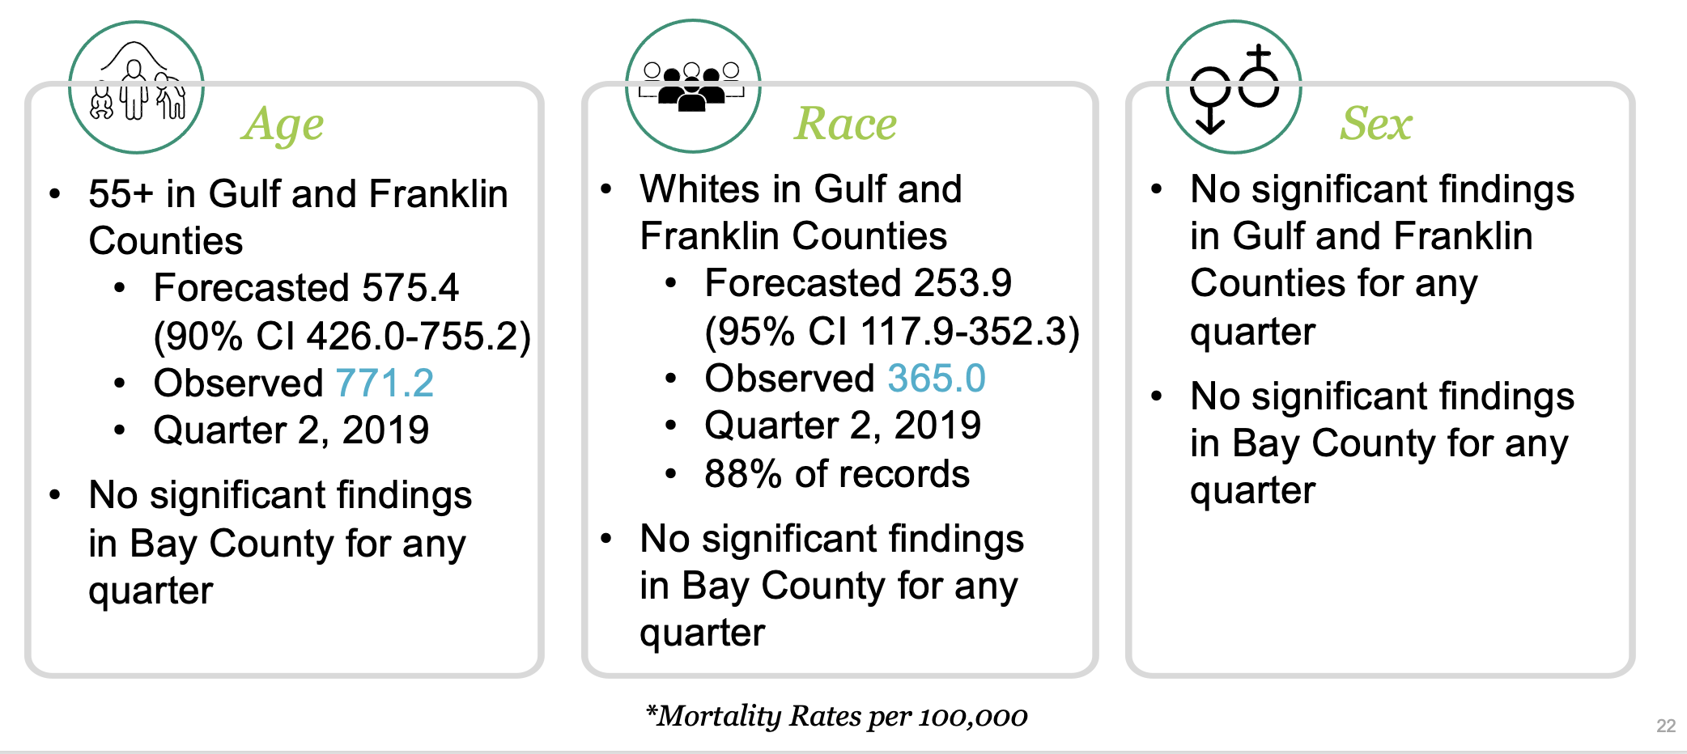
ADJUSTED MORTALITY
Excess mortality in older and White residents in Gulf and Franklin Counties

Slide 23
CAUSE OF DEATH
Excess mortality in cancer-related deaths
Most Common Causes of Death
Cancer
Cardiac
Cancer
Pulmonary
Natural Causes
Gulf and Franklin Counties
Forecasted 48.7 (90% CI 28.9-72.3)
Observed 80.6
Quarter 3, 2019
Estimated 9 additional deaths
No significant findings in Bay County for any cause of death in any quarter
*Mortality Rate per 100,000

Slide 24
PHASE 1 FINDINGS
What geographical areas, demographic groups, and causes of death experienced excess mortality in the year after Hurricane Michael?
Gulf and Franklin Counties
Quarter 2 (April-June), 2019
Total mortality
Ages 55+
Whites
Quarter 3 (July-September), 2019
Cancer-related deaths
36 additional deaths
27 in quarter 2
9 in quarter 3

Slide 25
PHASE 2: COMMUNITY HEALTH IMPACTS
Methods
Thematic analysis
Findings

Slide 26
QUALITATIVE METHODS
Focus groups and interviews with survivors and responders
Data Collection & Analysis
Questions Asked
6 Focus groups and 9 interviews with 46 total participants in May through August of 2022
Thematic analysis of transcripts
How long did it take the area to recover?
How did people’s mental and physical health change the year after?
What were the factors that led to any health changes?
What were the changes in accessing health care?
Were any groups of people more impacted by Hurricane Michael than others?
Participants
Those that lived or worked in a Hurricane Michael impacted county since pre-storm or were part of the disaster response.

Slide 27
MENTAL HEALTH & WELL-BEING
A heavy psychological impact on the community
“We had a lack of mental health support across the board. "
Emotional Toll
Symptoms of anxiety, PTSD, and depression
Few available mental health services destroyed
Unrelenting reminders of the hurricane
“Physically, it took us about 11 months beyond the storm to find a home and get settled. Mentally, I still have some anxieties from that dreadful experience.”
Children
Schools were closed rest of the year and didn’t fully reopen until 2019
Increased involuntary psychiatric hospitalizations along with bomb and gun threats
Increased homeless due to damage and displacement
“The school Baker Acts went through the roof."

Slide 28
SERVICES & HOUSING
"We lost employees who had to move because of housing. Lost their house."
Housing crisis and prolonged service disruptions
“A lot of people are living in RVs and sheds. That's their primary homes now. I'm never even surprised anymore when I pull up to the shed to do the home visit for a pregnant women and children.”
Housing
Increase in people who are un-housed
Much of the affordable housing was destroyed
Uninsured and under-insured couldn’t afford repairs and others were scammed
Relocation post-storm
“well it happened October the 10th and I was without power until December the 14th."
Services
Electricity, telecommunications, out for months
Main highway was badly damaged
Trauma center, clinics, and pharmacies destroyed

Slide 29
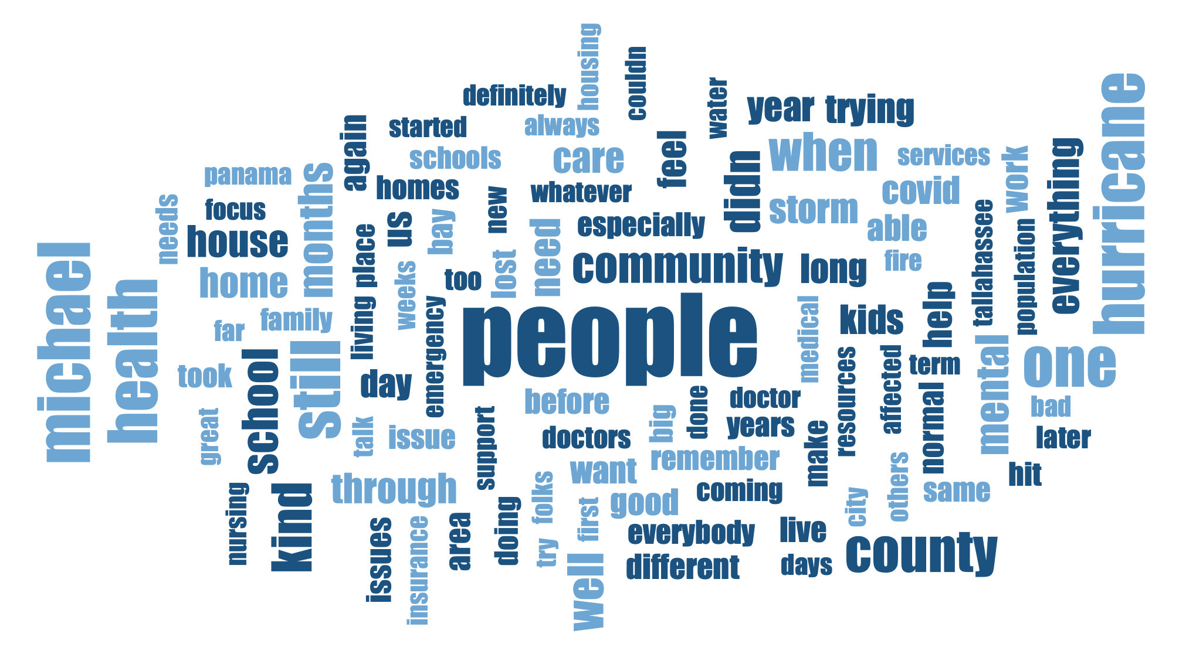
SOCIAL CAPITAL
“We didn't have no doctors. And you end up crying on your neighbor's shoulders or your family shoulders or, you know, letting out your anxieties."
Strong, positive connections were a resilience factor
“We're invested in each other. Because this county is so strong. And then the love that we have for one another."

Slide 30
PHASE 2 FINDINGS
How do survivors describe changes to health and health care services in the year after Hurricane Michael?
Mental Health, Rebuilding, and Services
Prolonged Depression, PTSD, and lingering anxiety
Particularly children
Compounded by lack of mental health services and COVID
Social capital
Service disruptions including health care

Slide 31
PHASE 3: ACCESS TO HEALTH CARE
Utilizing qualitative data
Health care barriers
Distances traveled

Slide 32
METHODOLOGY (2)
Thematic analysis to assess the accuracy of excess mortality results
Analyzing key findings on health and health care
Qualitative Data
Official Fatality Count
Excess Mortality Results
Analysis
Focus groups and interviews on changes to physical health and access to health care
Analyzed transcript segments on physical health, healthcare infrastructure and staffing, and medically fragile individuals
Evaluate which is a more accurate representation of the hurricane’s impact on health

Slide 33
HEALTHCARE INFRASTRUCTURE
Extensive damage to nursing homes, clinics, and the trauma center
"Yeah, from the ESF8 standpoint, long term. We're years from getting back to where we were.”
“You're talking about a town who, before Hurricane Michael, had five to six primary care providers on a normal day."
Physical Health
Few health issues noted by participants
Health Services and Facilities
Limited pre-storm in Gulf and Franklin counties
Nursing homes, specialists, and trauma center were in Bay County
Hurricane Michael destroyed most of the healthcare infrastructure in Bay County
The area is still not back to where it was before the hurricane
“we had lost so many facilities and buildings, and then the hospitals were at such a small capacity for a long time while they rebuilt.”
"they got that whole brand new wing, but they don't have the staffing to fill it.."

Slide 34
BARRIERS TO ROUTINE CARE
"And even as a provider, how we define what's happened in our medical history even has been "well, I didn't have a mammogram since before Hurricane Michael." "I haven't had a pap smear since before Hurricane Michael."
Limited routine care for chronic health conditions
Routine Medical Care
Challenges refilling maintenance drugs
Medical records destroyed
Delays in preventative screenings
“working in the ER, we've seen a lot of visits for months, months, seeing visits for med refills... six, seven months later, seeing "Oh, I can't get into somebody" and I'm out of my meds" and "I need my blood pressure medicine refilled.".”
“I had some skin cancer removed, years ago, the doctor's office basically had no way of providing me with my records, you know, for for another doctor, you know, so I could, to get a follow up."

Slide 35
BARRIERS TO SPECIALIZED CARE
"Yes, my son in law was diagnosed [cancer] in February. And then it took a long time to get things going. And a lot of his treatments was delayed because of Hurricane Michael."
Limited specialized treatment and surgeries
Specialists
Follow-up visits not available
Surgeries rescheduled elsewhere
Delayed cancer treatment
Next closest metro areas also had delays in treatment
”[surgical] procedures were backlogged for several months”
“And we both had
skin cancer. So we
felt like we would have to go to Tallahassee, but even then you have to wait and finding people that because we have insurance that's not local."
“I have struggled to get an immediate appointment with my endocrinologist. When I need my meds, I need my meds”

Slide 36
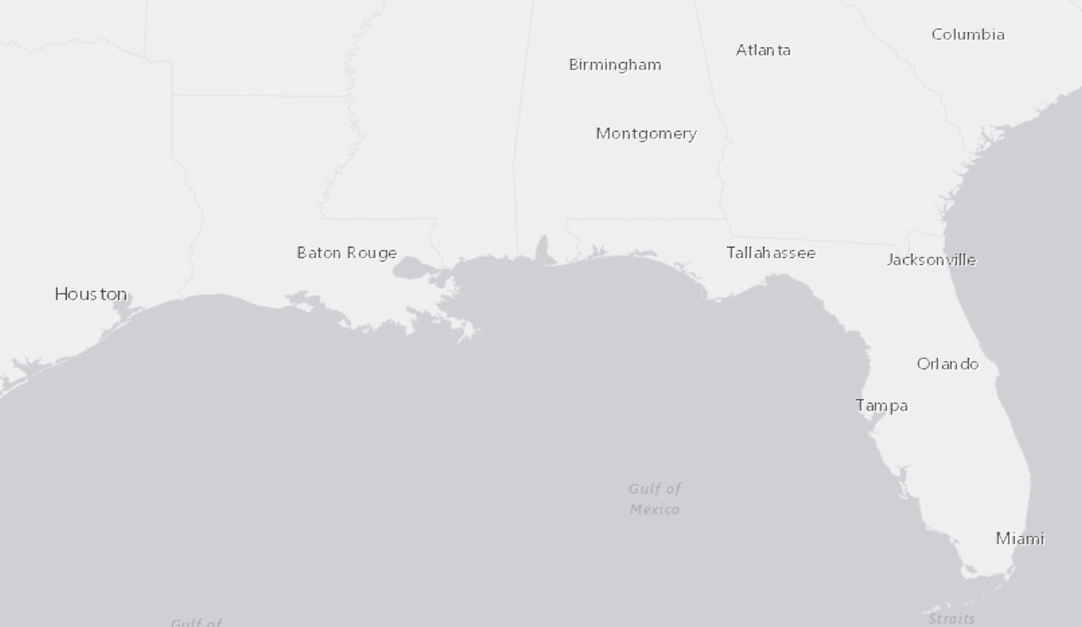
TRAVEL TO TREATMENT
Using facilities further away became the only option
“We tried to schedule
in Tallahassee for my sister and they were three months out... And so we said to hell with that and went to MD Anderson”
“Dothan, Tallahassee, [for cancer treatment]”
Reported Distances Traveled for Cancer Treatment
"Mayo Clinic, Moffitt, MD Anderson was the one we used, MD Anderson. And then you've got UAB [cancer treatment options].”
“When Mama's daddy was going through cancer treatments, which was before Michael, we went to Panama”
100 Miles
375 Miles
650 Miles

Slide 37
PHASE 3 FINDINGS
How do survivors’ accounts of post-storm health conditions and access to health care triangulate with excess mortality findings and the fatality count?
Multiple Barriers to Accessing Health Care
Nearly all healthcare infrastructure in Bay County was destroyed or damaged
Gulf and Franklin Counties had relied on those resources
Barriers to routine health services, screenings, and specialized care
Some had to travel far for cancer treatment
Supports a delayed, greater impact on health than just the fatality count

Slide 38
DISCUSSION & CONCLUSION
Overall Findings
Application
Conclusion

Slide 39
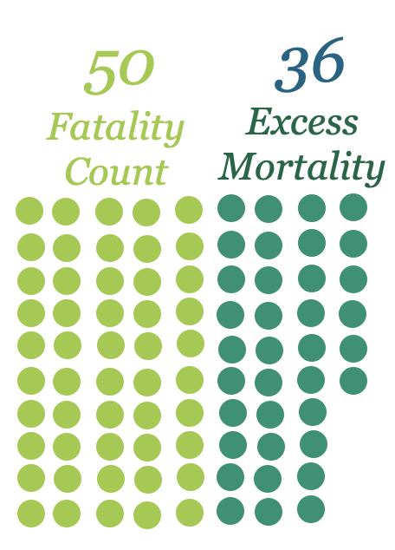
OVERALL FINDINGS
Vulnerabilities and damaged infrastructure resulted in delays in health care and contributed to additional deaths beyond the fatality count.
Pre-Existing Vulnerabilities
Hurricane Michael
Damaged Healthcare Infrastructure
Delays and Barriers to Treatment
Total Health Impact

Slide 40
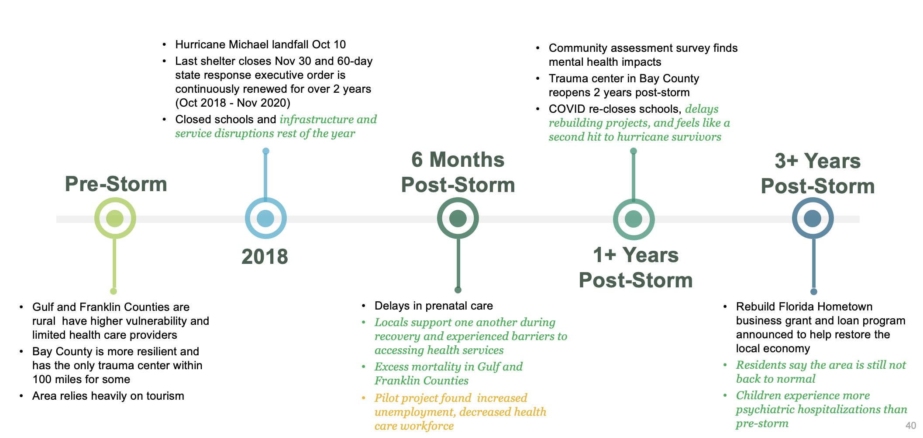
WHAT THIS STUDY ADDS

Slide 41
APPLICATION
Communicating and leveraging these findings
Local Agencies
Encourage health screenings during prolonged recovery periods
Build partnerships with nearby local health departments and share lessons learned
Connect with the closest facilities that offer specialized care and treatment
Conduct a post-disaster community assessment (CASPER)
Utilize telehealth services
Be mindful of burnout and tap into sources of social capital
Research Expansion
Excess mortality modeling can be applied to small population areas
Combining mixed methods can be a strength in disaster sciences
Policy Development
Considerations for long-term healthcare infrastructure rebuilding
Identify vulnerabilities to be aware of them before a disaster

Slide 42
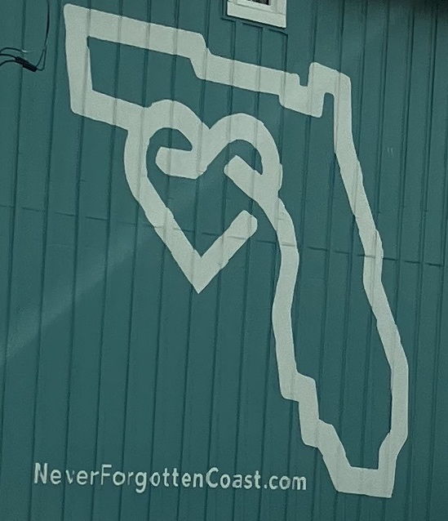
CONCLUSION
A hurricane’s impacts last much longer than the storm
Expanding how Hurricane Michael’s impact on health was measured showed the depth and breadth of how the community was affected.
By expanding the way that hurricane impacts are measured, we can better understand how to protect communities.

Slide 43
Questions?
Email: BLScott@usf.edu
Blake Scott, Ph.D., MPH
University of South Florida

Slide 44
ACTIVITY
How Differences in Social Vulnerabilities Change a Disaster’s Impact
To Begin, Pick a Location You Are Very Familiar With:
What type of natural disaster might happen there?
Who are the vulnerable populations that live there?
What resources are abundant there?
What industries make up the workforce there?

Slide 45
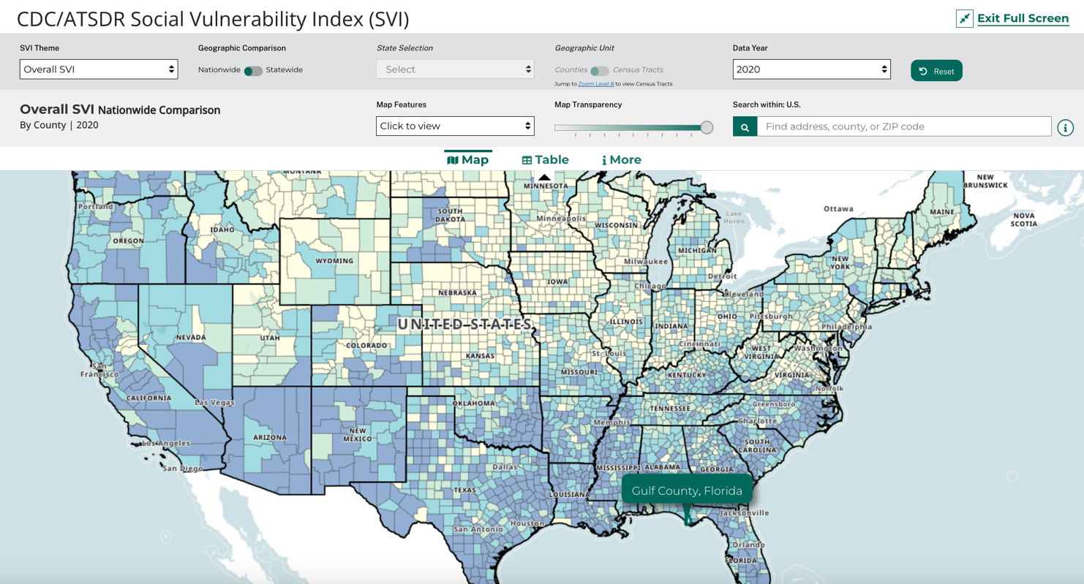
ACTIVITY (2)
Go to That Location on the CDC’s Social Vulnerability Index Interactive Map
https://www.atsdr.cdc.gov/placeandhealth/svi/interactive_map.html

Slide 46
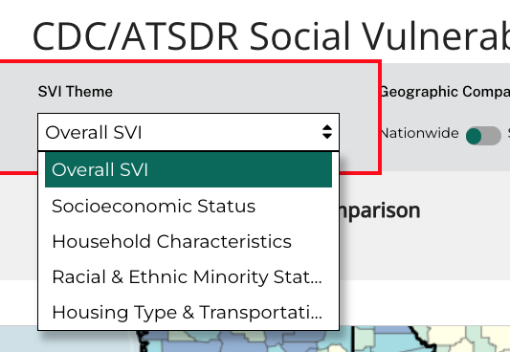
ACTIVITY (3)
Explore Various Vulnerability Categories
Socioeconomic Status:
Unemployment, poverty, income, education
Household Characteristics:
Older adults, children, single parents, disability, languages spoken
Racial and Ethnic Minority Status:
Racial and ethnic group identification
Housing Type and Transportation:
Multi-units, mobile homes, group housing, vehicle ownership
Select Different SVI Themes at the Top of the Map

Slide 47
ACTIVITY (4)
How Would Your Area Thrive or Struggle After a Disaster?
Questions to Consider:
Are there any resilience factors (low vulnerability)?
Are there high vulnerability for any category?
How could a natural disaster impact those local vulnerabilities?
Is there a nearby area with an abundance of certain resources?
What if a disaster hit a neighboring county, would your area become a hub of resources for them?

Slide 48
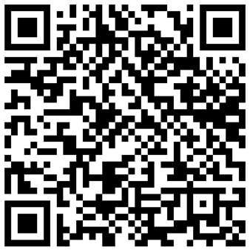
Thank you!
Email: BLScott@usf.edu
Email: BLScott@usf.edu
Blake Scott, Ph.D., MPH
University of South Florida
List of References

