Slide 1
Spanish for Library Staff: Bringing Language Access to your Library
April 23, 2024
Caroline Smith, Facilities & Access Consultant, South Carolina State Library

Slide 2
Agenda
Language Justice & barriers
Overview of South Carolina State Library program
Spanish mini-lesson
Is language learning for you?
Language access strategies

Slide 3
Objectives
Identify resources for learning and practicing Spanish in the context of library services
Articulate the need for language justice and cultural competence
Describe organizational best practices for libraries to create more equitable access for Spanish speakers

Slide 4
Introductions
Caroline Smith is the Facilities and Access Consultant at the South Carolina State Library, where she supports the state’s 42 public library systems. Prior to her current role, she worked for the Charleston County Public Library for nine years. Caroline received her
M.L.I.S. from the University of South Carolina in 2011 and has been a member of REFORMA since 2015. She currently serves as Treasurer for the newly formed REFORMA de las Carolinas chapter, which represents North and South Carolina. Caroline was recognized by Library Journal as a Mover & Shaker in 2020 and is a Certified Professional in Accessibility Core Competencies.

Slide 5
Language Justice: Are Libraries for Everyone?
Affirms the fundamental right to communication in your own language
Recognizes historic and current linguistic oppression
Honors the importance of linguistic and cultural identities

Slide 6
Barriers to access
Language Barriers:
Staff assistance
Collections
Programs
Marketing
Library policies & information
Specialized services
Past experiences
Perception of the library
Fear/anxiety
Awareness
Fines and fees
Transportation
Schedules
Childcare availability

Slide 7
South Carolina State Library’s Basic Spanish For Library Staff Program

Slide 8
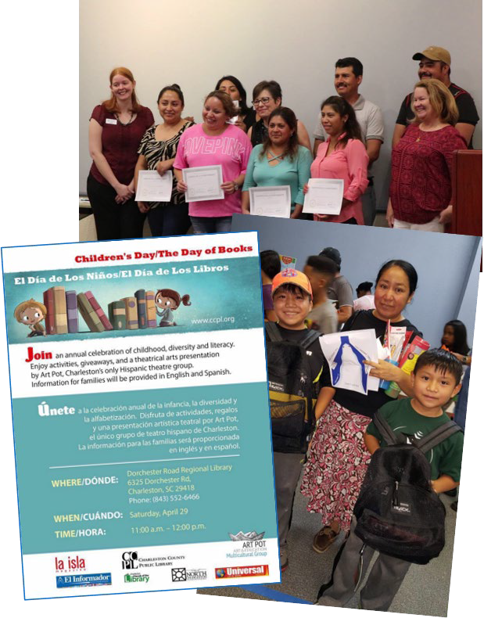
History
2014 - 2017
Personal experience learning Spanish on the job at Charleston County Public Library
2017
Started at the South Carolina State Library as Inclusive Services Consultant
2018
Started an informal virtual practice group
2019 - 2023
Repeated series every year with improvements

Slide 9
Program Goals
Equip staff with basic Spanish vocabulary and library-related scripts
Increase staff confidence to engage with Spanish-speakers
Raise awareness of barriers to access
Build cultural competency

Slide 10
Program Overview
6 weeks, 1 hour sessions
Offered 1-2 times each year
Live Zoom with recording option
Broad reach:
100 registrants
25 live participants
Included all levels
Co-hosted with native speakers

Slide 11
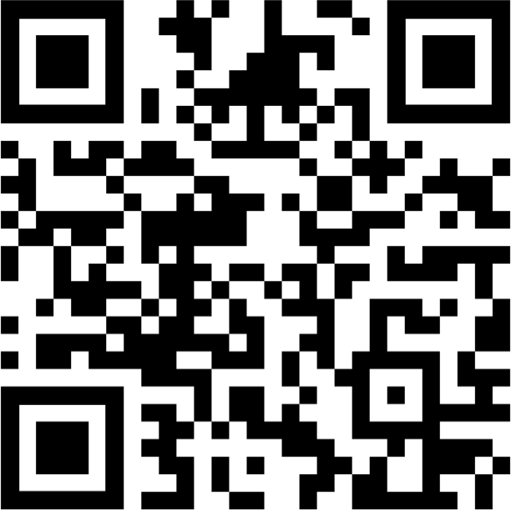
Weekly Themes
Customer Service & communication
Circulation
Library Cards
Events
Reference
Technology
Vocabulary lists and slides (guides.statelibrary.sc.gov/spanish)
Licensed for reuse with Creative Commons

Slide 12
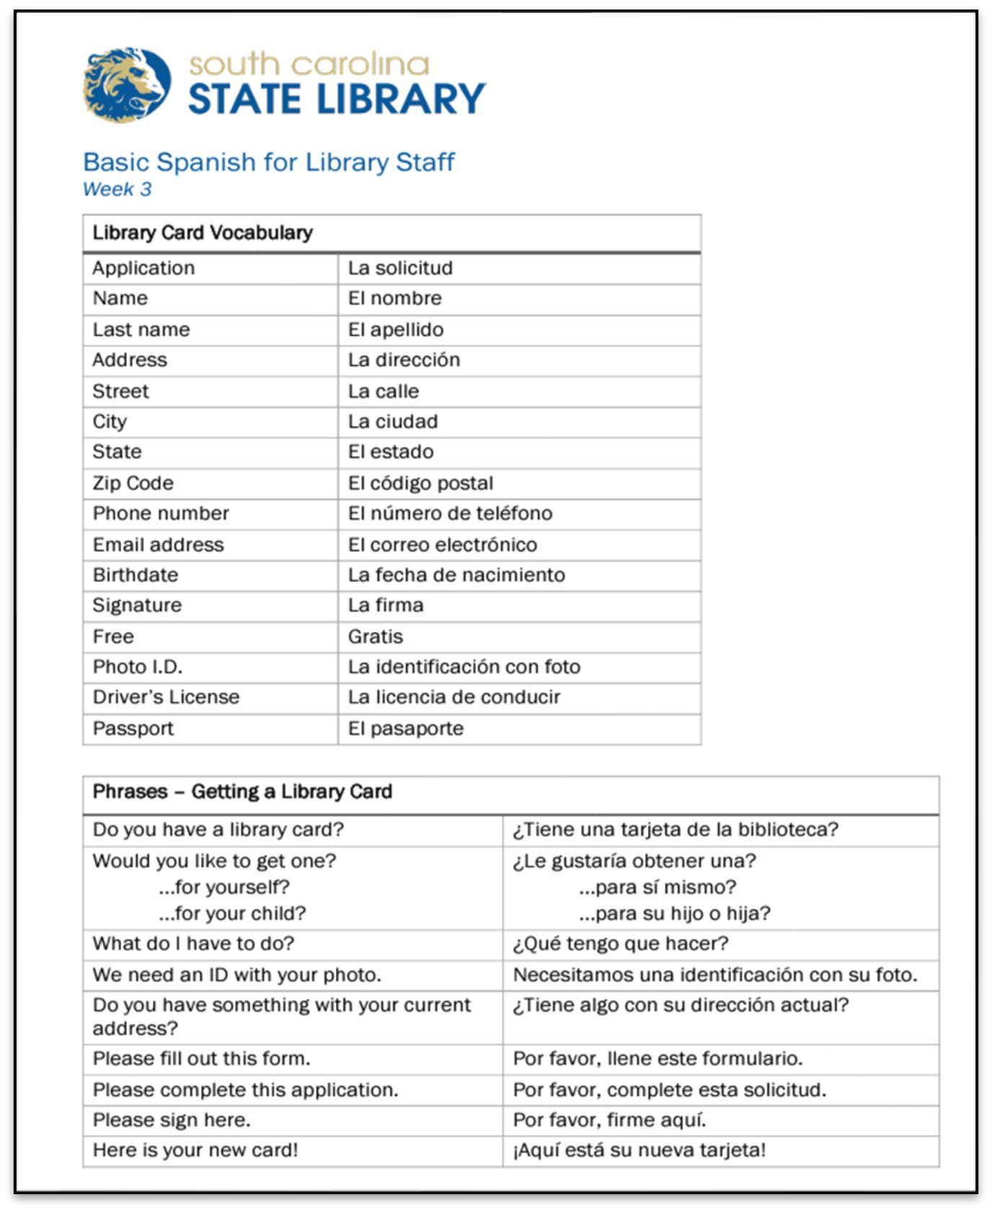
Activities
Introductions
Vocabulary review
Reading/speaking practice
Listening practice
Discussions
Resource sharing
Breakout groups

Slide 13
Discussion Topics
Outreach and partnerships
Advertising and promotion
Resource sharing
Spanish collections
Translations and language access

Slide 14
Lessons Learned & What’s Next
Lots of interest and need…unable to meet demand
Libraries can adapt materials to host their own groups!
Increased confidence & gave permission to try
Individual differences in learning- smaller group size is better
Engaging multiple levels simultaneously is a challenge
Zoom format has pros and cons
Look for collaborations with REFORMA

Slide 15
Library Spanish Mini-Lesson

Slide 16
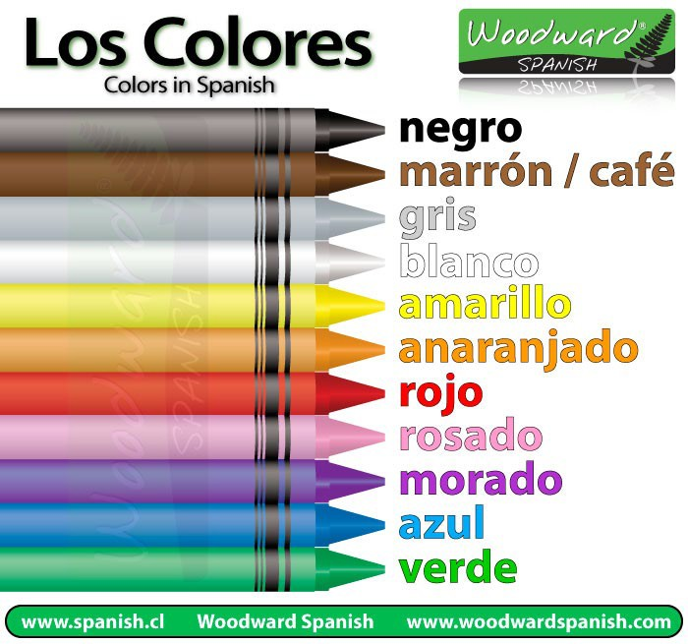
Introduce yourself!
¡Hola! Me llamo [name] .
Trabajo en la biblioteca de [city or county of library] .
Mi color favorito es el .

Slide 17
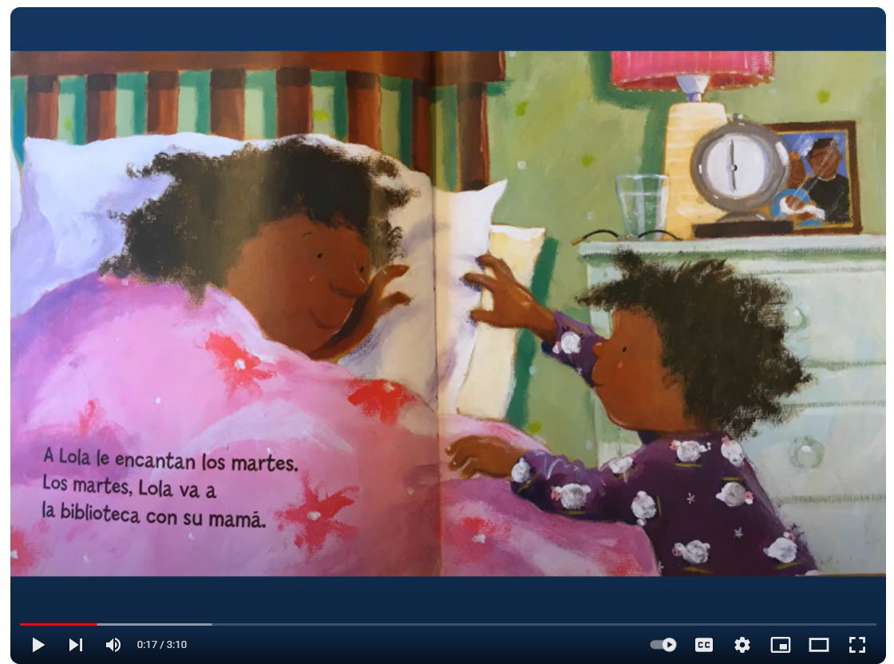
Reading Practice
Lola en la Biblioteca por Ana McQuinn
Watch on YouTube

Slide 18
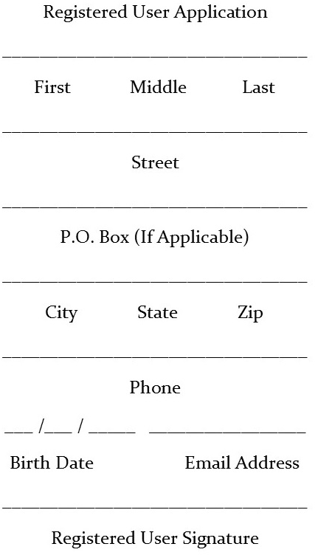
La solicitud
Apellidos
Nombre
Dirección (Calle y número)
Dirección para correo
(si es diferente)
Ciudad, estado, código postal
Número de teléfono
Fecha de nacimiento
Correo electrónico (no es necesario)
Firma

Slide 19
Phrases: Getting a Library Card
Do you have a library card? ¿Tiene una tarjeta de la biblioteca?
Would you like to get one? ¿Le gustaría obtenerla?
What do I have to do? ¿Qué tengo que hacer?
We need an ID with your photo. Necesitamos una identificación con su foto.
Please fill out this application. Por favor, llene este solicitud.
Please sign here. Por favor, firme aquí.
Here is your new card! ¡Aquí está su nueva tarjeta!

Slide 20
¡Basta!
Nombre (Name) | Animal (Animal) | Cosa (Thing) | Comida (Food) | Acción (Action) | Lugar (Place)
Caroline | Rana | Reloj | Raspados | Reír | Restaurante

Slide 21
Is Language Learning for You?

Slide 22
How long does it take to become fluent?
600-750
hours
24-30 weeks
(25 hours/week)
To reach Professional Proficiency according to Foreign Service Institute (FSI)
Individual factors include:
Natural ability
Prior experience
Time spent learning

Slide 23
What’s your level? (Beginners)
Interagency Language Roundtable
(ILR) scale
Level 0 – No proficiency
May know a few words Level 0+ Memorized proficiency
Use memorized phrases
Understand isolated numbers, words, & phrases Level 1 – Elementary proficiency
Understand basic questions and answers
Can fulfill basic travel needs
Level 2 – Limited working proficiency
Handle basic social situations
Can communicate routine work requirements

Slide 24
What’s your level? (More Advanced)
Interagency Language Roundtable
(ILR) scale
Level 3 – Professional working proficiency
Discusses relevant topics with relative ease
Understands normal rate of speech
Occasional errors don’t prevent understanding
Level 4 – Full professional proficiency
Fluent and accurate use of language in almost any situation
Not usually mistaken for a native speaker
Level 5 – Native or bilingual proficiency
Complete fluency, including idioms, figures of speech, slang, and cultural references
600 hour estimate

Slide 25
Language Access Strategies

Slide 26
What’s in your toolbox? (pros and cons)
Family/ friend translating for customer
Non-verbal communication
Prepared information in Spanish
Universal Design
Plain language
Basic Spanish skills
Community partners & volunteers
Bilingual staff
Automatic Translation apps
Paid translation & interpretation

Slide 27
Language Access Policies & Procedures
How is language access formally incorporated into your organization?
Limited English Proficiency (LEP) policy
Language Access Plan (internal procedures)
Language Access Coordinator
Communications / Public Relations
Bilingual recruitment, job descriptions, and pay
Learn more: Language Access Assessment and Planning Tool – LEP.gov (lep.gov/sites/lep/files/resources/2011_Language_Access_Assessment_and_Planning_Tool.pdf)

Slide 28
Takeaways
Every staff member plays a part
Imperfection still makes an impact – language learning requires getting out of your comfort zone!
Language learning can be one part of a bigger strategy of advocacy and access
Some libraries are further along than others; start where you are and move forward
Photo by Rıdvan Öner

Slide 29
Resources
South Carolina State Library: Spanish for Library Staff (guides.statelibrary.sc.gov/Spanish)
Spanish for Libraries: Colorado State Library (cde.state.co.us/cdelib/spanishforlibraries)
The New Spanish for Librarians (REFORMA Translations Committee)
REFORMA: The National Association to Promote Library & Information Services to Latinos and the Spanish Speaking (reforma.org)
Spanish for librarians/ library staff tracks: Mango, Transparent

Slide 30
Questions

Slide 31
Contact Information
Caroline Smith
Facilities & Access Consultant South Carolina State Library jcsmith@statelibrary.sc.gov

