Slide 1
Approaches to Centering Equity in Health Communication Research and Practice
Sandy Hilfiker, MA
Jaime Dawson, MPH
October 4, 2023

Slide 2
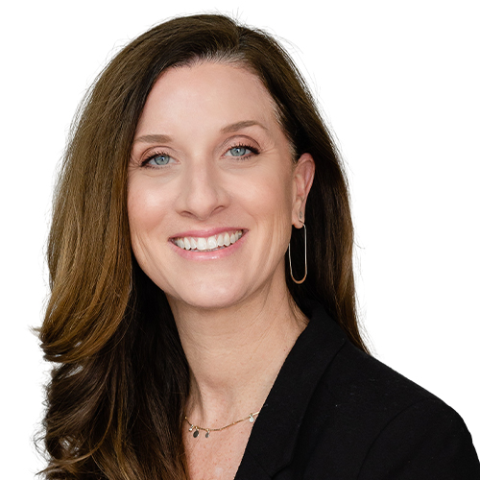
Meet the speakers
Sandy Hilfiker, MA
Jaime Dawson, MPH
Note: The speakers do not have conflicts of interests to report.

Slide 3
Learning Objectives
At the end of this webinar, you will be able to:
Describe the phases of the equity-centered health communication framework
Understand the characteristics of inclusive health communication products
Name strategies for developing more equitable and inclusive health communication materials and products

Slide 4
Icebreaker

Slide 5
A note about health equity

Slide 6
We are at a crossroads.
The pandemic brought some hard truths about inequities to the surface
There are huge gaps in health equity research and practice related to communication
We have an opportunity to fill these gaps

Slide 7
Word Cloud

Slide 8
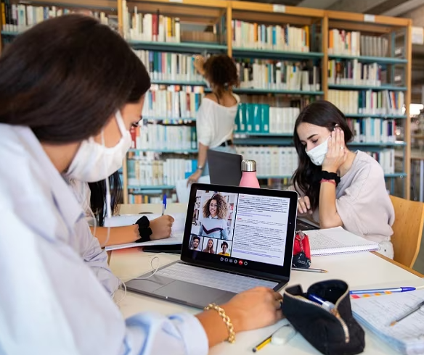
The role of libraries
Extensive reach across the U.S., in person and virtually
Librarians are trusted members of the community
Serve as a safe space for underserved communities
Provide access to reliable health information and resources

Slide 9
The ECHC framework

Slide 10
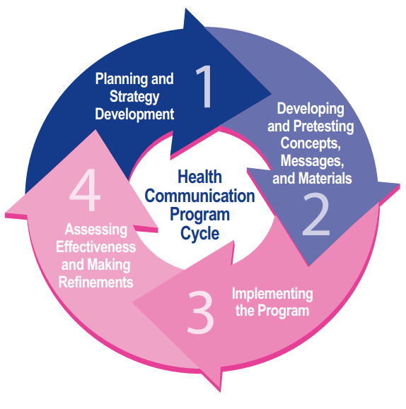
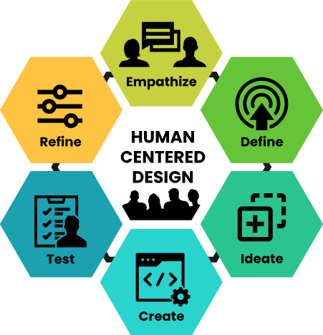
Foundations of ECHC framework

Slide 11
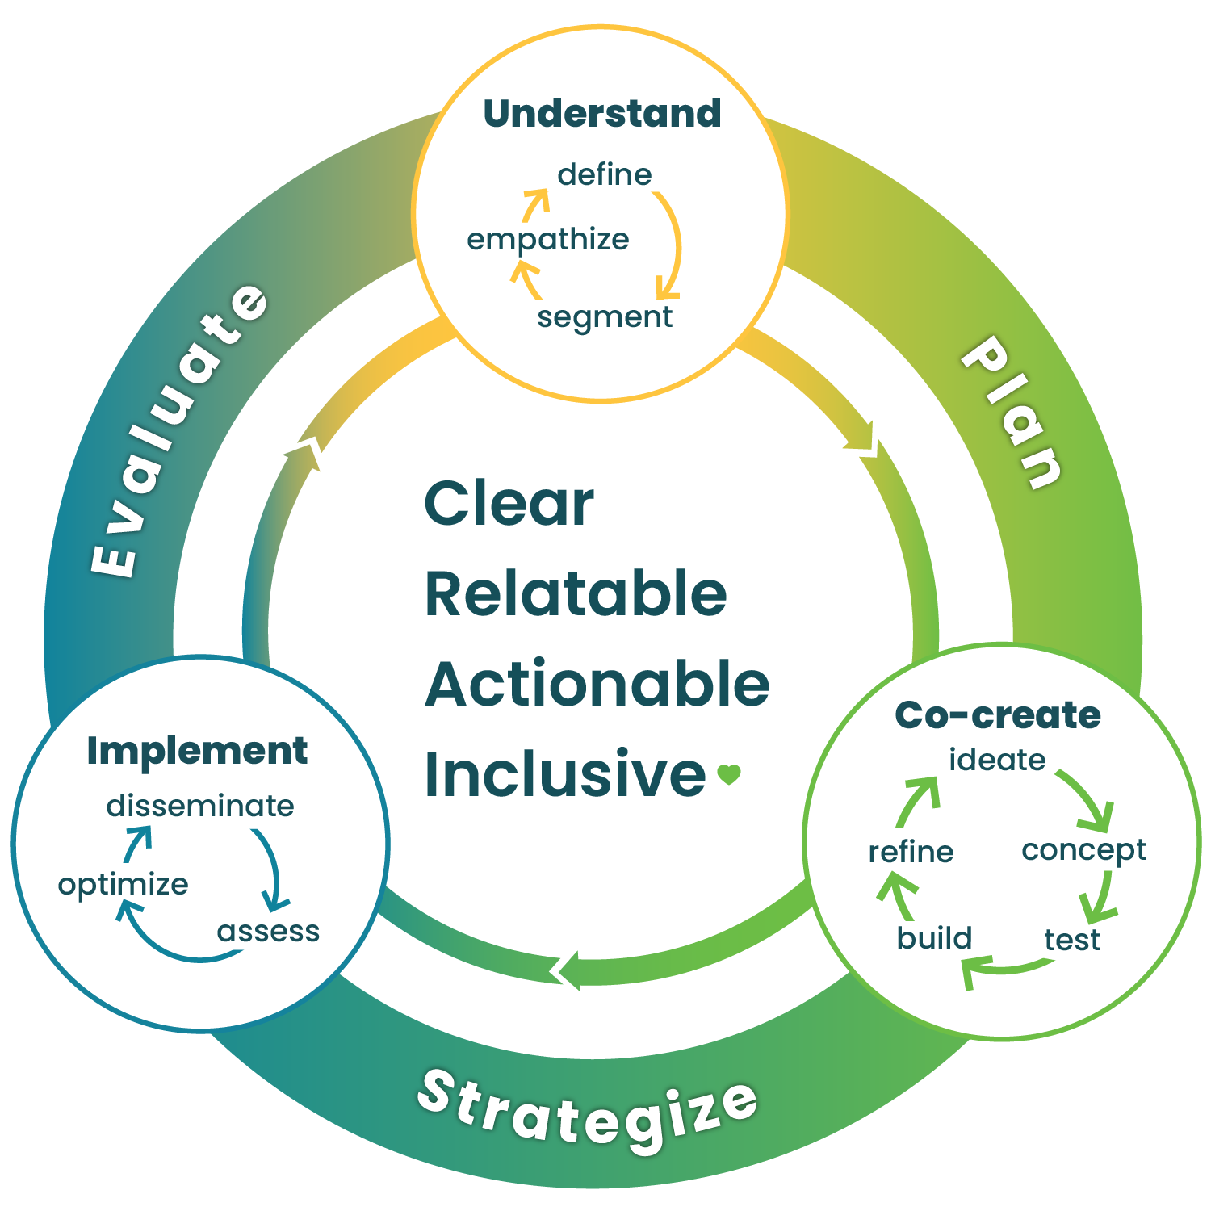
What is the ECHC framework?
Process or approach for designing health communication
Mindset that supports empathy and disrupts personal and systemic biases
Outcomes that result in inclusive communication`

Slide 12
Our ultimate goal
We can’t always follow every step of this process — but we do as much as we can
Our goal is to create health communications that meet audiences where they are and develop resources that are:
Clear
Relatable
Actionable
Inclusive

Slide 13
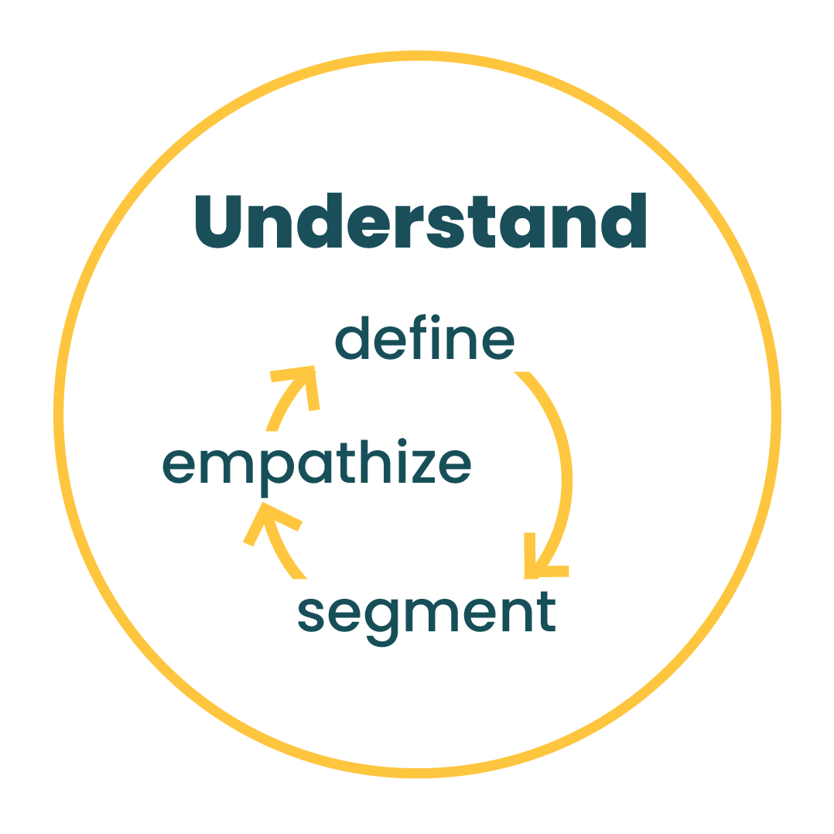
Phase 1: Understand

Slide 14
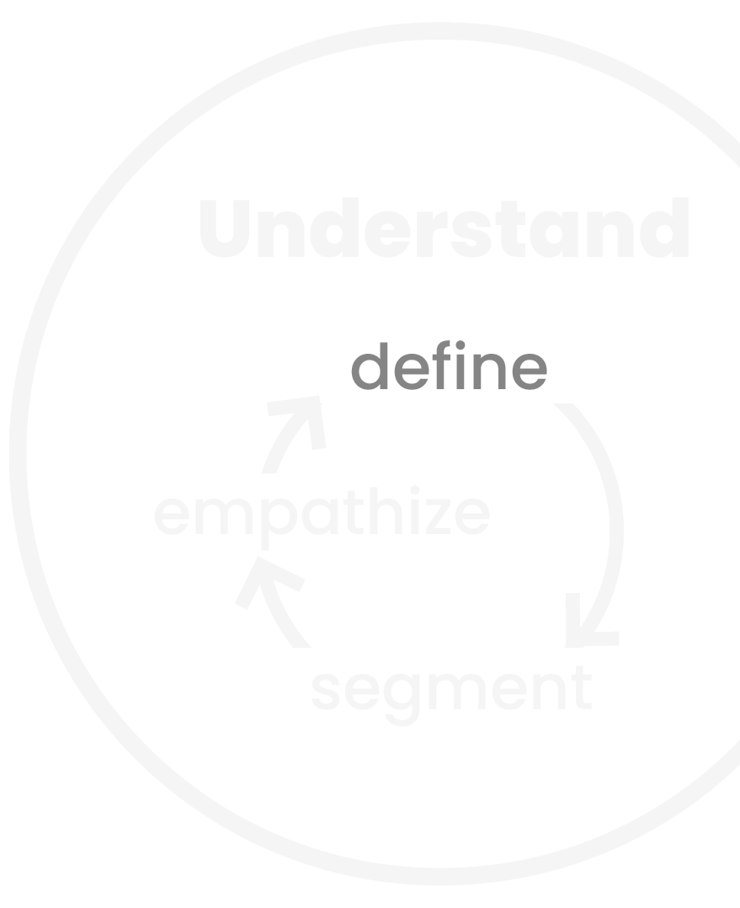
Define
We need to figure out and clearly explain the problem
We need to look at the problem from all angles
We need to understand how existing communications may be contributing to the problem

Slide 15
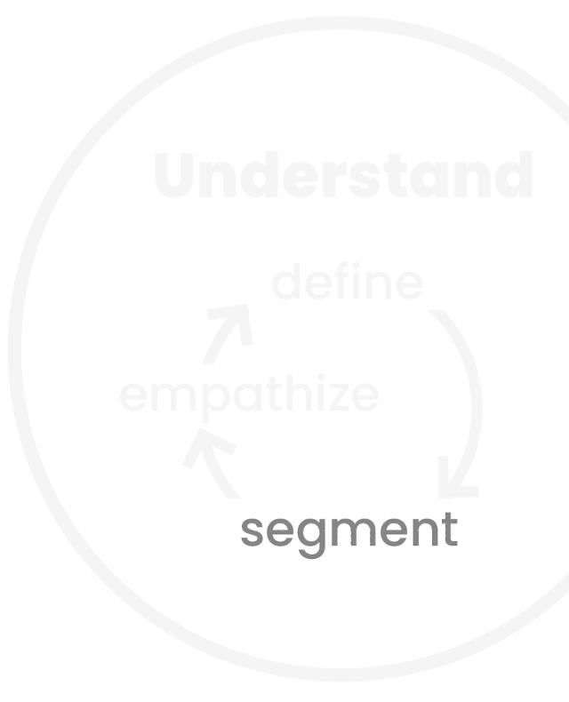
Segment
The “general public” is not our audience
We need to narrow to smaller groups for our messages to stick
We push for going beyond demographics and grouping people by characteristics like cultural practices, values, or preferences
We consider overlapping and multiple identities

Slide 16
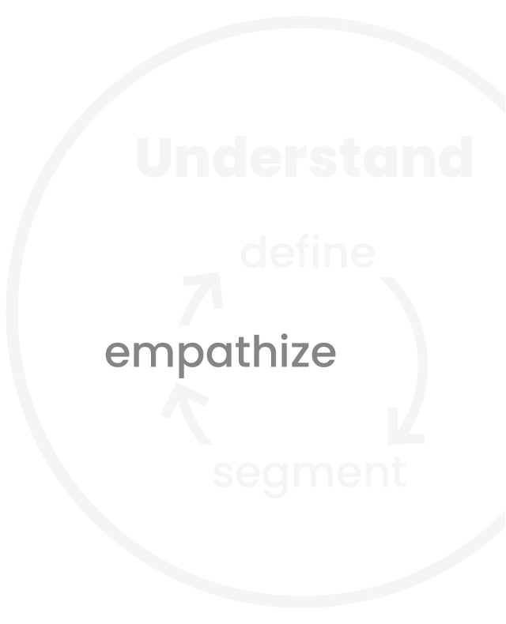
Empathize
We use a variety of methods to better understand the needs and preferences of our audience
We approach formative research with humility
We acknowledge our own biases and question our assumptions and experiences

Slide 17
Case study: Live to the Beat Campaign
Million Hearts® – Live to the Beat campaign aims to increase awareness and motivate behavior change in Black adults (ages 35 to 54) at risk for cardiovascular disease

Slide 18
Extended Parallel Processing Model (EPPM)
 | High Efficacy Belief in effectiveness of solutions and confidence to practice them | Low Efficacy Doubts about effectiveness of solutions and about one’s ability to practice them
High Threat Belief that the threat is harmful and that one is at risk | Danger Control People take protective action to avoid or reduce the threat Strategy: Provide calls to action | Fear Control People are too afraid to act so they try to reduce their fear and feel better Strategy: Educate about solutions
Low Threat Belief that the threat is trivial and that one is not at risk | Lesser Amount of Danger Control People know what to do but aren’t motivated to do it Strategy: Educate about risk | No Response People don’t feel at risk and don’t know what to do about it Strategy: Educate about risk and solutions

Slide 19
Persona example #1

Slide 20
Persona example #2

Slide 21
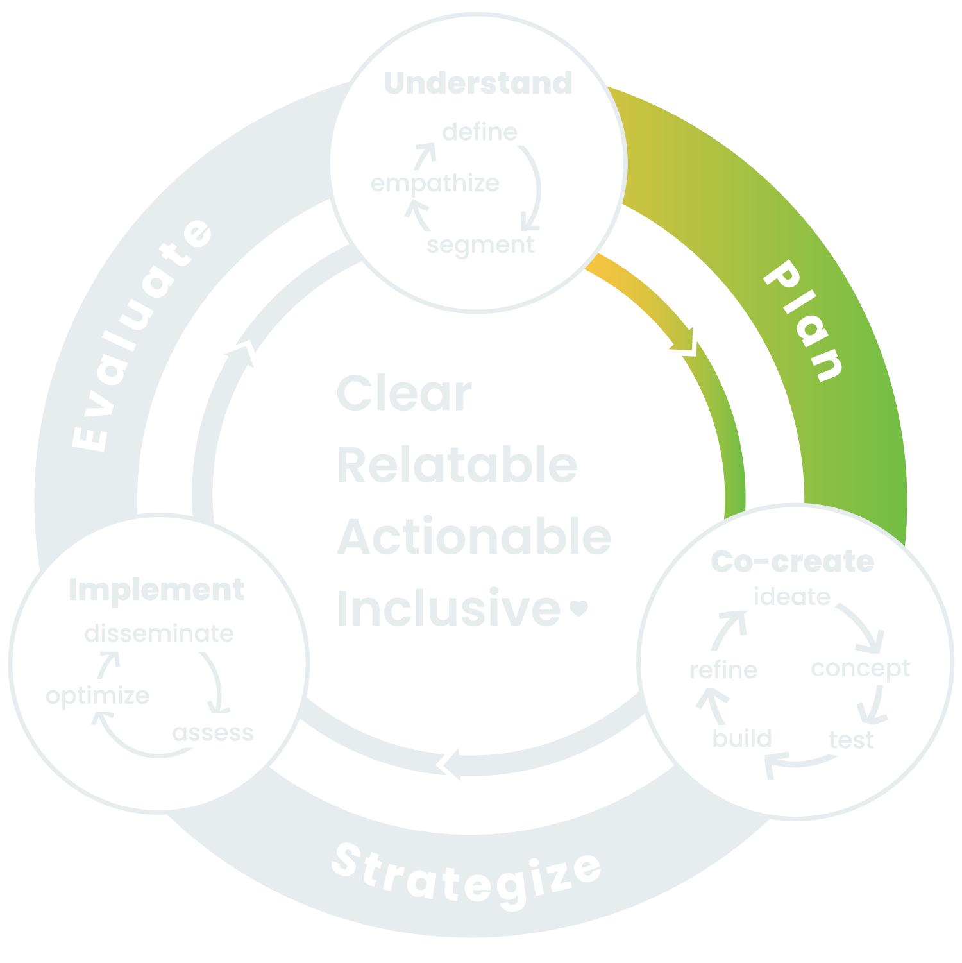
Transition phase: Plan

Slide 22
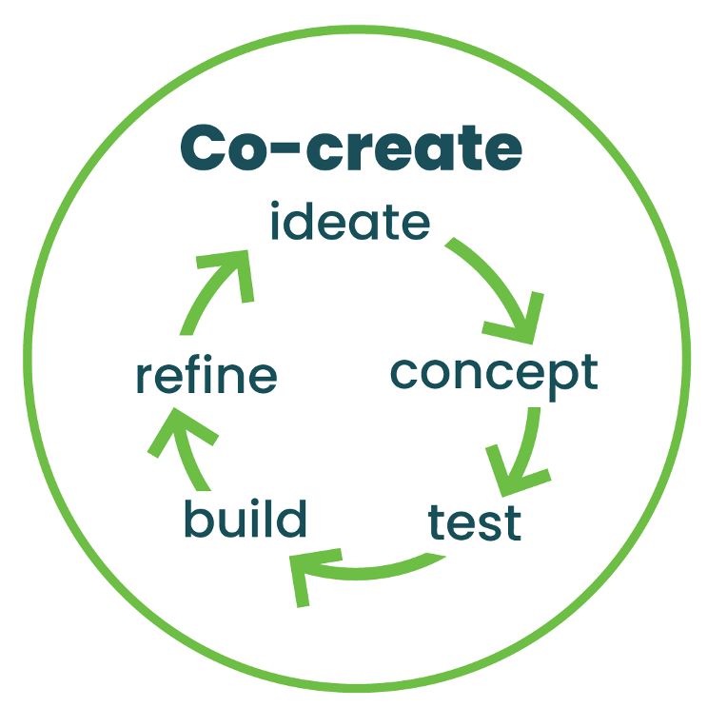
Phase 2: Co-Create

Slide 23
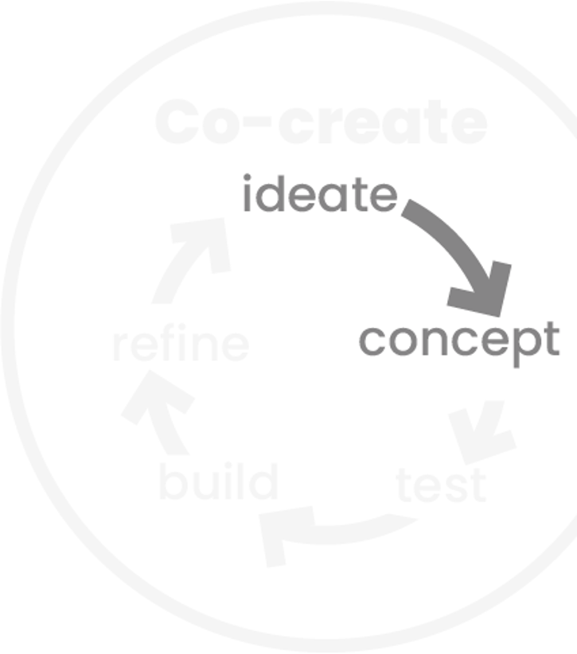
Ideate and Concept
It is tempting to jump to solutions when you understand the problem
We challenge the status quo by thinking through how our ideas may play out for different audiences and abilities
We start with concepts to make sure our audience thinks we’re on track
We develop concepts with empathy and using familiar language and imagery

Slide 24
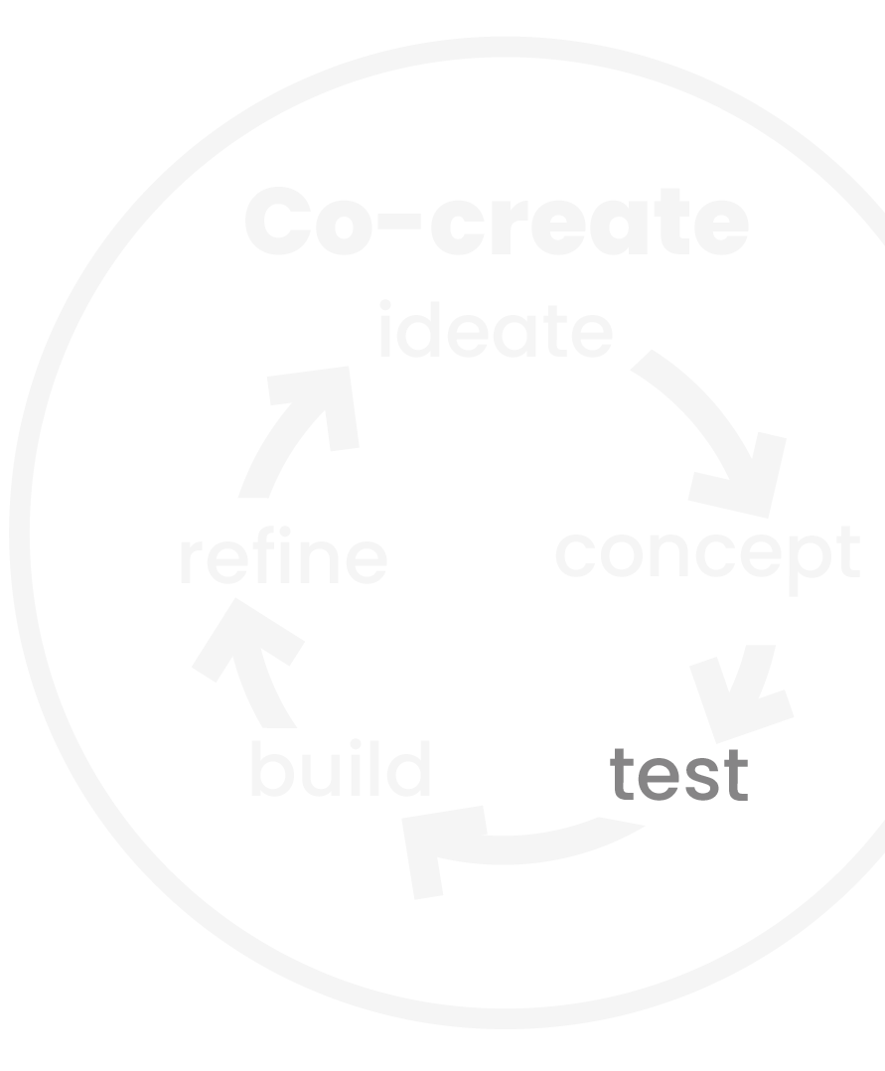
Test
Pre-testing is where we get feedback on our ideas (like draft messages)
We want to think carefully about recruitment and how to ensure a diverse mix of participants
We want to plan our sessions to allow time and the right setting for participants to feel comfortable

Slide 25
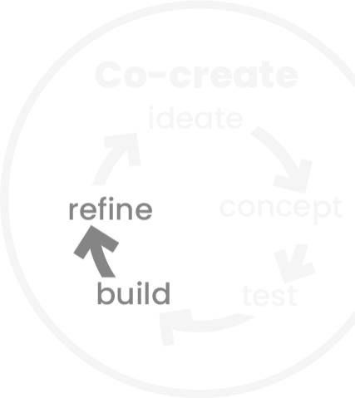
Build and Refine
This is when we start to see our communications come to life
We need to create products that account for a large spectrum of needs
Sometimes we have the chance to do more testing and refine based on results
Examples of this might include testing, material testing, or A/B testing

Slide 26
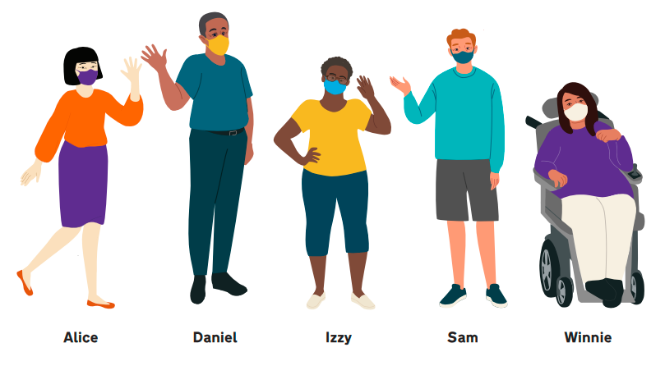
Case study: Creating resources for people with intellectual and developmental disabilities (IDD)
CH partnered with CDC and RTI International to create a suite of COVID-19 resources for people with IDD
After we developed draft materials, RTI conducted interviews to gather feedback from adults with IDD and their caregivers

Slide 27
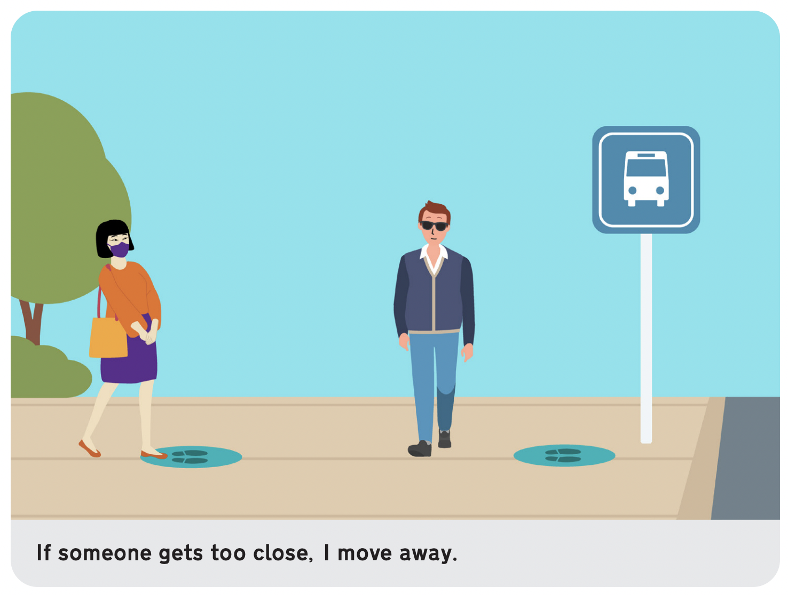
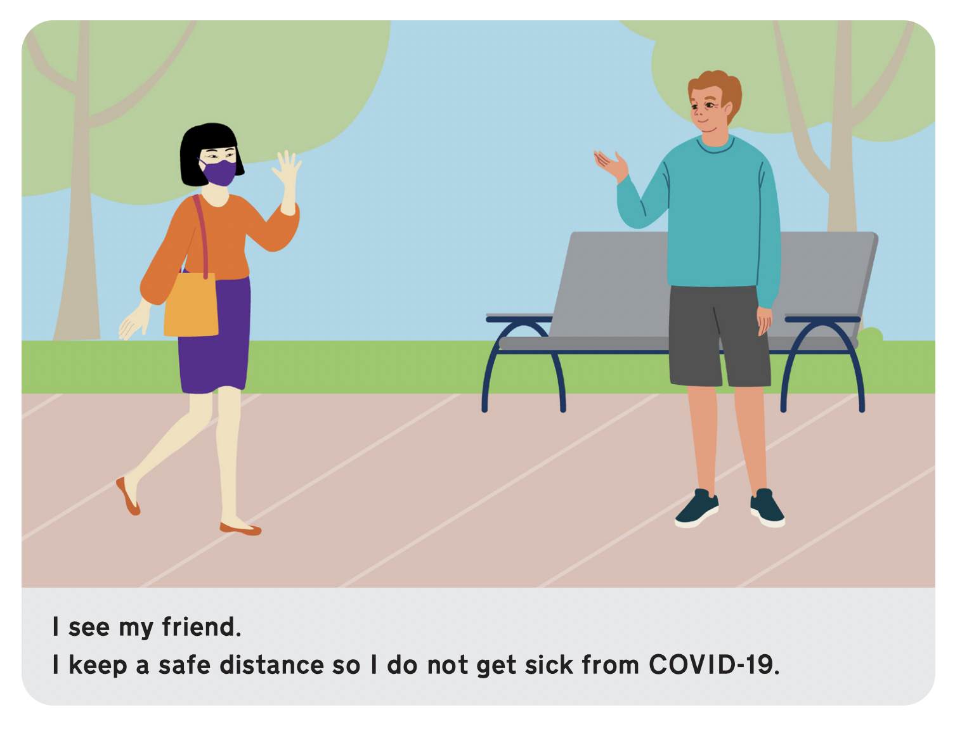
Testing concepts to refine best practices
In draft social distancing materials, we used a couch to illustrate the idea of staying 6 feet apart
Based on audience feedback, we replaced the couch with social distancing markers (in places where people would realistically see them)
In other scenes, our main character simply keeps her distance

Slide 28
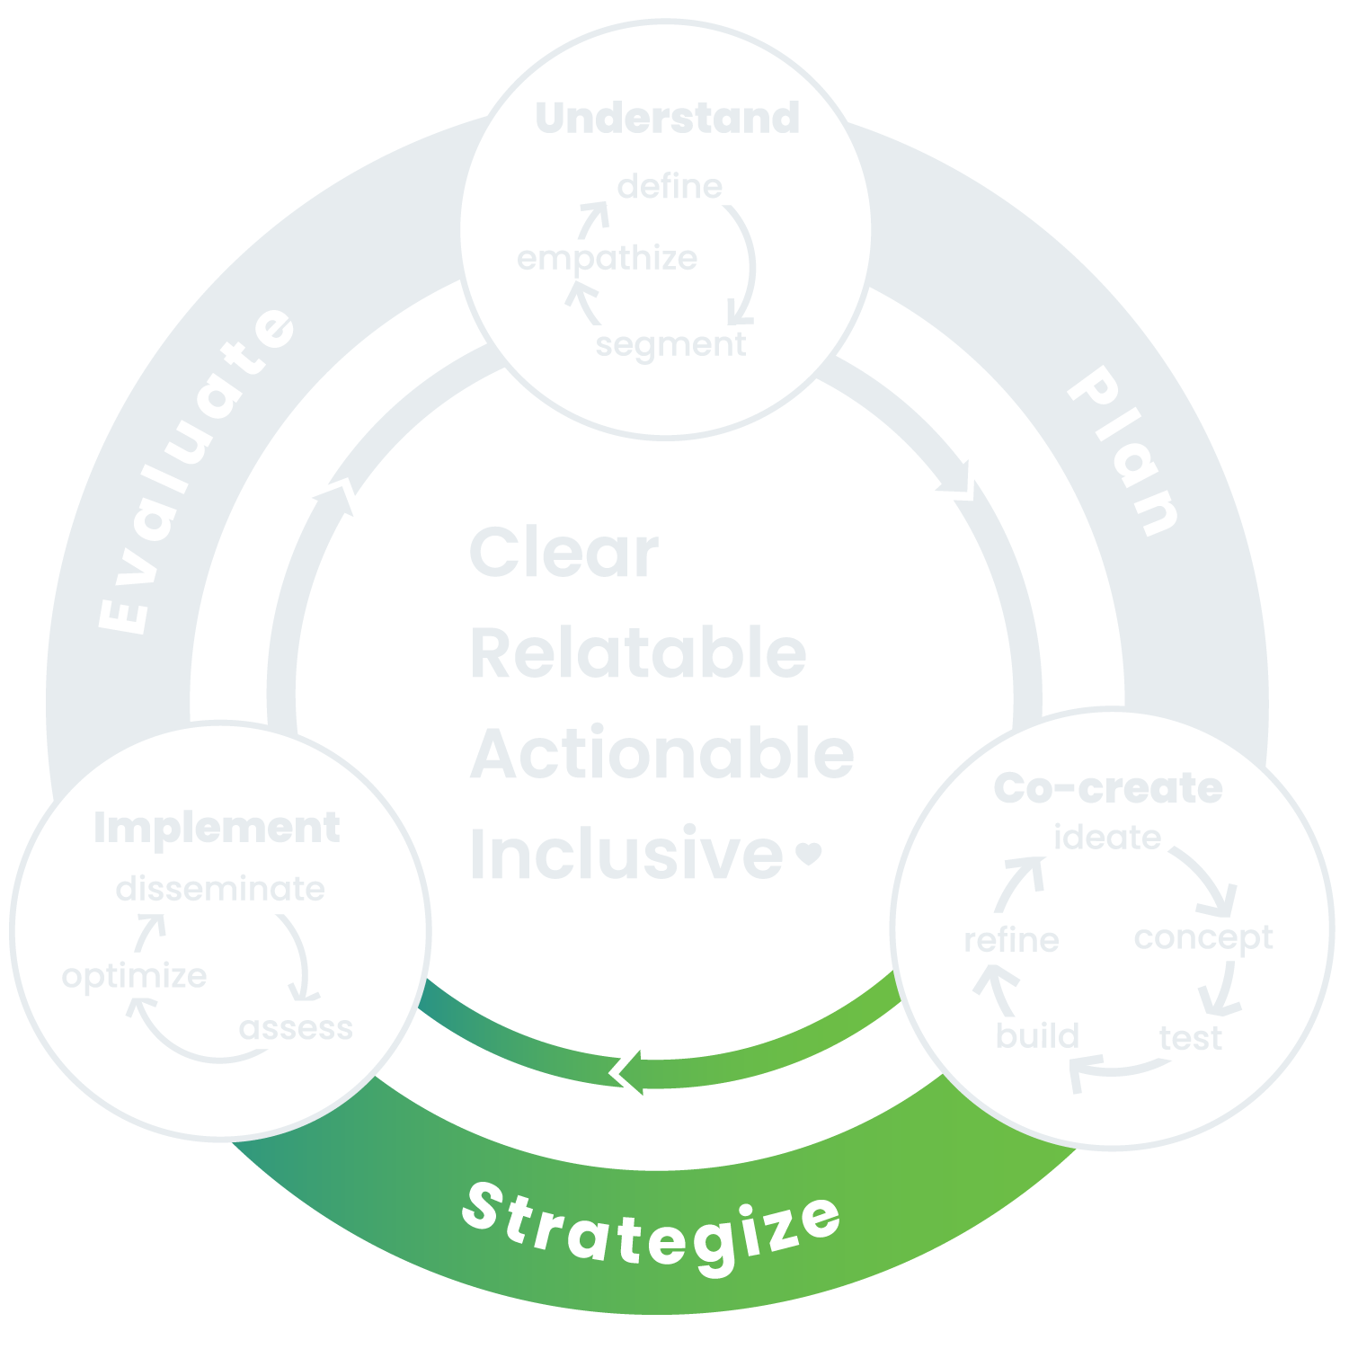
Transition phase: Strategize

Slide 29
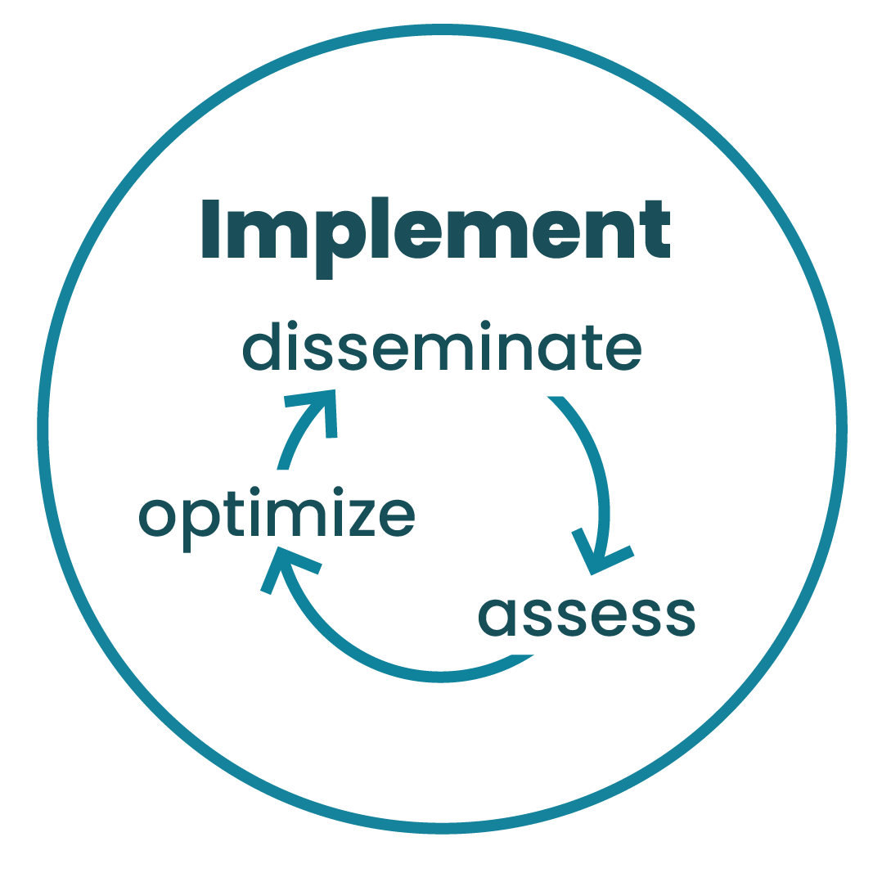
Phase 3: Implement

Slide 30
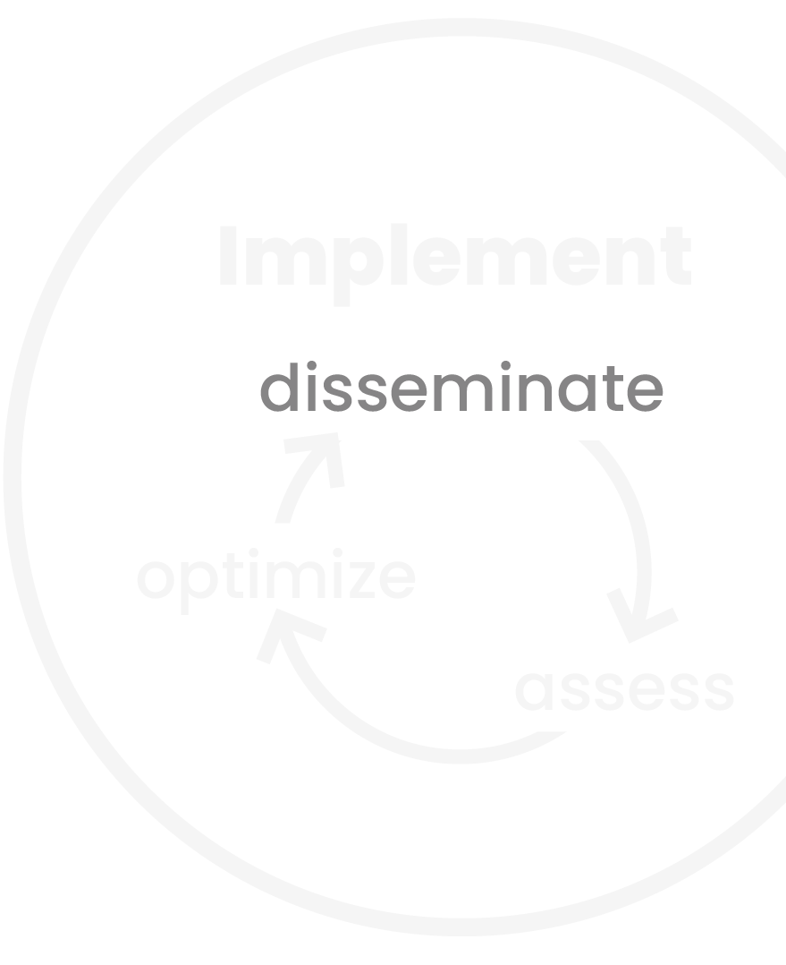
Disseminate
Our plans for dissemination are typically captured in communication strategy and promotion plan deliverables.
Equitable dissemination typically relies on:
A strong, diverse partner network — which should be built early
Building community capacity to support ongoing change

Slide 31
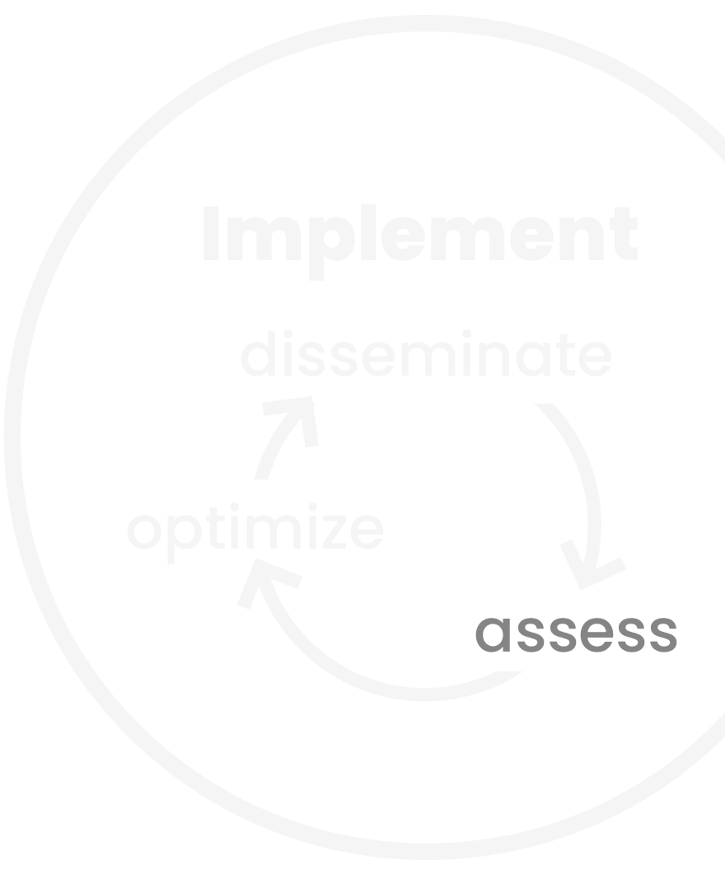
Assess
Are we reaching our priority audience?
Are the communications having the intended impact?
Are there any unexpected or unintended consequences?
We also want to consider how we can check our assumptions over time and involve the community in ongoing assessment.

Slide 32
Case study: Eye Health, My Health
Eye Health, My Health (EHMH) is the National Eye Institute’s campaign for Black/African American adults that seeks to build knowledge, challenge social norms, and address specific barriers to eye health care.

Slide 33
EHMH Community Pilot
The community pilot program allowed us to:
Empathize with our primary and secondary audiences and understand their information needs and communication preferences
Co-create materials with secondary audience who work closely with our primary audience
Gather direct feedback from primary audience to assess impact
Optimize approach and materials for engaging with primary audience
Evaluate outreach strategies to prepare to scale campaign nationally

Slide 34
Additional Resources

Slide 35
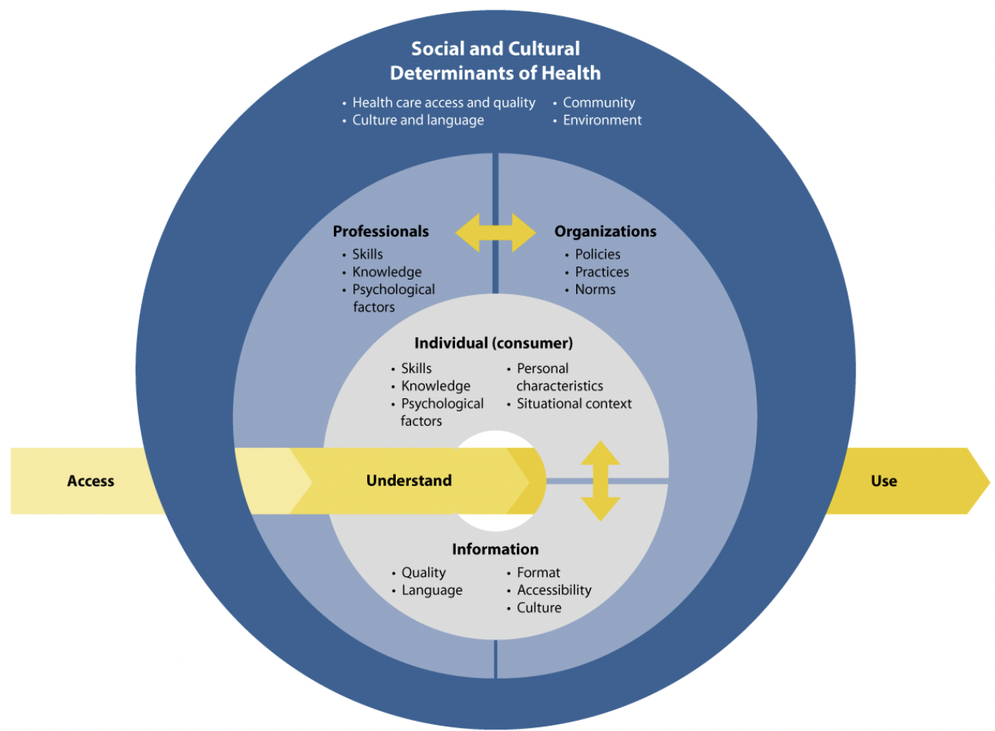
NNLM — Health Literacy Framework
Notes:
Could consider including this as a tool at the end instead of a case study.

Slide 36
NLM — HEMAT
Developed Health Education Materials Assessment Tool (HEMAT)
Assessed literature scan to identify visual communication best practices
Conducted IDIs with SMEs and with consumers with limited health literacy skills
Developed 508c tools in English and Spanish to
assess understanding
determine if material can be designated as easy-to-read

Slide 37
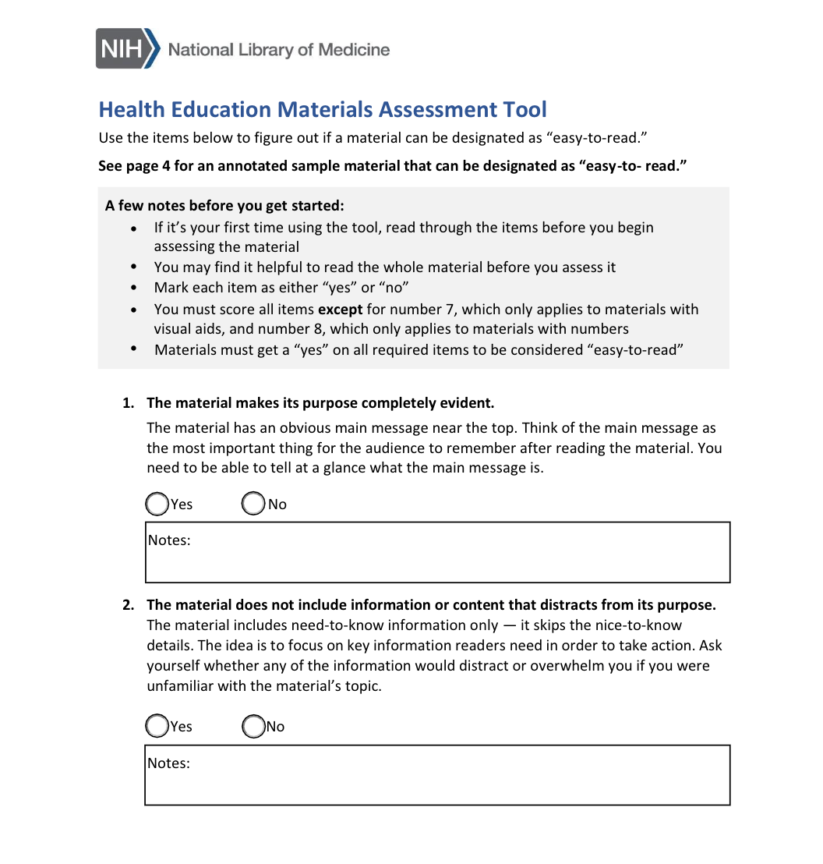
Using the HEMAT
The assessment tool is 8 yes-or-no questions, 2 of which are optional.
To be considered easy-to-read, a material must get a “yes” on all required items.

Slide 38
Recap of Learning Objectives
At the end of this webinar, you will be able to:
Describe the phases of the equity-centered health communication framework
Understand the characteristics of inclusive health communication products
Name strategies for developing more equitable and inclusive health communication materials and products

Slide 39
References
Simon, M. A., O’Brian, C. A., Nava, M., Dahdouh, R., Wafford, Q. E., Mack, S., & Holmes, K.L. (2021). Public Libraries as Key Partners for Advancing Health Equity. American Journal of Public Health, 111(1), 40–42. https://doi.org/10.2105/ajph.2020.306004
CDC. (2021, April 26). Libraries as Partners in Health Literacy. Centers for Disease Control and Prevention. https://www.cdc.gov/healthliteracy/education-support/libraries.html ‌

Slide 40
Questions?

Slide 41
We Heart Health Literacy
Subscribe at communicatehealth.com

Slide 42
Thank you!

