Slide 1
Health Literacy
Help patients understand…

Slide 2
Discussion points from last module
What is a negative outcome you’ve seen as a result of limited health literacy?
Notes:
FACILITATOR NOTE: You can ask a few audience members to share - encourage them to describe a real life situation to the rest of the group and see if others have had similar experiences. If time permits, you can ask if anyone has ideas for a solution.
[NOTE TO FACILITATOR: If you are completing these modules in an order other than suggested in the facilitation guide, you may need to adjust these discussion points.]

Slide 3
Objectives
By the end of the program, participants will:
Describe health literacy trends nationally and locally
Describe the relationship of health literacy to readability and plain language
Notes:
During our last conversation, we talked about the purpose for these brief and ongoing trainings, which is: health literacy plays an important role in patient care. As we move forward through these modules, we’ll get into things that we can do as healthcare providers to help patients understand. In today’s conversation, we will take a deeper look at health literacy nationally and locally, and discuss some health literacy related terms that are important to know moving forward.
[NOTE TO FACILITATOR: If you are completing these modules in an order other than suggested in the facilitation guide, you may need to adjust this note.]

Slide 4
Health Literacy in the U.S.
The National Assessment of Adult Literacy measured health literacy in adults 16+ in 2003⁸
Looked at health literacy tasks in clinical, prevention and health care system domains⁸
Only 12% of English-speaking adults in the United States had proficient health literacy skills⁸
Notes:
The 2003 National Assessment of Adult Literacy measured health literacy in those 16 and over⁸. The assessment looked at health literacy tasks in different clinical, prevention and health care system domains⁸. This report found that only 12% of English-speaking adults in the U.S. had proficient health literacy skills. In this assessment, proficient is defined as the ability to perform complex and challenging literacy activities. However, these are the types of skills believed to be necessary to respond to public health alerts, engage in preventive care and navigate the healthcare system⁹.

Slide 5
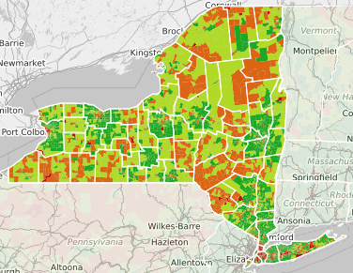
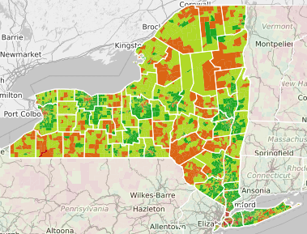
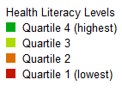
Health Literacy in New York State
National
State
Notes:
What does health look like in our state? This is a map generated by a tool developed at the University of North Carolina at Chapel Hill called the Health Literacy Data Map. It shows an estimated mean health literacy based on data from the Census and the American Community Survey⁷. The estimates are based on things such as: Gender, Age, Race/Ethnicity, Language spoken at home, Income, Education, Marital status, Time spent in the United States and Metropolitan statistical area⁷. The idea behind this is that there is not one predictor of health literacy, but it is the result of many factors working together⁷. Something that is important to remember about this data is that it is not the results of individuals taking some type of health literacy assessment but estimates based on demographic characteristics of census block groups. Therefore, the estimates may not be accurate for every person who lives in a particular census block group. On the left hand side, you can see the highest to lowest quartiles when our state is compared at a national level, and on the right you can see the highest and lowest census block groups when compared within the state. This is just to give everyone an idea about where people are likely to experience higher and lower levels of health literacy, but I want to stress that this doesn’t mean that everyone living in the highest quartile areas has high health literacy. There are inevitably still individuals in these regions that have low levels of health literacy.
NOTE TO FACILITATOR: Delete the slide that is not your state. Feel free to add any of your personal assessment of this data based on your organization’s location within the state.

Slide 6
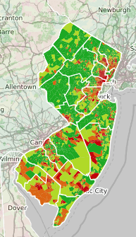
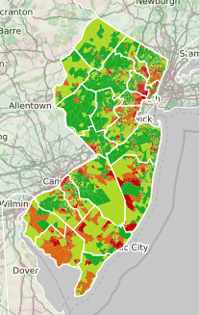
Health Literacy in New Jersey
National
State
Notes:
What does health look like in our state? This is a map generated by a tool developed at the University of North Carolina at Chapel Hill called the Health Literacy Data Map. It shows an estimated mean health literacy based on data from the Census and the American Community Survey⁷. The estimates are based on things such as: Gender, Age, Race/Ethnicity, Language spoken at home, Income, Education, Marital status, Time spent in the United States and Metropolitan statistical area⁷. The idea behind this is that there is not one predictor of health literacy, but it is the result of many factors working together⁷. Something that is important to remember about this data is that it is not the results of individuals taking some type of health literacy assessment but estimates based on demographic characteristics of census block groups. Therefore, the estimates may not be accurate for every person who lives in a particular census block group. On the left hand side, you can see the highest to lowest quartiles when our state is compared at a national level, and on the right you can see the highest and lowest census block groups when compared within the state. This is just to give everyone an idea about where people are likely to experience higher and lower levels of health literacy, but I want to stress that this doesn’t mean that everyone living in the highest quartile areas has high health literacy. There are inevitably still individuals in these regions that have low levels of health literacy.
NOTE TO FACILITATOR: Delete the slide that is not your state. Feel free to add any of your personal assessment of this data based on your organization’s location within the state.

Slide 7
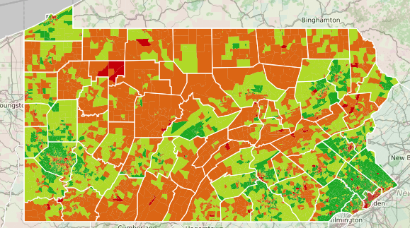
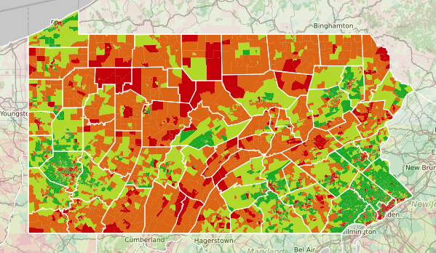
Health Literacy in Pennsylvania
National
State
Notes:
What does health look like in our state? This is a map generated by a tool developed at the University of North Carolina at Chapel Hill called the Health Literacy Data Map. It shows an estimated mean health literacy based on data from the Census and the American Community Survey⁷. The estimates are based on things such as: Gender, Age, Race/Ethnicity, Language spoken at home, Income, Education, Marital status, Time spent in the United States and Metropolitan statistical area⁷. The idea behind this is that there is not one predictor of health literacy, but it is the result of many factors working together⁷. Something that is important to remember about this data is that it is not the results of individuals taking some type of health literacy assessment but estimates based on demographic characteristics of census block groups. Therefore, the estimates may not be accurate for every person who lives in a particular census block group. On the left hand side, you can see the highest to lowest quartiles when our state is compared at a national level, and on the right you can see the highest and lowest census block groups when compared within the state. This is just to give everyone an idea about where people are likely to experience higher and lower levels of health literacy, but I want to stress that this doesn’t mean that everyone living in the highest quartile areas has high health literacy. There are inevitably still individuals in these regions that have low levels of health literacy.
NOTE TO FACILITATOR: Delete the slide that is not your state. Feel free to add any of your personal assessment of this data based on your organization’s location within the state.

Slide 8
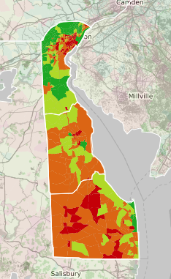
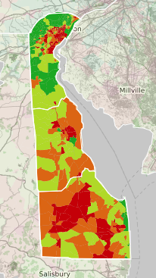
Health Literacy in Delaware
National
State
Notes:
What does health look like in our state? This is a map generated by a tool developed at the University of North Carolina at Chapel Hill called the Health Literacy Data Map. It shows an estimated mean health literacy based on data from the Census and the American Community Survey⁷. The estimates are based on things such as: Gender, Age, Race/Ethnicity, Language spoken at home, Income, Education, Marital status, Time spent in the United States and Metropolitan statistical area⁷. The idea behind this is that there is not one predictor of health literacy, but it is the result of many factors working together⁷. Something that is important to remember about this data is that it is not the results of individuals taking some type of health literacy assessment but estimates based on demographic characteristics of census block groups. Therefore, the estimates may not be accurate for every person who lives in a particular census block group. On the left hand side, you can see the highest to lowest quartiles when our state is compared at a national level, and on the right you can see the highest and lowest census block groups when compared within the state. This is just to give everyone an idea about where people are likely to experience higher and lower levels of health literacy, but I want to stress that this doesn’t mean that everyone living in the highest quartile areas has high health literacy. There are inevitably still individuals in these regions that have low levels of health literacy.
NOTE TO FACILITATOR: Delete the slide that is not your state. Feel free to add any of your personal assessment of this data based on your organization’s location within the state.

Slide 9
Literacy = Health Literacy?
Reading and writing are a part of health literacy because these skills make it easier to understand and use health information²
Ability to read and write does not mean someone has high health literacy²
“Research shows that many health and healthcare activities are unfamiliar, complicated, and technical to most people.”²
~Centers For Disease Control and Prevention
Notes:
Are limited health literacy and limited literacy the same problem? No, but they are related². Being able to read and write will make is easier to understand health information, but just the ability to read and write well does not mean that someone automatically has adequate health literacy². It’s common when people hear “literacy” to assume that because their patient is a lawyer, teacher, or other professional that they understand medical recommendations. You can see in this quote from the Centers for Disease Control and Prevention that “research shows that many health and healthcare activities are unfamiliar, complicated and technical to most people.”² Healthcare is its own environment, so we need to be cautious about how much we think people understand simply because they are well educated.

Slide 10
Readability ≠ Plain Language ≠ Health Literacy
Readability, plain language, and health literacy are different
Each term is unique
The terms are related
All are important
Notes:
Let’s move on to some common terms. They are all terms that relate in some way to health literacy that you may have seen before. However, it is important to know the difference when we are considering how we communicate with patients.

Slide 11
Readability
Readability measures the complexity of printed materials³
Readability is measured in printed documents and uses the length of words and the sentences in a document to determine a grade level³
Readability formulas can be helpful but should not be the only way that you attempt to address health literacy³
Notes:
Readability is how easy or difficult something is to read³. Readability is often used with different formulas that look at the length of words in a written document and determine a certain grade level³. However, these formulas shouldn’t be the only way that you attempt to address health literacy³. These are not always accurate with certain forms³ and, as we will discuss in a moment, cannot account for the use of plain language.

Slide 12
Plain Language
Plain language is communication that someone can understand the first time³
Plain language principles:
Using common words, not jargon or acronyms^{3,6}
Break up information logically³ & be concise⁶
Speaking conversationally vs. academically⁶
Remember: health information should also be actionable for patients⁴
Notes:
Plain language is described as communication that people can understand the first time they read or hear it³. One principle of plain language includes using familiar terms while avoiding jargon and acronyms^{3,6}. When you think about the previous description of readability, the formulas often look at the length of words - but if a document has a lot of acronyms, it may appear readable when it is still not understandable for the patient. Plain language also includes chunking information so that people can easily follow what is being discussed³ and writing or speaking conversationally as opposed to academically⁶. Many plain language resources talk about written materials, but these principles can be applied to verbal communication as well. While using plain language is an important piece of helping patients understand, it is also suggested that we focus on ensuring that patients have actionable health information⁴.

Slide 13
Health Literacy
Health literacy involves: Finding, understanding, evaluating, communicating and acting on health information⁵
Plain language is important when communicating^{3,6}—but addressing health literacy also means making the content understandable and actionable for everyone⁴
Notes:
The idea of actionable health information moves us back to the concept of health literacy. We discussed health literacy last time, but as a reminder, health literacy is a complex concept that includes someone being able to find, understand, evaluate, communicate and act on health information. Ensuring written documents for patients are at an appropriate reading level and using plain language will help, but making information actionable for the patient will help them understand what to do with the information. The bottom line is that readability, plain language, and health literacy are all important, but to improve patient’s understanding we need to know how they differ and how they can complement one another. For example, just because a document is written at a 4th grade level doesn’t mean that a patient will read it, understand it or know how they should use it to improve their own health. As we move forward through these training modules, we’ll talk about more strategies to address health literacy and ensure patients better understand information and take action on it.
[NOTE TO FACILITATOR: If you are completing these modules in an order other than suggested in the facilitation guide, you may need to adjust this note.]

Slide 14
Red Flags
Forms incomplete or incorrectly filled out
Non-adherence to medication instructions
Can’t name medications, purpose, or how to take
Frequently missed appointments
Anger
“I forgot my glasses”
“My wife, friend, etc. usually takes care of…”¹
Notes:
We’ve talked a lot about health literacy, its impact and some introductory ways to address it such as readability and clear communication. You might be wondering, “How do I know that a patient might struggle with understanding heath information?” These are some health literacy red flags that you can take note of. Things like struggling to complete medical forms and difficulty adhering to medication instructions may be indicators. Other red flags may be if someone usually has a friend or family member help them manage their care or uses excuses for not reading information such as “I forgot my glasses.”¹

Slide 15
Take home message
Practice:
Do you notice any health literacy red flags when working with patients?
Developed resources reported in this presentation are supported by the National Library of Medicine (NLM), National Institutes of Health (NIH) under cooperative agreement number UG4LM012342 with the University of Pittsburgh, Health Sciences Library System. The content is solely the responsibility of the authors and does not necessarily represent the official views of the National Institutes of Health.
Notes:
As you move forward in the coming (week/month/etc.) I ask you to consider what you think the important points of communication between yourself and your patients are and what you might be able to do to improve the process. Also - practice taking note of any health literacy red flags that you notice when speaking with your patients. What helps you notice possible concerns with health literacy?
[NOTE TO FACILITATOR: If you want to complete group discussion immediately following this module content, change the title of this slide to ‘Group Discussion’ and delete the slide with corresponding questions in the next module. If you would like to have discussion take place using your internal LMS system, you can include instructions here for how participants can participate. Then, adjust the slide with the corresponding questions in the next module as needed.]

Slide 16
References
AMA Foundation (2007). Health literacy and patient safety: Help patients understand. Retrieved from URL to source
Centers for Disease Control and Prevention (2016). Understanding Health Literacy. Retrieved from: URL to source
Indian Health Service (n.d.). Healthcare Communications. Retrieved from: URL to Source
National Academies of Sciences, Engineering, and Medicine (2016). Integrating health literacy, cultural competence, and language access services: Workshop summary. Washington, DC: The National Academies Press. doi:10.17226/23498.
Office of the Legislative Council (2010). Compilation of the Patient Protection and Affordable Care Act. Retrieved from URL to source
Plain Language Action and Information Network (2017). Plain Language Guidelines. Retrieved from: URL to Source
University of North Carolina Chapel Hill (2014). Health Literacy Data Map. Retrieved from: URL to Source
U.S. Department of Education (2006). The Health Literacy of America’s Adults: Results from the 2003 National Assessment of Adult Literacy. Retrieved from: URL to Source
U.S. Department of Health and Human Services, Office of Disease Prevention and Health Promotion. (2010). National Action Plan to Improve Health Literacy. Washington, DC.: Author. Retrieved from URL to source

