Slide 1
Writing and Submitting Your NNLM Proposal for Region 1 Grants
Part 4: Show
October 11, 2022
Nancy Patterson
Outreach Librarian
Tony Nguyen
Executive Director

Slide 2
Agenda
Evaluation
Reporting
Data Collected
Wrapping it Up
Carrying it Forward
Q&A

Slide 3
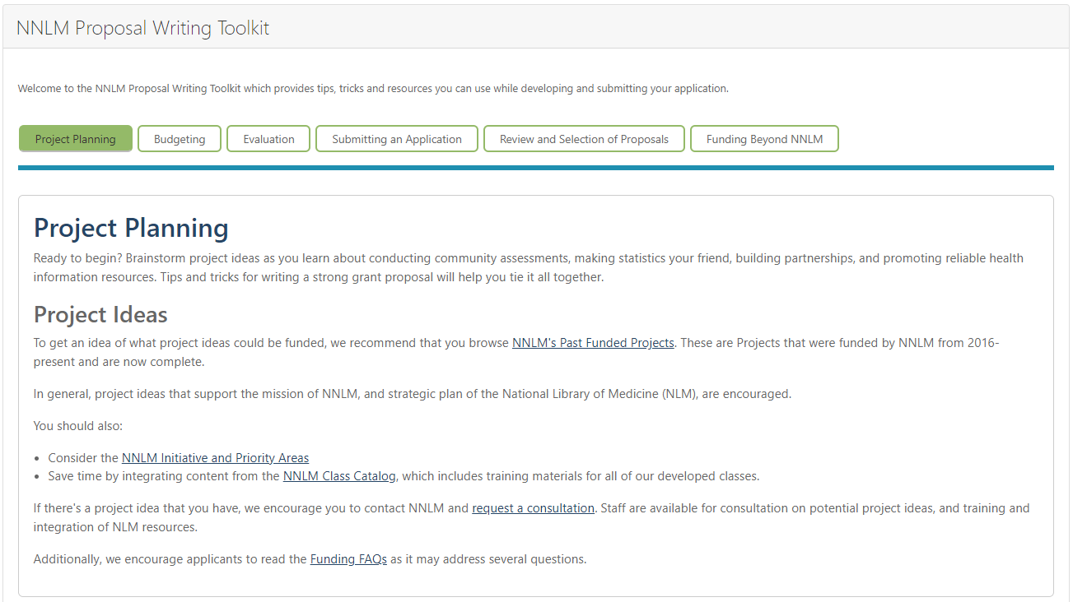
NNLM Proposal Writing Toolkit
https://nnlm.gov/guides/nnlm-proposal-writing-toolkit

Slide 4
Evaluation
So easy if you build it in from the start!
Community Assessment
Create a Logic Model
Logic Model – Develop Indicators
Create an Evaluation Plan
Collect Data, Analyze and Act
https://nnlm.gov/nec/resources

Slide 5
How Will You Capture:
Numbers: How many events, attendees, “likes” or usage?
Success stories?
Lessons learned?
Can your project be replicated?
Is your project a model?
Who can you inspire and educate with your experience?
After the project ends, how will you continue this program?

Slide 6
Reporting
Activities
What are the evaluation questions you intend to ask participants?
How will you collect participant data?
How will you collect information on how well the event went?
How will you report successes of an event?
Consider NNLM Expectations of Demographic/Information Requested when submitting a report.
Mid & Final
Progress thus far
Lessons learned
Observations
Success Stories Captured
Adjustments to Project
Technology
Review after first use of equipment/tech for outreach activity

Slide 7
Reports and Due Dates
Technology Reports: Submit after technology is utilized for first activity
Activity Reports: Due at the end of each month (if any activities occurred)
Mid-Project Reports: Mid-point of when you are given the go-ahead to begin your project
Final Project Reports: End of May

Slide 8
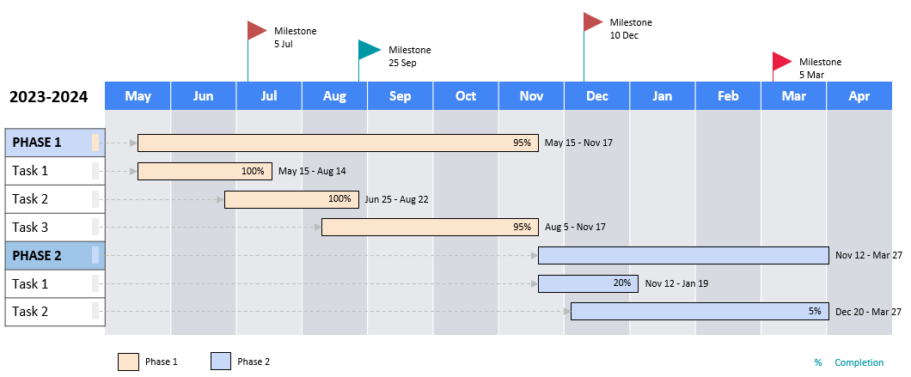
Draft a Project Timeline

Slide 9
Data Collected in NNLM Reporting System

Slide 10
Activity Reports

Slide 11
Activity Type
Awareness and Promotion | Career Development and Training | Additional Career Development and Training | Persistent User Engagement and Partnerships
Demos | Career Development | Presentations | Focus Groups
Exhibits/Health Fairs | Classes, Courses, Training, Workshops | Symposia | Site Visits
Poster Sessions | Lectures | Webinars | Technology
Other Promotional Activity | Panels |  | User Feedback/Needs Assessment

Slide 12
NLM Products
National Library of Medicine Products
Assembly | BLAST | ChemID Plus | ClinicalTrials.gov | ClinVar | Collections
DailyMed | dbGap | dbSNP | DOCLINE | Drug Information Portal | Emergency Access Initiative
Exhibitions | GenBank | Gene | Genome | HMD Traveling Exhibitions | IndexCat
Library LinkOut | LitCOVID | LocatorPlus | MedGen | MedlinePlus | MedlinePlus Connect
MeSH | Nucleotide | Open-I Multimedia Search Engine | Protein | PubChem | PubMed
PubMed Central | RxNorm | SNOMED CT | SRA | WISER - Wireless Information System for Emergency Responders | Other: Please share

Slide 13
Additional Content
Additional Content
All of Us Research Program | Assessment & Evaluation | Citizen Science | Clinical Resources
Consumer Health Resources | Data Management | Data Science | Digital Literacy
Disasters & Emergencies | Electronic Health Information Resources | Evaluation Health Information Resources / Websites | Funding
Grant & Proposal Writing | Health Literacy | HHS Resources | HIV/AIDS
NIH Resources | NNLM Resources | Opioid Use Disorder / Pain Management | Public Health Resources
Technology Awareness | Other: (Please share)

Slide 14
Organizations Associated
Academic Institutions | Library | More Libraries | Organization
College or University | Academic Health Sciences Library | K-12 Library | Community-Based Organization
Community College | College or University Library | Public Library | Faith-Based Organization
K-12 | Community College Library | Vocational or Training Program Library | HIV Services
Vocational or Training Program | Hospital Library | Other Library | Other Organization
Other Academic Institution

Slide 15
More Organization Options
Government | Association | Health / Healthcare | Unknown | Other
Department of Public Health | Professional Society | Hospital | Unknown Org Type | List other orgs not listed
Federal Government | Other Association | Medical Office / Clinic | Public Health Organization (Non-Government)
Local Government |  | Other Health / Healthcare | State or County / Regional Government
Tribal Government
Other Government Agency / Initiative

Slide 16
Demographics
Age Group
Children (0-12 yrs.) | Teens (13-18 yrs.) | Adults (19-64 yrs.) | Seniors (65+ yrs.)
Sexual & Gender Minorities
LGBTQIA+ | Women
Geographic Type
Rural | Suburban | Urban
Medically Underserved Areas/Populations | International

Slide 17
Issues and Interests
Issues and Interests
Behavioral / Social Determinants of Health | HIV/AIDS
Maternal Health | NIH Helping to End Addiction Long-Term (HEAL) Initiative
Opioids | Socioeconomically Disadvantaged Populations
Vaping

Slide 18
Direct Role of Activity Participants
Direct Role of Activity Participants
Data Scientist | Educator - College & Post-grad | Educator - K-12
Emergency Preparedness and First Responder | General Public | Government Staff - Federal
Government Staff - Local & Municipal | Government Staff - State | Government Staff - Tribal
Health Professional | Historian | Library or Information Professional
Library Staff - Community College | Library Staff - Health Sciences | Library Staff - Public
Library Staff - Other | Organization Staff - Community Based | Organization Staff - Faith Based
Public Health Professional | Researcher | Student - College & Post-grad
Student - K-12 | Other:

Slide 19
Activity’s Goals
Awareness
Awareness of NLM
Awareness of NLM Resources
Awareness of NLM programs and Services
Career Impact
Professional Performance (ability to perform novel tasks at work, or ability to perform old tasks more efficiently)
Career growth and advancement
Community Building
Opportunity for knowledge exchange and collaboration
Health Behavior
Health behavior (e.g., wellness habits)
Knowledge & Skills
General information evaluation skills
General information seeking skills
Professional data services skills
Professional evidence-based practice & research skills
Professional information management skills
Proficiency with specific NLM resources or tools (ability to perform specific tasks beyond the awareness of the existence of the resources)
Specific health-related content knowledge
Technology and Internet proficiency (skills impacting the digital divide)

Slide 20
Activity’s Goals (II)
Self-Efficacy, Values, & Trust
Self-efficacy in interacting with health information and health information resources (feeling confident about one’s ability to use resources and find information)
Perception of health information/health information access as valuable
Trust in NLM as a reliable health information source
Trust in NLM as a partner in programs, activities, and initiatives
Use of NLM Resources
Use of NLM resources in personal life (e.g., to look up information about a personal health concern)
Use of NLM resources in professional settings (e.g., in the context of working with clients or patients, or in research)
Other:
What participant-level survey data were collected?
NNLM Training Survey
NNLM Outreach Activity Survey
Other
None

Slide 21
What’s Collected in a Mid & Final Report?

Slide 22
Approaches and Interventions Used
Describe the specific steps or activities used in the following areas:
Identifying and scheduling sessions
Promotion/Marketing
Training
Personnel/Staffing
Equipment/Telecommunications
Website Development
Guiding questions:
List your goals and objectives for this project.
What were the steps and activities you used to accomplish your goals and objectives?
How did each team member contribute to the project?
Please list URLs to project resource material that is publicly available (e.g., abstracts, posters, promotional material, slide presentations.)

Slide 23
Problems or Barriers Encountered
The NNLM will make this section available to the public via the NNLM web site.
List any major problems or barriers you encountered when pursuing your objectives, including (but not limited to) the areas of:
Promotion/marketing
Scheduling
Training
Equipment / Telecommunications
Personnel / Staffing
Unanticipated Budgetary Issues
Website and Resource Development
Exhibiting
Translations
Partnerships

Slide 24
How Was It Evaluated?
How was the project evaluated? What results were achieved based on the objectives of the project?
Guiding questions:
What methods did you use to assess whether or not you met your goals and objectives?
Were your original project goals and objectives met?
What goals and objectives were not accomplished and why?

Slide 25
Continuation Plans
What parts of this project will continue and how?
Guiding questions:
What activities will be continued and which partners will participate in the continuation?
If there are plans to expand or replicate this project, explain how this will be done. Who will provide the funding and staffing to continue project activities?

Slide 26
Lessons Learned
If answers to these questions are contained elsewhere in your report, repeat them here.
Guiding questions:
What unexpected results (positive or negative) did you have with the program?
Which of your strategies would you not use again and why?
If you offer this program in the future, what will you do differently?
What recommendations would you have for someone who wanted to apply your program in their region?
What significant lessons were learned which would be of interest or use to others conducting outreach projects?
Which strategies were the most effective in implementing the project?

Slide 27
Impact
The NNLM will make this section available to the public via the NNLM web site. Why do you think this project was important?
Guiding questions:
What was the impact of your project? For example, did the project:
Help a low-resource organization serve a high risk population?
Contribute toward the ability of your organization’s or your partner organization’s ability to meet its mission, values and priorities?
Benefit any of the partner organizations, e.g. raising visibility; increasing utilization)?
Please tell a “success story” that gives an example of your project’s impact.
How do you plan to share your project and lessons learned with colleagues, such as through a conference presentation or publication?
Other
Share any additional comments you’d like to share.

Slide 28
What’s Next?
Notes:
Nancy - finish to the end.

Slide 29
Share what will you do at the end of the project?
Where can you present?
Where can you publish?
Who can you inspire?
Who might replicate your project?
How can you draw attention to disparities?
What resources can you share?

Slide 30
Spread the Word!
Social media
Announcements to community
Institutional news
Professional & community listservs
Professional association conferences
Write an article for publication
Local and regional papers
Webinars for the public or professional groups

Slide 31
Questions?
Review Presentations 1, 2, & 3
Nancy Patterson​
Outreach Librarian
npatters@hshsl.umaryland.edu
https://www.calendly.com/nancy-nnlm
Tony Nguyen​
Executive Director
ttnguyen@hshsl.umaryland.edu
https://calendly.com/ttnguyen-1

