Slide 1
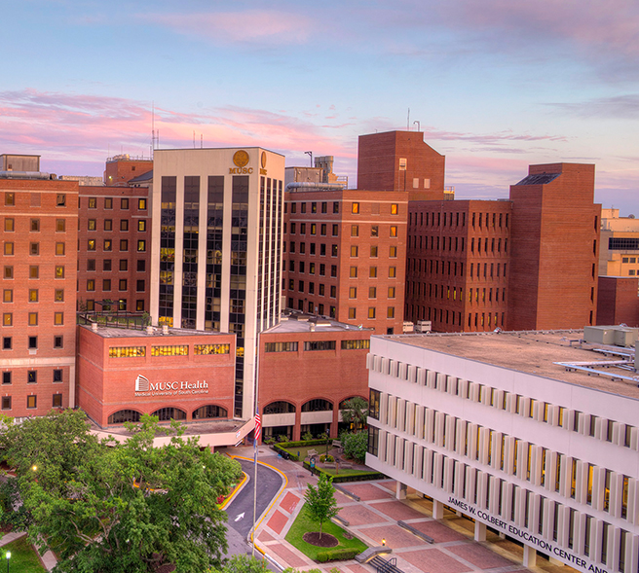
Opioid Toolkit: A Professional Aid Created for Understanding the Opioid Crisis 02/27/24
Region2@nnlm.gov | @nnlmregion2

Slide 2
Land Acknowledgement
Land acknowledgements are an honest and historically accurate way to recognize native communities. Presenting land acknowledgments recognizes histories that have been systematically erased.
The native peoples of this region include the Etiwan, Kiawah, Santee, Edisto, Nachez-Kusso, and Wassamassaw people.
The Region 2 RML recognizes the native communities of the land on which we live and work in Charleston, South Carolina. We commit to remaining mindful and to use our work to support the health and well-being of all people, including native communities.

Slide 3
Labor Acknowledgement
Labor acknowledgments recognize how historically, much of the substantial economic development in a geographic area or industry resulted from the unpaid labor and forced servitude of people of color, specifically people from Africa.
The R2 RML acknowledges that much of what we know of this country today was possible because of the labor of enslaved Africans, their descendants, immigrant workers, impoverished people, domestic workers, and others.
We commit to remaining mindful and to use our work to support the health and well-being of all people, including those whose labor has been historically exploited.

Slide 4
Community Agreements
Take care of yourself
No one knows everything/Together we know a lot
Make Space/Take Space
One mic/One voice
Understand the difference between impact and intent
Respect confidentiality
Be curious and respectful
Adapted from GLSEN Guidelines from Respectful GSA Spaces
https://www.glsen.org/activity/guidelines-respectful-gsa-spaces
Notes:
Take care of yourself – Feel free to take breaks and hydrate as you need to.
No one knows everything / Together we know a lot - Listen to understand.
Make Space / Take Space – Be aware of how much you are speaking. If you are speaking a lot, be mindful to make space for those with quieter voices, especially those from marginalized groups.
One mic / One voice - Only one person should speak at a time. Speak from your own experiences. Do not assume other people’s experiences or generalize.
Understand the difference between impact and intent – What you are intending is less important than how it impacts another person.
Respect confidentiality – What we learn here, leaves here…what we say here, stays here.
Be curious and respectful – Be a mindful listener. Do not blame or shame. -

Slide 5
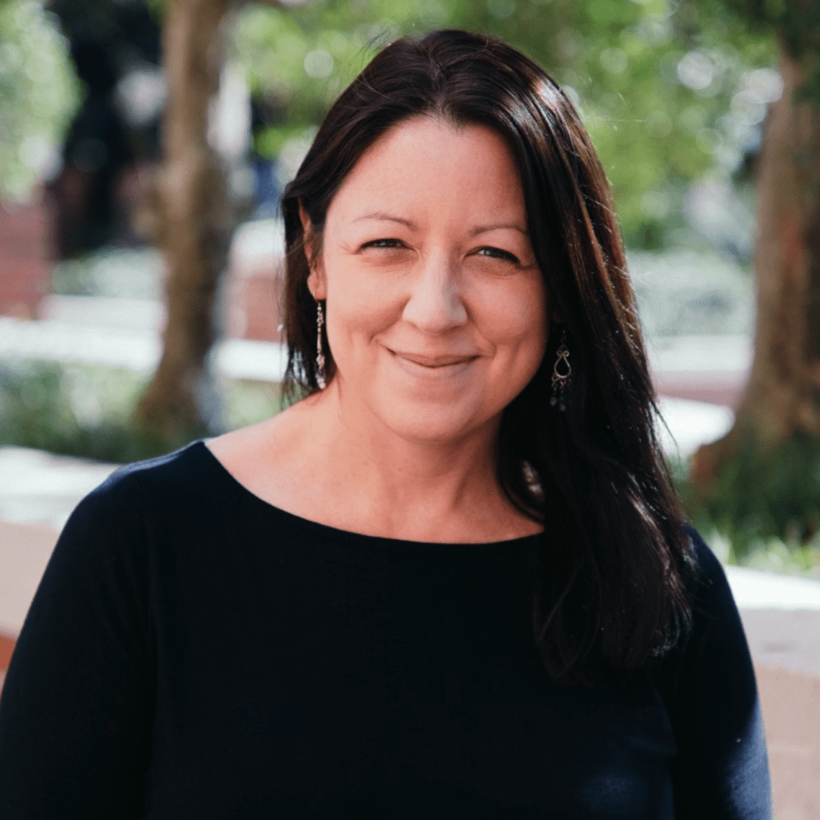
Introduction
Carli Lucius, MSW
(she/her)
CFC Center,
Program Associate, Community Outreach Specialist.
Margaret Sullivan, PhD
(she/her)
Assistant Professor, School of Information, Florida State University
Notes:
* As a recent Master of Social Work graduate from Florida State University, Carli Lucius’ interests in Child Welfare, Trauma, Grief, and Research led her to her current work with the Stoops Center for Communities, Families, and Children (CFC Center). Ms. Lucius is employed at the CFC Center as a Program Associate and Community Outreach Specialist. Ms. Lucius leads the team in outreach efforts on their "ROTA-RC" project, where the CFC Center functions as the Southeast Rural Opioid Technical Assistance Regional Center serving Region Four (ROTA-RC). Ms. Lucius conducts outreach to ensure all community members, librarians, direct service providers, and other key stakeholders are aware of and participate in the free services offered through the ROTA-RC.
* Margaret Sullivan is an assistant professor in the School of Information at Florida State University. She completed a doctorate in Library and Information Science from the University of South Carolina. She also has a Master’s in Information Systems and a Master’s in Library Science from Drexel University. Her research areas of interest focus on the health-seeking behaviors and patterns of disadvantaged populations, with a focus on the opioid-use population. Dr. Sullivan studies the impact that information access, information literacy, health literacy, and reading and literacy has had in affecting the health and well-being of the people that she studies. She also studies, publishes on, and advocates for the universal human right to credible health information.

Slide 6
COMBATING THE OPIOID EPIDEMIC, ONE RURAL LIBRARIAN AT A TIME
MARGARET SULLIVAN, PH.D., CARLI LUCIUS, MSW
SOUTHEAST RURAL OPIOID TECHNICAL ASSISTANCE REGIONAL CENTER
AT THE STOOPS CENTER FOR COMMUNITIES, FAMILIES, AND CHILDREN AT FLORIDA STATE UNIVERSITY’S COLLEGE OF SOCIAL WORK

Slide 7
AGENDA
01
04
05
WHAT IS SE ROTA-RC?
ACTION STEPS
₀₂ THE OPIOID EPIDEMIC &
LIBRARIES
QUESTIONS & FEEDBACK SURVEY
03
WHAT IS THE OCLC TOOLKIT? HOW DID IT COME TO BE?

Slide 8
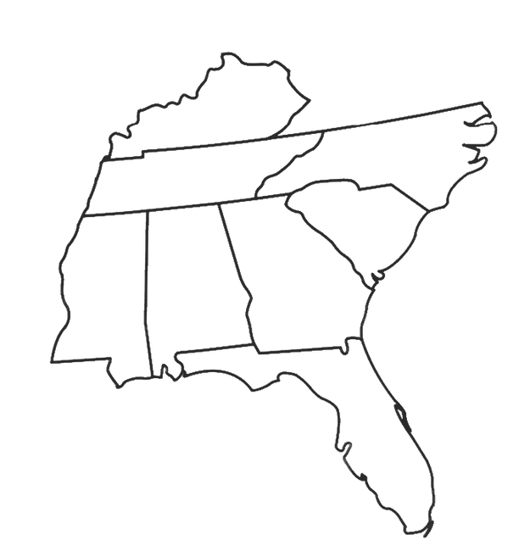
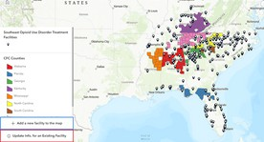
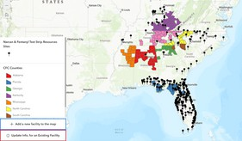
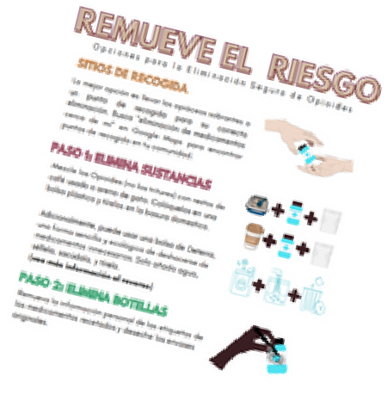
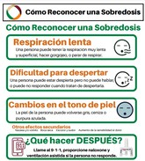
About Us
What is SE ROTA-RC?
ROTA-RC seeks to develop and disseminate training and technical assistance to address opioid and stimulant use affecting rural communities in the eight states in Region 4.
ROTA-RC expands awareness of opioid and stimulate use, harm reduction, and options for treatment to improve the resiliency of rural communities.
Pocket Guide:: How to Respond to an Overdose
1. ^{Try to wake them up} Naloxone
Shout or call their name and rub the middle of their chest with a closed ^{How-To Video:}
fist.
HOW TO RESPOND TO AN OVERDOSE POCKET GUIDE
You
NAR CAN
Save
Lives
Overdose Prevention Training
NARCAN TRAINING
Call 9-1-1
Most states, 47 total, have The Good Samaritan Law that protects you from arrest for possession of drugs. The states that do not are Texas, Wyoming, and Kansas.
Give Naloxone
Follow the directions for nasal or intramuscular naloxone kits.
If needed, Give Support Ventilation
CPR
How-To Video:
Overdose Prevention
Start CPR if the person is not breathing AND has no pulse. Push hard & Training:
fast in the center of the chest to the beat of the classic song, Stayin Alive.
5. Put them in a Recovery Position
If you can't stay to wait for help, put the person on their side supported
by a bent knee.
OPIOID TREATMENT FACILITIES MAP
NARCAN & FENTANYL TEST STRIP LOCATOR MAP
FREE VIRTUAL OR IN-PERSON TRAININGS FOR YOUR ORGANIZATION
FREE PRINTABLE PDFS ON VARIOUS OPIOID/SUBSTANCE USE RELATED TOPICS
OVERDOSE PREVENTION, EDUCATION, AND HARM REDUCTION STRATEGIES
CARLI LUCIUS, MSW
SOUTHEAST RURAL OPIOID TECHNICAL ASSISTANCE REGIONAL CENTER
AT THE CENTER FOR COMMUNITIES, FAMILIES, AND CHILDREN AT FLORIDA STATE UNIVERSITY’S COLLEGE OF SOCIAL WORK

Slide 9
IMPORTANCE OF LIBRARIES IN RESPONSE TO THE OPIOID CRISIS
Public libraries are trusted institutions that are viewed by over 90% of Americans as vital to community well-being and opportunity.
Public libraries host 1.4 billion visits annually and serve over 96.4% of the U.S. population.
Public libraries are important resources for community health, with one-third of visitors seeking health information.
2017 survey of all public libraries across Pennsylvania, half of respondents reported providing support to patrons regarding substance use and mental health concerns in the previous month.
12% of public libraries in Pennsylvania reported at least one on-site overdose in the previous year.
There are 17,454 libraries in the United States.

Slide 10
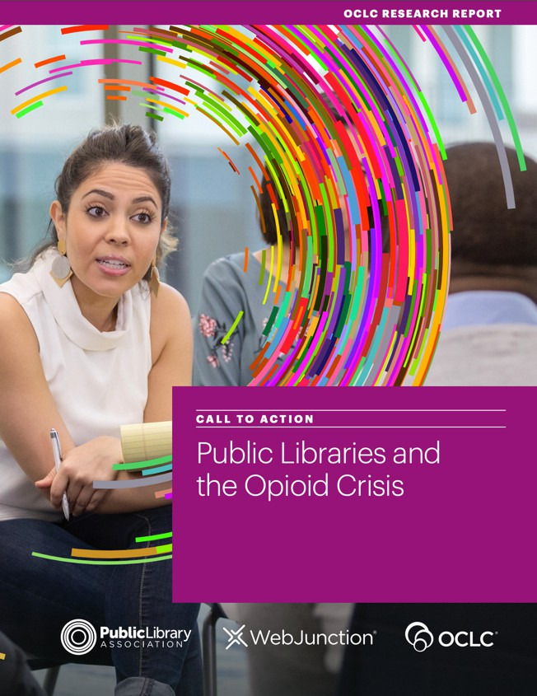
OCLC OPIOID TOOLKIT
OCLC case studies (2019)
to a
Data-driven response (2020)

Slide 11
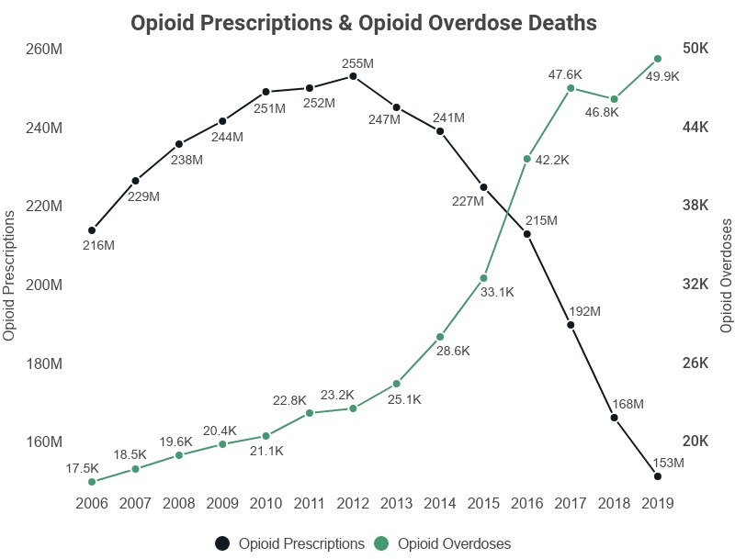
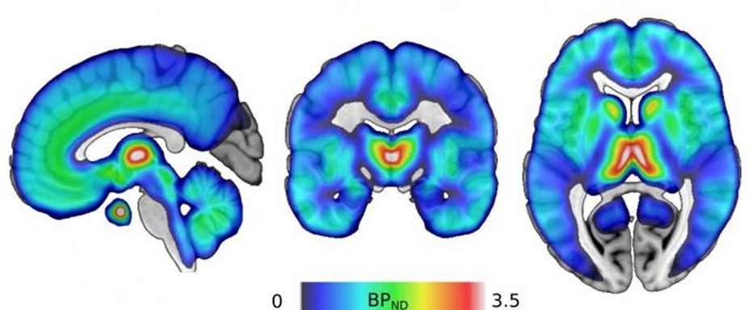
FIRST: A BRIEF INTRODUCTION TO OPIOID ADDICTION

Slide 12
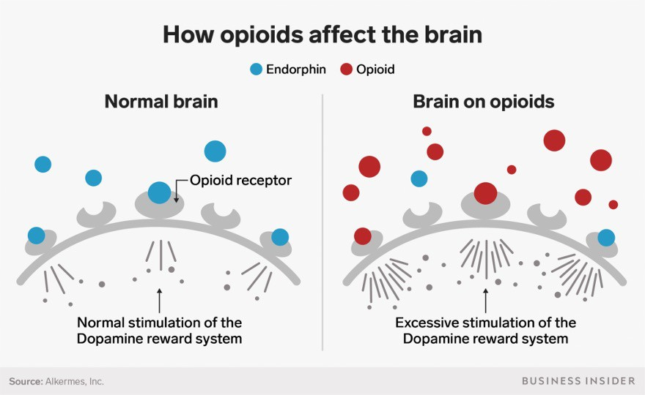
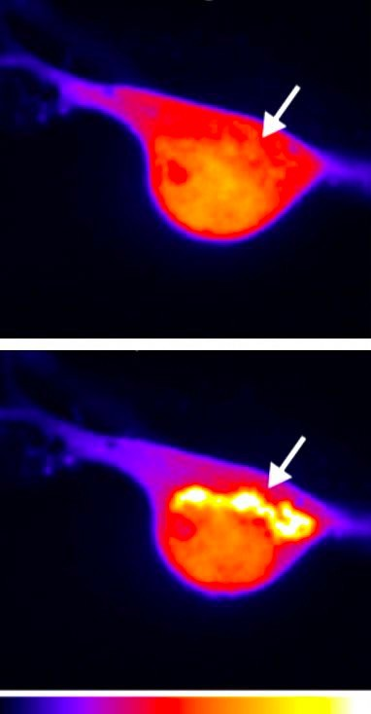
A BRIEF INTRODUCTION TO OPIOID ADDICTION
A nerve cell before opioid receptor activation
and
20 seconds after activation by morphine.
Drs. Miriam Stoeber and Damien Jullié of von Zastrow lab, UCSF

Slide 13
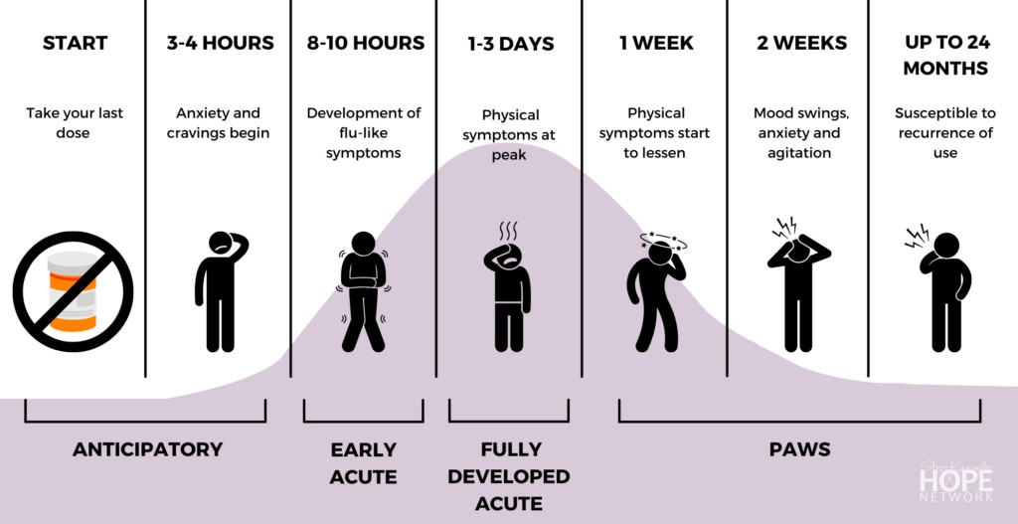
What is withdrawal?
Graphic by Sergey Nivens

Slide 14
WHO will become addicted to drugs?
Genetic factors account for 40-60% of a person’s vulnerability to addiction including the effects of environment on these factors
Parents or older family members who abuse alcohol or drugs, or who engage in criminal behavior, can increase children's risks of developing their own drug problems
The earlier a person begins to use drugs the more likely they are to progress to more serious abuse
Method of administration. Smoking a drug or injecting it into a vein increases its addictive potential
Some people will never develop diabetes because they never go over a certain weight – much like some people will never become drug dependent because they never try drugs. If they did, they would in both cases
Developed by Act On Addiction

Slide 15
LET‘S DISCUSS
What did you learn?
What is one thing you heard that was new to you?

Slide 16
SOME PRACTICAL INFORMATION
If someone has signs of an overdose, call 911
Opioid overdose signs include:
The person's face is extremely pale and/or feels clammy to the touch Their body goes limp
Their fingernails or lips have a purple or blue color They start vomiting or making gurgling noises They cannot be awakened or are unable to speak Their breathing or heartbeat slows or stops

Slide 17
Opioid Toolkit Overview 1
OPIOID TOOLKIT OVERVIEW
Consider Community
Assets & Connect with Partners
Focus on Library Staff Care
1
2
3
4
5
Explore your Community Data
Increase Awareness & Knowledge of the Issue Among Staff & the Community
Offer Community Engagement & Programming Options

Slide 18
Opioid Toolkit Overview 2
OPIOID TOOLKIT OVERVIEW
STEP 1
EXPLORE YOUR COMMUNITY DATA
1

Slide 19
OPIOID TOOLKIT ACTION STEP OVERVIEW
ACTION 1: EXPLORE YOUR COMMUNITY DATA
Assess Community Needs
Inform
Explore Community Health Data
Community
Leadership
Stakeholders

Slide 20
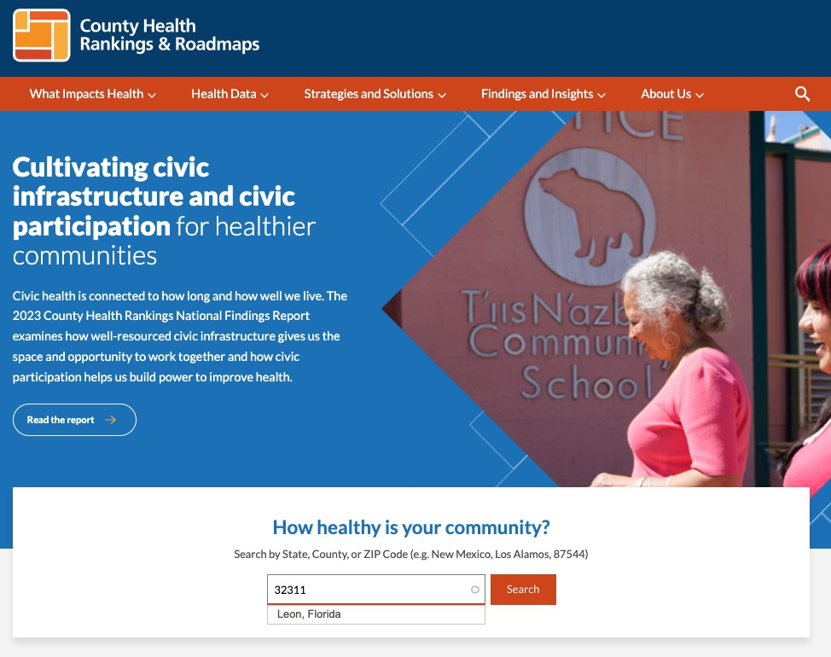
Action 1: Explore Your Community Data 1
OPIOID TOOLKIT ACTION STEP OVERVIEW
ACTION 1: EXPLORE YOUR COMMUNITY DATA
County Health Rankings & Roadmaps
Customize by County or Zip Code
CountyHealthRankings.org

Slide 21
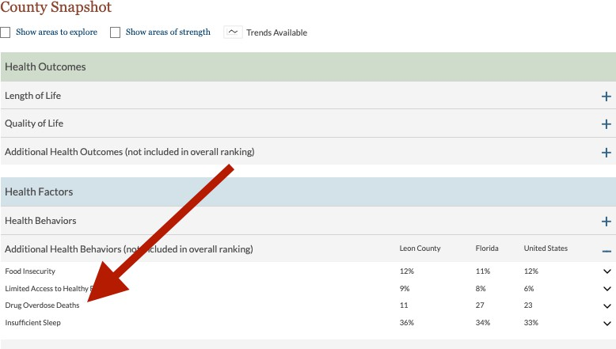
Action 1: Explore Your Community Data 2
OPIOID TOOLKIT ACTION STEP OVERVIEW
ACTION 1: EXPLORE YOUR COMMUNITY DATA
Statistical County Breakdown of Drug Overdose Deaths

Slide 22
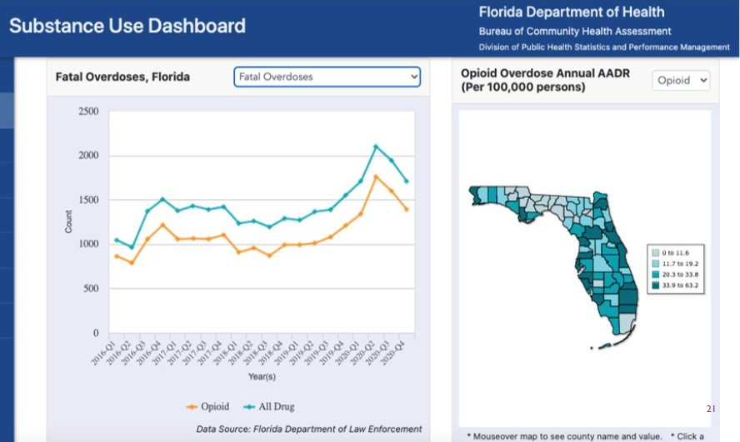
ACTION 1: EXPLORE YOUR COMMUNITY DATA
OPIOID TOOLKIT ACTION STEP OVERVIEW
Florida Department of Health – Health Charts
Obtain state & county data for drug and opiate abuse stats
FLHealthCharts.gov

Slide 23
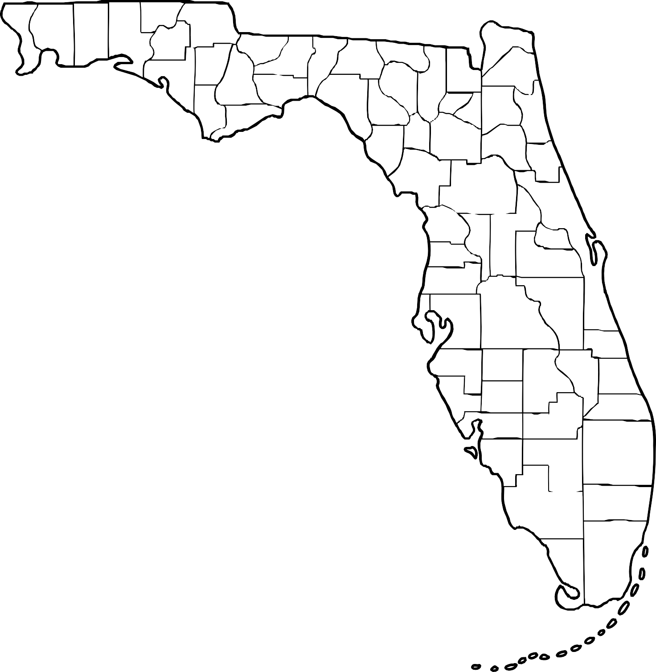
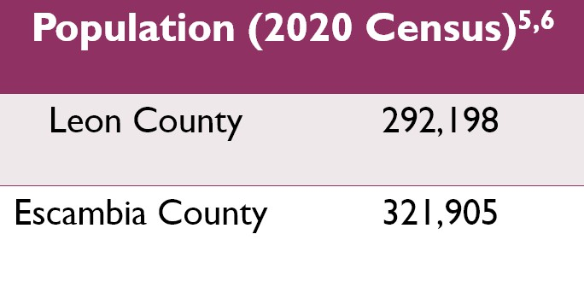
FLORIDA PUBLIC HEALTH STATE OF EMERGENCY DECLARED 2017-ONGOING

Slide 24
Action 1 Explore Your Community Data 2
OPIOID TOOLKIT ACTION STEP OVERVIEW
ACTION 1: EXPLORE YOUR COMMUNITY DATA

Slide 25
STEP 2: CONSIDER COMMUNITY ASSETS & CONNECT WITH PARTNERS
1
2
Explore your Community Data

Slide 26
ACTION 2: CONSIDER COMMUNITY ASSETS
OPIOID TOOLKIT ACTION STEP OVERVIEW
ACTION 2: CONSIDER COMMUNITY ASSETS AND CONNECT WITH PARTNERS
Identify: Who is already “doing the work” and what does the library bring to the table?
Trusted
organization in community
Staff experience
& professional knowledge
Resources
rooted in science
Accessible
meeting locations

Slide 27
ACTION 2: CONSIDER COMMUNITY ASSETS AND CONNECT WITH PARTNERS
OPIOID TOOLKIT ACTION STEP OVERVIEW
Public Health Departments
Social Workers
Leon County Health Department Escambia County Health Department Florida Department of Health
National Association of Social Workers
Non-Profits/Associations
Recovery Directories
i Save Florida
211 Big Bend (Leon County)
211 Northwest Florida (Escambia County) Florida Perinatal Quality Collaborative
Maternal Opioid Recovery Efforts Florida Medical Association
Opioid Resource Center
Neighborhood Navigator (Opioid Filters) SAMHSA Opioid Treatment Directory Florida Department of Children and Families

Slide 28
ACTION 2: CONSIDER COMMUNITY ASSETS AND CONNECT WITH PARTNERS 2
OPIOID TOOLKIT ACTION STEP OVERVIEW
ACTION 2: CONSIDER COMMUNITY ASSETS AND CONNECT WITH PARTNERS
Florida Department of Health Public Awareness Campaign
I Save Florida Social Media Example

Slide 29
POTENTIAL BENEFITS OF PARTNERSHIPS
Specialized resources geared toward specific population groups (e.g., youth or multilingual materials)
Subject matter experts that can provide training to library staff and/or patrons and/or participate in library programs or events
In-kind donations (e.g., Deterra bags for safely disposing of unused medications or naloxone to revive someone who is experiencing an overdose)
Information about drug take back events and location sites to safely dispose of unused medications
Connecting with individuals with lived experience
Collaborating on funding/grant requests to better address shared needs and priorities Promotion of and advocating for library programs and services in the community, reaching previous untapped users/patrons
OPIOID TOOLKIT ACTION STEP OVERVIEW

Slide 30
WHAT DOES THE LIBRARY BRING TO THE TABLE, AGAIN?
OPIOID TOOLKIT ACTION STEP OVERVIEW
A lot!
A trusted organization that reaches diverse community members Physical space for meetings
A safe, non-stigmatized place for people to talk about difficult issues Marketing reach for programs the organization offers
Vetted topical resources, including books, journals, and databases
Staff knowledgeable in curating and connecting people with community resources

Slide 31
STEP 3: INCREASE AWARENESS & KNOWLEDGE OF THE ISSUE AMONG STAFF & THE COMMUNITY
Consider Community Assets & Connect with Partners
1
2
3
Explore your Community Data

Slide 32
ACTION 3: INCREASE AWARENESS & KNOWLEDGE OF ISSUE AMONG STAFF
OPIOID TOOLKIT ACTION STEP OVERVIEW
Quick Facts
Increase Understanding of Issue
End Stigma
Around 21% to 29% of chronic pain patients who are prescribed opioids misuse them
Opioid overdoses decreased by 14% when states enacted naloxone access laws
About 130 Americans die from opioid overdose daily
Create Confidence in Staff

Slide 33
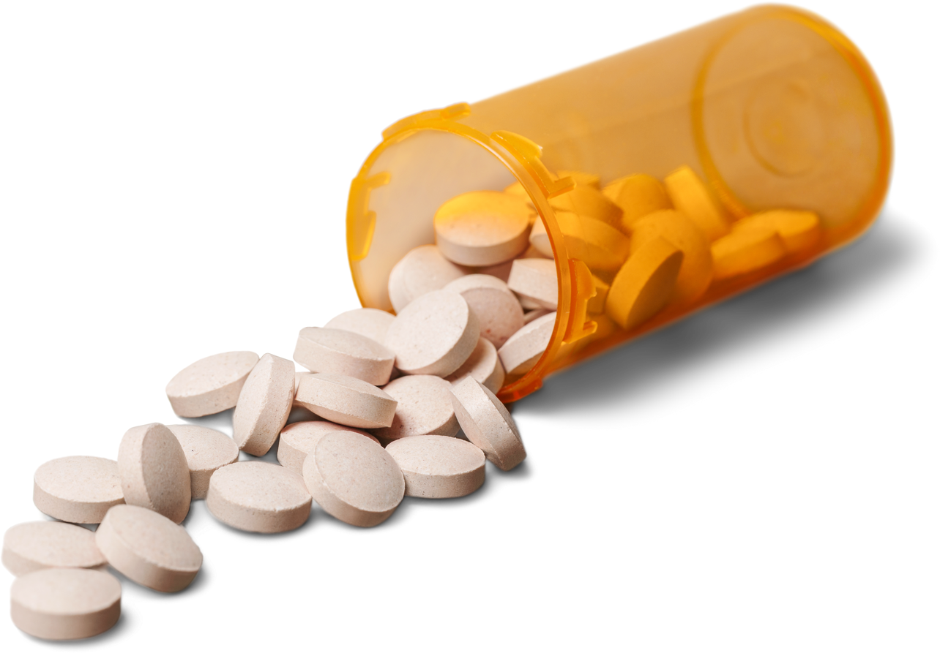
ACTION 3: RESOURCES
OPIOID TOOLKIT ACTION STEP OVERVIEW
Libraries & Trauma
Trauma Informed Care
Trainings
Mental Health First Aid
Talking About Addiction
Addiction-ary
Words matter: How language choice can reduce stigma

Slide 34
ACTION 3: POLICY...?
OPIOID TOOLKIT ACTION STEP OVERVIEW
“Treat every patron with equal respect and every request with equal importance.” Wixom Public Library (MI)
“The library will offer the same quality of services to all patrons regardless of age, race, sex, nationality, educational background, physical limitations, or any other criteria that may be the source of discrimination.” Fairview Public Library (NY)
“All interactions and transactions between a library patron or group of patrons and the Saugus Public Library are considered confidential and will be discussed only in a professional context…Staff must remember that, although the temptation to discuss or share difficult transactions at the public desk is great, any such discussions are to be private and kept among staff.” Saugus Public Library (MA)

Slide 35
STEP 4: FOCUS ON LIBRARY STAFF CARE
Consider Community Assets & Connect with Partners
1
2
3
4
Explore your Community Data
Increase Awareness & Knowledge of the Issue Among Staff & the Community

Slide 36
ACTION 4: FOCUS ON LIBRARY STAFF CARE
OPIOID TOOLKIT ACTION STEP OVERVIEW
OPIOID TOOLKIT ACTION STEP OVERVIEW
Lets talk about compassion fatigue...
Webinars
Libraries and Compassion Fatigue Webinar
Preventing and Treating Compassion Fatigue with Self-Care
Acknowledge Fatigue
Create a Plan

Slide 37
ACTION 4: CREATING A POST CRISIS PLAN
OPIOID TOOLKIT ACTION STEP OVERVIEW
ACTION 4: CREATING A POST CRISIS PLAN
Your staff successfully responds to an overdose. Now what...?
Provide counselor information
Via Health Insurance Employee Assistance Program (EAP)
Via Department of Health

Slide 38
QUESTIONS TO DISCUSS:
OPIOID TOOLKIT ACTION STEP OVERVIEW
Does your library have a post-crisis plan in place?
What could be in your organization’s post-crisis plan?
Remember that even if you don’t have control over establishing a policy within your organization, that you can still reflect on your own needs for clarity and support.

Slide 39
STEP 5: OFFER COMMUNITY ENGAGEMENT & PROGRAMMING OPTIONS
STEP 5: OFFER COMMUNITY ENGAGEMENT & PROGRAMMING OPTIONS
Consider Community Assets & Connect with Partners
Focus on Library Staff Care
1
2
3
4
5
Explore your Community Data
Increase Awareness & Knowledge of the Issue Among Staff & the Community

Slide 40
ACTION 5: OFFER COMMUNITY ENGAGEMENT & PROGRAMMING OPTIONS
OPIOID ACTION STEP OVERVIEWTOOLKIT
Informational book displays for library patrons Add addiction resources to library website Pamphlets discussing substance use and misuse
Programming – guest speakers, film screening, book clubs, community forums
Drug Take Back Events
Make & distribute Deterra bags
Partner with local organizations or public awareness campaigns
LOW EFFORT
HIGH EFFORT

Slide 41
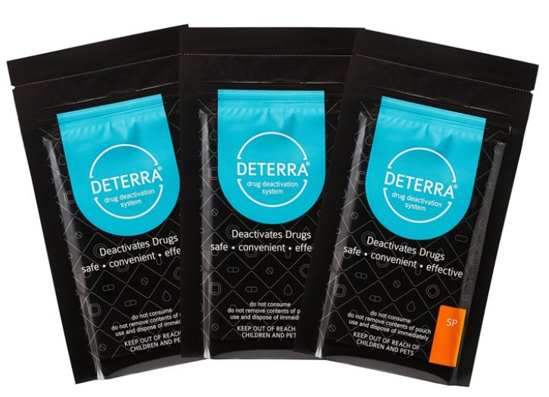
ACTION 5: DETERRA BAGS
OPIOID TOOLKIT ACTION STEP OVERVIEW
How it works:
Drop Medication in Deterra Bag
Fill with water
Seal bag, shake, and throw away
DeterraSystem.com

Slide 42
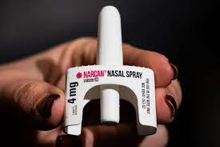
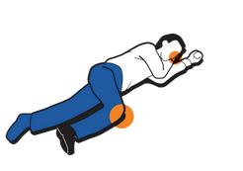
ACTION 5: NALOXONE ACCESS
OPIOID TOOLKIT ACTION STEP OVERVIEW
Responding to an Overdose: Call 911
Administer Narcan (Inject or Spray)
CPR
Recovery Position (side) Stay with them until paramedics arrive
Pocket Guide: How to Respond to an Overdose
Try to wake them up
Shout or call their name and rub the middle of their chest with a closed fist.
Call 9-1-1
Most states, 47 total, have The Good Samaritan Law that protects you from arrest for possession of drugs. The states that do not are Texas, Wyoming, and Kansas.
Give Naloxone
Follow the directions for nasal or intramuscular naloxone kits.
4. If needed, Give Support Ventilation
Start CPR if the person is not breathing AND has no pulse. Push hard & fast in the center of the chest to the beat of the classic song, Stayin Alive.
Put them in a Recovery Position
If you can't stay to wait for help, put the person on their side supported by a bent knee.
1.
Naloxone How-To Video:
2.
CPR
How-To Video:
3.
Overdose Prevention Training:
5.

Slide 43
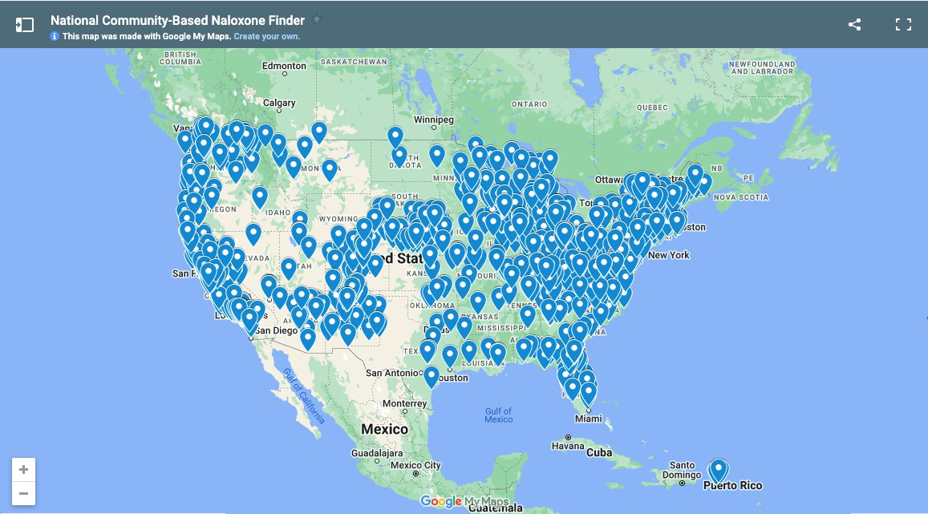
ACTION 5: LOCATING NALOXONE NATIONALLY
OPIOID TOOLKIT ACTION STEP OVERVIEW
National Harm Reduction Coalition Naloxone Finder Map
Online Request to receive Narcan by mail Visit NextDistro.org

Slide 44
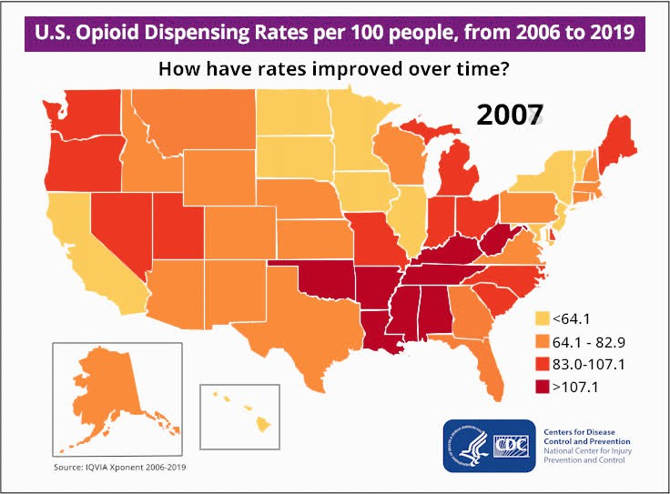
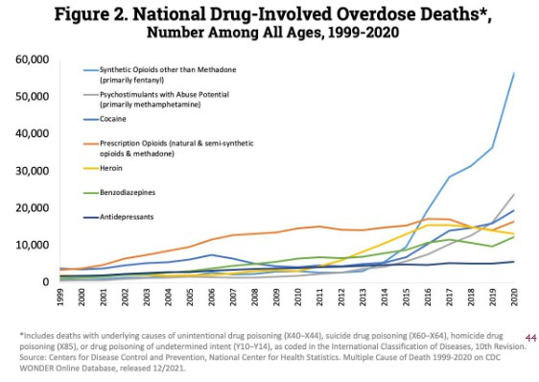
CONCLUSION
Decrease in Prescribing Opioids
Increase in Opioid Related Deaths

Slide 45
Questions?
PLEASE TAKE OUR ANONYMOUS FEEDBACK SURVEY!
CLUCIUS@FSU.EDU MZIMMERMAN@FSU.EDU SEROTARCNETWORK.ORG
bit.ly/3T5eYGR

Slide 46
The Opioid Epidemic Video
https://youtu.be/V0CdS128-q4?si=tJLAfc5Jwor9Z3DF

Slide 47
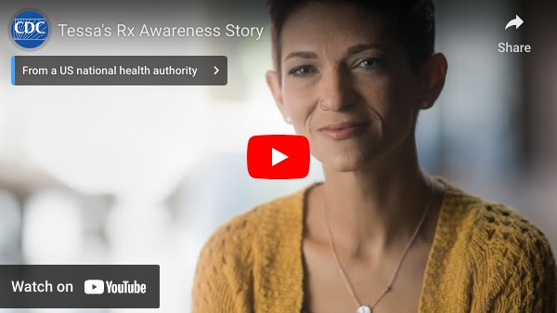
Tessa’s Rx Awareness Story Video
https://youtu.be/oNyTT_S5t4w?si=D3kEnTs6HOYMiASj

Slide 48
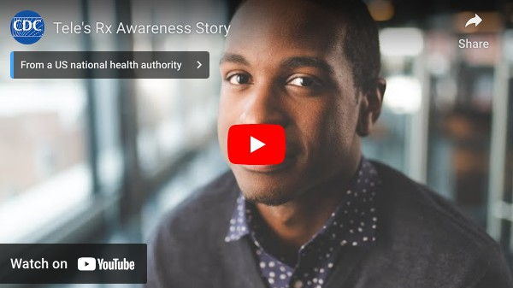
Tele’s Rx Awareness Story Video
https://youtu.be/MF-3jeD05sk?si=R2S9_FFQuhtQFMaL

Slide 49
References 1
REFERENCES
1Allen, Scott G., Larra Clark, Michele Coleman, Lynn Silipigni Connaway, Chris Cyr, Kendra Morgan, and Mercy Procaccini. 2020. Call to Action: Public Libraries and the Opioid Crisis. Dublin, OH: OCLC. https://doi.org/10.25333/w8sg-8440
2Ahmad FB, Rossen LM, Sutton P. Provisional drug overdose death counts. National Center for Health Statistics. 2021.
3Centers for Disease Control and Prevention. (2021, March). Drug overdose deaths. U.S. Department of Health and Human Services, National Center for Injury Prevention and Control. https://www.cdc.gov/drugoverdose/deaths/index.html
4Florida Department of Health. (2017, June 30). State of Florida Department of Health: Declaration of public health emergency and statewide ordering for Naloxone. [Press Release]. https://www.floridahealth.gov/_documents/newsroom/press-releases/2017/08/081717-phe-opioid-re-dec-6-30-17-004.pdf
5U.S. Census Bureau (n.d.) Quick Facts: Escambia County, Florida. U.S. Department of Commerce. https://www.census.gov/quickfacts/fact/table/escambiacountyflorida,US/PST045221
6U.S. Census Bureau (n.d.) QuickFacts: Leon County, Florida; Tallahassee city, Florida. U.S. Department of Commerce. https://www.census.gov/quickfacts/fact/table/leoncountyflorida,tallahasseecityflorida,US/PST045221
7County Health Rankings and Roadmaps. (2021) Drug overdose deaths in Florida: Data. https://www.countyhealthrankings.org/app/florida/2021/measure/factors/138/data
8Florida Department of Health. (2020). Substance use dashboard: Overdoses. https://www.flhealthcharts.gov/ChartsDashboards/rdPage.aspx? rdReport=SubstanceUse.Overdose
9Florida Health. (2021) Public health campaigns. Florida Department of Health. https://www.floridahealth.gov/programs-and-services/public-health- campaigns/index.html
10I Save Florida. (n.d.) Resources. Florida Department of Children and Families. Retrieved 7 April 2022, from https://www.isavefl.com/resources.shtml 11National Harm Reduction Coalition. (n.d.). Responding to Opioid Overdose. Retrieved 6 April 2022, from https://harmreduction.org/issues/overdose- prevention/overview/overdose-basics/responding-to-opioid-overdose/
12I Save Florida. (n.d.). Find Naloxone. Florida Department of Children and Families. Retrieved 15 February 2022, from https://isavefl.com/find-naloxone.shtml 13National Harm Reduction Coalition. (n.d.). Harm reduction resources near you. Retrieved 14 February 2022, from https://harmreduction.org/resource-center/harm- reduction-near-you/
14Next Distro. (n.d.) Free Naloxone access for impacted communities. Retrieved 15 February 2022, from https://nextdistro.org/naloxone
15Centers for Disease Control and Prevention. (2021, November). U.S. opioid dispensing rate maps. U.S. Department of Health and Human Services, National Center for Injury Prevention and Control. https://www.cdc.gov/drugoverdose/rxrate-maps/index.html
16Abuse, N. I. on D. (2022, January 20). Overdose Death Rates. National Institute on Drug Abuse. https://www.drugabuse.gov/drug-topics/trends-statistics/overdose- death-rates

Slide 50
References 2
REFERENCES
Call to Action: Public Libraries and the Opioid Crisis https://doi.org/10.25333/w8sg-8440
CDC Drug Overdose Deaths https://www.cdc.gov/drugoverdose/deaths/index.html Provisional Drug Overdose Death Counts https://www.cdc.gov/nchs/nvss/vsrr/drug-overdose-data.htm
U.S. Census – Leon County, Florida https://www.census.gov/quickfacts/fact/table/leoncountyflorida,tallahasseecityflorida,US/PST045221
U.S. Census - Escambia County, Florida https://www.census.gov/quickfacts/fact/table/escambiacountyflorida/AGE295219 County Health Rankings and Roadmap
www.countyhealthrankings.org
County Health Rankings and Roadmap – Drug Overdose Deaths in Florida (2021) https://www.countyhealthrankings.org/app/florida/2021/measure/factors/138/data Florida Department of Health – Health Charts
https://www.flhealthcharts.gov/ChartsDashboards/rdPage.aspx?rdReport=SubstanceUse.Overdose Neighborhood Navigator
https://navigator.aafp.org/ Healthy Cities https://www.healthycity.org/ Collective Impact
https://www.collectiveimpactforum.org/what-is-collective-impact/ Community Anti-Drug Coalition
https://www.cadca.org/resources/handbook-community-anti-drug-coalitions Maps for Community Organizing
https://facesandvoicesofrecovery.org/wp-content/uploads/2019/06/Maps-for-Community-Organizing- Toolkit.pdf
Community Led Libraries Toolkit https://www.vpl.ca/sites/vpl/public/Community-Led-Libraries-Toolkit.pdf Leon County Health Department
https://leon.floridahealth.gov/ Escambia County Health Department https://escambia.floridahealth.gov/ Florida Department of Health https://www.floridahealth.gov/

Slide 51
References 3
REFERENCES
I Save Florida https://www.isavefl.com/ 211 Big Bend https://211bigbend.org/ 211 Northwest Florida
https://211nwfl.communityos.org/ Florida Perinatal Quality Collaborative
https://health.usf.edu/publichealth/chiles/fpqc/MORE Florida Medical Association
https://www.flmedical.org/florida/Florida_Public/Resources/Opioid/Opioid_Resources.aspx National Association of Social Workers – Florida Chapter
http://www.naswfl.org/
Neighborhood Navigator (Opioid Filters) https://www.findhelp.org/health/addiction-&-recovery--tallahassee-fl?
cursor=0&postal=32303&filters=%7B%22attribute_tags%22%3A+%5B%22opioid+dependency%22%5D%7D&clearedfilter=1 SAMSHA Opioid Treatment Directory
https://dpt2.samhsa.gov/treatment/ Florida Department of Children and Families
https://www.myflfamilies.com/service-programs/samh/ Trauma Informed Care
https://www.ala.org/pla/sites/ala.org.pla/files/content/tools/Public-Library-Social-Work_Overview-of-Trauma-Informed-Care_FINAL.pdf Mental Health First Aid
https://www.mentalhealthfirstaid.org/ Language Matters
https://www.addictionpolicy.org/language-matters Addiction-ary https://www.recoveryanswers.org/addiction-ary/ Words matter: How language choice can reduce stigma
https://facesandvoicesofrecovery.org/wp-content/uploads/2019/06/Words-Matter-How-Language-Choice-Can-Reduce-Stigma.pdf Change Your Language
https://www.shatterproof.org/our-work/ending-addiction-stigma/change-your-language

Slide 52
References 4
REFERENCES
Libraries and Compassion Fatigue Webinar https://vimeo.com/220517757
Preventing and Treating Compassion Fatigue with Self-Care https://learn.webjunction.org/course/search.php?search=preventing+and+treating+compassion+fatigue Deterra
deterrasystem.com
Responding to Opioid Overdose
https://harmreduction.org/issues/overdose-prevention/overview/overdose-basics/responding-to-opioid-overdose/ Naloxone Providers in Florida
https://www.isavefl.com/find-naloxone.shtml Health and Hope Clinic https://www.healthandhopeclinic.org/narcan.html Lakeview Center, Inc. https://www.elakeviewcenter.org/TheFriary
New Season #11
https://www.newseason.com/treatment-center-locations/florida/pensacola-metro-treatment-center/ DISC Village, Inc.
https://discvillage.org/index.html Oxford Houses, Tallahassee https://www.oxfordhousefl.org/
National Harm Reduction Coalition – Naloxone Finder Map https://harmreduction.org/resource-center/harm-reduction-near-you/ Next Distro – Nalaxone Access https://nextdistro.org/naloxone#stateselector

